Slide 1
Twitter Collection 2024
CS4264
Multimedia, Hypertext, and Information Access
Dr. Edward Fox
Chris Lam, Enk Naran, Ilya Mruz, Sushen Kolakaleti, Kevin D’Alessandro
Virginia Tech, Blacksburg VA 24061
4/30/2024

Slide 2


Outline
Introduction / Recap
The Sources
Events Archive Spreadsheet
Timeline
DMI-TCAT
YTK
SFM
System Design
Machine Learning
Challenges Faced
Lessons Learned
Future Work
Acknowledgements, References, Q&A

Slide 3

Introduction / Recap of Project Details
The Digital Library Research Laboratory collected billions of tweets
Collected in 3 formats (YTK, DMI-TCAT, SFM)
Goal: convert them to one format (JSON)
2021 team wrote initial scripts
2022 team optimized the scripts, began converting, and introduced a machine learning model to classify tweets
2024 team delayed by a credentials mix up
Notes:
The Digital Library Research Laboratory has collected billions of tweets, and the objective of this project is to convert them in a way that makes access and research easier
Tweets were collected in 3 formats (SFM, YTK, DMI-TCAT) with the goal being to convert them into a JSON format
2021 team wrote the initial python scripts for the project
2022 team optimized the scripts, began the conversion process, and introduced a machine learning model to classify tweets

Slide 4
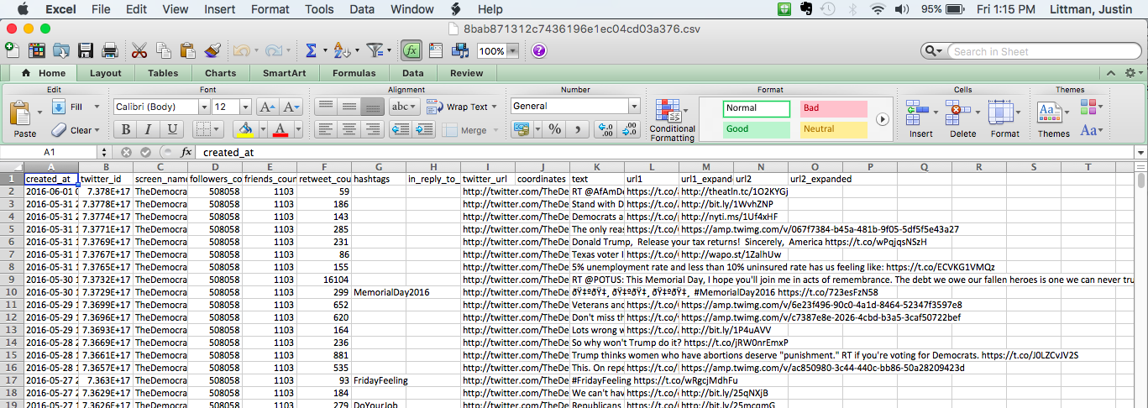
The Sources
Digital Methods Initiative Twitter Capture and Analysis Toolset (DMI-TCAT)
MySQL database
1 tweet split into 7 tables
Social Feed Manager (SFM)
JSON file
One Tweet per line
yourTwapperKeeper (YTK)
MySQL database

Slide 5
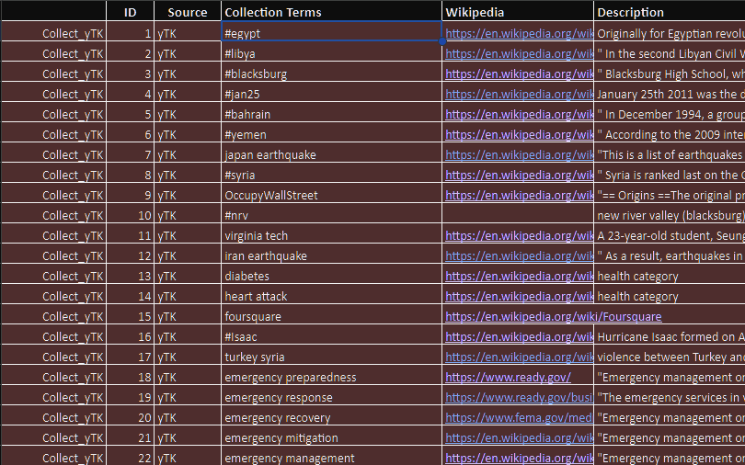
Events Archive Spreadsheet
Running compilation of all collections
Key Columns:
  Source
  Term used to collect
  Count of tweets in the collection
YTK is comprehensively compiled
SFM and DMI are not

Slide 6
Timeline
January
March
April
May
Finalize Plan
Process
Analyze/Document
Wrap Up Project
- Meet with client
- Plan objectives
- Get approval
- Start conversions
- Start ML
- Continue conversions
- Validate data
- Analyze
- Machine Learning
- Presentation
- Documentation
- Submit to VTechWorks
Notes:
Meet with client and finalize details of project/milestones, receive approval (by end of January)
Finish processing tweets from SFM, YTK, DMI-TCAT (beginning of March)
Previous group completed roughly 800,000,000 tweets out of 6 billion
Validate data with given tests. Run analytics and statistics on finished JSON file (beginning of April)
Start documentation the project, work on completing the ML model's for categorizing tweets based on keywords (beginning of May)
Give final report and presentation for end of project (end of semester)

Slide 7
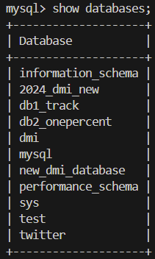
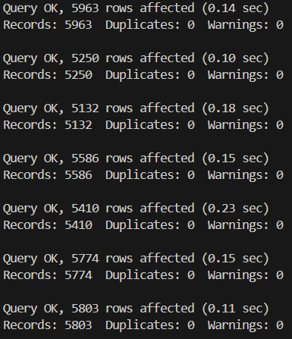
DMI-TCAT Database
Hosted on the tweets.cs.vt.edu
Raw SQL files are accessible
Transferred some of the whole SQL file into a database
  db1track
Notes:
It’s a mess of directories

Slide 8
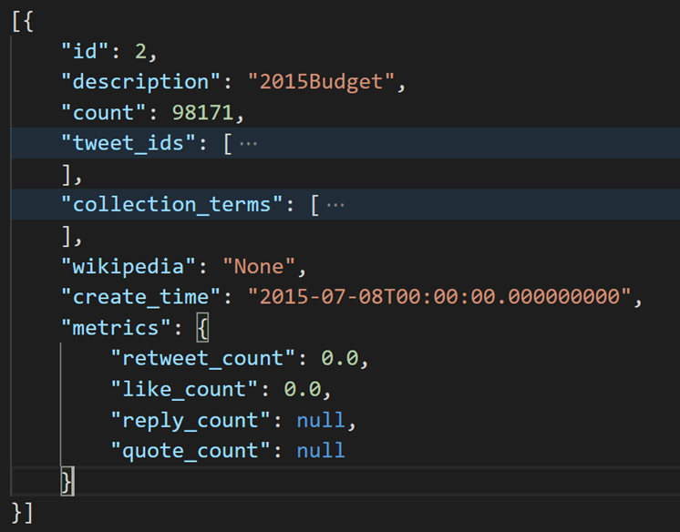
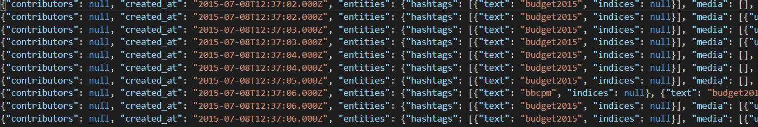
DMI-TCAT Conversion
Individual Level
Collection Level
Determines tweet IDs
Determines number of tweets
DMI-TCAT does not store collection data
Attributes pulled from Events Archive spreadsheet
Establishes connection
Retrieves data
Transforms to JSON schema

Slide 9
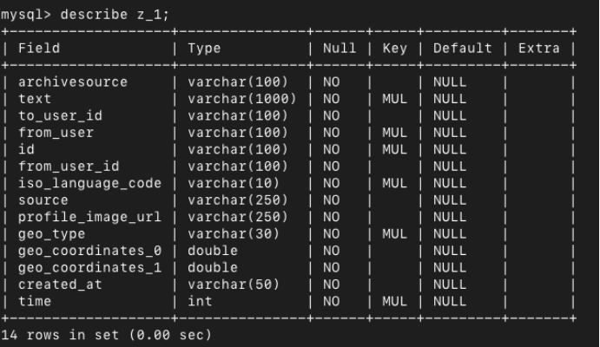
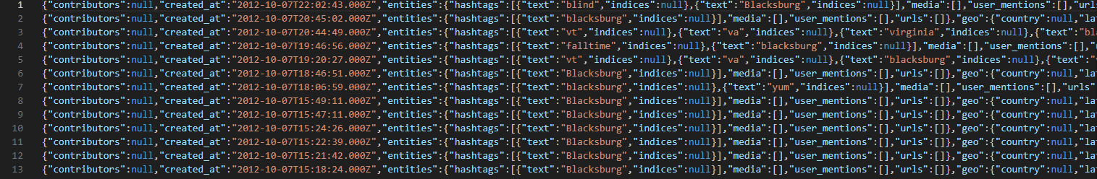
YTK Conversion
Individual Level
Python script that converts the MySQL YTK data to JSON
Values that aren’t found set to NULL
Most fields are NULL due to limited number of fields available from YTK
Example conversion

Slide 10
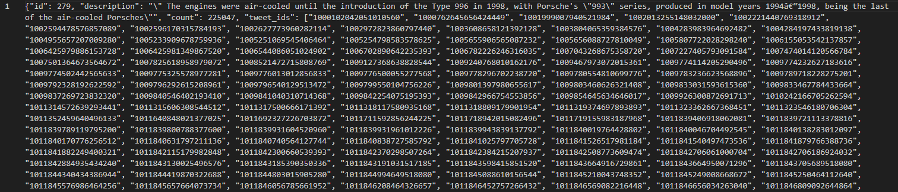
YTK Conversion Continued
Collection Level
Made some improvements to the script speed up the conversions from last team
Doesn’t account for additional fields past tweet ID
Places tweet IDs as a list after conversion
Example conversion

Slide 11
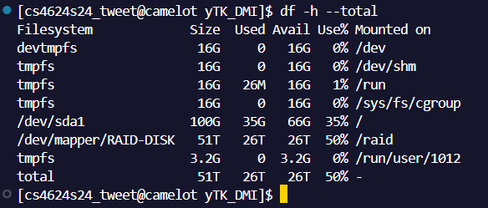

SFM Camelot Virginia Tech Machine Info
24 Terabytes of Storage for SFM tweet JSON data, Raid Node
Virtual Machine to run SFM (sfm1.cs.vt.edu)

Slide 12
SFM UI Website
A website to access the collections created by various research groups
Can collect from a wide variety of websites:
  Twitter
  Tumblr
  Flickr
  Weibo
Can collect using various methods such as: search, username, etc.
We used the export feature to decrypt and uncompress the JSON files

Slide 13
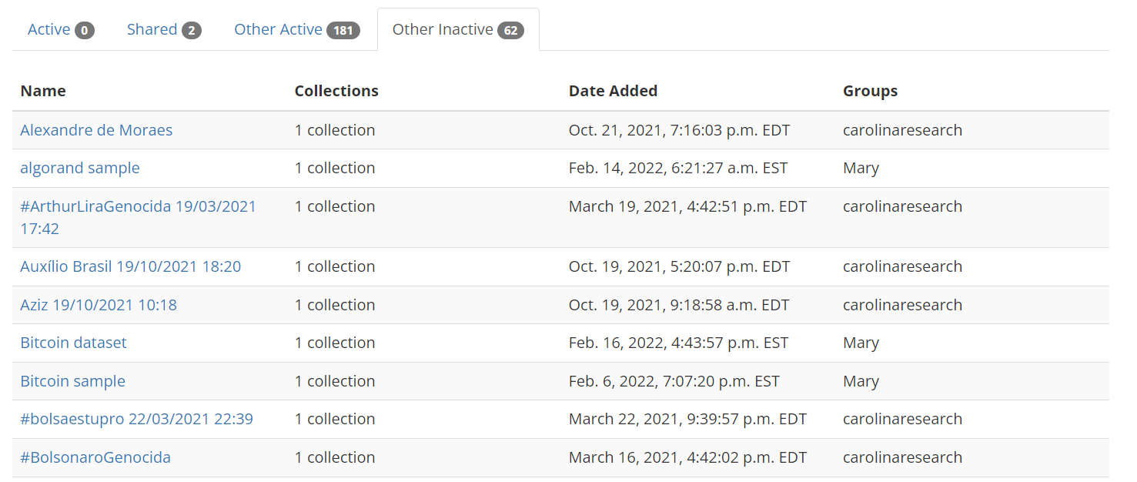
SFM UI Collection Sets

Slide 14
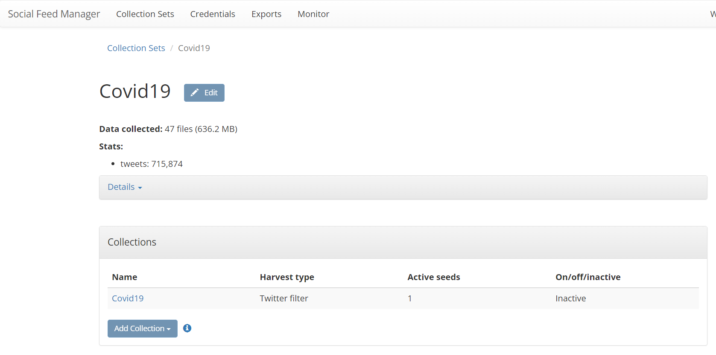
SFM UI Collection Set Information

Slide 15
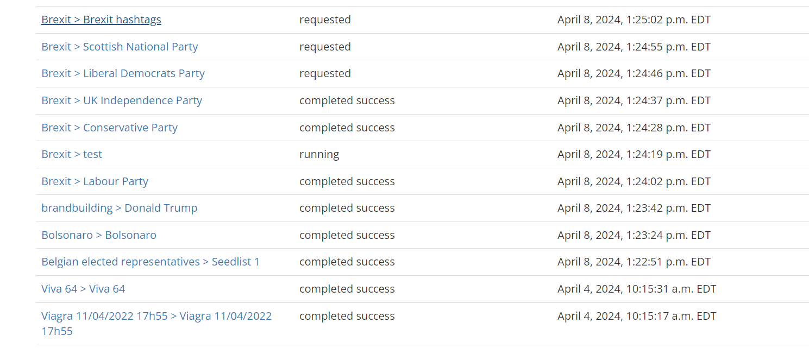
SFM UI Exports

Slide 16
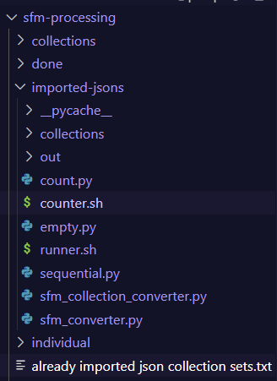
SFM New Scripts / Automation
How It Works:
  Import the raw JSON files from the exports in SFM UI
  Run the runner.sh script (runs the collection and individual conversion scripts sequentially)
  Collection level goes to collections folder
  Individual level goes to out folder
  Move the finished JSON files to collections and done folder once scripts are complete
Scripts:
  runner.sh, counter.py, sequential.py, sfm_converter and sfm_collection_convert.py

Slide 17
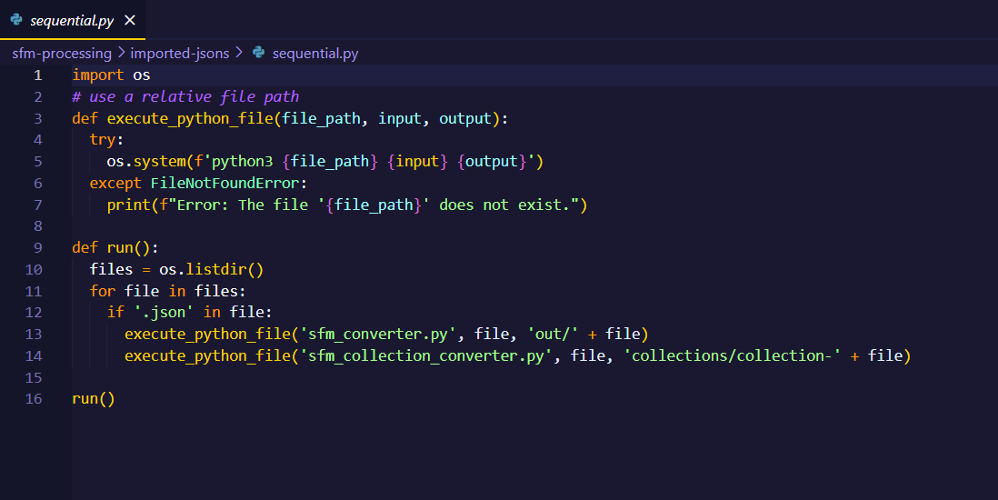
SFM New Scripts / Automation Continued

Slide 18
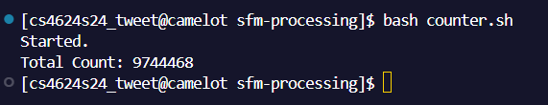
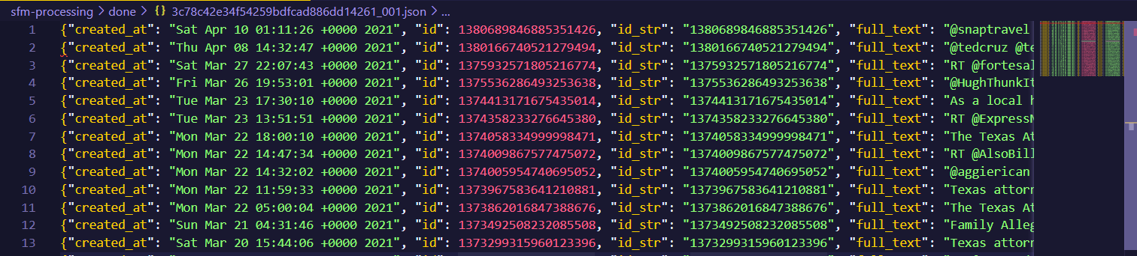
SFM Tweet Conversion Data
Completed 9744468 SFM tweet conversions as of 4/28.
Below is part of an output for the individual conversion script
Notes:
Talk about completed work on the tweets in sfm?

Slide 19
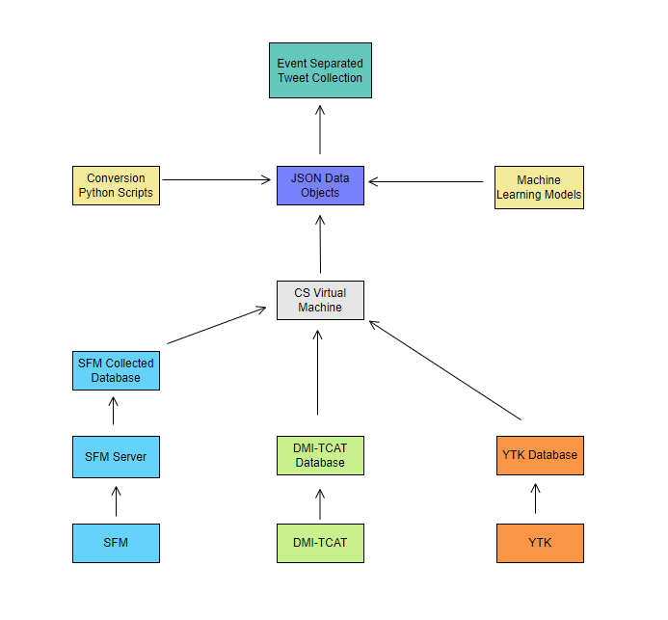
System Design
Gather databases and store on CS Machines (Camelot, Tweets, etc.)
Convert to JSON objects using conversion automation scripts
Convert to JSON collections using collection automation scripts
Notes:
Categorization
Main portion of ML part to segment and spit collections based on detected keywords.
We plan to use as a proof of concept with a few hundred tweets from each source (SFM, YTK, etc)
Plan to use a BERT model with a NN to categorize tweets based on collections of hashtags from the tweets sources

Slide 20
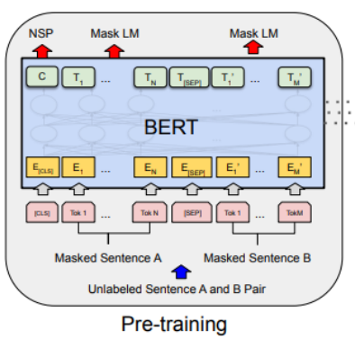
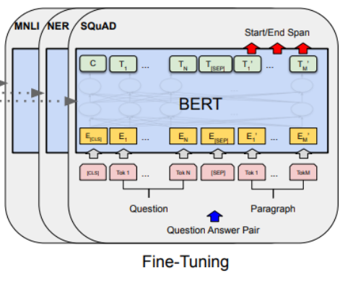
Machine Learning
Hate Speech Detection
Detect hate speech on tweets
Tested a GloVe model with a Naive Bayes classifier
And a BERT model with a Naive Bayes classifier
Notes:
Categorization
Main portion of ML part to segment and spit collections based on detected keywords.
We plan to use as a proof of concept with a few hundred tweets from each source (SFM, YTK, etc)
Plan to use a BERT model with a NN to categorize tweets based on collections of hashtags from the tweets sources

Slide 21

ML Results
DistilBERT | GloVe
Running Time: 4m 02s | Running Time: 58s
Accuracy: 83.12% | Accuracy: 70.01%
Cost Ratio: 284.10 | Cost Ratio: 82.85
Notes:
Hate Speech Detection
Second portion, “nice to have” to detect hate speech on the same few hundred tweets from different sources
Hate speech is prevalent on social sites, so could be a great insight on social media “hate trends”
Plan to use a GloVe model with a NN or Naive Bayes classifier to detect hate speech quickly.

Slide 22
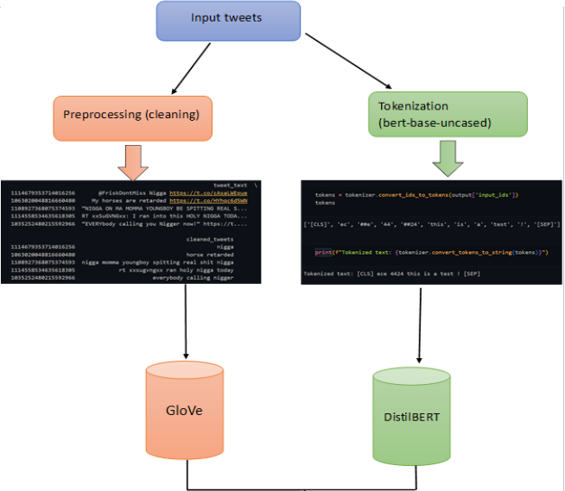

Slide 23
Challenges Faced
Documentation out of date / not fully covering the whole project
Getting access to all the different VT servers and services for the project
Communication within the team members and client
Equally dividing the work between the team members
Working through team member schedules throughout the semester

Slide 24
Lessons Learned
Ask questions about parts of previous team’s work earlier rather than later
Spend more time reviewing old code and documentation earlier
Don’t be afraid to ask questions where you’re confused

Slide 25
Future Work for the Project Tweet Conversion
Add any and all missing collections to the Events Archive Spreadsheet once more conversions are completed.
SFM: We have exported around 45 collections from the SFM machine. For future work the next team needs to continue where we left off from exporting JSON files from the SFM machine to then process on the Camelot server. The converted JSONs are hosted on the Raid Node on the Camelot Machine for data storage. Any future team can view them there for keeping track of already completed Collection Sets.
DMI_TCAT / YTK: Need to transfer rest of SQL file to a new database to convert the remaining tweets in the DMI_TCAT.sql file and the ytk1-big_all_mysql.sql files. Currently the transfer for DMI_TCAT is underway in 2030 Torgerson Hall, Virginia Tech and the YTK transfer should be started once the DMI_TCAT is completed.
Integrate Machine Learning into Data Pipeline of JSON Objects. Any future work should start running the machine learning models on the growing tweet data to get more accurate results with a larger training set.

Slide 26
Acknowledgements
Dr. Andrea Kavanaugh, Associate Director Center for Human/Computer Interaction, kavan@vt.edu,
Dr. Mohamed Magdy Farag, Research Associate, VTTI-Sustainable Mobility, mmagdy@vt.edu,
Dr. Edward A. Fox, Professor of CS 4624 Capstone, fox@vt.edu,
Satvik Chekuri, Ph.D. student, GTA, satvikchekuri@vt.edu,
Past CS4624 Tweet Collection 2022 Team.

Slide 27
References
[1] M. Gonely, R. Nicholas, N. Fitz, G. Knock, and D. Bruce, “Twitter Collections,” vtechworks, May 10, 2022. http://hdl.handle.net/10919/109988 (accessed Jan. 23, 2024).
[2] P. Dhakal, Y. Bhargava, A. Herms, K. Powell, and D. Burdisso, “Library Tweets Conversion,” vtechworks, Dec. 16, 2021. http://hdl.handle.net/10919/107086 (accessed Jan. 23, 2024).
[3] XDevelopers, “Data dictionary: Standard v1.1,” Developer Platform, 2024. https://developer.twitter.com/en/docs/twitter-api/v1/data-dictionary/object-model/tweet (accessed Feb. 04, 2024).

Slide 28

Q&A

