Slide 1


Chapter 7
Formulate Corporate-Level Strategy
Strategic Management
MGT 4394
Notes:
These slides serve as a study guide for Chapter 7: Formulate Corporate-Level Strategy in Strategic Management and Case Analysis: An Integrated Approach ©Lori Anderson, Dirk Buengel, and Joseph J. Simpson, which is provided at https://doi.org/10.21061/strategicmanagementandcaseanalysis under an open license, Creative Commons BY NC-SA 4.0. The slides are also provided at https://hdl.handle.net/10919/138831 under the same open license, Creative Commons BY NC-SA 4.0.
Note to Instructors: These study guides are intended to be a concise and comprehensive accompaniment that follows the logic of the textbook. Our intention is to support you in your instruction and is based on our experience that it can be easier and quicker to remove slides you do not want to include than to create additional slides.

Slide 2
Study Guide
These slides serve as a study guide for Chapter 7: Formulate Corporate-Level Strategy in Strategic Management and Case Analysis: An Integrated Approach by Lori Anderson, Dirk Buengel, and Joseph J. Simpson, which is provided under an open license, Creative Commons BY NC-SA 4.0. The slides are also provided under the same open license, Creative Commons BY NC-SA 4.0.
Notes:
Note to students: These study guides are intended to be a concise and comprehensive accompaniment that follows the logic of the textbook and may support your learning, mastery, and application of these concepts. They are are intended to supplement, not replace, your review of the textbook and any other sound study strategies you have made, such as taking notes to support your most effective learning.

Slide 3
Learning Objectives, 1 of 2
After you have engaged with the concepts in this chapter, you will understand and be able to apply the following key strategic management concepts.
Corporate level strategy
Synergy and its role in corporate level strategy
Related and unrelated diversification as a means of addressing corporate level strategy
The relationship between diversification and financial performance.
Ways a company diversifies, including internal development, strategic alliances, joint ventures, and mergers and acquisitions.
Ways a firm reverses diversification, including retrenchment and divestment.

Slide 4
Learning Objectives, 2 of 2
After you have engaged with the concepts in this chapter, you will understand and be able to apply the following key strategic management concepts.
What an industry value chain is and its application to corporate level strategy
Vertical integration as a means of addressing corporate level strategy
Geographical scope as a means of addressing corporate level strategy
Portfolio planning
How to analyze a firm’s corporate level strategy
Why corporate level strategy is important to business level graduates
You will be equipped to
Analyze a firm’s corporate level strategy

Slide 5
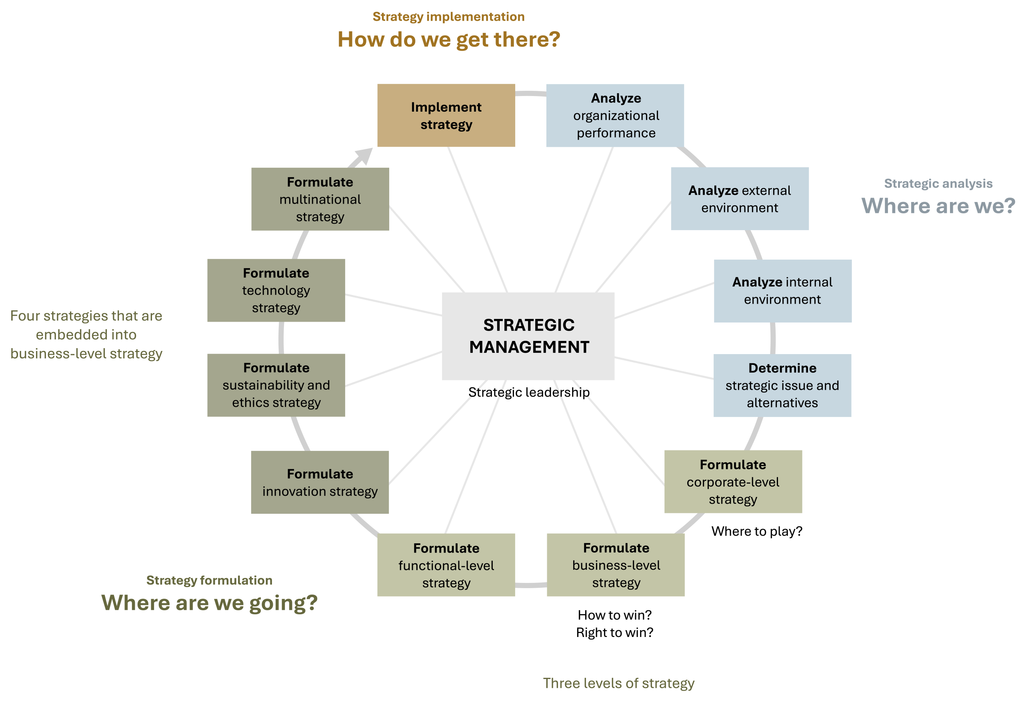
Corporate-Level Strategy in the AFI Framework
Figure 1.3: The analysis, formulation, implementation (AFI) framework [Kindred Grey. 2025. CC BY-NC-SA.]

Slide 6
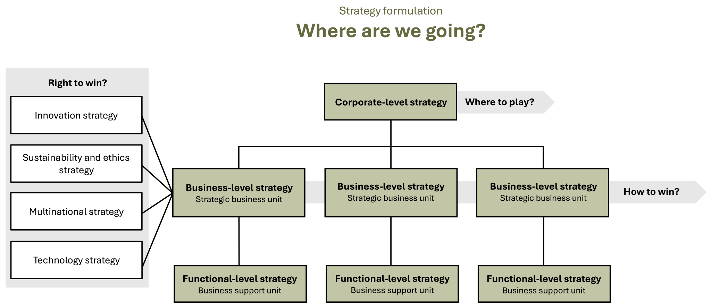
Corporate-Level Strategy in Strategy Formulation
Figure 1.5: Strategy formulation [Kindred Grey. 2025. CC BY-NC-SA.]

Slide 7
Strategy Formulation: Where Are We Going?
Strategic management’s foundations rest in three essential questions that align with the three stages of strategic management:
Strategic analysis: Where are we?
Strategy formulation: Where are we going?
Strategy Implementation: How are we going to get there?
Corporate-level strategy is the first strategy you learn, and like all strategy formulation, it addresses the question of where a firm is going.

Slide 8
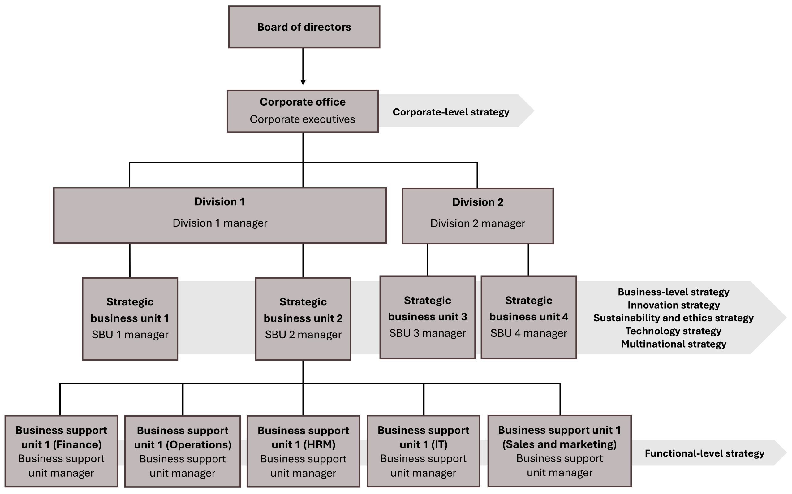
3 Levels of Strategy
There are three levels
of strategy in an organization.
corporate-level
business-level
functional-level
Strategy is formulated
at all three levels.
Figure 7.1: Three levels of strategy
Figure 7.1: Three levels of strategy [Kindred Grey. 2025. CC BY-NC-SA.]

Slide 9
The Three Levels of Strategy
Corporate-level strategy: Companywide strategy
What industries to compete in
What stage in the value chain to compete
Where geographically to compete.
Business-level strategy: Strategy of a strategic business unit
Strategic market position
Strategic market size
Functional-level strategy: How support functions (HR, IT, etc.) enable strategy.

Slide 10
Corporate-Level Strategy, 1 of 7
Corporate-level strategy is the broadest level of strategy.
Corporate-level strategy is a companywide strategy that focuses on synergy across industries, markets, market segments, locations, and businesses.
The corporate level of a company consists of senior executives in the C-suite, and if the company is large enough, it includes the board of directors.

Slide 11
Corporate-Level Strategy: Where to Play?, 1 of 2
Strategy can be described as a firm’s answer to three critical strategic questions that every organization needs to answer.
Corporate-level strategy: Where to play?
Business-level strategy: How to win?
Strategies embedded into business-level strategies: Right to win?
    Innovation strategy
    Sustainability and ethics strategy
    Technology strategy
    Multinational strategy

Slide 12
Corporate-Level Strategy: Where to play?, 2 of 2
“Where to play?” investigates where the firm is going to compete, considering which industries, markets, market segments, businesses, and regions in which the firm wants to operate (or play).
This is largely determined by the firm’s assessment of the attractiveness and profit potential of alternative markets, market segments, and businesses and the synergies between them.
The answers to the question of where to play also provide important solutions to issues related to the allocation of limited company resources to different businesses. In this sense, it is also important for every organization to decide where not to play.
Overall, “where to play” strategy can be described as the firm’s search for markets and market segments that are attractive today and in the future.

Slide 13
External and Internal Analysis
When executives analyze their organizational environments, they consider factors that relate to both the external environment and the internal environment of the firm.
The external analysis focuses on an outside-in perspective of the firm.
The internal analysis focuses on an inside-out perspective of the firm.
You analyze companies through these same lenses when you conduct a case analysis.

Slide 14
Strategy: Outside-In Perspective
When strategic management leaders and managers formulate strategy, they focus on an outside-in perspective.
All successful strategies are driven by outside-in perspectives, including corporate-level and business-level strategy as well as the strategies embedded in business-level strategies, such as innovation, sustainability and ethics, technology, and multinational strategies.

Slide 15
VUCA, 1 of 2
This means that companies need to carefully monitor their external environment, analyzing trends and developing strategies that are forward-looking.
Firms must navigate an external environment that is volatile, uncertain, complex, and ambiguous (VUCA), where change and disruption have become the new normal.

Slide 16
VUCA, 2 of 2
Volatility: refers to rapid, unpredictable environmental changes, such as shifts in consumer demand, disruptive technologies like AI, and fluctuating stock prices.
Uncertainty: the lack of clear information or predictability, often seen in events like climate change or unexpected competitor actions.
Complexity: arises when interconnected factors create ripple effects, making outcomes hard to predict and manage.
Ambiguity: means situations have multiple valid answers or interpretations, making decisions difficult.

Slide 17
Synergy, 1 of 2
Corporate-level strategy seeks ways to generate synergy.
Synergy means that the whole is greater or better than the sum of its parts.
In business, synergy occurs when two or more strategic business units or businesses perform more effectively together than they do independently.
        To review, a strategic business unit is a fully functional unit of a business that has its own vision and direction and may be part of a larger organizational unit like a division. It may be based on markets served, products offered, or regions served. Smaller firms may have only one strategic business unit, and large corporations may have multiple.

Slide 18
Synergy, 2 of 2
        Firms gain synergy in various ways, such as by sharing administrative overhead expenses like accounting, human resources, and sales and marketing when two business units are combined.
        This is an opportunity to capture operational efficiency.

Slide 19
Corporate-Level Strategy, 2 of 7
        Corporate-level strategy is a companywide strategy that focuses on creating and maintaining a firm’s competitive advantage by creating synergy within and between multiple industries, markets, market segments, and businesses, across multiple industry value chain(s), and in different geographical locations.

Slide 20
Corporate-Level Strategy, 5 of 7
        Corporate-level strategy focuses on these questions:
        In what industries, markets, market segments, and businesses should a firm operate?
            This is a question of diversification.
        In what stage of the industry value chain(s) should the company participate?
        This is a question of vertical integration.
        Where should the organization compete geographically?
          This is a question of geographical scope.

Slide 21
Corporate-Level Strategy, 6 of 7
        Q 1. In what industries, markets, market segments, and businesses should a firm operate?
            This is a question of diversification.

Slide 22
Differentiation vs. Diversification
Differentiation is how a company makes its products distinct from its competitors.
    Apple makes a Mac distinct from a PC and an iPhone different from a Galaxy phone.
    Diversification refers to how a company simultaneously deals with different products and services in different industries, markets, market segments, and businesses. After the firm decides which industries, markets, market segments, and businesses it wants to operate in, it then decides which products and services it is going to offer.
    Apple’s range of products—desktop computers, laptops, iPhones, iPads, and watches—represent product diversification.

Slide 23
Diversification
Through diversification, a company spreads its risk by participating in different industries, markets, market segments, and businesses.
Beyond risk management, diversification allows the firm to leverage its resources, capabilities, and core competencies into different industries, which drives growth for the firm.

Slide 24
Related Diversification and Unrelated Diversification
As it relates to corporate-level strategy, we focus on two types of diversification: related diversification and unrelated diversification.
In corporate-level strategy, geographical diversification is covered in questions of geographical scope.

Slide 25
Single Business Firms and Dominant Business Firms
To understand related and unrelated diversification, it is helpful to understand single business firms and dominant business firm.
Single Business Firm: a firm that derives 95 percent or more of its revenues from one business.
Dominant Business Firm: a firm that derives between 70 percent and 95 percent of its revenues from one business.

Slide 26
Related Diversification, 1 of 2
Related diversification refers to expanding into new and similar markets, market segments, and businesses in a new industry that has similarities to a firm’s current industry or industries.
In contrast to a single business firm or a dominant business firm, a company that engages in a related diversification strategy receives less than 70 percent of its revenues from a single business and the remaining revenue from a business or businesses that are related to the primary business.
Related diversification also encourages and supports synergies.

Slide 27
Related Diversification, 2 of 2
For example, Unilever was originally a soap manufacturer but engaged in related diversification by expanding its product line to include personal care products such as skincare like Vaseline lotion and Axe deodorant.

Slide 28
Unrelated Diversification, 1 of 2
Unrelated diversification refers to expanding into new markets, market segments, and businesses in a new industry that has little or no similarities to a firm’s current industry or industries.
In contrast to a single business firm or a dominant business firm, a company that engages in an unrelated diversification strategy receives less than 70 percent of its revenues from a single business and the remaining revenue from a business or businesses that are unrelated to the primary business.

Slide 29
Unrelated Diversification, 2 of 2
Unrelated diversification has positive impacts on the firm’s risk management because it expands into new markets, market segments, and businesses.
On the other hand, this approach does not involve synergies, one of the main drivers of corporate strategy.

Slide 30

Unrelated Diversification
For example, Unilever also engaged in unrelated diversification by expanding into food products such as Hellmann’s mayonnaise and Magnum ice cream.
Figure 7.3 Magnum ice cream bar
© cyclonebill. 2008. CC BY-SA 2.0. Magnum Double Caramel ice cream bar image

Slide 31
Related Diversification and Unrelated Diversification, 1 of 2
In contrast to single and dominant business firms, firms that engages in both related and unrelated diversification strategy receives less than 70 percent of their revenues from a single business.
Both related and unrelated diversification require significant resources to execute.

Slide 32
Related Diversification and Unrelated Diversification, 2 of 2
Related diversification is considered less risky and often produces greater profit potential.
This is because the company already has expertise with the industry that it can apply to the new products and services.
However, there are times when expanding into a new industry taps into significant profits.

Slide 33
Decision to Diversify
When considering whether to enter new businesses in new industries, consider how attractive the new industry is.
New business in new industries must have strong profit potential to make the risk worth taking.

Slide 34
External Analysis Supports Decision of Diversify
In choosing between related or unrelated diversification, it is useful to analyze the external environment of the firm.
PESTEL analysis of the general environment
Porter’s Five Forces analysis of the industry environment.
Strategic Group Mapping analysis of the competitive environment.
SOAR Analysis
Together, these analyses support an evidenced-based decision about related or unrelated diversification.

Slide 35
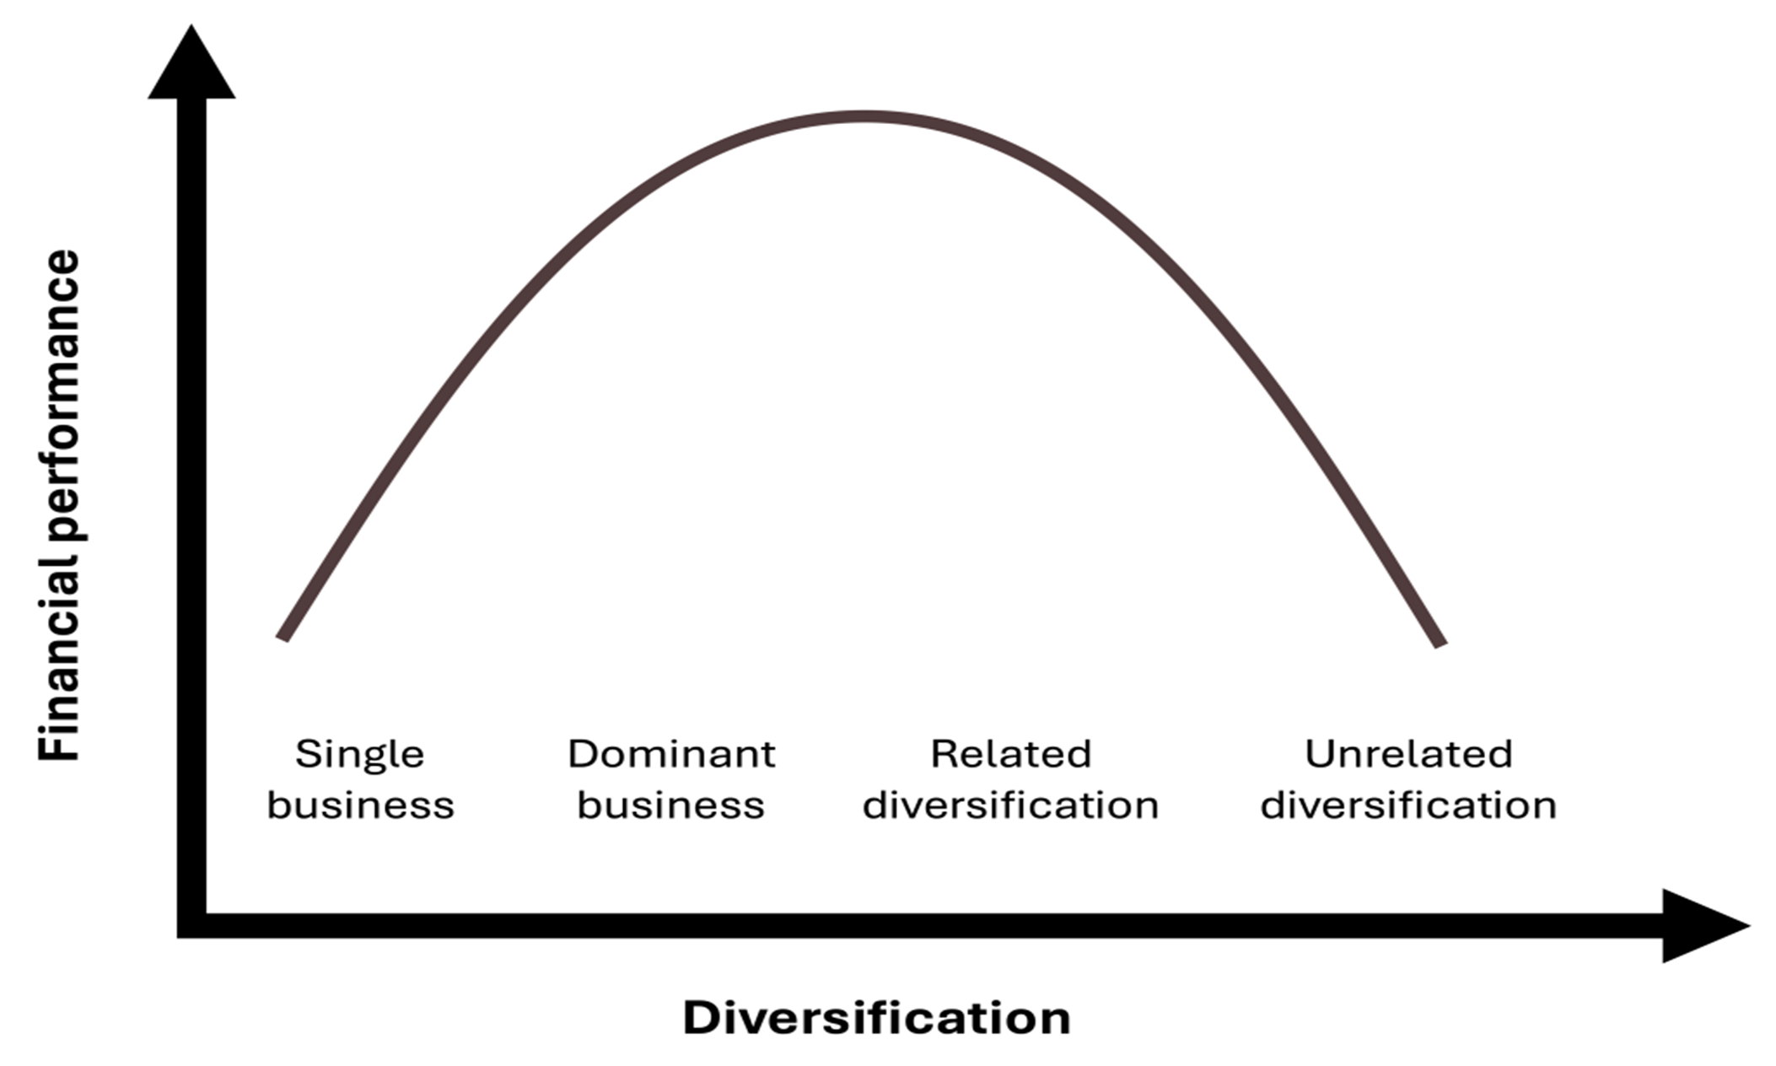
Diversification and Financial Performance
Figure 7.5: Diversification and financial performance. [Kindred Grey. 2025. CC BY-NC-SA.]
Notes:
First quadrant of an X-Y graph. The x-axis represents diversification and the y-axis represents financial performance. The graph features a purple parabolic curve that opens downwards. From left to right, the curve is labeled (1) single business (low diversification and low financial performance), (2) dominant business (slightly higher diversification and high financial performance), (3) related diversification (moderate diversification and high financial performance), and (4) unrelated diversification (high diversification and low financial performance).

Slide 36
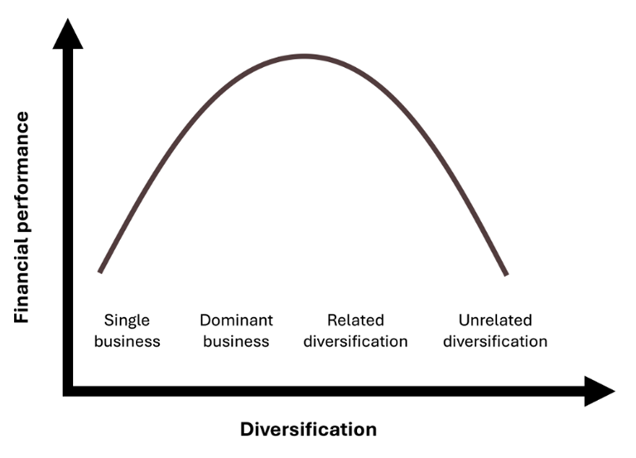
Diversification: Check Your Knowledge So Far
A corporate strategy where a company operates across multiple products, industries, or markets to spread risk and leverage capabilities.
Type | Definition | Example
Single Business Firm | 95%+ revenue from one business | Crocs (shoes only)
Dominant Business Firm | 70–95% from one business | Harley-Davidson (motorcycles)
Related Diversification | New but similar markets and industries | Disney (films, TV, parks, streaming)
Unrelated Diversification | New, unrelated industries | Amazon (books → cloud computing & food)
Why Diversify?
Reduce risk
Leverage shared resources or capabilities
Enter new markets or industries for growth
Increase organizational resilience
Figure 7.5: Diversification and financial performance
Notes:
Diversification is a corporate strategy where a company expands into new products, markets, and industries to spread risk and grow as firms can be single business and dominant business firms, focusing most revenue on one area like Crocs with shoes or Harley-Davidson with motorcycles. Related diversification involves expanding into new but similar industries to create synergy, such as Disney combining films, theme parks, and streaming as unrelated diversification is when firms enter completely different industries, such as Amazon moving from books into cloud computing and groceries. Overall, diversification helps reduce risk, leverage shared resources, enter new markets, and build organizational resilience.

Slide 37
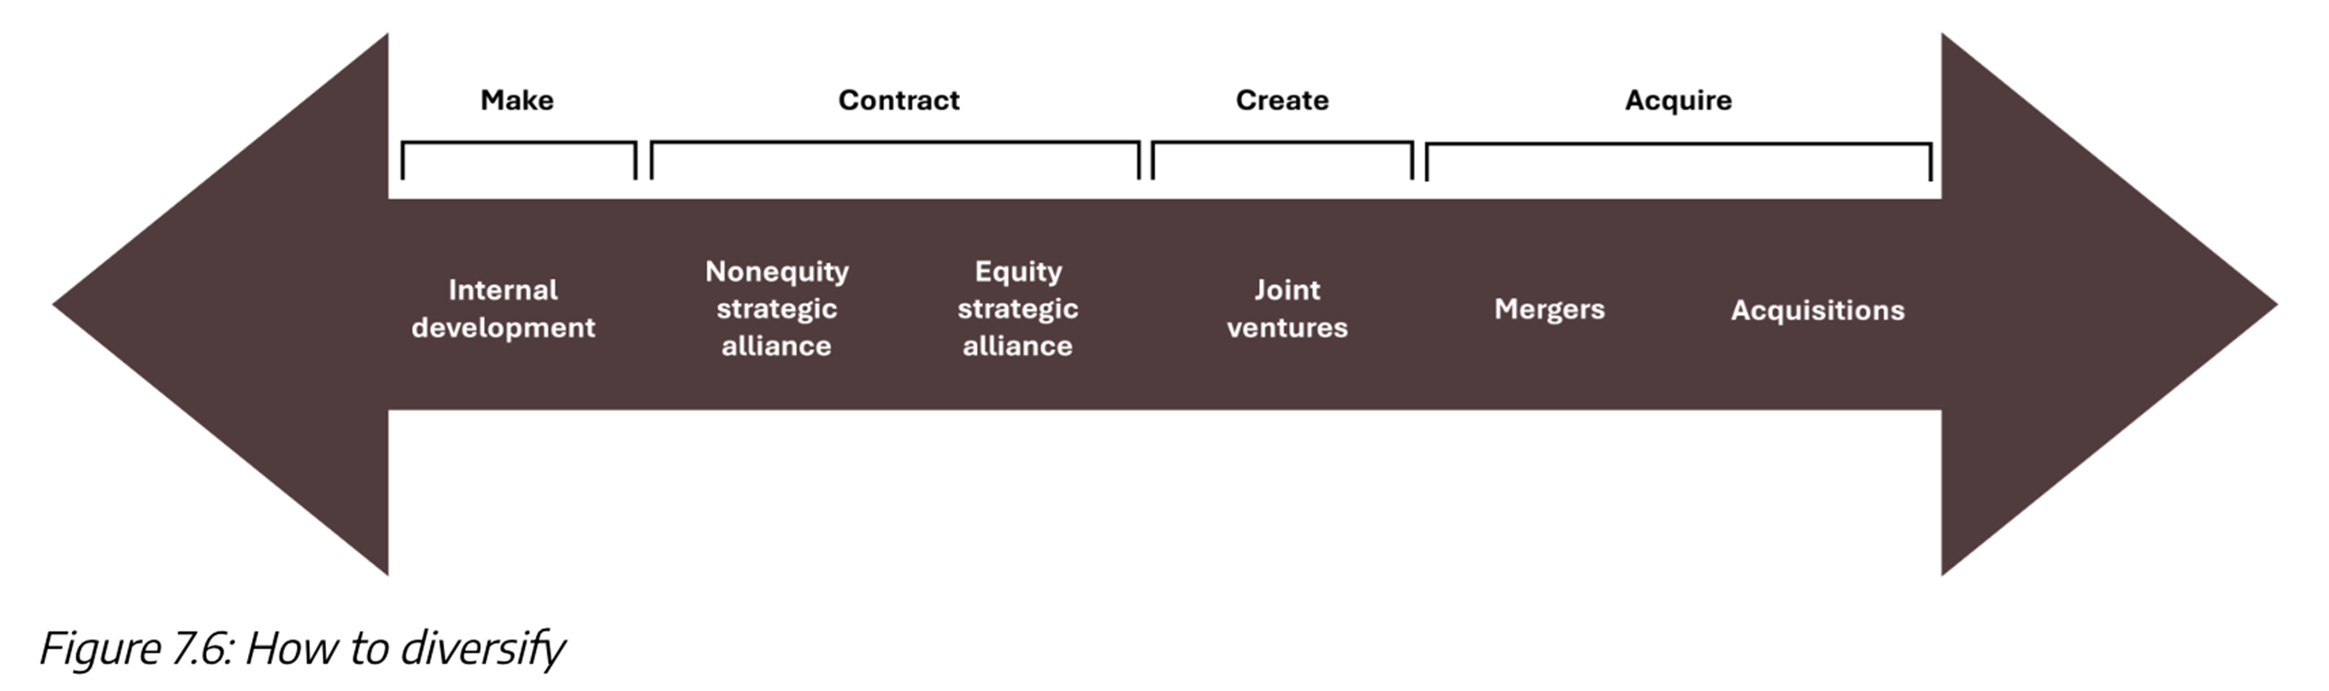
Ways to Diversify: The Make–Contract–Create–Acquire Continuum
Kindred Grey. 2025. CC BY-NC-SA.
Notes:
Companies may diversify by using internal development to make their own products or design new services. They also may enter into contracts with other companies to achieve diversification. This includes non-equity and equity alliances. Firms can diversify by creating a new company through a joint venture. Finally, companies may acquire additional companies as a means of diversification through mergers and acquisitions.

Slide 38
Make: Internal Development, 1 of 2
Internal development: the process by which a firm expands its resources, capabilities, core competencies, products, or services by leveraging internal resources and expertise.
Companies can also develop and launch whole new business lines through internal development.

Slide 39

Make: Internal Development, 2 of 2
Microsoft expanded from mostly software development to offering full tech solutions by diversifying its offerings through internal development, producing products like Microsoft Teams for collaboration and Azure for cloud services.
Figure 7.8: Microsoft building 92, Redmond, WA
© Microsoft. 2015. CC BY 3.0. Microsoft Redmond Campus Building 92 image

Slide 40
Make: Internal Development: Check Your Knowledge So Far
When a firm uses its own resources, capabilities, and R&D to build new products, services, or business lines from within.
🎯 Strategic Benefits:
Full control over development process
Builds and protects core competencies
Enables creation of unique, proprietary offerings
Often lower risk than M&A in early stages
🔍 Real-World Examples:
Apple designs hardware, software, and chips (Apple Silicon) in-house
Microsoft built Teams & Azure internally to expand beyond OS and Office
Tesla develops its own batteries and AI systems instead of licensing them
⚠️ Challenges:
Slower than acquiring external capabilities
Requires significant investment in R&D, infrastructure, and time
Success depends on the firm’s internal innovation capacity
📍 Key Takeaway:
Internal development is a powerful diversification strategy when firms have the talent, technology, and time to innovate from within — and want to maintain full control
Notes:
Uses own resources, R&D, and capabilities to innovate
Benefits: full control, builds core strengths, unique products, lower risk early on
Challenges: slower than buying capabilities, high investment in R&D/time
Success needs strong internal innovation capacity
Examples: Apple (chips in-house), Microsoft (Teams, Azure), & Tesla (batteries, AI)

Slide 41
Contract: Strategic Alliances, 1 of 2
Strategic Alliance - a mutually beneficial contractual relationships between two organizations.
Equity Strategic Alliance - is created when one company contracts with another company to purchase a certain equity percentage of the other company.
Private Placement - a sale of stock shares or bonds to pre-selected investors and institutions rather than on a public exchange.
Non-Equity Strategic Alliance - created when two or more companies enter a contractual relationship to pool their resources and capabilities together.

Slide 42

Contract: Strategic Alliances, 2 of 2
in 2010, Panasonic invested $30 million in the automaker Tesla by purchasing shares of Tesla common stock in a private placement,
Figure 7.9: Panasonic’s President, Naoto Noguchi, and Tesla’s Chief Technology Officer, JB Straubel. Tesla Motors Inc.
2010. Public domain. Tesla and Panasonic signage image

Slide 43
Create: Joint Ventures
A joint venture is a strategic partnership where two or more firms create a new, jointly-owned entity to pursue a shared business objective.
Type | Definition | Example
Joint Venture (JV) | Two parent firms create a new jointly-owned child company | Hulu (NBC + Disney + others)
50-50 JV | Both partners own 50% of the new entity, sharing control and risk | Dow Corning (Dow + Corning Inc.)
Majority-Owned JV | One firm owns over 50% of the new company, maintaining strategic control | GM-SAIC (GM owns majority in China)
Why Companies Form Ventures:
Enter new markets together
Share costs, risk, and resources
Combine complementary strengths (ex: tech + distribution)

Slide 44
Acquire: Mergers and Acquisitions (M&A)
Merger - occurs between two companies of similar size voluntarily join forces and create a new business.
Acquisition - the process in which one company purchases and takes control of another company, integrating its assets, operations, and management into the acquiring business
Holding company - owns controlling shares in other companies but doesn’t produce goods or services itself.

Slide 45
Reducing and Reversing Diversification
Retrenchment - reducing a company’s size or offerings to stay profitable, often involving layoffs.
Divestment - selling an unprofitable business or product line.
Spinoff - selling part of a company, such as a division of strategic business unit.

Slide 46
Corporate-Level Strategy: Check Your Knowledge So Far
Defines the overall direction of a firm by determining which industries, markets, or regions it will compete in.
Key Characteristics:
Developed by top executives and board of directors
Answers the question: “Where should we compete?”
Focuses on the scope of the firm’s activities (products, markets, geographies)
Involves decisions like diversification, M&A, and vertical integration
Why It Matters:
Aligns business units with long-term vision
Helps allocate resources strategically
Shapes how the company responds to VUCA environments
Example:
Disney uses corporate strategy to diversify across film, TV, theme parks, and streaming—creating synergy across its entertainment brands.
Notes:
This slide breaks down corporate-level strategy, which is the highest level of strategy in a firm.
It’s created by top executives and boards to set the overall direction of the company.
It answers ‘Where should we compete?’ aka choosing industries, markets, and regions to enter.
It defines the scope of the business such as which products, markets, or geographies the firm operates in.
Key decisions include diversification, mergers & acquisitions, and vertical integration to expand, buy firms, or control more of the value chain.

Slide 47
Corporate-Level Strategy, 7 of 7
        Q 2. In what stage of the industry value chain(s) should the company participate?
        This is a question of vertical integration.
        To consider at what stage of the industry value chain(s) a company should participate requires an understanding of industry value chains and how analyzing them relates to corporate strategy.
        A supply chain and an industry value chain are related ideas.

Slide 48
Supply Chain
Supply Chain - the steps of product production from multiple entities, from raw materials to the final delivered product.

Slide 49
Industry Value Chain
Industry Value Chain - considers the ways a firm adds value to each step or node in the production process.

Slide 50
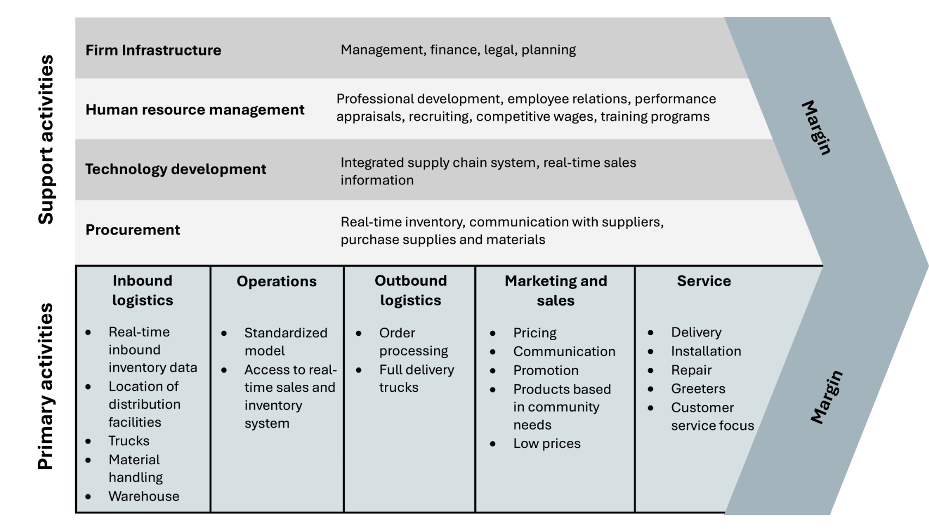
Company vs Industry Value Chain Analysis
Company Value Chain analysis examines internal company practices and their optimization relative to creating value for customers and a sustainable competitive advantage for the firm (primary and secondary activities and margins)
Figure 5.9 Primary and support activities of a corporation – crossed out. Kindred Grey. 2025. CC BY-NC-SA.

Slide 51
Industry Value Chain Analysis
Industry Value Chain Analysis - examines each production stage—from raw materials to final delivery—with a focus on value creation.
An industry value chain analysis examines each node of a product’s value chain to analyze value creation at each.
The stage of the industry value chain(s) at which the company should participate is a question of business integration—more specifically, vertical integration.

Slide 52
Business Integration
Business integration: the process of combining different components of a business into a unified and cohesive operation.
There is horizontal and vertical integration.

Slide 53
Vertical vs. Horizontal Integration
 | Definition | Example
Vertical Integration | Expanding control over supply or distribution (up/down the value chain) | Amazon buying Whole Foods
Horizontal Integration | Expanding within the same stage or industry by acquiring competitors | Marriott acquiring Starwood Hotels
Why Use Vertical Integration?
Increases control over supply chain
Reduces costs or risks
Enhances quality and delivery efficiency
Why Use Horizontal Integration?
Expands market share
Reduces competition
Increases customer base through acquisition
Notes:
This slide breaks down the difference between vertical and horizontal integration, which are two ways firms grow strategically.
Vertical integration is when a company expands upstream or downstream in its supply chain such as Amazon buying Whole Foods to control grocery distribution channels and data on customer purchases. It gives the firm more control over its inputs or distribution, cuts costs, reduces reliance on external suppliers, and can improve efficiency.
Horizontal integration, on the other hand, is when a firm expands within the same industry stage by buying competitors just like Marriott acquiring Starwood Hotels. This increases market share, reduces competition, and gives the firm access to more customers and locations in one move.
Both are about gaining more control, but vertical goes up or down the chain, and horizontal is about building dominance at the same level.

Slide 54
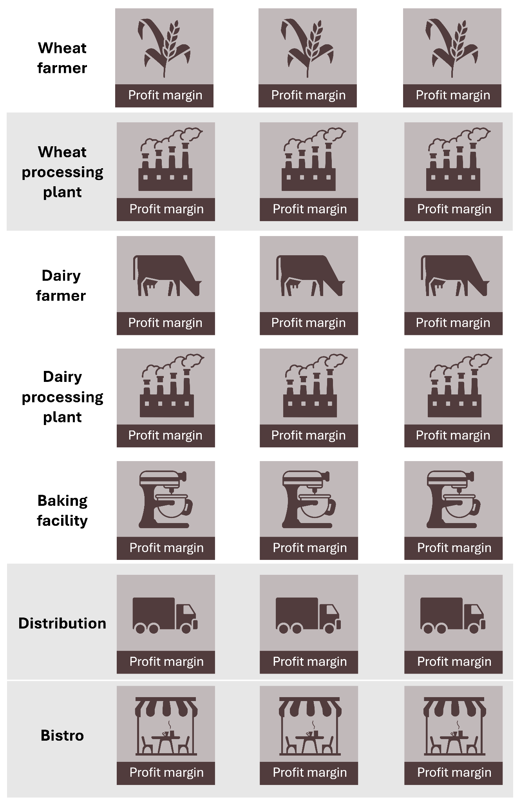
Horizontal Integration
Figure 7.14: Horizontal integration
Kindred Grey. 2025. CC BY-NC-SA. Includes the following icons from the Noun Project (Noun Project license): Wheat (sentya irma, 2024, Wheat icon (Noun Project)), factory (Kevin, 2022, Factory icon (Noun Project)), cow (Laymik, 2019, Cow icon (Noun Project)), stand mixer (I'm Vattie, 2024, Stand mixer icon (Noun Project)), box truck (Andrianxia, 2024, Box truck icon (Noun Project)), and cafe (Ruby, 2023 Cafe icon (Noun Project))
Notes:
This graphic shows horizontal integration in action as each row represents a stage in the food value chain, like wheat farmers, dairy farmers, baking facilities, distribution, and bistros.
What’s happening here is that within each stage, companies can buy out or merge with their direct competitors to gain more control, increase market share, and boost their profit margins. For example, if one dairy processing plant buys out two other dairy processing plants, it’s consolidating power within that same level of the chain.
The key idea is that horizontal integration doesn’t move up or down the supply chain; it stays at the same level but increases dominance by acquiring competitors, allowing the company to control prices, reduce competition, and create economies of scale.

Slide 55
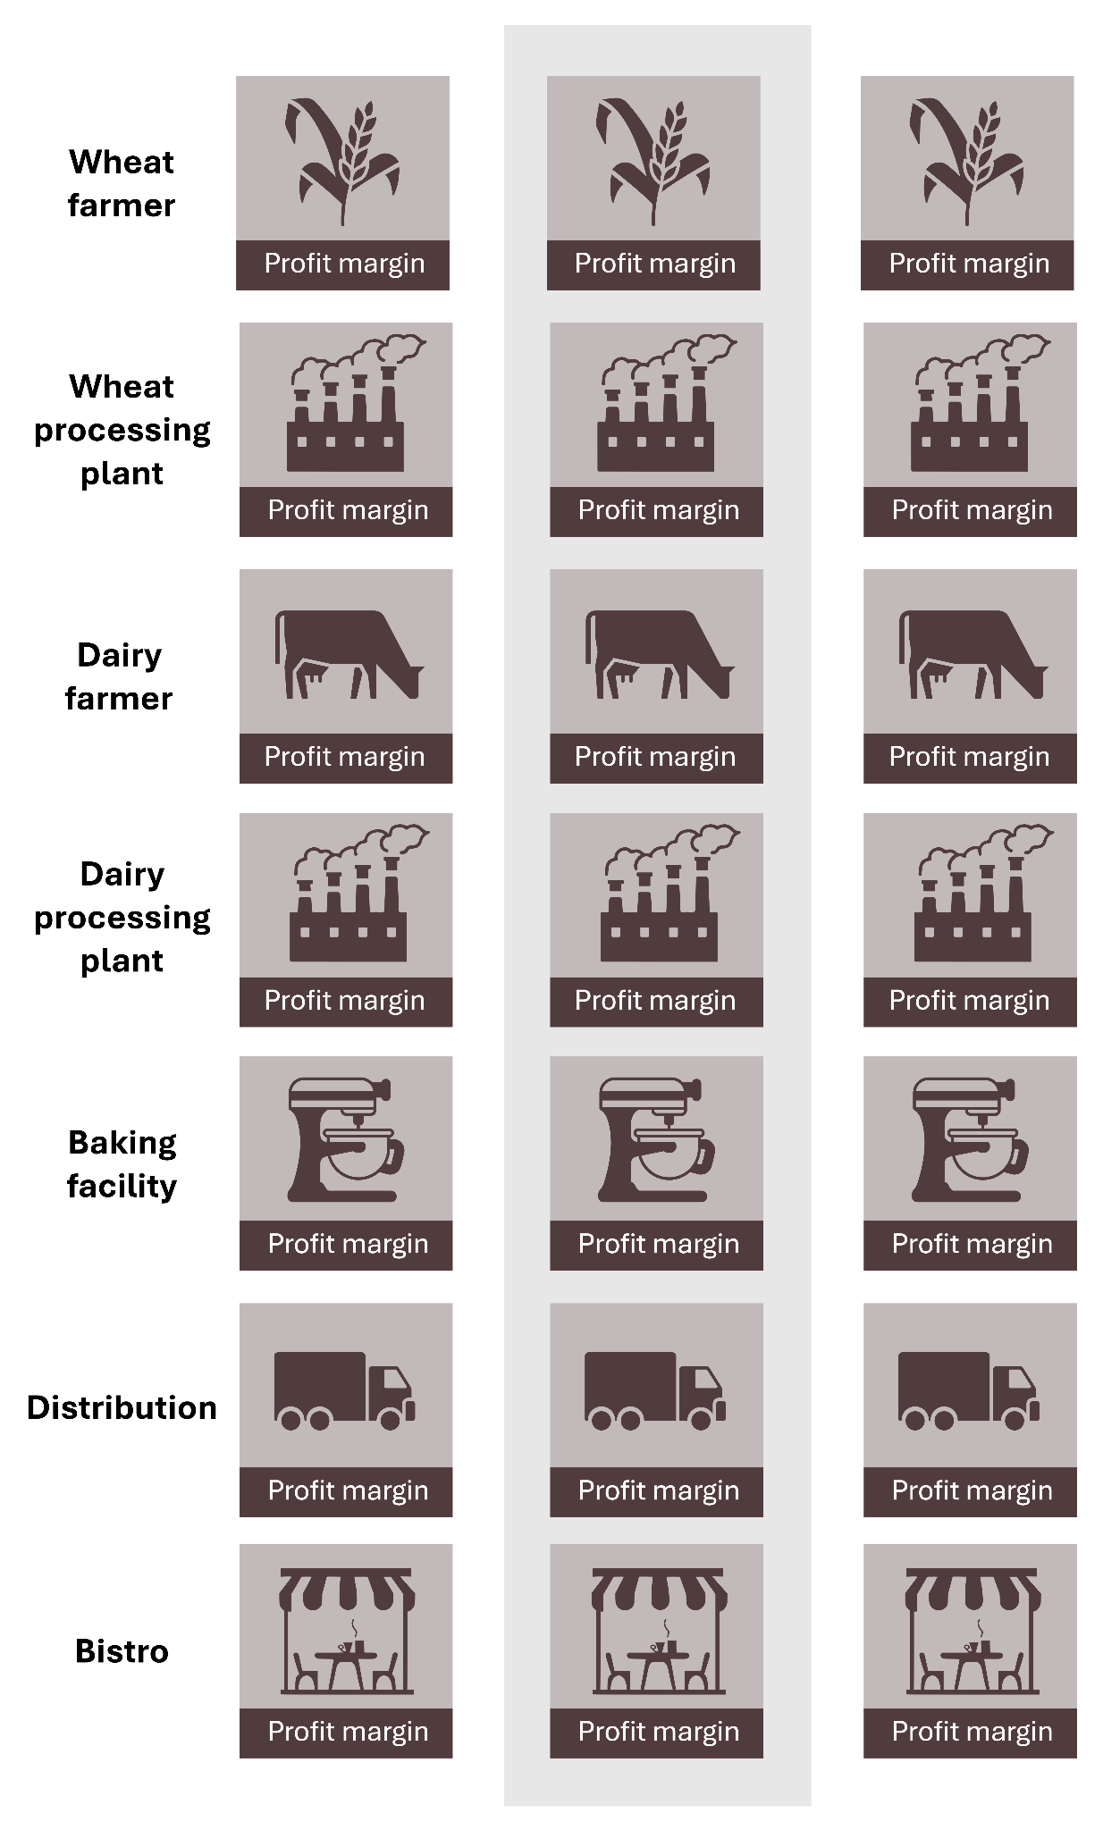
Vertical Integration
Figure 7.15: Vertical integration
Kindred Grey. 2025. CC BY-NC-SA. Includes the following icons from the Noun Project (Noun Project license): Wheat (sentya irma, 2024, Wheat icon (Noun Project)), factory (Kevin, 2022, Factory icon (Noun Project)), cow (Laymik, 2019, Cow icon (Noun Project)), stand mixer (I'm Vattie, 2024, Stand mixer icon (Noun Project)), box truck (Andrianxia, 2024, Box truck icon (Noun Project)), and cafe (Ruby, 2023 Cafe icon (Noun Project))
Notes:
This slide shows what vertical integration looks like in practice unlike horizontal integration, which buys out competitors at the same level, vertical integration is about owning multiple stages along the supply chain.
Here, you can see the company owns everything from wheat farms, wheat processing plants, dairy farms, dairy processing plants, baking facilities, distribution, all the way to the final bistro.
This means the firm controls each step from raw materials to final sales to the consumer. The advantage is it reduces reliance on outside suppliers or distributors, improves coordination and efficiency, and can capture profit margins at each stage, ultimately leading to lower costs and more control over quality and delivery.

Slide 56
Backward vs. Forward Vertical Integration
Vertical integration includes two types: backward and forward. Both involve a company expanding its control along the industry value chain.
Type | Definition | Goal | Example
Backward Vertical Integration | Moving upstream/backwards to control suppliers or input sources | Secure supply, reduce costs | A café buys a coffee bean farm
Forward Vertical Integration | Moving downstream/forwards to control distribution or customer-facing activities | Control delivery, improve access | A bakery opens its own retail store
Key Differences:
Backward = Taking control of inputs or raw materials
Forward = Gaining control over how the product reaches the customer
Notes:
This slide explains the two directions of vertical integration: backward and forward.
Backward integration is when a company moves upstream, taking control of its suppliers or raw materials. For example, if a café buys a coffee bean farm, it secures its coffee supply and potentially reduces costs by cutting out the middleman.
Forward integration is moving downstream, closer to the customer, by controlling distribution or retail. For instance, if a bakery opens its own retail store, it’s making sure it has direct access to customers and controls how its products are sold.
The key difference is the direction: backward secures inputs, forward controls how products reach customers. Both give firms more control over their value chain, but for slightly different strategic reasons.

Slide 57
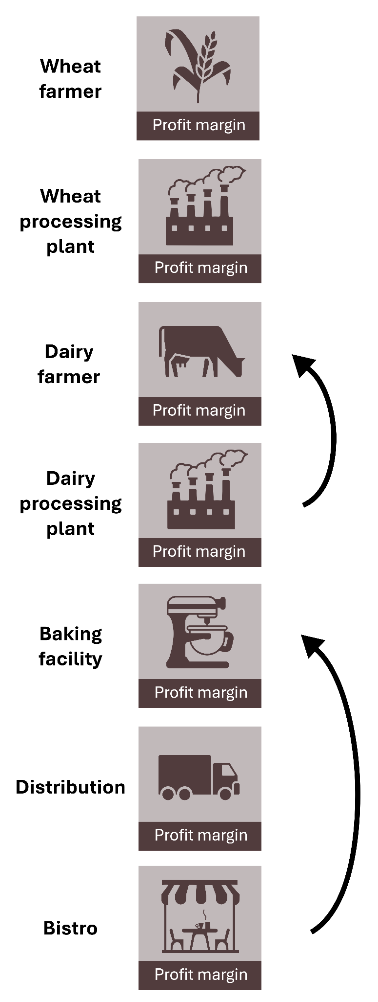
Backward Vertical Integration
Figure 7.16: Backward vertical integration
Kindred Grey. 2025. CC BY-NC-SA. Includes the following icons from the Noun Project (Noun Project license): Wheat (sentya irma, 2024, Wheat icon (Noun Project)), factory (Kevin, 2022, Factory icon (Noun Project)), cow (Laymik, 2019, Cow icon (Noun Project)), stand mixer (I'm Vattie, 2024, Stand mixer icon (Noun Project)), box truck (Andrianxia, 2024, Box truck icon (Noun Project)), and cafe (Ruby, 2023 Cafe icon (Noun Project))
Notes:
This diagram shows what backward integration looks like in a supply chain.
Imagine you’re the bistro at the bottom of this chart. By integrating backward, you start buying or acquiring firms upstream such the baking facility, dairy processing plant, dairy farm, wheat processing plant, or even wheat farms themselves.
The arrows here point upstream, indicating that the company is gaining control over its inputs and raw materials. The goal is to secure supply, ensure quality, reduce dependence on outside suppliers, and potentially cut costs by capturing the profit margins at each upstream stage.
A real-life example is Starbucks buying coffee farms to control bean quality and supply chain stability.

Slide 58
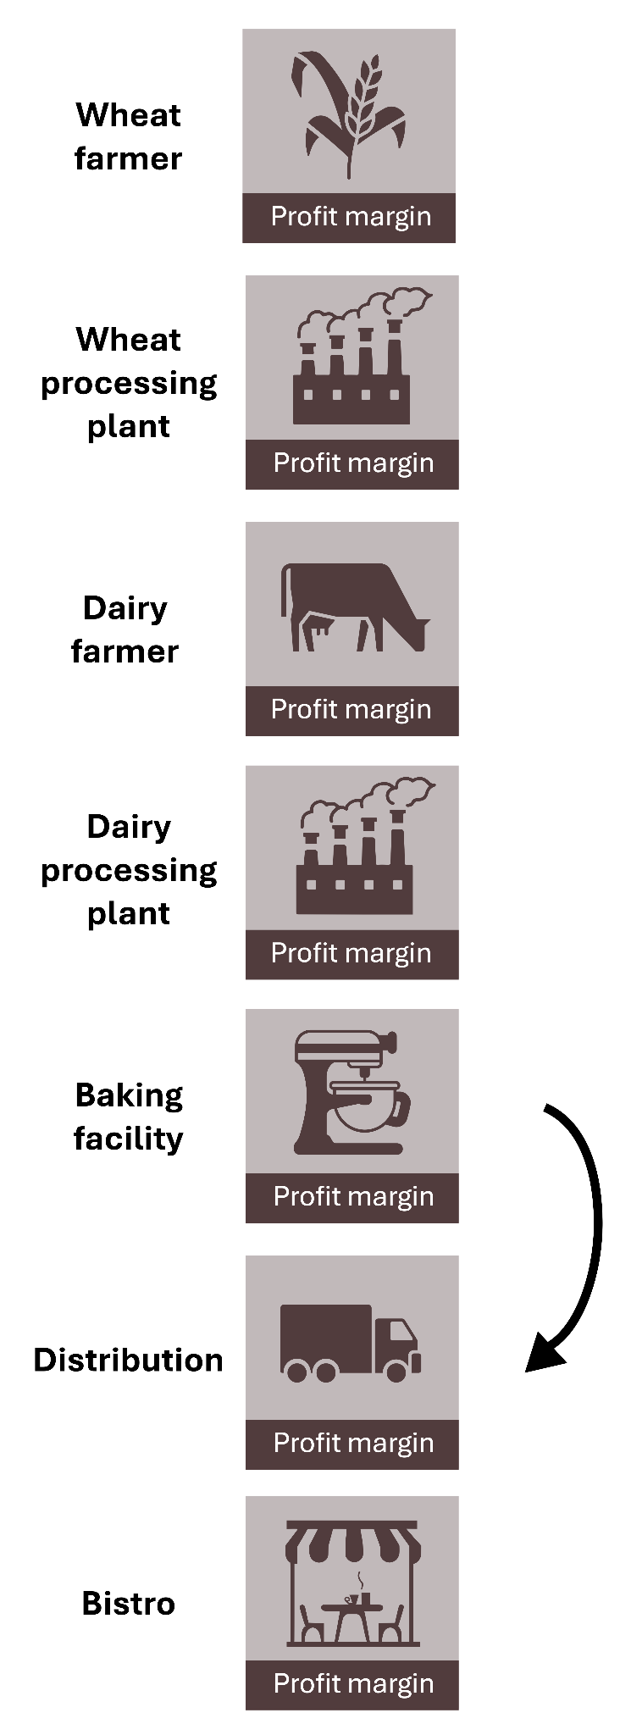
Forward Vertical Integration
Figure 7.17: Forward vertical integration
Kindred Grey. 2025. CC BY-NC-SA. Includes the following icons from the Noun Project (Noun Project license): Wheat (sentya irma, 2024, Wheat icon (Noun Project)), factory (Kevin, 2022, Factory icon (Noun Project)), cow (Laymik, 2019, Cow icon (Noun Project)), stand mixer (I'm Vattie, 2024, Stand mixer icon (Noun Project)), box truck (Andrianxia, 2024, Box truck icon (Noun Project)), and cafe (Ruby, 2023 Cafe icon (Noun Project))
Notes:
This diagram shows what forward integration looks like along the supply chain.
In forward integration, a company moves downstream, closer to the end customer. For example, if a baking facility starts acquiring distribution companies and even bistros or cafés to sell its products directly to consumers, it’s moving forward in the chain.
The arrow here points downstream, indicating that the firm is taking control over distribution channels and retail sales. The strategic goal is to gain better access to customers, control how the products are marketed and sold, and potentially capture the profit margins from those later stages instead of sharing them with other businesses.
A real-life example is Apple opening its own Apple Stores to control the retail experience and customer relationship directly.

Slide 59
Corporate-Level Strategy, 6 of 6
        Q 3. Where should the organization compete geographically?
          This is a question of geographical scope.

Slide 60
Geographical Scope
Refers to the range of regions or markets in which a firm chooses to compete — local, national, or global.
Key Considerations:
Market fit: Are customer needs similar across regions?
Legal environment: Local laws, regulations, and restrictions
Logistics: Supply chain and infrastructure challenges
Cultural differences: Language, norms, and buying behavior
Cost vs. reach trade-off: Global scale vs. operational complexity
Example:
McDonald's adapts its menu globally but keeps brand consistency — balancing global reach with local responsiveness.
Notes:
Geographical scope is about deciding which regions or markets a company wants to operate in local, national, or global regions. When expanding, firms need to consider factors like customer differences across regions, legal rules, logistics and supply chains, cultural norms, and the trade-off between wider reach and increased complexity. For example, McDonald’s operates globally but adjusts its menu locally to fit cultural preferences while maintaining brand consistency.

Slide 61
Portfolio Planning
A firm’s business portfolio consists of all the products and services it sells, all the business it is in, and all the market segments, markets, and industries in which it participates.
An essential part of continuously assessing and managing corporate-level strategy includes portfolio planning.
Portfolio planning addresses how a firm should manage its portfolio of businesses, like strategic business units or divisions, to achieve synergy and create value.
It also addresses how the parent company adds value to its business divisions and strategic business units.

Slide 62
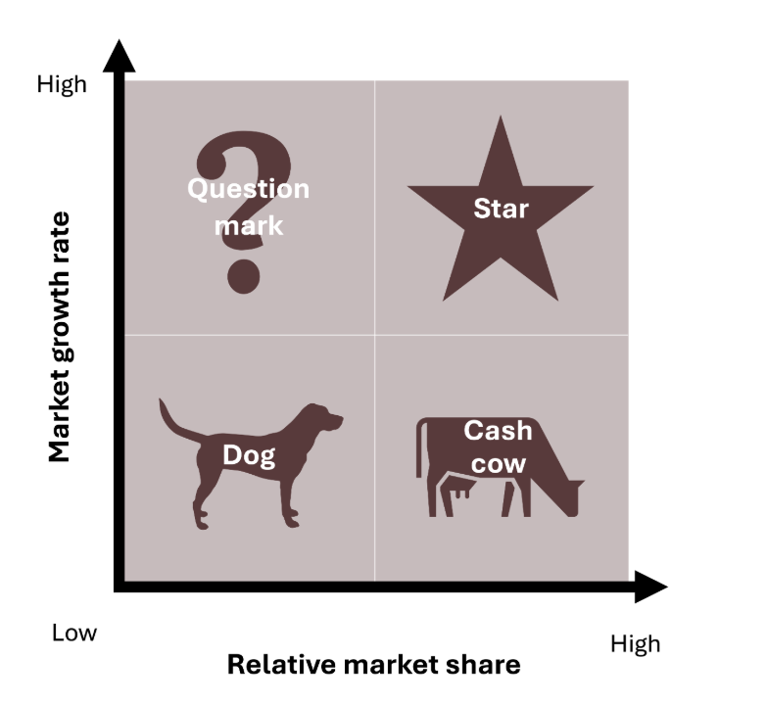
Portfolio Planning – BCG Matrix
BCG Matrix: helps firms evaluate their business units based on market growth and market share to guide resource allocation.
Star – High market share & growth → Invest for dominance
Cash Cow – High market share & low growth → Use profits to support others
Question Mark – Low market share & high growth → Evaluate potential or exit
Dog – Low market share & growth -> Divest or manage minimally
Figure 7.18: The BCG matrix.
Kindred Grey. 2025. CC BY-NC-SA. Includes the following icons from the Noun Project (Noun Project license): Cow (Laymik, 2019, Cow icon (Noun Project)) and Dog (Daniel Ducrocq, 2013, Dog icon (Noun Project))
Notes:
The BCG Matrix is a portfolio planning tool that helps firms decide how to allocate resources across different business units based on their market growth rate and relative market share.

Slide 63
BCG Matrix Example – Apple Inc.
How Apple allocates resources across its product portfolio
 | Low Marker Share | High Market Share
High Growth | Vision Pro ❓ | iPhone 🌟
Low Growth | iPod 🐶 | MacBook & iPad 🐄
Apple uses internal development to move Question Marks into Stars, and quickly exits Dogs to preserve focus.
Notes:
This slide applies the BCG Matrix to Apple’s products. The iPhone is a Star because it has high market share and is in a high-growth market, so Apple invests heavily in it.
MacBooks and iPads are Cash Cows with high share but lower market growth, providing steady profits.
The Vision Pro (spatial computing) is a Question Mark with potential for growth but currently low market share, meaning Apple needs to decide whether to invest further.
The iPod is considered a Dog, with low share and growth, so Apple discontinued it to focus on more profitable products.

Slide 64
Analyze Corporate-Level Strategy, 1 of 2
6. As appropriate to the case, analyze strategies: Corporate-level, business-level, innovation, sustainability and ethics, technology, and multinational strategies.
Use strategic management analytical frameworks to analyze, interpret, and evaluate strategies.
Ensure line of sight and congruence within analysis of each strategy.

Slide 65
Analyze Corporate-Level Strategy (2 of 2)
Purpose: To analyze corporate strategy by assessing how well a firm’s business units, industries, and geographic reach align to support long-term goals and competitive advantage.
Key Questions to Ask:
Do the business units complement each other? (synergy)
Is the firm competing in the right industries or regions?
Does the strategy fit the firm’s resources and capabilities?
Is the firm using the right growth methods (M&A, alliances, internal development)?
Is the company over-diversified or too narrowly focused?
Common Tools Used:
BCG Matrix – for evaluating business unit performance
Industry Value Chain Analysis – to identify where value is created
Example Insight:
If a company is in too many unrelated businesses with no synergy, it may be time to divest or restructure to improve strategic focus.
Notes:
This slide explains how to analyze corporate-level strategy by assessing if a firm’s business units, industries, and geographic reach align with its goals and strengths. It involves checking for synergy between units, choosing the right industries, ensuring strategies fit resources, using appropriate growth methods like M&A and alliances, and avoiding being too diversified and too narrow. Tools used include the BCG Matrix, Value Chain Analysis, SWOT, and VRIO frameworks.

Slide 66
How Do You Know If Corporate Strategy Is Working?
🧭 Strategic Alignment
Are business units aligned under a shared vision and long-term goals?
📈 Performance & Synergy
Is the company generating value from synergy between units?
Are integration efforts (like M&A or restructuring) improving results?
📉 Overreach & Focus
Is the firm spreading too thin across markets or industries?
Is there clear strategic focus, or confusion across units?
🔍 Strategic Fit
Does the strategy match the firm’s capabilities, resources, and external environment?
🧠 Key Insight:
Strong corporate strategy balances ambition and focus — and drives sustainable performance across the portfolio
Notes:
This slide shows that to know if corporatelevel strategy is working, firms should check for alignment across units, value from synergy, clear focus without overextending, and a good fit with their strengths and environment as overall, strong strategy balances ambition with focus to drive sustainable success.

Slide 67
Why Corporate Strategy Matters to Business Majors
🎓 From Classroom to Career
Most business grads start in functional roles such as marketing, HR, finance, etc, but corporate strategy helps you see how your unit fits into the big picture.
💼 Why It Matters:
Think Like an Executive
Understand how decisions about where to compete shape the whole business
Understand M&A, Diversification & Integration
Know why firms buy, build, spin off, or scale operations — and how it impacts YOU
Contribute to Strategic Conversations
You'll better support your team, present ideas with context, and grow into leadership
🏢 Real-World Company Examples:
Amazon: Started as an online bookstore, diversified into AWS, grocery, and logistics —that’s corporate strategy
Disney: Acquired Pixar, Marvel, and Fox to expand its portfolio and reach global markets
👨‍🎓 Where You Fit In
Intern in Marketing → Your campaign supports SBU growth goals
Analyst in Finance → Your budget affects M&A feasibility
HR in a retail division → You enable strategic expansion by hiring locally
🧩 Key Takeaway:
Corporate strategy isn't just for the C-suite — it's for anyone who wants to lead, grow, and make decisions that matter.
Notes:
Corporate strategy matters because it helps you see the big picture of how a company decides where to compete and grow, as it lets you think like an executive, understand M&A, diversification, and integration decisions, and contribute strategically in your role. Examples of this include Amazon’s diversification into the AWS and Disney’s acquisitions of Pixar, Marvel, and Fox. Overall, strategy knowledge helps you lead, support your team effectively, and grow into leadership roles.

Slide 68
Demonstrate Your Knowledge, Skills, and Competence (1 of 2)
Use these questions to test your knowledge of the chapter.
Describe corporate level strategy. Who is responsible for corporate level strategy? What questions does it answer? How does it relate to a VUCA environment? What is the role of synergy in corporate level strategy? What is the primary focus of corporate level strategy?
Describe diversification and its role in corporate level strategy. Explain how diversification begins to answer a primary focus of corporate level strategy, in what industries, markets, market segments, and businesses should a firm operate. Explain how diversification can contribute to a company’s competitive advantage.
Discuss related diversification and how this relates to a single business firm and a dominant business firm. Give an example.
Discuss unrelated diversification. Give an example.
Explain the relationship between diversification and financial performance.

Slide 69
Demonstrate Your Knowledge, Skills, and Competence (2 of 2)
Use these questions to test your knowledge of the chapter.
Use the Make Contract Create Acquire continuum to describe the ways a firm may diversify.
Describe the ways a company may reduce or reverse diversification. Give an example of each.
Describe an industry value chain, how you analyze it, and why this is useful.
Describe horizontal integration and give an example.
Discuss vertical integration and its role in corporate level strategy. Explain how vertical integration begins to answer a primary focus of corporate level strategy, in what stage of the industry value chain(s) should the company participate. Explain how vertical integration can contribute to a company’s competitive advantage.
Describe backward vertical integration and how this answers, in what stage of the industry value chain(s) should the company participate

Slide 70
Demonstrate Your Knowledge, Skills, and Competence
Use these questions to test your knowledge of the chapter.
Discuss forward vertical integration and how this answers, in what stage of the industry value chain(s) should the company participate.
Describe how geographical scope relates to corporate level strategy. Explain how geographical scope begins to answer a primary focus of corporate level strategy, where should the organization compete geographically. Explain how geographical scope can contribute to a company’s competitive advantage.
Explain the purpose of portfolio planning.
Explain the BCG matrix and its limitations.
Describe how competence with corporate level strategy is relevant and important to you.
Now you are competent with corporate level strategy. Your hard work has paid off!

