Slide 1


Chapter 10
Formulate Sustainability and Ethics Strategy
Strategic Management
MGT 4394
Notes:
These slides serve as a study guide for “Chapter 10: Formulate Sustainability and Ethics Strategy” in Strategic Management and Case Analysis: An Integrated Approach ©Lori Anderson, Dirk Buengel, and Joseph J. Simpson, which is provided at https://doi.org/10.21061/strategicmanagementandcaseanalysis under an open license, Creative Commons BY NC-SA 4.0. The slides are also provided at https://hdl.handle.net/10919/138831 under the same open license, Creative Commons BY NC-SA 4.0.
Note to Instructors: These study guides are intended to be a concise and comprehensive accompaniment that follows the logic of the textbook. Our intention is to support you in your instruction and is based on our experience that it can be easier and quicker to remove slides you do not want to include than to create additional slides.

Slide 2
Study Guide
These slides serve as a study guide for “Chapter 10: Formulate Sustainability and Ethics Strategy” in Strategic Management and Case Analysis: An Integrated Approach by Lori Anderson, Dirk Buengel, and Joseph J. Simpson, which is provided under an open license, Creative Commons BY NC-SA 4.0. The slides are also provided under the same open license, Creative Commons BY NC-SA 4.0.
Notes:
Note to students: These study guides are intended to be a concise and comprehensive accompaniment that follows the logic of the textbook and may support your learning, mastery, and application of these concepts. They are are intended to supplement, not replace, your review of the textbook and any other sound study strategies you have made, such as taking notes to support your most effective learning.

Slide 3
Learning Objectives, 1 of 2
After engaging with this chapter, you will understand and be able to apply the following concepts.
What sustainability and ethics strategy is.
Disruptive megatrends and how they impact business strategy.
The drivers of climate change as the defining megatrend and approaches to fight the climate crisis.
The concept of sustainability and the stakeholder-driven business case for companies to implement business sustainability strategies.
The pros and cons of companies embracing a social responsibility beyond the profit motive.

Slide 4
Learning Objectives, 2 of 2
After engaging with this chapter, you will understand and be able to apply the following concepts.
The triple bottom line approach.
The concept and content of corporate social responsibility (CSR) strategy.
Environmental, social and governance (ESG) strategies as the latest and most relevant concept of sustainability.
The elements of a robust ethics strategy.
Contemporary issues of corporate ethics that are shaping the business strategy agenda.
Why sustainability and ethics strategy is important to business graduates.
You will be equipped to analyze sustainability and ethics strategy.

Slide 5
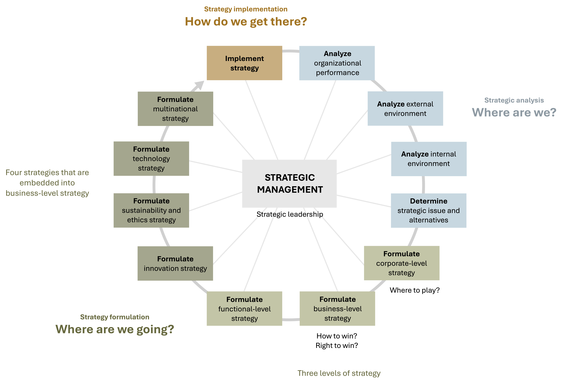
Sustainability and Ethics Strategy in the AFI Framework
Figure 1.3: The analysis, formulation, implementation (AFI) framework. [Kindred Grey. 2025. CC BY-NC-SA.]

Slide 6
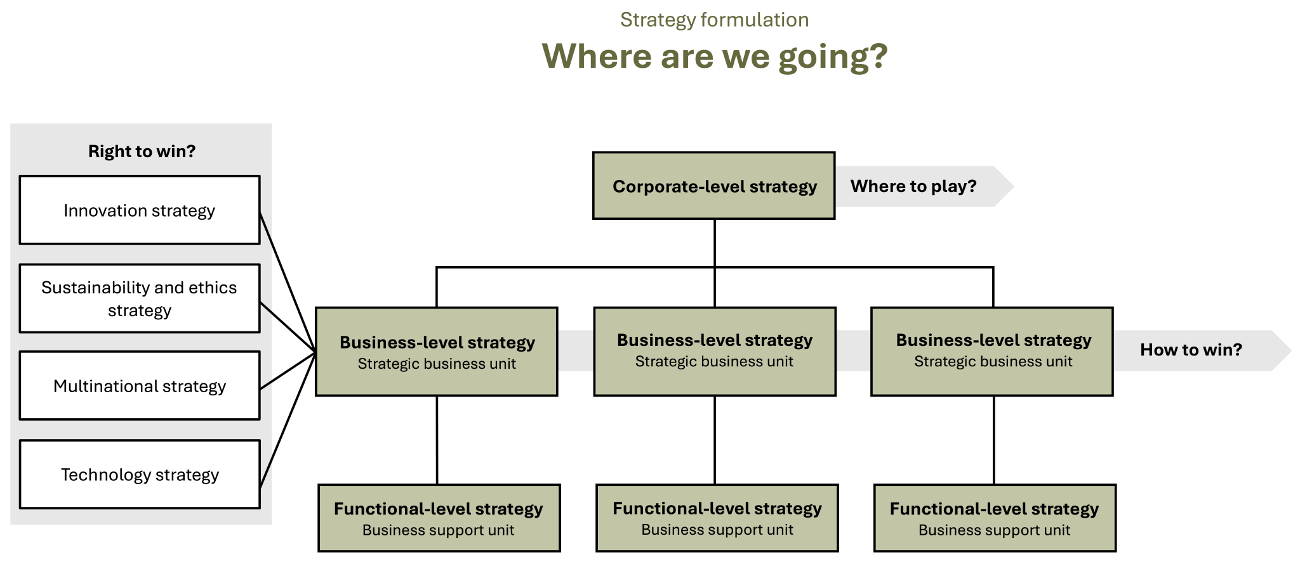
Sustainability and Ethics Strategy in Strategy Formulation
Figure 1.5: Strategy formulation [Kindred Grey. 2025. CC BY-NC-SA.]

Slide 7
Strategy Formulation: Where Are We Going?
Strategic management’s foundations rest in three essential questions that align with the three stages of strategic management:
Strategic analysis: Where are we?
Strategy formulation: Where are we going?
Strategy Implementation: How are we going to get there?
Like all strategy formulation, sustainability and ethics strategy addresses the question of where a firm is going.

Slide 8
Sustainability and Ethics Strategy: Embedded into Business-Level Strategy
Strategy can be described as a firm’s answer to three critical strategic questions that every organization needs to answer.
Corporate-level strategy: Where to play?
Business-level strategy: How to win?
Strategies embedded into business-level strategies: Right to win?
Innovation strategy
Sustainability and ethics strategy
Technology strategy
Multinational strategy

Slide 9
Strategy: Outside-In Perspective
When strategic management leaders and managers formulate strategy, they focus on an outside-in perspective.
All successful strategies are driven by outside-in perspectives, including corporate-level and business-level strategy as well as the strategies embedded in business-level strategies, such as innovation, sustainability and ethics, technology, and multinational strategies.

Slide 10
VUCA
This means that companies need to carefully monitor their external environment, analyzing trends and developing strategies that are forward-looking.
Firms must navigate an external environment that is volatile, uncertain, complex, and ambiguous (VUCA), where change and disruption have become the new normal.

Slide 11
Sustainability and Ethics Strategy: Right to Win?, 1 of 2
Sustainability and ethics strategy is embedded in business-level strategy at the strategic business unit level of a firm.
Strategies that are embedded in business-level strategies address the “Right to win?” question.
This right is supported by truly differentiating and valuable resources, capabilities, and core competencies that are unique for the specific organization.
The right to win needs to be clearly anchored in business-level strategy because it is in strategic business units where a firm decides how it wants to win in its chosen markets.

Slide 12
Sustainability and Ethics Strategy: Right to Win?, 2 of 2
All companies have the ambition to win in their chosen markets. They want to gain market share, increase revenue and profit, and enter new markets and regions, among other barometers of success.
However, strategy is more than a wish list of what a company would ideally want to do and achieve.
Strategy is a company-specific roadmap for navigating in its industry, directing how a firm moves from its current state toward the firm’s vision.

Slide 13
Sustainability and Ethics Strategy: Right to Win?
Has our strategic business unit formulated a differentiating, company-specific, evidence-based sustainability and ethics strategy that is anchored in our SBU’s business-level strategy, helps us successfully navigate our VUCA environment, is supported by differentiating and valuable resources, capabilities, and core competencies that are unique to us, and directs our progress from our current state toward our vision?
Are we earning our right to success by implementing an excellent sustainability and ethics strategy?

Slide 14
Sustainability and Ethics Strategy
Changes in the external environment of the firm drive strategic responses with companies
embracing their corporate social responsibility,
developing environmental, social, and governance strategies and
treating corporate business ethics as a possible source of winning in the market versus just a legalistic approach to stay compliant.

Slide 15
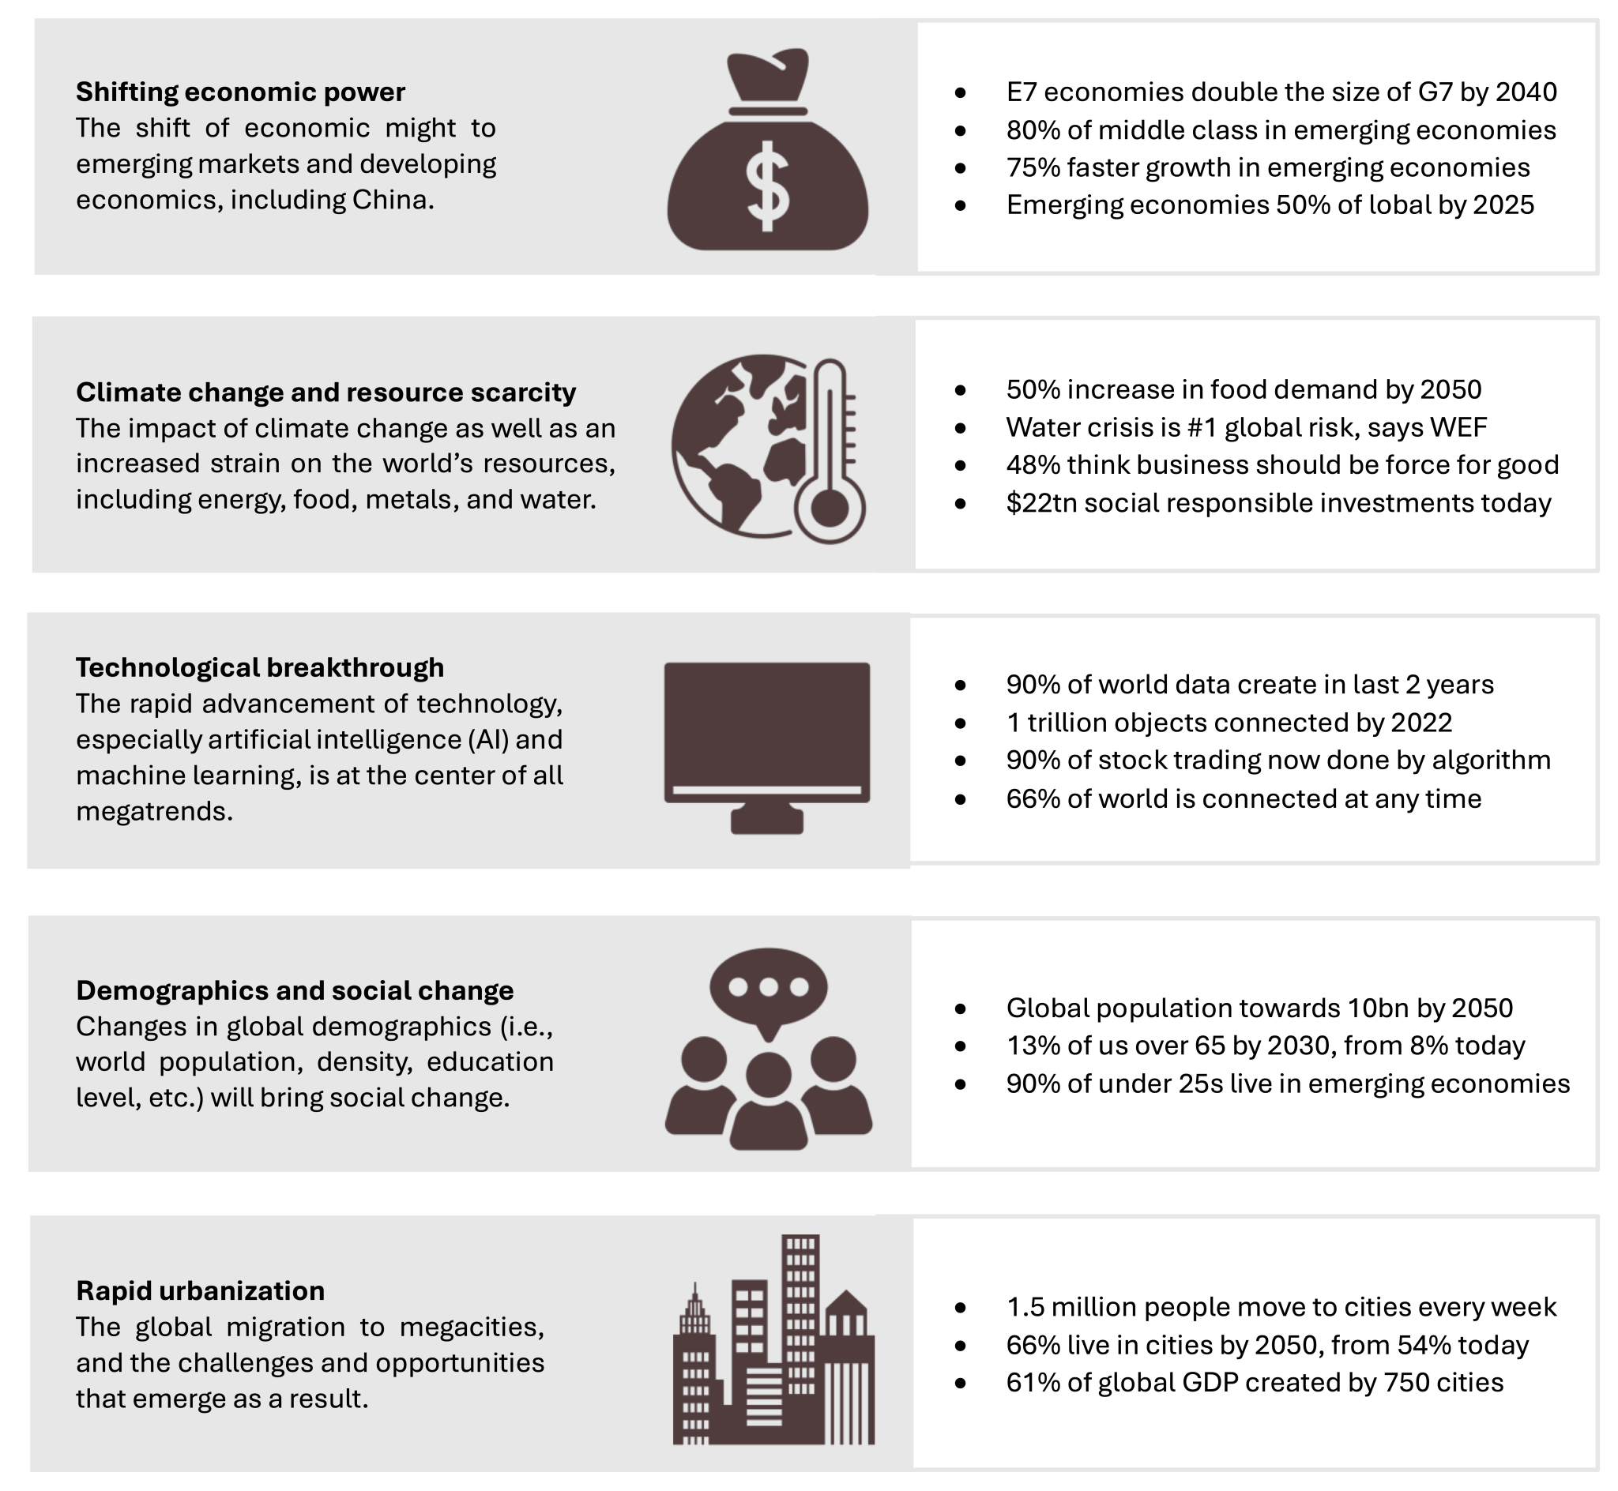
Disruptive Megatrends
Figure 10.1: Disruptive megatrends will impact strategy formulation and implementation
Kindred Grey. 2025. CC BY-NC-SA. Adapted under fair use from Mega-trends with mega-impacts article by Peter Fisk. Includes the following icons from the Noun Project (Noun Project license): Money (New River, 2025, Money icon (Noun Project)), climate change (Lewen Design, 2024, Climate change icon (Noun Project)), computer (Siti Zaenab, 2024, Computer icon (Noun Project)), social (Adrien Coquet, 2024, Social icon (Noun Project)), and city (mohkamil, 2018, City icon (Noun Project))
Notes:
The five major disruptive megatrends shaping business strategy with shifting economic power refers to the rise of emerging economies like China, which will double the size of G7 economies by 2040. Climate change and resource scarcity create risks such as food demand increasing by 50% by 2050 and water crises becoming a top global concern as technological breakthroughs, especially AI and machine learning, transform industries as most data is created in recent years and 90% of stock trading is algorithm-based. Demographics and social change include an aging global population with 13% over age 65 by 2030 and a youth-heavy emerging market base. Finally, rapid urbanization involves mass migration to cities, with 1.5 million people moving each week, and by 2050, two-thirds of people living in urban areas as these megatrends create both strategic risks and opportunities, requiring firms and companies to adapt proactively.

Slide 16
Climate Change
Climate change: refers to long-term shifts in temperature and weather, mainly driven by human activities since the 1800s—especially the burning of fossil fuels that release heat-trapping greenhouse gases.
Greenhouse effect: when the earth absorbs the sun’s energy, or when atmospheric gases prevent heat released by the earth from radiating into space
Global Warming: A rise in Earth’s average temperature, primarily caused by greenhouse gases—especially carbon dioxide—as part of broader climate change.
Notes:
Addressing climate change is the defining challenge of our time and is one megatrend that threatens to disrupt modern society. Climate change is a significant variation of average weather conditions (warmer, wetter, or drier) over several decades. When the earth absorbs the sun’s energy, or when atmospheric gases prevent heat released by the earth from radiating into space (the greenhouse effect), the planet warms. Global warming refers to the increase in the planet’s overall average temperature in recent decades. Global warming is part of climate change and is driven by greenhouse gases (GHGs), with carbon dioxide (CO₂) being the main driver of global warming. The burning of fossil fuels like coal, oil, and gas for electricity, heat, and transportation is the main root cause of the huge increase of CO₂ emissions. CO₂ concentration is now at its highest level in 800,000 years, leading to a rapidly increasing global temperature which is causing draughts, rising sea levels, extreme weather events, food shortages, the reduction of biodiversity, lack of fresh water and climate refugees, among other issues.

Slide 17
Megatrends and Climate Change: Check Your Knowledge So Far
🔮 What are Megatrends?
Long-term, global shifts that reshape business and society
Examples: Climate change, digital transformation, globalization
Influence long-term strategy, innovation, and value creation
🔥 Climate Change as a Strategic Driver
Rising greenhouse gas emissions → global warming
Disrupts operations, supply chains, and stakeholder expectations
Businesses face pressure from regulators, investors, and consumers
♻️ Strategic Response
Firms adopt sustainable practices, green innovation
Climate risk = financial risk
Companies develop ESG strategies to stay competitive and credible
🏢 Business Examples
Microsoft: Carbon negative goal by 2030
Unilever: Climate action embedded in brand strategy
Patagonia: Sustainability as a brand identity
🔑 Key Takeaway:
Climate change is a strategic business challenge. Companies must adapt to shifting risks, regulations, and stakeholder expectations.
Notes:
This slide explains that megatrends are long-term global shifts, like climate change or digital transformation, that reshape business strategy and innovation. Climate change, specifically, drives firms to adopt sustainable practices because rising emissions and global warming disrupt operations and increase regulatory, investor, and consumer pressures. Companies like Microsoft with there carbon negative by 2030, Unilever, and Patagonia integrate climate action into their brand and strategy. Overall, climate risk is treated as a financial risk, requiring ESG strategies to remain competitive and credible.

Slide 18
Sustainability
Sustainability: is meeting our own needs without compromising the ability of future generations to meet their own needs as it addresses the issues of climate change, resource scarcity, social issues, and social justice
Example: Patagonia sources sustainable materials and encourages customers to repair worn gear rather than buy new—reducing waste and promoting environmental stewardship.
Notes:
Addressing the issues of climate change, resource scarcity, biodiversity, human rights, social issues, and social justice are covered by the term sustainability. Sustainability is defined by the UN Commission for Sustainable Development (Brundtland Commission) as meeting the needs of the present generation without compromising the ability of future generations to meet their own needs. Sustainability strategy is a company’s strategy to reduce adverse environmental and social impacts resulting from business operations while still pursuing profitable growth. Strategies that fall under this umbrella include corporate social responsibility (CSR) strategies and environmental, social, and governance (ESG) strategies. Sustainability is a business imperative and should be at the core of every business’s strategy and operations.

Slide 19
Sustainability Strategy
Sustainability Strategy: a company’s plan to reduce environmental and social harm from operations while still growing profitably—often through CSR and ESG initiatives.
Example: Starbucks has a sustainability strategy that includes ethically sourcing coffee, cutting carbon emissions, and promoting social equity through hiring and community investments.
Notes:
Sustainability strategy is a company’s strategy to reduce adverse environmental and social impacts resulting from business operations while still pursuing profitable growth. Strategies that fall under this umbrella include corporate social responsibility (CSR) strategies and environmental, social, and governance (ESG) strategies. Sustainability is a business imperative and should be at the core of every business’s strategy and operations.

Slide 20
Sustainability Statements
Company | Sustainability statement
Ford | Vision For The Future: We aim to reach carbon neutrality no later than 2050. This encompasses our entire impact on the planet – from the emissions from our vehicles to the power in our factories, to our suppliers.
McDonald’s | Our Planet: We’re helping to drive climate action, protecting natural resources, reducing waste, and transitioning to more sustainable packaging and toys.
Oatly | So, you may be wondering why a company needs a to-do list or how long a company’s to-do list might be. Hopefully, this explains it or leaves you with your own questions. Anyway, it’s our to-do list to take important steps toward our vision for a food system that is better for people and the planet. But it’s not just a to-do list! It’s our sustainability plan outlining the actions we will take to meet our sustainability ambitions.
Tesla | Tesla’s mission is to accelerate the world's transition to sustainable energy. Sustainability is integral to Tesla, and it is central to its mission.
Avon | We’re open to all. Every member of our team has the right to personal self-expression such as dress, hair, or other forms of body adornment. We believe in inclusive beauty and support self-expression by challenging stereotypes, supporting freedom of expression, and representing a wide range of people.
Figure 10.2: Sustainability statements from companies

Slide 21
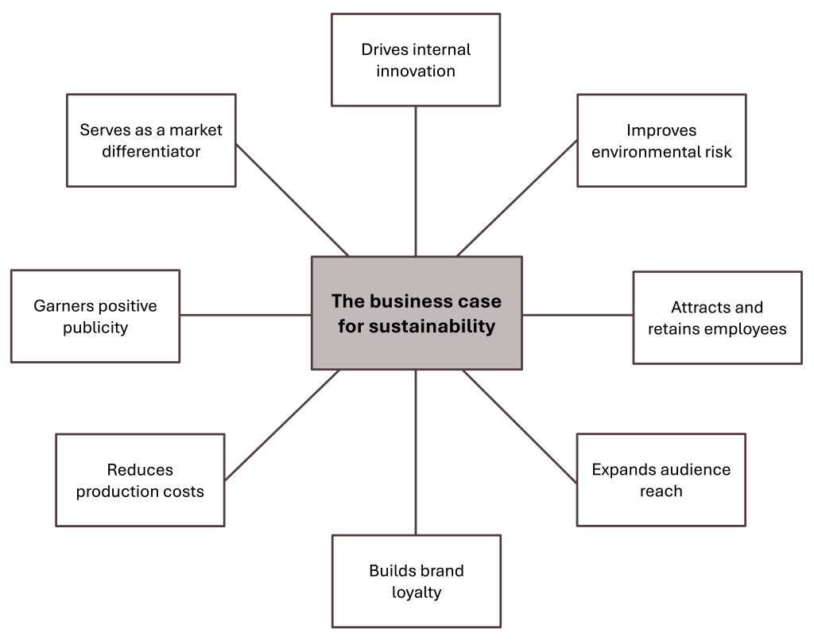
Business Case for Sustainability
Figure 10.5: The business case for sustainability
[Kindred Grey. 2025. CC BY-NC-SA. Information from The Benefits of Corporate Social Responsibility Training (HBS Online) ]

Slide 22
Why Sustainability Strategy is Strategic: Check Your Knowledge So Far
📊 The Business Case
Consumers: 80% more likely to buy from eco-conscious brands
Employees: 40% of Millennials consider sustainability when choosing jobs
Investors: 88% see ESG-focused companies as better long-term bets
Governments: Pushing for carbon neutrality (ex: Paris Agreement & fossil fuel bans)
🏆 Key Benefits for Firms
Cost savings (energy, waste, water)
Boosts brand image and customer loyalty Attracts and retains talent
Opens new markets & innovation opportunities
Improves regulatory compliance & reduces risk
“To prosper over time, every company must not only deliver financial performance but also show how it makes a positive contribution to society.”
– Larry Fink, CEO of BlackRock
🔑 Key Takeaway:
Sustainability strategy isn’t just ethical—it’s profitable, expected, and essential for long-term success
Notes:
Sustainability strategies are not just ethical obligations but key business advantages as consumers are 80% more likely to buy from eco-friendly brands, 40% of Millennials consider sustainability when job searching, and 88% of investors view ESG-focused companies as better long-term investments. Governments are also pushing for carbon neutrality through agreements like the Paris Accord however for firms, benefits include cost savings on energy and resources, stronger brand image and customer loyalty, attraction and retention of talent, access to new markets, and better regulatory compliance with reduced risks. Overall, sustainability drives both profitability and long-term success, as highlighted by Larry Fink’s quote that companies must contribute positively to society to prosper.

Slide 23
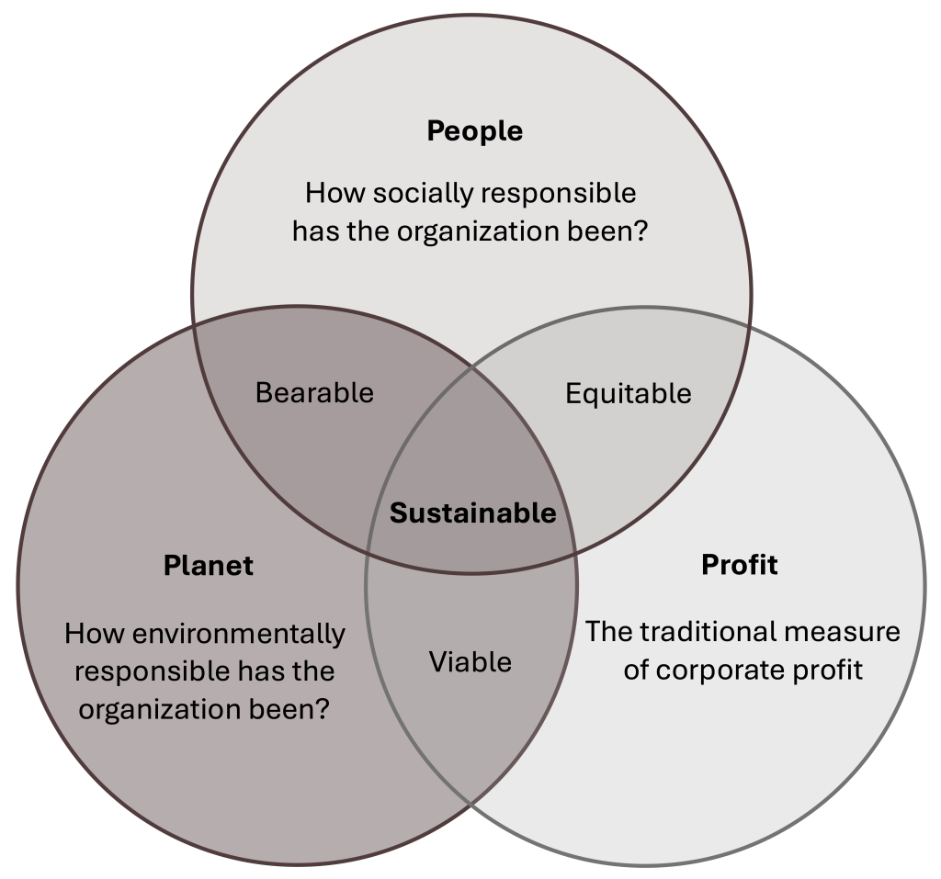
Triple Bottom Line
The logic of the business case for sustainable business management and the triple bottom line approach can be summarized by the following statements:
Doing well by doing good
Making “doing the right thing” profitable
Creating a better world through better business
Figure 10.7: The triple bottom line emphasizes the three Ps of people (social concerns), planet (environmental concerns), and profits (economic concerns). [Kindred Grey. 2025. CC BY-NC-SA.]
Notes:
The Triple Bottom Line framework, combines People (social responsibility), Planet (environmental sustainability), and Profit (economic performance) to define true business success as this diagram shows that sustainability lies at the intersection of all three areas, ensuring strategies are bearable (social + environmental), equitable (social + economic), and viable (environmental + economic). The logic behind this approach is that businesses can “do well by doing good,” make ethical actions profitable, and create a better world through responsible business, as overall, it shifts companies from focusing solely on profit to creating holistic value for society and the environment as well.
Instead of asserting that doing positive things for the environment and society comes at the expense of profit, the triple bottom line states that a good environmental and social performance will support the financial performance of companies. There is no tradeoff between profit and people and the environment; in fact, there is a positive correlation. Companies use sustainability strategies to enhance financial performance, and sustainability becomes a driver of competitive differentiation.
The triple bottom line framework emphasizes a broader view that focuses on the three Ps: people, planet, and profits. These may also be referred to as social/societal, environmental, economic/financial. The triple bottom line ensures that organizations consider not only financial success but also their impact on society (people) and the environment (planet). Although the concept originated in the 1980s, it gained significant traction in the late 1990s as businesses began recognizing that sustainable and ethical practices lead to long-term success. Almost all companies have embraced this approach, prioritizing environmental sustainability and social responsibility alongside their financial goals.

Slide 24
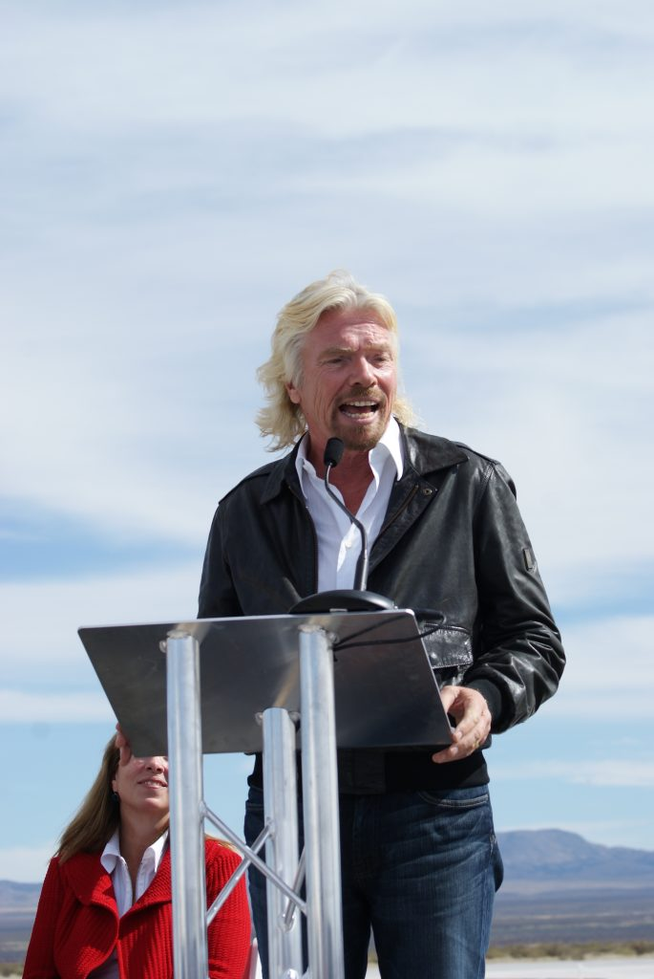
Triple Bottom Line: Check Your Knowledge So Far So Far
📘 What is the Triple Bottom Line?
A sustainability framework that expands business success beyond just profit
Focuses on three P’s:
People (Social responsibility)
Planet (Environmental sustainability)
Profit (Economic performance)
🧩 Purpose
Encourages businesses to create value for all stakeholders—not just shareholders
Balances ethical impact, environmental care, and financial health
💡 Examples
People: Fair labor practices, DEI initiatives, community support
Planet: Emissions reduction, eco-friendly packaging, energy efficiency
Profit: Revenue growth, cost savings from sustainability, long-term ROI
🧠 Insight
“Doing good is good for business.” – Richard Branson
Figure 10.6: Richard Branson
[Jeff Foust. 2010. CC BY 2.0. Sir Richard Branson ]
🔑 Key Takeaway:
The Triple Bottom Line helps companies become more responsible, resilient, and respected—by measuring success in social, environmental, and financial terms.
Notes:
The Triple Bottom Line is a sustainability framework that expands business success beyond profit to include social and environmental responsibility. It focuses on three P’s:
People - examples of this are fair labor, DEI initiatives, & community support
Planet - examples of this are emissions reduction, eco-friendly packaging, & energy efficiency
Profit - examples of this are revenue growth and cost savings from sustainable practices
Its purpose is to create value for all stakeholders, not just shareholders, balancing ethical, environmental, and financial considerations.
As Richard Branson says, “Doing good is good for business,” highlighting that ethical impact often supports long-term ROI and brand reputation.

Slide 25
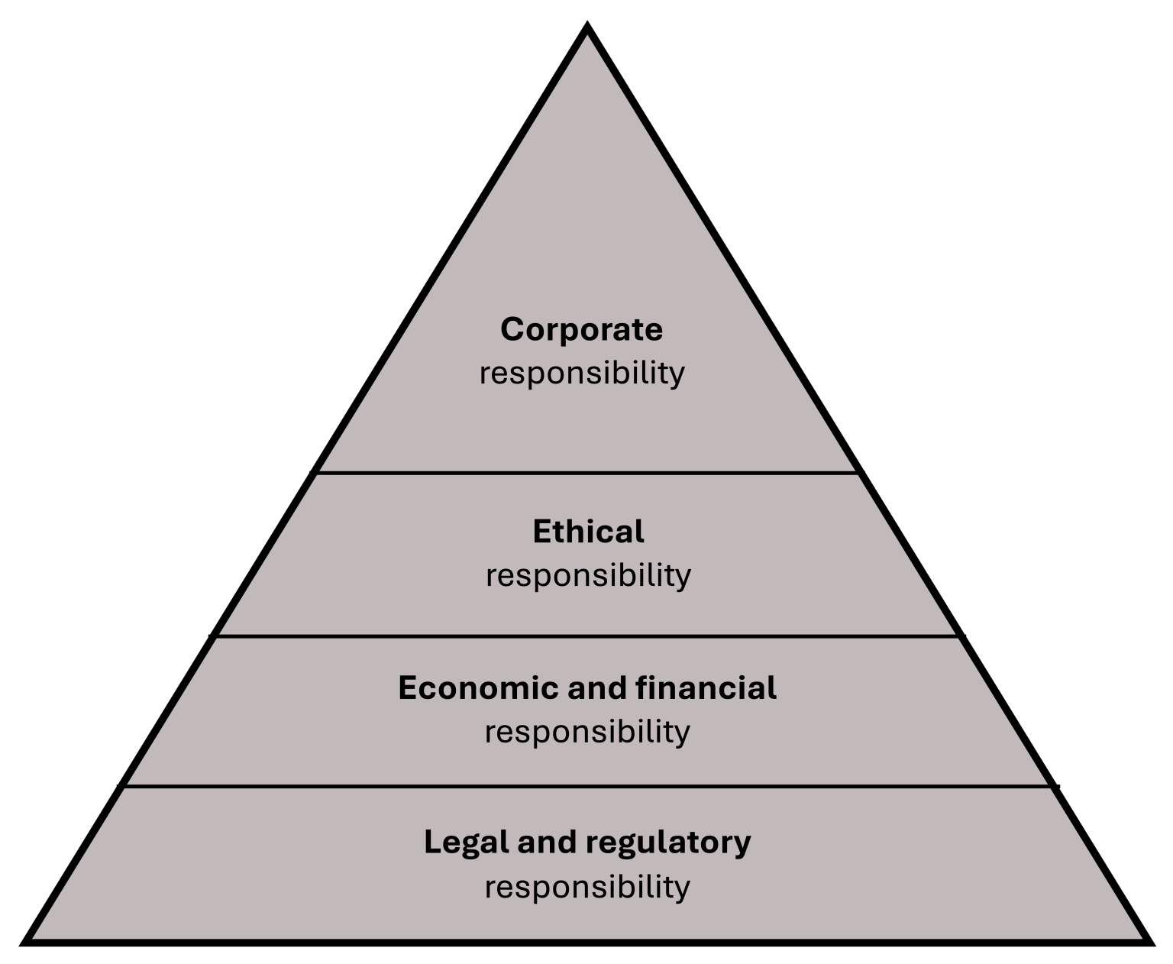
Corporate Social Responsibility
📘 What is CSR?
The idea that businesses have a responsibility to society beyond profits
Operates to enhance society and the environment while pursuing financial goals
Closely aligned with the Triple Bottom Line: People, Planet, Profit
Figure 10.10: Different corporate responsibilities
[Kindred Grey. 2025. CC BY-NC-SA]
Notes:
Corporate Social Responsibility (CSR) is the idea that businesses have obligations to society beyond profits, as CSR improves society and the environment while pursuing financial goals, aligning with the Triple Bottom Line of People, Planet, and Profit. With it’s purpose is to focus on stakeholder well-being, strengthen a firm’s social license to operate, and encourage ethical behavior, long-term thinking, and stakeholder trust. Examples of this include Levi’s worker protection and equity programs, Lego’s WWF partnership, Ben & Jerry’s social justice foundation, and Starbucks’ commitment to ethically sourced coffee. Overall, CSR is now a core strategy driving brand trust, loyalty, and long-term value creation, not just a “nice to have.”

Slide 26
Corporate Social Responsibility: Check Your Knowledge So Far
🏢 Purpose of CSR Strategy
A sustainability strategy focused on stakeholder well-being
Strengthens business’ social license to operate
Encourages ethical behavior, long-term thinking, and stakeholder trust
🌍 Examples of CSR in Action
Levi’s – Worker protection, racial equity, sustainability
Lego – WWF Climate Savers Partner
Ben & Jerry’s – Foundation for social justice
Starbucks – 99% ethically sourced coffee
🔑 Key Takeaway:
CSR is no longer a “nice to have”—it’s a core strategy that builds brand trust, supports stakeholder loyalty, and drives long-term value creation
Notes:
Corporate Social Responsibility (CSR) is the idea that businesses have obligations to society beyond profits, as CSR improves society and the environment while pursuing financial goals, aligning with the Triple Bottom Line of People, Planet, and Profit. With it’s purpose is to focus on stakeholder well-being, strengthen a firm’s social license to operate, and encourage ethical behavior, long-term thinking, and stakeholder trust. Examples of this include Levi’s worker protection and equity programs, Lego’s WWF partnership, Ben & Jerry’s social justice foundation, and Starbucks’ commitment to ethically sourced coffee. Overall, CSR is now a core strategy driving brand trust, loyalty, and long-term value creation, not just a “nice to have.”

Slide 27
Environmental, Social, and Governance (ESG) Strategy, 1 of 2
Environmental, Social, and Governance Strategy: A business model and strategy that pursues at the same time financial performance and high environmental, social, and governance performance. Investors use ESG frameworks to assess a company's sustainability efforts & societal impact
Ex: Unilever cuts emissions, supports fair labor, and promotes ethical leadership—all under one sustainability strategy.
Notes:
An organization’s sustainability practices are typically analyzed against environmental, social, and governance (ESG) metrics. Sustainability has environmental, social, and economic perspectives. In addressing sustainability challenges, almost all companies develop environmental, social, and governance strategy.
Although CSR strategy still holds relevance and importance, ESG has emerged as the leading concept for achieving or maintaining a sustainable and ethical organization. ESG has become a success-critical strategy element. ESG focuses on a company’s environmental performance, its support of social topics, such as social justice and human rights, and its corporate governance. Sometimes ESG is called “CSR with teeth” because ESG is more heavily regulated than CSR. There are far-reaching ESG disclosure and reporting requirements for companies that are not found under the CSR model. In the European Union, the Corporate Sustainability Reporting Directive (CSRD) requires around 50,000 companies to report and disclose their environmental, social, and governance performances through audit-grade reporting. There is also a high level of transparency with ESG reports, and ESG ratings must meet formal transparency standards.

Slide 28
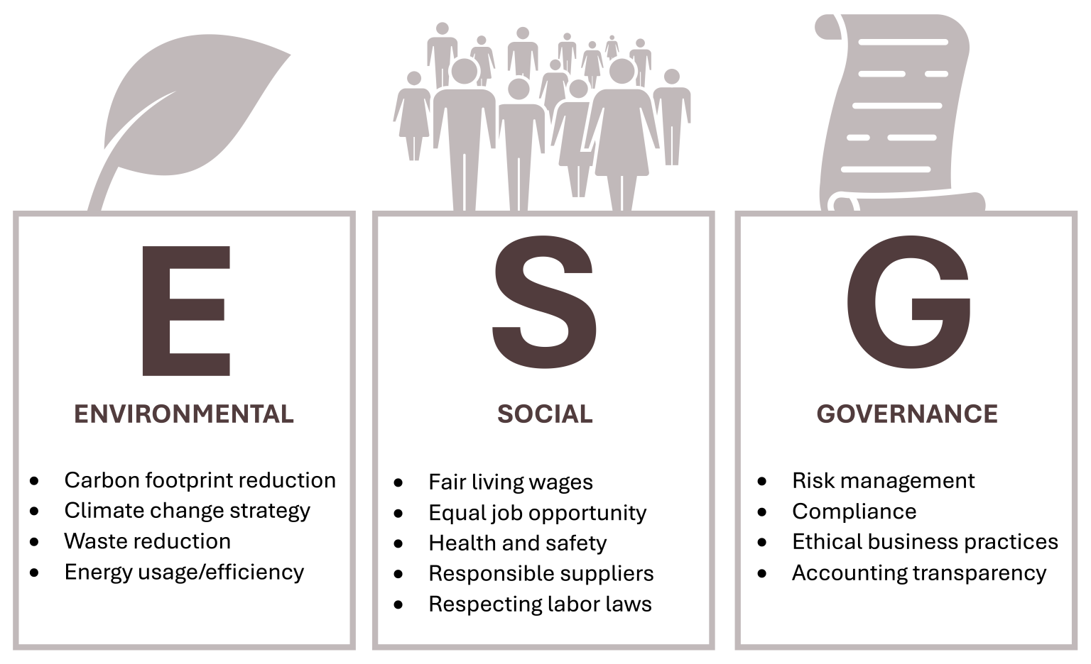
Environmental, Social, and Governance (ESG) Strategy, 2 of 2
Figure 10.11: ESG [Kindred Grey. 2025. CC BY-NC-SA. Includes the following icons from the Noun Project (Noun Project license): Leaf (Dwi Budiyanto, 2025, Leaf icon (Noun Project)), people (Wilson Joseph, 2024, People icon (Noun Project)), and scroll (ardi muctar, 2024, Scroll icon (Noun Project))]
Notes:
ESG is divided into three components with practical examples:
Environmental practices include reducing carbon footprints, developing climate change strategies, minimizing waste, and improving energy efficiency.
Social practices focus on fair living wages, equal job opportunities, health and safety standards, working with responsible suppliers, and respecting labor laws.
Governance involves strong risk management, legal compliance, ethical business practices, and transparent accounting.
Together, these pillars ensure that companies operate responsibly, ethically, and sustainably, which is increasingly critical for gaining stakeholder trust and long-term competitive advantage.

Slide 29
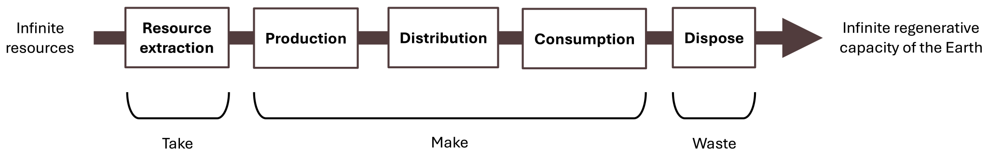
Environmental Pillar: Linear Economy
Figure 10.12: Linear economy
Kindred Grey. 2025. CC BY-NC-SA.
Notes:
The decarbonization of a company’s business model is the most critical element in fighting climate change and often the main element of the ESG environmental pillar. Companies need to define their journeys to become carbon-neutral by 2050 at the latest. As a consequence, companies are currently transparently assessing and measuring their emissions as the baseline for defining specific programs to reduce carbon emissions along their complete value chains. This is covered under corporate decarbonization strategy, which is a part of an overall sustainability strategy and includes measures like energy efficiency projects, the use of renewable energy, electrification, the use of life cycle assessments (LCA) to reduce the environmental impact of products, and partnerships with suppliers.
Another important and strategy-changing environmental element of ESG is the transformation to a circular economy. This contrasts with the current linear economy and linear business model, which follow a take-make-waste approach where resources are used to make products that are being consumed and then wasted.
Linear Economy:
An important and strategy-changing environmental element of ESG is the transformation to a circular economy. The current linear economy and business model follows a ‘take – make – waste’ approach where infinite resources are used to make products that are being consumed and then wasted.
Circular Economy:
Other important elements of the environmental pillar are the reduction of pollution and waste, responsible management of water, support of biodiversity, reduction of land use, opportunities in green building, renewable energy, and investment in green technology.

Slide 30
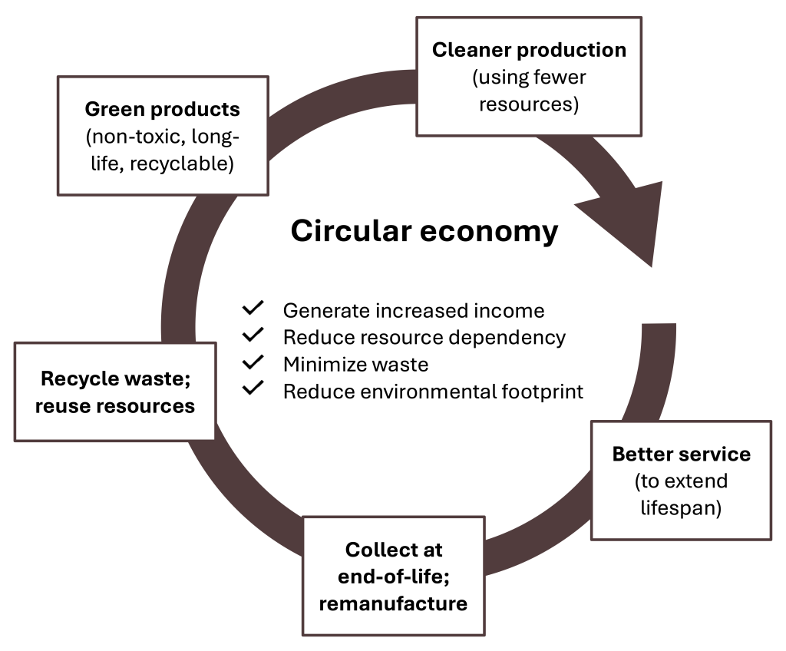
Environmental Pillar: Circular Economy
Figure 10.13: Circular economy
Kindred Grey. 2025. CC BY-NC-SA.
Notes:
Linear Economy:
An important and strategy-changing environmental element of ESG is the transformation to a circular economy. The current linear economy and business model follows a ‘take – make – waste’ approach where infinite resources are used to make products that are being consumed and then wasted.
Circular Economy:
Other important elements of the environmental pillar are the reduction of pollution and waste, responsible management of water, support of biodiversity, reduction of land use, opportunities in green building, renewable energy, and investment in green technology.

Slide 31


Social Pillar
The main differentiator and the source of Patagonia’s competitive advantage is its sustainable business model and its focus on its environmental, social, and governance performance, which is the core of ESG and CSR strategy.
Figure 10.15: The Patagonia story: making business sustainability the strategic right to win
and the main source of competitive differentiation [© Dave Dugdale. 2010. CC BY-SA 2.0. Patagonia Wood Sign ]
Notes:
Patagonia, Inc., is an American retailer of outdoor recreation clothing, equipment, and food. It was founded by Yvon Chouinard in 1973 and is based in Ventura, California. Patagonia’s revenue is estimated at $1.5 billion, and the company has shown strong growth and robust success over time. However, the driver of this success is not just its high-quality products. The main differentiator and the source of Patagonia’s competitive advantage is its sustainable business model and its focus on its environmental, social, and governance performance, which is the core of ESG and CSR strategy. This is rewarded by key stakeholders like customers, who respond with brand loyalty and a higher willingness to pay for Patagonia’s sustainable products.
The company has three pillars—environmental programs, social programs, and business conduct—that follow the ESG structure. Patagonia explicitly addresses climate change in declaring “The climate crisis is our business.” Patagonia is radically reducing its carbon emissions and is transforming how they make products, using materials that cause less harm to the environment. Patagonia’s commitment goes beyond its own company and includes a goal to make a positive impact along the full global value chain, from suppliers to customers, which is one of the best practices for a robust ESG strategy.
Since 1985, Patagonia has pledged 1 percent of sales to the preservation and restoration of the natural environment. The firm awarded over $140 million in cash and in-kind donations to domestic and international grassroots environmental groups making a difference in their local communities. This is an example of strategic philanthropy, which is part of the CSR pyramid and part of the social ESG pillar.

Slide 32
ESG Strategy in Action: Patagonia
Why This Matters: Patagonia is one of the most respected ESG leaders
🌍 Net-zero carbon goals -> Environmental
♻️ Circular design (recycling, re-use) -> Environmental
🤝 Transparent labor practices -> Social
🌎 “Earth is our only shareholder” -> Governance
📊 Real-World Impact:
♻️ Diverted 1000+ tons of clothing from landfills through Worn Wear
🌱 Pledged 100% of profits to climate and environmental causes
Notes:
This slide highlights Patagonia as a leading example of ESG strategy in action:
Environmentally, it has set net-zero carbon goals and uses circular design through recycling and reuse initiatives.
Socially, it maintains transparent labor practices ensuring fair treatment of workers.
Governance, Patagonia declares that “Earth is our only shareholder,” showing environmental stewardship is central to its decision-making.
Its real-world impact includes diverting over 1000 tons of clothing from landfills through its Worn Wear program and pledging 100% of profits to climate and environmental causes, as overall, Patagonia’s integrated ESG approach strengthens its brand, stakeholder trust, and long-term mission.

Slide 33
Governance Pillar: Corporate Governance
Corporate Governance: The system of rules, practices, and processes by which a company is directed, managed, and controlled.
Ex: Apple uses a board of directors to ensure ethical leadership, shareholder protection, and transparent decision-making.
Notes:
Corporate governance is the system of rules, practices, and processes by which a company is directed, managed, and controlled. The system guides a company’s relationships with its shareholders and stakeholders. Establishing and implementing these rules and practices involves balancing the interests of a company’s many stakeholders. Creating and implementing transparent rules and controls can guide leadership in aligning the interests of shareholders, directors, management, community members, and employees. Good corporate governance can benefit various stakeholders as well as the operations and reputation of a company. Bad corporate governance can destroy a company’s operations and ultimate profitability.

Slide 34
ESG: Check Your Knowledge So Far
📊 ESG = Strategy + Accountability
ESG goes beyond CSR with formal regulations and required reporting
Core to business-level strategy, not just marketing or philanthropy
Companies align ESG with mission, vision, and values
📈 Why ESG Strategy Matters:
83% of consumers expect companies to shape ESG best practices
86% of employees prefer values-aligned employers
Over 50% of all investments will be ESG-driven soon (Morgan Stanley)
🏛 The 3 Pillars of ESG:
Environmental: Net-zero goals, circular economy, green tech Social: Employee safety, DEI, supply chain labor standards
Governance: Board oversight, anti-corruption, executive accountability
✅ Example: Patagonia
“The climate crisis is our business.”
Patagonia embeds ESG into its brand—cutting emissions, ensuring fair labor, and promoting recycling.
🔑 Key Takeaway:
A robust ESG strategy helps firms compete, comply, and lead—while building trust and long-term value with all stakeholders.
Notes:
ESG (Environmental, Social, Governance) strategies goes beyond CSR by involving formal regulations, reporting, and accountability as ESG is embedded into business-level strategy and aligned with a company’s mission and values. With its three pillars are Environmental such as net-zero goals, & green tech, Social such as employee safety, DEI, & fair supply chain labor, and Governance such as board oversight, anti-corruption, & executive accountability. ESG matters due to 83% of consumers expecting companies to lead on ESG practices, 86% of employees prefer values-aligned employers, and over half of the investments becoming ESG-driven. Patagonia is highlighted as a leader, integrating ESG into its brand by cutting emissions, ensuring fair labor, and promoting recycling, as overall, robust ESG strategies help firms compete, build trust, and create long-term stakeholder value.

Slide 35
Ethics Strategy, 1 of 2
Business ethics covers the moral principles, policies, and values that govern the way companies and individuals engage in business activity.
Business ethics applies to all aspects of business conduct and is relevant to the conduct of individuals and entire organizations.
Notes:
Business ethics covers the moral principles, policies, and values that govern the way companies and individuals engage in business activity. It is a form of applied professional ethics that examines ethical principles and problems that can arise in a business environment. Business ethics applies to all aspects of business conduct and is relevant to the conduct of individuals and entire organizations. At the minimum, companies need to stay compliant with all applicable laws and regulations to avoid lawsuits and fines, and they must also avoid violating regulation that will limit the business’s freedom to act. Strategy development should always occur through acceptable practices in the industry and in light of the firm’s own code of ethics and compliance.

Slide 36
Ethics Strategy, 2 of 2
At the minimum, companies need to stay compliant with all applicable laws and regulations to avoid lawsuits and fines, and they must also avoid violating regulation that will limit the business’s freedom to act.
Strategy development should always occur through acceptable practices in the industry and in light of the firm’s own code of ethics and compliance.
Notes:
Business ethics covers the moral principles, policies, and values that govern the way companies and individuals engage in business activity. It is a form of applied professional ethics that examines ethical principles and problems that can arise in a business environment. Business ethics applies to all aspects of business conduct and is relevant to the conduct of individuals and entire organizations. At the minimum, companies need to stay compliant with all applicable laws and regulations to avoid lawsuits and fines, and they must also avoid violating regulation that will limit the business’s freedom to act. Strategy development should always occur through acceptable practices in the industry and in light of the firm’s own code of ethics and compliance.

Slide 37
Ethics Strategy: Doing Right & Doing Good
📘 What is Business Ethics?
Moral principles and values guiding individual and organizational conduct
Goes beyond compliance—embedded in culture, strategy, and decisions
Key to avoiding fines, lawsuits, and reputational damage
🚨 Corporate Scandal Examples
Volkswagen – Cheated emissions tests → billions in fines
Wells Fargo – Opened fake accounts under customer names
Theranos – Misled investors with false health tech claims
Purdue Pharma – Fueled opioid crisis through unethical marketing
✅ From Compliance to Culture
Today’s ethics strategies focus on doing good, not just avoiding harm
A strong ethics culture builds trust, pride, and stakeholder loyalty
Ethics is now a source of competitive advantage
🧠 Insight
“It takes 20 years to build a reputation and five minutes to ruin it.”
— Warren Buffett
🔑 Key Takeaway:
Ethics is not optional—it's strategic, cultural, and essential for long-term value, brand reputation, and public trust.
Notes:
Business ethics are moral principles guiding individual and organizational behavior, going beyond legal compliance to be embedded in culture, strategy, and decisions as it helps firms avoid fines, lawsuits, and reputational damage, as shown by scandals such as Volkswagen’s emissions cheating, Wells Fargo’s fake accounts, Theranos’ fraudulent health tech claims, and Purdue Pharma’s unethical opioid marketing. Modern ethics strategies focus on doing good, by building a culture of trust and pride, and serving as a source of competitive advantage; as Warren Buffett warns, reputation takes years to build but minutes to destroy, making ethics essential for long-term value and public trust.

Slide 38
Contemporary Corporate Ethics
🗂️ Data Governance: A set of policies, processes, roles, metrics, and standards that ensure data is used ethically, effectively and efficiently
🌍 Ethics in a Globalized, Stakeholder-Driven World
Shift from shareholder focus → stakeholder focus
Companies now address societal, environmental, and human rights issues
Ethics isn’t optional—it’s expected across global value chains
🤖 Tech Ethics & Data Governance
Ethical lag: Tech outpaces ethical standards
Regulation lag: Laws can’t keep up with innovation
Key need: Ethical leadership + self-regulation
Hot topic: How AI & machine learning reflect human values
Companies must embed data governance into ethics & ESG strategy
📢 Shareholder Activism
Even small shareholders influence ethical issues
Example: Rio Tinto CEO resigned after sacred Aboriginal site destruction
Shows rising accountability & public scrutiny
🔑 Key Takeaway:
Modern business ethics requires firms to be tech-responsible, globally conscious, and stakeholder-focused. With great power comes great ethical responsibility.
Notes:
Modern corporate ethics, emphasizes data governance as policies that ensure data is used ethically and efficiently. In tech ethics, there’s an “ethical lag” where technology outpaces ethical standards and regulations can’t keep up, which creates a need for ethical leadership and self-regulation, mainly around AI and machine learning. With global firms shifting focus from just shareholders to all stakeholders, addressing social, environmental, and human rights issues, as ethics is now expected across value chains. Shareholder activism is rising, with small investors influencing ethical decisions, shown with Rio Tinto’s CEO resigned after destroying a sacred Aboriginal site, as overall, modern business ethics requires firms to be tech-responsible, globally conscious, and stakeholder-focused, reinforcing that with great power comes great ethical responsibility.

Slide 39
What Makes a Strong Sustainability and Ethics Strategy?
✅ Clear alignment with business values and goals
🧩 Embedded in Strategic Business Units and business-level strategy
🌍 Responds to external megatrends (ex: climate change, stakeholder expectations)
🧠 Integrates ethical culture beyond compliance
📊 Measurable ESG targets with public transparency
💡 Firms with strong ESG strategy don’t just report, they embed ethics into decision-making and value creation
Notes:
✅ Clear alignment with business values and goals
A strong strategy isn’t separate from the firm’s mission an example of this , Patagonia aligns sustainability directly with its brand purpose of environmental stewardship, making it authentic rather than a marketing add-on.
🧩 Embedded in Strategic Business Units (SBUs) and business-level strategy
It’s not enough to have sustainability at the corporate PR level; it must influence each SBU’s operations and decisions as for instance, Unilever integrates sustainability into product development, sourcing, and distribution choices.
🌎 Responds to external megatrends
Firms need to anticipate major global changes, such as climate change regulations, shifting stakeholder expectations, and social justice movements, and proactively adapt strategy rather than reacting late.
🧠 Integrates ethical culture beyond compliance
Compliance ensures minimum standards, but firms with strong strategies go further by fostering a culture where ethical decision-making is part of daily operations, hiring, supply chain choices, and leadership practices.
📊 Measurable ESG targets with public transparency
Strong strategies set specific, quantifiable targets an example would be the net zero by 2040, and report progress publicly, building stakeholder trust and accountability.
💡 Key Insight
Companies with strong ESG (Environmental, Social, Governance) strategies integrate sustainability and ethics into core decision-making to create value, not just to avoid risks or improve reputation.

Slide 40
Sustainability and Ethics Strategy: Check Your Knowledge So Far
🔍 Purpose of the Strategy
Answers: “Where are we going?”
Uses sustainability and business ethics to build competitive advantage
Meets evolving customer demands and stakeholder expectations
🏢 Strategic Placement
Like innovation, it’s developed at the Strategic Business Unit (SBU) level
Embedded in business-level strategy
Answers: “Right to win?” – how a firm competes in chosen markets
🌍 External Focus
Based on an outside-in perspective
Responds to a VUCA world (Volatile, Uncertain, Complex, Ambiguous)
Emphasizes trend analysis and forward-looking planning
♻️ Strategic Response Examples
Corporate Social Responsibility (CSR)
Environmental, Social, and Governance (ESG) strategies
Treats ethics as a business asset, not just compliance
🔑 Key Takeaway:
Sustainability and ethics are not optional — they’re integral to how firms win in a modern, disrupted, and value-driven market.
Notes:
Sustainability and ethics strategies guide where a company is headed by integrating responsible practices into its core goals to build competitive advantage and meet stakeholder expectations. They take an external, forward-looking focus to respond to trends in a volatile and complex world and are developed at the business unit level to support how a firm competes; examples of these include CSR and ESG strategies, which treat ethics as a strategic asset rather than just compliance as, overall sustainability and ethics are essential for success in today’s disrupted markets.

Slide 41
Analyze Sustainability & Ethics Strategy, 1 of 2
📘 Step 6 in Case Analysis Process
Analyze: Corporate, Business, Innovation, Sustainability & Ethics, Technology, and Multinational Strategies
🔍 What to Evaluate:
Is the company pursuing a clear sustainability or ethics strategy?
Are CSR or ESG initiatives aligned with business goals?
Is there a line of sight from mission → strategy → action?
🧠 Use Strategic Frameworks:
SWOT Analysis (Strengths/Weaknesses in ethics/sustainability)
Triple Bottom Line (TBL) – People, Planet, Profit
Stakeholder Analysis – Who’s affected and how?
ESG Pillars – Environmental, Social, Governance
🎯 Tips for Strong Analysis:
Look for congruence between the firm's values, strategy, and actions
Identify gaps or misalignments (ex: greenwashing, & ethics violations)
Use real data, not just mission statements or claims
🔑 Key Takeaway: Strong strategy analysis connects a firm's ethical and sustainability efforts to its broader competitive goals with clear alignment and accountability.
Notes:
How to analyze a company’s sustainability and ethics strategy within case analysis, as it’s important to check if the firm has a clear strategy, whether CSR or ESG initiatives align with business goals, and if there is a clear link from mission to strategy to action. Strong analysis looks for consistency between a company’s values, strategies, and actions, identifies gaps such as greenwashing or ethics violations, and uses real data instead of relying solely on mission statements. Useful frameworks include SWOT Analysis (for ethics/sustainability strengths and weaknesses), Triple Bottom Line (People, Planet, Profit), Stakeholder Analysis, and ESG Pillars. Overall, strong strategy analysis ties ethics and sustainability efforts to competitive goals with clear alignment and accountability.

Slide 42
Analyze Sustainability & Ethics Strategy, 2 of 2
6. As appropriate to the case, analyze strategies: Corporate-level, business-level, innovation, sustainability and ethics, technology, and multinational strategies.
Use strategic management analytical frameworks to analyze, interpret, and evaluate strategies.
Ensure line of sight and congruence within analysis of each strategy.
Notes:
How to analyze a company’s sustainability and ethics strategy within case analysis, as it’s important to check if the firm has a clear strategy, whether CSR or ESG initiatives align with business goals, and if there is a clear link from mission to strategy to action. Strong analysis looks for consistency between a company’s values, strategies, and actions, identifies gaps such as greenwashing or ethics violations, and uses real data instead of relying solely on mission statements. Useful frameworks include SWOT Analysis (for ethics/sustainability strengths and weaknesses), Triple Bottom Line (People, Planet, Profit), Stakeholder Analysis, and ESG Pillars. Overall, strong strategy analysis ties ethics and sustainability efforts to competitive goals with clear alignment and accountability.

Slide 43
Why It Matters to Business Graduates
🌱 Sustainability is a Must-Have Skill
66% of CEOs plan to upskill/reskill their workforce in sustainability (PwC Global CEO Survey, 2023)
71% of leaders plan to make sustainability experience a hiring criterion (IBM Business Leader Survey, 2023)
💼 What This Means for You
Sustainability impacts all functions: marketing, finance, HR, supply chain
Knowledge of ESG & ethics gives you a competitive edge in job applications
You’ll be expected to think beyond profits, to people, planet, and purpose
🧭 Ethics Keeps You Grounded
A strong ethical foundation helps you avoid trouble, build trust, and lead responsibly
Business ethics = career-long compass for sustainable success
🔑 Key Takeaway:
Understanding sustainability and ethics isn’t optional as it’s a core career skill that sets you apart and prepares you to lead in a values-driven business world.
Notes:
Sustainability and ethics are essential skills for business graduates; with 66% of CEOs planning to upskill their workforce in sustainability and 71% making it a hiring criterion, these areas are becoming core job requirements. Sustainability impacts all functions, from marketing to supply chain, and knowledge of ESG and ethics give candidates a competitive edge. Furthermore, strong ethics helps avoid trouble, build trust, and lead responsibly, becoming a career long compass for success. Overall, understanding sustainability and ethics prepares graduates to think beyond profits and lead in a value-driven business world.

Slide 44
How Do You Know If ESG Strategy Is Working?
🔍 Questions to Ask:
✅ Are ESG goals measurable and tracked over time? Emissions reductions & supply chain audits
📊 Does the company publicly report progress and setbacks? Transparency builds trust with stakeholders
🌍 Are environmental/social outcomes improving, not just brand image? Real impact, not just marketing
🤝 Do stakeholders (employees, investors, communities) feel engaged and heard? Stakeholder trust is a performance driver
⚖️ Are ethics embedded into decision-making, or treated as compliance only? True integration means ethics show up in real business choices
Notes:
Outlines key questions to evaluate the effectiveness of an ESG strategy, as it asks whether ESG goals are measurable and tracked over time, such as through emissions reductions and supply chain audits. It checks if the company publicly reports both progress and setbacks to build transparency and stakeholder trust. Effective ESG should produce real environmental and social outcomes, not just improve brand image. It also examines whether stakeholders, employees, investors, and communities, feel engaged and heard, as their trust drives performance. Finally, it assesses if ethics are embedded into decision making rather than treated as mere compliance, showing true integration into business practices.

Slide 45
Why Sustainability & Ethics Matter
🌍 The Business Landscape Is Evolving
Companies are expected to do well by doing good
Ethics and sustainability are no longer add-ons—they’re strategic imperatives
📈 Strategy Meets Responsibility
Sustainable and ethical practices drive trust, innovation, and long-term value
CSR, ESG, and ethical decision-making are now core to business success
🎓 What It Means for You
Employers are actively seeking graduates with sustainability literacy
Ethical awareness helps you lead with integrity and impact
🚀 Final Takeaway:
Sustainability and ethics are not just trends—they are the future of business. Understanding them today prepares you to lead with purpose tomorrow.
Notes:
Ethics and sustainability are no longer optional but are strategic imperatives in today’s business landscape, as companies are expected to do well by doing good, making CSR, ESG, and ethical decision-making central to success. For students, this means employers seek graduates with sustainability literacy and ethical awareness, which help them lead with integrity and impact. Sustainable and ethical practices build trust, drive innovation, and create long term value. Overall, understanding these topics now prepares graduates to lead with purpose in a business world where ethics and sustainability define future competitiveness.

Slide 46
Demonstrate Your Knowledge, Skills, and Competence, 1 of 2
Use these questions to test your knowledge of the chapter.
Describe megatrends, the major categories of megatrends, and give an example of each. Discuss the impact of megatrends of strategy formulation and implementation.
Discuss climate change, the greenhouse effect, and global warming. Explain the relationship of these concepts.
Describe sustainability strategy and its relationship to business level strategy.
Explain the business case for sustainability.
Describe the triple bottom line.
Discuss corporate social responsibility (CSR) and how this is a sustainability strategy.

Slide 47
Demonstrate Your Knowledge, Skills, and Competence, 2 of 2
Use these questions to test your knowledge of the chapter.
7. Describe environmental, social, and governance (ESG) strategy and how this is a sustainability strategy.
8. Discuss the relationships between the triple bottom line, CSR, and ESG.
9. Describe ethics strategy and its relationship to business level strategy.
10. Discuss key contemporary questions of corporate ethics.
11. Describe how competence with sustainability and ethics strategy is relevant and important to you.
You have just demonstrated your knowledge of sustainability and ethics strategy. Congratulations!

