Slide 1
What Diversity Means to Different Library Departments and why it Matters
VLA Diversity and Inclusion Forum
Liz Kent León ● Anthony Wright de Hernandez

Slide 2
Diversity Matters
3.4% of Virginians self-identify as LGBTQ
37% of Virginians are people of color
More than 11% of Virginians are foreign born
Around 12% speak a language other than English at home
6% belong to a non-Christian faith
Notes:
LGBTQ: at around 3.4%, that’s roughly 285,000 people. If your library is closer to DC, you may encounter higher numbers of patrons who identify as LGBTQ as as the percentage of self-identified LGBTQ people there is 8.6%.
http://www.pewforum.org/religious-landscape-study/state/virginia/
https://factfinder.census.gov/faces/nav/jsf/pages/community_facts.xhtml
http://www.lgbtmap.org/equality_maps/profile_state/VA
http://www.gallup.com/poll/203513/vermont-leads-states-lgbt-identification.aspx

Slide 3
Diversity Matters
Diverse employees:
  Creativity and problem solving
  Diverse perspectives
  More welcoming environment for patrons
  Attract/retain the best talent
Diverse programs and collections:
  Serve the needs of ALL patrons
  Promote community investment
  Support equity and inclusion

Slide 4
Cataloging and Technical Services: Challenges
Staffing:
Recruiting diverse staff
Creating a welcoming environment
Training current staff
Metadata:
Content descriptions
Accurate and complete subject headings
Discoverability
Collection Development:
Inclusive representation in collection
Processing donations

Slide 5
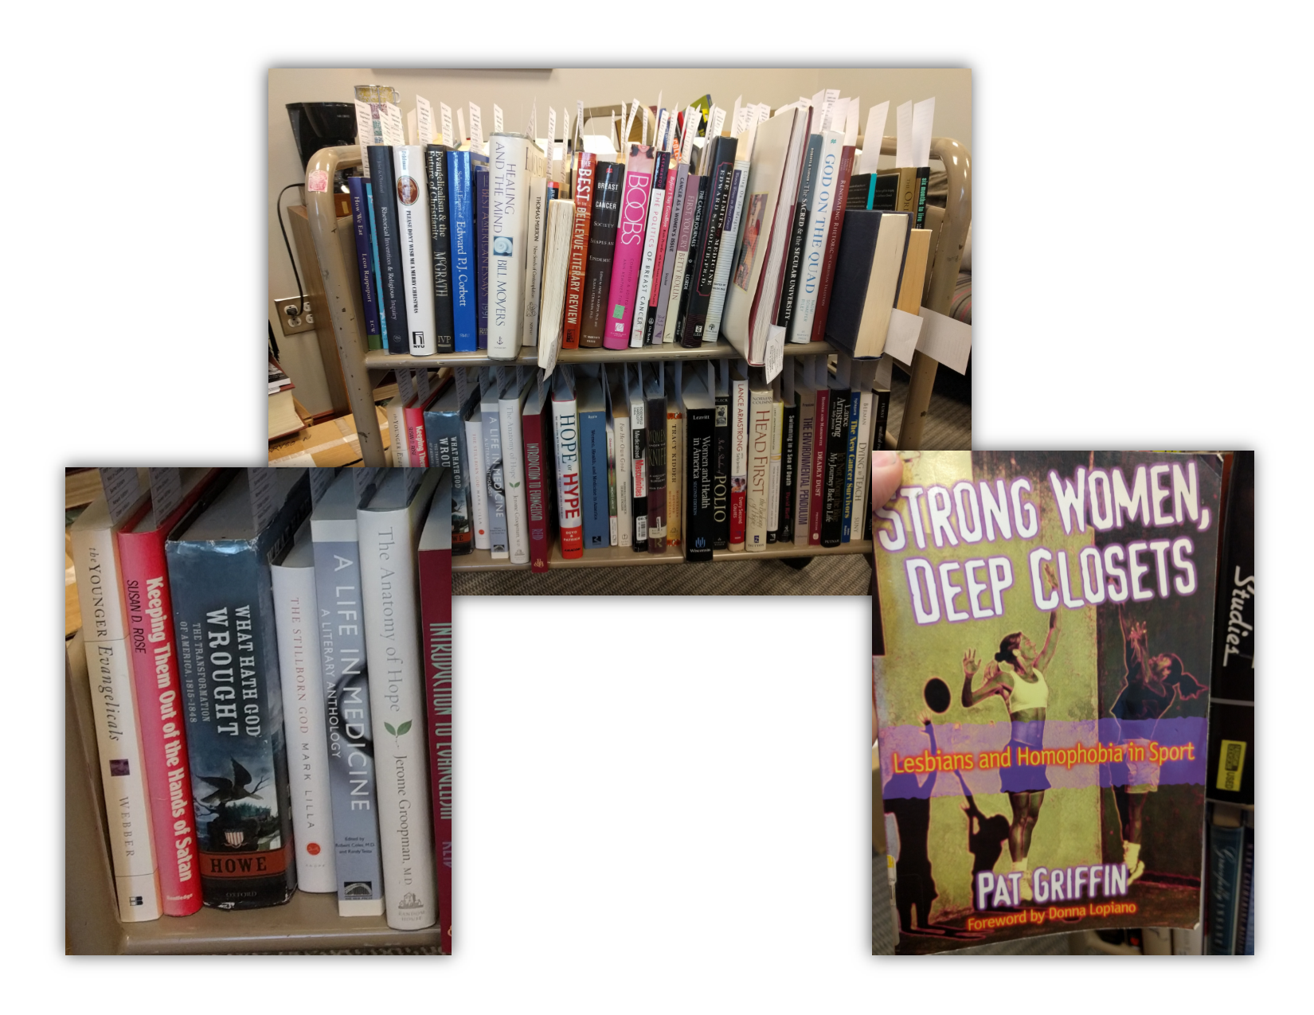
The Donation Cart
Awareness of personal bias
Donations from minority organizations and sources
Diversity-positive collection and donation guidelines
Opportunities for community engagement
Notes:
This is my current donation cart. I couldn’t have asked for a more perfect example for this purpose.

Slide 6
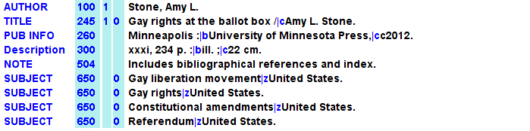
505 and 520
MARC Records:
Barebones records are common with ebooks and some batch processed files
505 and 520 fields are sometimes absent, even if subject headings are comprehensive
Patrons sometimes don’t know what they are searching for and don’t know the subject headings
Patrons are making decisions with very little information about the content
All of this means decreased usefulness and discoverability
Notes:
The meat and potatoes of cataloging world is the MARC record, but we sometimes have limited control over what we get, especially in regards to batch loaded records. Copy cataloging allows us for more control because we have to touch each record - or someone in our department does. I’ve seen workflows structured in all different ways. Some libraries have the acquisitions person pull the MARC record when they place an order, which is fine, but is that MARC record undergoing any scrutiny other than verifying the ISBN or OCLC number? Even non-catalogers can improve these records very quickly. The 505 field (typically this is the table of contents) and the 520 (the description of the contents) are the two biggest ones that I see missing from records all the time.

Slide 7
Cataloging and Technical Services: Opportunities
Staffing:
Take advantage of training opportunities and webinars
Display visual indicators of inclusion
Welcome a diverse range of student workers
Be seen at events on campus
Metadata:
Content descriptions increase discoverability
Accurate and complete subject headings
Collection Development:
Make diversifying the collection as outreach opportunities (students, faculty, community groups)
Collection development slips, lists, and DRA
Highlight minority literature and resources
Notes:
Allied Alliance training, online webinars, tagging foreign language collection
Be seen at events on campus -- maybe even jointly sponsor them, whether that be speakers or talks or exhibits
Accurate and complete subject headings - subject headings change (indian; native american; Indigenous peoples--United States)
Highlight minority literature and resources in book displays or on the website
Take advantage of training opportunities (and encourage your staff to do the same)
Content descriptions increase discoverability (undertake projects to improve key areas - 505 and 520 fields as well as tagging and custom subject heading)

Slide 8
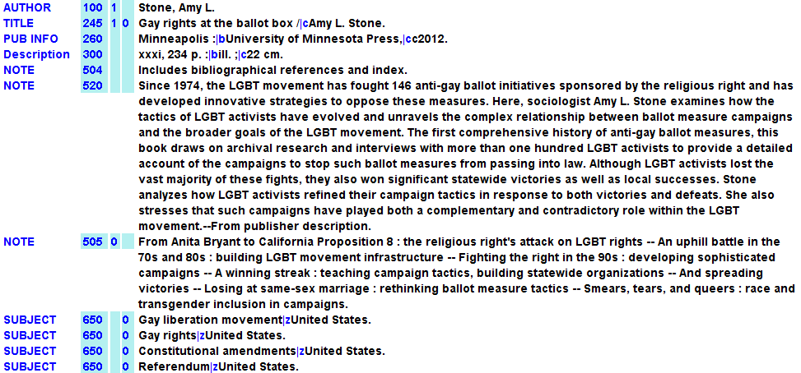
505 and 520
Taken from publisher description
From book
Notes:
If you search for “Proposition 8” “LGBT Ballot measures” “LGBT movement” “anti-gay ballot measures” you’ll pull up this record. These are perhaps more commonly used terms than “gay liberation” or “referendum”. Not only do more robust descriptions increase discoverability, but they also help patrons make a decision about whether a text is what they are looking for while they are still sitting (or standing) at the OPAC computer.
Depending on a lot of factors -- staffing, time constrains, amount of books you are purchasing - touching every MARC record isn’t always possible, but some tweaks can make a bit difference overall. You might just ask your copy catalogers to copy and paste in the publisher description if it’s easy to find and not already in the OCLC record. You might create lists or reports to identify high priority books for further cataloging work. If your OPAC supports tagging (Ex Libris does, I believe), then have student workers sitting at the circulation desk, find and tag books with commonly used words and phrases (I might give them a list of acceptable terms, mind you!). We actually use our student workers a fair bit for this type of thing.

Slide 9
Cataloging and Technical Services: Examples
Gay Alliance training and how the safe space can help recruit students (especially on an all male campus)
Efforts to tag foreign films and books

Slide 10
Archives and Special Collections: Challenges
Institutional History:
Legacies of discrimination
Cultural heritage lost in the archival black hole
History with specific groups
Staffing:
Recruiting a diverse staff
Idea of diversity
Retention
Traditional Archival Practice:
Ownership of cultural heritage materials
Processing and description of materials
Objectivity vs. Neutrality
Notes:
Archives have a number of issues when it comes to diversity and inclusion. I’m going to highlight three main areas today: Institutional History, Staffing, and Traditional Archival Practice.
Institutional History refers to the legacy that an institution has built up over the years. Many institutions of higher education have legacies of discrimination - Virginia Tech certainly does. If that isn’t enough of a barrier, early attempts by archives to acquire materials about diverse groups were handled poorly. Collections that enter the archives and disappear into an archival black hole can easily sour relations with communities that have too often seen their history erased. Similarly, relationships with specific groups that become strained can lead to bad relationships with whole communities.
Staffing remains an issue in archives, as with other areas of the information professions. For decades, archivists have discussed the need for a more diverse workforce. Yet, there has been slow progress to actual diversification. Recruiting to the profession is hard generally. Recruiting from “underrepresented” populations is doubly hard because archives are seen as documenting white cis heterosexual male Christian history.
The archival idea of diversity is also an issue. Too often, diversity is seen as bringing a representative of an underrepresented group into the white space of the archives - rather than expanding the archives beyond its whiteness.
This leads to a problem of retention when members of the underrepresented groups tire of whitening themselves to be accepted in the archival space.
Then we have traditional archival practice. Many archives will refuse to acquire materials if they can’t have clear title. Many communities that have felt poorly served by archives don’t want to give up all of their control over their cultural heritage materials. This dynamic creates challenges around collection development.
Archives are perpetually understaffed and struggle to process all the materials acquired. When things are processed, commonly used subject terms (like Library of Congress Subject Headings) retain offensive and disrespectful terminology in common usage. Using those terms to describe materials helps researchers find them - but alienates the groups being described.
Finally, the traditional detached objectivity of archivists prevents full service to traditionally underserved communities. The profession has traditionally seen objectivity as neutrality. They aren’t the same. Objectively collecting and describing materials does not mean neutrality in selection of those materials. If the goal is more balance in archival holdings, there must be advocacy for acquiring more material about traditionally underserved communities and for telling those communities’ stories from the perspective of the communities.

Slide 11

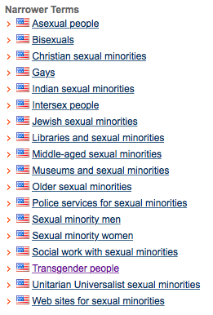
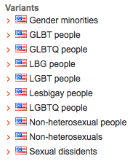
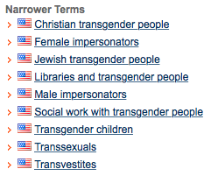
Unrelated Concepts - Causing Offense
Notes:
I’ll start with an issue related to processing and description. A commonly used subject authority is LCSH. It has changed and developed over the years in such a way that there are potentially offensive relationships.
The official term for all LGBTQ people is “Sexual Minorities” - which in itself marginalizes the Trans and Intersex people included under the LGBTQ umbrella. When working with materials related to LGBTQ, they are also automatically conflated with Sexual Dissidents - a relationship that doesn’t necessarily exist and is rooted in heterosexist privilege.
Digging a little deeper we find Transgender People in the narrower terms which is fine apart from the fact that being Trans is related to gender and not sexuality. The problem here is the narrower terms for Transgender people: Female Impersonators, Male Impersonators, Transsexuals, and Transvestites. Three of these terms, male impersonators, female impersonators, and transvestites again have nothing to do with being Trans. The last is an offensive term to most of the Trans community.
This becomes a problem for archives trying to work with the LGBT community because materials related to historic Male or Female impersonators will likely show up when someone is searching for materials about Transgender people. Having those show up in search is a great way to offend the community the archive is trying to work with.

Slide 12
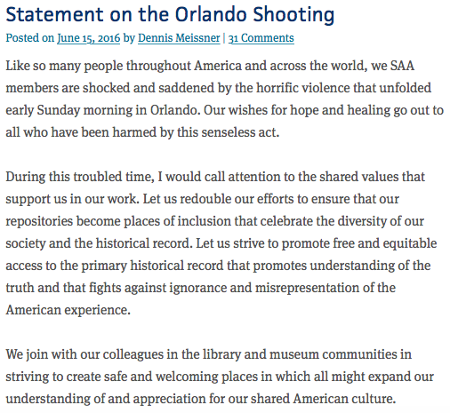
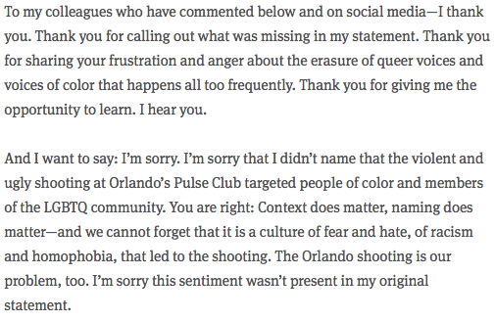
Documenting Pulse
Update - 2 days later:
https://offtherecord.archivists.org/2016/06/15/statement-on-the-orlando-shooting/
Notes:
Looking at institutional history, it is important to consider the broader institution of the profession itself. This statement by then SAA President Dennis Meissner following the Orlando Pulse Nightclub shooting was read by most as a professional response to a tragic community event. Many in the LGBTQ+ community, Hispanic and Latinx communities, and communities of color were incensed because the statement completely erased the context of the shooting as an act targeting LGBTQ+ people of color.
A few days later, Meissner issued an update after a flood of criticism followed the initial statement. Later that month, the Archivists and Archives of Color Roundtable, Latin American and Caribbean Cultural Heritage Archives Roundtable, and Lesbian and Gay Archives Roundtable put out a joint statement about how Meissner’s statement had illustrated the erasure of marginalized communities from the archival record and underscored the importance of being advocates for those communities rather than remaining impartial.

Slide 13
Archives and Special Collections: Opportunities
Institutional History:
Be active in the community
Quickly process and advertise accessions
Spend the time to mend relationships
Staffing:
Develop a pipeline with student workers, internships, etc.
Consider different perspectives on process / approach
Don’t place the burden of outreach on the “diverse” members of staff
Traditional Archival Practice:
Focus on the needs of the community being documented
Develop local terminology
Advocate for underserved communities

Slide 14
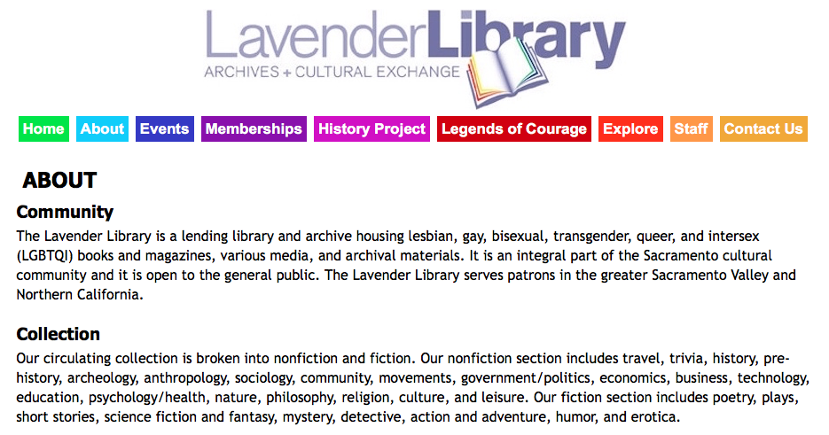
Community Focus
Notes:
LLACE is a great example of an archives that is engaged with the community they serve. They actually developed specifically to serve the LGBTQI community which helped them to develop a positive relationship with the community but their example can be used to better approach community relations. One of the most important things LLACE did was involve the community in decisions regarding their own cultural heritage. In traditional practice, an outside advisory board is an undesirable thing. For many marginalized communities, however, having an advisory board may be the only way to ensure that the archives is truly serving the needs of the community.

Slide 15
Information Literacy: Challenges
Truly inclusive Information Literacy instruction takes into account:
Neurodivergent students (The term encompasses brain differences on the autistic spectrum but it also indicates differences caused by brain injury and other variations in the neurocognitive functioning of human beings. )
ESL and International students who may also encounter gaps in cultural understanding
Learning or physically disabled students including those with deficits in vision or hearing and emotional and behavioral disabilities
Students of non-traditional age
Economically disadvantaged students
LGBTQIA students (Acronym for Lesbian, Gay, Bisexual, Transgender, Queer, Intersex and Asexual students.)
And other diversities stemming from motivation, experience, and learning styles.

Slide 16
Information Literacy: The “average” student is fictional
Library Instruction is largely still caught in “batch processing” mode as Todd Rose (The End of Average: How We Succeed in a World That Values Sameness by Todd Rose) has called it. But this is a holdover from the Industrial Age and its way of treating information as capital and students as passive consumers of facts. The students who were most prepared to succeed in that type of literacy came from homes that socialized children to the model early.
But the world is now a Knowledge Economy where individuals from a diversity of perspectives and backgrounds can learn to succeed if met as individuals by teachers. The global, transnational effects of the Knowledge Economy bring people of widely divergent backgrounds, lifestyles, abilities, values and skills together into one Information Literacy classroom. How to promote learning for everyone?

Slide 17
Information Literacy: Opportunity
Universal Design for Instruction/Learning
ALA has accepted the principles of Universal Design for people with disabilities since 2001 but relatively little has been published on how librarians can incorporate Universal Design for Instruction to accommodate student diversity in Information Literacy classrooms.
Universal Design for Instruction (UDI/UDL) has nine principles:

Slide 18
Information Literacy: UDI Principles
UDI principle 1: Equitable Use
The design is useful and marketable to people with diverse abilities.
This principle wants to ensure all students have access to the same content, even if it has to take different forms. At Sweet Briar, we provide online library guides for each department. Because they are web-based, students with visual impairments can alter the type size or stream the text to a screen reader. We use san-serif fonts since research has shown these to be easier for students with dyslexia to read on-line.

Slide 19
Information Literacy: UDI Principles
UDI principle 2: Flexibility in use
Instructional design accommodates a wide range of individual preferences and abilities.
Use varied teaching methods to address a wide range of learning profiles. Asking students questions and using multisensory instruction engages learners. Active learning techniques can include individual information discovery exercises, group work, and games that incorporate physical movement. For example, we play Boolean Simon Says (from The Library Instruction Cookbook) which has students standing and sitting to play. In general, moving the body helps retention and comprehension.

Slide 20
Information Literacy: UDI Principles
UDI principle 3: Simple and intuitive instruction
The instruction is easy to understand, regardless of the user's experience, knowledge, language skills, or current concentration level.
At Sweet Briar we scale instruction so that 1st year students get foundational skills that we build on in succeeding years. Frequently during an Information Literacy instruction session I will re-trace my steps to show “how we got here” and then eventually ask the students “what do I do next?” to complete the route to the information. We also minimize the use of library specific jargon. Where academic jargon must be used - for example in the concept of peer review - it is explained in accessible terms.

Slide 21
Information Literacy: UDI Principles
UDI principle 4: Perceptible information
The instruction communicates necessary information effectively to the user, regardless of ambient conditions or the user's sensory abilities.
An easy way to follow this principle is to show students how they can use the built-in features of databases to make the information easier for them to find and use. For example, I show students how to drill through WorldCat by using the Descriptors to refine their searches. Another example - how HTML and PDF versions of articles differ and when to use each. Finally, showing the video capabilities of our databases. Many students would rather watch video than read.

Slide 22
Information Literacy: UDI Principles
UDI principle 5: Tolerance for error
The design minimizes hazards and the adverse consequences of accidental or unintended actions.
Many user errors can be anticipated. We discuss common errors in the research process. For example - the ILL Request Form has two boxes marked “Title”. This is a regular point of confusion. In my classroom the approach is that there are no errors - there are only opportunities for learning how to cope with unintended consequences.

Slide 23
Information Literacy: UDI Principles
UDI principle 6: Low physical effort
The instructional design can be used efficiently, comfortably, and with a minimum of fatigue.
One of the ways I endeavor to minimize fatigue in students is to teach them to use the citation management tool Zotero. This free tool can screen scrape information for the student’s works cited, it includes a feature that allows them to make notes, and they can attach a copy of the digital book or article to the citation. I also teach them to read common database icons and how to use multiple browser tabs at once while doing research in order to keep various permutations of a search string open and evolving.

Slide 24
Information Literacy: UDI Principles
UDI principle 7: Size and space for approach and use
Appropriate size and space is provided for approach, reach, manipulation, and use regardless of the user's body size, posture, or mobility.
Some of the seating at Sweet Briar is adjustable for a person in a wheelchair. I try to minimize lighting during my sessions because fluorescent lights are notoriously distracting for students on the Autistic Spectrum and for students with AD/HD. Tangentially related, students are allowed to have their devices in class because they may want to record the class or use apps that help them retain the information.

Slide 25
Information Literacy: UDI Principles
UDI principle 8: A community of learners
The instructional environment promotes interaction and communication among students and between students and faculty.
At Sweet Briar we work to build a relationship with the students as their “personal librarian.” During every class I verbally give the group my email address and my phone number as I write them on the board. I describe the location of my office and hand out my business card. During class we often discuss the direction of individual student’s research. This builds bridges of interest among the students when we do sample searches in relevant databases.

Slide 26
Information Literacy: UDI Principles
UDI principle 9: Instructional climate
Instruction is designed to be welcoming and inclusive. High expectations are espoused for all students.
We know from years of research that a student who does not feel respected or valued by a teacher, will not learn from that person. (I Won't Learn from You!: The Role of Assent in Learning by Herbert Kohl). Todd Rose says that a teacher who provides the welcoming attitude, the interest, and the belief in a student’s ability is the key factor in student success - because there are no average students.

Slide 27
Information Literacy: UDI/UDL Resources
Center for Applied Special Technology - CAST: http://www.cast.org/our-work/about-udl.html#.WTb2k-vyvct
National Center on Universal Design for Learning: http://www.udlcenter.org/aboutudl/take_a_tour_udl
Understood: https://www.understood.org/en/school-learning/assistive-technology/assistive-technologies-basics/universal-design-for-learning-what-it-is-and-how-it-works?gclid=CPuqr4zuqdQCFRUkgQodG8sCoA

Slide 28
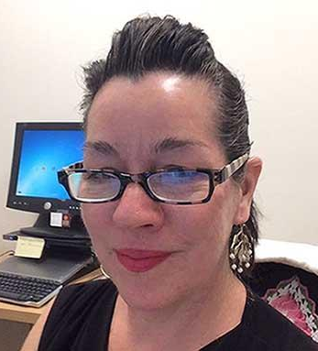
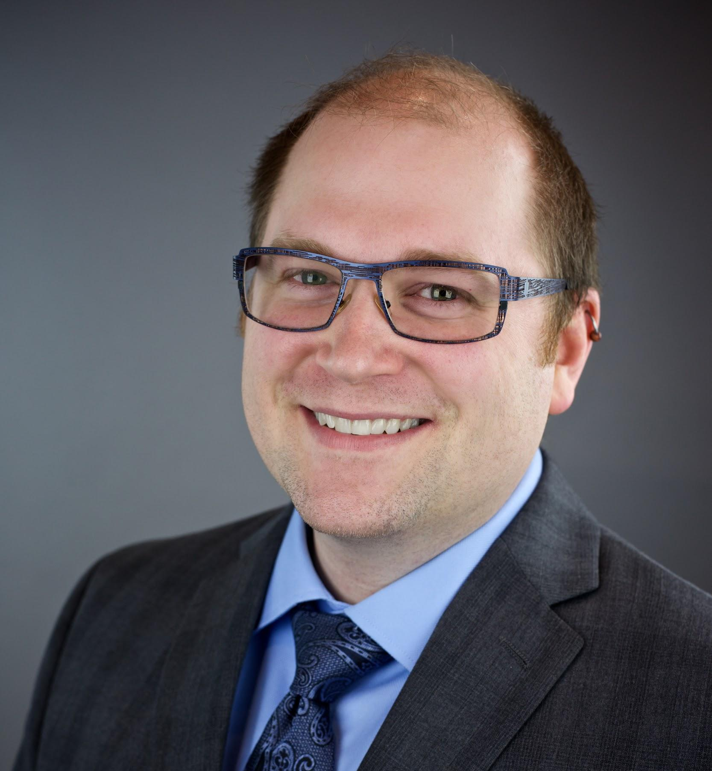
Questions & Discussion
The panel:
Liz Kent León ● Anthony Wright de Hernandez
Notes:
I thought it this would be a good way of providing our names to any attendees that might not already know us.

