Slide 1


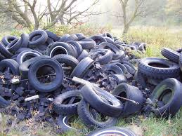
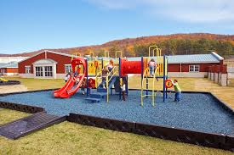
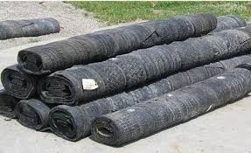
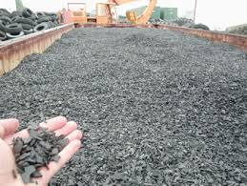
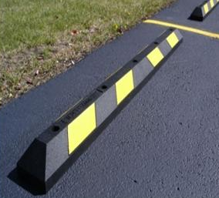
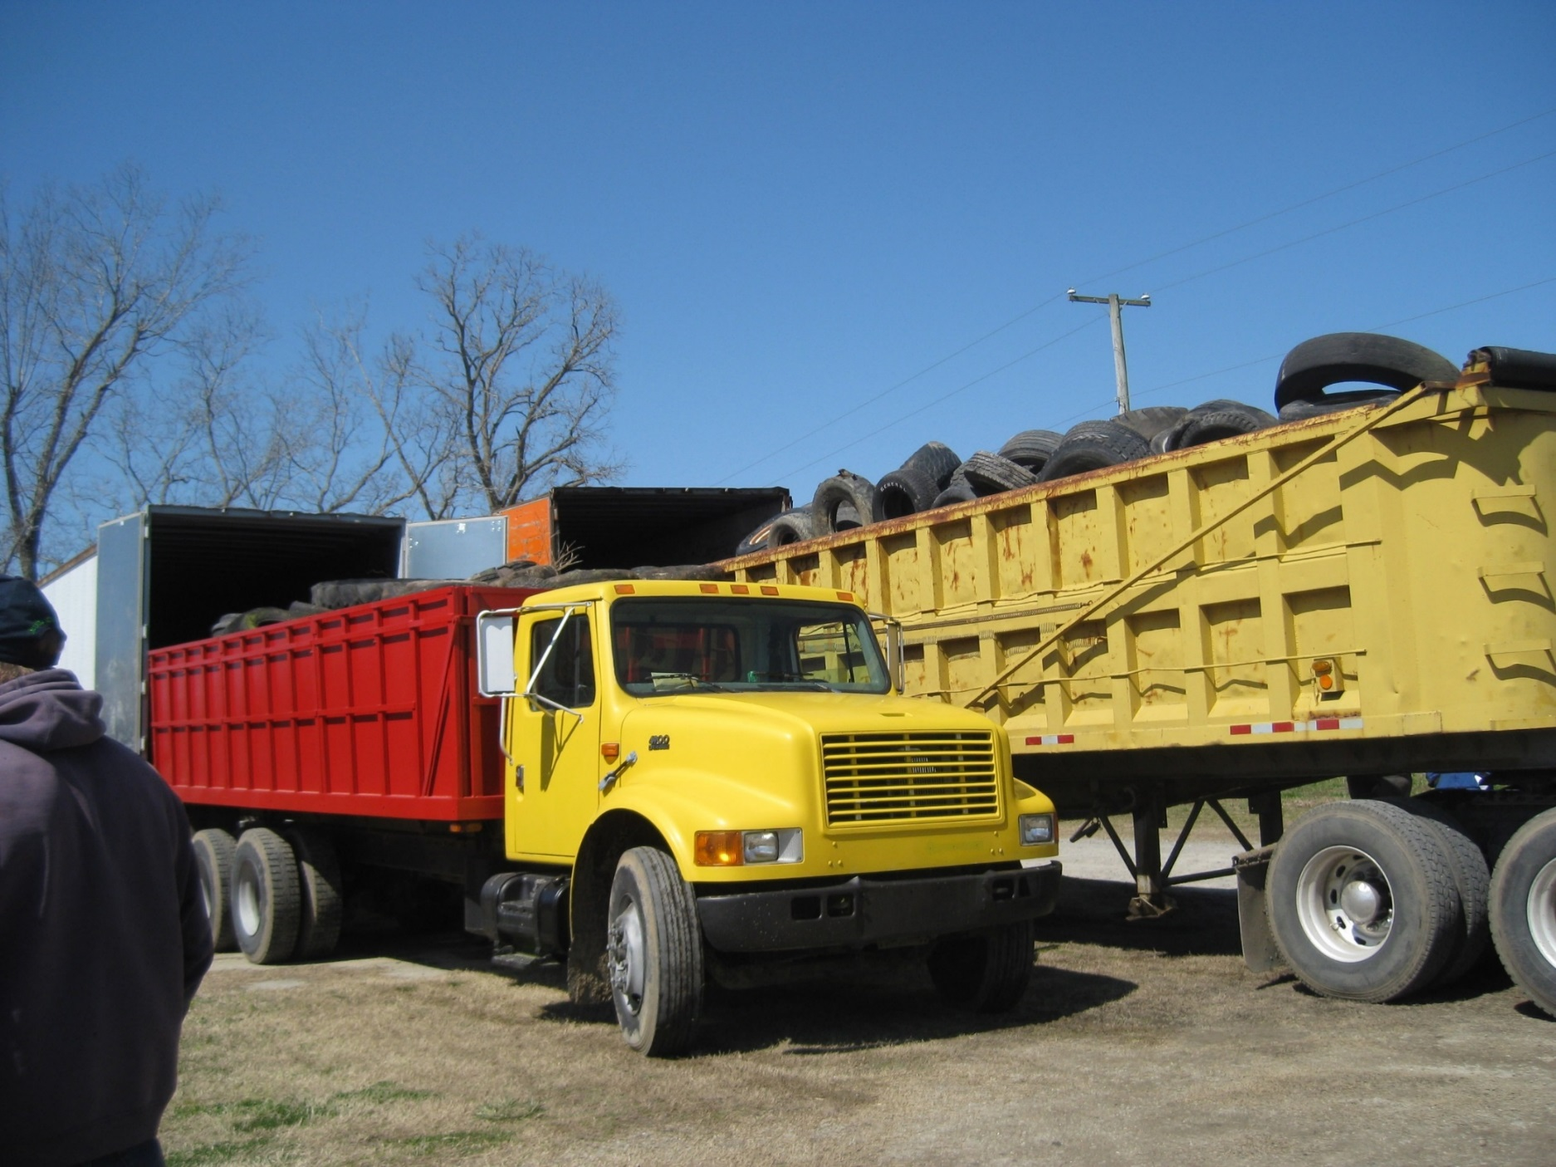
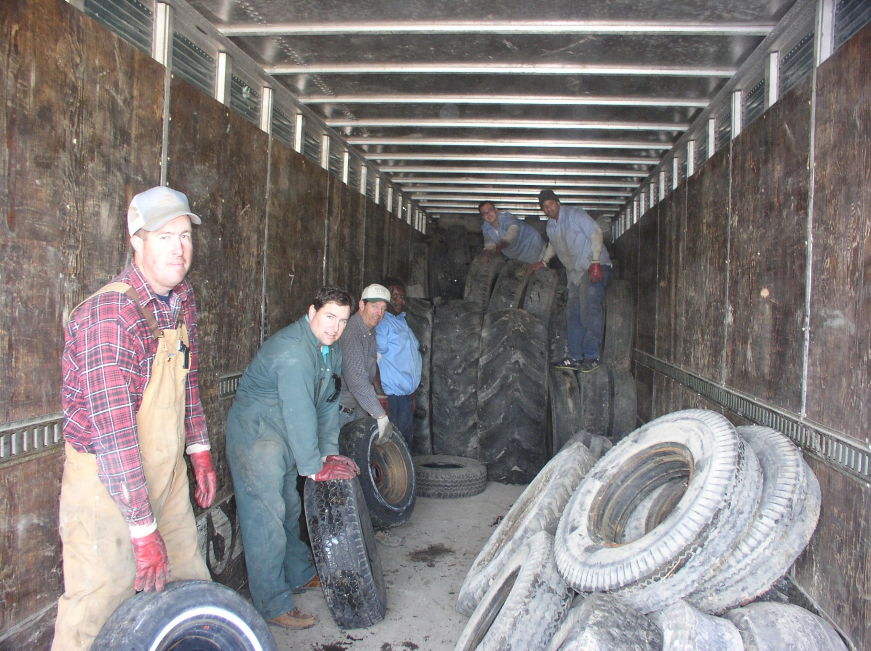
FARM TIRE RECYCLING PROGRAM PROTECTS ENVIRONMENT AND
RECYCLES A RENEWABLE RESOURCE
Watson Lawrence, Senior Extension Agent, ANR, Chesapeake, VA (watsonL@vt.edu);
Roy Flanagan, Extension Agent, ANR, Virginia Beach, VA (royf@vt.edu);
Cory Hoar, Conservation Specialist, Virginia Dare SWCD, Chesapeake and Virginia Beach, VA (choar@vbgov.com)
ABSTRACT
RESULTS
In the past, it was a common practice for farmers to “collect” old worn-out tires to be utilized to stoke fires as land was cleared and drained. At some point in time the burning of tires was deemed inappropriate due to the emission of hazardous fumes. Consequently, the practice of burning changed, leaving farmers with piles of tires and no feasible way to dispose of them. Modern day agriculture operations utilize farm tires of all shapes and sizes. Many of these tires are left on farms as they are replaced for one reason or another. With large combine tires costing in excess of $150 each to be disposed of at the local landfills, one can understand why they are retained. Section 10.1-1418.2 B. of the Code of Virginia states: “B. It shall be unlawful for any person to store, dispose of, speculatively accumulate or otherwise place more than 100 waste tires on public or private property, without first having obtained a permit as required…”. To address this issue, as well as reduce area for potential mosquito breeding ground, the “Farm Tire Recycling Program” began. The current program is administered by the Virginia Dare Soil and Water Conservation District with additional promotional and logistic support provided by Virginia Cooperative Extension.
Since 2001, this program has been conducted annually in March, with exception of 2010. Records have been kept showing numbers of all categories of tires, tons of tires collected from actual loaded trailer weights and costs to conduct the program. The first year of the program in 2001, tires were not recycled, simply collected and disposed of in the landfill. Participation that year was limited due to limited SWCD funds available to pay for landfill fees. The following year, tires were recycled through a recycling company, reducing the overall costs, thus allowing more participation. Funding for the program has transitioned to become self-supporting through fees collected from farmers.
An estimated savings in landfill disposal charges for farmers has been estimated each year based on fees at the Southeast Public Service Authority (SPSA) landfill. In 2002, a record 148 tons of tires was collected, indicating the significance of the tire problem on local farms at that time. As the program has continued, total tons of tires collected has leveled off after the 9th year, to a consistent level today. This fact, testimony of farmers participating and evidence of tire piles disappearing from the rural landscape indicate the program is now functioning as a maintenance program.
Fig. 1. Abandoned pile of tires on local farm.
RESPONSE
Fig. 5. Historical Summary of Tire Recycling Program
Virginia Dare Soil and Water Conservation District (SWCD) in partnership with Virginia Cooperative Extension (VCE) offices of Chesapeake and Virginia Beach conducted a Farm Tire Recycling Program beginning in 2001. Sign-up for the program was promoted at Extension winter production meetings, in newsletters and by one-to-one contacts. Farmers registered farm tires they wished to recycle by category sizes. Fees according to tire size were collected by check with registration form prior to collection day. Those fees were collected to offset the costs of tractor trailers dispatched from Emmanuel Tire Recycling, Inc. in Waverly, VA.
A local farmer offered his farm as a central collection point. On collection day, farmers brought tires they had registered according to an arranged schedule. VCE secured help from the local Sheriff’s Department Work Force Program. This program allowed qualifying inmates of non-violent crimes to participate. They are supervised by Sheriff Deputies for this program and other Public Works Department tasks.
Tires of all sizes were collected and packed into empty tractor trailers. These tires were taken to the recycling plant in Waverly, VA to be shredded and separated into components of rubber and steel. The shredded rubber is recycled as fuel chips, blended into products for rubber mats, playground flooring, parking curb guards, among many other products. All wire and rims collected with the tires is recycled as metal.
IMPACTS
The Farm Tire Recycling Program has eliminated most large piles of old discarded tires on farms and in rural areas of Chesapeake and Virginia Beach, helping farmers comply with Virginia laws regarding limits on numbers of abandoned tires on farms. In addition to the economic savings of approximately $253,940 in landfill fees, this program has also helped farmers shoulder the burden of removing illegally dumped tires in rural areas. The program has eliminated a fire hazard as well as improved health safety by removing a breeding ground for mosquitoes. This very popular program has reached almost every farmer in the cities of Chesapeake and Virginia Beach. The problem of stockpiles of farm tires has been removed and the program today serves as mostly maintenance for farm tires recycled each year.
Playground footing
Rubber mats
Fig. 2. Registration form for Tire Recycling.
Fuel chips
Parking curb guards
Fig. 6 (top left), Fig. 7 (top right), Fig. 8 (bottom left) and Fig. 9 (bottom right) are images of products made from recycled tires.
Virginia Cooperative Extension programs and employment are open to all, regardless of age, color, disability, gender, gender identity, gender expression, national origin, political affiliation, race, religion, sexual orientation, genetic information, veteran status, or any other basis protected by law. An equal opportunity/affirmative action employer. Issued in furtherance of Cooperative Extension work, Virginia Polytechnic Institute and State University, Virginia State University, and the U.S. Department of Agriculture cooperating. Edwin J. Jones, Director, Virginia Cooperative Extension, Virginia Tech, Blacksburg; M. Ray McKinnie, Interim Administrator, 1890 Extension Program, Virginia State University, Petersburg.
Fig. 3. Farm trucks backed up to unload tires on collection date.
Fig. 4. Extension Agents and Workforce Inmates packing tires in trailer.

