Slide 1
Winter Feeding of Birds
Terry Abston​

Slide 2


Agenda
A
Birds needs
Feed preferences
Watering preference
Feeder styles
Maintenance

Slide 3
Introduction
Resident birds become dependent on feeding, so if you can’t make the commitment to feed through out the winter don’t.
Selection of feeds will depend on the variety of bird you would like to attract.

Slide 4
Feeds
In the winter birds need protein and high energy food.
Black oil sunflower seeds, hauled peanuts
Peanut butter mixed with corn meal dried fruit, suet
Apples or oranges
Pumpkin seeds or squash seeds are all great choices.

Slide 5
Water, water everywhere
Water is a vital part of a birds diet,
Birds get easily dehydrated during extreme cold weather. Having shallow pans, holes lined with plastic and heated bird baths are all great options. Place water near feeders to attract your thirsty birds.

Slide 6
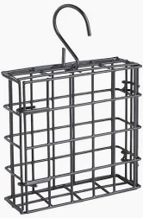
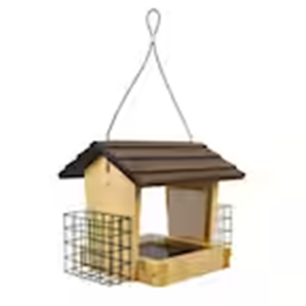
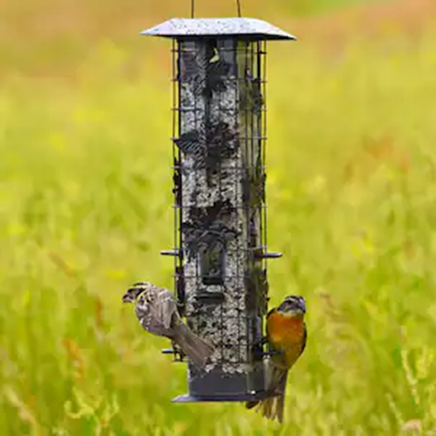

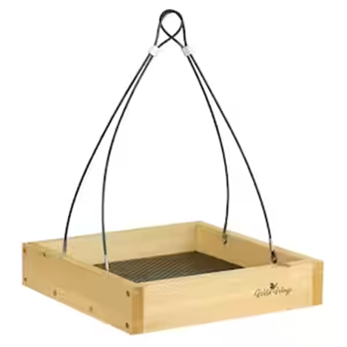
Types f Feeders

Slide 7
Feeds to avoid
Mixed seeds with striped sunflower seeds
Millet, Milo
Table scraps
Bread that is molded

Slide 8
Maintenance
Except during times when temperatures remain well below freezing, clean feeders about once every two weeks.
Scrape out old feed use soap and a week bleach solution to kill any lingering bacteria, let dry and replace with fresh feed. This eliminates mold growth which can compromise the birds ability to eat.

Slide 9
Primary goals
Healthy and happy birds for pictures and viewing all winter long.

Slide 10
Summary
Attracting birds is a gratifying hobby. Learning the different species of birds and documenting their comings and goings is also fun.
Conclusion, you have heard about feeds, watering, maintaining feeding stations, and attracting birds to your feeders. Enjoy birding season.
Now let’s learn our birds!!!!!!

Slide 11
Thank you
Credit:
Cornell lab of ornithology Bird notes number 1: Winter Bird Feeding

Slide 12
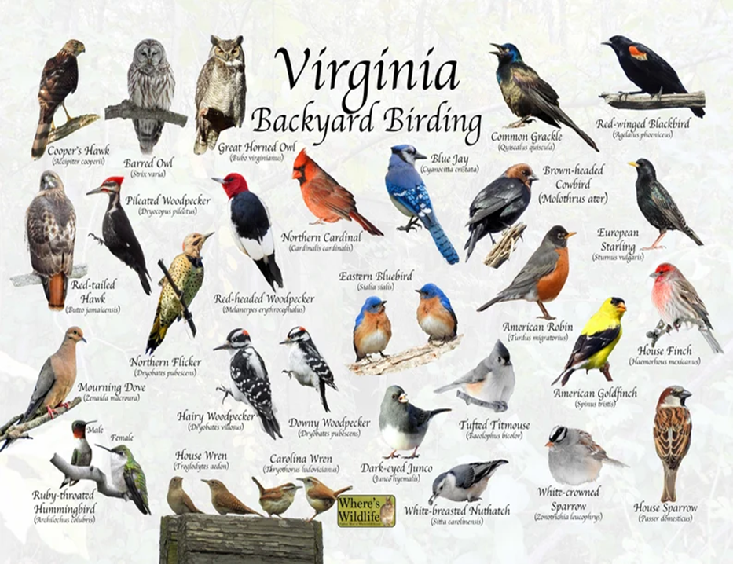
Birds of Virginia

