Slide 1
ArchiveSpark
Andrej Galad
12/6/2016
CS-5974 – Independent Study
Virginia Polytechnic Institute and State University, Blacksburg, VA 24061
Professor Edward A. Fox

Slide 2
AGENDA
ArchiveSpark Overview/Recap
Benchmarking
Demo

Slide 3
Archivespark
Framework - efficient data access, extraction and derivation on Web archive data
ArchiveSpark: Efficient Web Archive Access, Extraction and Derivation
  Helge Holzmann, Vinay Goel, Avishek Anand
  Published in JCDL 2016
  Nominated for the Best Paper Award
OS project - https://github.com/helgeho/ArchiveSpark

Slide 4
Two techniques
Pre-generated CDX metadata index
  Smaller dataset
  Reduction based on Web archive metadata
Incremental filtering workflow
  “Extract only what you need”
  Augment -> Filter -> Repeat
Concept – Enrichments
  ArchiveSpark Record extension
  Featured – StringContent.scala, Html.scala, Json.scala, Entities.scala, Prefix.scala, …
  Custom – mapEnrich[Source, Target](sourceField, targetField) (f: Source => Target)

Slide 5
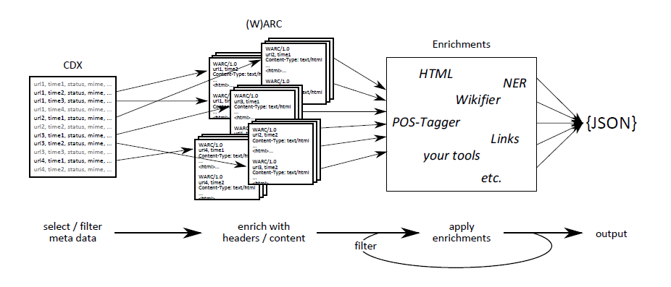
Workflow

Slide 6
Flexible deployment
Ultimately a Scala/Spark library
Environments
  Standalone solitary Spark instance
  Local HDFS-backed Spark cluster
  Large-scale YARN/Mesos-orchestrated cluster running Cloudera/Hortonworks
Quickstart – Docker (latest version)
ArchiveSpark version – 2.1.0
  Spark 2.0.2
  Scala 2.11.7 -> Java 8

Slide 7
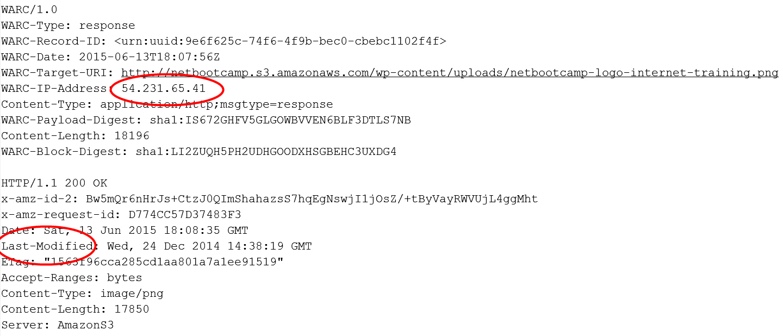
Warc files
Standard Web archiving format - ISO 28500
Single capture of web resource at a particular time
  Header section – Metadata (URL, timestamp, content length…)
  Payload section – Actual response body (HTML, JSON, binary data)
    HTTP Response – HTTP headers (origin, status code)

Slide 8
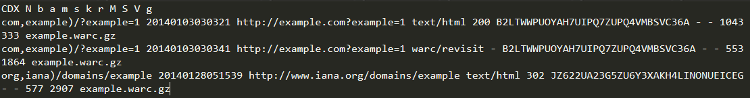
Cdx Index
“Reduced” WARC file
  WARC metadata
  Pointers to WARC records – offsets in WARC file
CDX
  Header – specifies metadata fields contained in the index
  Body – typically 9 – 11 fields
    Original URL, SURT, date, filename, MIME type, response code, checksum, redirect, meta tags, compressed offset

Slide 9
Tools
CDX Writer
  Python script for CDX extraction
  Alternative to Internet Archive’s Wayback Machine - http://archive.org
Jupyter Notebook
  Web application for code sharing/results visualization
Warcbase (only benchmarking)
  “State-of-the-art” platform for managing and analyzing Web archives
  Hadoop/HBase ecosystem – CDH
  Archive-specific Scala/Java objects for Apache Spark and HBase
  HBase command-line utilities - IngestFiles

Slide 10
Benchmarking
Evaluation of 3 approaches
  ArchiveSpark
  Pure Spark using Warcbase library
  HBase using Warcbase library
Preprocessing
  ArchiveSpark – CDX index files extraction
  HBase – WARC ingestion
ArchiveSpark Benchmark subproject
  Requirements:
    Built and included Warcbase
    sbt assemblyPackageDependency -> sbt assembly

Slide 11
ENVIRONMENT
Development
  Cloudera Quickstart VM – CDH 5.8.2
Benchmarking
  Cloudera CDH 5.8.2 cluster hosted on AWS (courtesy of Dr. Zhiwu Xie)
  5-node cluster consisting of m4.xlarge AWS EC2 instances
    4 vCPUs
    16 GiB RAM
    30 GB EBS storage
    750 Mbps network

Slide 12
Benchmark 1 – small scale
Filtering & corpus extraction
4 scenarios
  Filtering of the dataset for a specific URL (one URL benchmark)
  Filtering of the dataset for a specific domain (one domain benchmark)
  Filtering of the dataset for a date range of records (one month benchmark)
  Filtering of the dataset for a specific active (200 OK) domain (one active domain benchmark)
Dataset - example.warc.gz
  One capture of archive.it domain
  261 records
  2.49 MB

Slide 13
Benchmark 1 – Results

Slide 14
Benchmark 2 – Medium scale
Filtering & corpus extraction
4 scenarios
  Filtering of the dataset for a specific url (one url benchmark)
  Filtering of the dataset for a specific domain (one domain benchmark)
  Filtering of the dataset for a specific active (200 OK) domain (one active domain benchmark)
  Filtering of the dataset for pages containing scripts (pages with scripts benchmark)
Dataset – WIDE collection
  Internet Archive crawl data from Webwide Crawl (02/25/2011)
  214470 records
  9064 MB
  9 files – approx. 1 GB

Slide 15
Benchmark 2 – Preprocessing
CDX Extraction
  4 minutes 41 seconds
HDFS Upload
  2 minutes 46 seconds
HBase Ingestion x9
  1 file – (1 minute 10 seconds <–> 1 minute 32 seconds)
  Sequential ingestion – approx. 13 minutes 54 seconds

Slide 16
Benchmark 2 – Results

Slide 17
Benchmark 2 – Results

Slide 18
Benchmark 2 – Results

Slide 19
Benchmark 2 – Results

Slide 20
Acknowledgement & DISCLAIMER
This material is based upon work supported by following grants:
  IMLS LG-71-16-0037-16: Developing Library Cyberinfrastructure Strategy for Big Data Sharing and Reuse
  NSF IIS-1619028, III: Small: Collaborative Research: Global Event and Trend Archive Research (GETAR)
  NSF IIS - 1319578: III: Small: Integrated Digital Event Archiving and Library (IDEAL)
Any opinions, findings, and conclusions or recommendations expressed in this material are those of the author and do not necessarily reflect the views of the National Science Foundation.

Slide 21

Thank you
http://tinyurl.com/zejgc9f

Slide 22

tutorial

