Slide 1
Food Safety Website
(Mobile Friendly)
Prateek Mishra, Tim Nguyen, Mahek Mehta, Zachary Gehr, Kiel Lew, Chanaka Perera
CS 4624: Multimedia, Hypertext, and Information Access
Professor Fox
Virginia Tech, Blacksburg, VA 24061
April 28, 2020
Notes:
Zach

Slide 2
Outline
Overview
Timeline
Project Design
Deliverables
Problems Faced
Lessons Learned
Future Ideas
Acknowledgements
References

Slide 3
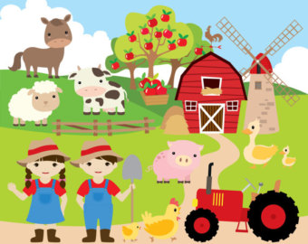
Overview
User based web/mobile application
  Helps navigate changing legislation for farmers
Helping farmers identify produce safety regulation
  Site uses info in accordance with FDA, CDC, and VA Cooperative Extension
Website Includes:
  Seven internal web pages
  Internal user-client created by our team
  FAQ page to help farmers with information
  External links to FDA produce requirements
  CDC food recall updates
  Surveys to provide essential information to users

Slide 4
Timeline
Feb 11
Feb 25
Mar 26
Apr 12
Apr 19
Apr 26
First Client Meeting
Front End Development
Continue Front End Development
Complete Back End Development
Get Final Feedback From Client
Final Presentation
Wireframe Prototyping
Present Prototype to Client and Receive Feedback
Get Backend Data from Client
Integrate Back End and Front End
Deploy Website
Final Report

Slide 5





Project Design - Front End
Developed using:
Node.js
React
HTML
CSS
Notes:
For the current project we used the technologies listed within this slide to develop the website.
All these technologies were easily integratable and provided us with the needed options to customize and design the website as we wanted.
let me give a brief introduction of each of these technologies:
Node.js is an open-source, cross-platform, JavaScript runtime environment that executes JavaScript code outside of a web browser.
React is a JavaScript library for building user interfaces. It is maintained by Facebook and a community of individual developers and companies.
HTML5 is a markup language used for structuring and presenting content on the World Wide Web.
Cascading Style Sheets is a style sheet language used for describing the presentation of a document written in a markup language like HTML.

Slide 6

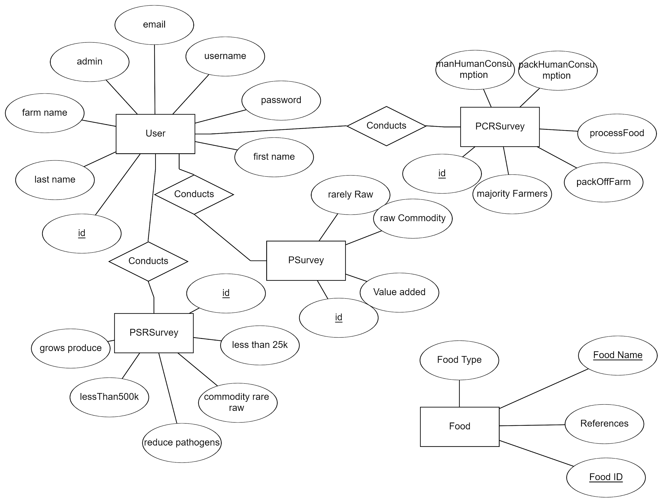
Project Design - Backend
Notes:
Chanaka
During the last presentation we talked about how we were waiting on our client to provide the tables and fields needed for the backend before starting backend development.
While we had thought of using postgreSQL and had a rough idea of what the backend would look like we had to change our vision of the backend as the semester progressed.
The ER diagram above is a representation of the current backend used to operate our website.
As you can see there are several entities related to surveys which was the main point of importance that our client stressed.
While we still provide safety information regarding agricultural produce, we have done our best to accomodate our clients’ request to integrate these surveys to our website and the ER diagram above that has three entities related to surveys reflects this.
We have also had to move from using postgreSQL as our database management service to mongoDB. MongoDB is a cross-platform document-oriented database program. Classified as a NoSQL database program, MongoDB uses JSON-like documents with schema. While MongoDB tends to use collections rather than tables we were able to integrate the database as represented above in a suitable format that supports the needed CRUD operations.

Slide 7
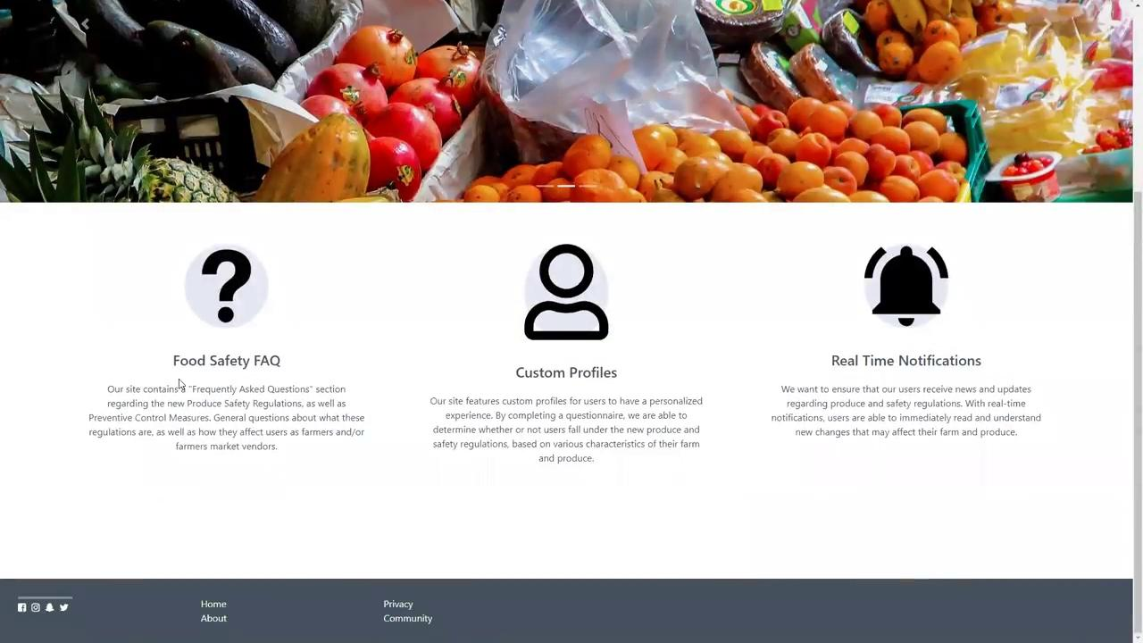
Deliverables

Slide 8
Problems Faced
Delay in receiving data
  Back end data stall resulted in reduced timeline for implementation
Deployment issues
  VM issues related to hosting our application
COVID-19 related issues (changes in timeline, communication, etc.)
  Working remotely made implementation slower
  Other issues lead to our project timeline changes/delays
  Communication became more difficult

Slide 9
Lessons Learned
Working with a direct customer/client
  Important to keep maximum contact throughout
  Client reported to higher authority making expectations skewed
Evolving client requirements/wants
  Expectations on deliverables kept evolving
Managing team dynamics

Slide 10
Future Ideas
Real Time Notification System
Add additional information and expand on the survey to include other food safety information outside of the Produce Safety Rule and Preventive Controls for Human Food Rule
Notes:
Kiel 8-11

Slide 11

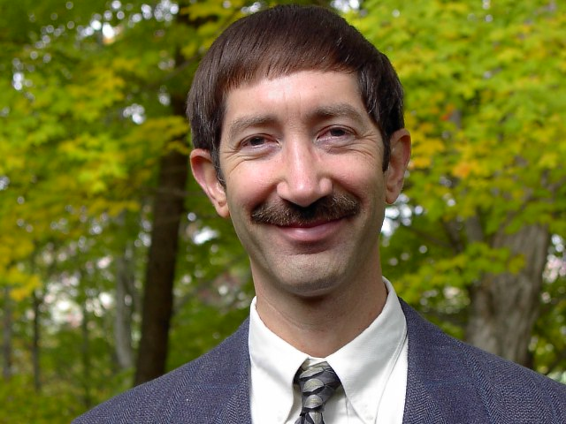
Acknowledgements
Client: Minh Duong
Doctoral Student in Food, Science & Technology
Professor Edward Fox
Department of Computer Science
Notes:
Minh Duong, our client.
Prof Fox
Assisting in the creation of a VM on the cs.vt.edu servers to facilitate the deployment of our website.
Other guidance throughout the semester on various issues.

Slide 12
References
Hartson, Rex, and Pardha S. Pyla. The Ux Book: Process and Guidelines for Ensuring a Quality User Experience. Burlington: Elsevier Science, 2012. http://www.sciencedirect.com/science/article/pii/B9780123852410000117. Accessed 4 May 2020.
“React Top-Level API.” React, 2020, reactjs.org/docs/react-api.html.
“Survey Library Overview, SurveyJS Library Documentation.” SurveyJS, 2020, surveyjs.io/Documentation/Library.
Vermaak, Stuart. “Online Survey Software: Qualtrics Survey Solutions.” Is My Farm Operation Covered or Exempt from the Produce Safety Rule?, Virginia Cooperative Extension, 2020, vce.az1.qualtrics.com/jfe/form/SV_emnhR0UpFpiVvlr.

Slide 13
Questions?

