Slide 1



Working with Minors:
TRAINING FOR WORKING WITH PreK12 TEACHERS AND STUDENTS
This training was based on materials originally created by the Center for Educational Networks and Impacts at Virginia Tech. It is released with permission under a Creative Commons Attribution NonCommercial ShareAlike 4.0 (CC BY NC-SA 4.0) license.
NOTE: Logos and photographs contained within are used with permission and are not subject to the Creative Commons license.
Notes:
Welcome to “Working with Minors” a training for working with PreK12 teachers and students of any age, but especially those under the age of 18. This training was based off materials originally created by the Center for Educational Networks and Impacts at Virginia Tech.

Slide 2
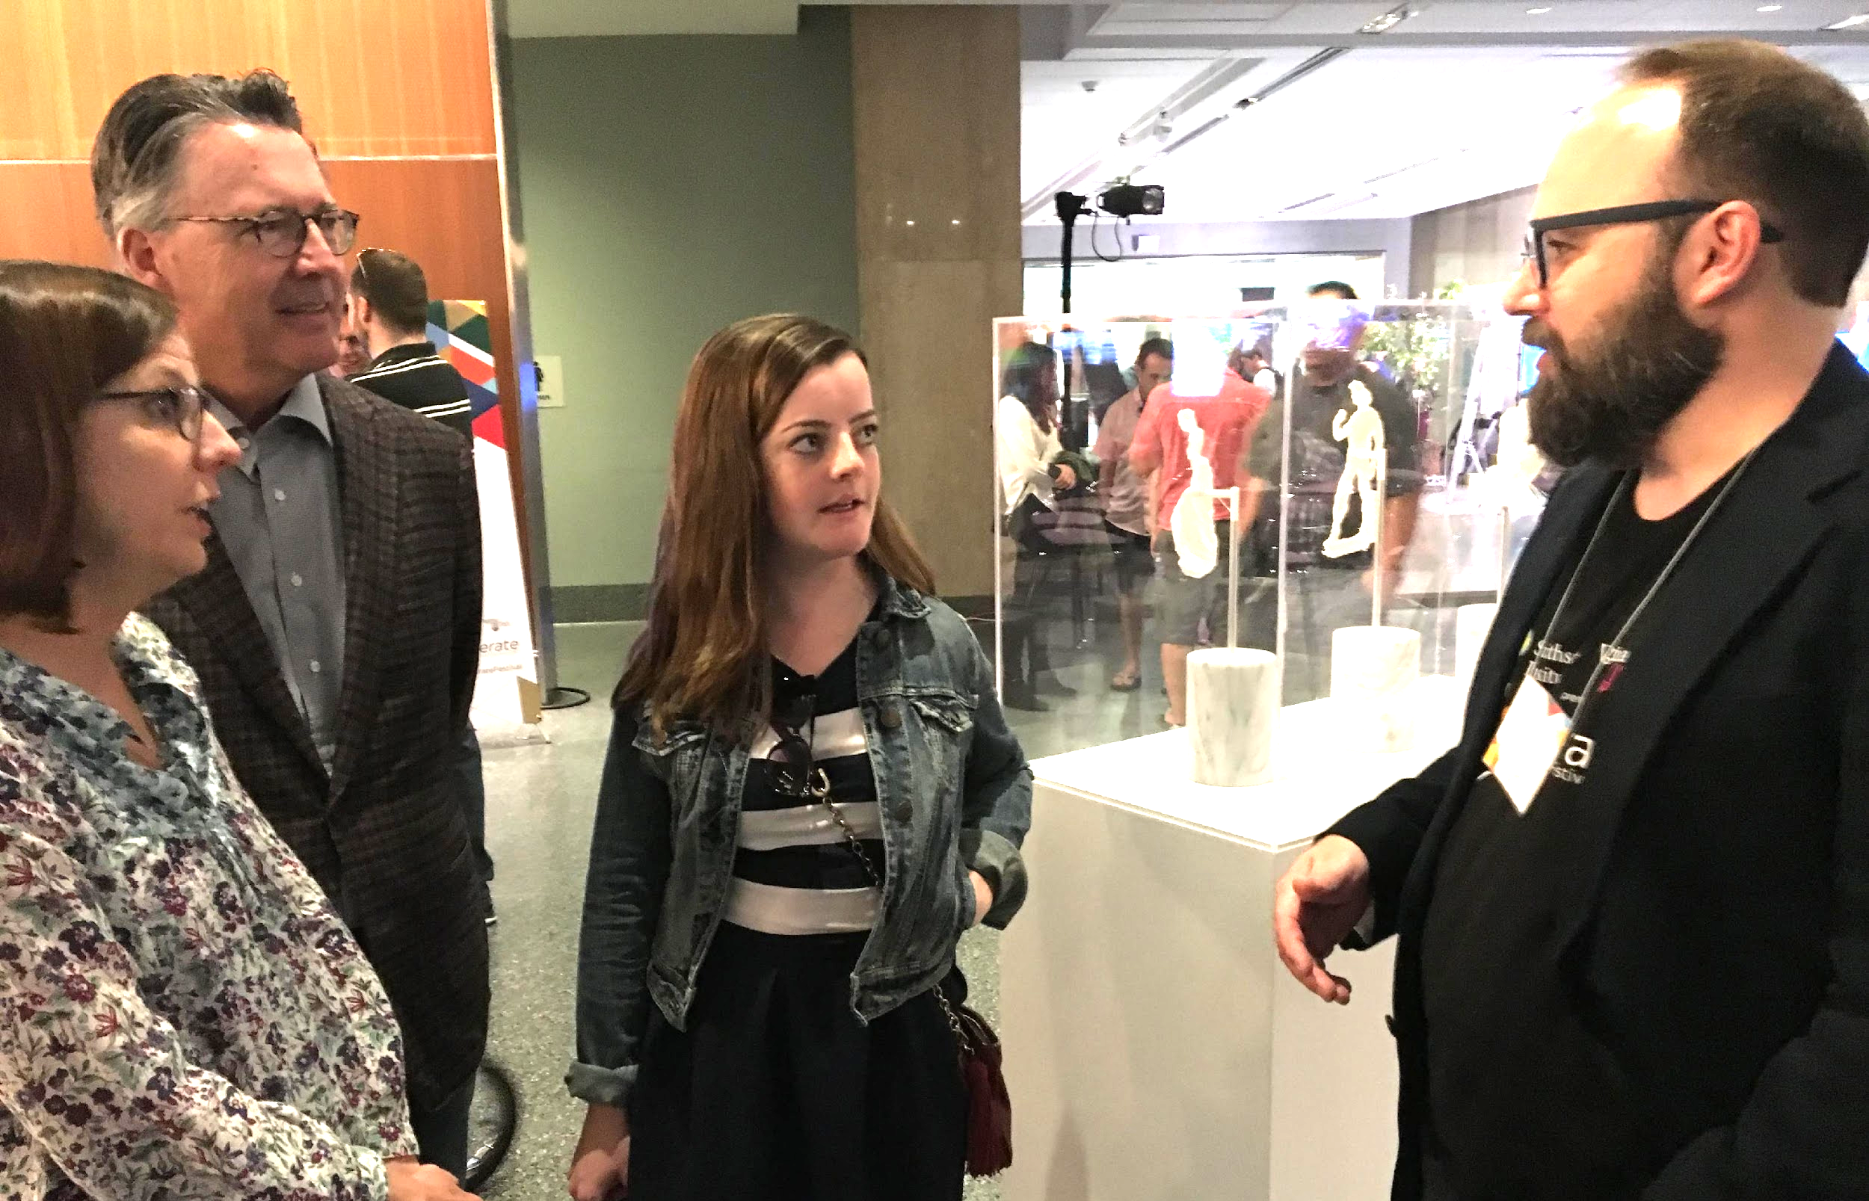
Priorities for informal education
Safe
Fun
Educational
These priorities for informal education were created and pioneered by Dr. Phyllis Newbill at the Center for Educational Networks and Impacts at Virginia Tech.
Notes:
The priorities for informal education may differ from formal education in that the goal of informal education is to inspire and interest students rather than focusing on acquiring facts. These priorities for informal education were created and pioneered by Dr. Phyllis Newbill at the Center for Educational Networks and Impacts at Virginia Tech.

Slide 3
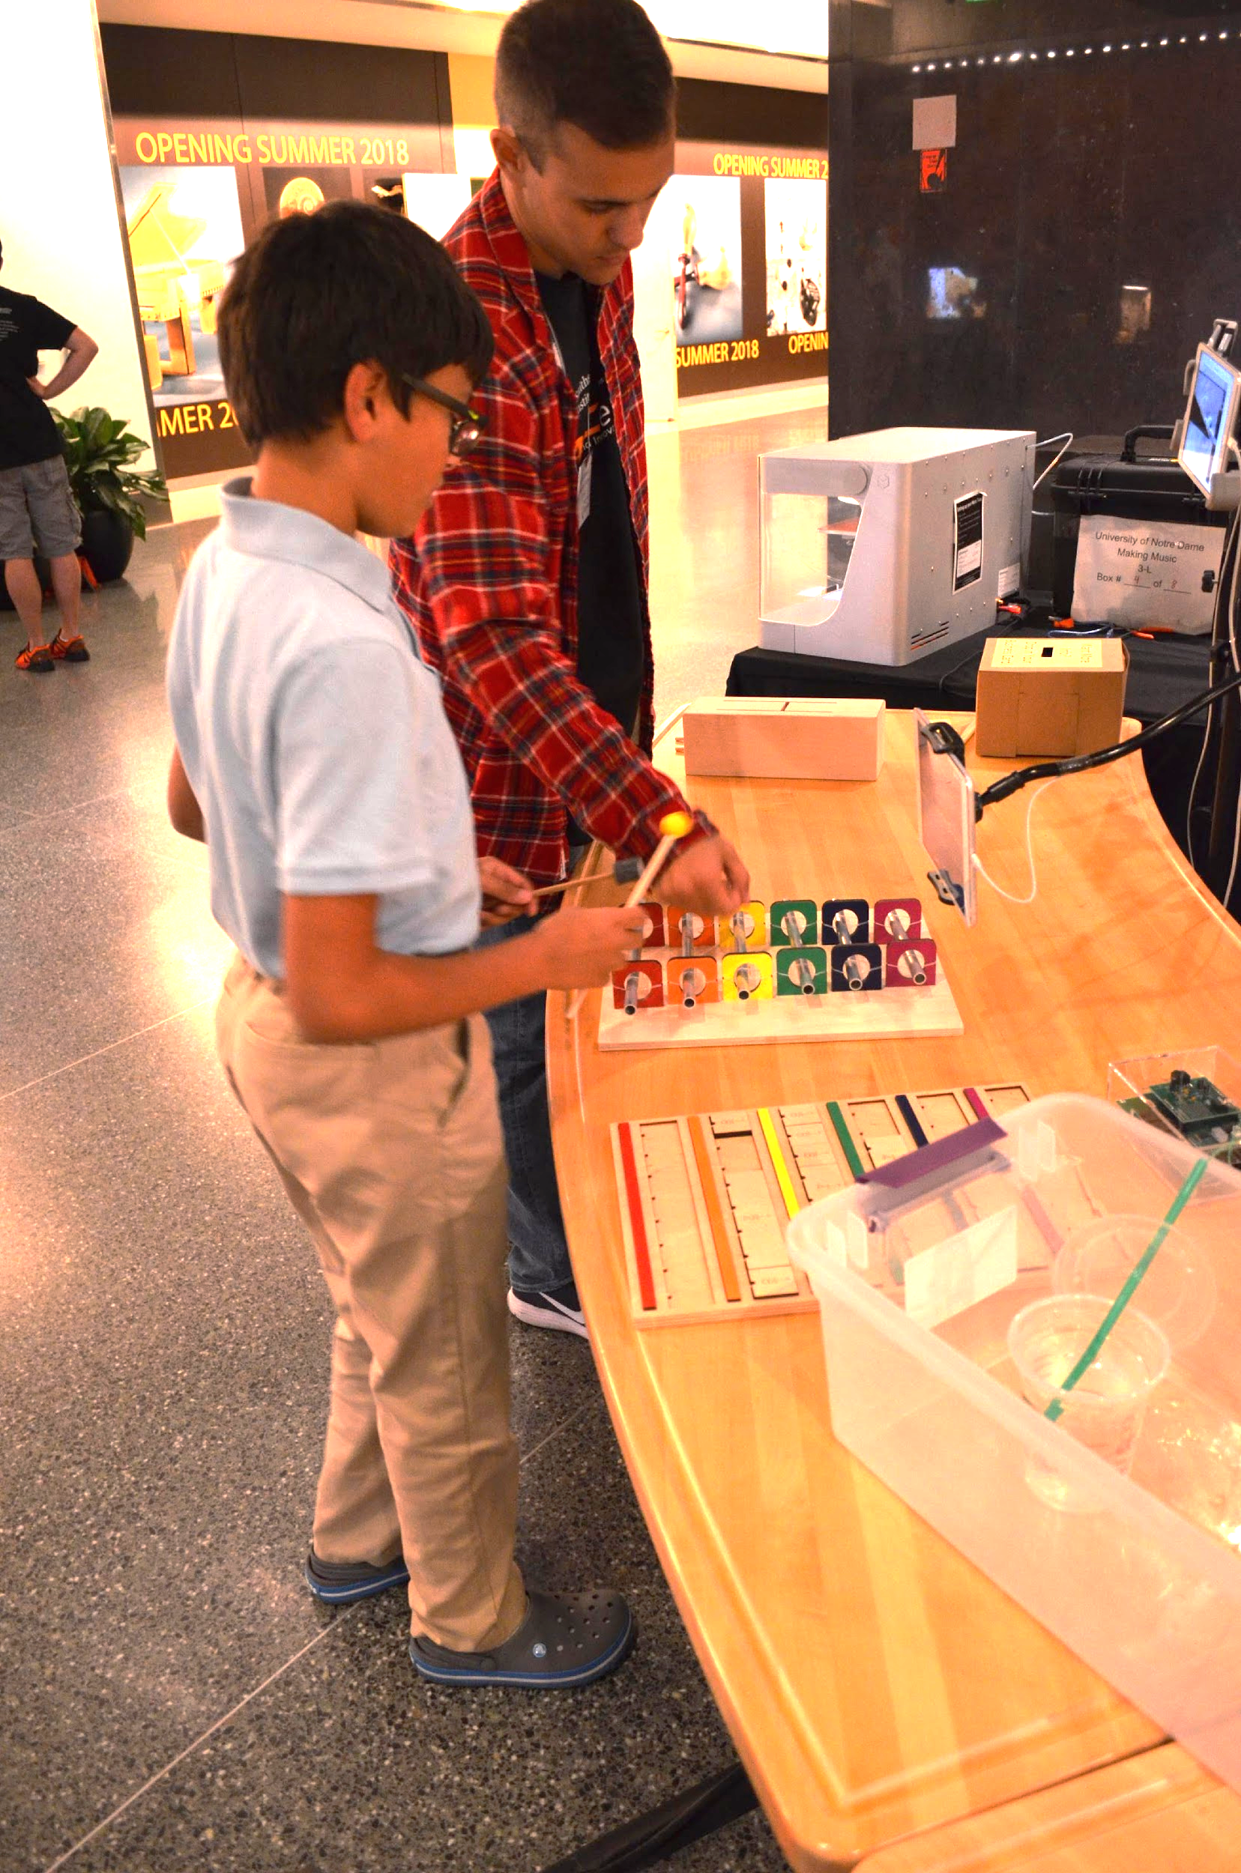
SAFETY is priority #1
You are in a position of responsibility.
Children will look to you for help.
Notes:
Always remember that safety is the number one priority. If people do not feel safe or comfortable, then they are not able to focus on learning or feeling inspired. You must ensure that you are creating a space that is both emotionally and physically safe for your learners. When you are leading an activity, you are in a position of responsibility, and children and even teachers will look to you for help.

Slide 4
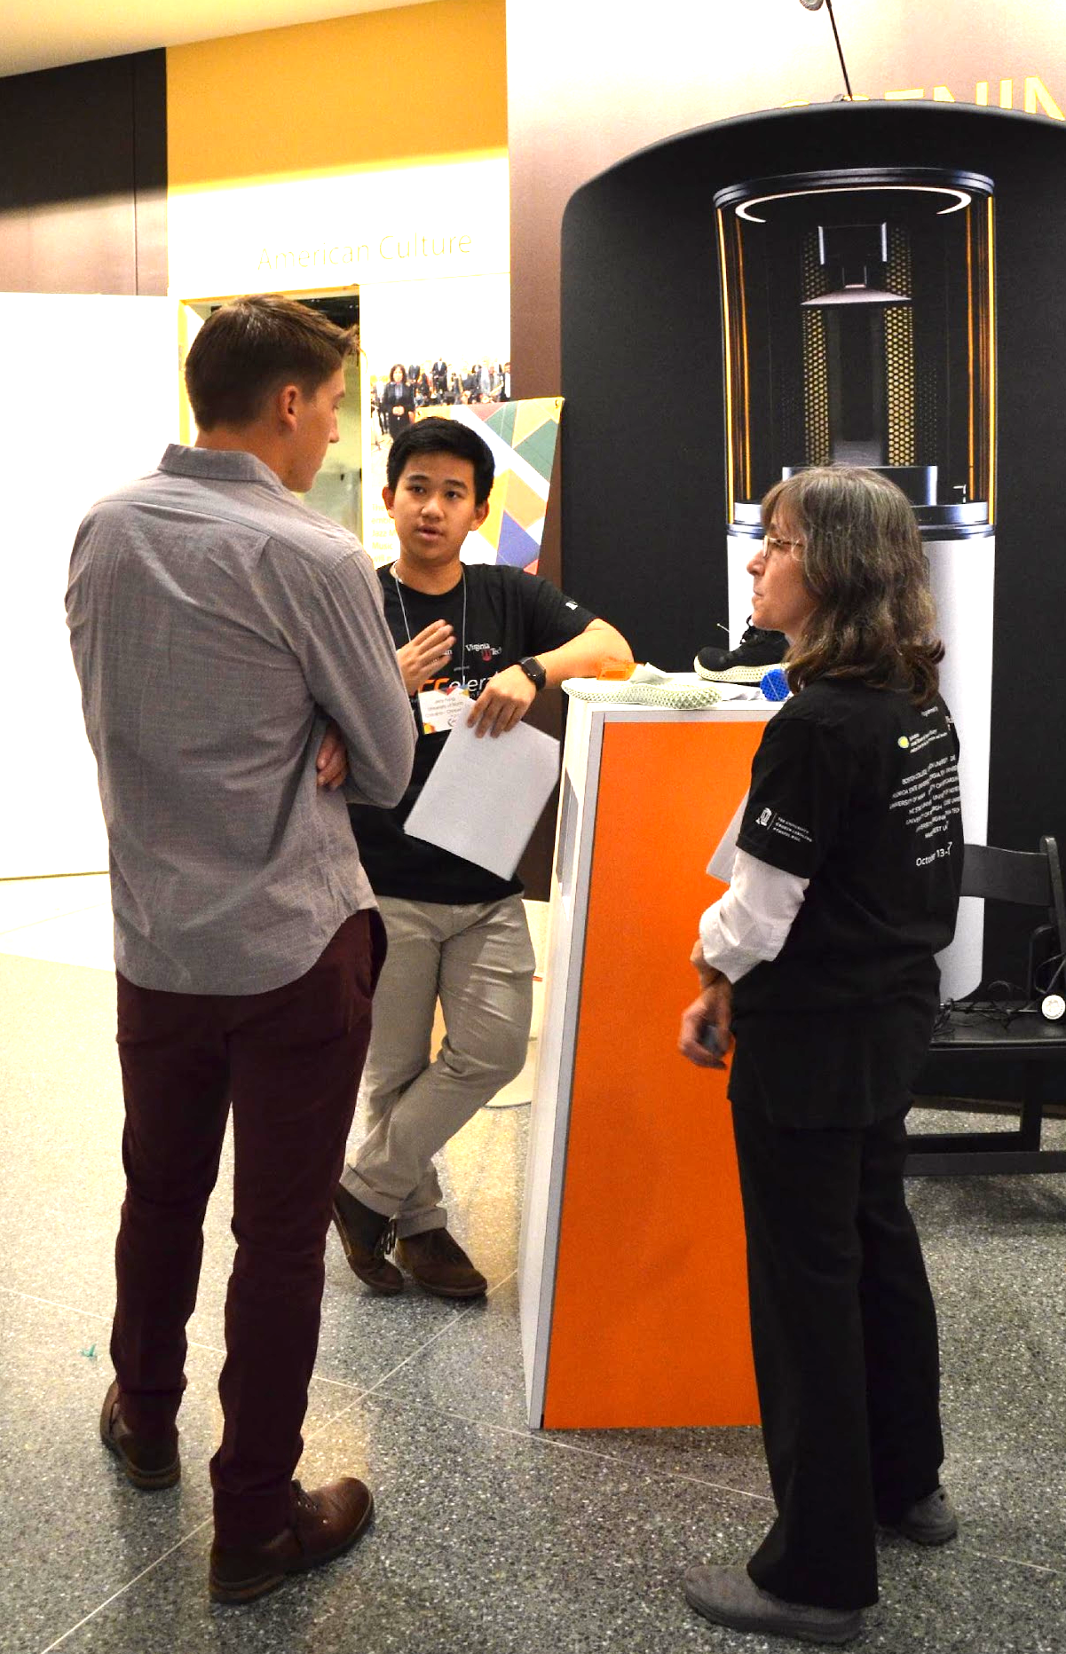
SAFETY is priority #1
Topics ahead
Never be alone with a minor.
Don’t allow others to be alone with a minor.
You may be legally bound to report suspected abuse or neglect.
Notes:
The topics we will discuss are: ensuring you and anyone you are working with are never alone with a minor and how to determine if you are legally bound to report abuse or neglect.

Slide 5

SAFETY: Preventing Abuse
Never be alone with a minor.
Don’t allow others to be alone with a minor.
This policy also prevents false accusations, so it protects the adult as well as the child.
Notes:
Never be alone with a minor in a physical or virtual space (e.g., Zoom) and do not allow others on your team to be alone with a minor. This policy protects both the minor and the adult.

Slide 6
SAFETY: What would you do? Question
A young person is the only other person in the bathroom when you arrive there. What do you do?
Notes:
Consider this scenario and what you should do in this situation. The answer is presented on the next slide.

Slide 7
SAFETY: What would you do? Answer
A young person is the only other person in the bathroom when you arrive there. What do you do?
  Go find another bathroom to use.
  Wait until the young person leaves to use the bathroom.
  Find another adult and take this second adult with you to the bathroom.
Notes:
The three options presented are all possible options. The best choice is to go find another bathroom to use. If that is not possible, you can wait until the young person leaves the bathroom to use it or find another adult and take this second adult with you to the bathroom. All of these solutions prevent you from being alone with a minor.

Slide 8
SAFETY: Reporting Abuse and Neglect
Your organization may legally require you to report abuse and neglect.
  This is known as being a “mandated reporter.”
Those who work in educational, childcare, and healthcare facilities are often mandated reporters although the laws vary by state.
  If you are not sure if you are a mandated reporter, you can check the laws in your state, talk to your supervisor, or contact the HR department for your workplace.
If you are a mandated reporter, your workplace will likely have a procedure for reporting abuse/neglect, and you should familiarize yourself with it as well as take any trainings your organization requires.
Notes:
Your organization may legally require you to report abuse and neglect.
This is known as being a “mandated reporter.”
Those who work in educational, childcare, and healthcare facilities are often mandated reporters although the laws vary by state.
If you are not sure if you are a mandated reporter, you can check the laws in your state, talk to your supervisor, or contact the HR department for your workplace.
If you are a mandated reporter, your workplace will likely have a procedure for reporting abuse/neglect, and you should familiarize yourself with it as well as take any trainings your organization requires.

Slide 9
SAFETY: Reporting Abuse and Neglect
If you suspect abuse or neglect, based on something you’ve seen or something a child has reported, you MUST report it if you are a mandated reporter.
  A culture of silence allows abuse to continue.
  You don’t want to be the person who ignored a child who trusted you enough to share. Survivors of childhood abuse often say: “I did say something, but nobody did anything.”
Notes:
If you are a mandated reporter, you must report suspected child abuse and neglect. Remember that a culture of silence allows abuse to continue.

Slide 10
Recognizing and Reporting Child Abuse
What is Title IX?
  No person in the United States shall, on the basis of sex, be excluded from participation in, be denied the benefits of, or be subjected to discrimination under any education program or activity receiving Federal financial assistance.
Gender discrimination, including sexual abuse, is covered under Title IX
Notes:
Sexual abuse and sexual harassment are covered under Title IX (nine).Title IX is a federal civil rights law, and it states that “No person in the United States shall, on the basis of sex, be excluded from participation in, be denied the benefits of, or be subjected to discrimination under any education program or activity receiving Federal financial assistance.”

Slide 11
SAFETY: About Abuse and Neglect
Keep people safe by preventing and reporting abuse and neglect.
Abuse can be emotional, physical, or sexual. Neglect is the failure to provide a child’s basic needs.
Abuse is not rare.
Notes:
Preventing and reporting abuse and neglect keeps people safe. Remember that abuse can be emotional, physical, or sexual. Neglect is the failure to provide for a child’s basic needs. Remember that abuse is not rare.

Slide 12
SAFETY: A Summary
One more time…
Never be alone with a minor.
Don’t allow others to be alone with a minor.
You may be legally bound to report suspected abuse and neglect.
Notes:
To summarize the safety section: remember to never be alone with a minor in either a physical or virtual space. Don’t allow others to be alone with a minor. You may be a mandated reporter and be legally bound to report abuse and neglect.

Slide 13
Fun: Priority #2
Let’s review the priorities of informal learning.
Safe
Fun
Educational
Notes:
Priority number two is fun.

Slide 14
Fun: Priority #2
If it’s fun, you might learn more about it.
If it’s not fun, you probably won’t choose to learn more about it.
Notes:
You want your activity to be fun because if a learner is doing something fun then they will likely want to learn more about it. If the activity is not fun, you probably won’t choose to learn more about that activity or that topic.

Slide 15

Fun: What to include
Stereotypes
Assumptions about relationships
Touchy subjects
A hook
Personal stories
Two-way conversations
Notes:
When planning your activity, you should include a hook, personal stories, and two-way conversations. Make sure to leave out stereotypes, assumptions about relationships, and sensitive topics. We will cover each of these topics in greater detail in the following slides.

Slide 16
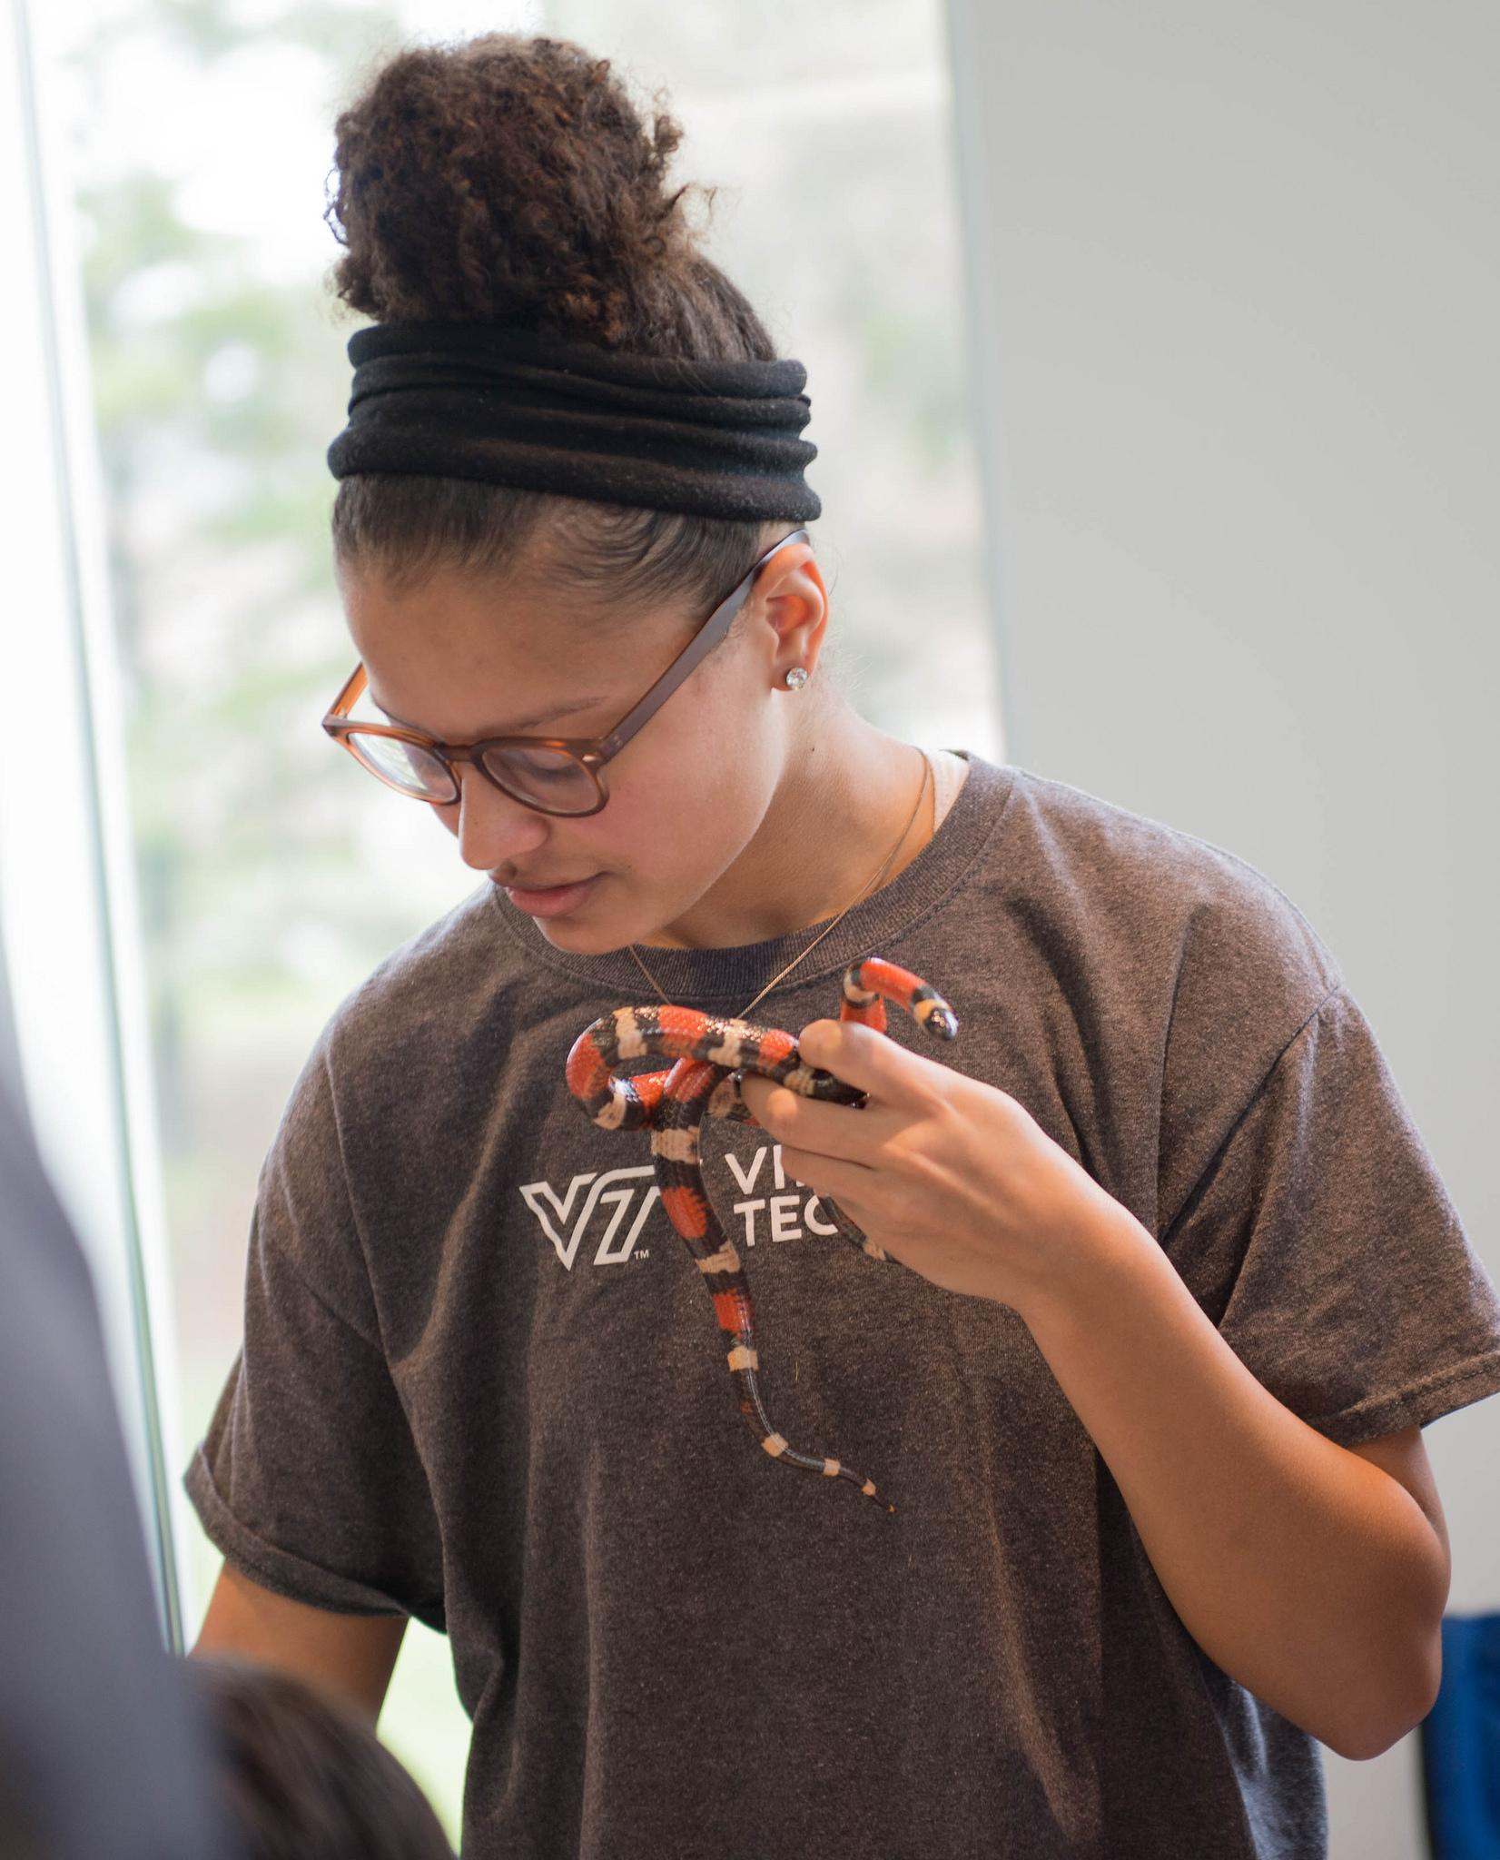
Fun: What to include: A hook
A learner is considering approaching you. What will make him or her decide to engage?
What will you say?
    Do you want to try this [cool thing I’m doing]?
    Hi, I’m [name].
What makes things look fun?
    Color
    Intriguing objects
Notes:
A hook is a good way to get learners interested in and engaging with your activity. You can engage learners verbally, by introducing yourself or your activity. You can also engage learners visually by using color or displaying an intriguing objects from your work.

Slide 17
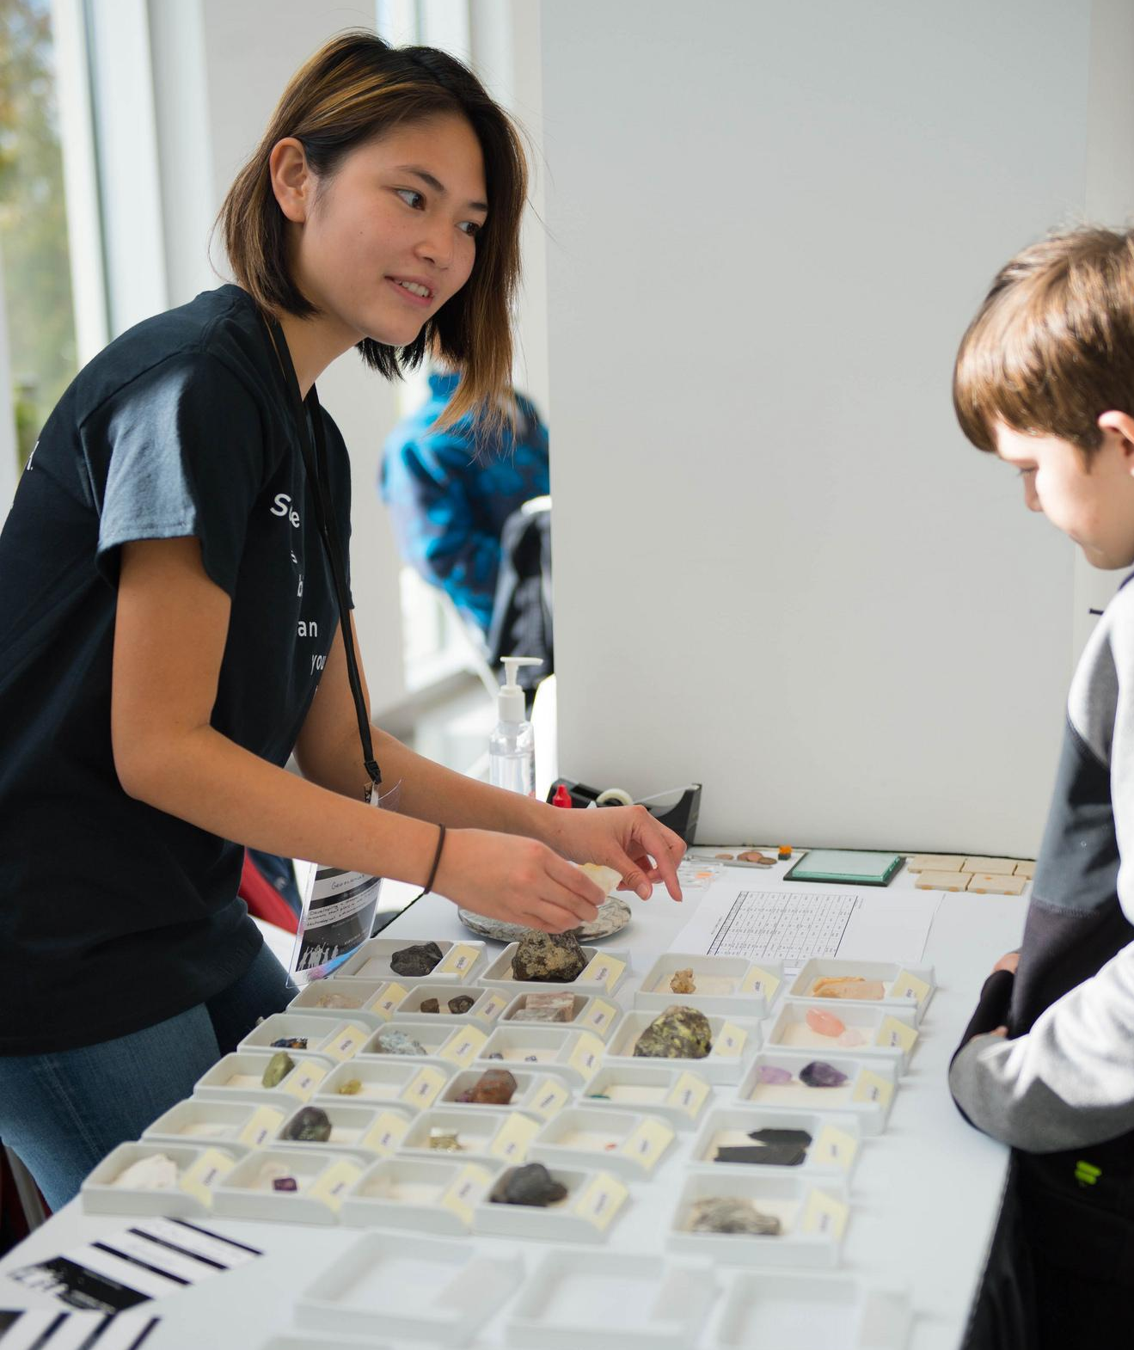
Fun: What to include: Personal stories
Stories are more exciting than facts.
Share how you got into this work.
What makes it exciting for you?
How is your experience different from others’?
Notes:
You can also engage learners by sharing a personal story or a story from your work. For example, you might talk about how you got in to your work, what is exciting or you, what makes your experience different from others, or an interesting story about the history of your work.

Slide 18
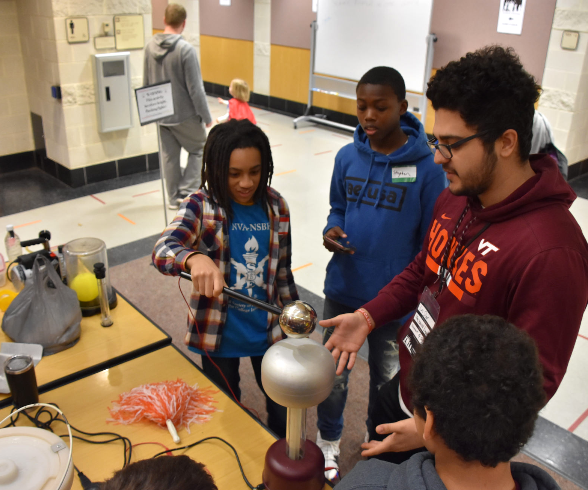
Fun: What to include: Two-way conversations
Make space for conversation.
Ask questions.
Listen.
Respond to what you heard.
You and your audience will have a richer experience.
Notes:
Another way to engage learners and to increase learning is to encourage two-way conversations in your activity. You encourage two-way conversations by asking questions as well as listening to learners and responding to them.

Slide 19
Fun: What to avoid
Stereotypes based on clothes, gender, race, etc.
Assumptions about families, living conditions, attention spans
  Instead of “Is this your grandma?” use “Let’s ask your grown up here.”
  Instead of “In your room” use “where you live.”
Touchy subjects: tattoos, romantic relationships, sex, religion, politics, curse words, alcohol and drugs, partying
Notes:
Avoid stereotyping your learners based on any physical or observable characteristics. For example, don’t assume that only female learners will be interested in your activity and male learners will find it boring. Also remember that teachers and students come from a wide range of backgrounds and home living situations, some of which may make the learner feel uncomfortable or singled out when discussed in front of their classmates.
Don’t make assumptions about families and living situations, for example assuming that every child has a mother and father at home or that every child has their own room. Avoid talking about sensitive topics such as tattoos, romantic relationships, sex, religion, politics, curse words, alcohol/drugs, and partying and focus your language and conversation on your activity instead. Your activity has the potential to reach and engage all learners and using inclusive language will help make sure you achieve that goal.

Slide 20
Fun: Arranging your space
Make your space a “yes” space. Put touchable things where people can touch them.
Protect untouchable or fragile things with physical barriers or design elements rather than “don’t touch” signage, or worse, verbal reminders.
If you have to use verbal protection, be sure to let people know NOT to touch before the object is available.
Notes:
When creating an exhibit or setting up an activity, especially one where you may be at a table and waiting for learners to approach you, think about how you can make your space a “yes” space. A “yes” space is one in which you can say yes as much as possible and minimize the number of times you will say no to a learner (e.g., ask them not to touch something). Put touchable items (remember that touchable items can be used as a hook to engage learners in your activity) where they can be touched. Create physical barriers for fragile items that you may not want to be touched and if you must tell a learner not to touch something, set a clear expectation by letting them know not to touch before presenting the object.
See an example of a “yes” space on the next slide.

Slide 21
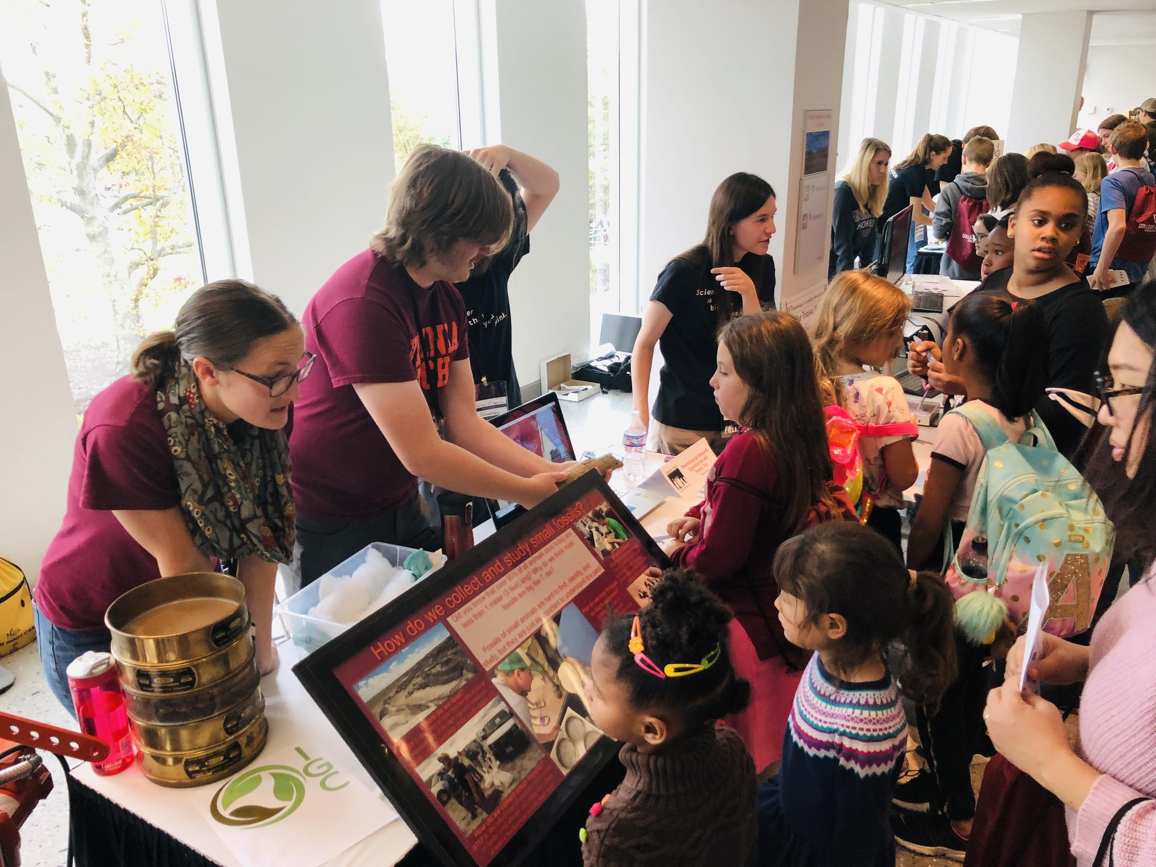
Hook: Cool thing to touch
Asking questions for engagement
Fragile objects
Physical barrier protects fragile objects
Notes:
This exhibit demonstrates a “yes” space. There is a hook of a cool object to touch that is placed in an easily accessible area of the table. There is also a hook of a person asking questions to promote engagement with the exhibit. This exhibit does showcase fragile objects that should not be touched, and notice how the fragile objects are protected by a physical barrier. Think about how you can set up your space so that you can maximize the number of times you say yes to someone who wants to engage with you and your activity and minimize the number of times you will say no.

Slide 22
Fun: Review
Include a hook, stories, and conversation.
Avoid stereotypes, assumptions, and sensitive topics.
Arrange your space as a “yes” space.
Notes:
As a review of the second priority, “fun”: 1) Make sure to include a hook, stories, and conversation in your activity; 2) avoid stereotypes, assumptions, and sensitive topics; and 3) arrange your space to be a “yes” space.

Slide 23
Educational: Priority #3
Let’s review the priorities of informal learning.
Safe
Fun
Educational
Notes:
We will now move onto priority three: making your activity educational.

Slide 24
Educational: Topics
Figuring out learner capabilities
Language use
Sensory-friendly work
Choosing an activity
Education standards
Notes:
In this component of the training, we will discuss how to determine learner capabilities, language use, making your activity sensory-friendly, how to choose an appropriate activity, and educational standards in your state.

Slide 25
Educational: Learner Capabilities
A boy in a wheelchair comes with his family to your exhibit. His body is twisted, and he does not make eye contact with you. Should you address him?
Notes:
Consider the scenario presented on this slide. The answer is presented on the next slide.

Slide 26
Educational: Learner Capabilities
Many diseases attack the body and not the mind. Assume that the child can understand you until you have information otherwise and engage this learner as you would any other learner.
Notes:
Remember what we learned in the previous module about not relying on stereotypes when interacting with students. You cannot determine someone’s cognitive capabilities based on their physical appearance. Engage with this learner as you would any other learner.

Slide 27
Educational: Learner Capabilities
Two children come to your exhibit with an adult. One child is six inches taller than the other. Which one can understand bigger words?
Notes:
Consider the scenario presented on this slide. The answer is presented on the next slide.

Slide 28
Educational: Learner Capabilities
Heights vary greatly among children. They might be the same age, or the shorter one may be older. Learner capabilities are not related to their height.
Notes:
Remember what we learned in the previous module about not relying on stereotypes when interacting with students. You cannot determine someone’s cognitive capabilities based on their physical appearance.

Slide 29
Educational: Learner Capabilities
Assumptions based on physical appearance don’t work well. What can you do?
Ask questions of children first and then caregivers. Start simply and move up as you assess their understanding.
Show an object and ask the learner to describe it. You’ll learn about their vocabulary quickly.
Notes:
We learned in the previous module that assumptions about learner abilities based on physical appearance are not reliable ways to judge learner capabilities. Instead, you can ask questions of children, beginning with simple questions and asking more complex or difficult questions if the learner seems interested and to understand you. You can also ask the learner to describe an object, which will give you a good idea of their vocabulary and sentence structure skills.

Slide 30
Educational: Language use
Plan what you will say.
How do you know if your “script” is appropriate for young learners?
Use readability functions in Word
Use readability score apps
Additional Resources: The Thing Explainer and/or The Up-Goer Five text editor
Notes:
Plan what you will say to learners during your activity, both to ensure that your content is age appropriate as well as to ensure that your activity will take the amount of time you believe it will.
Once you have your script, you can use readability functions in Microsoft Word/PowerPoint or readability score applications to determine the grade level for your content. Make sure that your content is not too difficult or too easy. For example, a fifth grade reading level would likely be too difficult for a second grader and too easy for a twelfth grader. Try to ensure that your content is easy to understand for your learner group.
Other resources that may be helpful are The Thing Explainer book and The Up-Goer Five text editor both of which use only the vocabulary of the 1,000 (or "ten hundred") most common words in the English Language.

Slide 31
Educational: Sensory-friendly
Use signage to communicate the experience.
Surprises are not cool.
Don’t pressure learners to engage with you before they are ready to.
Warn visitors about bright lights, repetitive noises, or loud noises. Leave these out if possible.
Notes:
When preparing your activity, remember that some sensory experiences may be overwhelming for learners, which will limit their ability to engage with your activity. Having a written sign to describe your experience may be useful, and if you have sensory aspects to your activity make sure to let learners know about those ahead of time. Leave out bright lights and repetitive or loud noises if possible.
In general, avoid surprises, which may frighten some learners. Also, do not put pressure on learners to engage with your activity if they seem hesitant; instead, let them engage at their own pace.

Slide 32
Educational: How to choose an activity
Choose a topic or activity that you’re interested in or that excites you
Ask local teachers what their needs might be
Think about why you want to do outreach and how this outreach might fit in to your big picture
What grades or subjects do you feel most comfortable talking to?
Notes:
When you are trying to determine what activity you should do, try to select something that you think is interesting or exciting. If you’re excited, your learner group will be able to detect your excitement, and they will be more interested. You can also think about why you want to do outreach, what has inspired you, and how this outreach might fit into the bigger picture of your life and career.
You can also ask local teachers or school administrators what their needs are. For example, they may have difficulty meeting certain educational standards in standardized testing or may have an existing venue for outreach in their district. You can also discuss with teachers which grades or subjects may be best aligned with your activity; be sure to be honest about which grade levels or ages you feel most comfortable talking to and if there are any subjects you feel more comfortable talking about.

Slide 33
Educational: Educational Standards
The state you live in likely has educational standards that schools must meet, such as standardized testing.
These standards vary by state and are related to student learning and achievement in grades PreK12 subjects.
Finding and becoming more familiar with the educational standards in your state may be a good next step.
Notes:
The state you live in likely has educational standards that schools must meet, such as standardized testing. These tests and standards typically cover key concepts and vocabulary that students must know.
These standards vary by state and are related to student learning and achievement in grades PreK12 in English, mathematics, science, and history/social science among others.
Finding and becoming more familiar with the educational standards in your state may help you include important information in your activity and help you determine which subjects and grade levels may be most appropriate for your activity.

Slide 34
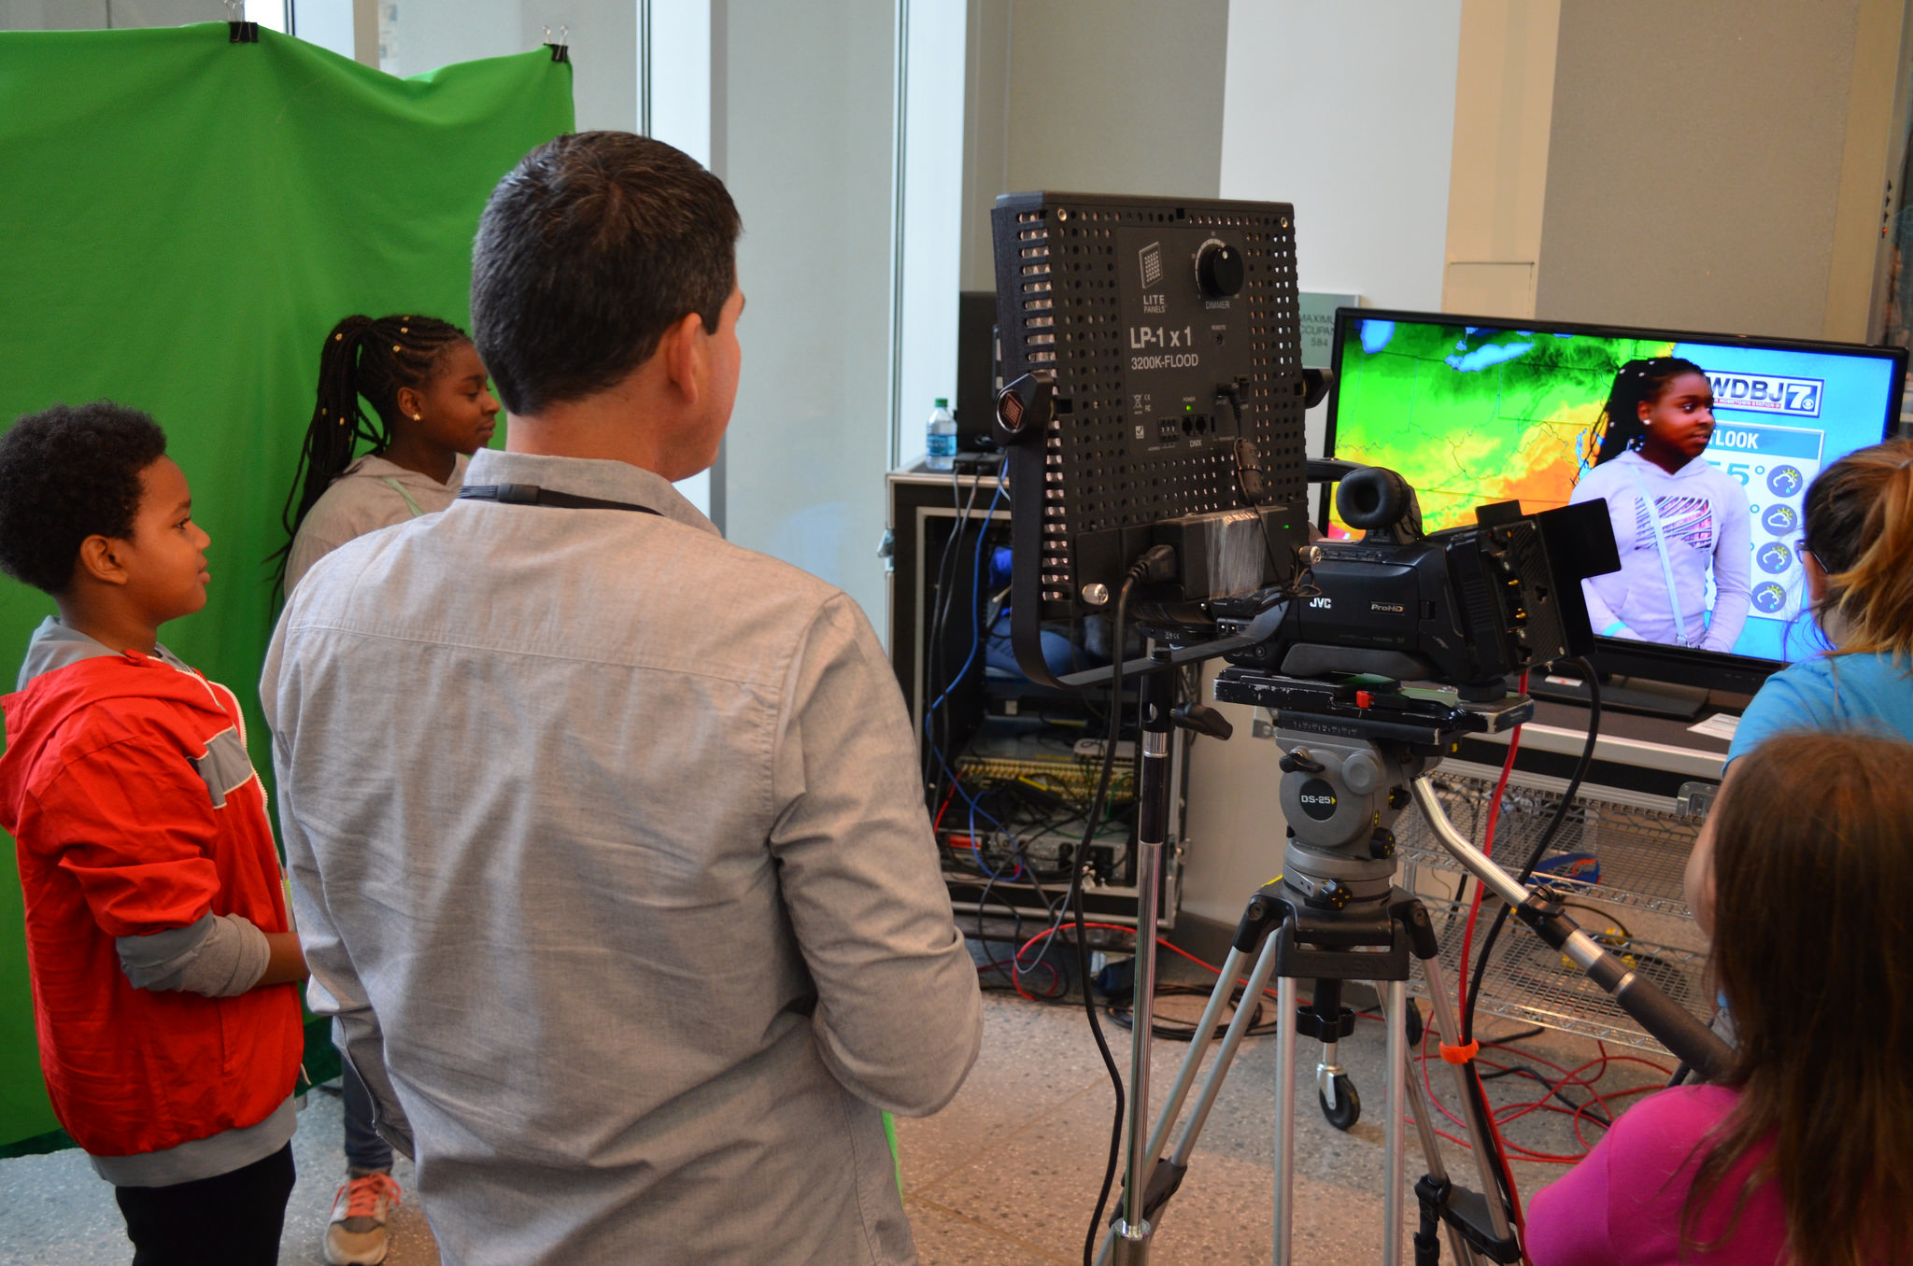
Educational: Review
Learner capabilities
Language use
Sensory-friendly
Choosing an activity
Educational standards
Notes:
As a review, remember to determine learner capabilities by asking them questions or asking them to describe objects. Make sure you plan what you will say in your activity and that your language is at an appropriate level for your learner group. If possible, avoid loud and repetitive noises, bright lights, and other overwhelming stimuli in your activity. When planning your activity, think about what ages you feel comfortable talking to as well as what interests you and what you are excited about; if you are excited, your learners are more likely to be excited. Finally, use educational standards in your state to help create your activity.

Slide 35
Discussion
This training was based on materials originally created by the Center for Educational Networks and Impacts at Virginia Tech. It is released with permission under a Creative Commons Attribution NonCommercial ShareAlike 4.0 (CC BY NC-SA 4.0) license.
NOTE: Logos and photographs contained within are used with permission and are not subject to the Creative Commons license.

