Slide 1


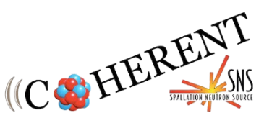
COHERENT: Latest Results and Future Prospects
Jonathan Link
Center for Neutrino Physics, Virginia Tech
23rd International Workshop on Next Generation Nucleon Decay and Neutrino Detectors

Slide 2

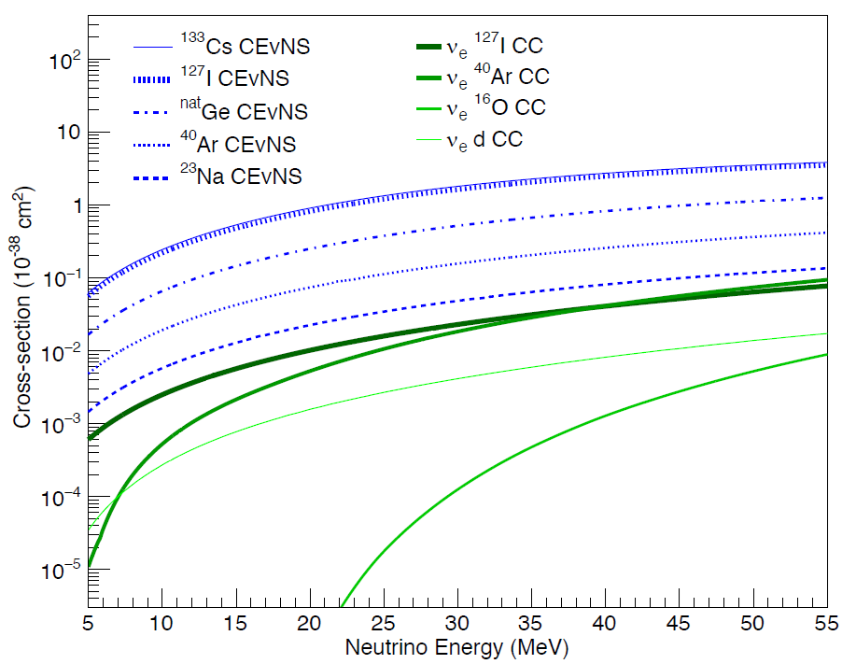


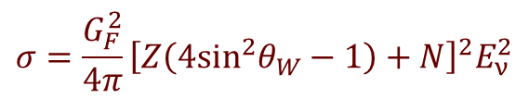
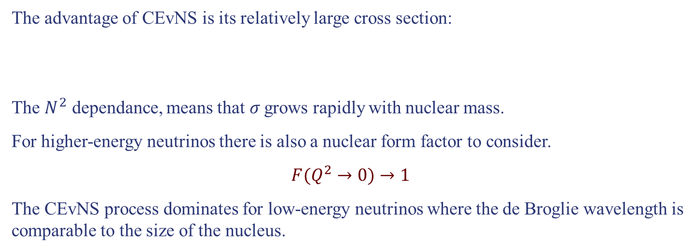
Coherent Elastic Neutrino Nucleus Scattering
E
CEvNS is a Standard Model process, first predicted by Daniel Freedman in 1974,
in which a neutrino transfers momentum to a nucleus, as a whole, without changing its internal structure.
Due to the large mass difference, the energy transfer is very small,
Which makes detecting the recoiling nucleus extraordinarily challenging.
Coherent
C
Elastic
Neutrino
ν
Nucleus
S
v
N
Scattering
Daniel Freedman
Phys. Rev. D 9, 1389 (1974)
The advantage of CEvNS is its relatively large cross section:
$$σ=\frac{G_{F}^{2}}{4π}{\left[Z\left(4\sin^{2}θ_{W}−1\right)+N\right]}^{2}E_{ν}^{2}$$
The $N^{2}$ dependance, means that$σ$ grows rapidly with nuclear mass.
For higher-energy neutrinos there is also a nuclear form factor to consider.
$$F(Q^{2}→0)→1$$
The CEvNS process dominates for low-energy neutrinos where the de Broglie wavelength is comparable to the size of the nucleus.
$$σ=\frac{G_{F}^{2}}{4π}{\left[Z\left(4\sin^{2}θ_{W}−1\right)+N\right]}^{2}E_{ν}^{2}$$
$$≈\frac{G_{F}^{2}}{4π}N^{2}E_{ν}^{2}$$
$$F(Q^{2})$$

Slide 3
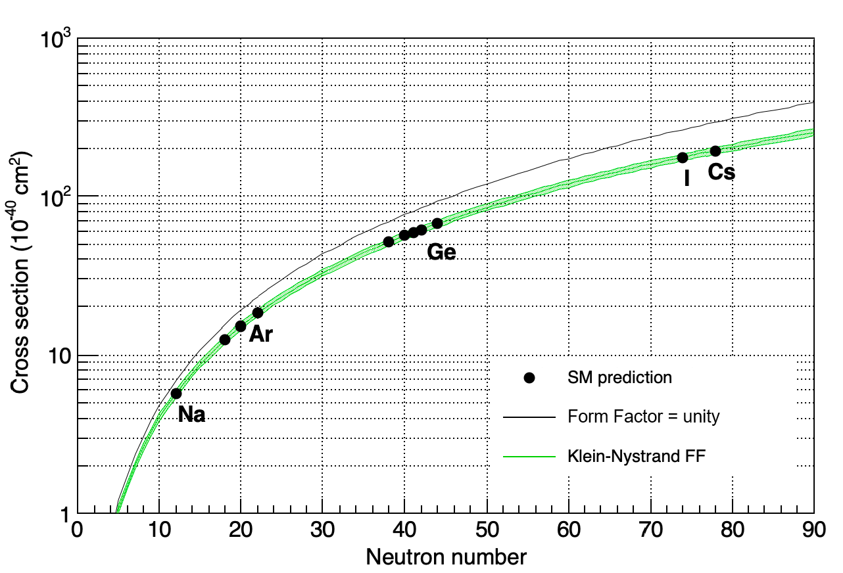
CEvNS Standard Model Cross Section

Slide 4


Illustrating the Scale of CEvNS
A lead nucleus is about 2 trillion times more massive than an electron neutrino.
Neutrino
mass < 0.12 eV
Lead Nucleus
mass = 193.7 GeV
For comparison, an African elephant is also about 2 trillion times more massive than a mosquito
Not to scale
Mosquito
mass ~ 2.5 mg
Elephant
mass ~ 5000 kg
Notes:
This seems crazy to imagine the elephant recoiling off a mosquito strike, so what’s going on here?
The neutrino is ultra relativistic,
Relative to the elephant’s mass, the friction force between the elephant and the ground is greater than the molecular bond strengths binding a lead nucleus and
The de Broglie wavelength of a mosquito is infinitesimal compared to the physical size of the elephant.

Slide 5
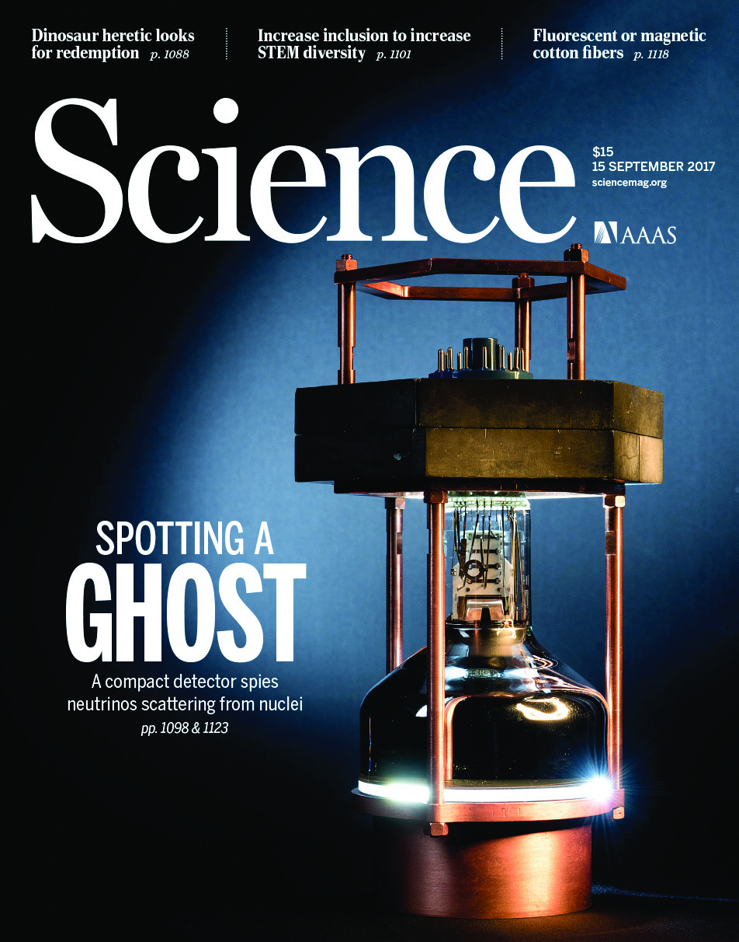
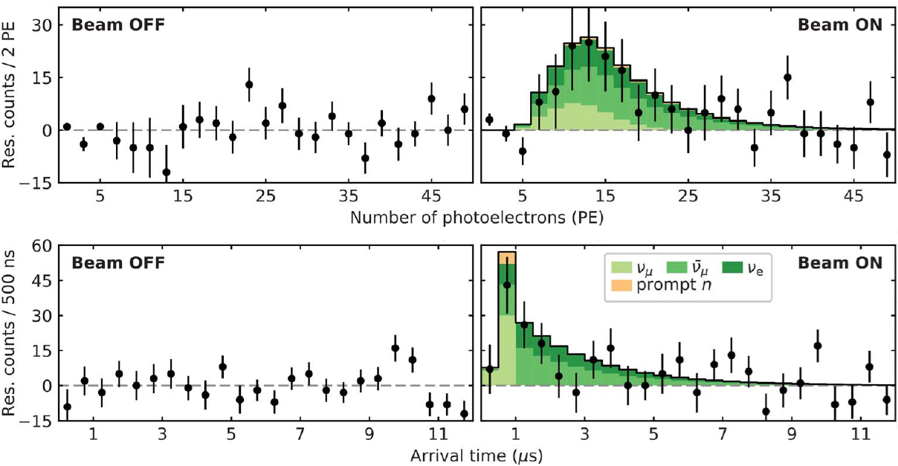
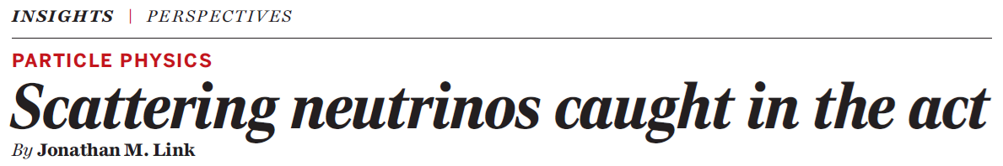
Discovery of CEvNS 43 Years Later
CEvNS was discovered by the COHERENT Collaboration in 2017.
They used a 14.6 kg cesium iodide crystal instrumented with a single 5-inch PMT,
Deployed in a basement hallway at the Spallation Neutron Source (SNS).
CEvNS was observed an excess of events with energy and time structure consistent with the pulsed stopped-pion beam
Science 357, 1123 (2017)

Slide 6
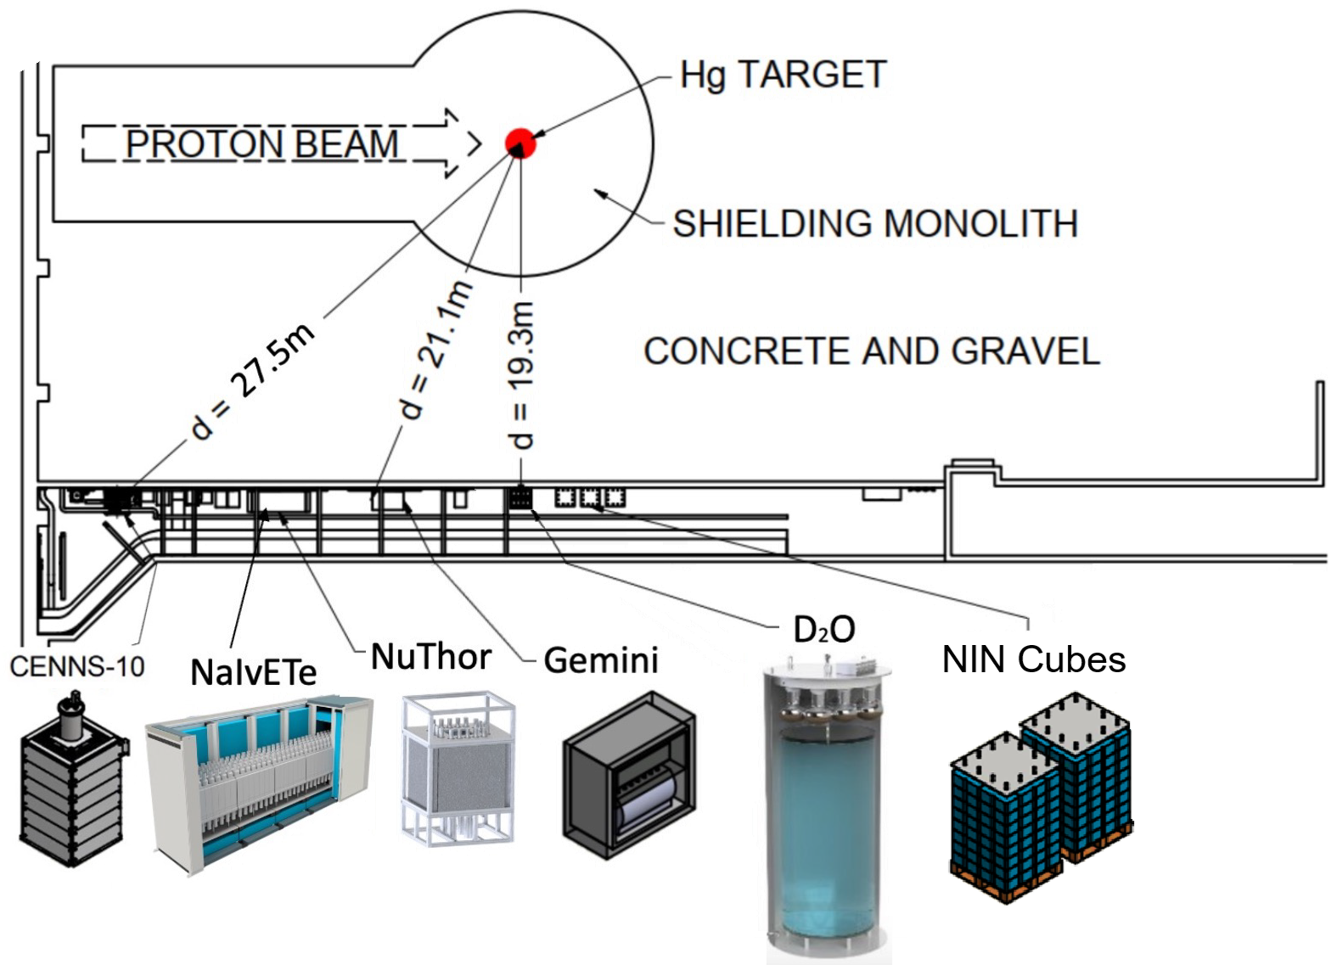
The COHERENT Experiment
COHERENT is a suite of detectors located in a basement hallway of the Spallation Neutron Source at Oak Ridge National Laboratory.
The current detectors include:
  Liquid Argon (upgrade coming)
  Sodium Iodide (upgrade underway)
  Thorium, ν Induced Fission
  Germanium
  Heavy Water (D₂O)
  ν Induce Neutron Cubes (Pb & Fe)
Future detectors include:
Cryogenic Cesium Iodide
Lead Glass
Plus many more ideas…
The main focus is CEvNS, but we’re also studying charged current interactions, searching for dark matter, with dedicated detectors to study backgrounds and measure neutrino flux.

Slide 7



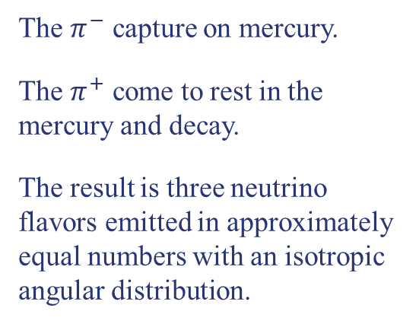





The SNS as a Neutrino Source
1.3 GeV proton beam, strikes mercury target at 60 Hz with average power of 1.7 MW (→ 2 MW).
The goal is to knock out neutrons, but it also produces pions.
The $π^{−}$ capture on mercury.
The $π^{+}$ come to rest in the mercury and decay.
The result is three neutrino flavors emitted in approximately equal numbers with an isotropic angular distribution.
$$π^{−}$$
Capture
Proton
$$π^{+}$$
$$e^{+}$$
$${\overline{ν}}_{μ}$$
Hg
$$μ^{+}$$
$$ν_{e}$$
$$ν_{μ}$$

Slide 8
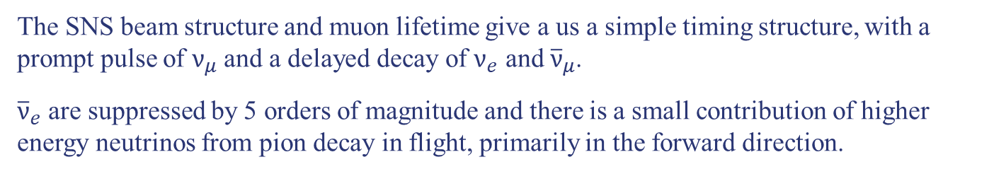
The SNS as a Neutrino Source
Pion decay-at-rest neutrinos have a well understood energy distribution.
Phys. Rev. D 106, 032003 (2022)
The SNS beam structure and muon lifetime give a us a simple timing structure, with a prompt pulse of $ν_{μ}$ and a delayed decay of $ν_{e}$ and ${\overline{ν}}_{μ}$.
${\overline{ν}}_{e}$ are suppressed by 5 orders of magnitude and there is a small contribution of higher energy neutrinos from pion decay in flight, primarily in the forward direction.

Slide 9
Neutrino Alley
This is an active hallway with only 1 meter of space for detectors between the wall and the walkway.

Slide 10
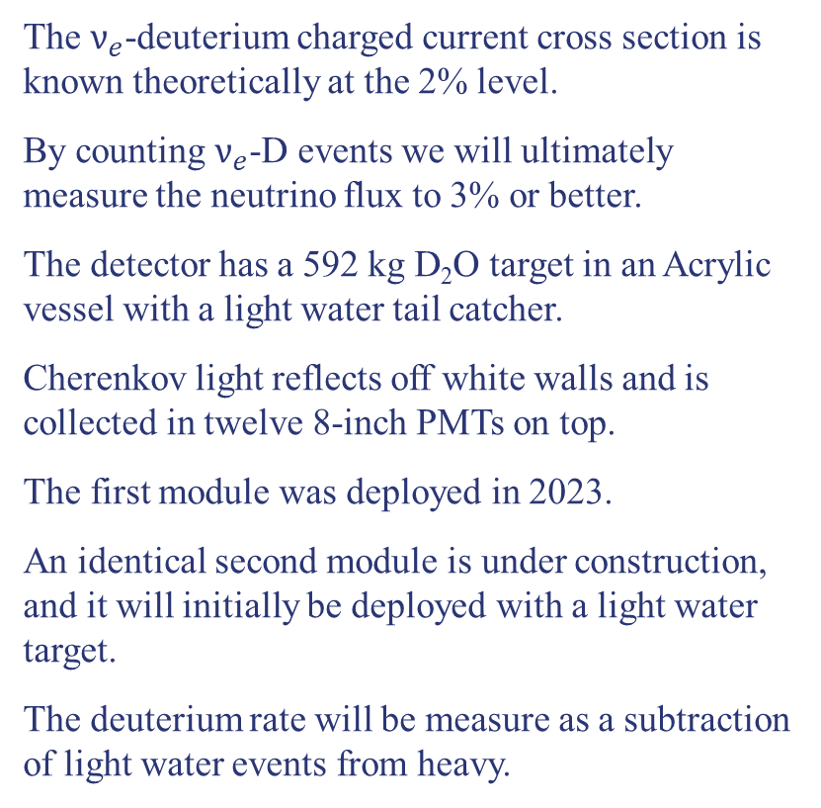
Neutrino Flux Uncertainty
The largest systematic error on the CEvNS cross section comes from pion production.
To reduce this error, we are building a heavy water detector system.
The $ν_{e}$-deuterium charged current cross section is known theoretically at the 2% level.
By counting $ν_{e}$-D events we will ultimately measure the neutrino flux to 3% or better.
The detector has a 592 kg D₂O target in an Acrylic vessel with a light water tail catcher.
Cherenkov light reflects off white walls and is collected in twelve 8-inch PMTs on top.
The first module was deployed in 2023.
An identical second module is under construction, and it will initially be deployed with a light water target.
The deuterium rate will be measure as a subtraction of light water events from heavy.
D₂O
H₂O

Slide 11
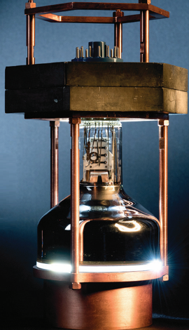
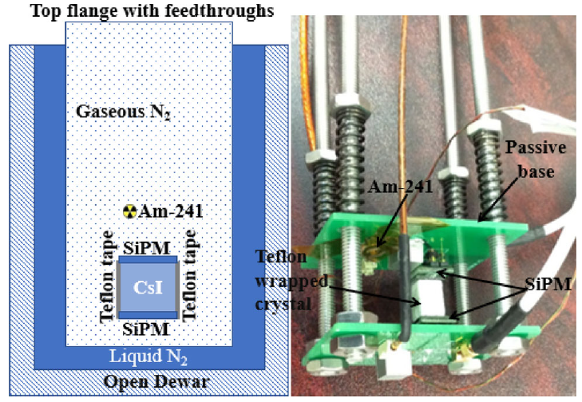
Cesium Iodide Detectors
The CEvNS discovery was done with a 14.6 kg sodium-doped Cesium Iodide (CsI[Na])
These results were updated with the full data set in 2022.
This detector is now decommissioned.
We are developing an undoped CsI detector that will operate at 40 K and be readout by SiPMs.
This approach has serval advantages:
  Lower background (from PMT glass)
  Higher light output
  Better light collection efficiency.
Cryo-CsI Prototype
Results in a lower threshold CEvNS detection.
Eur. Phys. J. C 82, 344 (2022)

Slide 12
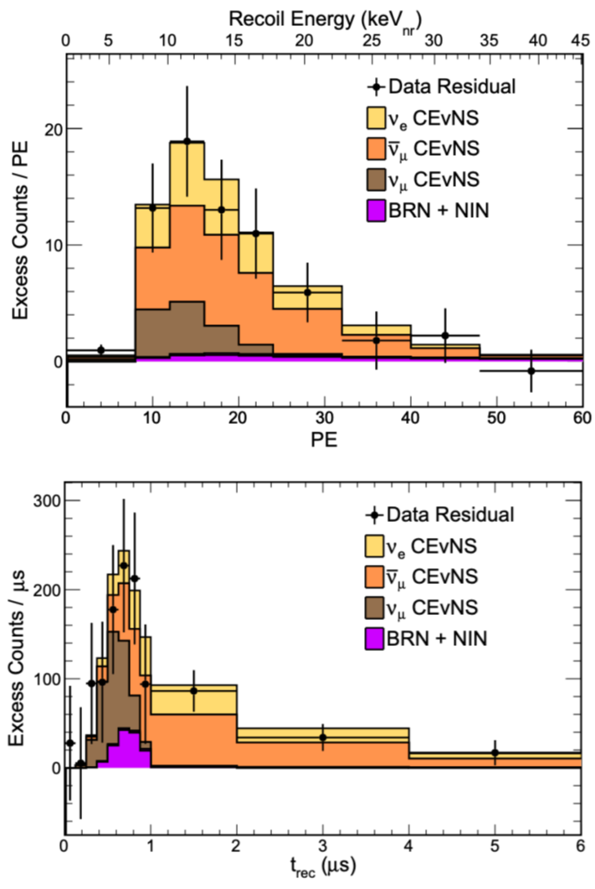
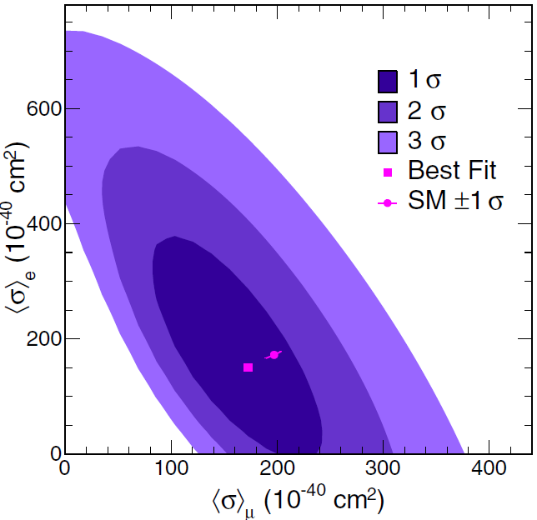
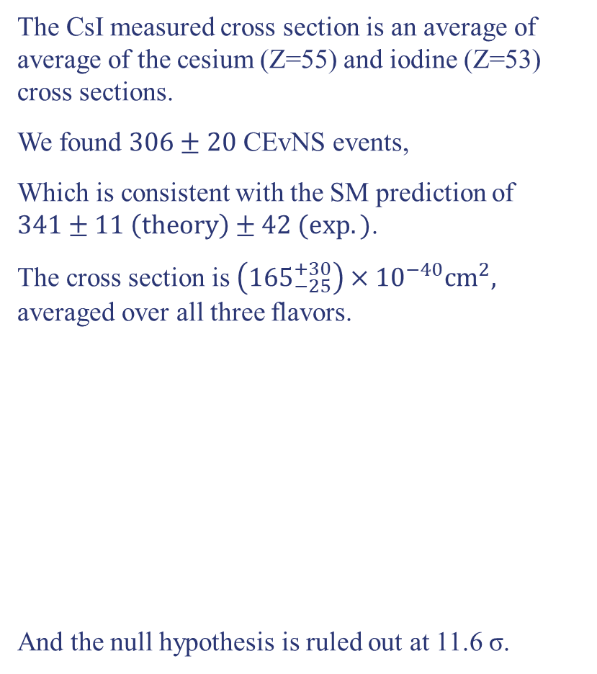
Cesium Iodide CEvNS
The CsI measured cross section is an average of average of the cesium (Z=55) and iodine (Z=53) cross sections.
We found $306±20$ CEvNS events,
Which is consistent with the SM prediction of $341±11 \left(theory\right)±42 (exp.)$.
The cross section is $\left({165}_{−25}^{+30}\right)×{10}^{−40}{cm}^{2},$ averaged over all three flavors.
And the null hypothesis is ruled out at 11.6 σ.
PRL 129 (2022) 081801

Slide 13
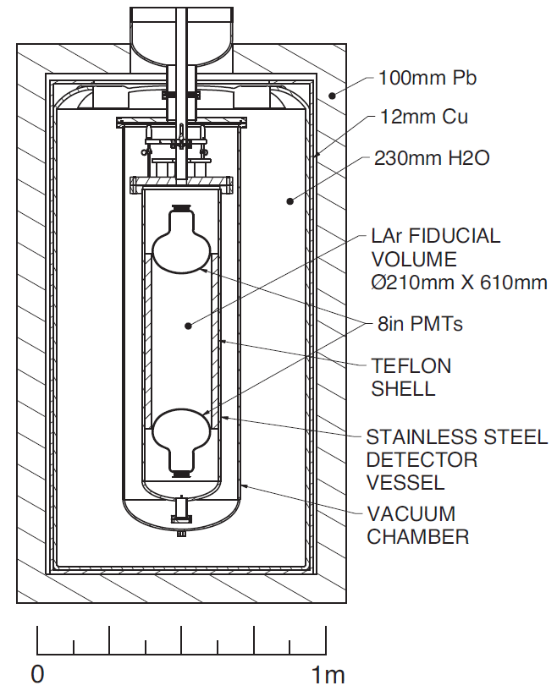
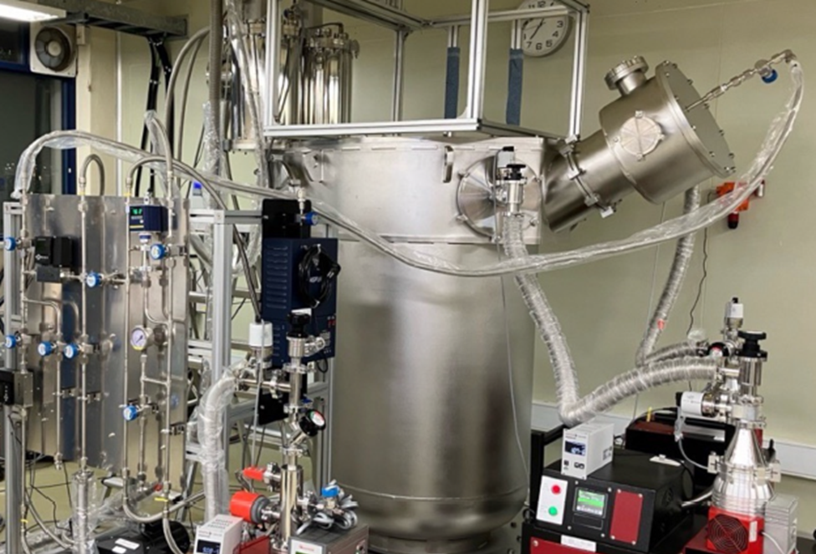
Liquid Argon Detectors
CENNS-10
CENNS-10 is a liquid argon scintillation detector filled with 22 kg of LAr, with 10 kg in the fiducial volume.
It’s viewed by two 8-inch PMTs, and shielded by a hybrid lead, copper and water shield.
It started taking physics data in Neutrino Alley in 2017.
COH-Ar-750
Our LAr capability is undergoing a major upgrade to a 750 kg (600 kg fiducial) detector known as COH-Ar-750.
This will be viewed by 122 PMT.
We expect ~3000 CEvNS events per SNS-year, along with ~400 charged current events.

Slide 14
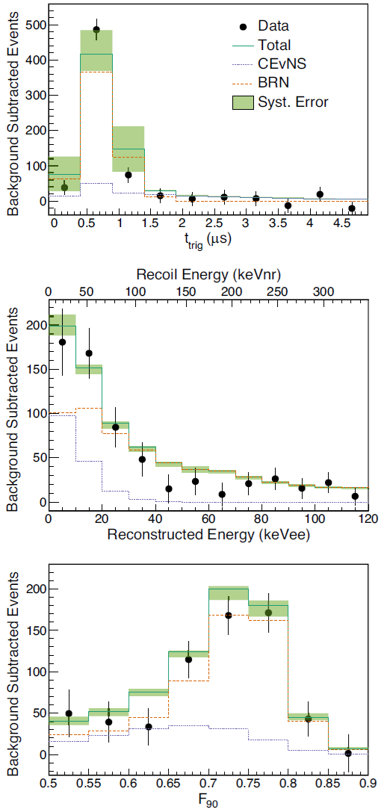
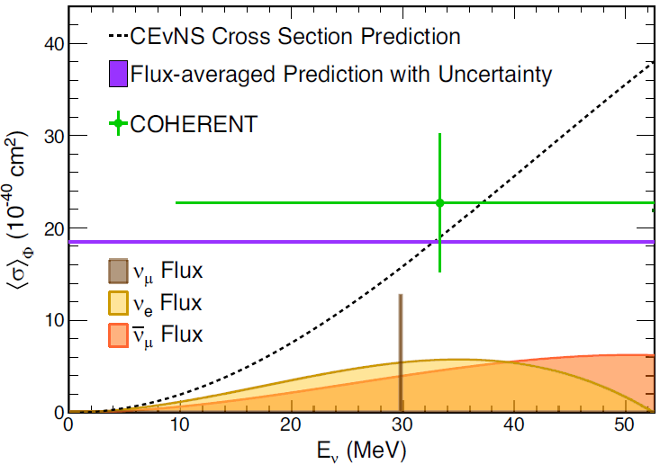

Argon CEvNS
This is a three-dimensional analysis in time, energy and pulse shape discrimination.
We found $159±43$ CEvNS events,
With a measured cross section of
$$\left(2.3±0.7\right)×{10}^{−39}{cm}^{2}$$
This is within 1 σ of the SM value of $1.8×{10}^{−39}{cm}^{2},$
And the null hypothesis is excluded at 3.5 σ.
Pulse Shape Discrimination Parameter
PRL 126, 012002 (2021)

Slide 15
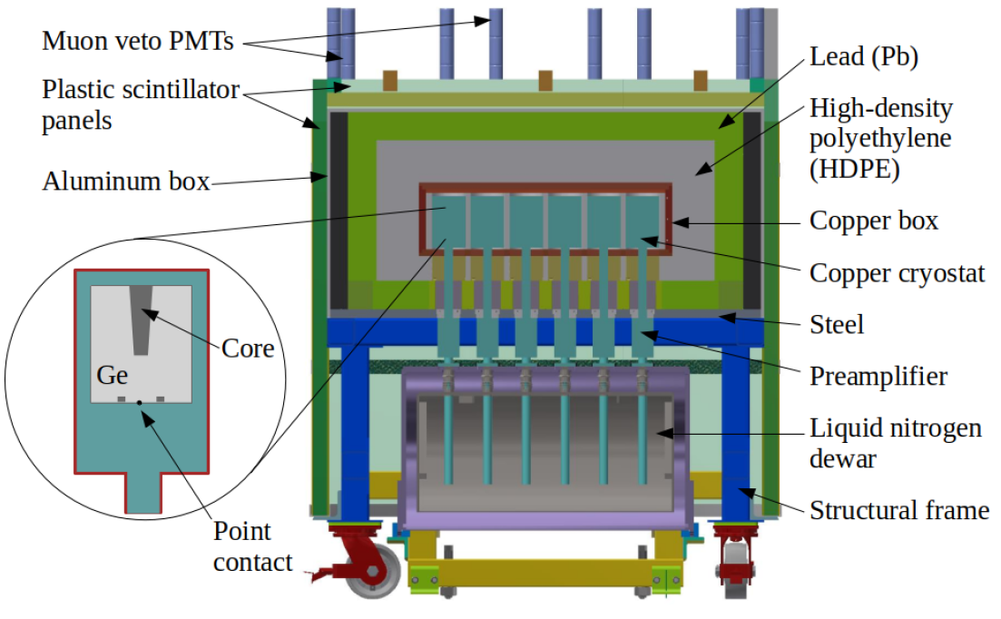
Germanium Detectors
The Ge-Mini is an array of eight 2.2 kg Inverted Coaxial Point Contact detectors in a low-background cryostat.
This started taking data in June 2023.
Reported first CEvNS measurement this year…

Slide 16
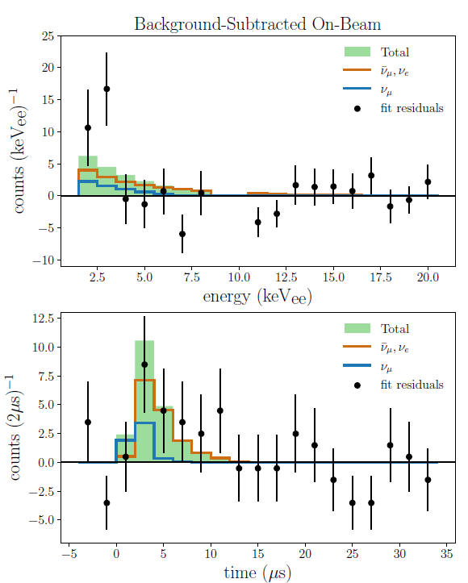
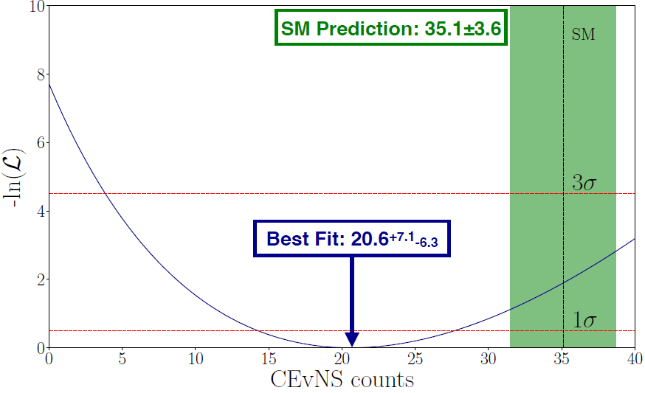

Germanium CEvNS
We released a first look analysis of our Ge-Mini detector in June based on 10.22 GWhkg.
We found a beam-on excess of ${20.6}_{−6.3}^{+7.1}$ events.
This result rejects the no-CEvNS hypothesis at 3.9 σ.
And it agrees with the Standard Model within 2 σ.
But it’s a bit lower than the SM expectation.
Preliminary
Preliminary
arXiv:2406.13806

Slide 17
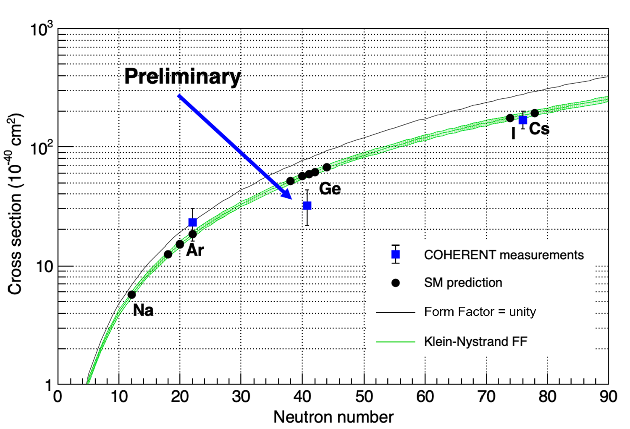
Current State of CEvNS Measurements

Slide 18
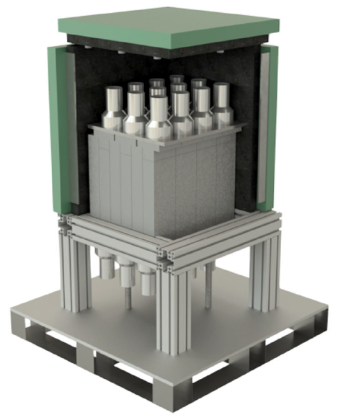
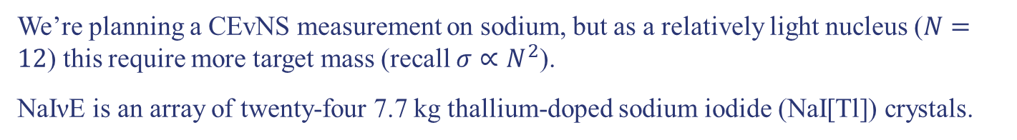
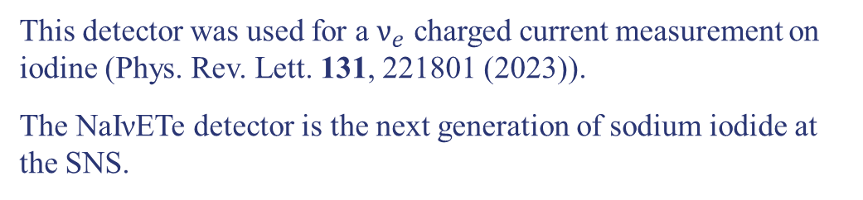
Sodium Iodide
We’re planning a CEvNS measurement on sodium, but as a relatively light nucleus ($N=12$) this require more target mass (recall $σ∝N^{2}$).
NaIνE is an array of twenty-four 7.7 kg thallium-doped sodium iodide (NaI[Tl]) crystals.
This detector was used for a $ν_{e}$ charged current measurement on iodine (Phys. Rev. Lett. 131, 221801 (2023)).
The NaIνETe detector is the next generation of sodium iodide at the SNS.
NaIνETe
Ultimately it will be 2.45 tons of NaI[Tl] crystals.
It is being deployed in stages while taking useable physics data.
NaIνE
Stay tuned for first CEvNS cross section on sodium. Will be the lightest nucleus to date!

Slide 19
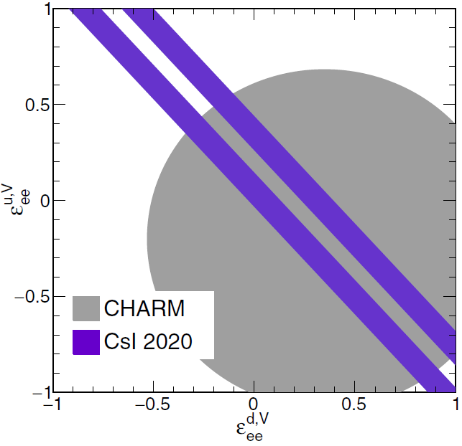
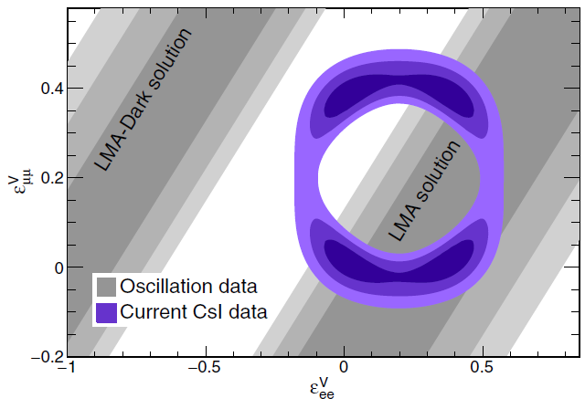

Constraints on BSM Physics
These COHERENT CEvNS cross section measurements on different nuclei test the SM prediction $N^{2}$ scaling.
They can also be used to place tight constrains on non-standard interactions.
These constraints will improve as the CEvNS cross section uncertainty comes down.

Slide 20
Conclusions/Final Thoughts
COHERENT has observed coherent elastic neutrino nucleus scattering (CEvNS) in three different nuclear mass ranges (Ar, Ge and Cs/I)
These are the only undisputed observations of this standard model process, first predicted 50 years ago.
We are using these measurements for increasingly more precise test of the standard model, and to search non-standard neutrino interactions.
We’re also studying neutrino charged current process on nuclei that have never been seen before, including iodine and lead.
New charged current results are expected soon for nuclei including thorium, sodium, germanium and oxygen.
Beyond the SNS, CEvNS will prove to be an important process to measure neutrinos from nuclear reactors and supernovae to name a few examples.

Slide 21


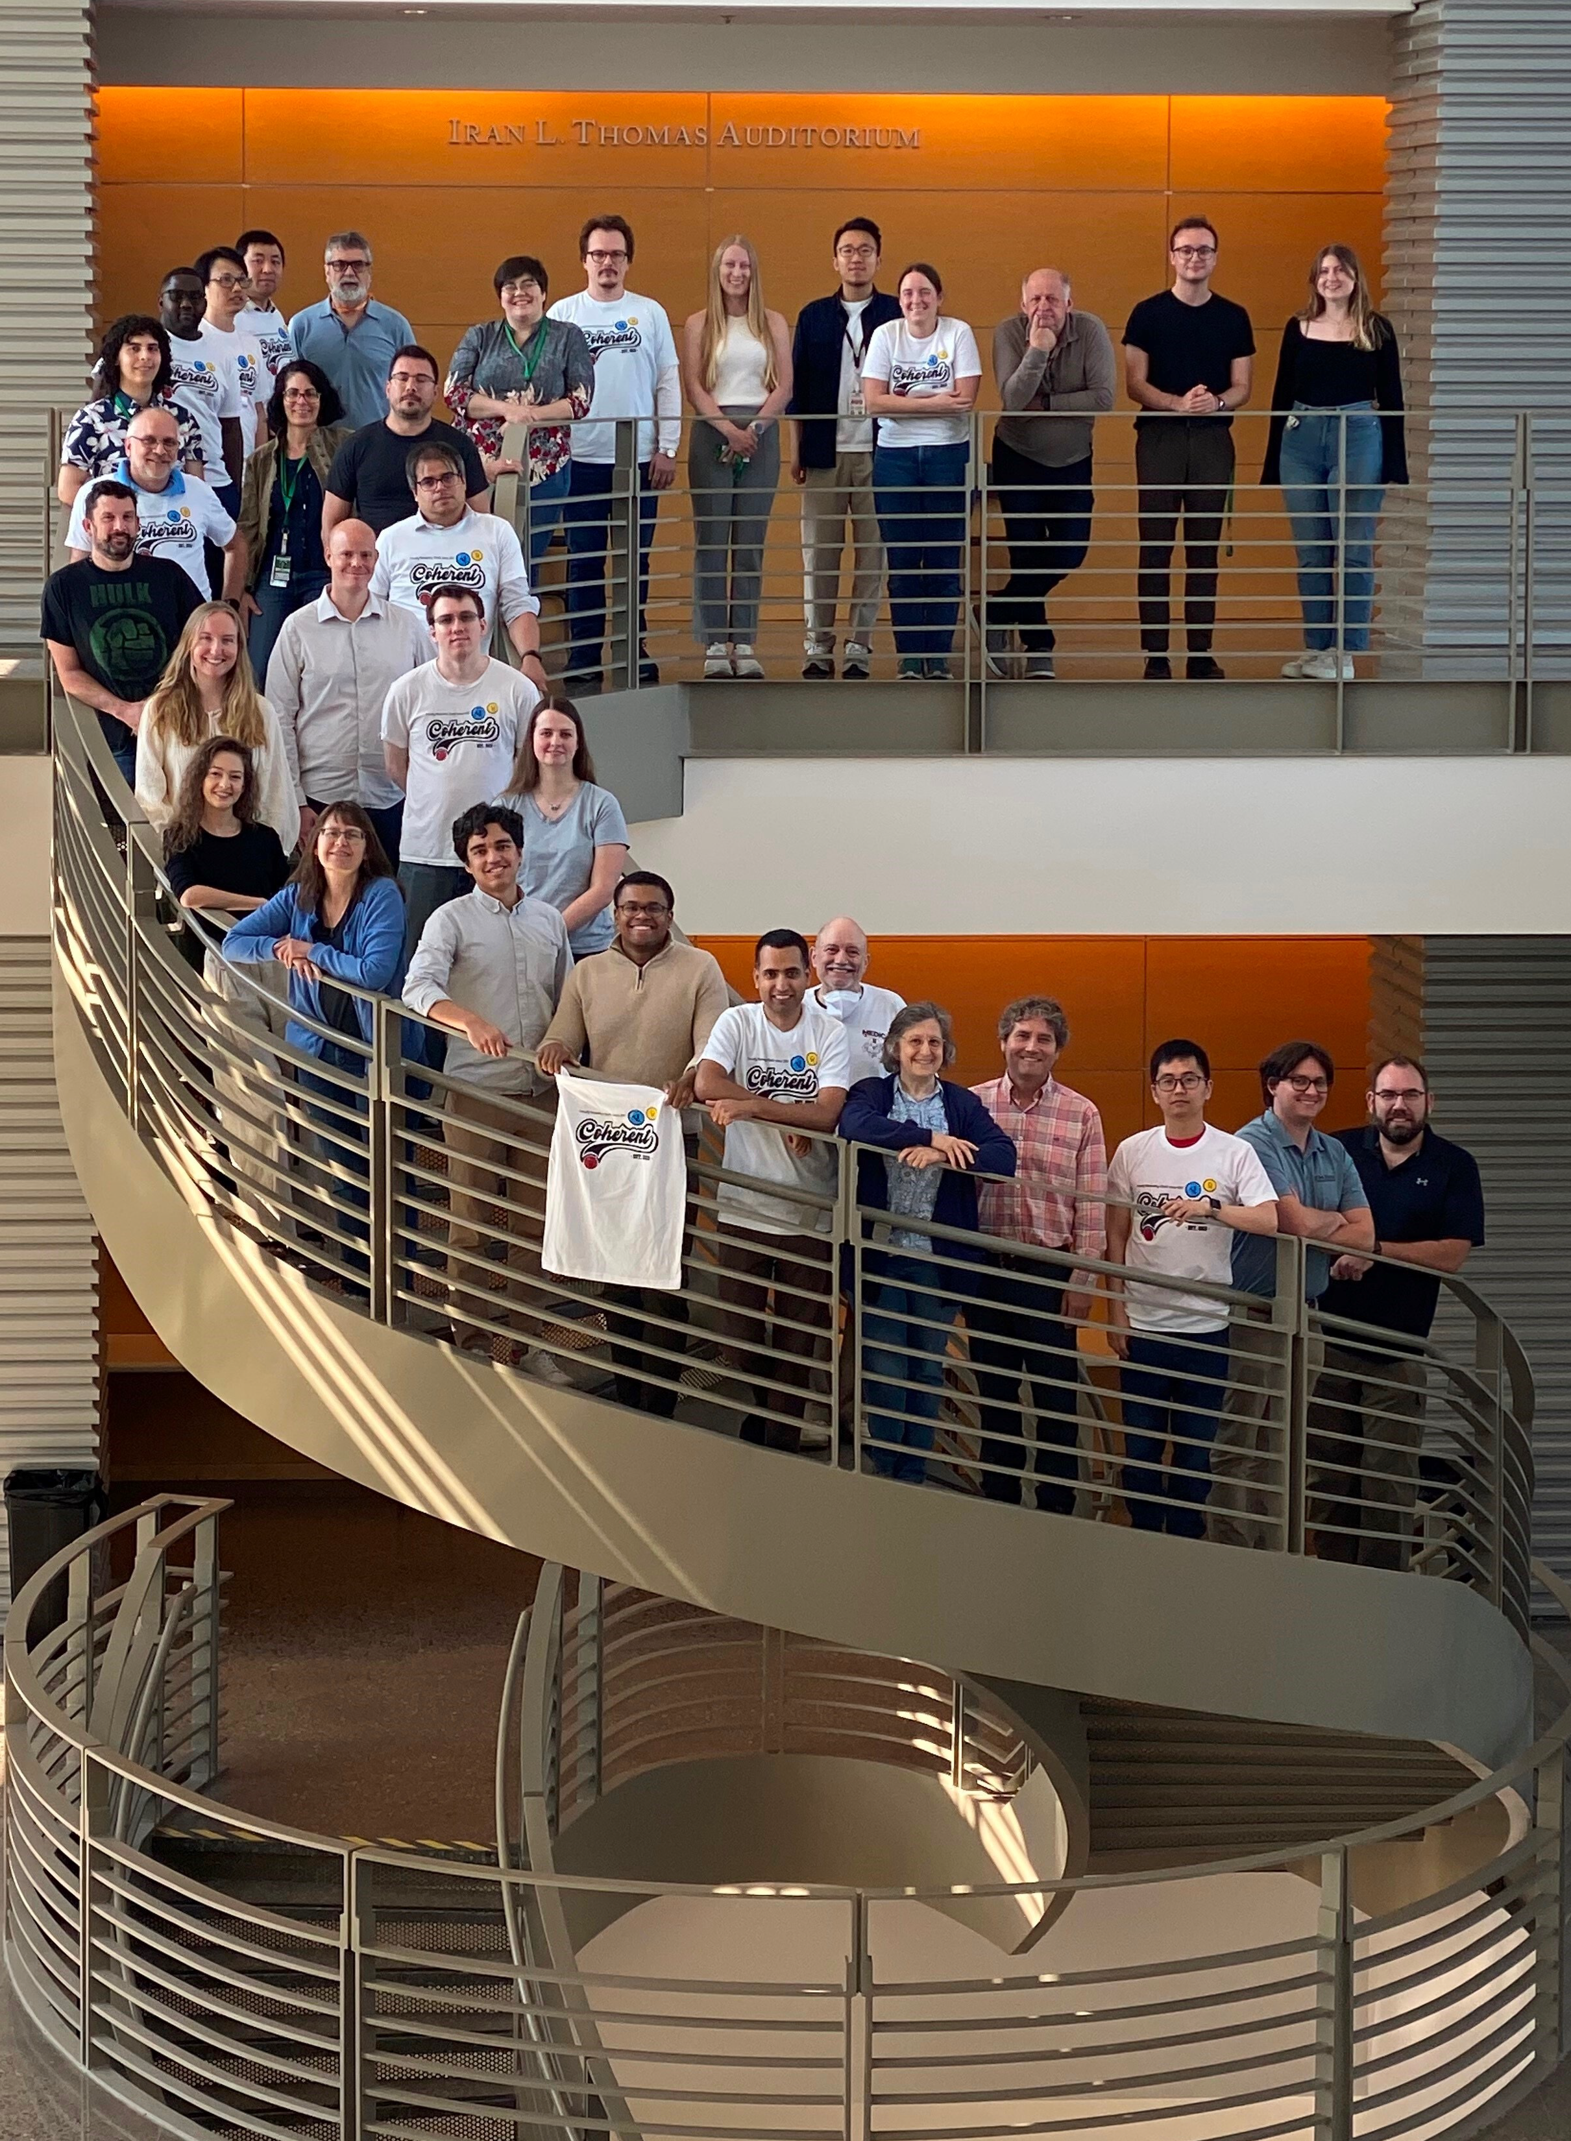

























The COHERENT Collaboration

