Slide 1
MUSIC Survey
Yash Makkena, Mrinal Save, Kelly Tran, Mehmet Yuksel
CS4624: Multimedia, Hypertext, and Information Access (13033, Spring 2020)
Instructor: Edward A. Fox
Virginia Tech, Blacksburg VA 24061
May 12, 2020
Notes:
Mehmet

Slide 2
Outline
Project Implementation
Database
Access Code
Queries
Visualization
Testing
Challenges
Future Work
Acknowledgments
Notes:
Mehmet

Slide 3
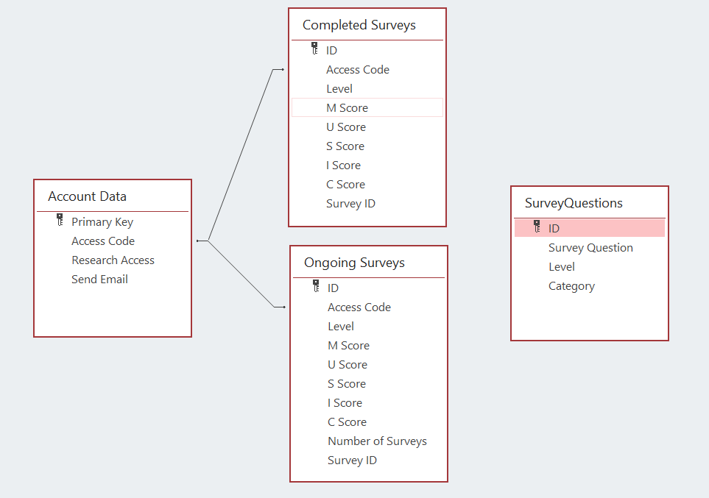
Database Relationships
Notes:
Mehmet

Slide 4
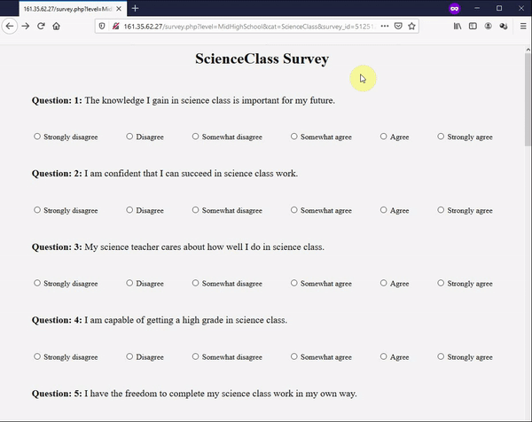
Survey Page
Survey questions are pulled from the database according to the link provided by teacher.
http://161.35.62.27/survey.php?level=MidHighSchool&cat=Activity&survey_id=5125123
http://161.35.62.27/survey.php?level=MidHighSchool&cat=ScienceClass&survey_id=5125123
Notes:
Mehmet

Slide 5
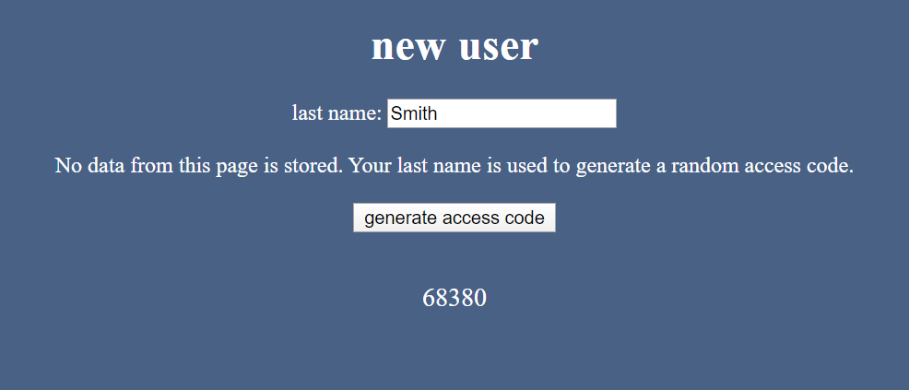
Access Code
Previously was username/password
Hashing
Notes:
Mrinal

Slide 6
Queries
Displaying survey questions
Computing the MUSIC score
Notes:
Yash
Most of our HTML pages relied on PHP queries to either POST/ GET/ DELETE from our databases.
There are a few major queries that are the basis of our project that I’m going to talk about.

Slide 7
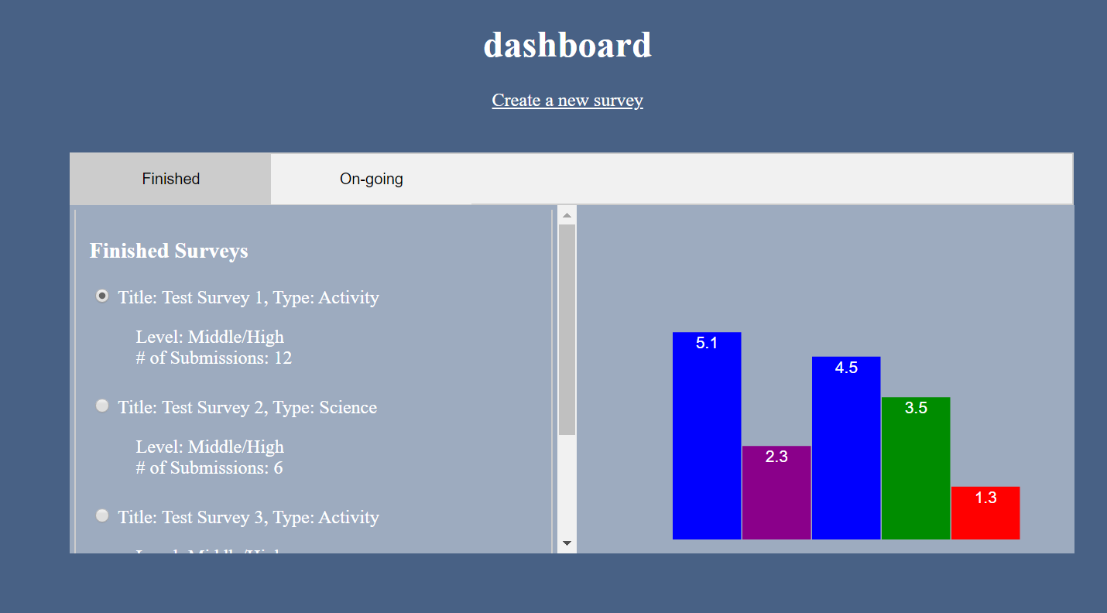
Visualization
Link to Visualization Demo: https://youtu.be/9vVDFxEiJkE
Notes:
Yash

Slide 8
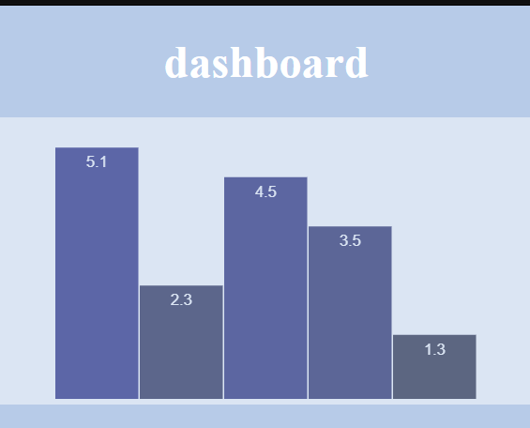

Testing
Visualization
Local vs. client-side
Notes:
Yash

Slide 9
Challenges
HTML formatting
Communication with client
Notes:
Mrinal

Slide 10
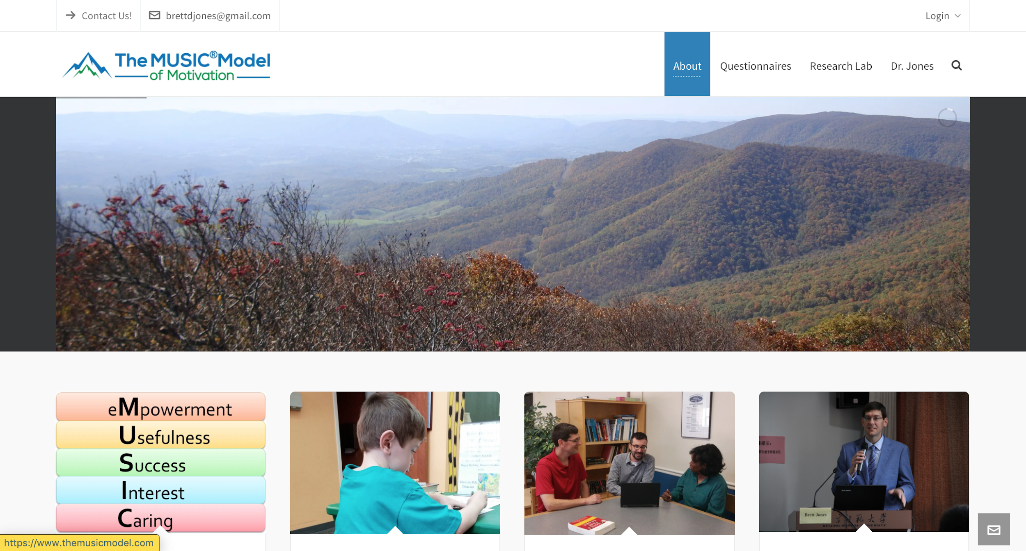
Work to be Completed
Integration into the site
Final testing
Notes:
Kelly
Visuals will be updated upon integration to website

Slide 11
Future Work
Cleaner design
Collision reduction
Multiple submissions
Notes:
Mrinal

Slide 12

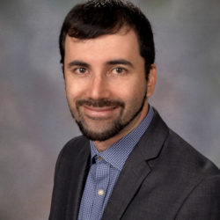
Acknowledgements
Brett D. Jones, Professor, Educational Psychology Program, School of Education, Virginia Tech
Juan M. Cruz, Assistant Professor, Experiential Engineering Education Department (ExEED), Rowan University
Notes:
kelly

Slide 13
References
[1] B. Jones, “MUSIC Model of Motivation,” MUSIC Model of Motivation. [Online]. Available: https://www.themusicmodel.com/. [Accessed: 06-May-2020].
[2] “Bluehost,” Bluehost. [Online]. Available: https://www.bluehost.com/. [Accessed: 06-May-2020].
[3] B. Jones, “User Guide for Assessing the Components of the MUSIC ® Model of Motivation”. [Accessed: 06-May-2020].
Notes:
kelly

Slide 14
Questions?
Notes:
Kelly

