Slide 1
CS5604: Information Storage and Retrieval
Collection Management Tobacco Settlement Documents
December 5, 2019
Virginia Tech, Blacksburg, VA - 24061
Instructor: Dr. Edward A. Fox
TA: Ziqian Song
Team: Alon Bendelac, Andrei Svetovidov,
Ashin Marin Thomas, Debasmita Biswas,
Sushmethaa Muhundan, Yan Zhao

Slide 2
Outline
Background
Objective
Approach
Metadata Processing
Text Processing
OCR Comparison
Future Work
References

Slide 3
Background

Slide 4
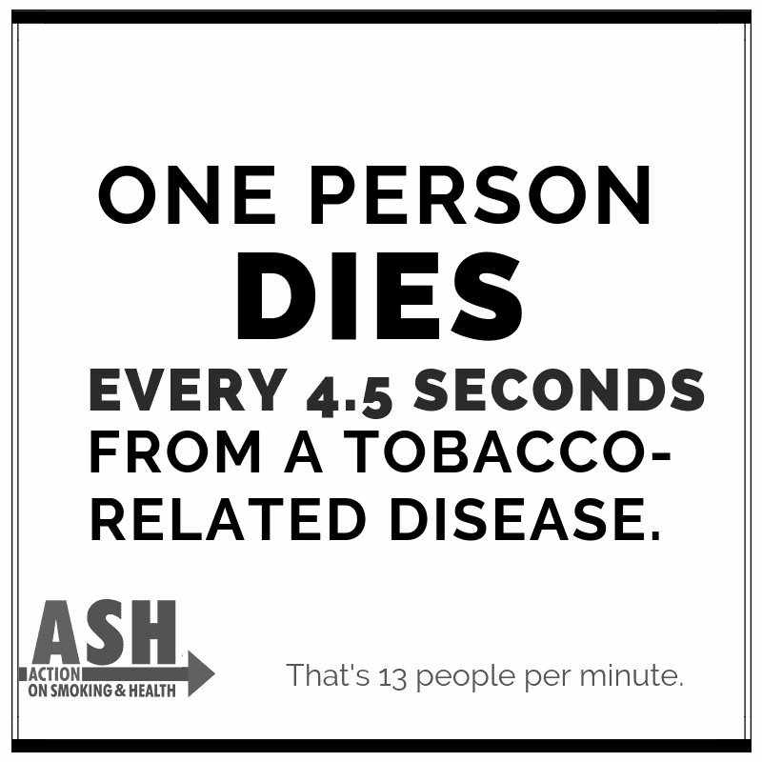

How Do You Sell Death?

Slide 5
Dr. Townsend’s Research
Understand the organizational strategies and corporate tactics employed by tobacco companies to fight through the Tobacco Settlement Cases
Be able to construct a timeline and uncover the most prominent characters and analyze the roles they have played in these cases

Slide 6
UCSF Industry Documents Library
Five industries: tobacco, drug, chemical, food, fossil fuel
14M tobacco documents that were produced during litigation between 39 states and the seven major tobacco industry organizations
Bulk of documents date between 1950 - 2010
Documents have been OCR’ed and managed using MySQL database

Slide 7
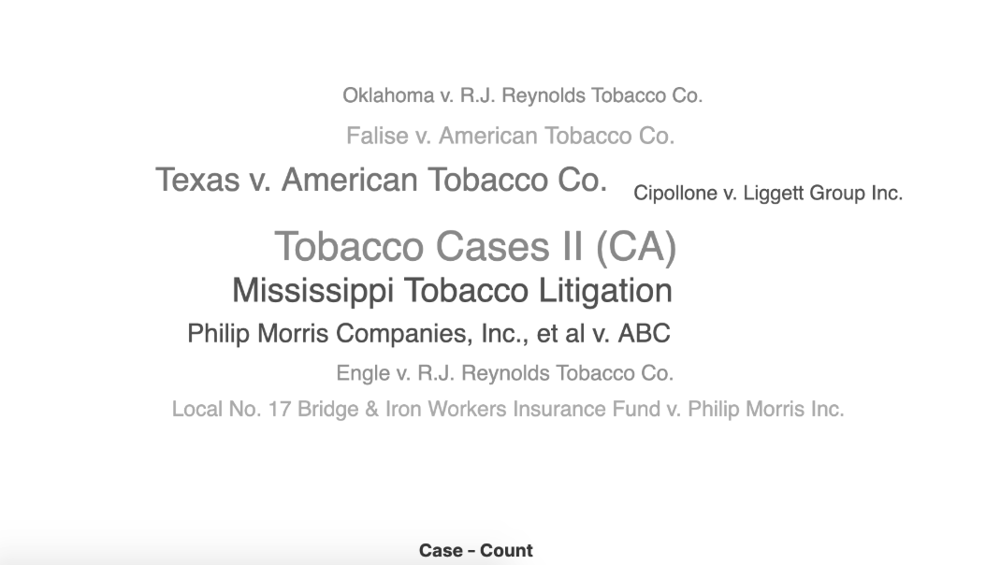
Top 10 cases

Slide 8
Objective
Process the 14 million Tobacco Settlement Documents
Clean and extract meaningful data from the documents
Build an efficient information retrieval system
Aid Dr.Townsend’s research

Slide 9
Approach

Slide 10
Progress
Enable full-text searching
Compare alternate OCR methods
Work on ingesting new data into the system
Combine data with metadata + OCR comparison + Ingestion of new data
Extract metadata for all 14M documents
Close to 72,000 document types; impractical to go type by type
Optimized our script to extract metadata 1 million at a time!
Determined various document types
Created Python scripts to extract metadata for deposition documents
Simultaneously started working on cleaning, lemmatization and tokenization of data for TML team to consume
Extract metadata for deposition documents + Pre-process data
Understand structure
of data
No proper documentation
Contacted UCSF developers for details regarding the data

Slide 11


Flowchart
ELS Team
Metadata
Metadata + Data
Cleaned data
TML Team

Slide 12
Deliverables
The metadata and data processed are stored in Ceph for the other teams to consume
/mnt/ceph/shared/tobacco
  metadata
  data

Slide 13
Metadata Processing
Notes:
Alon

Slide 14
Metadata Processing
Overview
  Metadata is managed in a MySQL database
  Each document is defined by a numerical ID
  For each document, the metadata consists of a set of key-value pairs
Goal
  Transform metadata from MySQL database to a collection of JSON files in Elasticsearch format
Notes:
Alon

Slide 15
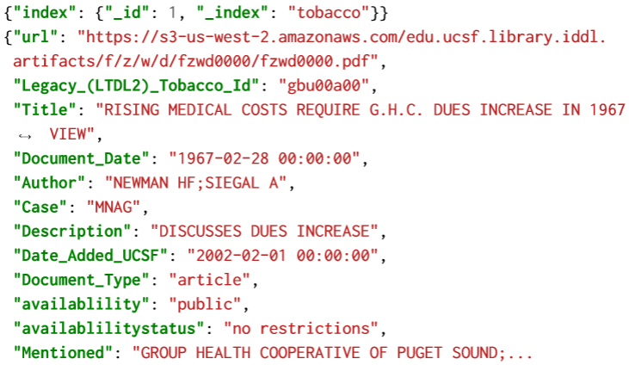
Metadata JSON Format for Elasticsearch
Header
Key-value entries

Slide 16
Metadata Processing Approach
MIN_ID, MAX_ID
Metadata Processor
Metadata JSON
Metadata for doc IDs 0-1M
Metadata for doc IDs 1M-2M
...
Metadata for doc IDs 14M-15M
Notes:
Provided the URL and date formatting required by the ELS and FEK team to link the documents

Slide 17
Metadata Processor Pseudocode
Goal: Print metadata entries for documents with ID between MIN_ID and MAX_ID
Connect to DB
Retrieve all metadata entries for documents with ID between MIN_ID and MAX_ID, ordered by ID
While there are entries left:
  Print header (identifying next document)
  Print “{“
  For each key-value pair for next doc ID, print “<key>: <value>”
  Print “}”
Notes:
Alon

Slide 18
Text Processing

Slide 19
Text Processing - Overview
Text processing is a crucial part in preparing stored documents for further digestion by other systems. It involves:
Text cleaning
Text preprocessing
Format adjustment

Slide 20
Document Text Cleaning - Overview
Why cleaning is necessary?
Characters in documents which can represent noise for ML approaches (line numbers, page numbers, excessive spaces, etc.)
Service symbols generated after OCR processing (\n, \r, etc.)
Garbage characters appeared as a result of low quality of OCR (handwritten notes and OCR artifacts)

Slide 21
Document Text Cleaning - Algorithm
Read .ocr files from the collection one-by-one (using record keys)
Represent the file as a set of lines
Modify lines, deleting unnecessary characters
Reassemble and save file in a specified directory
…
…
…
…
Cleaning algorithm
Folder 1
ffbb0000
ffbb0000 cleaned
Folder 1
cleaned

Slide 22
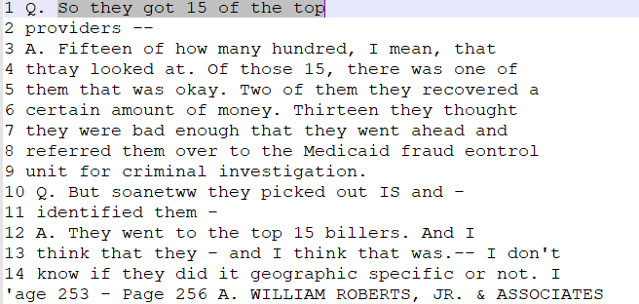
Line Numbers Removal
Before
vs.
After

Slide 23
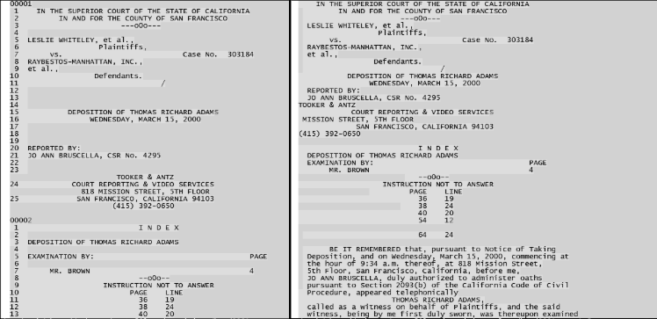
Page and Line Numbers Removal
(Before vs. After)

Slide 24
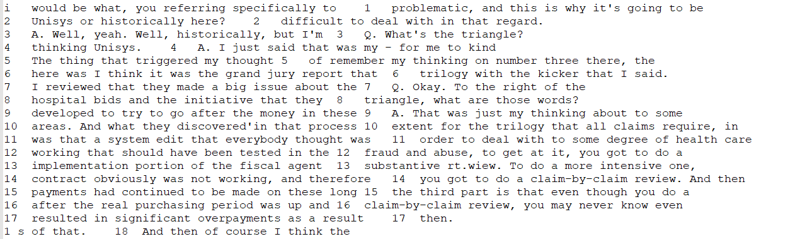
Limitations: Line Numbers within Text

Slide 25
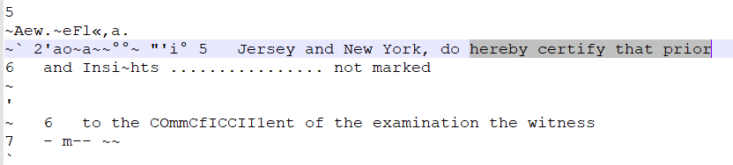
Garbage Characters Removal
Before
vs.
After

Slide 26
Document Text Preprocessing - Overview
Some of ML algorithms require normalized text data instances.
Text preprocessing includes:
Tokenization (splitting texts into lexical entities - tokens)
Lemmatization (bringing the tokens into their initial lexical form)
Concatenation of lines in documents of ‘Q&A’ type (for instance, articles)

Slide 27
Results of Tokenization

Slide 28
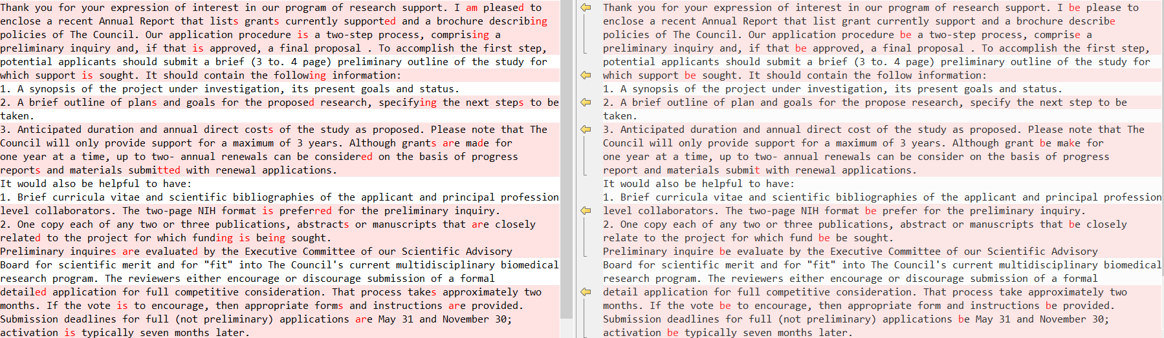
Results of Lemmatization - Before vs. After

Slide 29
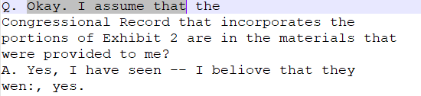
Concatenation of Q’s and A’s - preliminary results
Before
vs.
After

Slide 30
Format Adjustment - Overview
All the preprocessed text need to be transformed into the format that is digestible by the end system (used in search engine). The following steps are required:
Concatenate lines
Concatenate pages
Convert files to JSON format
Add text field to metadata JSON file
Extract data from OCR files

Slide 31
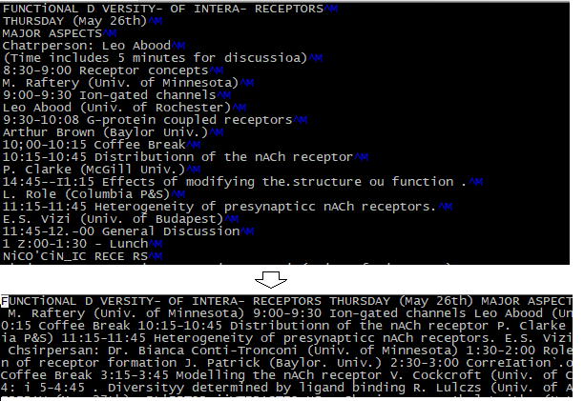
Concatenation
Before
vs
After
Before
vs.
After

Slide 32
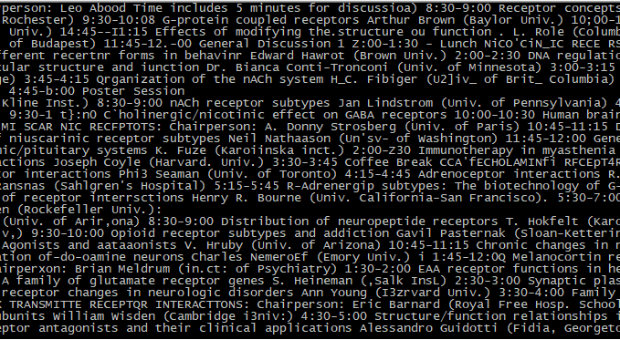
Extract text from OCR files
Page 1
Page 2
page3
“text”:”XXXX”

Slide 33
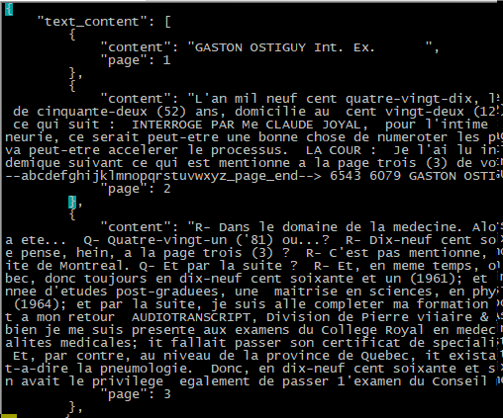
Converting file to JSON format
“Text_content”:[
{“page”: 1,
“content”:”xxxx”},
{“page”: 2,
“content”:”xxxx”}]

Slide 34
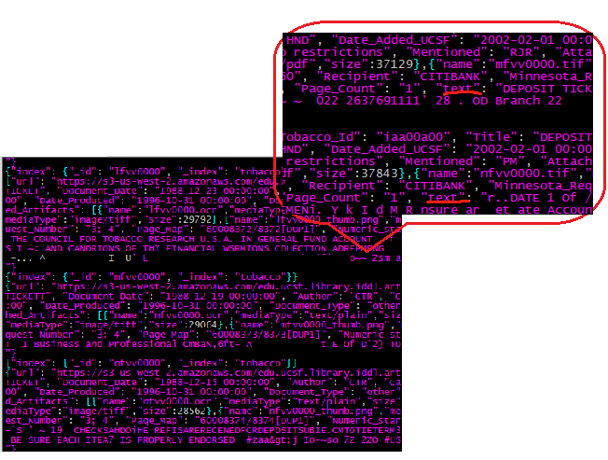
Adding Text Field to Metadata JSON
“text”:”XXXX”

Slide 35
Text Processing - Deliverables
Text cleaning:
Documents of ‘deposition’ type were cleaned (with line number removal)
Millions of documents were cleaned (without line removal) and formatted (concatenated lines and pages)
Text preprocessing:
A small subset of documents (depositions) was tokenized and lemmatized as requested by TML
Format adjustment:
Depositions and articles files provided in JSON format
Metadata with text fields for ELS Team

Slide 36
Unit Testing : JSON Validation
Validation script written to check the contents of the JSON files provided to the ELS team.
This ensures that the JSON provided will not fail at a later point during ingestion.

Slide 37
OCR Comparison

Slide 38
Motivation for OCR Comparison
Documents OCR’ed with a proprietary tool by UCSF
  Documents come in a variety of formats
  Does not work well for documents with special format (e.g., multi-column, tables)
  Creates garbage characters from handwritten text
Alternative open-source OCR methods explored:
  PyPDF2
  PDFMiner
  Abbyy Cloud OCR
Goal
  Compare different OCR methods across different document formats that represent the whole collection of documents

Slide 39
Performance on different types of documents
 | UCSF | PyPDF2 | PDFMiner | Abbyy Cloud OCR
Two Column PDFs | Poor to Average (comparable to pdfminer) | Poor | Average (comparable to UCSF) | Good
Newspaper Articles | Very poor | Extremely poor / No result | Very poor | Average
Tables | Average (comparable to pdfminer) | Poor | Average (comparable to UCSF) | Excellent
Plain texts, letters | Excellent | Good | Excellent | Excellent
Handwritten Texts | Very Poor | Extremely poor | Very Poor | Poor to Average

Slide 40
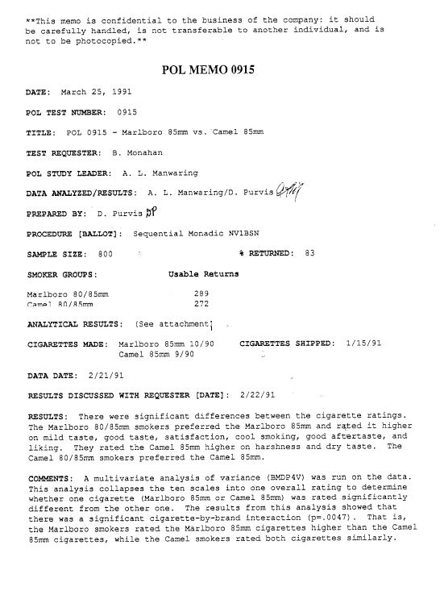
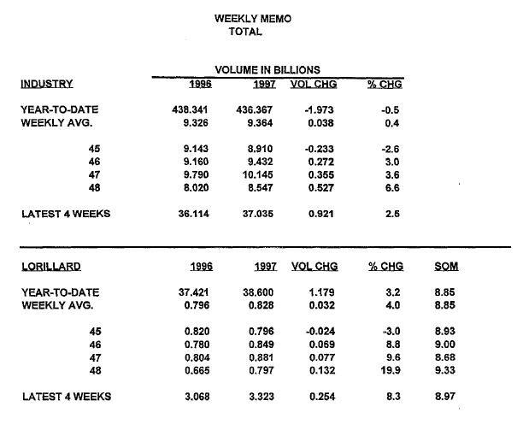
Original Documents
Document A: frlf0127
Document B: gpny0069

Slide 41
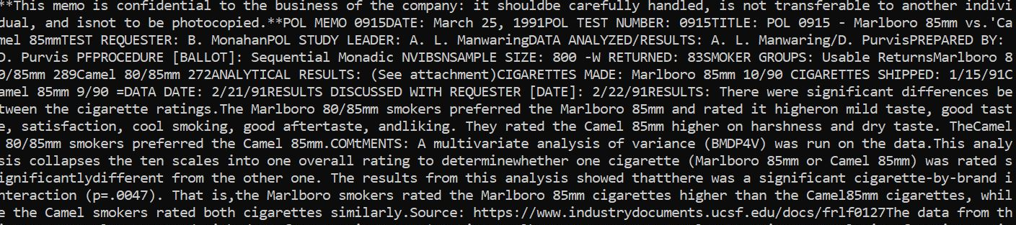
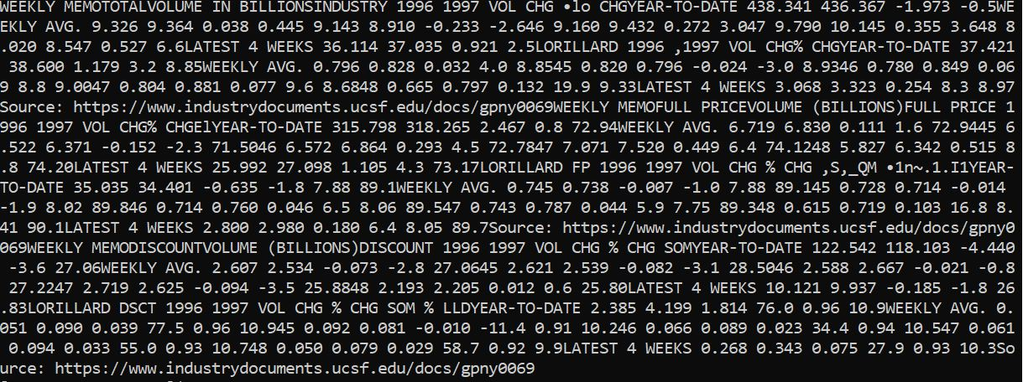
PyPDF2
Document A: frlf0127
Document B: gpny0069

Slide 42
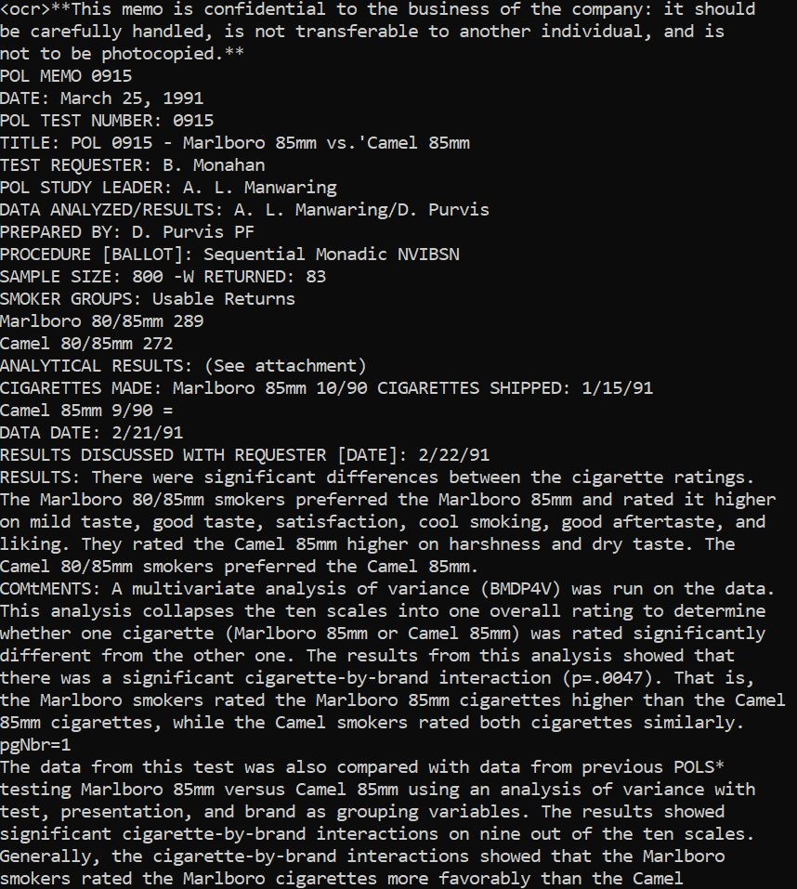
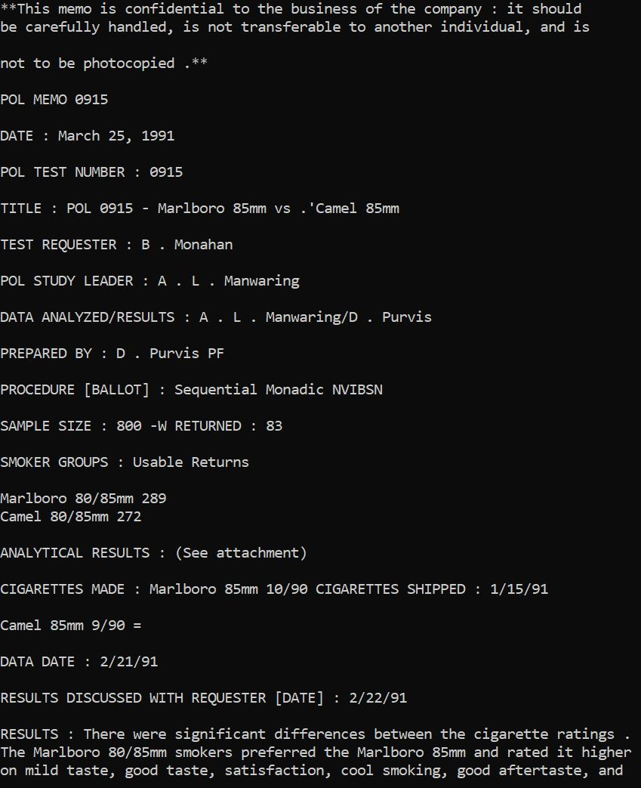
Document A: frlf0127
UCSF
PDFMiner

Slide 43
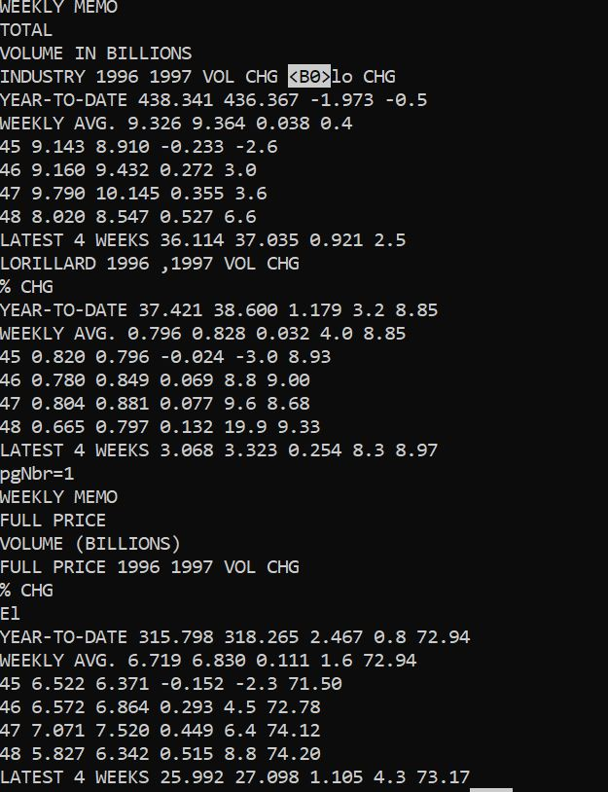
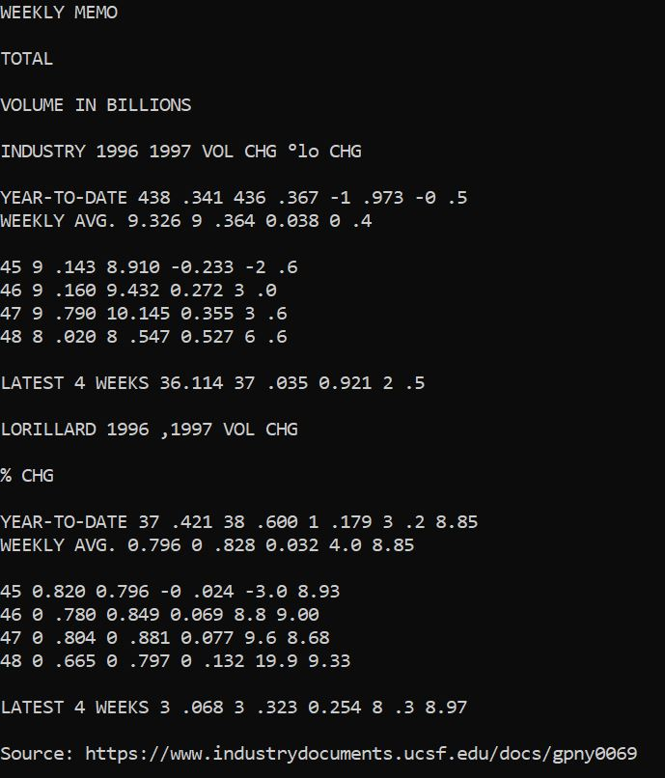
Document B: gpny0069
UCSF
PDFMiner

Slide 44
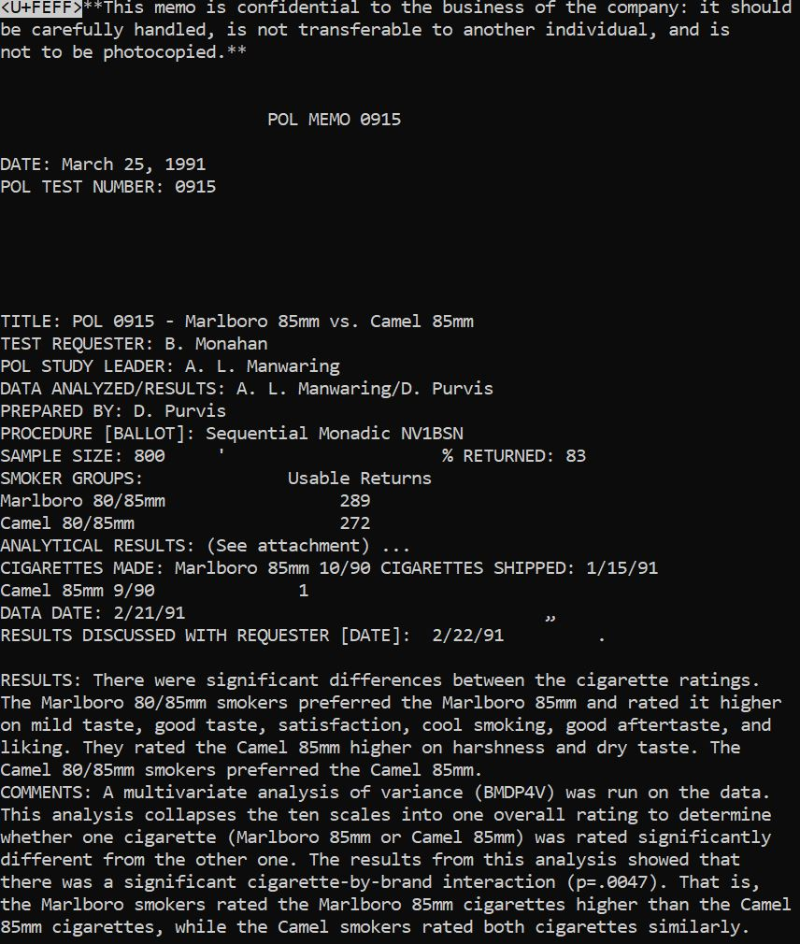
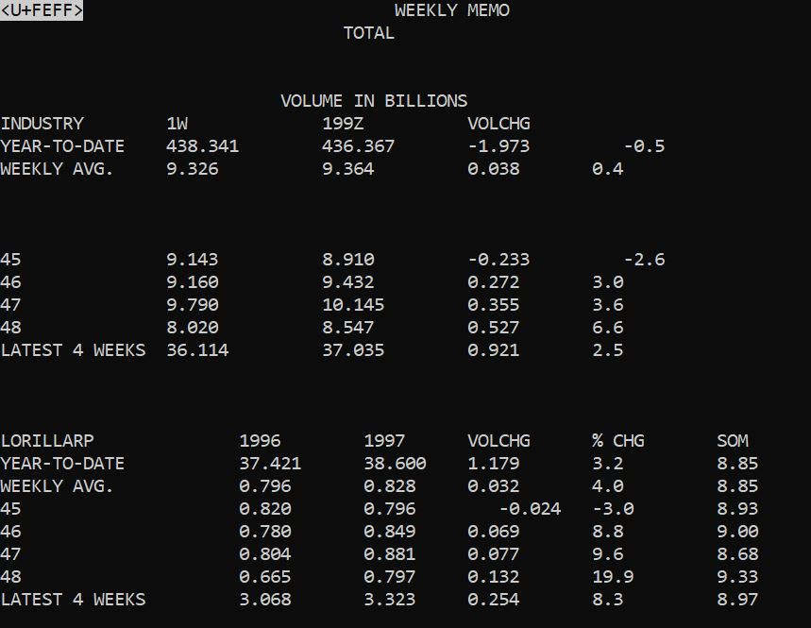
Abbyy Cloud OCR
Document A: frlf0127
Document B: gpny0069

Slide 45
Performance Based on Time & Cost
 | UCSF | PyPDF2 | PDFMiner | Abbyy Cloud OCR
Time | Unknown | Good | Good | Average (depending upon server speed)
Cost | Unknown | None | None | Paid

Slide 46
VM independent Metadata & Data retrieval for INT

Slide 47
Approach
Problem: Addition of new tobacco files to the system in the future.
Constraint:
Inaccessibility of the database hosted on the tobacco.cs.vt.edu from the Computer Science Cluster used by the Integration team.
Inability to set up Kafka in time.
Interim Work Around:
Creation of a demo folder outside the VM containing instances of metadata files, PDFs & text editable content of tobacco documents.
Python script to pick metadata and data from these files and parse them into JSON format matching the one for tobacco files currently present on the VM.

Slide 48
Implementation
Choose a set of dummy Tobacco Files:
  Retrieve their metadata from the current DB and pull into a CSV file on local machine
Convert metadata to JSON:
  Build Python script to-
    Merge the CSV files of the tables idl_doc_tobacco and idl_doc_field based on common ID values; and export results into new CSV file ‘output.csv’.
    Store itag descriptions in an array ‘itag_array’
    Pick data from the columns of ‘output.csv’ that contain the Itag and Value associated with a document ID; retrieve corresponding itag description based on itag_array.
    Parse the data into desired JSON format and store into a new file ‘output.json’.
Convert Data to JSON:
  Build Python script to-
    Download PDFs corresponding to each record key and convert them into text editable files using Optical Character Recognition (OCR).
    Parse the contents of each text document into JSON format and store in separate files.

Slide 49
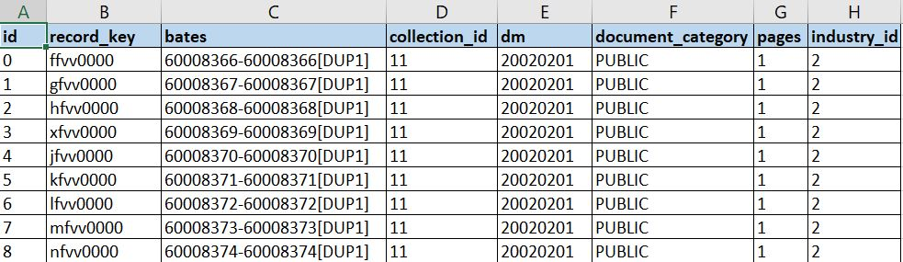
idl_doc_tobacco.csv

Slide 50
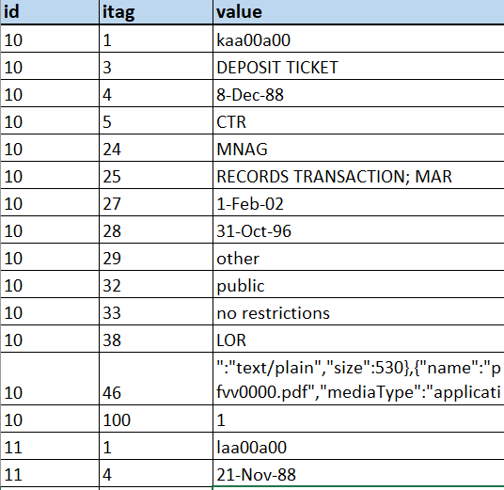
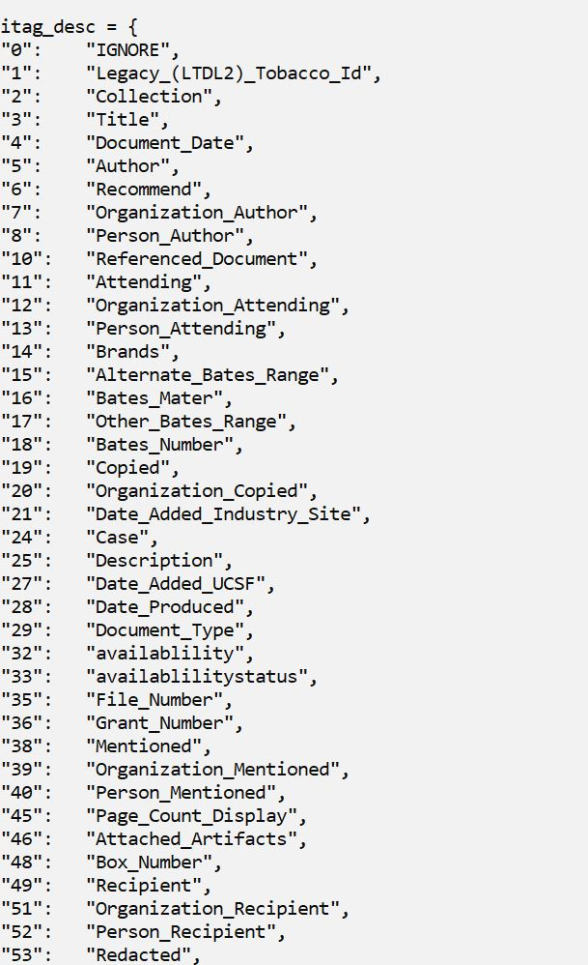
idl_doc_field.csv
Excerpt from Array containing metadata field descriptions

Slide 51
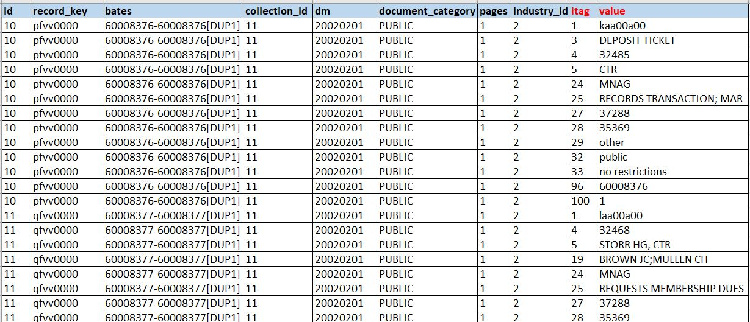
output.csv
CSV file obtained after merging idl_doc_tobacco.csv and idl_doc_field.csv

Slide 52
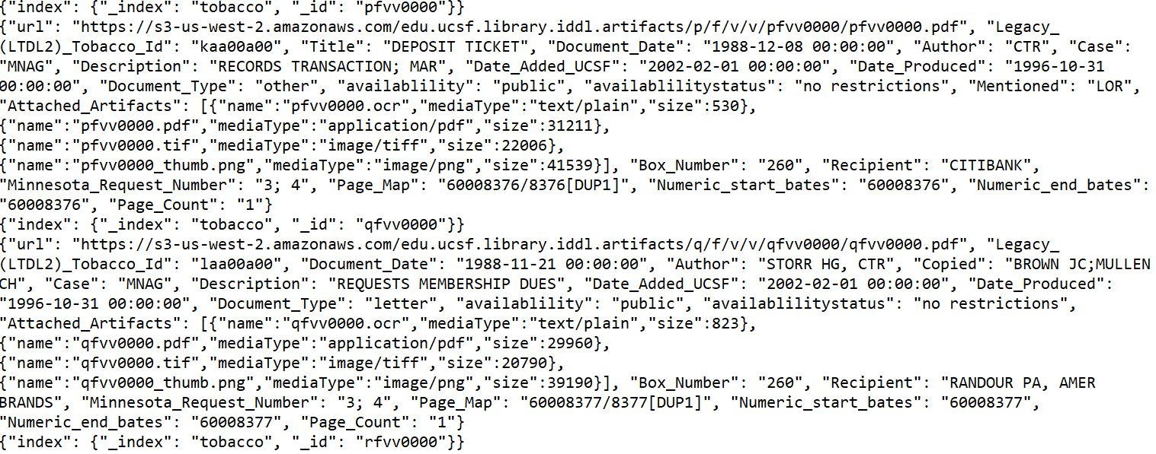
JSON file containing metadata

Slide 53
Future Work
Improve the text cleaning process (account for line numbers within the text and more precise identifying of garbage characters)
Add more test coverage for the scripts
Finalize the OCR method and apply it to the documents

Slide 54
Thank you

Slide 55
References
Truth tobacco industry documents - https://www.industrydocuments.ucsf.edu/tobacco/
Tobacco Tactics - https://tobaccotactics.org/index.php/Advertising_Strategy#cite_note-1
Tobacco Industry Marketing -Fast Facts and Fact Sheets: Tobacco Industry Marketing
Abbyy OCR SDK- https://www.ocrsdk.com/

Slide 56
Questions?

