Slide 1
MemoryModules
Sai Yerra, Abhishek Vishwanathan, Shalene Johnson, Rishon Elliott
CS 4624 Multimedia, Hypertext, and Information Access
Dr. Edward Fox
Virginia Tech, Blacksburg VA 24061
December 5, 2022

Slide 2
Outline
Lessons Learned
Work Left
Timeline
Acknowledgements
References
Project Background
Work Accomplished Overview
Video-Shooting Recap
Editing
Problems Faced

Slide 3

Project Background
Assisting Engagement Center for Creative Aging (ECCA)
  Helps those with cognitive issues such as dementia
  Provides clients with rehabilitation services
    Adult Day Services, Caregiver Wellness, Memory Masterclass
Promotional video deliverables
  Virtual Tour
  Interviews

Slide 4
Work Accomplished Overview
Virtual Tour
  Planned out technicalities
  Gathered Equipment
  Demo Videos
  Finished filming + Editing Tour
Interview
  Finished filming + Editing

Slide 5
Video-Shooting Recap
Virtual Tour
  GoPro Max 360 Camera
  Interior + outside patio of ECCA center
Interview Video
  Caregivers, staff, field study students
  Sony Handycam AX53 Video Camera
  Determine background setting
Questions Asked During the Interviews
Who are you and what is your role within ECCA?
Why/How did you get involved with ECCA?
How has engagement with ECCA impacted you?

Slide 6

Tour Video Editing
Adobe Premiere Pro
  In-built support for 360 Video
  Keyframing
  Equirectangular Projection
  Videographer cover & ECCA Logo
  Panning Video

Slide 7
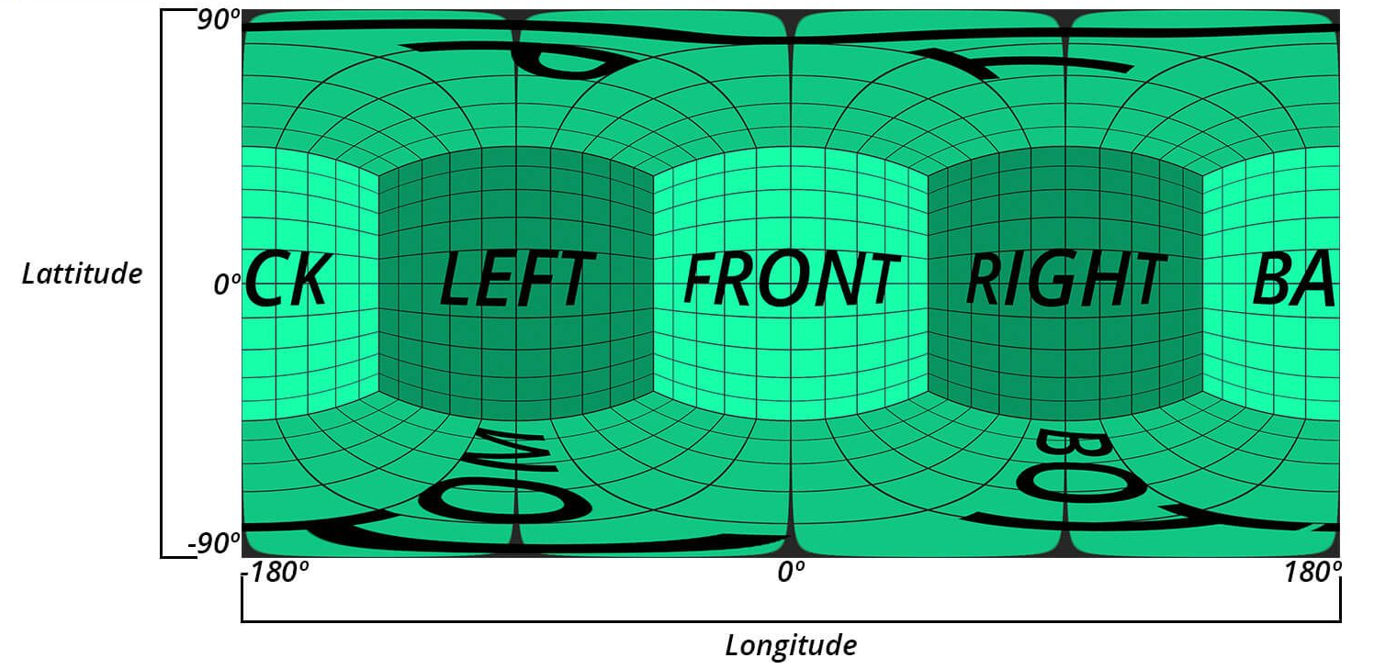
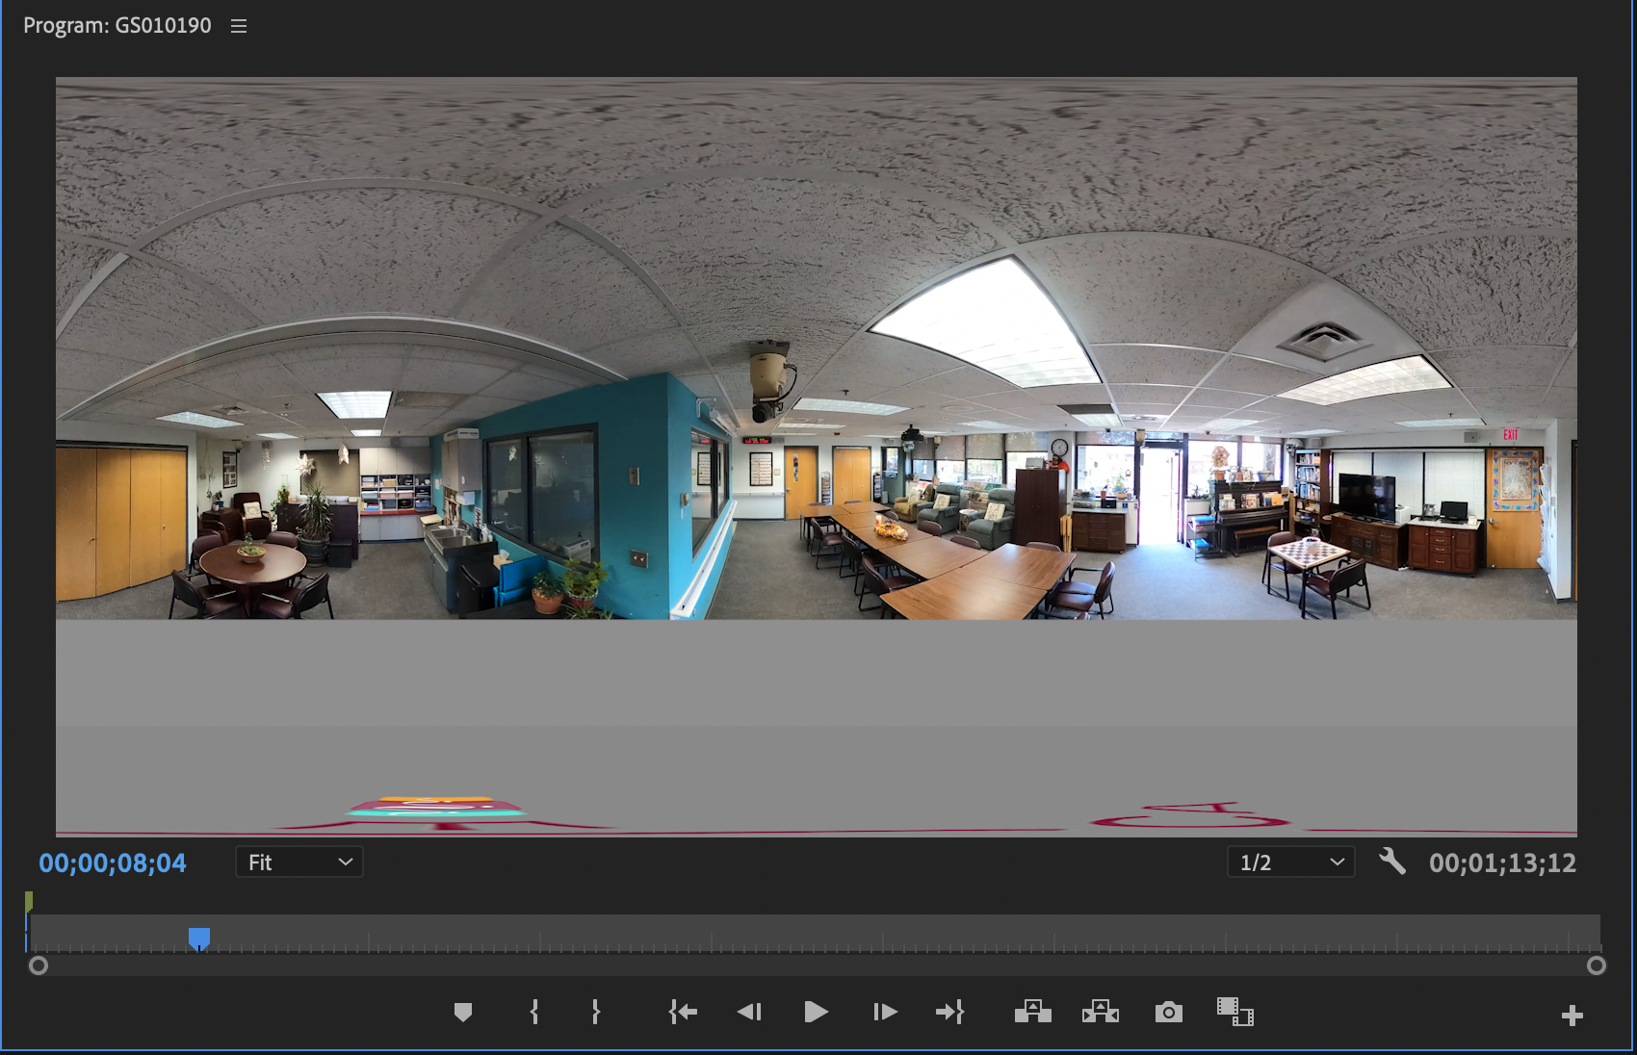
Equirectangular Projection

Slide 8
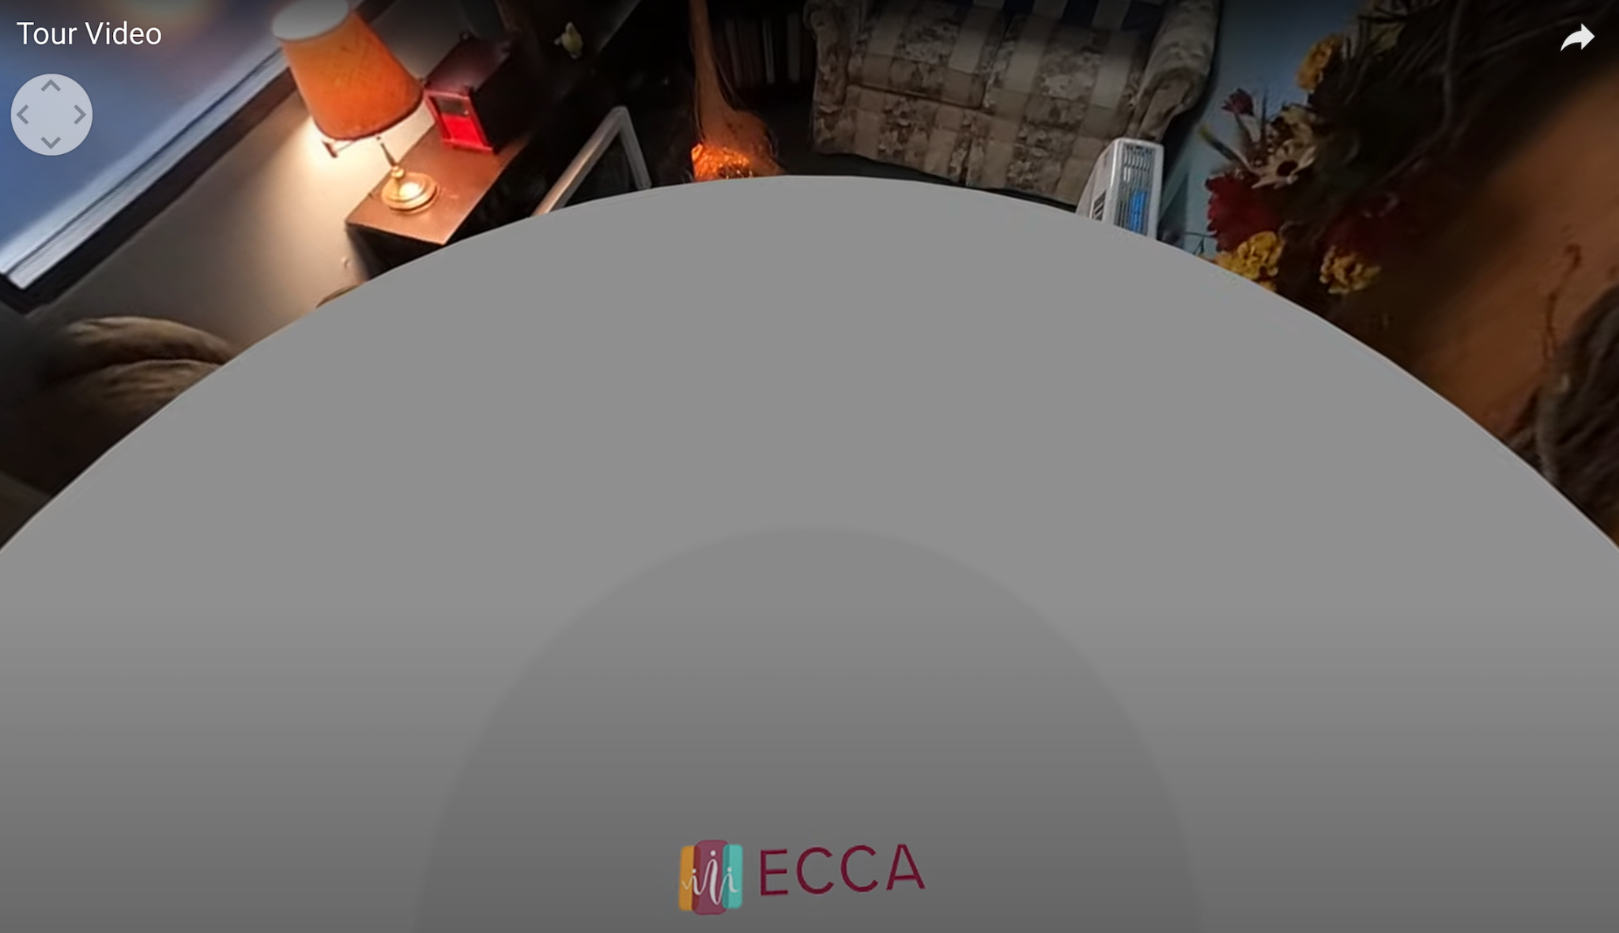
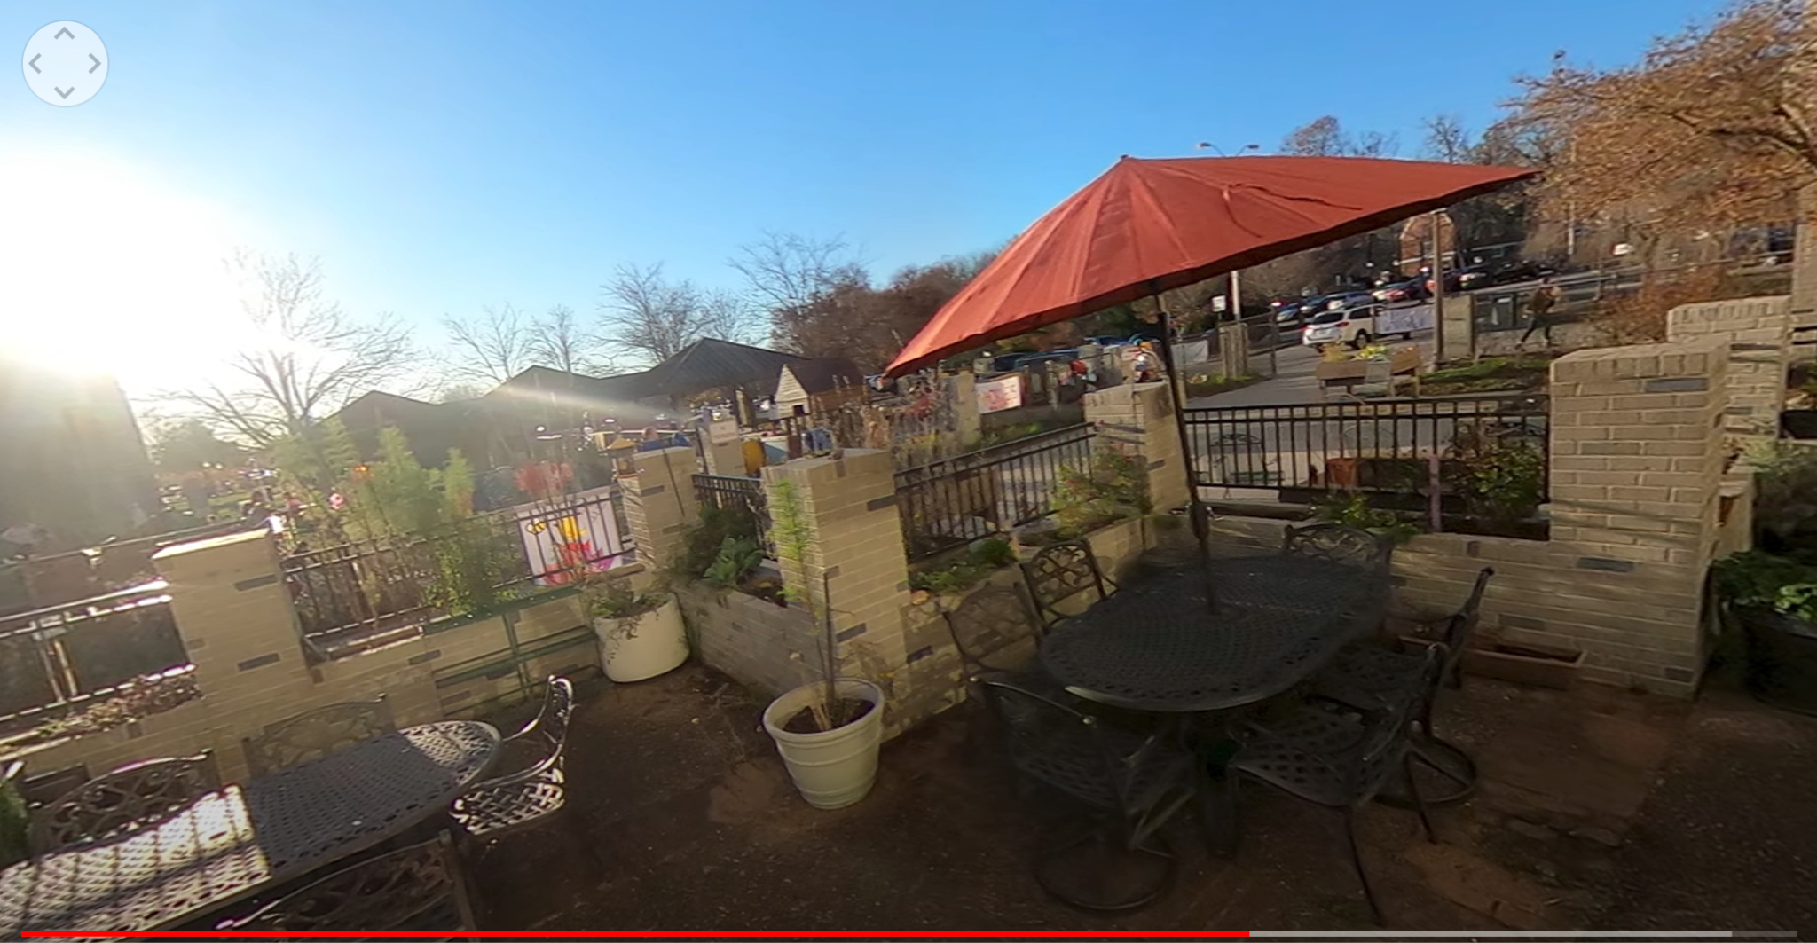
ECCA Logo 360 View

Slide 9

Interview Video Editing
iMovie
  Reduce background noise
  Straighten Video (Keynote)
  Question Split
  Choosing Videos
  Merging and Transitions
  Adding Text

Slide 10
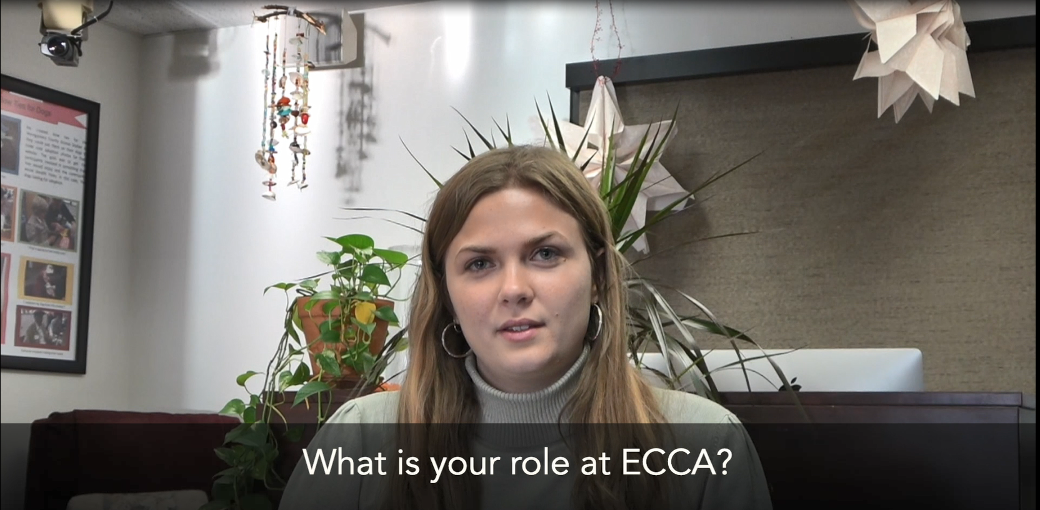
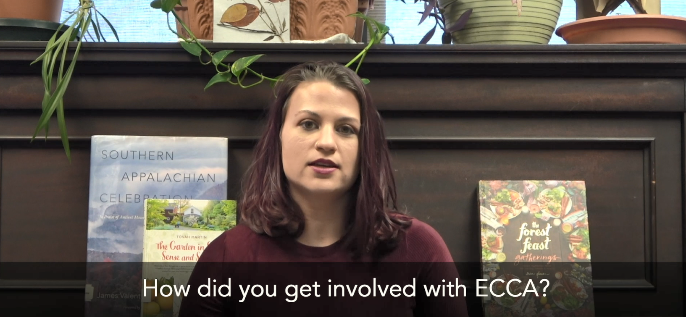
Interview Video Screenshots

Slide 11

Problems Faced
Interview video
  Changing the location of the interview
  Mic setup
  SD card formatting
Virtual Tour
  Selecting the right camera
  Hands being in the footage captured

Slide 12

Lessons Learned
Taking the Interview Video
  Using the camera provided
  Using the mic provided
  Setting up the camera
Taking the Virtual tour
  Using the GoPro Max
  Setting up the ECCA center
  How to edit the footage
  Adding the black circle

Slide 13
Work Left
Final touches for deliverables if needed
Final meeting with client
  Post videos onto the ECCA website
  Determine other social media platforms to post videos

Slide 14
Timeline
2022
2022
2022
2022
September
October
November
December
Meet up with communications group to figure out interview details
Research and video scripting
Acquire equipment from Newman Library
Take video tour
Set up interviews and record
Edit videos
Seek approval with mentor about videos edited
Finalize videos
Upload videos to ECCA website
Determine social media platforms to upload videos

Slide 15
Acknowledgements
Mentor - Ms. Ila Schepisi
Instructor - Dr. Edward Fox

Slide 16
References
Image sites:
A deeper look at 360 video projections | Trek View
https://travelshift.com/blog/challenges-facing-travel-agencies/
https://www.pmmajik.com/conduct-project-lessons-learned-review/
https://www.macworld.com/wp-content/uploads/2021/03/imovie-logo-100863302-orig-1.jpg?quality=50&strip=all
https://logodownload.org/wp-content/uploads/2019/10/adobe-premiere-pro-logo-0.png
Content References:
https://wiki.panotools.org/Equirectangular_Projection
https://ads.hdfs.vt.edu/
https://www.adobe.com/creativecloud/video/discover/keyframing.html
https://helpx.adobe.com/premiere-pro/using/VRSupport.html

