Slide 1

Recruiting and Retaining Club Members
Leona Ransdell

Slide 2

About Me
Leona Ransdell
  ‘12 Clemson Grad
    Equine Business
  Volunteer, Club Leader, County Agent, Program Associate

Slide 3

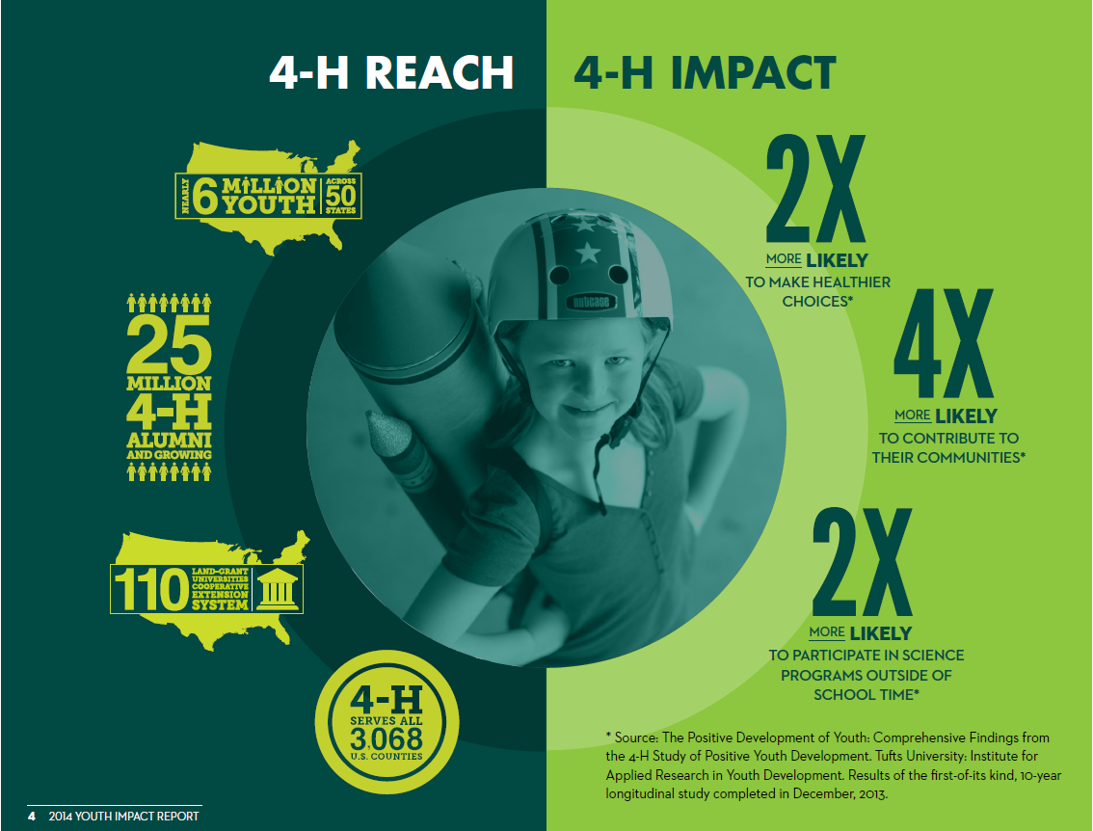
4H Fast Facts

Slide 4


Gaining New Members
Brand New Club
  Meet with Agent
  Local Farms/Businesses/Schools
  Make presence known
Established Club
  Make presence known
  Attend local events
  Promotional materials

Slide 5
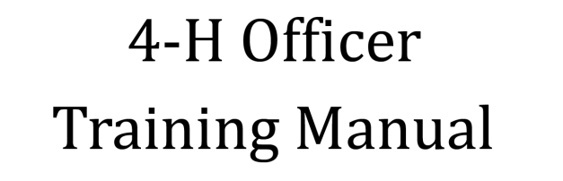

Retaining Members
Long Term Benefits
  Developing life skills
  COLLEGE
  Scholarships
Active
  Get out there
  Promotional materials
Mixture of Events
  Horse and Horseless youth
Youth Centered
  Take Ownership

Slide 6
Help is out there!
http://www.4-h.org/resource-library/promotional-toolkits/
http://www.4-h.org/resource-library/4-H-volunteer-resources/
http://www.4-h.org/information-for/parents-youth/

