Slide 1

ABC Drone: Tactical Sports Footage
Connor Bartal, Jared Cooper
4/27/2021
Edward A. Fox
Virginia Tech, Blacksburg VA 24061
CS 4624 - Multimedia, Hypertext, and Information Access Capstone

Slide 2
Outline
Project Overview
Accomplishments
Deliverables Completed Showcase
Post Process Demo
Future Plans
Lessons Learned
Q&A

Slide 3
Project Overview
Software solution to operate tethered sports drone
Drone will be capturing tactical footage for coaches
  Secondary feature of being able to live-stream
Target audience:
  Youth
  College Club
  Semi-Pro
Pivot from Live Streaming/Tracking to Post Processing and game footage editing.

Slide 4
Accomplishments
GUI Rework
Player Stats
Player Highlights
Manual tracking (Plan B)
Output Video Creation
Minimum Viable Tracking (70% accuracy)
Field Tracking-Bounds
Digitally PTZ Pre-Recorded
Mar
May
Feb
Improved Tracking (85%+ )
Log all video framing
Proof of Concept GUI
Neural Network Creation and Training
AWS
Apr
Full system Proof of Concept*
Prototype System*
Demonstration*
*Future Plans

Slide 5
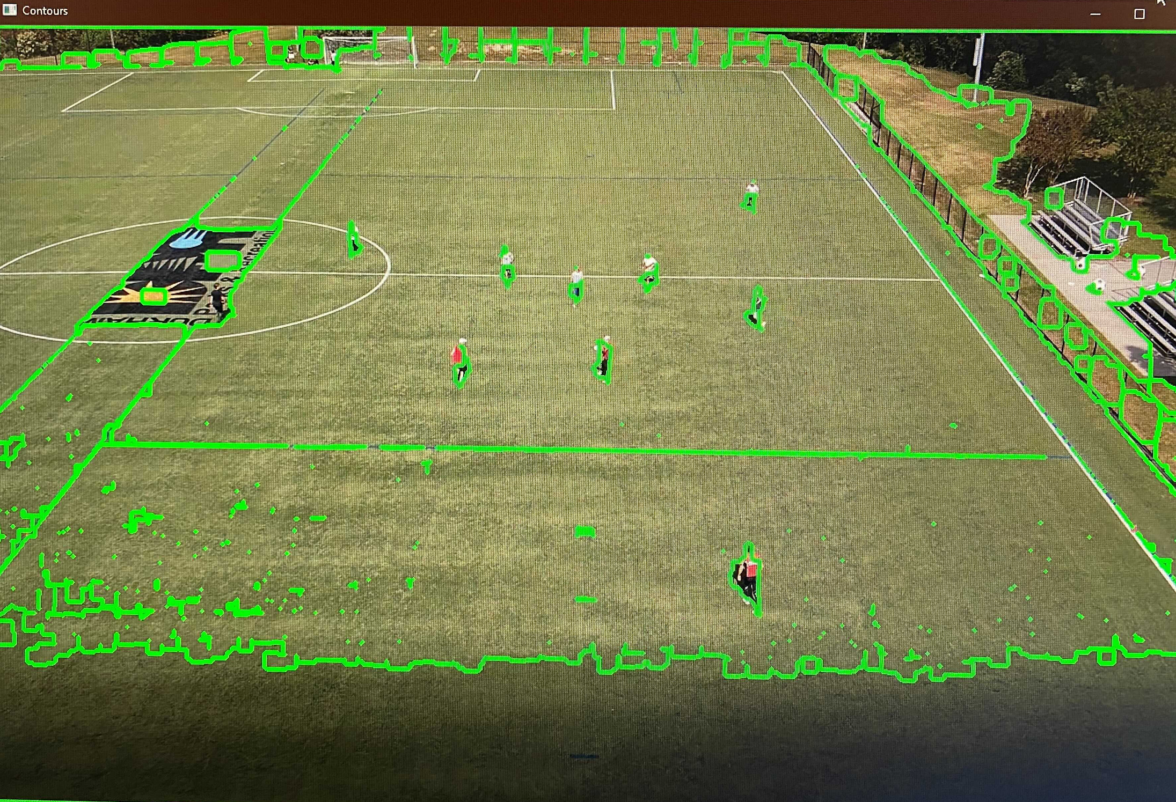
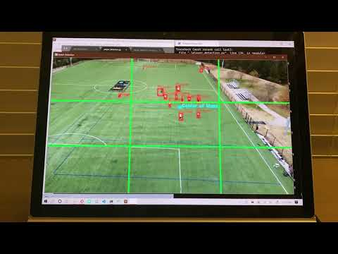
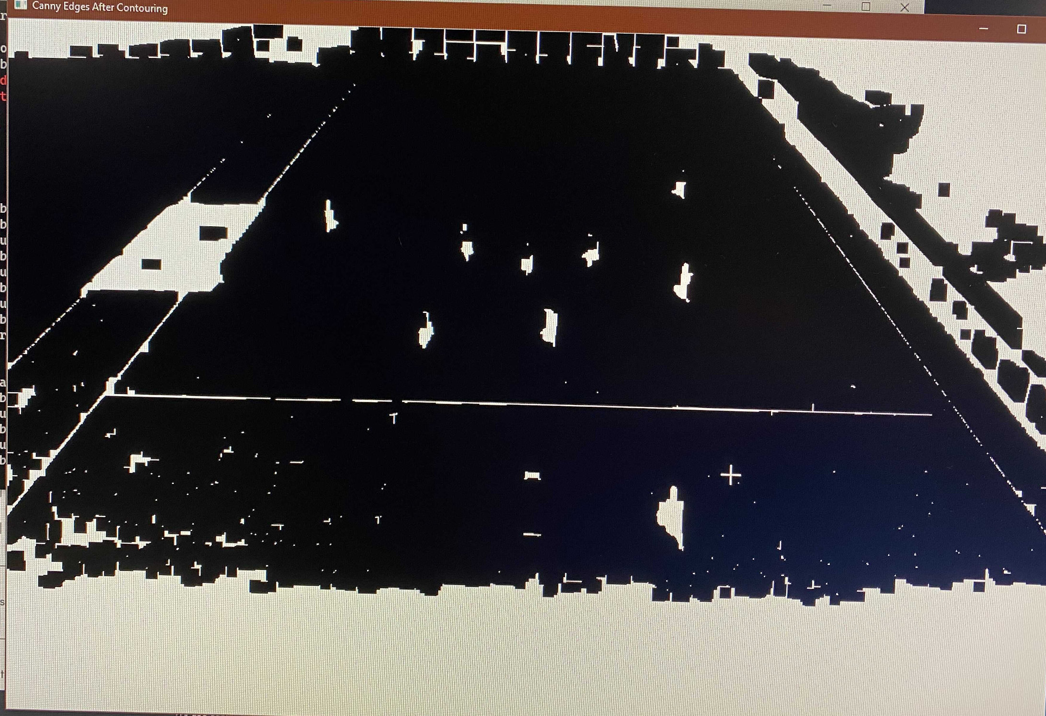
Minimum Viable Tracking
Contours
Threshold

Slide 6
Field Bounds
Please see supporting presentation files to view the Field Boundary demonstration.

Slide 7
Digital PTZ
Please see supporting presentation files to view the Digital PTZ demonstration.

Slide 8


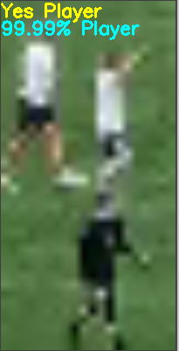
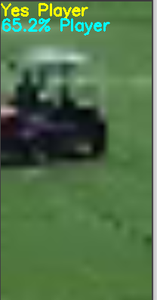
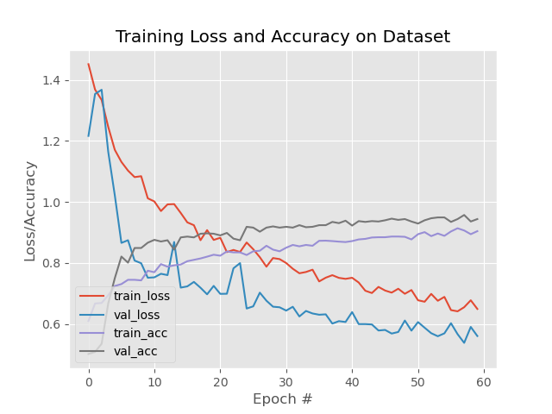

Machine Learning Model
Highly accurate, very slow
Could create PTZ video in background
  Not practical at this stage
Left Click
Right Click
click!

Slide 9
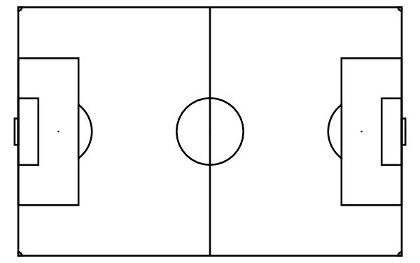
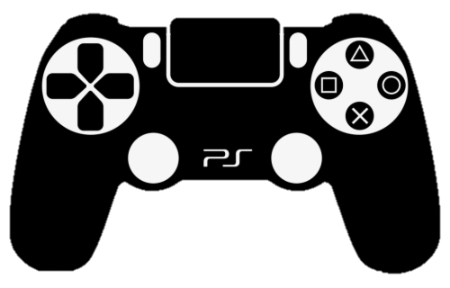
Plan B - Manual Tracking
Alternative to our automated tracking system.
Uses a video game controller to pan, tilt, zoom, FF, and cut a digital feed.
Pan/Tilt
Zoom

Slide 10
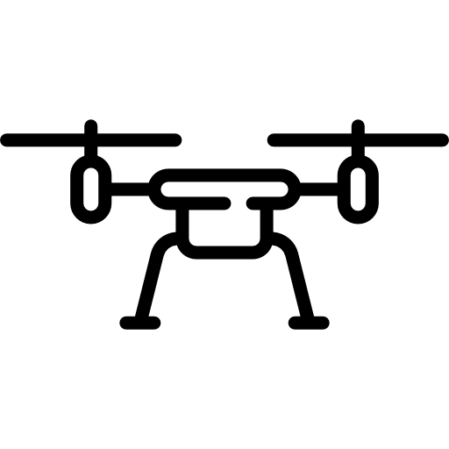



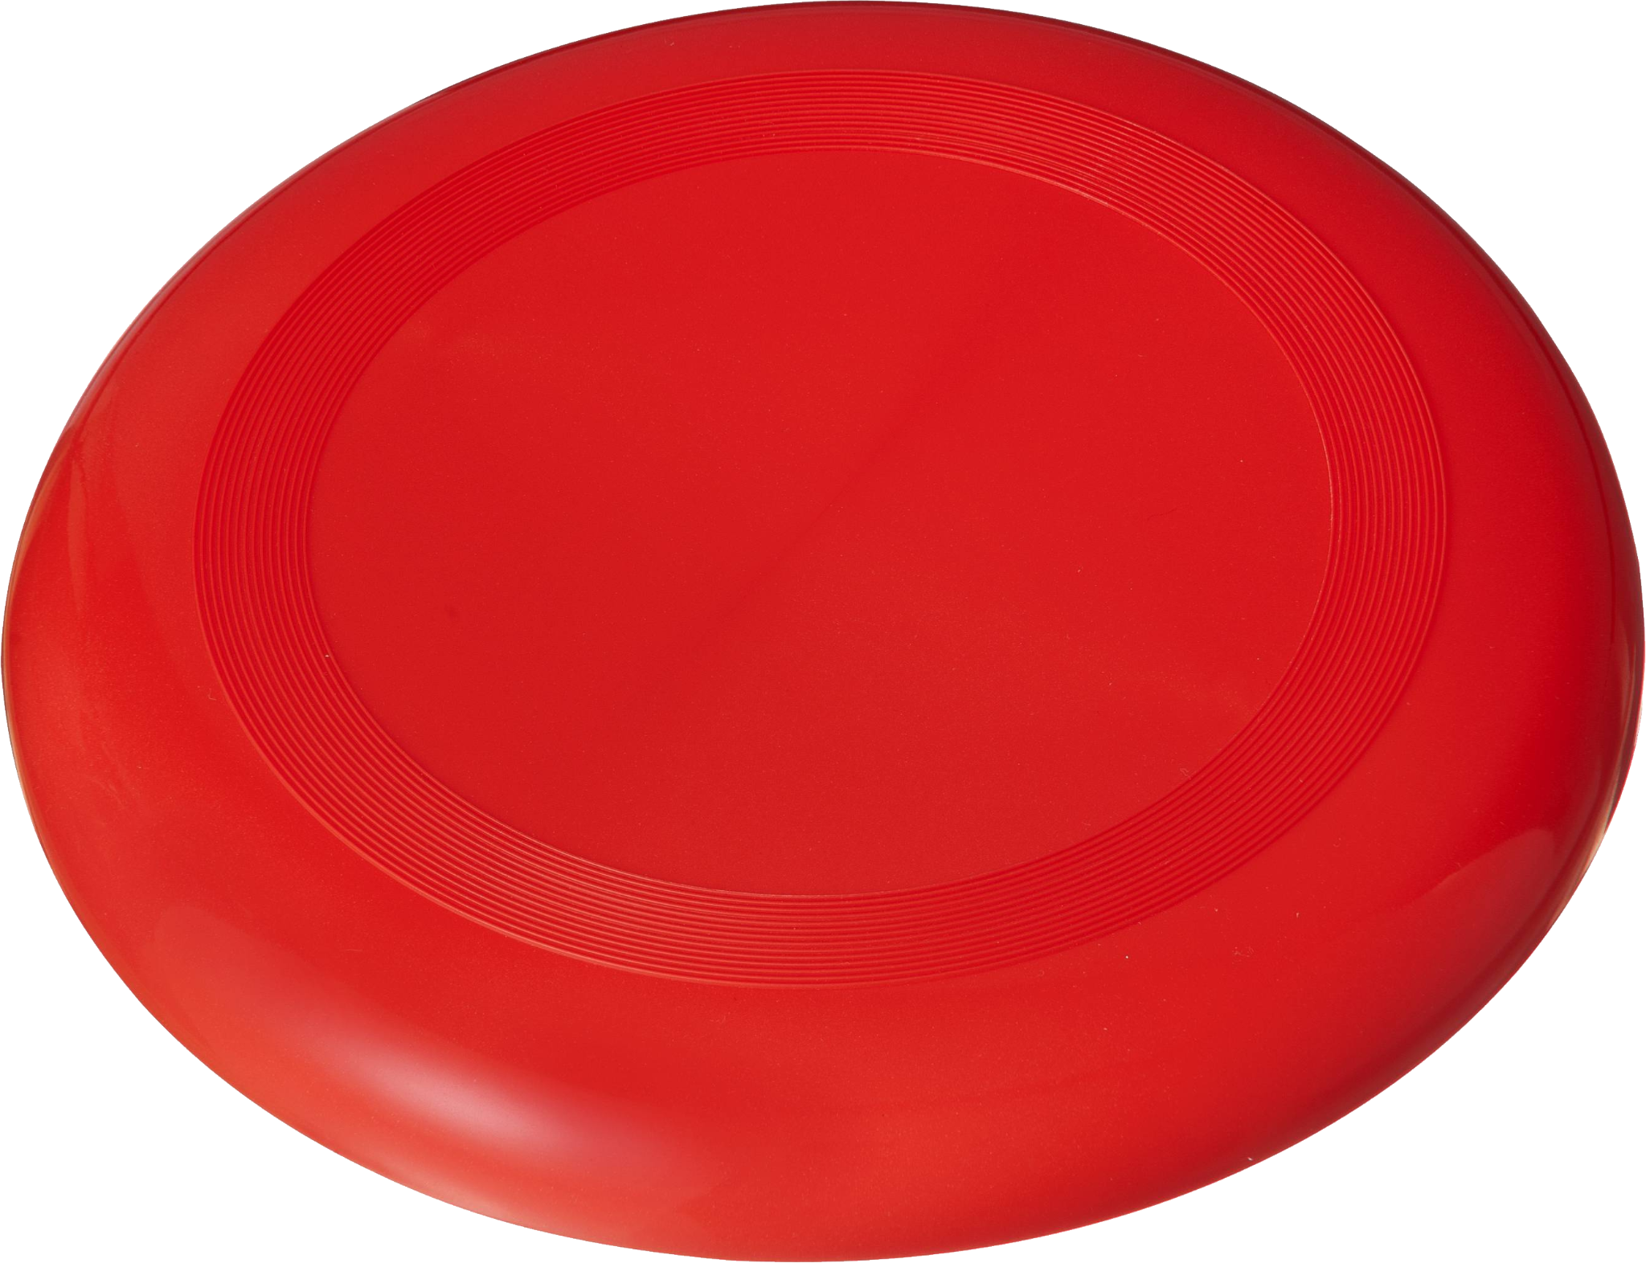





Live
Player Stats/Highlights
Cut Video (excludes stoppages in play)
Key Plays File
PTZ EDL Creation
OR
EDL
EDL Processing

Slide 11
Full Scale Demo
Please see supporting presentation files to view the Full Scale demonstration.

Slide 12

What Did Not Work?
AWS Integration (for now)
Live Tracking with ML Model
Persistence Tracking
Auto-Adjusting Field Boundary

Slide 13

Future Plans
Streamline Post Process
Get ML Model to create EDL File
Document Code
Prettify GUI
Create Companion App for GUI

Slide 14

Lessons Learned
Document as you go
Video manipulation = math
Use Objects as much as possible in large projects
Be willing to adapt at a moment’s notice

Slide 15
Acknowledgements
Client - Charles Kerr.
  Independent Consultant based in Raleigh, NC.
  Coach, and Founder of JinxCam.
Dr. Fox and all of the CS 4624 support staff.
Qualified for $2500 AVUSI Drone Grant.
Important Libraries:
  OpenCV Library (https://opencv.org)
  Tkinter Library (https://docs.python.org/3/library/tkinter.html)

