Slide 1
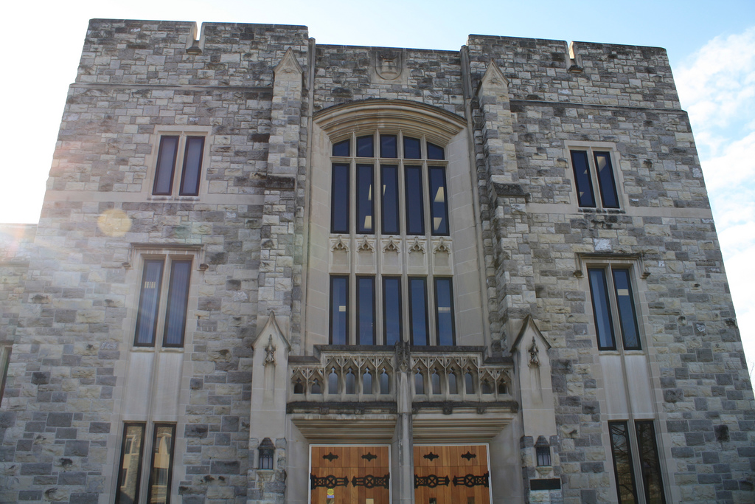
Virginia Tech
University Libraries
A LEARNING PLATFORM
(September 2012)
2nd Floor, Newman Library, Conceptual Draft #2

Slide 2
Newman Library, Second Floor
  WHY?
  More than a renovation, we’re redefining libraries
Knowledge needs have changed and to be effective the library must adapt
Offer a comprehensive and integrated environment for academic support and skill-building
Explore and encourage new literacies and pedagogies as well as active and applied learning
Address shift from information consumption to knowledge production and sharing
Cultivate campus pride in the University Libraries

Slide 3
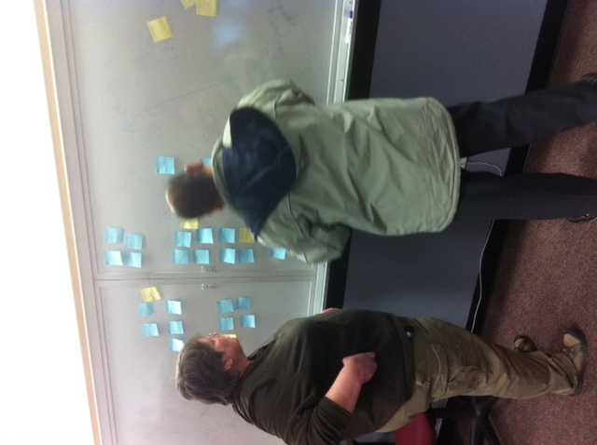
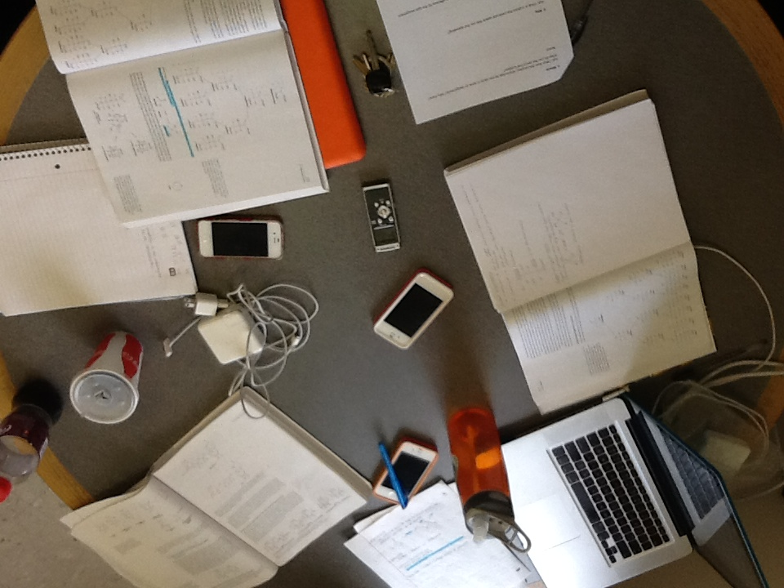
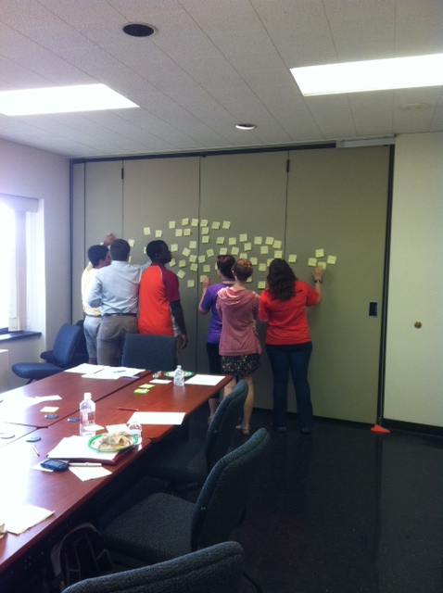
We spent the last year
UNDERSTANDING
student needs.
Focus Groups
Observation Studies
Interviews

Slide 4
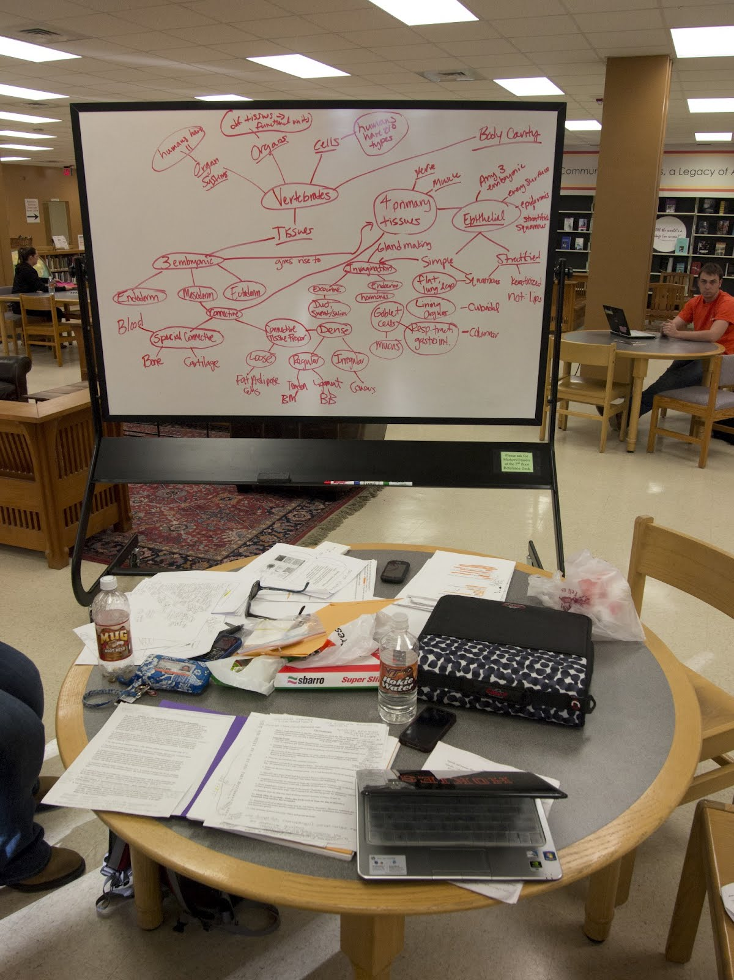
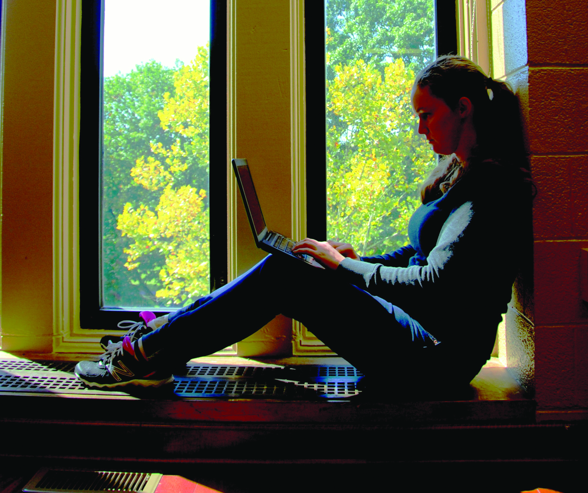
Connectivity
Variety
Convenience
SOMETHING FOR EVERYONE

Slide 5
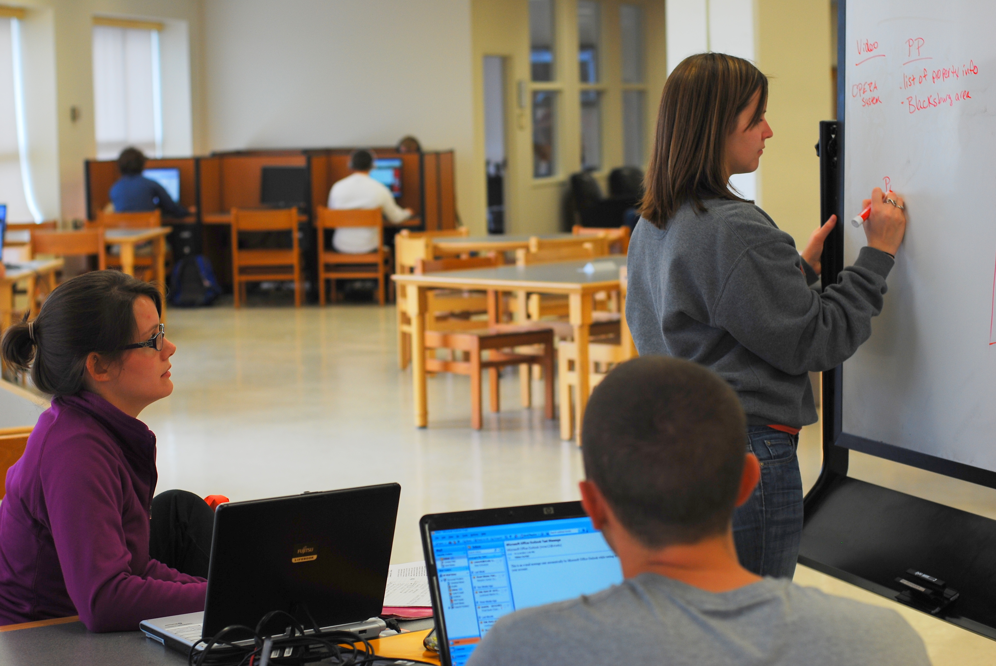
  LEARNING
  PLATFORM

Slide 6
  LEARNING
  PLATFORM
An adaptive immersive environment that is configurable for a diverse range of knowledge needs.

Slide 7
  What should
  the space do?
Motivate to learn and produce knowledge
Inspire creativity
Engender inquisitiveness and discovery
Create a vibe that says “learning happens here”
Reflect ‘life of mind’ and foster learning encounters and serendipity
Showcase learning, creativity, and innovation at VT
Provide individual and group control of the environment

Slide 8
  How should
  the space feel?
Intimate (warm, welcoming, comfortable)
Inspiring
Sense of Identity (cultural mirror, “Hokie” culture)
Awake (energy, forward motion)
Continuity (relationship between future and past)

Slide 9
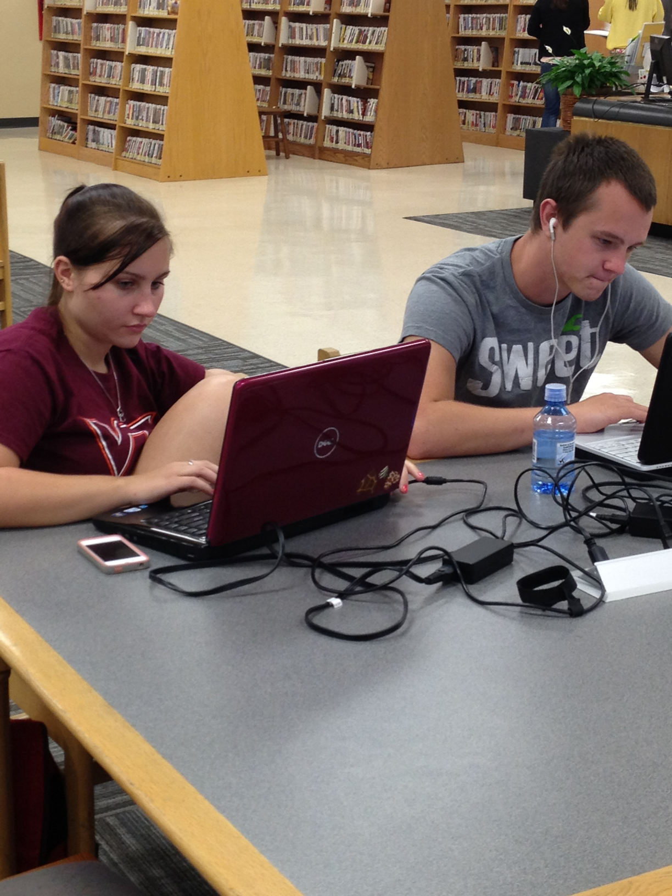
  GUIDING
  CHARACTERISTICS
Newman Library, Second Floor
  Undergraduate-focused
  Task-varied
  Culturally-enriching
  Technology-rich
  Collaboration-heavy
  Expertise-enabled
  Serendipitous

Slide 10
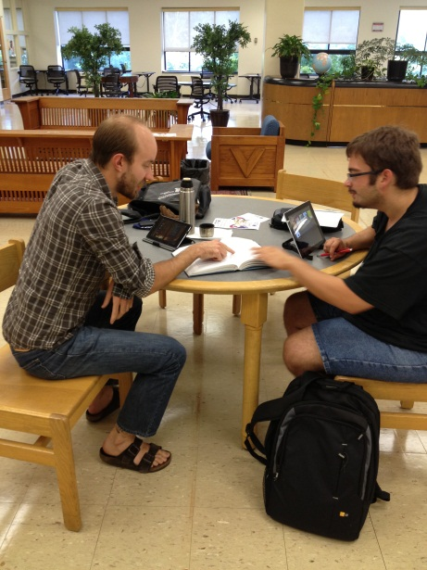
  DESIGN
  PRINCIPLES
Newman Library, Second Floor
  Stimulate & facilitate individual and group knowledge production
  Allow users to control the environment
  Accommodate flexibility and diverse needs
  Support mentoring & expertise services
  Engage users with experimental space

Slide 11
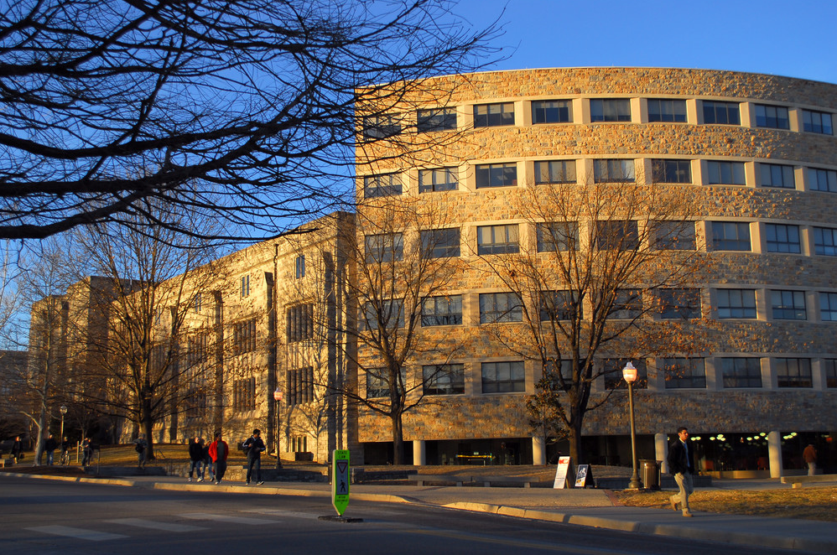
WHEN IS A LIBRARY
MORE THAN A
BUILDING?
Libraries are social, cultural, and academic destinations.

Slide 12
HIGH LEVEL CONCEPTS / METAPHORS
HOTEL LOBBY
VILLAGES
LEARNING
STUDIOS
VILLAGES
NEIGHBORHOODS
VILLAGES
KNOWLEDGE PARK
LEARNING
STUDIOS
KNOWLEDGE PARK
MARKETPLACE

Slide 13
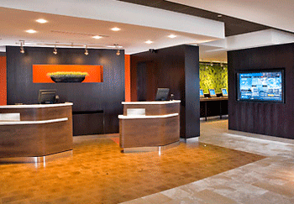
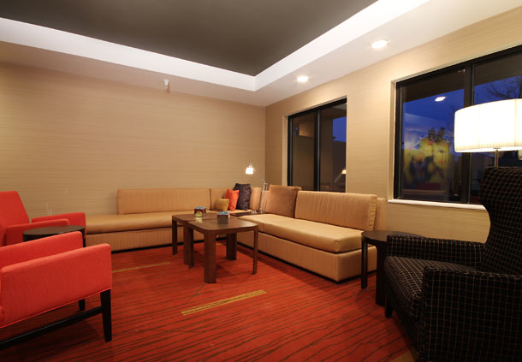
  HOTEL LOBBY
  MEET & GREET

Slide 14
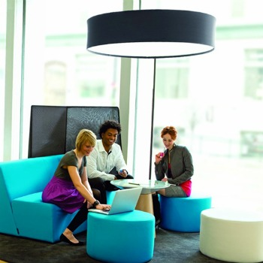
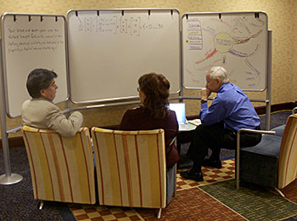
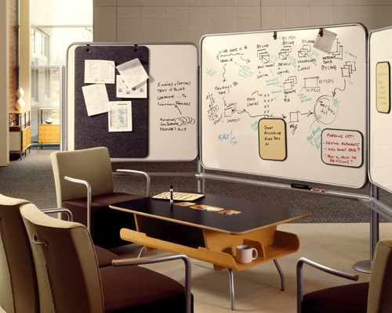
  VILLAGES
  Flexible brainstorming & sharing spaces

Slide 15
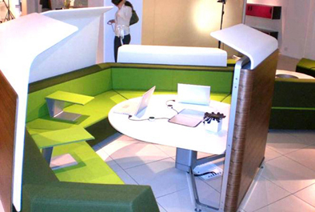
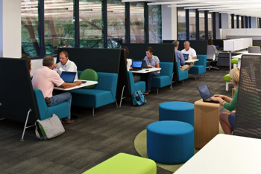
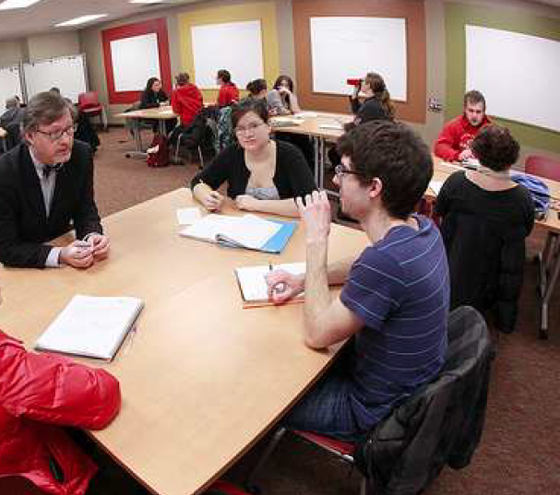
  NEIGHBORHOODS
  Open group work areas

Slide 16
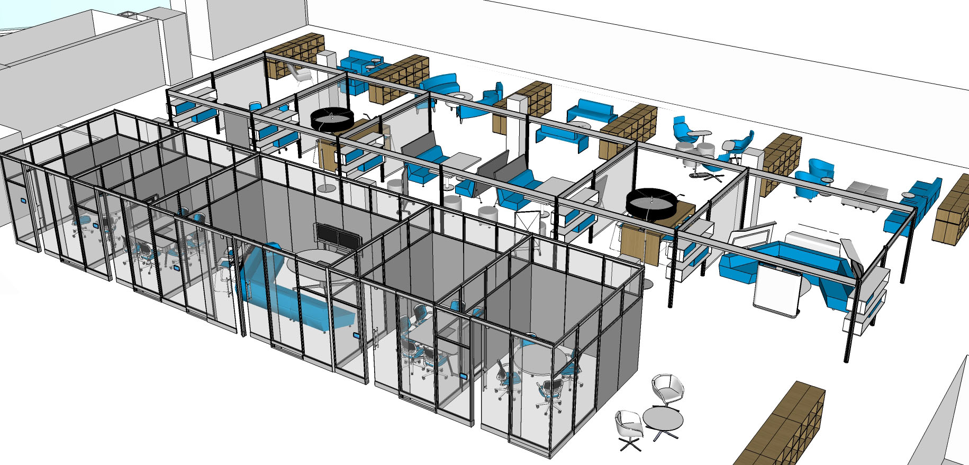
  GROUP COMMONS
  Intersection of villages & neighborhoods

Slide 17
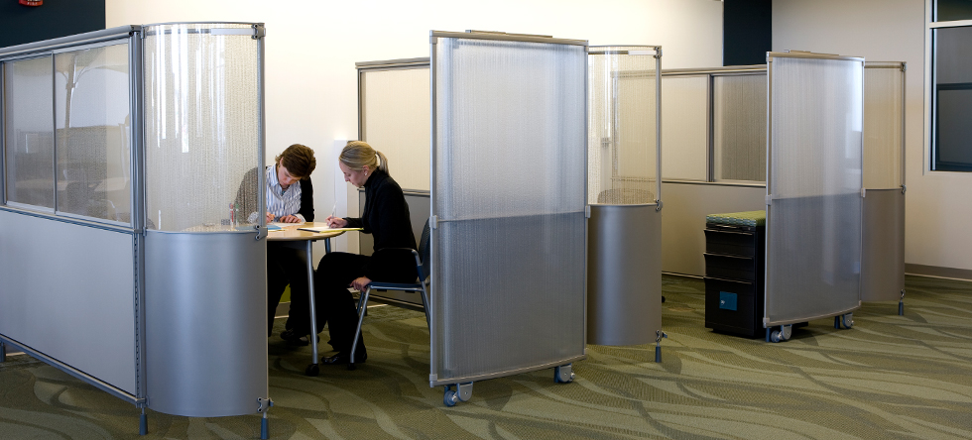
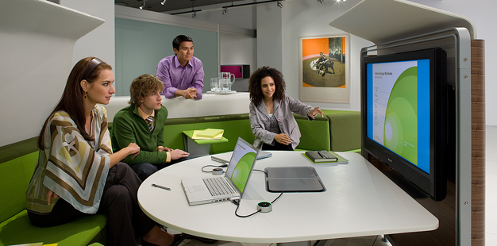
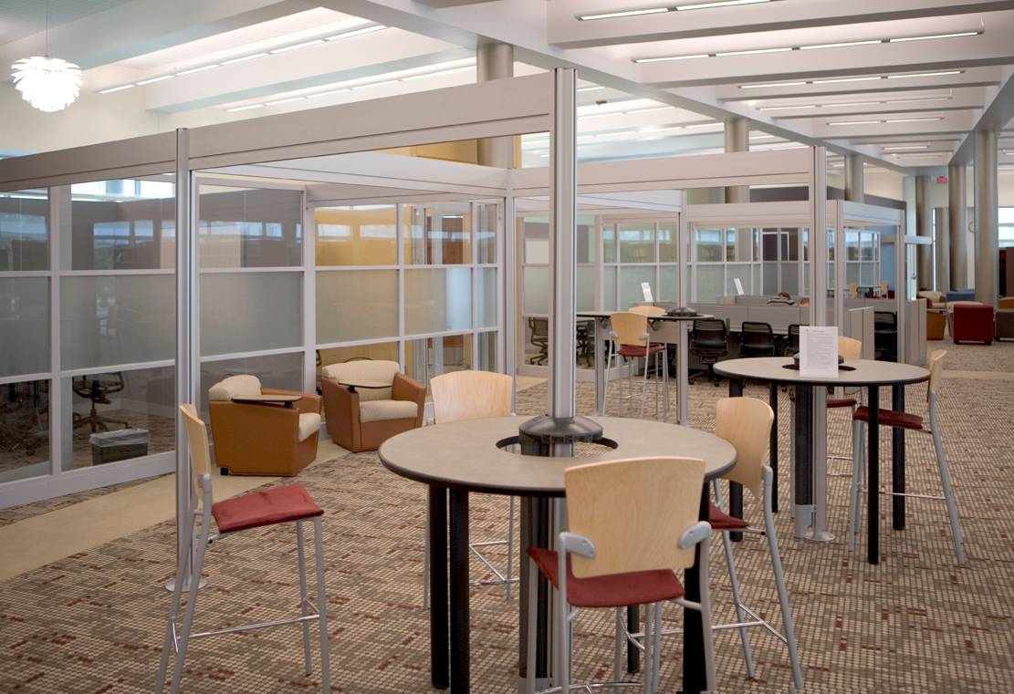
  MARKETPLACE
  Convergence of academic support
Writing Center
CommLab
Multimedia & Design
Math & Stats
Library Support
IT Support
Languages
GIS & Spatial Data

Slide 18
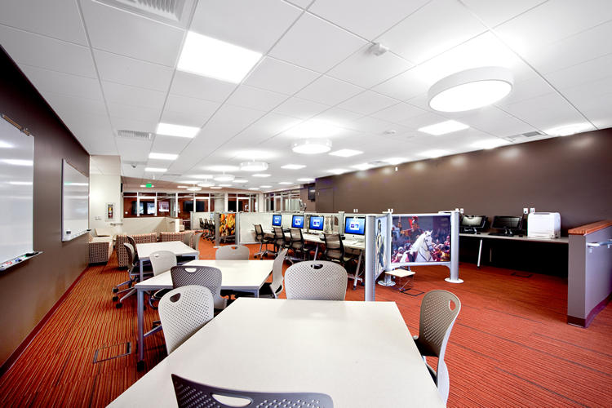
  MARKETPLACE
  Coworking environment

Slide 19
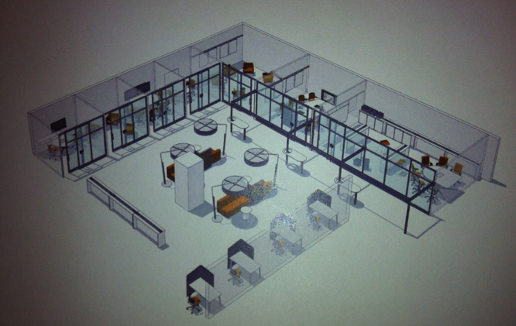
  MARKETPLACE
  Adaptable for specific needs

Slide 20
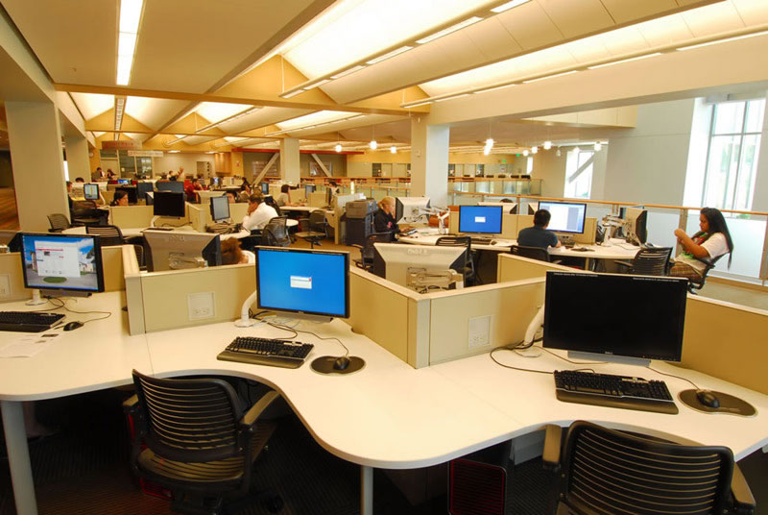
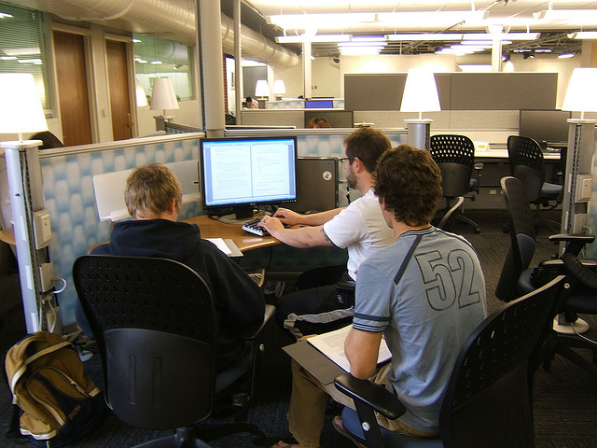
  KNOWLEDGE PARKS
  Focused areas for individuals & small groups

Slide 21
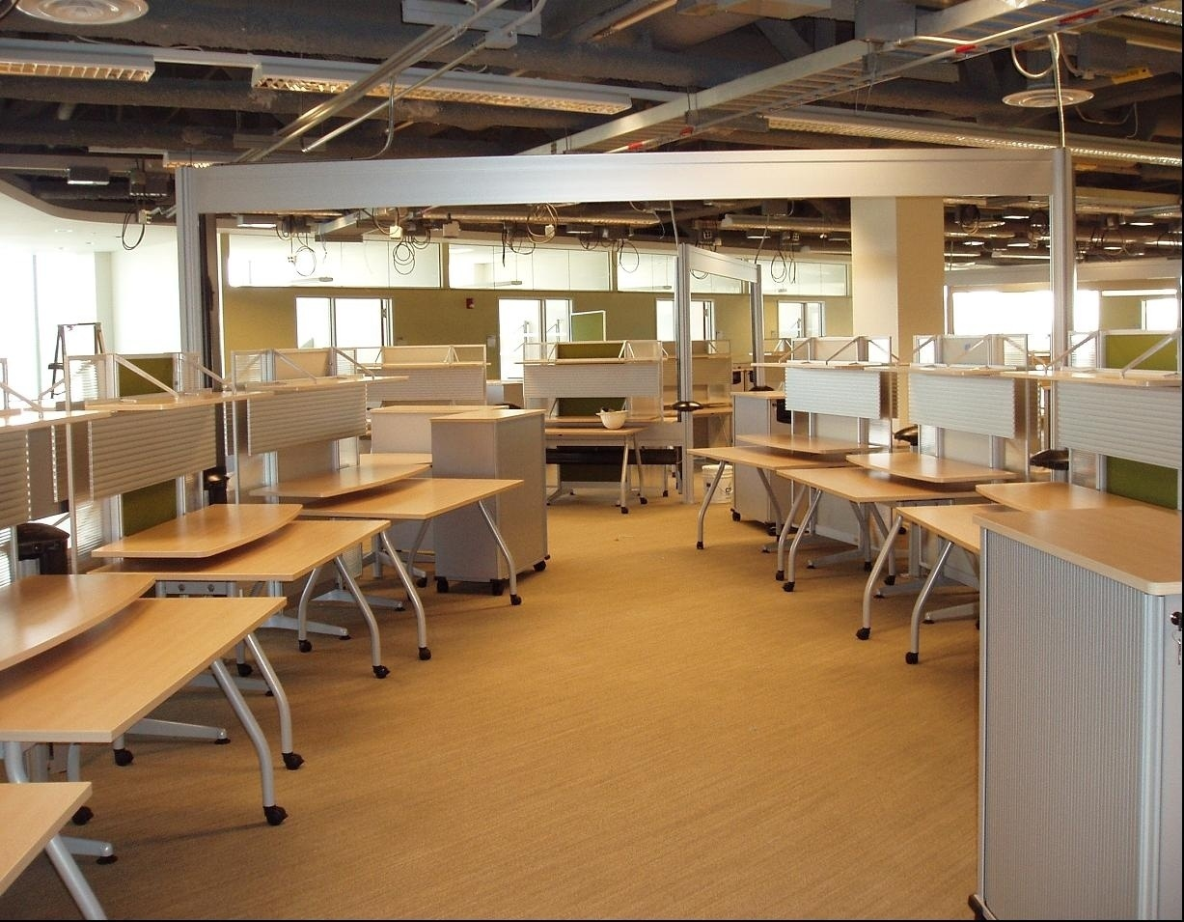
  KNOWLEDGE PARKS
  Focused areas for individuals & small groups

Slide 22
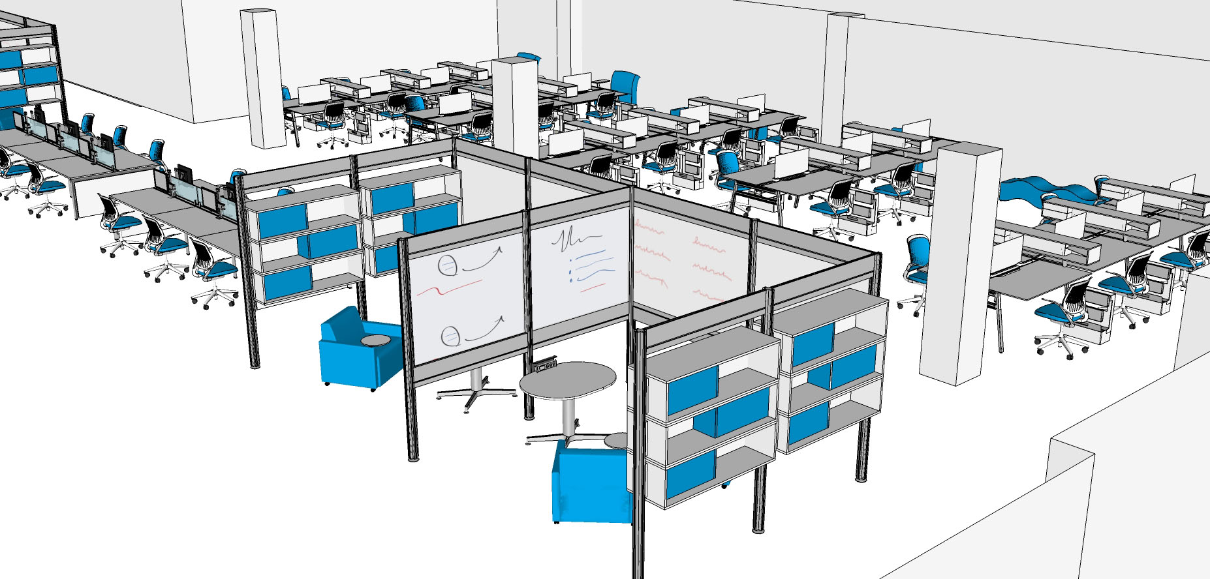
  KNOWLEDGE PARKS
  Focused areas for individuals & small groups

Slide 23
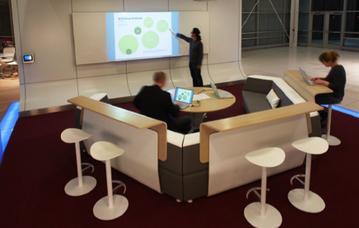
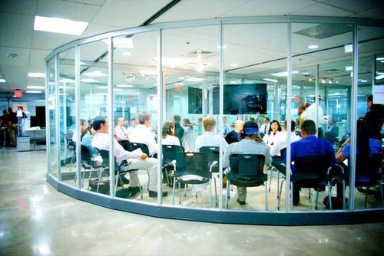
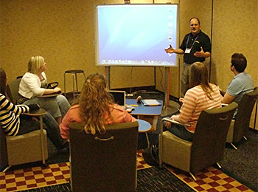
  LEARNING STUDIOS
  Reservable group spaces
Instructors
Tutors
Teaching Assistants
Librarians

Slide 24
Newman Library, Second Floor
  BENEFITS
  Helping students succeed
Double the amount of student space
Create a dynamic mixture of areas that foster a wide range of learning experiences
Enhance technology capabilities
Expand instructional and academic support settings
Showcase learning, creativity, and innovation at Virginia Tech

Slide 25
  LIBRARY
  TRANSFORMATION
We are not just updating study space. We are reimagining and reprogramming the learning and research environment.

Slide 26
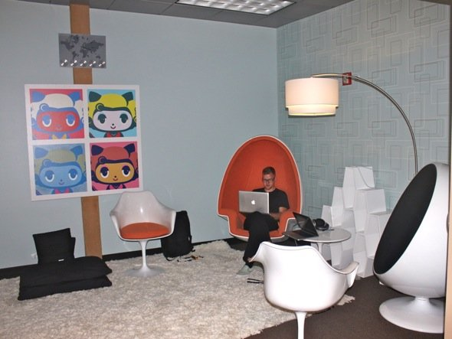
  A LEARNING PLATFORM
  Experiences & Encounters
Canvas
Stage
Gallery
Workshop
Studio
Lab
Discussion Hub
Discovery Center

Slide 27
  LIBRARY
  TRANSFORMATION
For more information please visit:
www.lib.vt.edu/renovation

Slide 28
Appendix #1
PROGRAMMABLE SPACE
concept overview

Slide 29
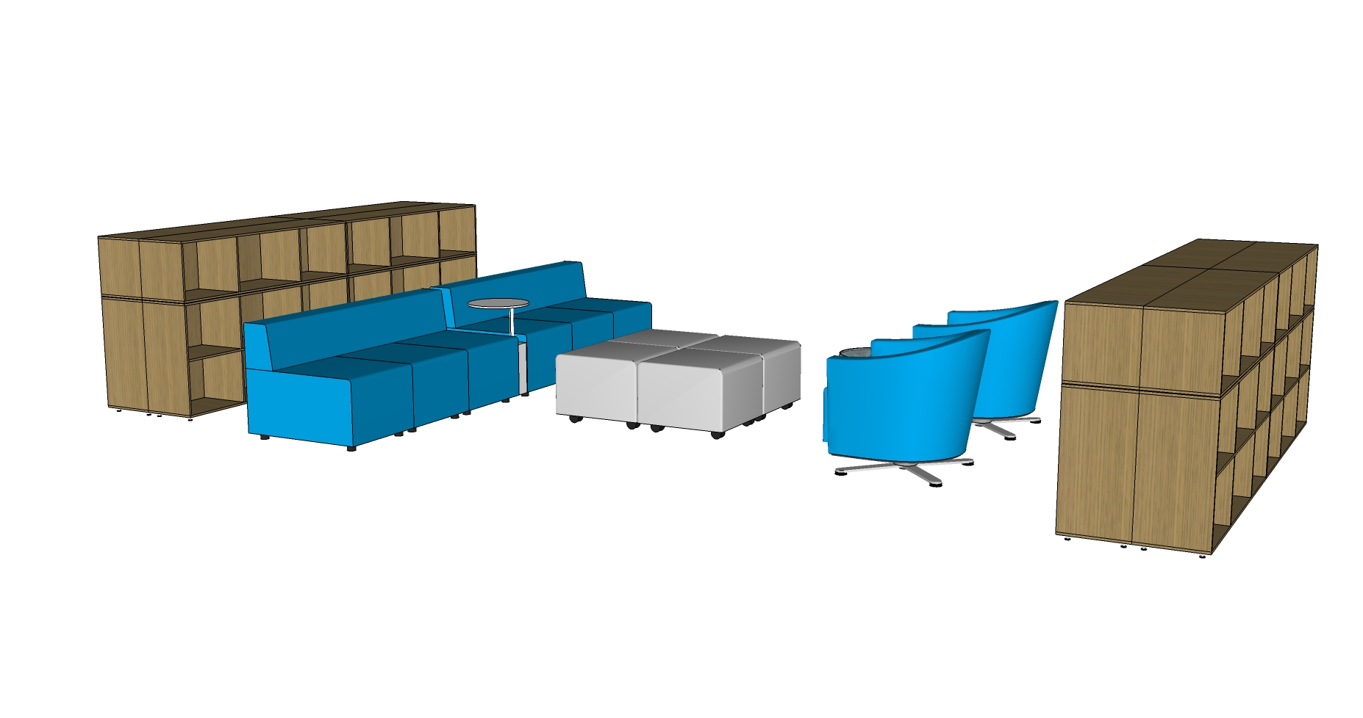
Programmable Space
Villages can be “checked out” by departments, professors, or librarians.
This enables them to curate or develop a public area based on a common theme or an assignment.

Slide 30
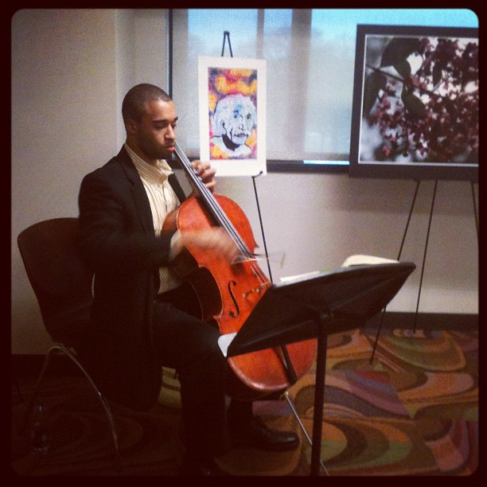
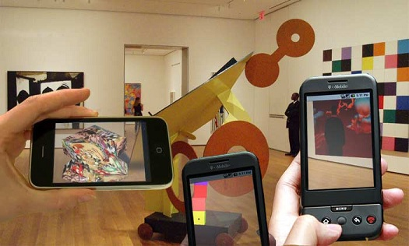

Programmable Space
The music department could feature their students. Every day at a set time a different musician performs a solo piece.
A class could develop interactive art.
Campus units could host open conversations and outfit a village.

Slide 31
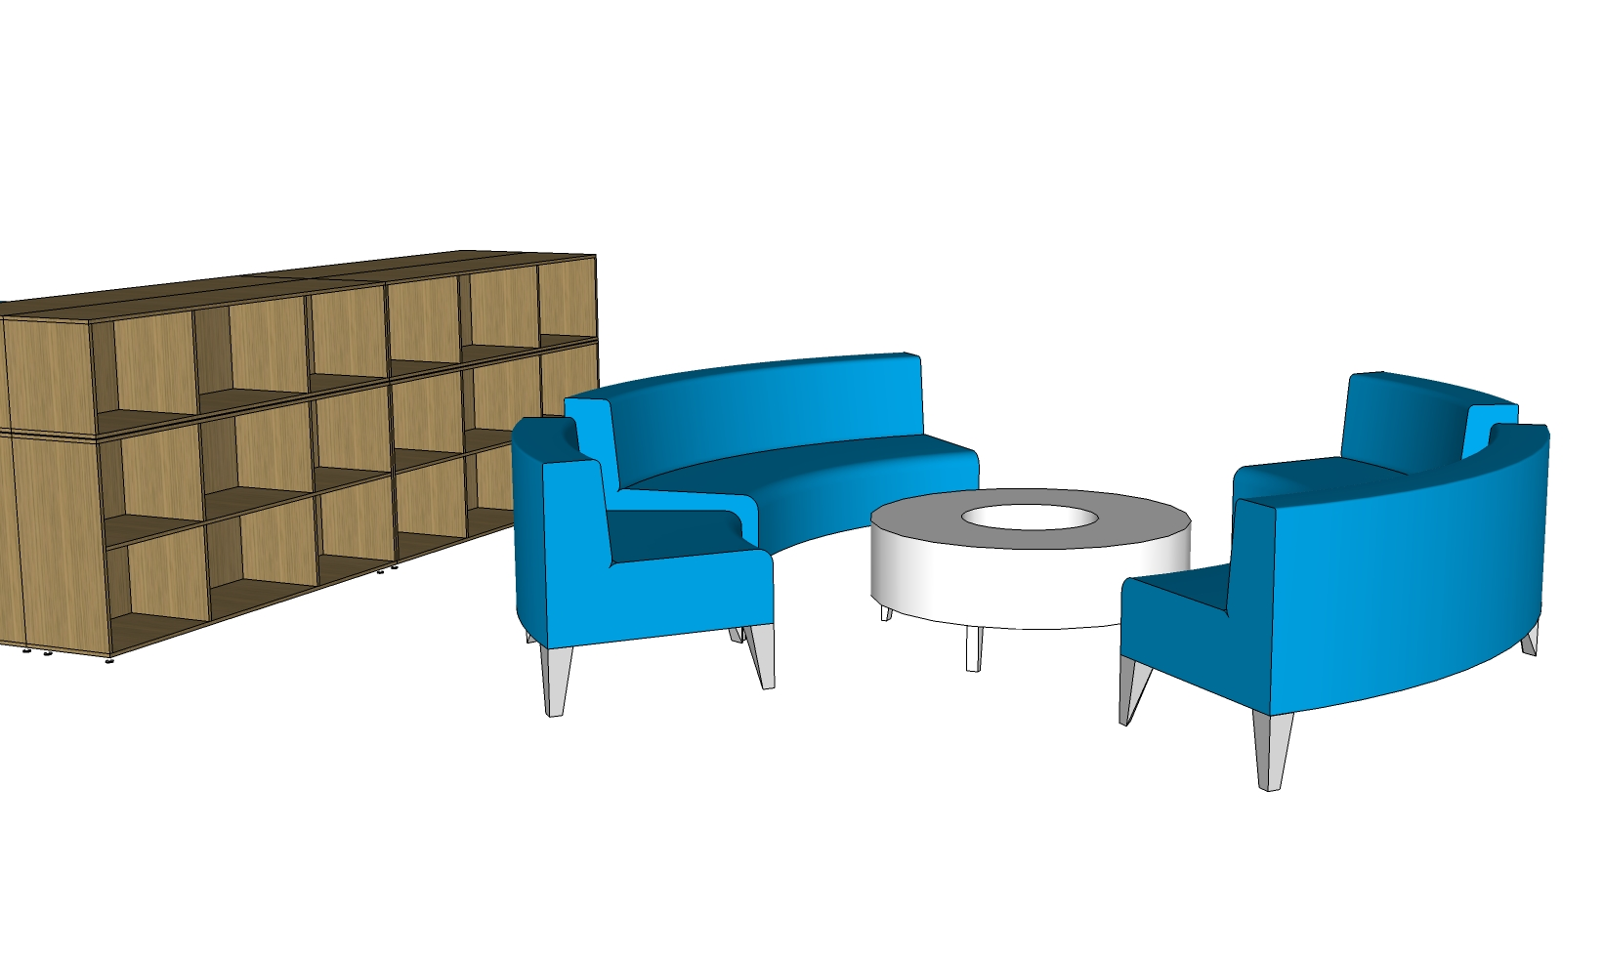
Programmable Space
This creates a variety of immersive settings. Students working in these areas are surrounded by stimulating materials.
Books
Posters
Display cases
Portable walls
Digital screens
Art installations
Interactive artifacts

Slide 32
Appendix #2
GROUP COMMONS:
An Ongoing Experiment
concept overview

Slide 33
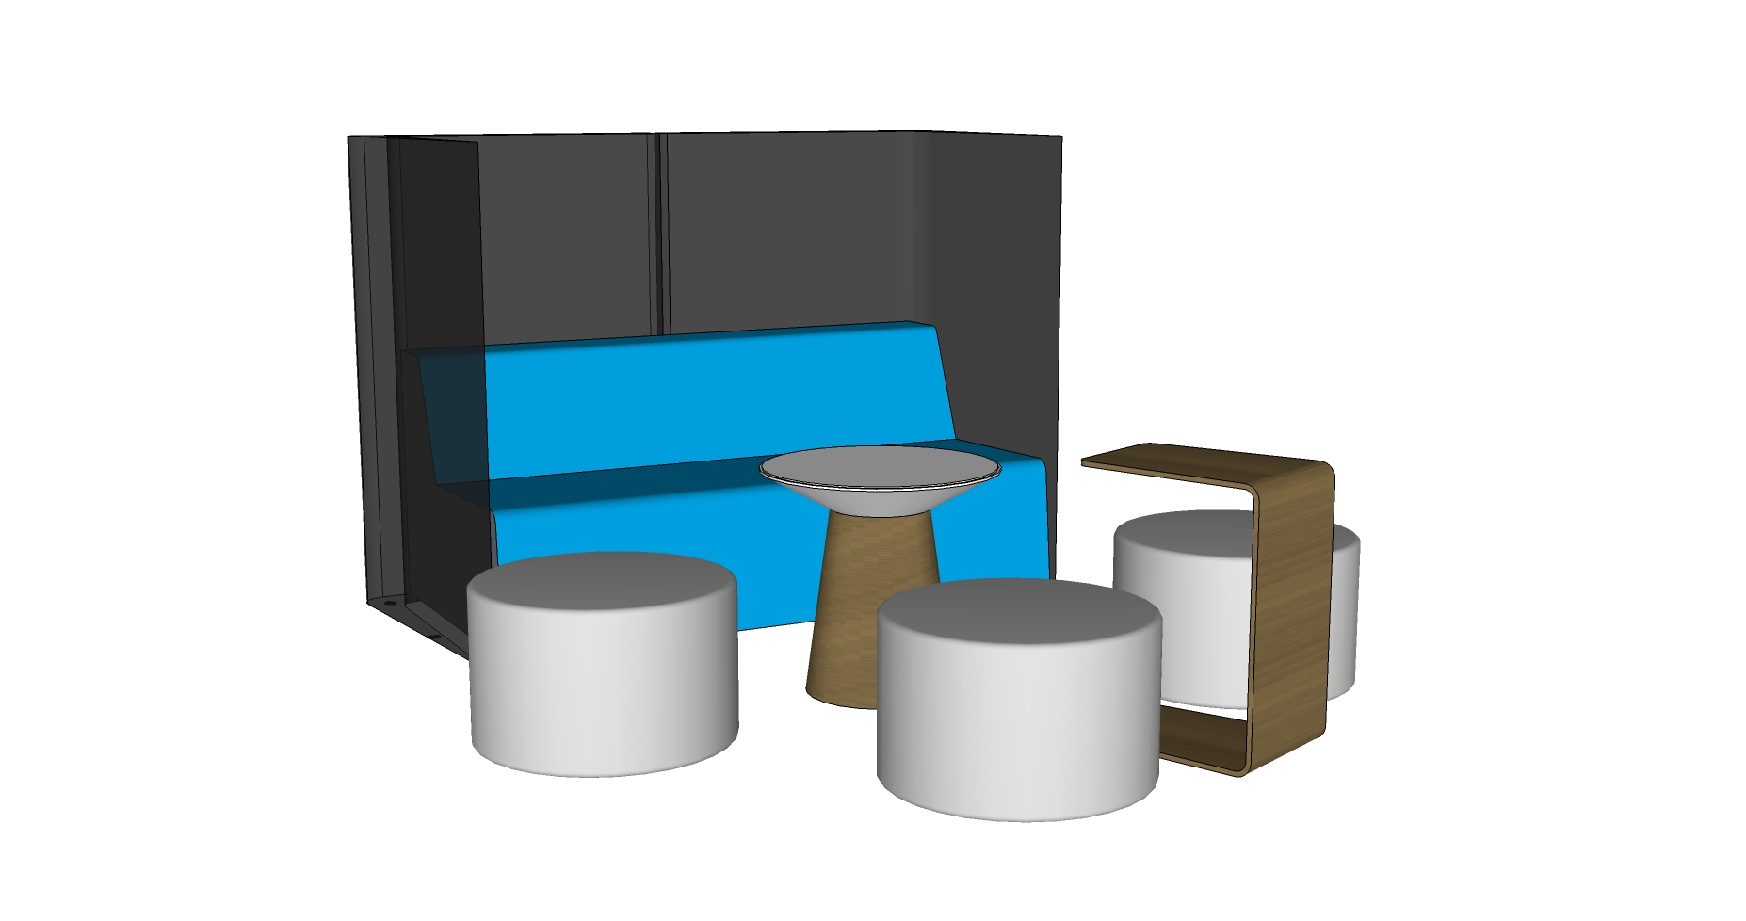
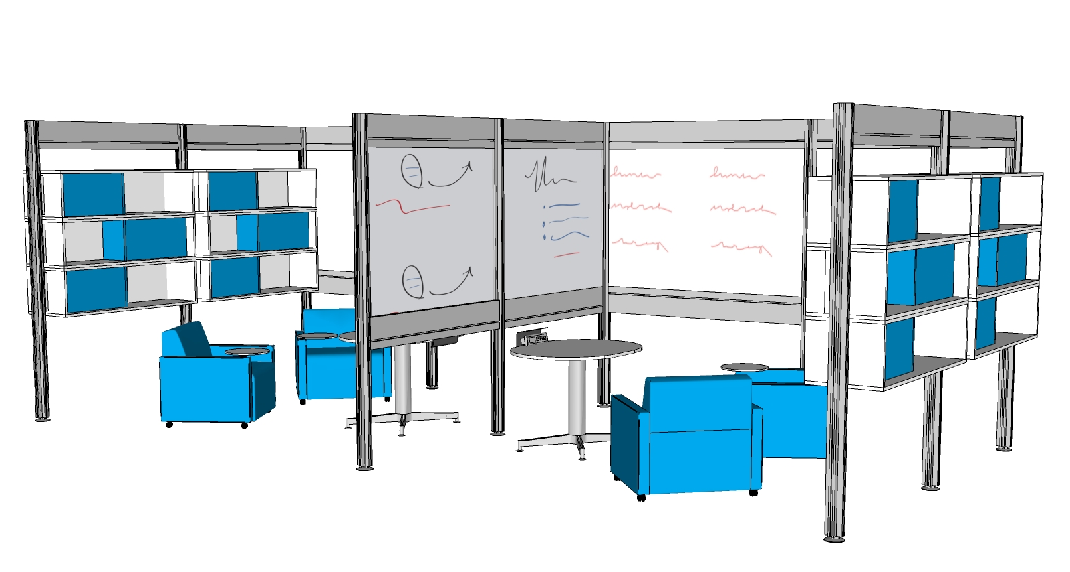
Group Commons Concept
Each semester we experiment with different types of furniture and technology in various configurations. Our objective is to consistently try new arrangements that support collaboration and group learning.

Slide 34
Appendix #3
TECHNOLOGIES
ON THE HORIZON
concept overview

Slide 35
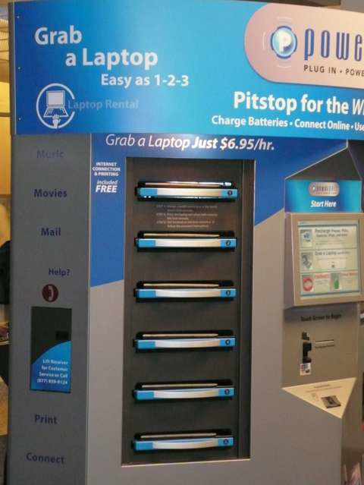
  A glimpse into the future
  Technologies on our radar
Self-service lending of laptops, eReaders, and other devices.
Swipe your card. Enter a pin. Borrow it for two hours.

Slide 36
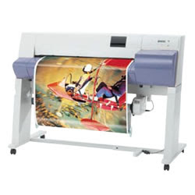
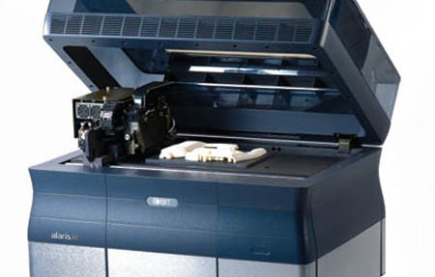
  A glimpse into the future
  Technologies on our radar
Printers for various formats.
Plotter for large formats.
3D Printers

Slide 37
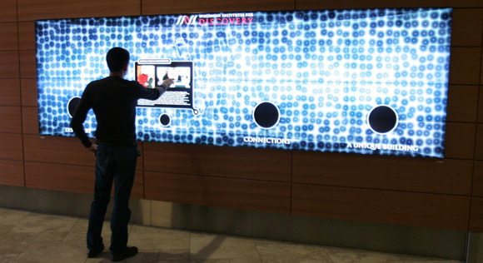
  A glimpse into the future
  Technologies on our radar
Interactive media walls for large screen displays.

Slide 38
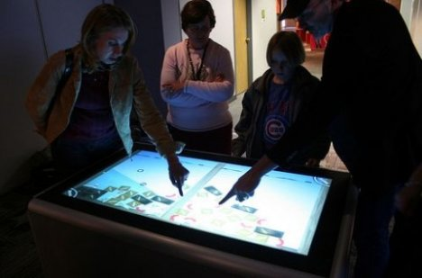
  A glimpse into the future
  Technologies on our radar
Touchscreens built into tabletops and walls.

Slide 39
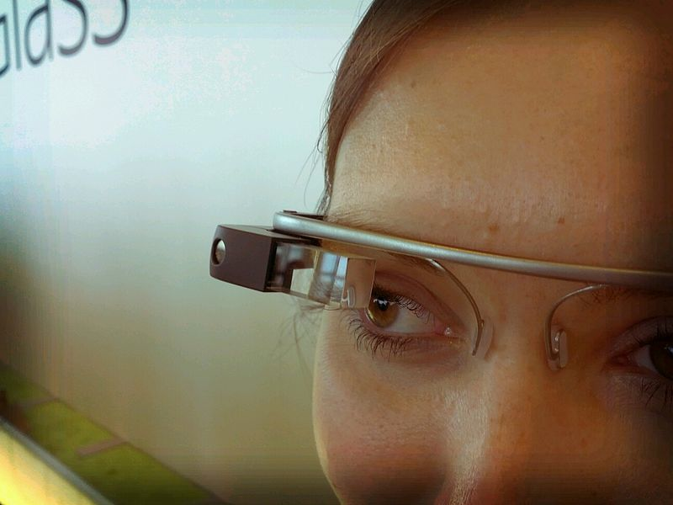
  A glimpse into the future
  Technologies on our radar
Wearable computers.

Slide 40
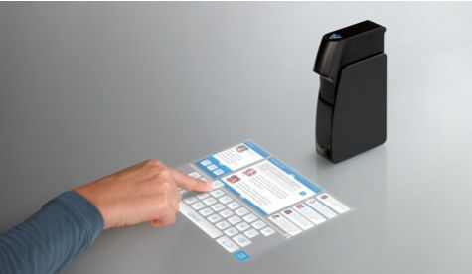
  A glimpse into the future
  Technologies on our radar
Touchscreen computer projection systems.

Slide 41
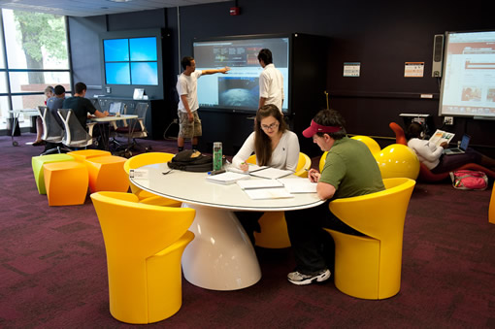
  A glimpse into the future
  Technologies on our radar
Technology & Knowledge
Sandboxes

Slide 42
LIBRARY NAVIGATION SYSTEM
Plan your visit and interact with the space
Mobile App
Web Page
Kiosks
Interactive Digital Signs
Directory
GPS – where am I?
Room Availability
Laptop Availability
Computer Availability
Reserve Room
Make Appointment
Group Tools
How to (print, scan, etc)
Research Tutorials
News & Events
Ask

Slide 43
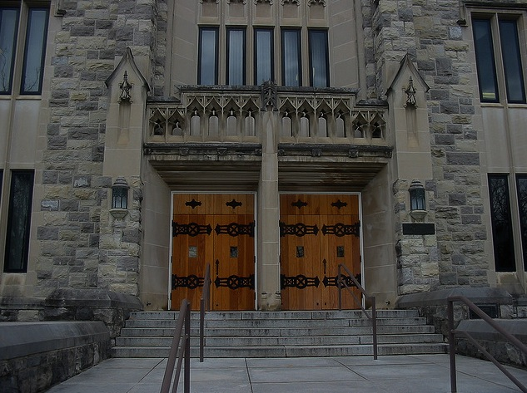
Virginia Tech
University Libraries
A LEARNING PLATFORM
(September 2012)
http://www.lib.vt.edu/renovation/

