Slide 1


Maptivity
Conor O’Neill, Kaz Eslami, Cody Douglass
Multimedia, Hypertext, and Information Access
Dr. Edward A. Fox
Virginia Tech Blacksburg VA 24061
26 April 2018

Slide 2
Outline
Project Recap
Progress
Work Completed
Finishing Touches
Obstacles/Lessons Learned

Slide 3
Project Recap
Real-time data visualization
Vital for operating conditions and business performance
Working with IT Engagement and Experience @ VT

Slide 4


Progress
Parsed phone data
Area code to geolocation DB
Websockets framework
Front-end improvements
Time-scaled playback simulations

Slide 5
Work Completed
Data

Slide 6
Phone Data
Received two years of phone data from our client
Parsed data, extracted area codes/country codes to translate into geolocations
  Stored DB dictionary on server
Employed the data to run simulations as viable proof of concept
International numbers

Slide 7
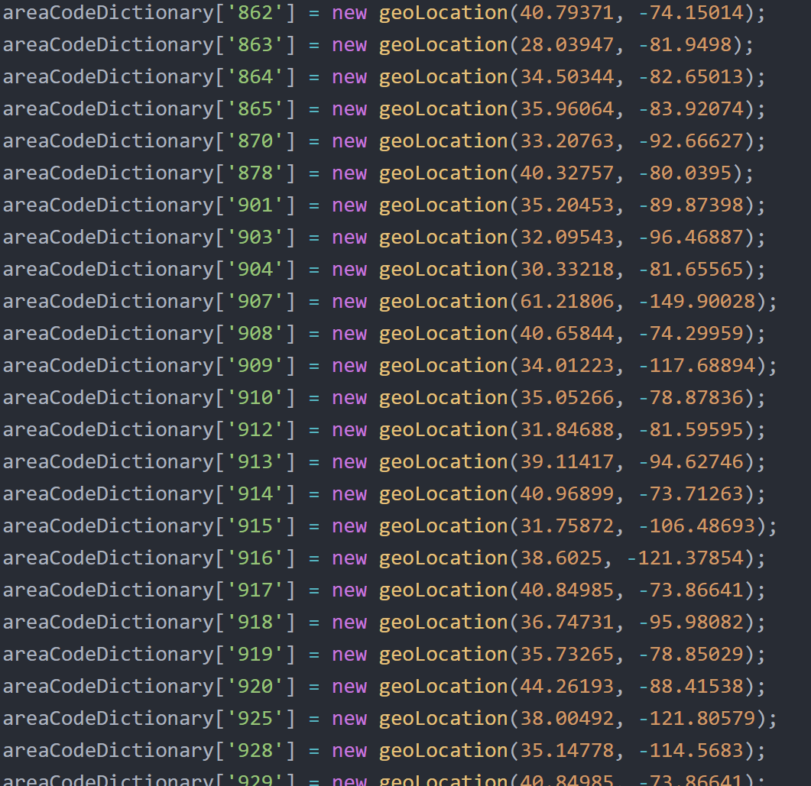
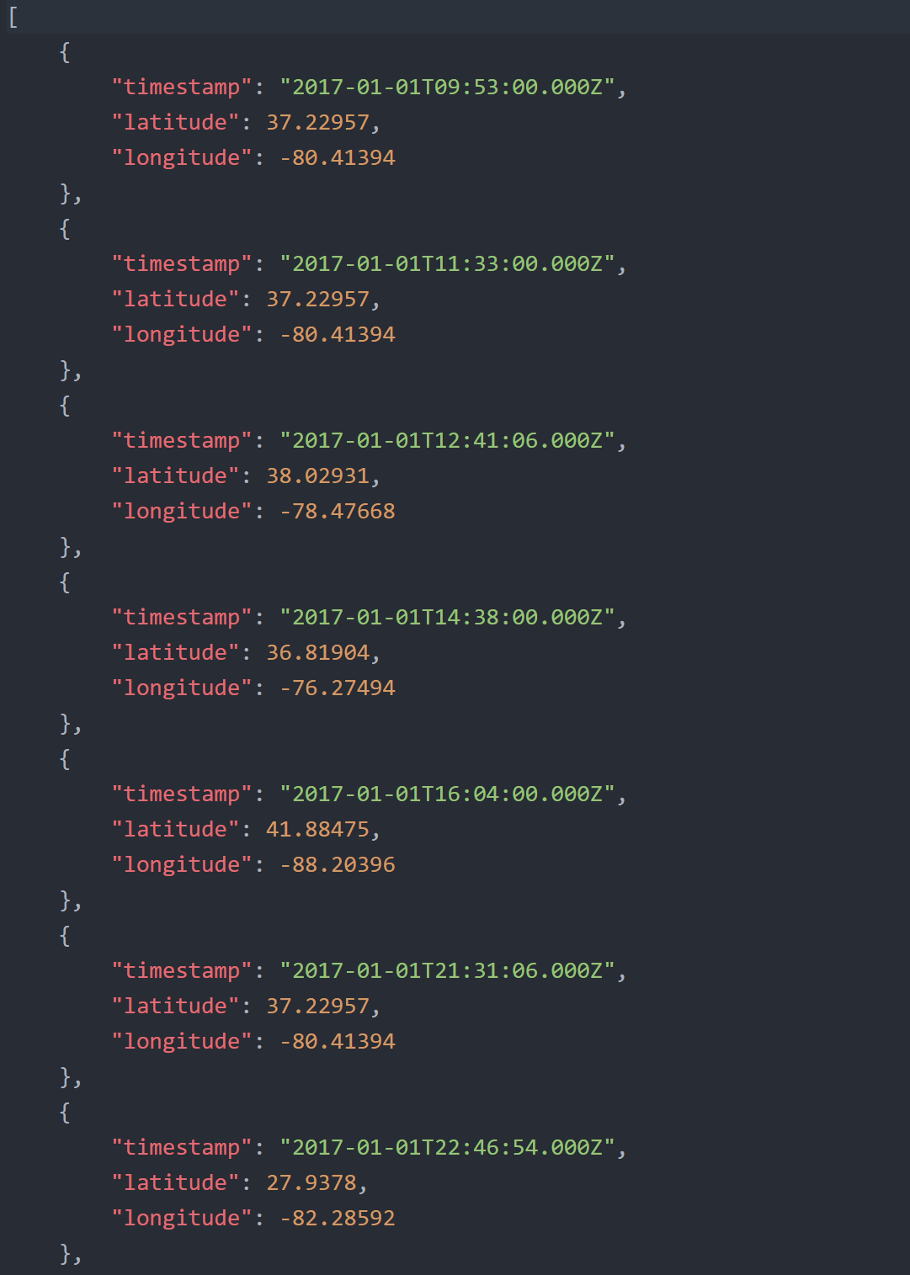

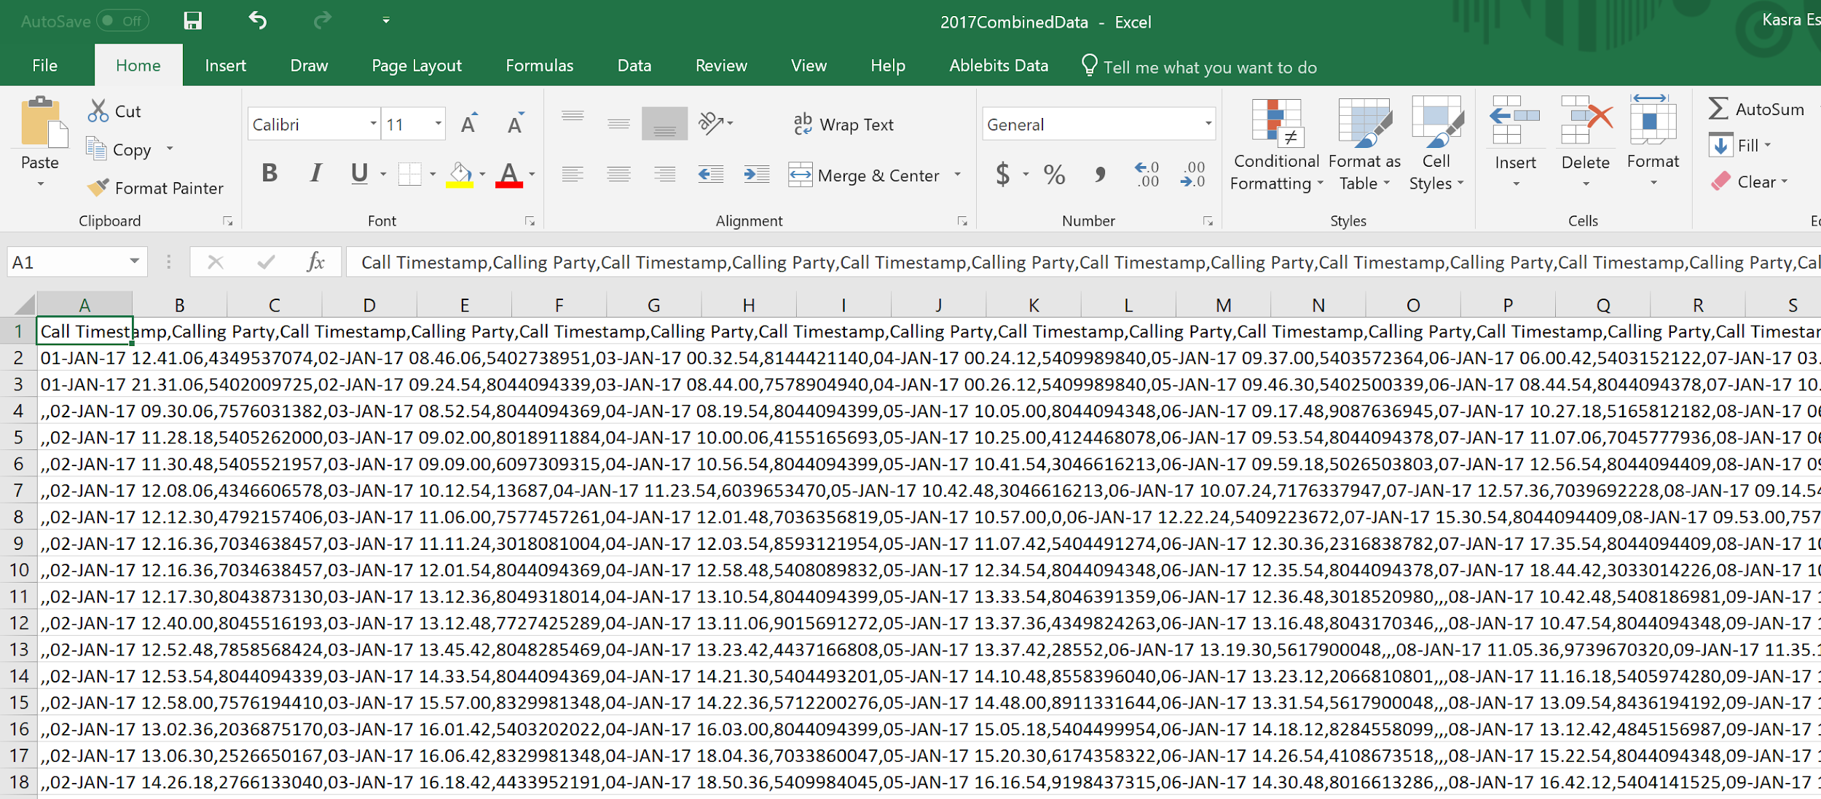

Slide 8
Work Completed
Map styling/UI, playback simulation

Slide 9
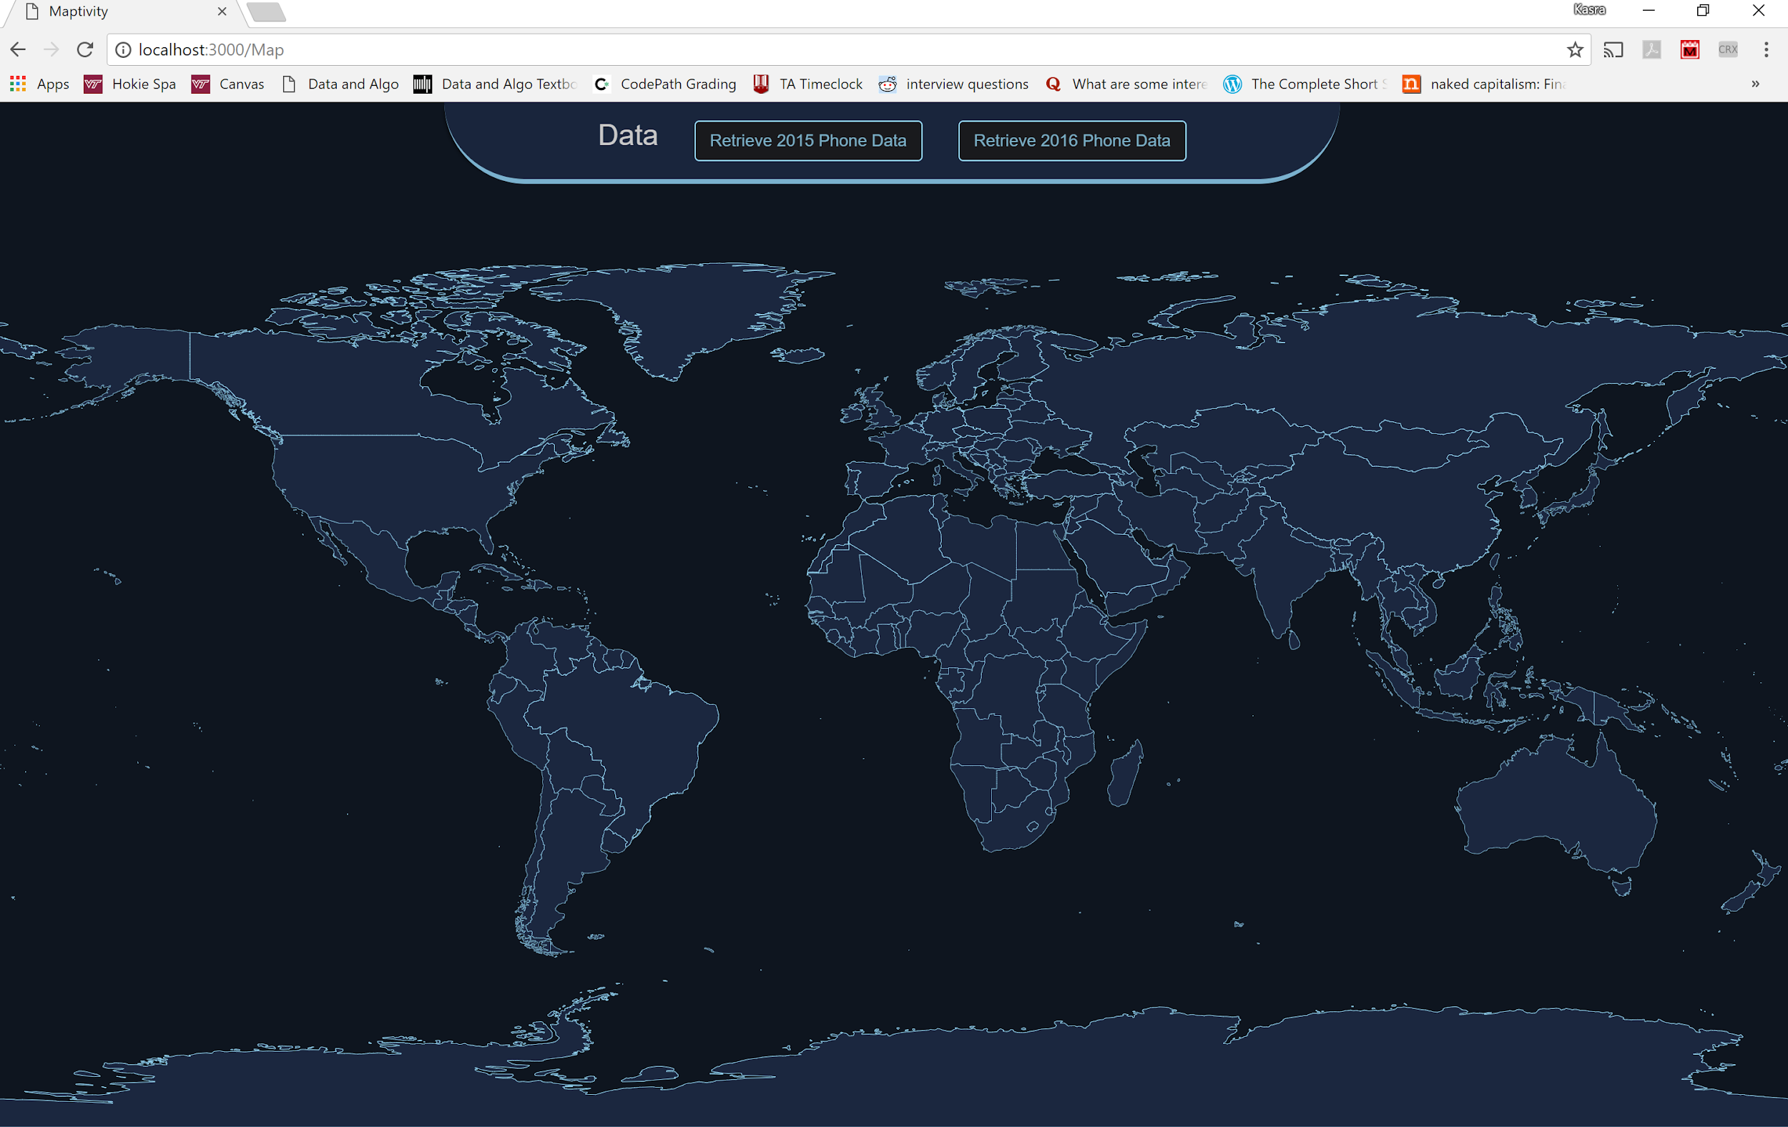
Demo

Slide 10
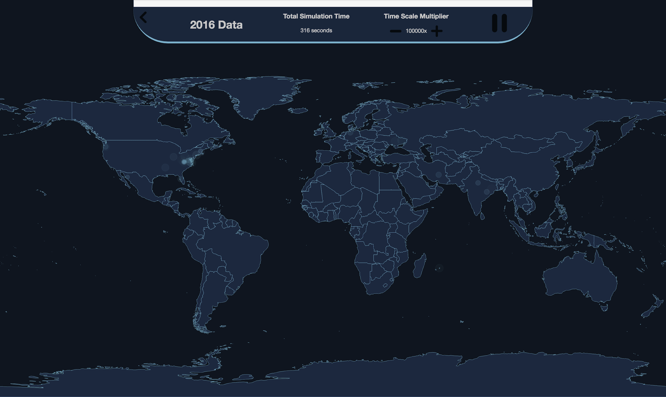

Slide 11
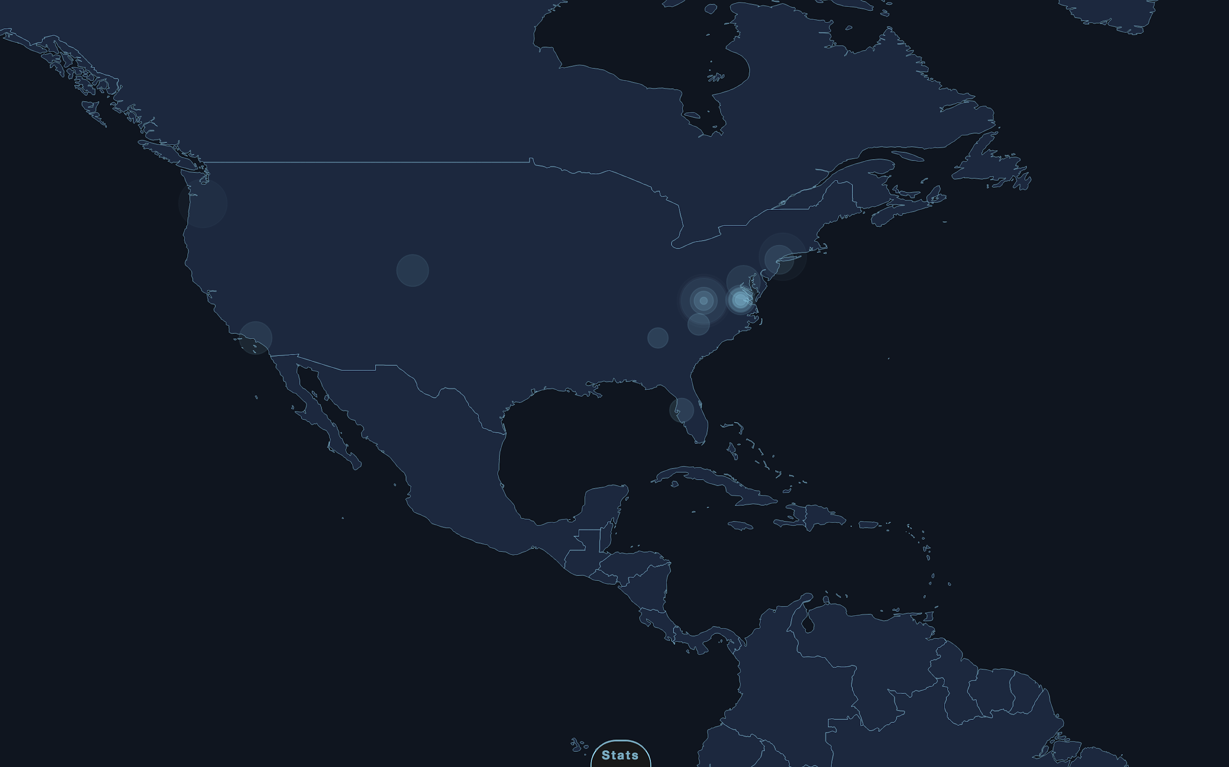

Slide 12
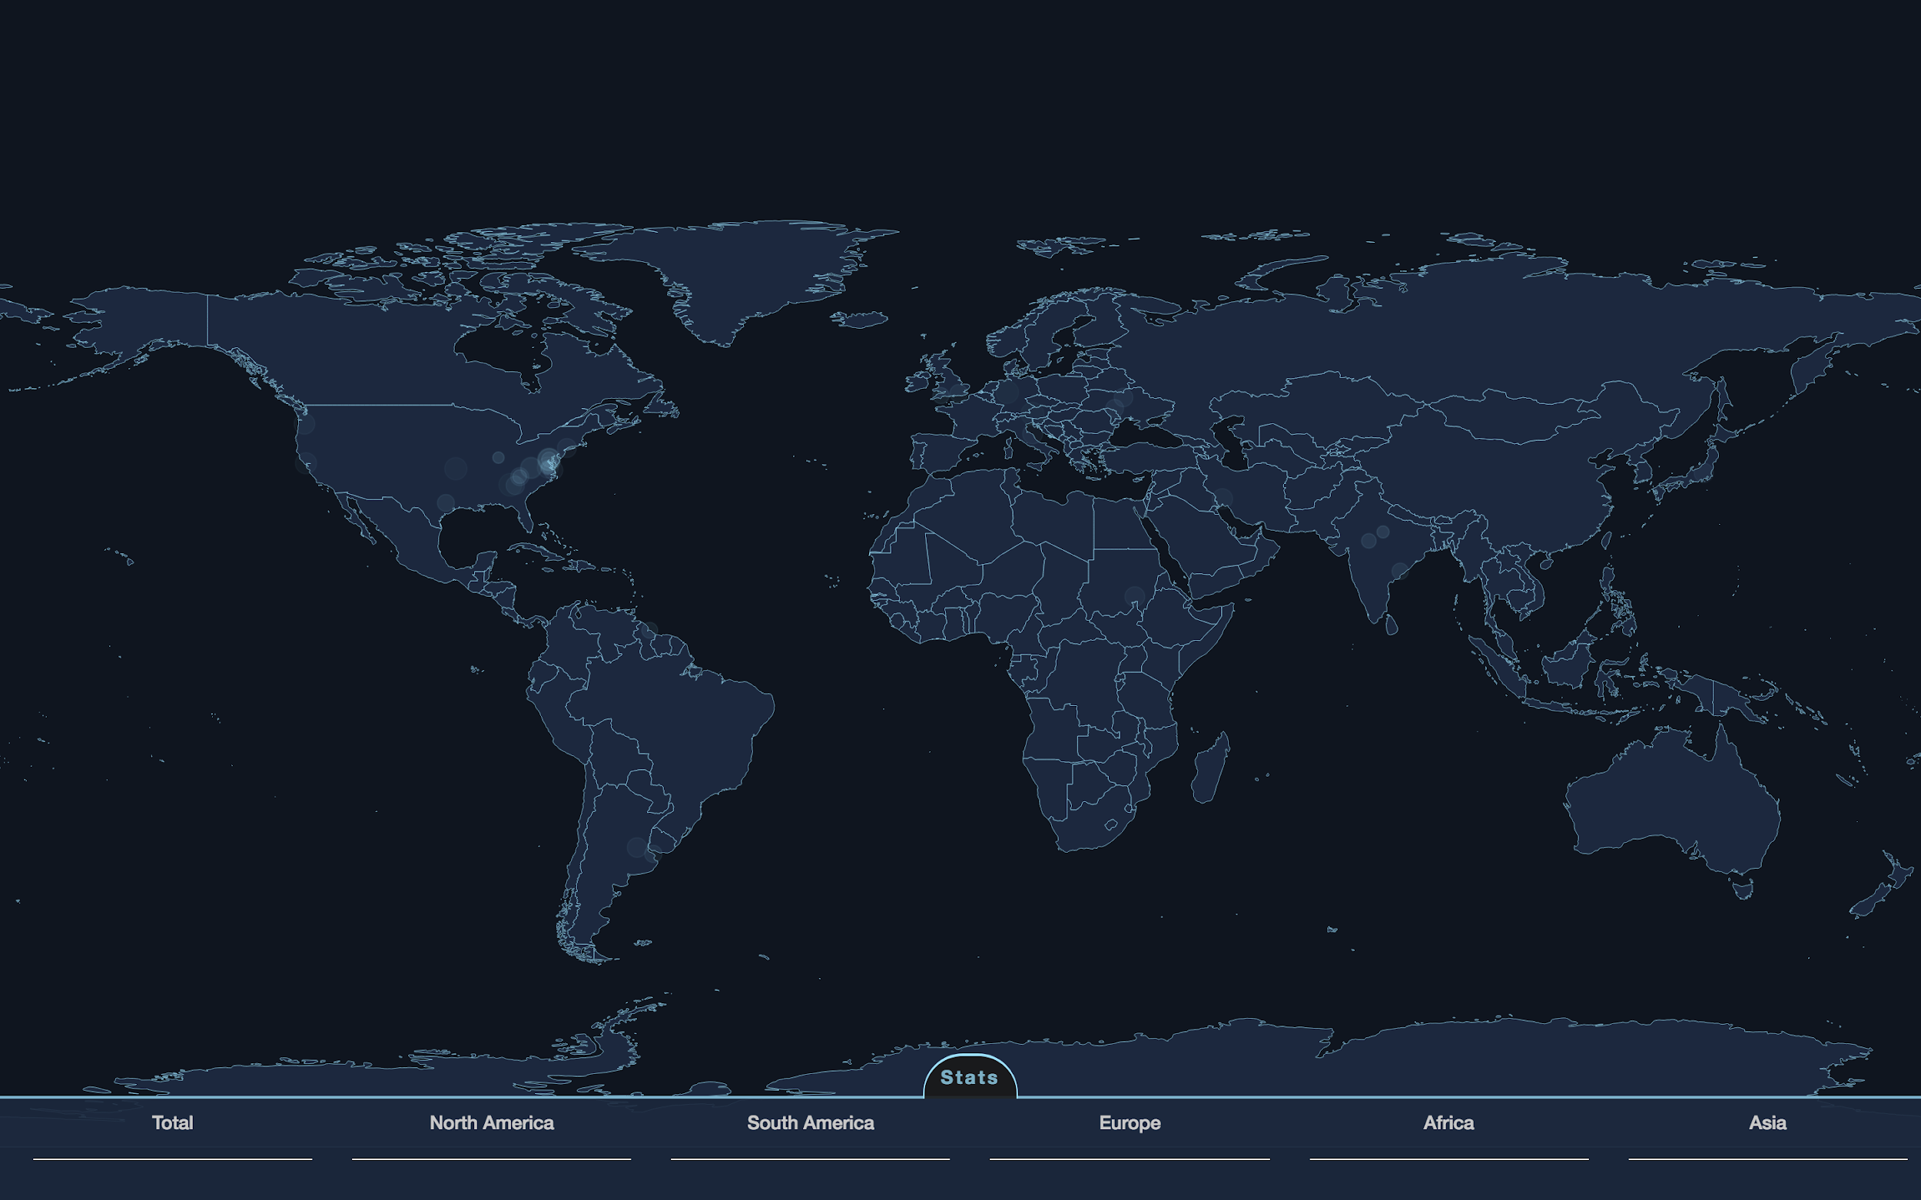

Slide 13
Lessons Learned
Client communication/interaction will not always go smoothly
Learning curve with new technologies, tech stacks
Team management

Slide 14
Finishing Touches
Employ existing websockets framework and API endpoint for real-time data feed
Polish UI
Add additional features for data analytics
Deploy to EC2 Instance

Slide 15
Questions?
?

