Slide 1
Graph Query Portal
Amit Dayal
David Brock
CS4624: Multimedia, Hypertext, and Information Access
Instructor: Edward A. Fox
Virginia Tech, Blacksburg, VA, 24061
May 1, 2018

Slide 2
Outline
Problem Description
Challenges
System Architecture
Data Flow
Scenario Description
Live Demo
Extra Features
Acknowledgments
References
Questions

Slide 3
Problem Description:
Background
Social Interactome project
Set of social network-based clinical trials to test interventions to improve network effect on addiction recovery.
Problem
How do we make the data analysis process easier?

Slide 4
Challenges
Data preparation is hard, time consuming. (MySQL schema is messy).
Analysis across heterogeneous sources and info is difficult.
Analysis process is not currently stream-lined and/or reproducible.

Slide 5
Aims
Identify key, repeated tasks executed by SI researchers.
Model data and operations to support these tasks.

Slide 6
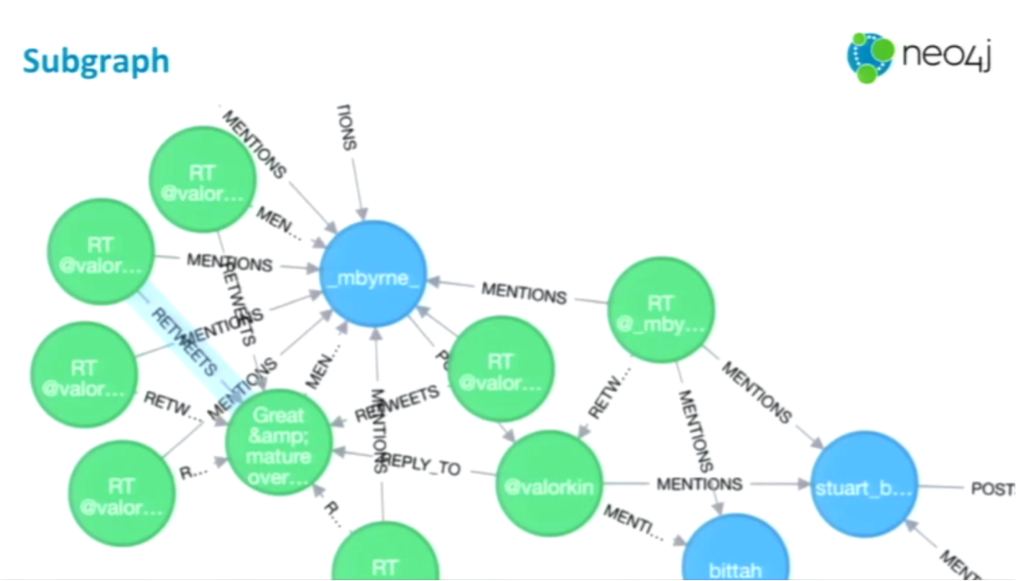
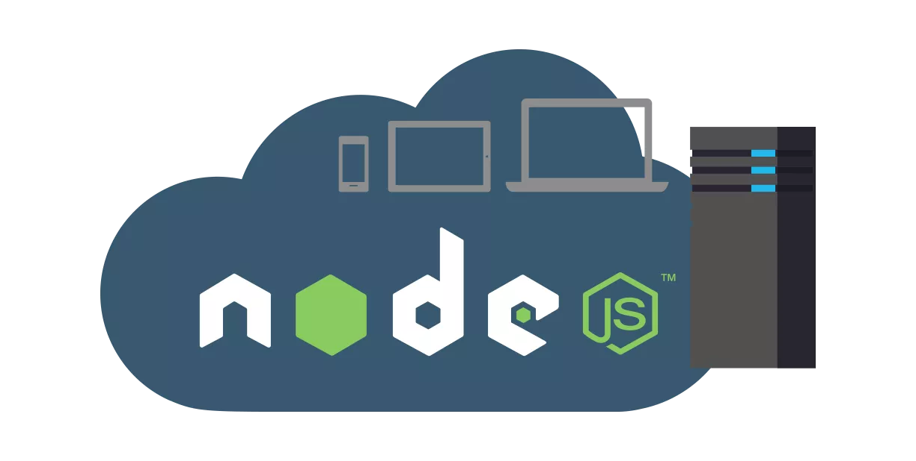
System Architecture Cont.
Graph Query Portal Data Storage: Neo4j
Middleware: Node.js
https://s3.amazonaws.com/dev.assets.neo4j.com/wp-content/uploads/20160309120002/subgraph-query-in-neo4j.png
https://i0.wp.com/securitytraning.com/wp-content/uploads/2017/08/Nodejs-server-setup.png?fit=1224%2C618&ssl=1

Slide 7
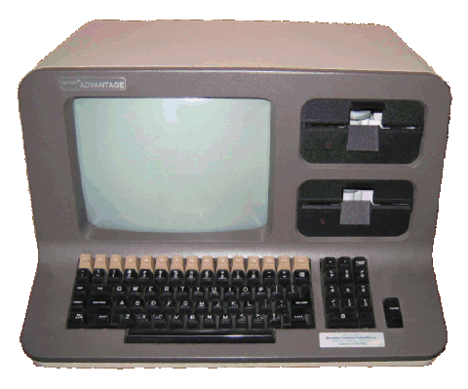


Data Flow
HTTP Response
Neo4j Results
Processing
HTTP Request
Query

Slide 8
Live Demo - Scenarios
As a researcher:
I want to see a single participant’s data
I want to see all participant data
I want to see all the nodes in this graph
I want to see the amount of engagements between two people
I want to see the number of engagements between people and compare it with another network’s engagements

Slide 9
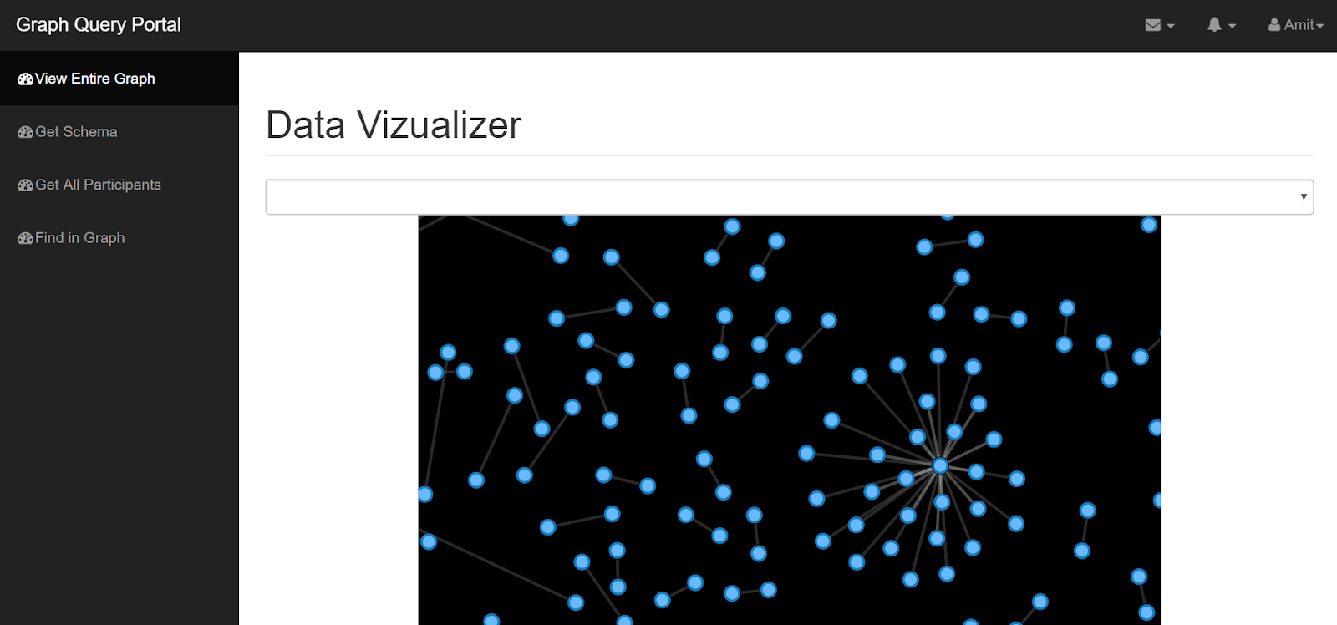

Extra Features
Added a Mongo Database instance for logging API and Neo4j interactions
Created a Front-end website to display information from the API in a browser
Can interact with data
Support for all read APIs

Slide 10


Acknowledgments
Clients: Prashant Chandrasekar, Dr. Fox
NIH Grant 1R01DA039456-01: The Social Interactome of Recovery: Social Media as Therapy Development

Slide 11
Questions

Slide 12
References
"node-v0.x-archive on GitHub". Retrieved 2 August 2014.
"Node.js 10 ChangeLog". Retrieved 25 Apr 2018.
"Node.js 8 ChangeLog". Retrieved 30 Mar 2018.
"node/LICENSE at master". GitHub. Node.js Foundation. 12 July 2017. Retrieved 12 July 2017.
Neubauer, Peter [@peterneubauer] (17 Feb 2010). "@sarkkine #Neo4j was developed as part of a CMS SaaS 2000-2007, became released OSS 2007 when Neo Technology spun out"(Tweet) – via Twitter.
neo4j (February 9, 2018). "Release 3.3.3" – via Github.
"Release Notes: Neo4j 3.3.3". Neo4j Graph Database Platform. February 12, 2018. Retrieved 2018-03-06.
Neo Technology. "Neo4j Graph Database". Retrieved 2015-11-04.

Slide 13
Appendix:
See Following Slides for Live Demo Information

Slide 14
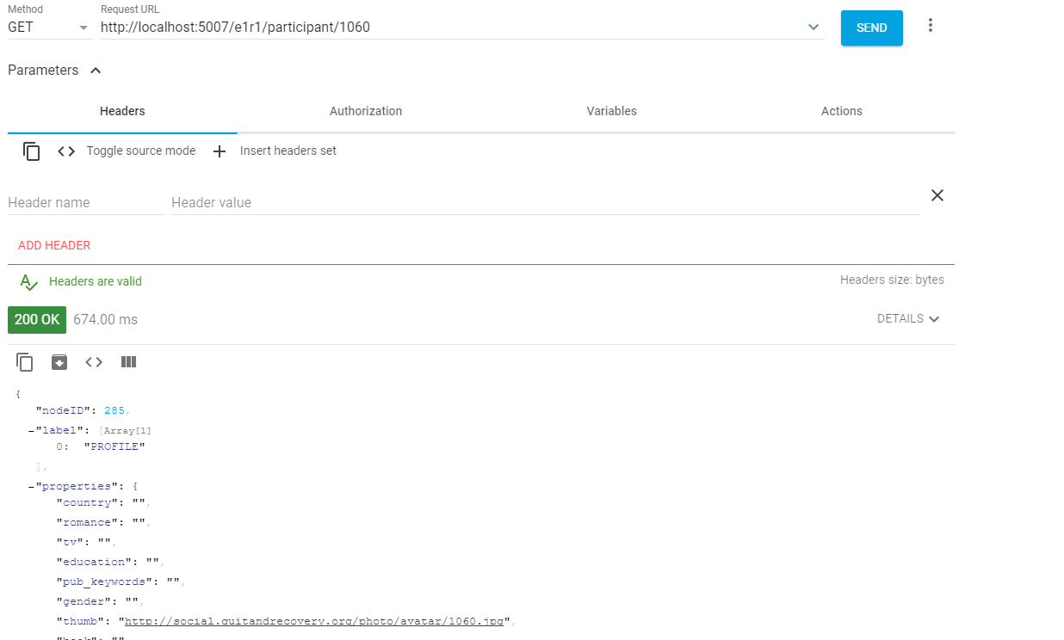
Scenario 1: I want to see a single participant’s data

Slide 15
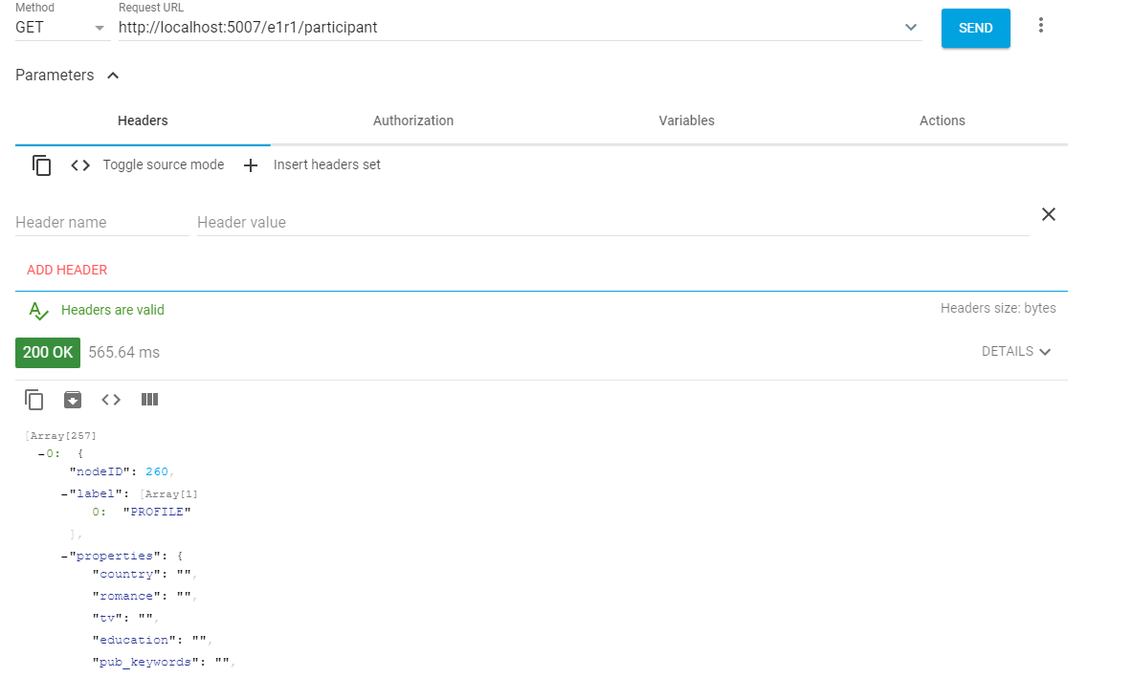
Scenario 2: I want to see all the participants’ data

Slide 16
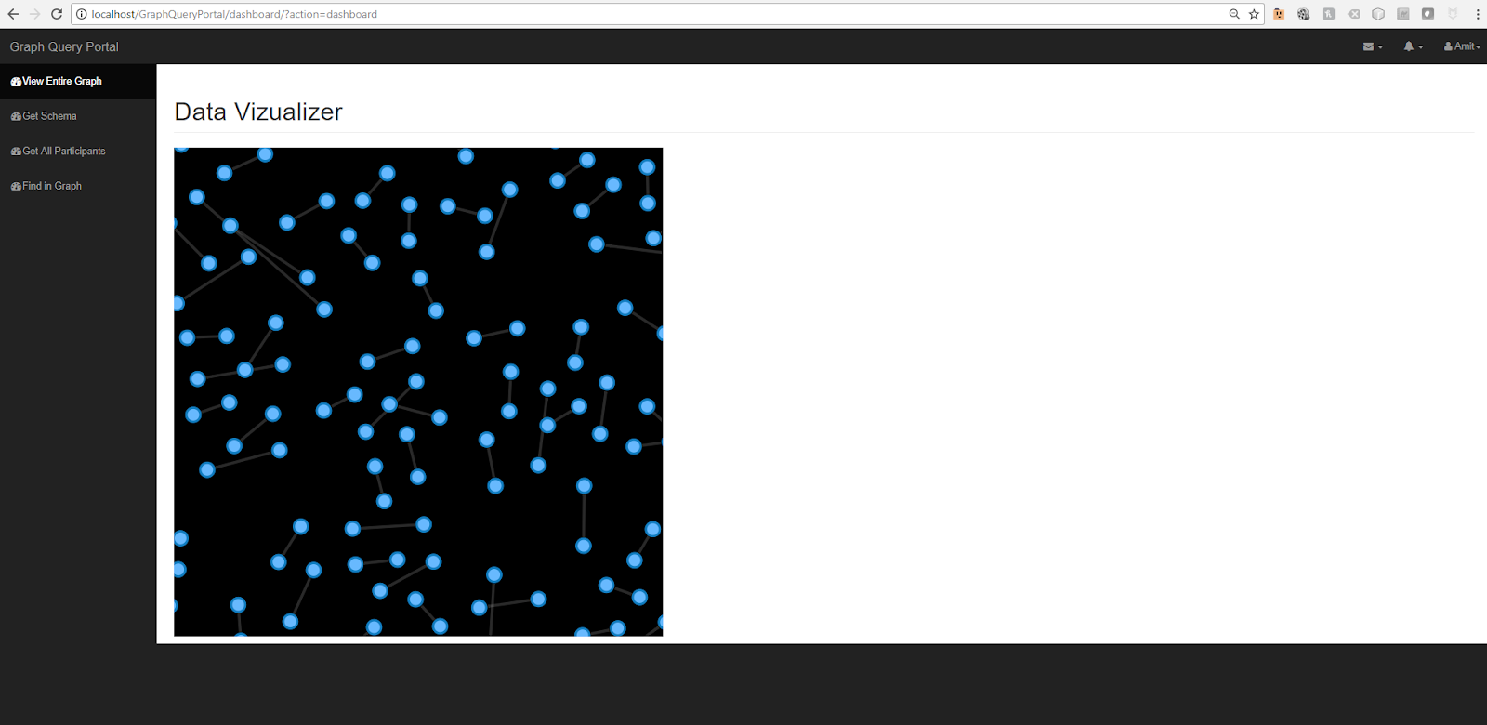
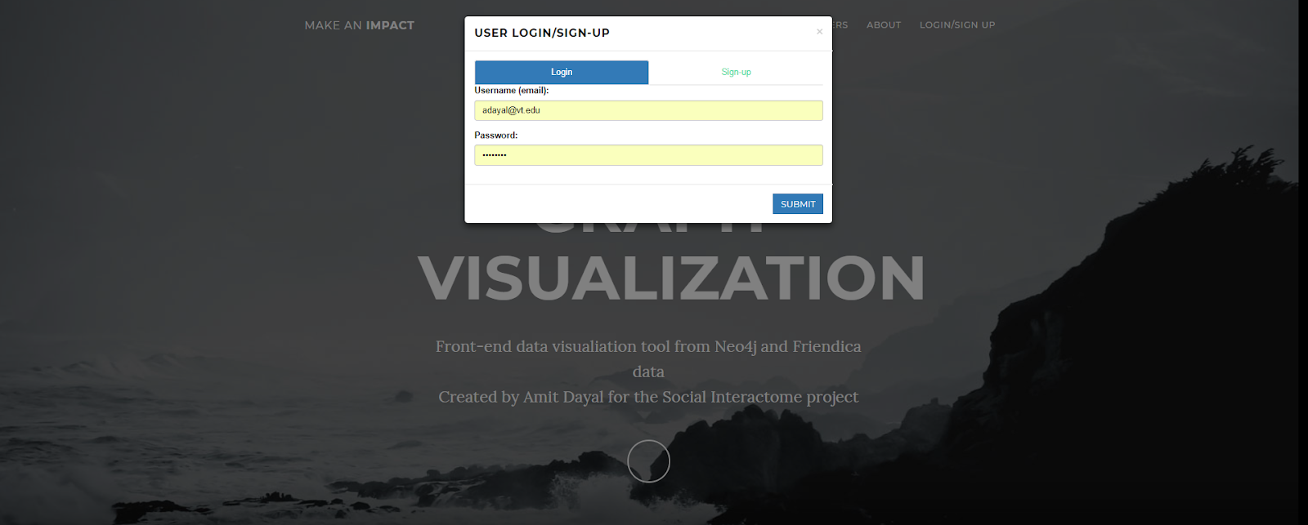
Scenario 3: I want to see the graph in its entirety

Slide 17
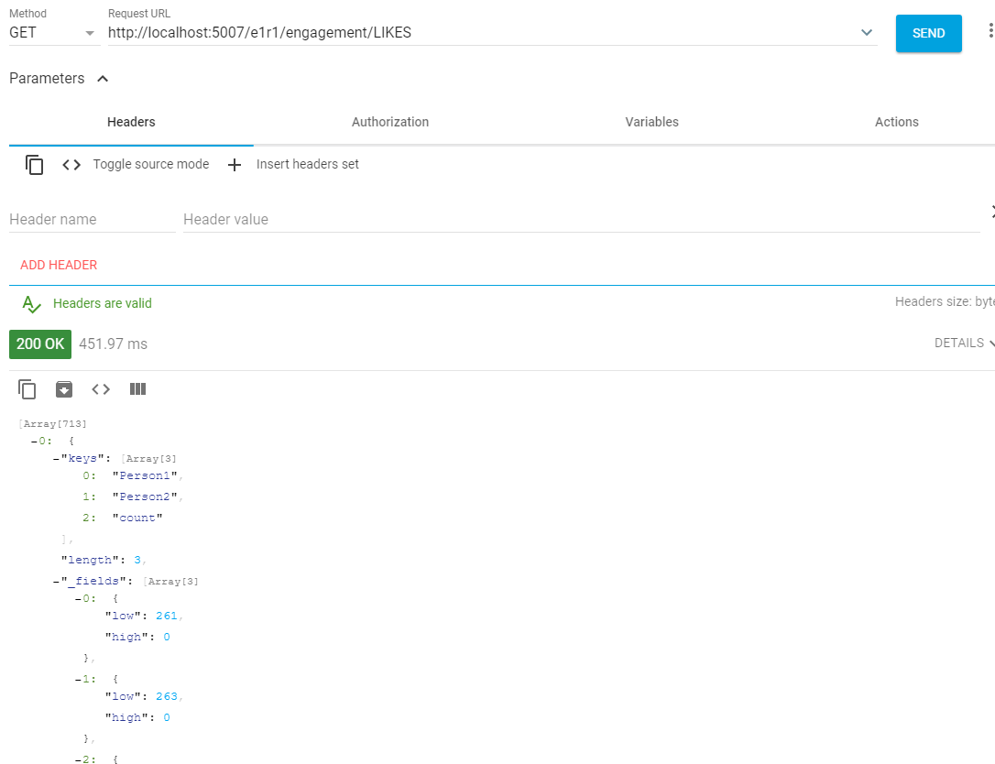
Scenario 4: As a researcher, I would like to see the amount of engagements between two people

Slide 18
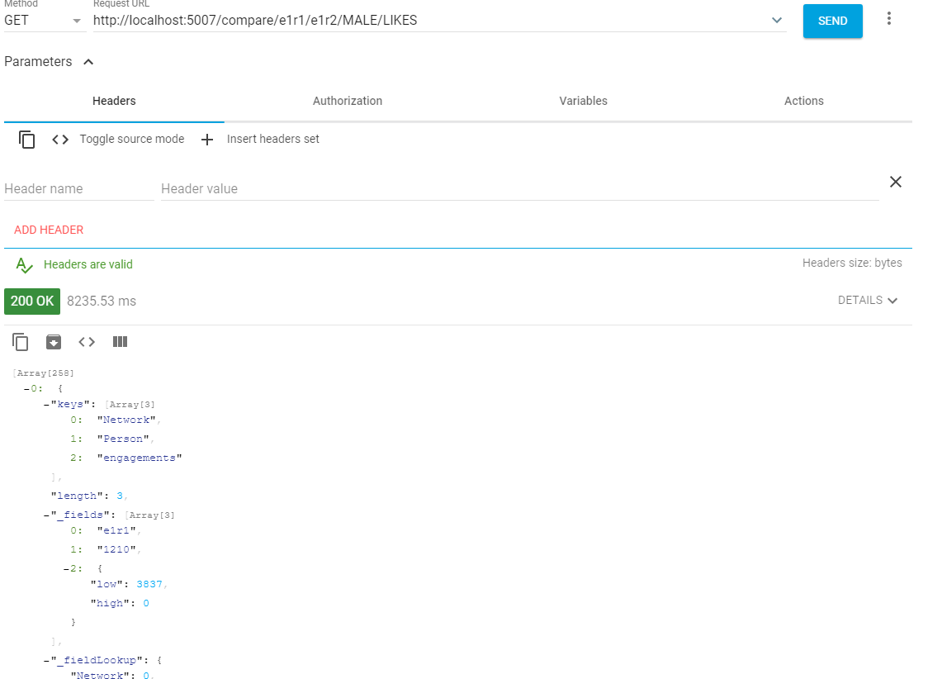
Scenario 5: I want to see the number of engagements between people and compare it with another network’s engagements

