Slide 1
BIG DATA TEXT SUMMARIZATION:
Using Deep Learning to Summarize
Theses and Dissertations
TEAM 16: Naman Ahuja, Ritesh Bansal, Bill Ingram, Palakh Jude, Sampanna Kahu, Xinyue Wang
CS4984/5984: Big Data Text Summarization, Fall 2018
Instructor: Dr. Edward A. Fox
Department of Computer Science, Virginia Tech
Blacksburg, VA 24061
December 14, 2018

Slide 2
OUTLINE
Introduction
Extracting ETD Chapters
Training Data
Deep Learning Models
Evaluation
Conclusion

Slide 3
1. INTRODUCTION

Slide 4
RESEARCH
QUESTIONS
This project addresses problems related to summarizing long documents by answering the following research questions.

Slide 5
RESEARCH QUESTIONS
RQ1
Can we identify and extract individual chapters from an ETD document?
RQ2
Can we automatically construct summaries of chapters from an ETD through existing deep learning models with non-local training data?
RQ3
Can we improve the quality of automatically constructed summaries for the same model through partial-local training data?
RQ4
Can we improve the quality of automatically constructed summaries for the same model through combining partial-local and non-local training data?

Slide 6
2. EXTRACTING
ETD CHAPTERS

Slide 7
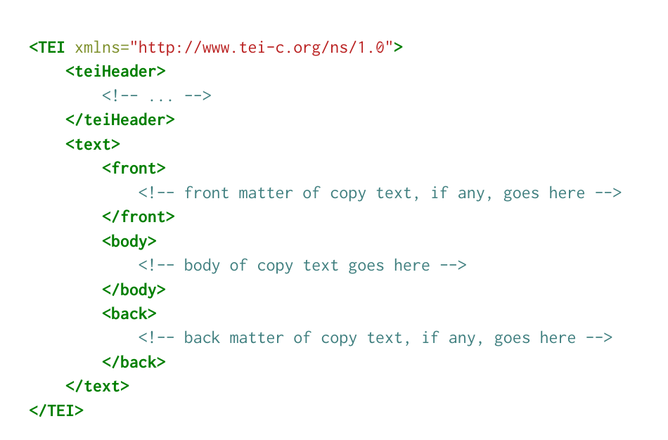

GROBID
GeneRation Of BIbliographic Data
Grobid is a machine learning library for extracting, parsing and re-structuring raw documents such as PDF into structured TEI-encoded documents.

Slide 8
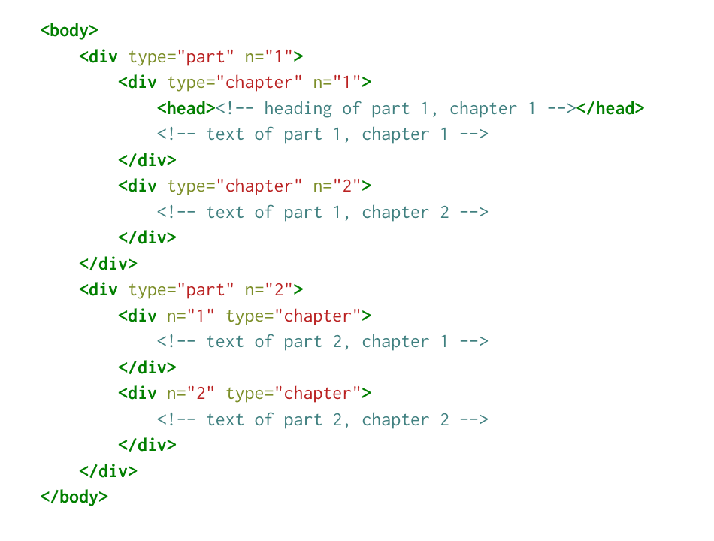
CHAPTER TEXT IS EASILY EXTRACTED FROM TEI XML
E.g., XPath: //body/div[@type=”chapter”]

Slide 9
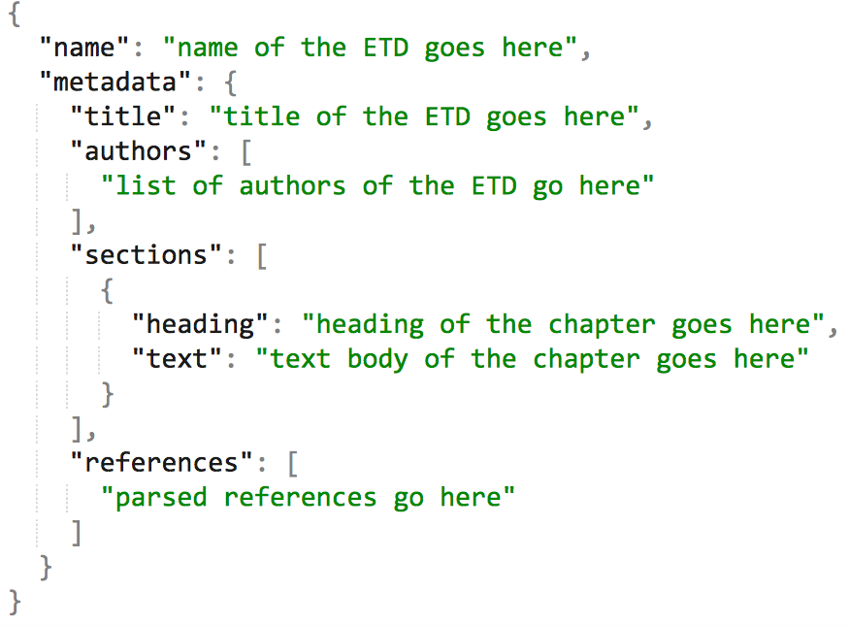
ScienceParse
Science Parse parses scientific papers (in PDF form) and returns them into a structured JSON form.

Slide 10
RQ1: Can we identify and extract individual chapters from an ETD document?
We experimented with two applications
  Grobid
  Science-parse
Both performed well at generating structured data from unstructured sources. Grobid was better at identifying chapters in ETDs.

Slide 11
3. TRAINING DATA

Slide 12
TRAINING DATA
CNN/DailyMail
News articles of CNN and Daily Mail and corresponding summaries.
Size: 300k records
Wikipedia All (WikiAll)
ETD related Wikipedia articles with separated introduction section and article body.
Size: 270,241 records
Wikipedia Thesis (WikiTh)
Sub-collection of Wikipedia, made up of only thesis-related Wikipedia articles.
Size: 66,300 records

Slide 13
GET ETD RELATED WIKIPEDIA
THROUGH DOC2VEC
most_similar(chapter_vector)
Article 1 0.876543
Article 2 0.654321
Article 3 0.987654
…
Returns vectors with shortest cosine distance
Wikipedia articles embedded as document vectors
infer_vector(chapter_text)
Each chapter becomes a document vector
ETD Chapters
Model trained on Wikipedia

Slide 14
4. DEEP LEARNING MODELS

Slide 15

STATE-OF-THE-ART DEEP NEURAL NETWORK MODELS
Pointer-Generator
Sequence-to-Sequence
Fast Abstractive Summarization-RL
Image credit: https://www.arl.army.mil/www/default.cfm?article=3179

Slide 16
Training Design
We apply following training resources for each model:
CNN DailyMail
All ETD related Wikipedia Pages
CNN DailyMail + Thesis related Wikipedia Pages
CNN DailyMail + All ETD related Wikipedia Pages

Slide 17
Sequence-to-sequence
Hyper-parameter values used for training on CNN dataset
Max tokens of generated summary | Max source text tokens | Batch size | Vocabulary size | Number of iterations
100 | 400 | 64 | 40000 | 22K
Hyper-parameter values used for training on Wikipedia dataset
Max tokens of generated summary | Max source text tokens | Batch size | Vocabulary size | Number of iterations
500 | 500 | 64 | 40000 | 5134

Slide 18
Pointer-Generator
Hyper-parameter values used for training
Experiments on Hyper-parameter tuning | Max tokens of generated summary | Max source text tokens | Coverage | Batch size | Vocabulary size | Number of iterations
E1 (Finished) | 100 | 400 | NO | 2 | 50000 | 50K
E2 (Finished) | 500 | 1000 | YES | 2 | 20000 | 50K
E3 (In training) | 500 | 1000 | YES | 4 | 100000 | 50K

Slide 19
Fast Abstractive Summarization - RL
Configuration used for training the abstractor and extractor models
Training Data | Vocabulary Size | Word Embedding Dimensions | Batch Size | Gradient Clipping
CNN | 30000 | 128 | 32 | 2.0
CNN + WikiThesis | 50000 | 300 | 32 | 2.0
Configuration used for training the RL mode (On Training)
Reward Function | Learning Rate Decay Ratio | Discount Factor | Gradient Clipping | Batch Size
rouge-l | 0.5 | 0.95 | 2.0 | 8

Slide 20
5. EVALUATION

Slide 21
ROUGE PERFORMANCE:
Sequence-to-Sequence
 | 1 | 2 | L
CNN | 0.20417 | 0.06918 | 0.16152
WikiAll | 0.06272 | 0.0115 | 0.05816
CNN+ WikiThesis | 0.01029 | 0.00342 | 0.01029
CNN+WikiAll | 0.07748 | 0.0181 | 0.06899

Slide 22
GS: The primary source of data for this study of mentoring and instructional coaching in conjunction with new teacher support came from interviews in 4 elementary schools with four novice teachers, two mentors, and two instructional coaches. There were 3 main findings, regarding classroom procedures to academic achievement, emotional support coupled with academic and instructional guidance, and emotional support vs. academic support. Mentorship helped novice teachers learn the practical things not taught in college, and the everyday operations of a teacher. While mentorship is focused on teacher wellbeing and support, instructional coaching aims at student support and their academic success. Novice teachers indicated feelings of overwhelming isolation. They expressed feeling emotionally supported by their mentors, which helped to fight the feeling of isolation. The subjects’ reported perceptions of instructional coaching were also positive. The mentors and instructional coaches reported seeing incredible value in the service they offer to novice teachers. Perceptions were learned about each program to improve their function and importance. | CNN-DailyMail: <UNK> new teachers is critical to their overall career success and ultimately influences student achievement . <UNK> <UNK> There often leave the field of education within their first five years of teaching . <UNK> <UNK> There are a variety of ways to support new teachers which are part of the induction process . <UNK>
 | CNN-DailyMail+WikiAll: <UNK> is a mentor of venues , such as a <UNK> teacher of the <UNK> teacher of the nation of the nation of the nation of the nation of the nation of the nation of the nation of the nation of the nation of the nation of the nation of the nation of the nation of the nation of the nation of the nation of the <UNK> .</s>

Slide 23
ROUGE PERFORMANCE:
Pointer-Generator
E1 | 1 | 2 | L
CNN | 0.23783 | 0.09704 | 0.21277
WikiAll | 0.17199 | 0.0562 | 0.15392
CNN+ WikiThesis | 0.19376 | 0.07587 | 0.17449
CNN+WikiAll | 0.11133 | 0.0336 | 0.10251
E2 | 1 | 2 | L
CNN | 0.22982 | 0.07827 | 0.2068
WikiAll | 0.18828 | 0.06504 | 0.17319
CNN+ WikiThesis | 0.21424 | 0.07804 | 0.18966
CNN+WikiAll | 0.13725 | 0.04079 | 0.1219
Applying coverage with longer encoding and decoding sequence length is improving the performance for Wikipedia training.

Slide 24
GS: The primary source of data for this study of mentoring and instructional coaching in conjunction with new teacher support came from interviews in 4 elementary schools with four novice teachers, two mentors, and two instructional coaches. There were 3 main findings, regarding classroom procedures to academic achievement, emotional support coupled with academic and instructional guidance, and emotional support vs. academic support. Mentorship helped novice teachers learn the practical things not taught in college, and the everyday operations of a teacher. While mentorship is focused on teacher well being and support, instructional coaching aims at student support and their academic success. Novice teachers indicated feelings of overwhelming isolation. They expressed feeling emotionally supported by their mentors, which helped to fight the feeling of isolation. The subjects’ reported perceptions of instructional coaching were also positive. The mentors and instructional coaches reported seeing incredible value in the service they offer to novice teachers. Perceptions were learned about each program to improve their function and importance. | CNN-DailyMail E2: Novice shortages are occurring in the nation , but these shortages could be offset by having novice teachers stay in the field of education within their first five years of teaching . Teachers are a variety of ways to support new teachers which are part of the induction process . Two are the perceptions of mentoring and instructional coaching as new elementary teacher support in NVPS ?
 | CNN-DailyMail + WikiTh E2: teachers need various supports as they begin their careers in education . Supports teachers need to recruit and hire qualified applicants . I shortages could be offset by having novice teachers stay in the field of education longer . The are the perceptions of mentoring and instructional coaching as new elementary teacher support in NVPS . The are the perceptions of novice teachers and the instructional leaders -LRB- mentors and instructional coaches -RRB- toward induction program supports and what best matches the needs of a novice teacher in public education in NVPS . The , studying perceptions allows for the research to find how novice teachers felt toward the support and if it was what they wanted and needed as they embarked on their career .
WikiAll E1: A Novice teacher is a teacher who is interested in the field of education in the United States and Canada . It is a part of the broader field of instructional coaching , and is a part of the broader field of instructional coaching .

Slide 25
ROUGE PERFORMANCE:
Fast Abstractive Summarization-RL
 | 1 | 2 | L
CNN | 0.2334 | 0.0939 | 0.1999

Slide 26
GS: The primary source of data for this study of mentoring and instructional coaching in conjunction with new teacher support came from interviews in 4 elementary schools with four novice teachers, two mentors, and two instructional coaches. There were 3 main findings, regarding classroom procedures to academic achievement, emotional support coupled with academic and instructional guidance, and emotional support vs. academic support. Mentorship helped novice teachers learn the practical things not taught in college, and the everyday operations of a teacher. While mentorship is focused on teacher well being and support, instructional coaching aims at student support and their academic success. Novice teachers indicated feelings of overwhelming isolation. They expressed feeling emotionally supported by their mentors, which helped to fight the feeling of isolation. The subjects’ reported perceptions of instructional coaching were also positive. The mentors and instructional coaches reported seeing incredible value in the service they offer to novice teachers. Perceptions were learned about each program to improve their function and importance.
CNN-DailyMail: novice teachers need various supports as they begin their careers. supports exist through a variety of venues , such as a buddy teacher , a mentor , and instructional. teachers often leave the field of education within their first five years of teaching . this can occur with the proper support and guidance through induction programs. induction . supporting new teachers is critical to their overall career success .

Slide 27
6. CONCLUSION

Slide 28
ROUGE PERFORMANCE
Model | Training Data | 1 | 2 | L
Seq2Seq | CNN WikiAll CNN+WikiThesis CNN+WikiAll | 0.20417 0.06272 0.01029 0.07748 | 0.06918 0.0115 0.00342 0.0181 | 0.16152 0.05816 0.01029 0.0689
Pointer-Generator | CNN E2 WikiAll E2 CNN+WikiThesis E2 CNN+WikiAll E2 | 0.22982 0.18828 0.21424 0.13725 | 0.07827 0.06504 0.07804 0.04079 | 0.04079 0.17319 0.18966 0.1219
Fast Abstractive Summarization-RL | CNN | 0.2334 | 0.0939 | 0.1999

Slide 29
RQ1 Can we identify and extract individual chapters from an ETD document?
Answer: Both GROBID and ScienceParse had trouble accurately parsing ETD chapters. We feel this could be improved by training them on ETDs, but we leave that for future work.
RQ2 Can we automatically construct summaries of chapters from an ETD through existing deep learning models with non-local training data?
Answer: All our models can automatically generate summaries with limited information that is related to our target
RQ3 Can we improve the quality of automatically constructed summaries for the same model through partial-local training data?
Answer: Wikipedia collection helps the model to generate different information that are related to our target comparing to RQ2
RQ4 Can we improve the quality of automatically constructed summaries for the same model through combining partial-local and non-local training data?
Answer: The model is not able to combine the good features from models trained on individual resource; The prediction of the model on ETD chapters generally fails

Slide 30
ACKNOWLEDGMENTS
This project was completed over the course of CS4984/5984: Big Data Text Summarization at Virginia Tech. ETD data analyzed was provided by Virginia Tech University Libraries, and the students who have submitted theses or dissertations in connection with their Virginia Tech studies.
The authors would like to thank Dr. Edward A. Fox, Liuqing Li, and our classmates for providing insight and expertise that greatly helped us accomplish this research project.
We thank Dr. Xuan Zhang for sharing his research on deep neural networks for user review summarization.
We thank Dr. Srijith Rajamohan for his lecture on using Cascades and Pytorch.
We thank Dr. Michael Horning for his informative talk on news summarization.
We thank Yaser Keneshloo for assistance with running RLSeq2Seq and Fast Abstractive RL.
We thank Chreston Miller for sharing his expertise with building Pointer-Generator models with TensorFlow. Although we used a different technique for our work, his in-sight was beneficial.
We thank Frank Wanye and his team for sharing their LaTeX template with us for our report.
We thank the other teams working on ETDs, Team 10 and Team 17, for sharing their experience, knowledge, and insights with us. We especially thank Team 10 for sharing the burden of processing the ETDs with Grobid.
Last but not least, we are immensely grateful to the creators of all the open source software we used to create this project. Thank you very much!

Slide 31
THANKS!
Any questions?
TEAM 16:
Naman Ahuja, Ritesh Bansal, Bill Ingram, Palakh Jude, Sampanna Kahu, Xinyue Wang

Slide 32
CREDITS
Special thanks to all the people who made and released these awesome resources for free:
Presentation template by SlidesCarnival
Photographs by Unsplash

