Slide 1

Team 5: Integration
CS5604: Information Storage and Retrieval
Advised by Dr. Edward Fox
Blacksburg, VA 24061
Dec. 06, 2022
Aaron Travasso | Anmol Shukla | Harish Babu | Pallavi Sisodiya | Yuze Li
Subject Matter Expert: Dhanush Dinesh

Slide 2
Agenda
Workflow automation
Workflow CRUD interface
Developer Operations
Future work
Notes:
Ano

Slide 3
01
Workflow Automation

Slide 4
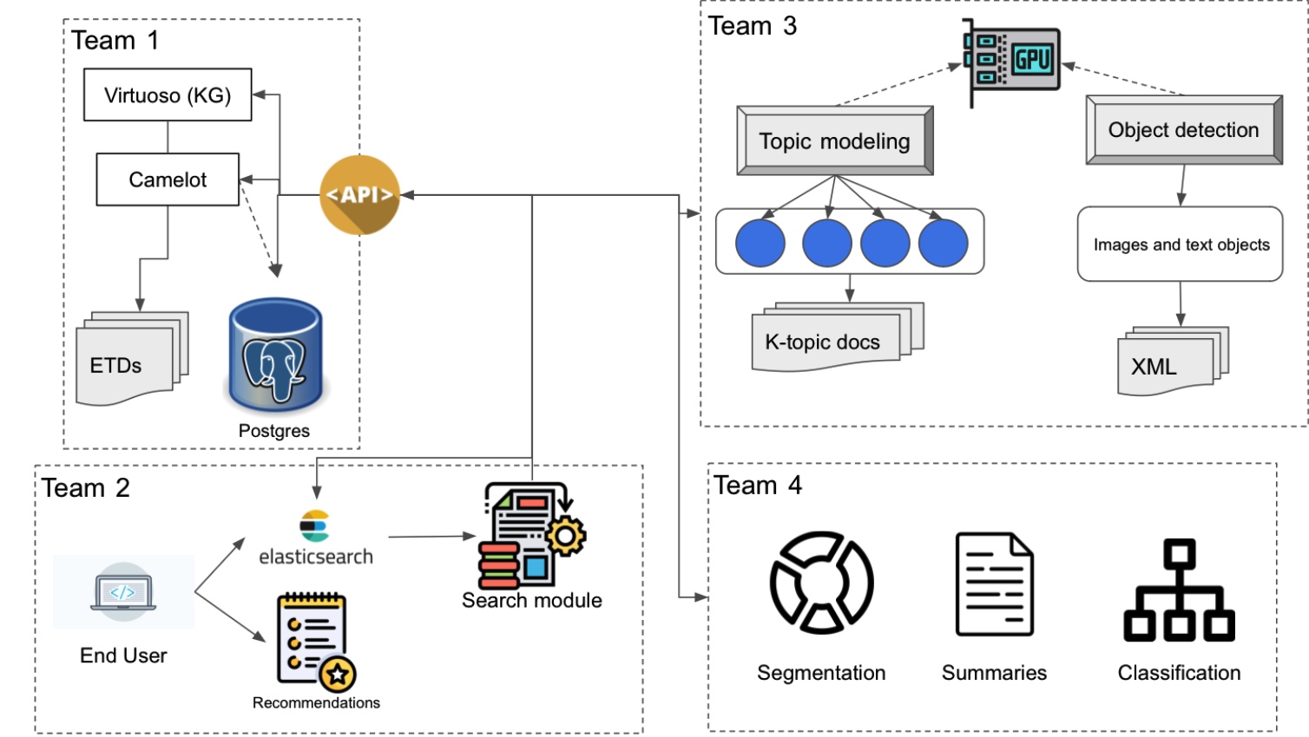
Requirements
Containerization of bunch of services
For developers, hard to maintain dependencies
For end-users, hard to know what they need
Workflow automation helps end-users by abstracting/hiding complex low-level services.
For developers, each service in workflow is containerized, easy to maintain
For end-users, they only see the predefined workflow, don’t care about what’s inside the black box
Notes:
Yuze

Slide 5
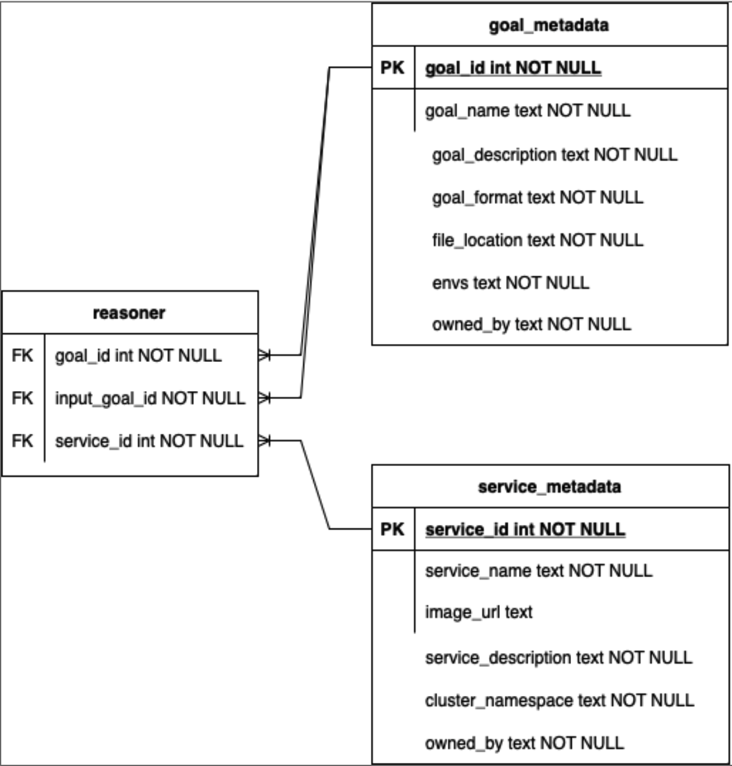
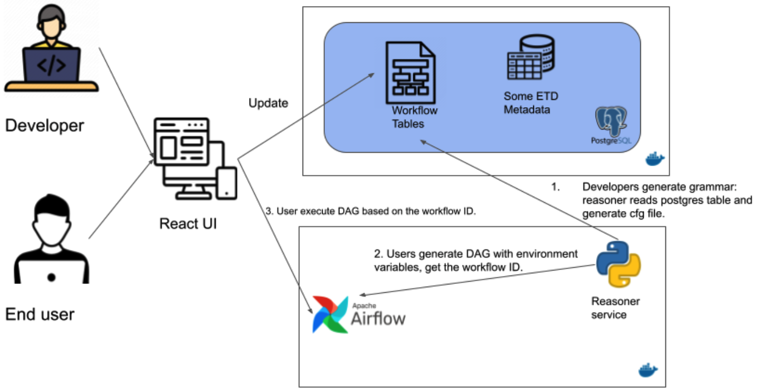
Design
Notes:
Yuze

Slide 6
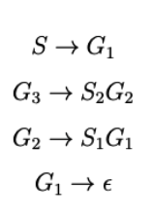
Implementation
Context-Free Grammar (CFG)
Recursively generate patterns
Represents goals and services
Reasoner APIs
Generate grammar (CFG file)
Generate workflow
Required input: <goal_id>
Optional input: <environment (ETD_ID)>
Output: <workflow_id>
Execute workflow
Required input: <workflow_id>
Optional input: <service_id(s)>
Output: <log_url>, <status_key>
Check workflow status
Required input: <status_key>
Output: <status_metadata>
G3->S1S2 epsilon
Notes:
Aaron

Slide 7
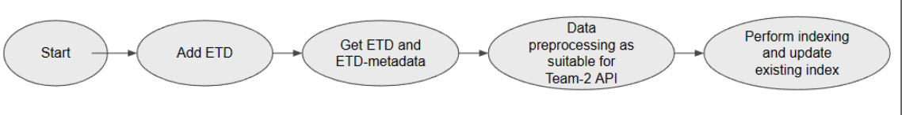
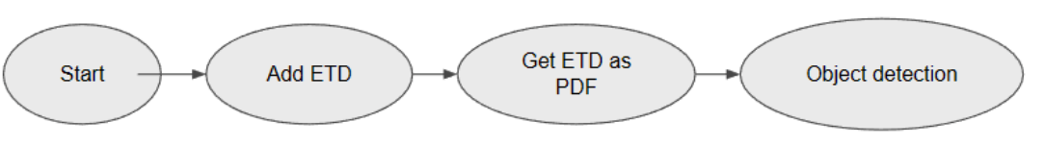
Implementation
Workflows implemented
Indexing
Object detection
Notes:
Aaron

Slide 8
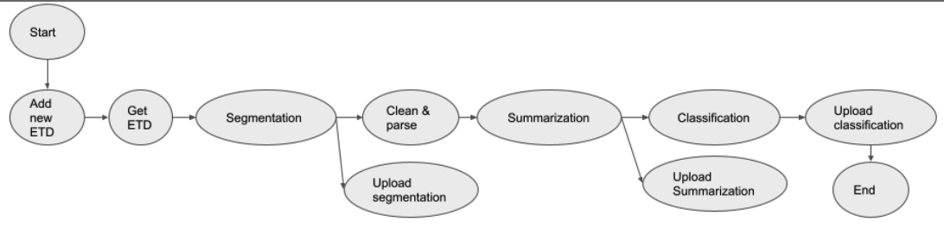
Implementation
Workflows implemented
Segmentation, summarization, classification
Notes:
Aaron

Slide 9
Demonstration
Team-4’s segmentation
File Team5INTdemo.mp4 - Team 4's Segmentation Demo Video
Notes:
Aaron

Slide 10
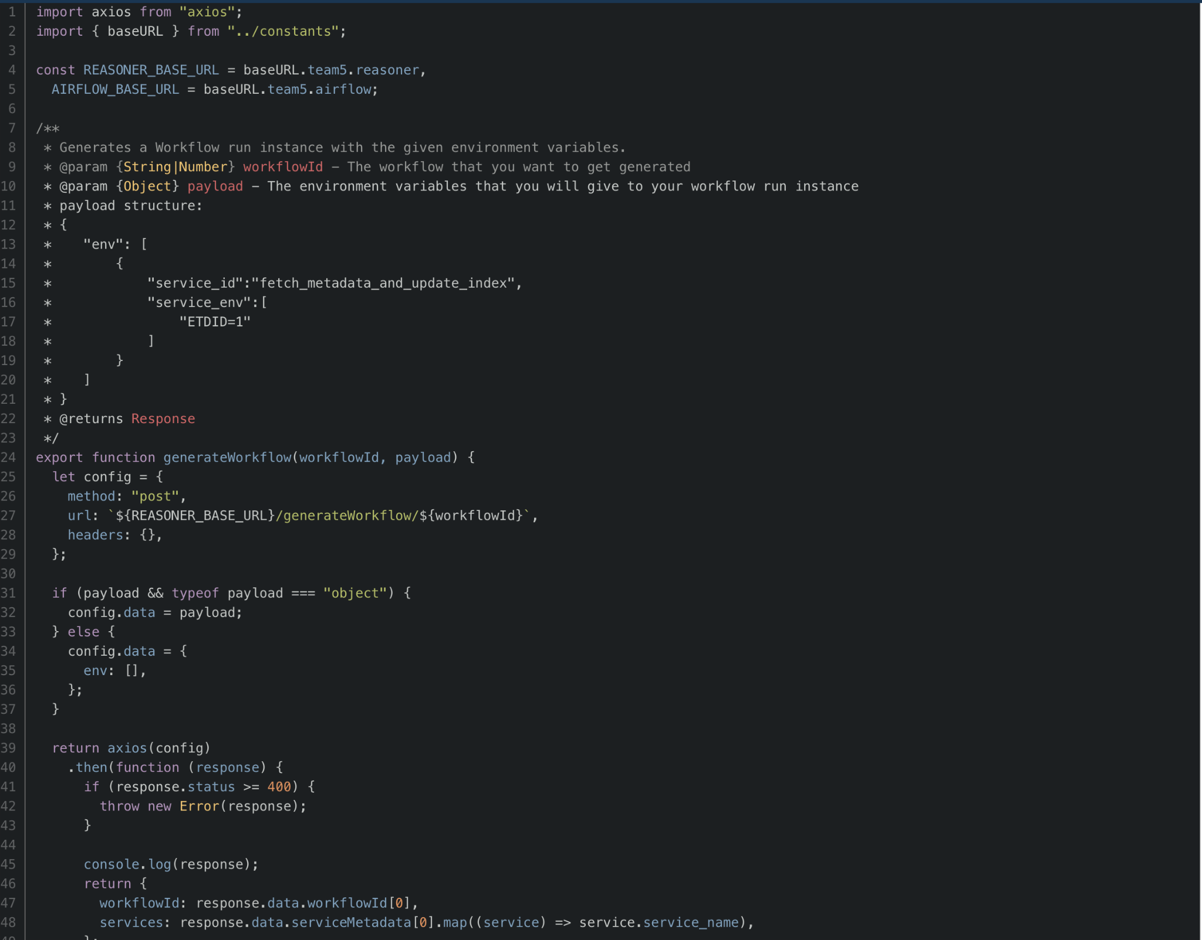
How do I integrate this?
Helper code to generate reasoner [6]
generateWorkflow()
runWorkflow()
getWorkflowStatus()
List of container registries [2]
Notes:
Ano

Slide 11
02
Workflow CRUD Interface

Slide 12
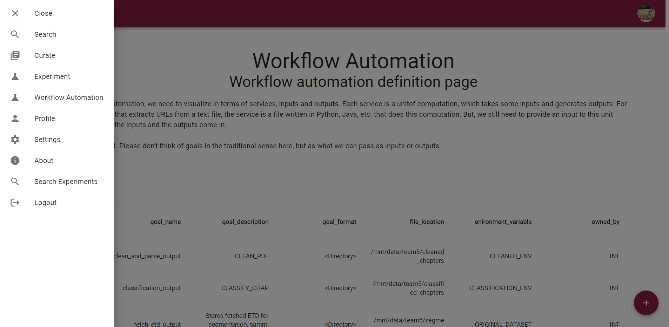
Notes:
Ano

Slide 13
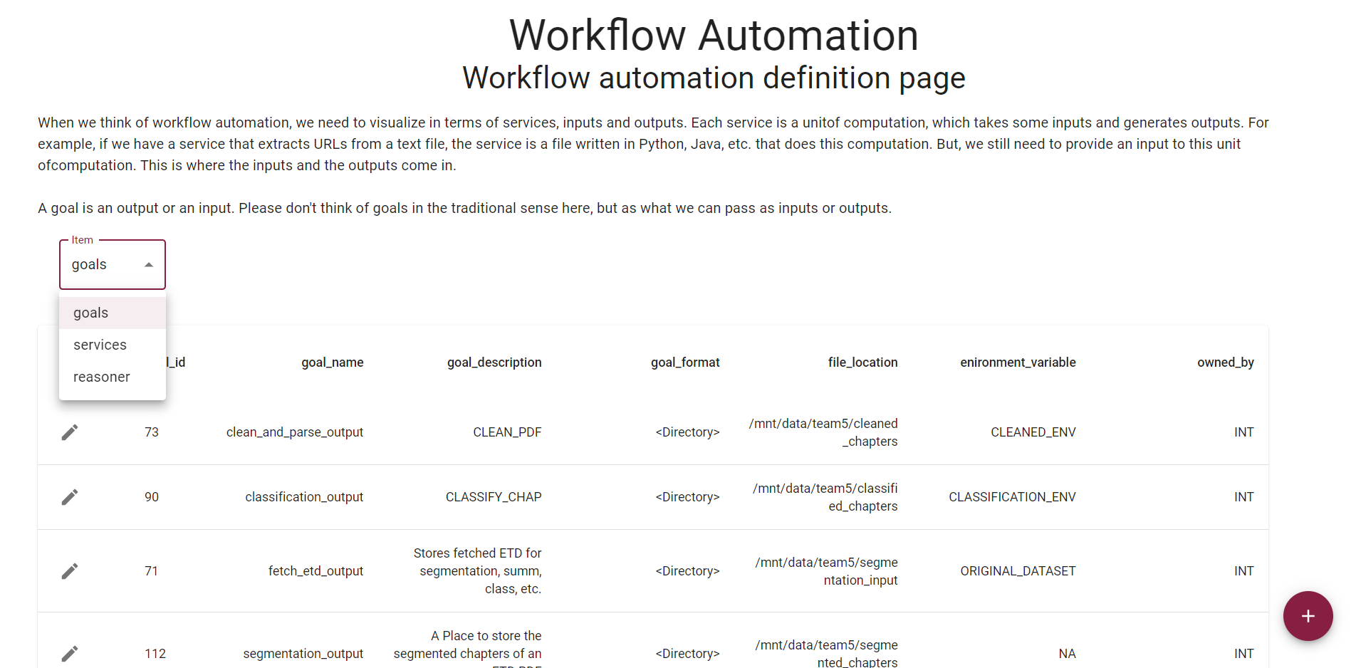
Notes:
Ano

Slide 14
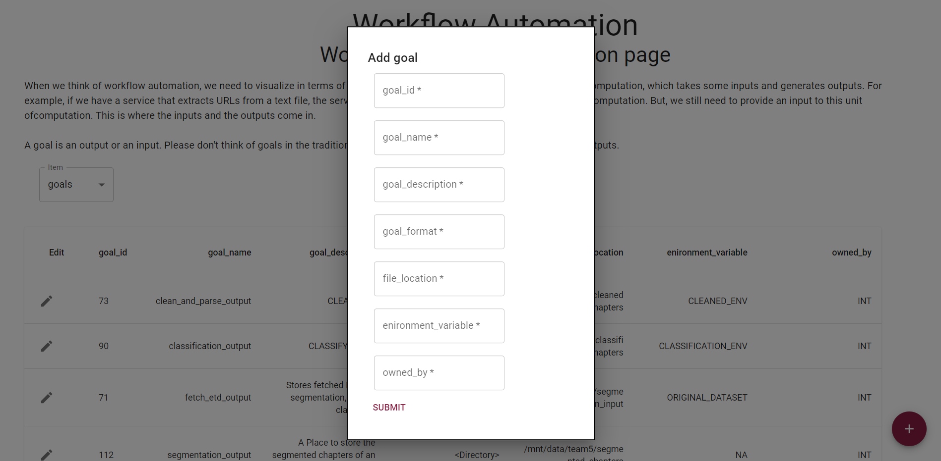
For the complete frontend, please check here [4]
Notes:
Ano

Slide 15
03
Developer Operations

Slide 16
CONTAINERIZATION
Notes:
Pallavi

Slide 17





TEAM-1
TEAM-2
PostgreSQL
Python Jupyter
Virtuoso
Jupyter Notebook
Elasticsearch
TEAM-3
TEAM-4
PyTorch & other dependencies -
Segmentation
PyTorch & other dependencies -
Summaries
PyTorch & other dependencies -
Classification
PyTorch with CUDA
PyTorch with CUDA
Notes:
Pallavi

Slide 18
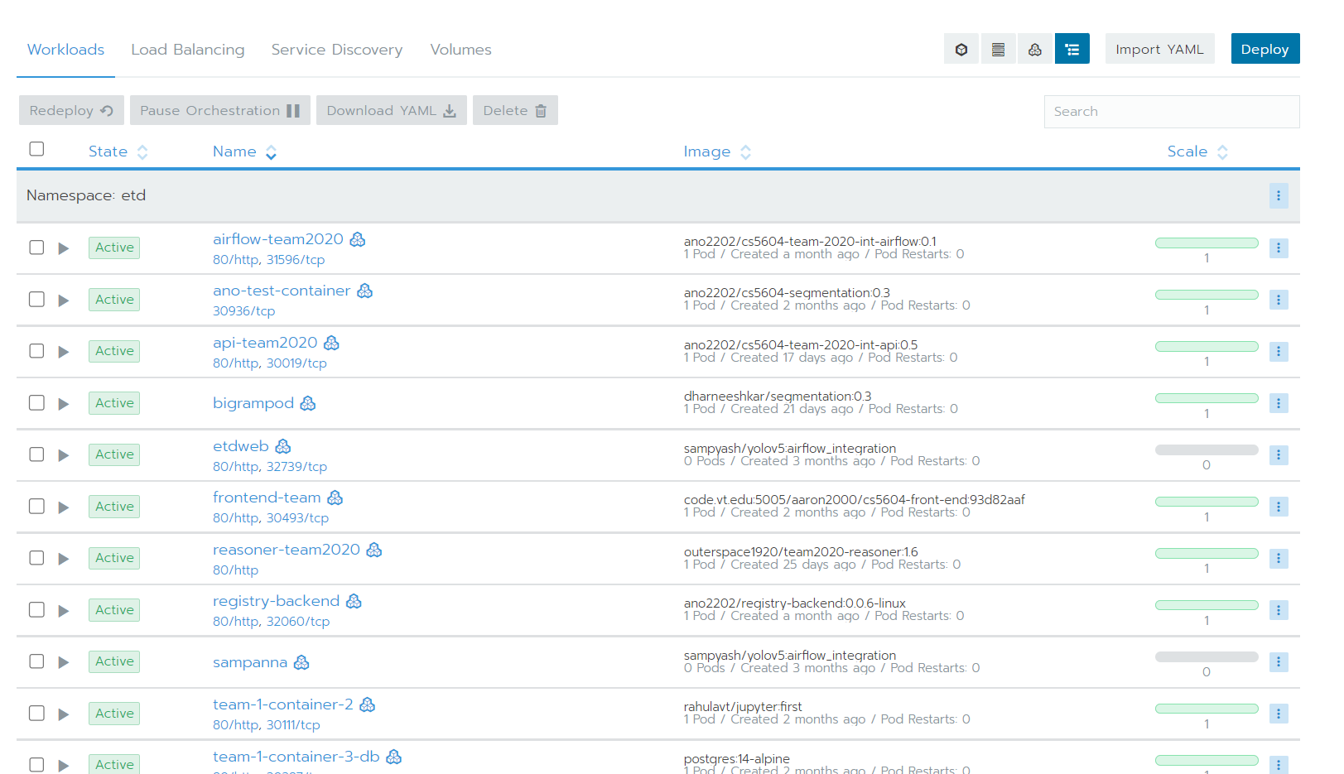

Slide 19
Cluster statistics
45 Deployments
40 Ingresses
39 Pods
180 Services
13 Secrets
Volumes
CEPH¹: etd-cephfs-cs5604-pv:
Total: 19TB, Used: 13T, Available: 6.3T, Used: 66%
Although the total capacity is 19TB, due to it being a shared space, it was recommended to use no more than 4TB.
Notes:
Pallavi

Slide 20
CONTINUOUS INTEGRATION AND CONTINUOUS DEPLOYMENT

Slide 21
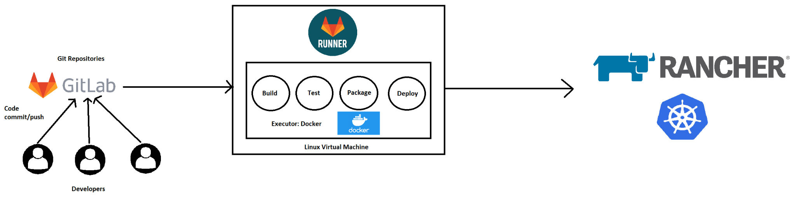
Implementation
CI/CD has been implemented for Teams 1, 2, 3 and frontend.
GitLab Runner is hosted on containers.cs.vt.edu
All Docker Images are located in code.vt.edu Container Registry.
Notes:
Pallavi

Slide 22
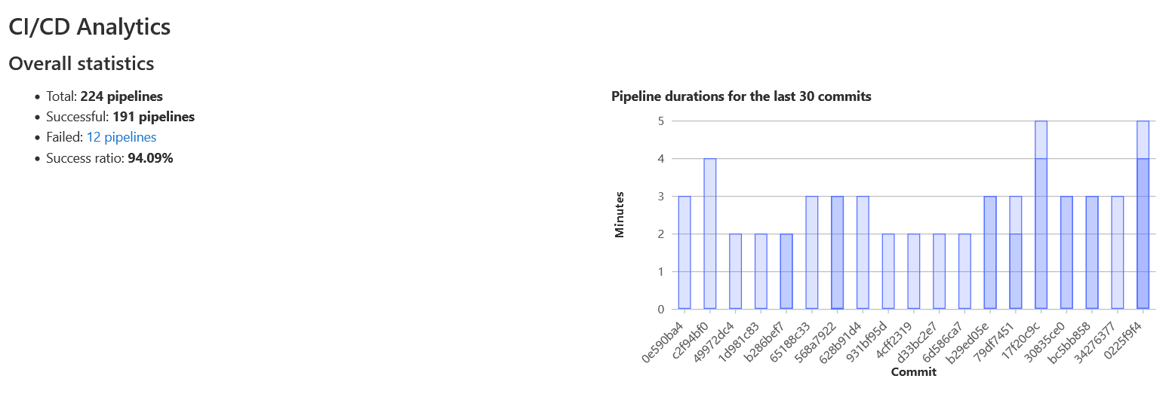
Frontend CI/CD Analytics
Notes:
Pallavi

Slide 23
04
Future Work
Notes:
Yuze

Slide 24

Reasoner Optimization
Saving/loading intermediate data. For example, if two workflows overlap in some steps, the succeeding workflow can directly read the intermediate output produced by the former workflow, instead of executing the workflow end-to-end.
S1
S2
1st time executing:
Same env
Diff env
2nd time executing:
S1
S2

Slide 25
System Performance Trade-off
Observation: Image provisioning & container spawning up take constant time, service execution time varies.
Optimization: Merging several insignificant/lightweight services into one monolithic service.
Trade-off: Decoupled services VS. user response time.
Timeline ----->
Image Provisioning
Container Spawn up
Exec 1st service
Image Provisioning
Container Spawn up
Exec 2nd service
Image Provisioning
Container Spawn up
Exec 1st and 2nd services
<----------- time saved ---------->

Slide 26
Future work
Gitlab issue board for issues for future teams [3]
Notes:
Harish

Slide 27
References
[1] Wiki, https://code.vt.edu/aaron2000/cs5604-f22-team-5-repo-2/-/wikis/home
[2] List of container registries: https://hub.docker.com/u/ano2202, https://hub.docker.com/u/outerspace1920, https://hub.docker.com/u/lyuze
[3] Future work, https://code.vt.edu/aaron2000/cs5604-f22-team-5-repo-2/-/issues
[4] Front-end website: https://frontend.discovery.cs.vt.edu/workflows
[5] Postman collection to trigger Workflow API, https://documenter.getpostman.com/view/4087380/2s8YzL2kT9
[6] Helper code for integrating reasoner, https://code.vt.edu/aaron2000/cs5604-front-end/-/blob/team4-experimenter-updates/src/api/AirflowReasoner.js

Slide 28
THANK YOU!
Questions?

