Slide 1
EmoViz
Tom Evans
Matt Barnett
Fuadul Islam
Yibing Zhang
Visualizing Facial Expressions and Emotions
CS 4624 - Multimedia, Hypertext, and Information Access
Dr. Edward A. Fox
Virginia Tech, Blacksburg VA 24061
May 1, 2018

Slide 2
Outline
Project Background
Back-End Implementation
Front-End Implementation
Job Execution
Challenges
Acknowledgements

Slide 3
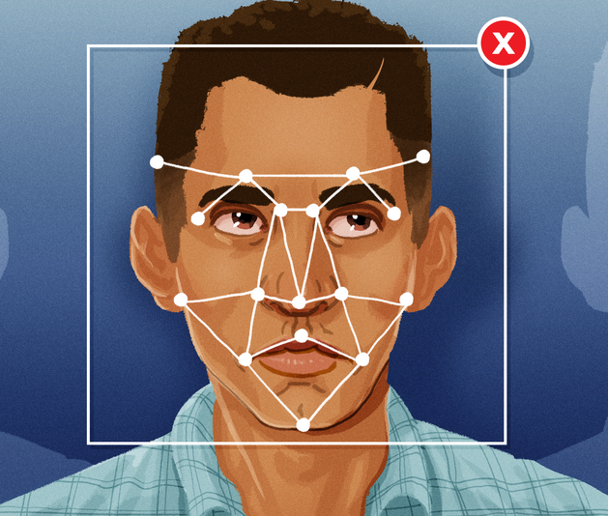
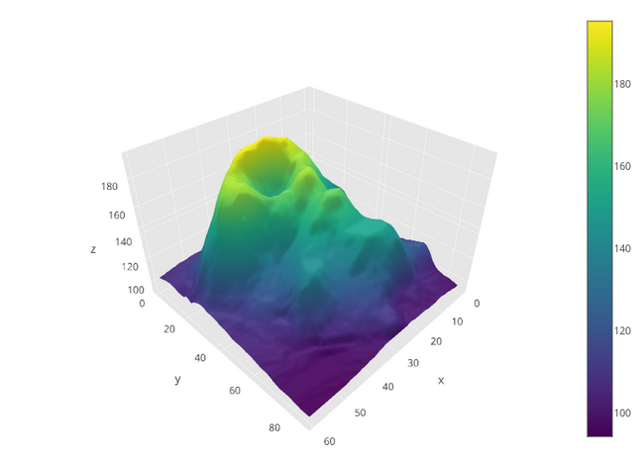

Project Background
Create tool to visualize FACS emotion data
https://mashable.com/2018/02/28/how-to-turn-off-facebook-face-recognition/#D9SF01cRpqqV https://icons8.com/icon/2576/csv
Notes:
Mention that WE ARE NOT CREATING THIS DATA - we’re just making a visualization tool for this format
https://mashable.com/2018/02/28/how-to-turn-off-facebook-face-recognition/#D9SF01cRpqqV
https://icons8.com/icon/2576/csv
Develop tool that creates visualizations
Use FACS emotion data gathered from VT study
Include functionality to compare and contrast data sets

Slide 4



Back-End Implementation
Source code:
Execution framework:
Graphing library:
Notes:
The majority of the code was written in Python, which consisted of object oriented design to handle tasks such as data processing. file storage, and most importantly connecting different endpoints together.

Slide 5
Back-End Features
FACS data time adjustments
Data persistence
Spark cluster integration
Extensible design of code
Multiple visualization types

Slide 6
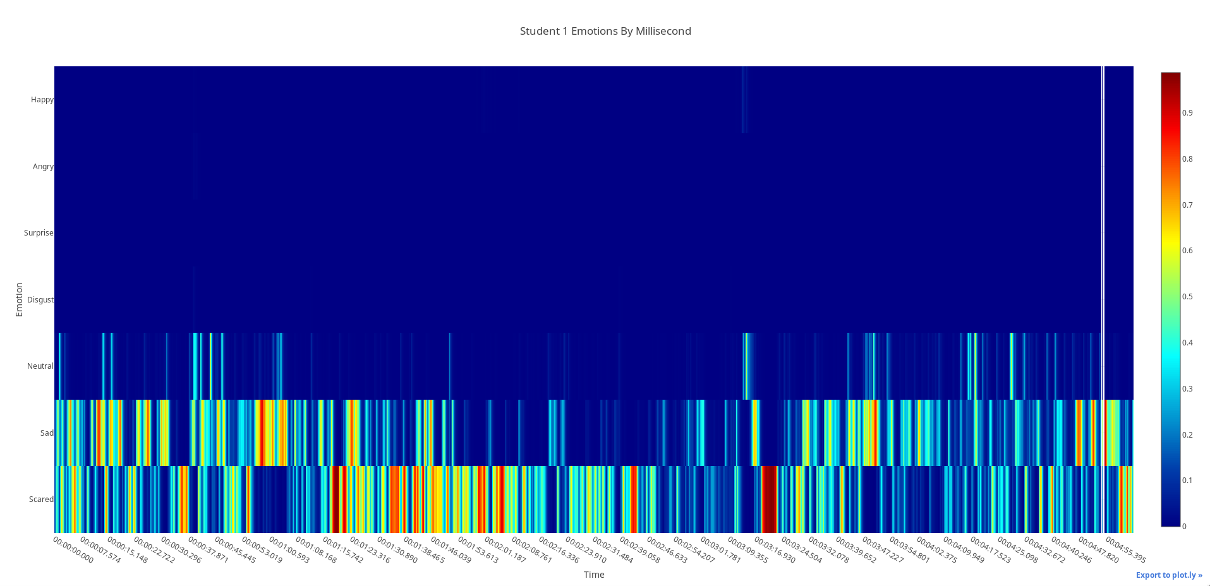
Heat Maps

Slide 7
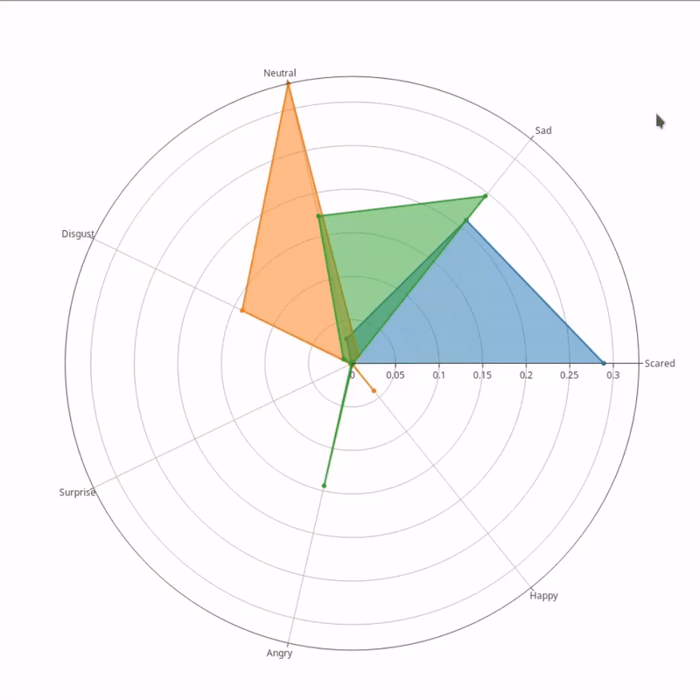
Radar Charts
Notes:
Radar charts show average value of each emotion throughout the duration of the 5 minute video.
On this radar chart there are three colors, each corresponding to a different student’s average emotions.
These visualizations can be rotated and zoomed into, as well as hovered over by the cursor to see details of a measurement.

Slide 8
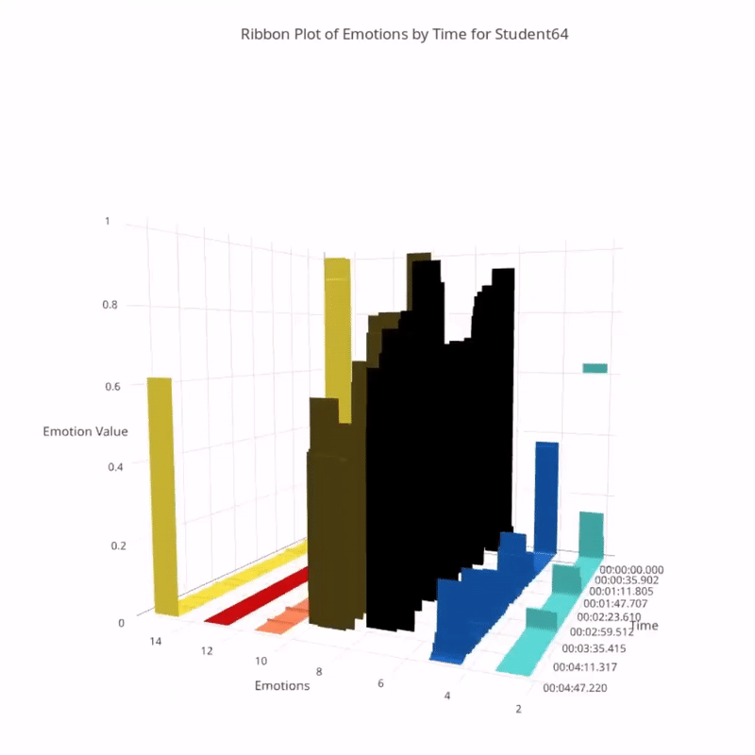
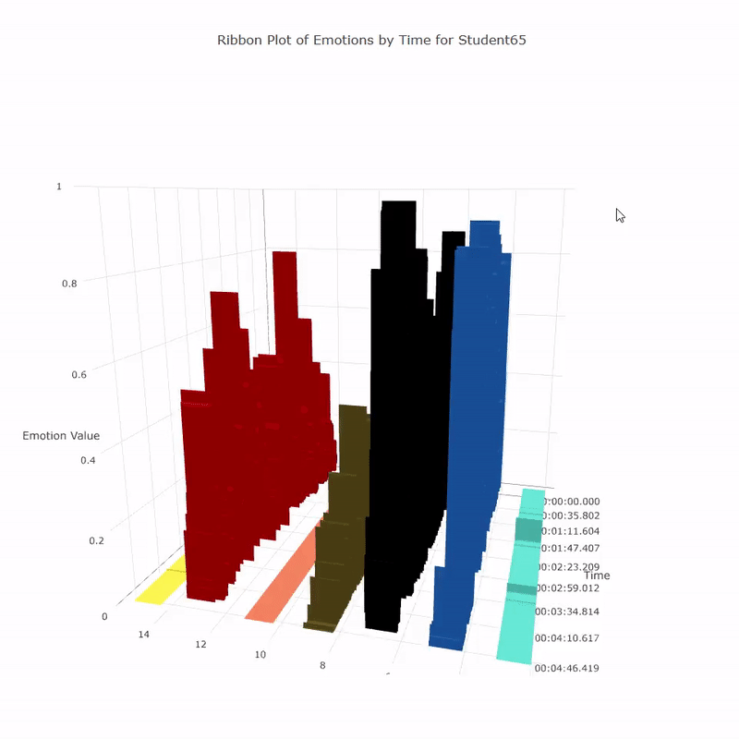
Ribbon Plots

Slide 9


Front-End Implementation
User interface:
Server-side PHP
scripts interact
with user interface:
Notes:
The majority of the code was written in Python, which consisted of object oriented design to handle tasks such as data processing. file storage, and most importantly connecting different endpoints together.

Slide 10
Front-End Features
Dynamic data file selection
PHP built-in web server
Form validation
Interactive visualizations
Export to .png

Slide 11
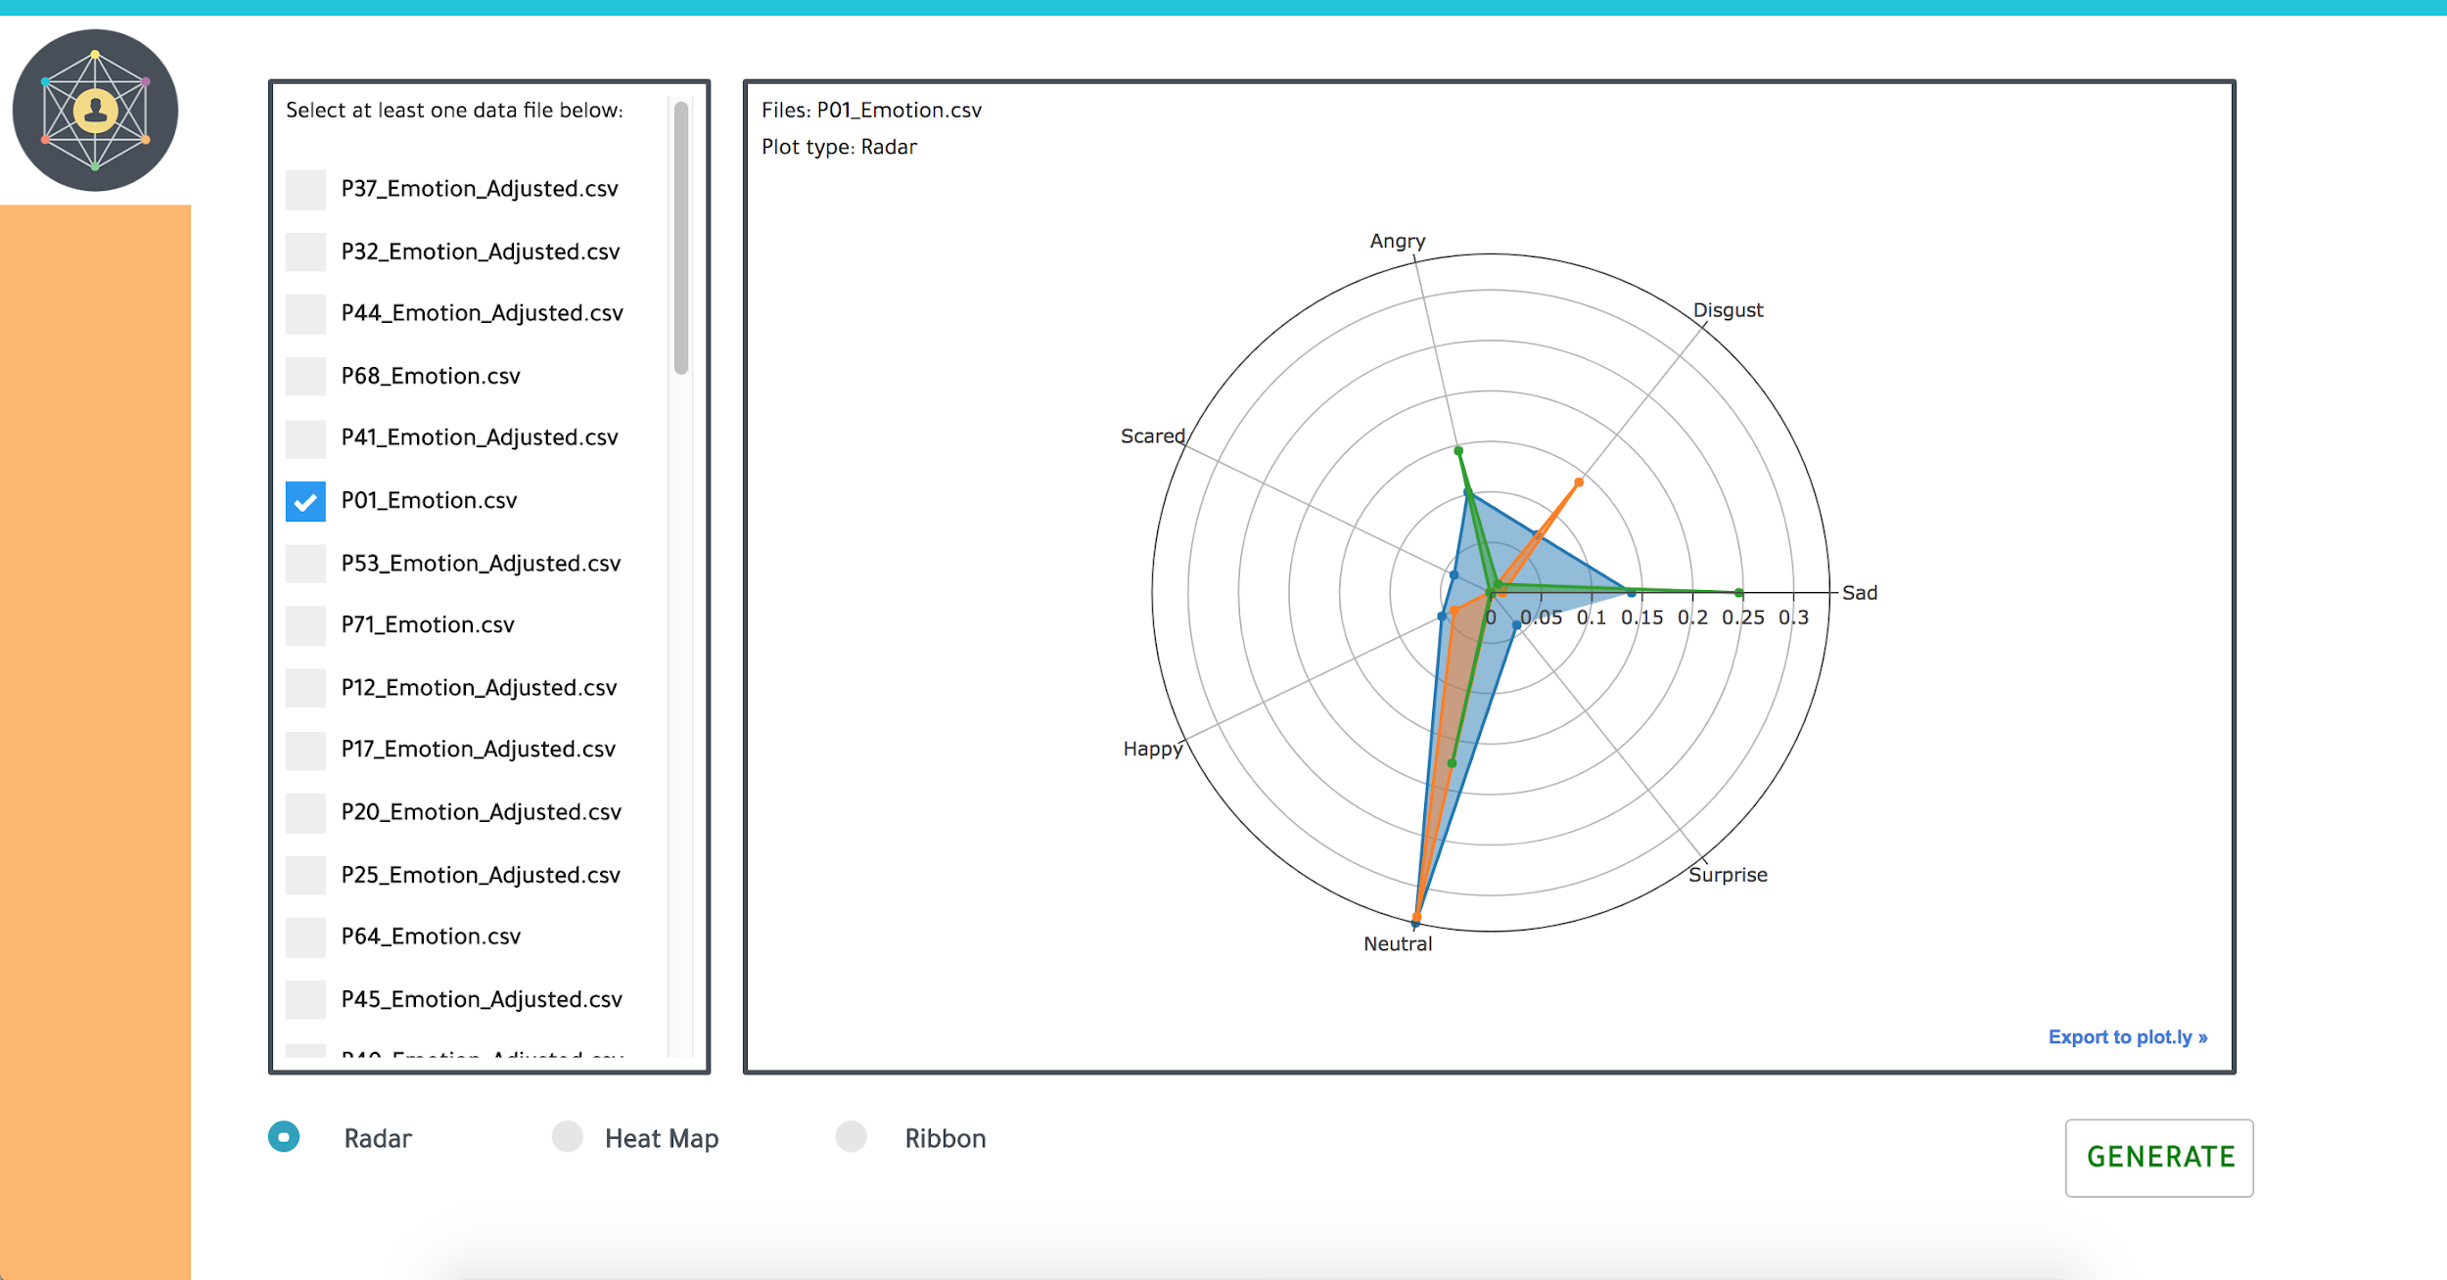

Slide 12
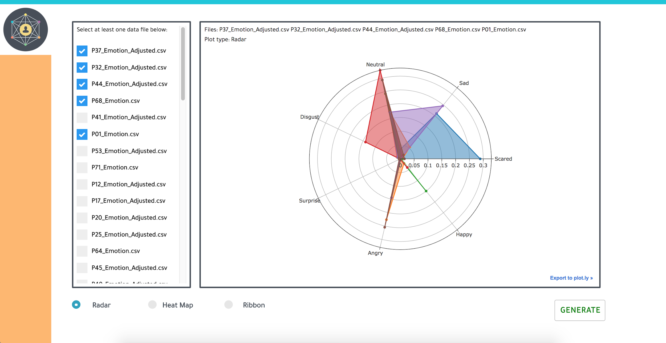

Slide 13
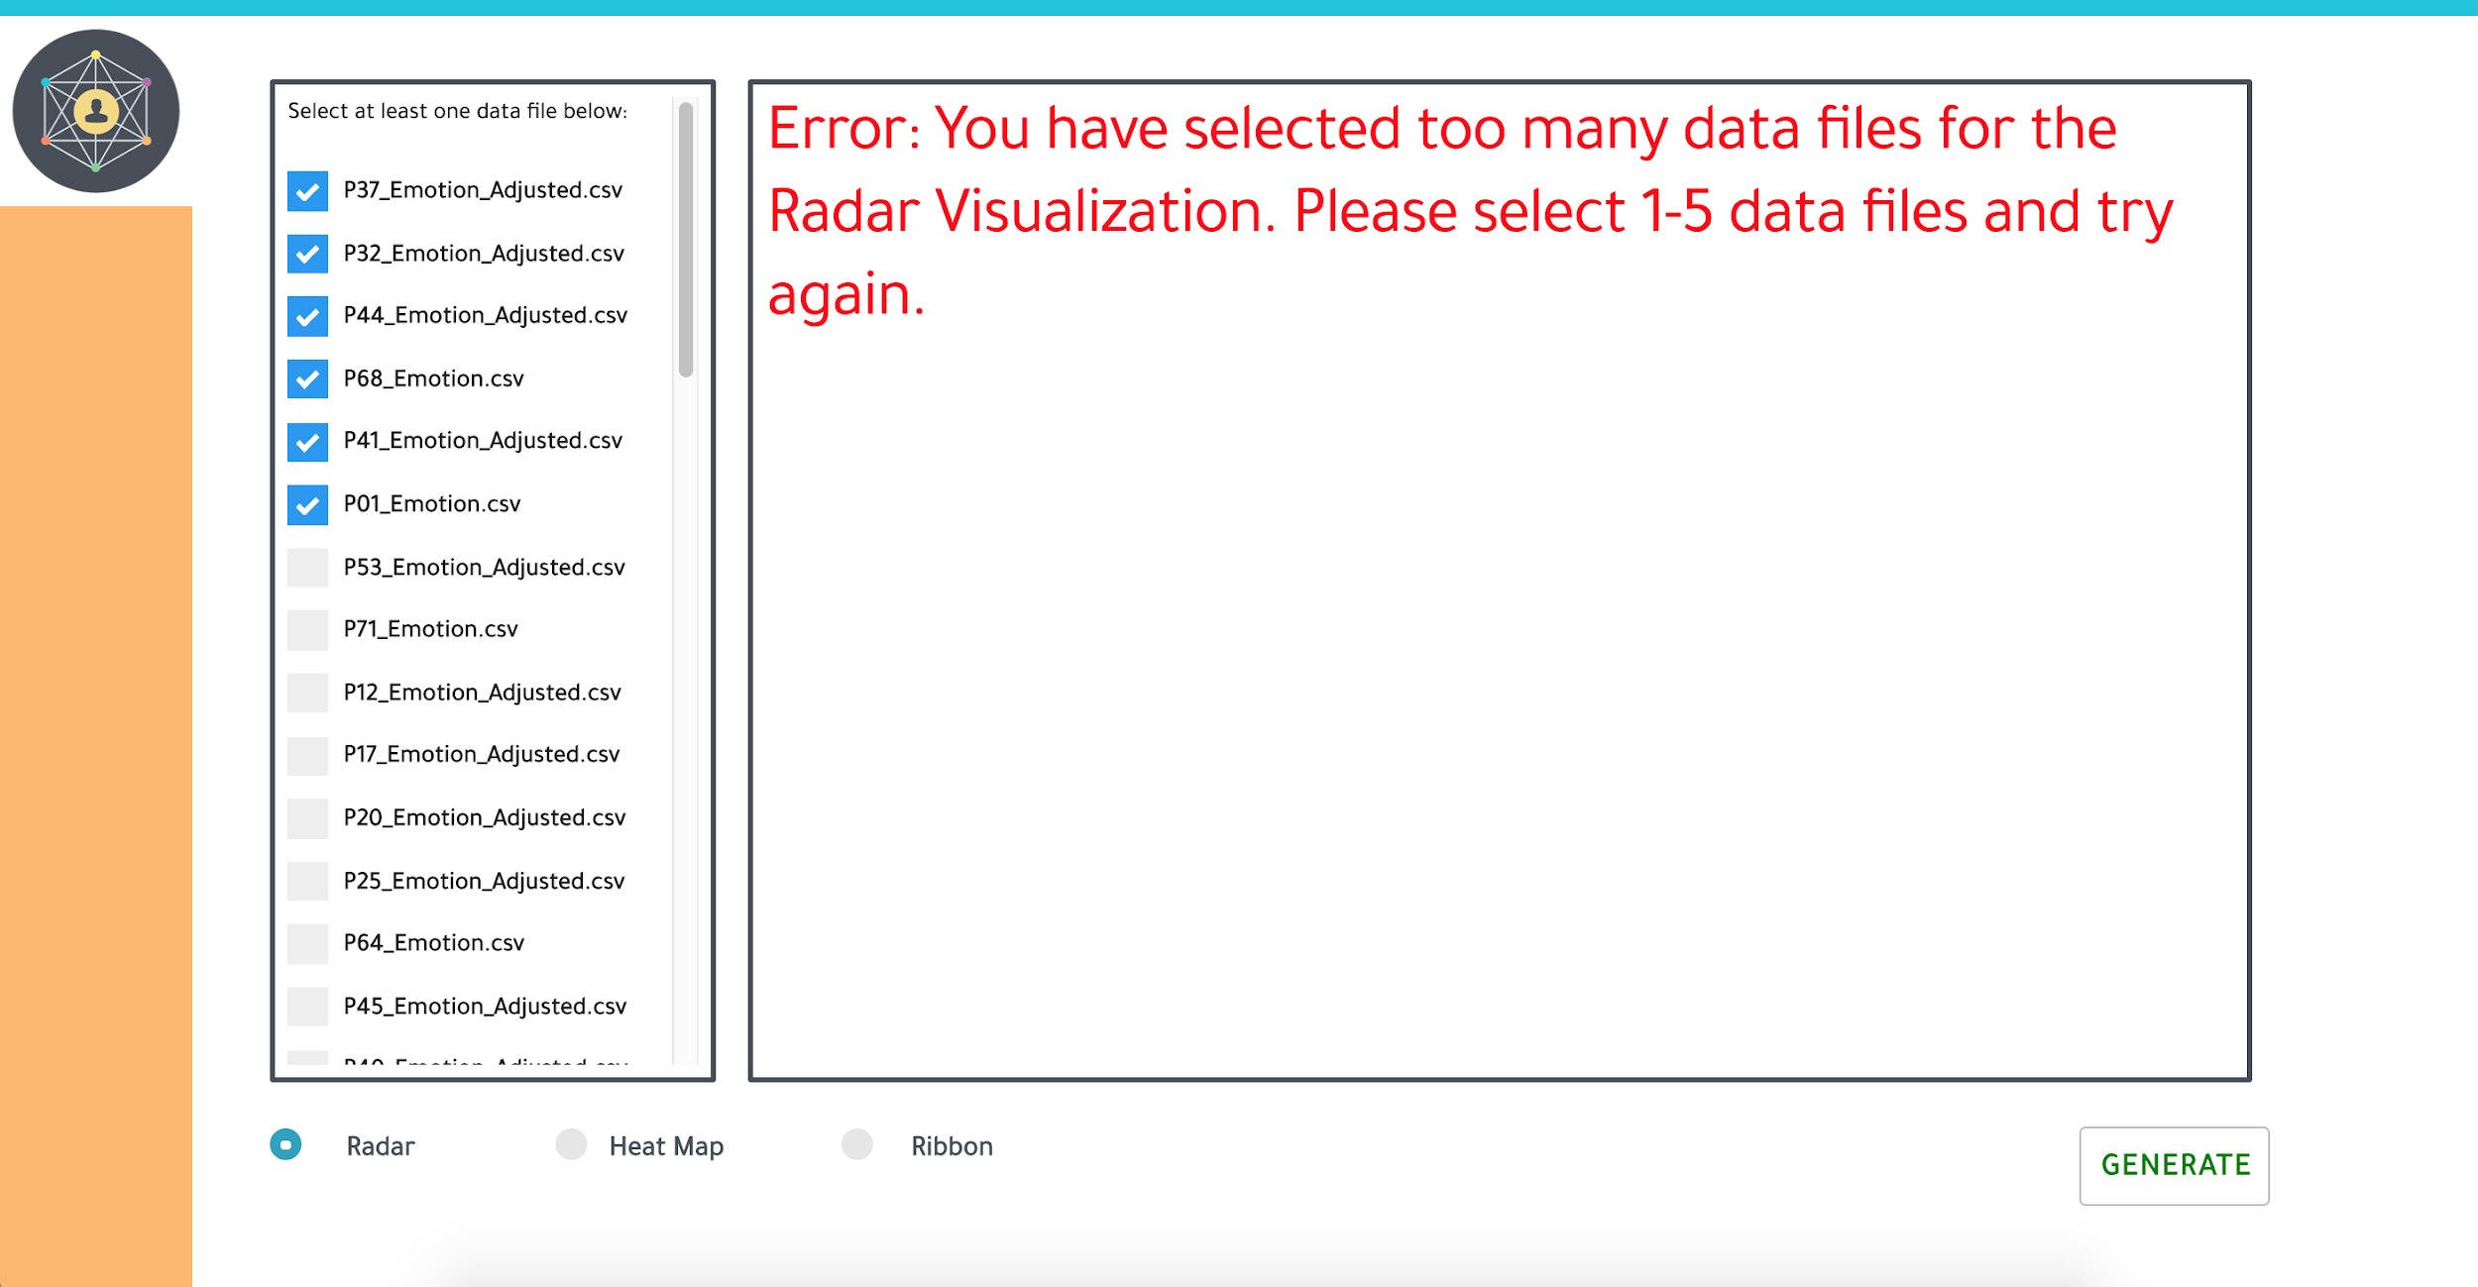

Slide 14
Steps for Execution
csv files
1. Data keys selected for processing
2. Check local index for existing python object
EmoViz executor
3. If not found, search for match in /data directory
4. Process match as python object and write to index
5. Objects converted to spark dataframe for plotting
index.dat
/data
Notes:
*Notes for stuff you might want to include or be familiar with*
List of file names (or single file name) selected on front end
Fast path: optimized using local index of already processed/normalized data (so data doesn’t have to be processed every time it’s needed)
Slow path: search all files on disk
NOTE: Files will be guaranteed to exist on disk because list from front end (where selection happens) are mapped to existing set of data
When match is found, write it to the index so next time it is needed you won’t have to

Slide 15
Challenges
Cross-platform compatibility
Limited communication with client
Unable to map timestamps to deception cues
Testing on foreign systems
Notes:
Solution:
Virtual environment
Well documented report
Epoch cues given in a table but we could not figure out how the cues map to the timestamps

Slide 16

Acknowledgements
Dr. Steven D. Sheetz
Professor of Accounting & Information Systems

Slide 17
Questions?

