Slide 1
Project M.E.L.T.
Notes:
Project MELT is the Middle English Language Translator made for the English department under Dr. Karen Swenson’s guidance. I’m Zack and my teammates were Tam and Mike.

Slide 2
IN 7 MINUTES…
Notes:
With little time, I’m going to do a quick recap of the project’s aim, give you a quick demo, tell you a bit about how it works, and then explain where it’s headed.

Slide 3
RECAP
Notes:
So to recap, MELT is meant to take a user’s input of Middle English text. Such as….

Slide 4
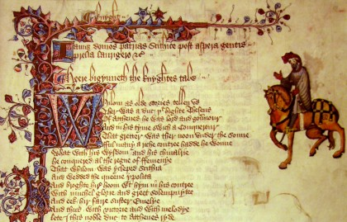
Notes:
The 15th century Chaucer’s Canterbury tales and send back both

Slide 5
TRANSLATION
&
PRONUNCIATION
Notes:
A translation into modern English and a generated audio file of it’s true pronunciation. However, with our client’s needs in mind, the group decided early on

Slide 6
TRANSLATION
&
PRONUNCIATION
Notes:
To focus our efforts on pronunciation rather than text translation. This functionality was more important to Dr. Swenson and also had more to do with multimedia manipulation. However,

Slide 7
Project M.E.L.T.
Notes:
Project MELT sounds much better than

Slide 8
Project M.E.L.P?
Notes:
Project MELP and it turns out that we had enough time to get pretty close to both aspects, but only the one is live right now.

Slide 9
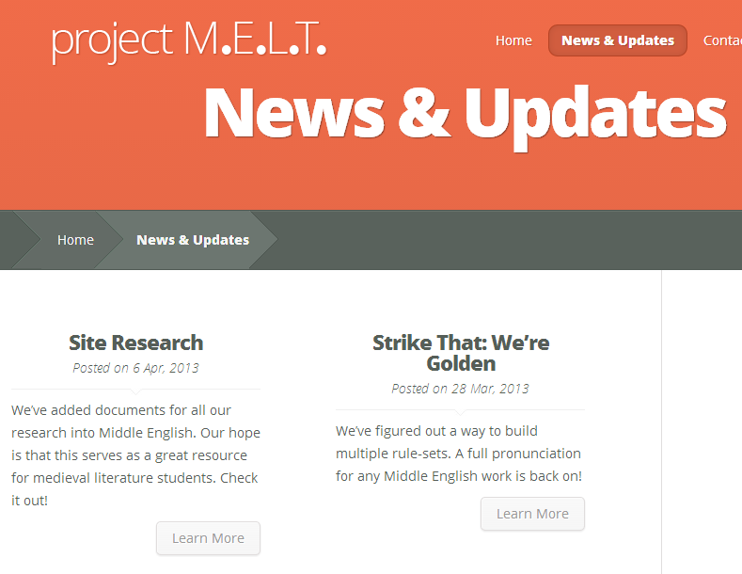
Notes:
Beyond this early decision, I’m not going to go into details of our design process or timeline as they can all be seen on our blog at

Slide 10
www.project-melt.org
Notes:
At this address. We’ll head there now so I can give you a demo of the site and the app.

Slide 11
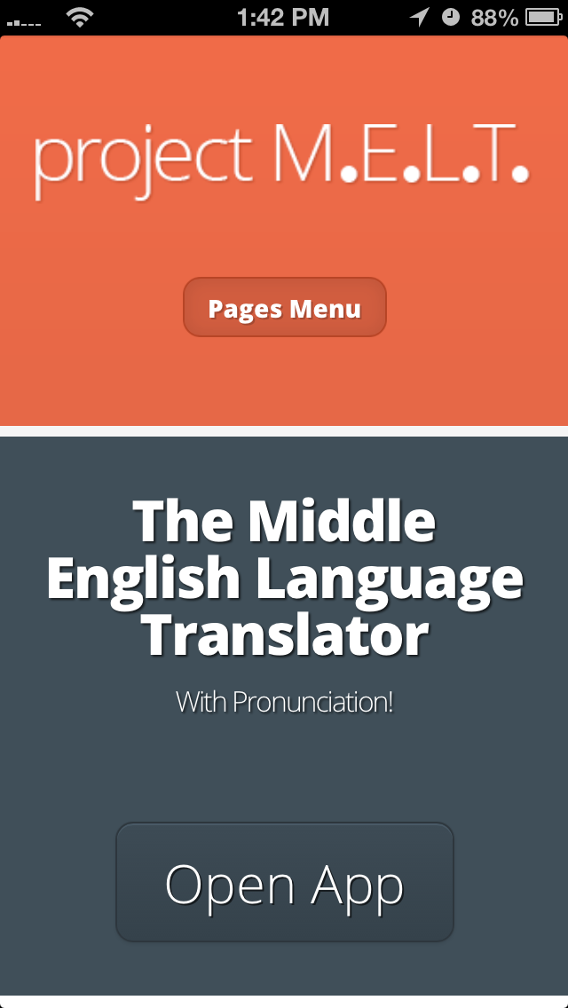
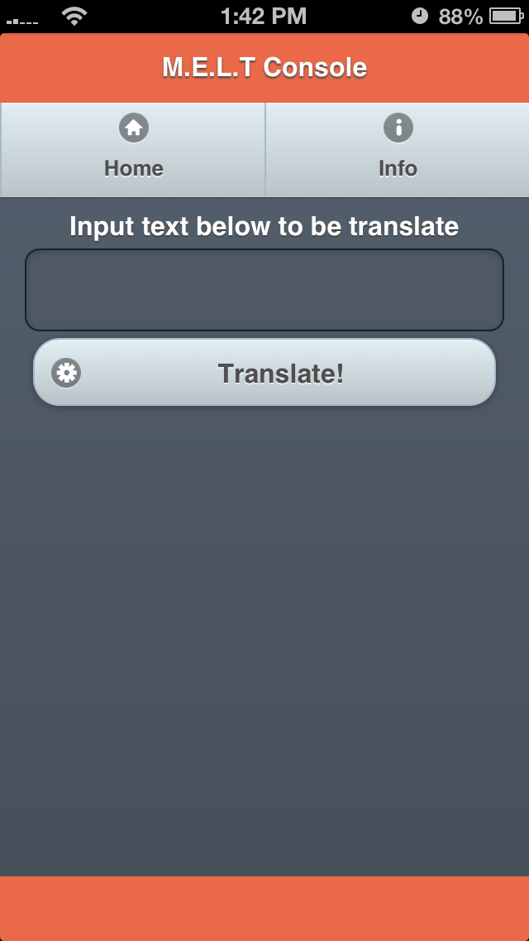
Notes:
The website and app are already responsive to any device resolution.

Slide 12
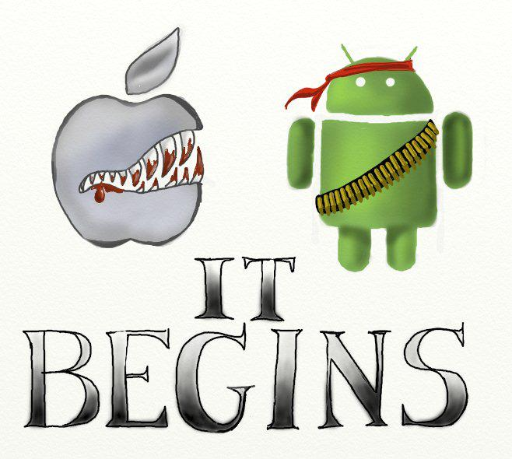
Notes:
But we pushed it to the AppStore and Play Store just because we could. So how does it work? Well…

Slide 13
PHONETIC RULE SET
SPEECH SYNTHESIZER
MIDDLE
ENGLISH
TEXT
DIPHONE
VOICE
ENGLISH
RECORDINGS
Notes:
There are 4 main processes to the application’s function. The text input is broken down into a bunch of symbols that represent phonemes in the International Phonetic Alphabet. We developed a markup language that lets the rule-set contain special parameters for syllable count, end-of-a-word,
Early on in the project, we knew we wanted to use diphone recordings so the output would sound less robotic. So I contacted a sports announcer / podcasting friend in the UK and asked if he would be willing to donate his recordings and transcripts to the project. Since we were writing this all at the same time, the phonetic ruleset

Slide 14
Server?
Notes:
There’s currently a server in the middle of all this, but we’re planning on pushing the processing to the client once we figure out what we want to do with the IP. We’ve tested entry counts of two hundred hits every half second, so for now it’s more than okay.

Slide 15
$
Notes:
I mentioned our indecision about licensing so I’ll go ahead and conclude there. The Middle English part of the project and the app that came with it were really only the beginning, we finished them months ago. But we’ve built another app…

Slide 16
Most.Every.Language.Toolkit
Notes:
We’ve packaged the entire system into a modular toolkit for use in mobile and HTML5 development and plan on setting up a commercial license through the company Tam and I started. We’re pulling in a few more people and (we hope) by the end of the summer your phone will be able to speak to you with your own voice in almost every language just by listening to how you speak. It can happen almost instantaneously

