Slide 1
Custom Sound Library (PhoneETech)
SOUND LIBRARY
Rachel Egnor & Tress Cochran
Multimedia, Hypertext, and Information Access | CS 4624
Professor Edward Fox
Virginia Tech, Blacksburg VA 24060
Client: Aries Defense
May 4, 2022
SOUND LIBRARY
Notes:
Introduce ourselves, name of project, & company name | explain that we created this project on our own

Slide 2
OUTLINE
CUSTOM SOUND LIBRARY
Our Goals
Timeline
Overview of Project
Final Mobile Application
Application Tutorial
Future Application Development
Acknowledgments
References
CUSTOM SOUND LIBRARY

Slide 3
Our Goals
Display Text With Audio
User Friendly Mobile App.
Internal Communication
Recording Functionality
Notes:
Our goals have been slightly altered but remain fairly constant since the beginning
In the beginning we just wanted a user friendly app but this meant aesthetically pleasing whereas now the user friendly portion means that its applicable to all, including those with color blindness etc.
The biggest new goal for our team is just the aspect of communication, we reached the point where we just seemed to be on different pages and when we did communicate it wasn’t as effective as we would have liked to be. That being said we have since then taken a step back and agreed that we want to be in contact every day regardless of whether this project is the topic of discussion. We just wanted to do daily check ins

Slide 4
Timeline
Early february
Late February
Early March
Late March
Early April
Late April
Establishing Contact With Client
Research into Audio Creation
Begin Development
Research Best UX practices
Finished Development
Testing and Presentation

Slide 5
Final App Design

Slide 6
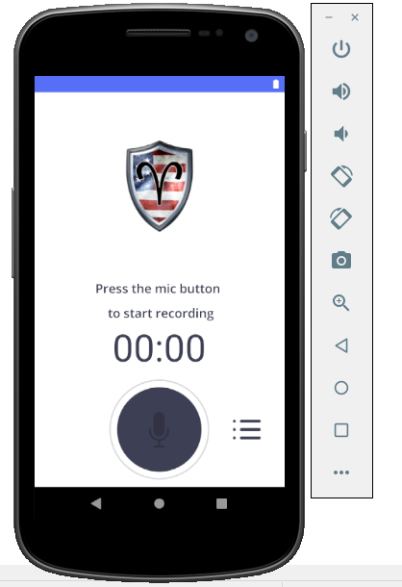
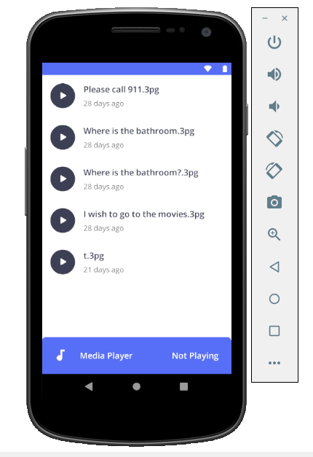
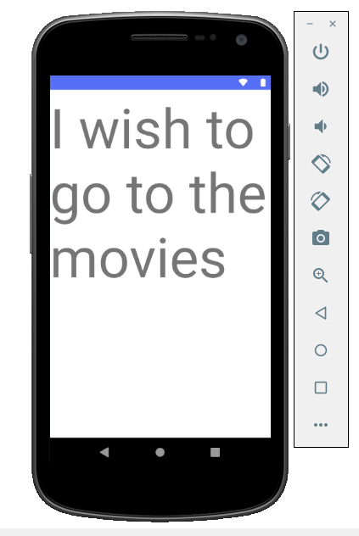
What We Accomplished
Notes:
We have a fully functioning recording app that can play back files, rename files, and display the text of the files.

Slide 7
Lessons We Learned
Communication is key!
Managing time in a team
How to make a project that can be modified by others

Slide 8
Future Application Development
Implement storage for text scrawl
Implement landscape - mode support
Add customizable colors and fonts
Speech - to - text support

Slide 9
Thank you!
SOUND LIBRARY
Special Thanks to -
Aries Defense
Eric Donovan |
Our Client
Dr. Fox |
Professor & Support
SOUND LIBRARY

