Slide 1
Focused Crawler
Wil Collins, Will Dickerson
Client: Mohamed Magdy and CTRnet

Slide 2
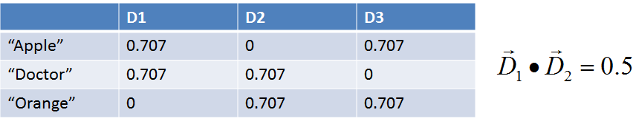
Vector Space Modeling
Models: tf-idf, LSI
D₁=“One apple a day keeps the doctor away”
D₂=“This doctor enjoys eating anything orange”
D₃=“You can’t compare an apple and an orange”

Slide 3
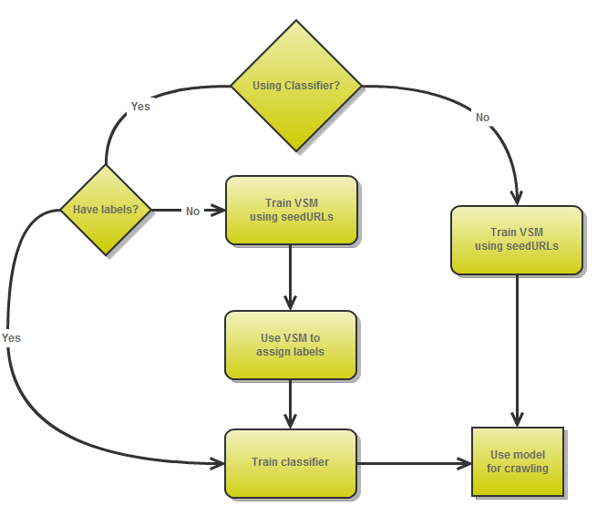
Model Training Process

Slide 4
Current State
Improved Relevance Calculations
Enabled use of Naive Bayesian and SVM classifiers
Limited use of tf-idf and lsi as labellers
Configuration and documentation

Slide 5
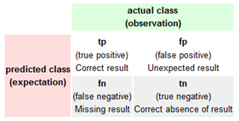


Current State
Error Handling
Improved Search Algorithm
Real-time model updates
Initial: Recall: .4821 Precision: .2842
Final: Recall: .4252 Precision: .9908
Recall:
Precision:

Slide 6
Demo Video

Slide 7
CTRnet Collection
http://wilcollins.com/ctrnet

Slide 8
Future Plans
Seed generation
Improve recall
Speed/Memory improvements
Better web text extraction
Better training documents

Slide 9
Questions?

