Slide 1

Library Selection -- and Uses -- of Printed Open Textbooks
VIVA Collections Forum
June 7, 2019 – Richmond, VA
Anita Walz, Associate Professor
Open Education, Copyright & Scholarly Communication Librarian arwalz@vt.edu
All images are Public Domain and from Unsplash

Slide 2

open education
OER engagement
Grant program
VT Publishing
Liaison copyright & licensing
Notes:
- Raise awareness of open education
- Aid others in engaging with OER
- Design, administer grant program
- Collaborate with VT Publishing
- Liaison librarian (math, econ, law)

Slide 3
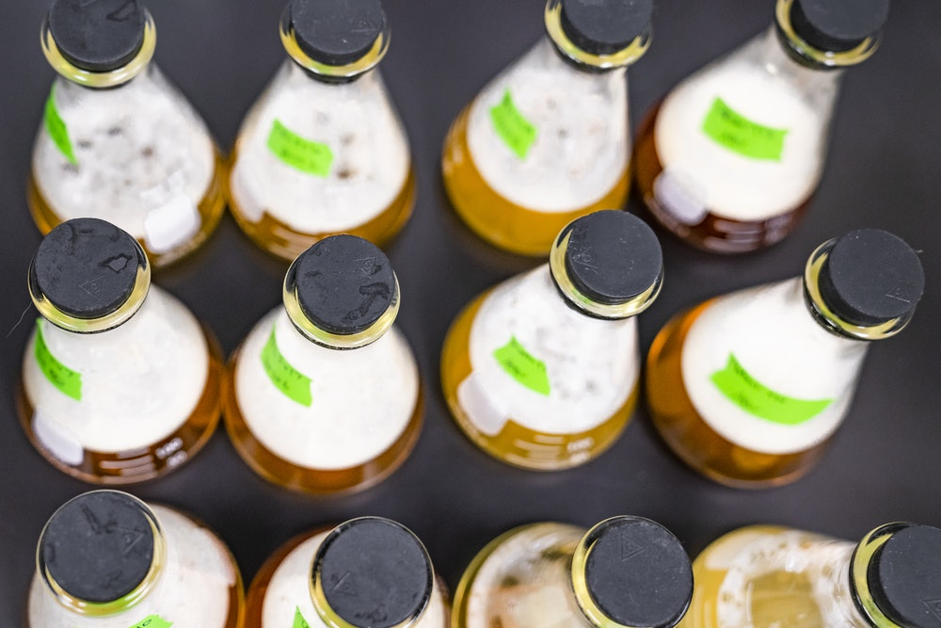
Notes:
Because a lot of the work I do doesn’t have a roadmap – it feels at times very experimental.
Public domain. Source: https://unsplash.com/photos/BnePwPa2ciU

Slide 4
ENGAGE
Notes:
Working to ENGAGE faculty, staff, and students with ideas about WHAT COULD BE . . .

Slide 5
Scholarly Communication
Learner-
centered
learning
©literacy
technology
Notes:
Working to ENGAGE faculty, staff, and students with ideas about WHAT COULD BE . . .

Slide 6

Notes:
No one teaches us how to do this kind of work…
NESA by Makers. Source: https://unsplash.com/photos/BVr3XaBiWLU

Slide 7

Notes:
Public Domain: Pepi Stojanovski https://unsplash.com/photos/MJSFNZ8BAXw

Slide 8
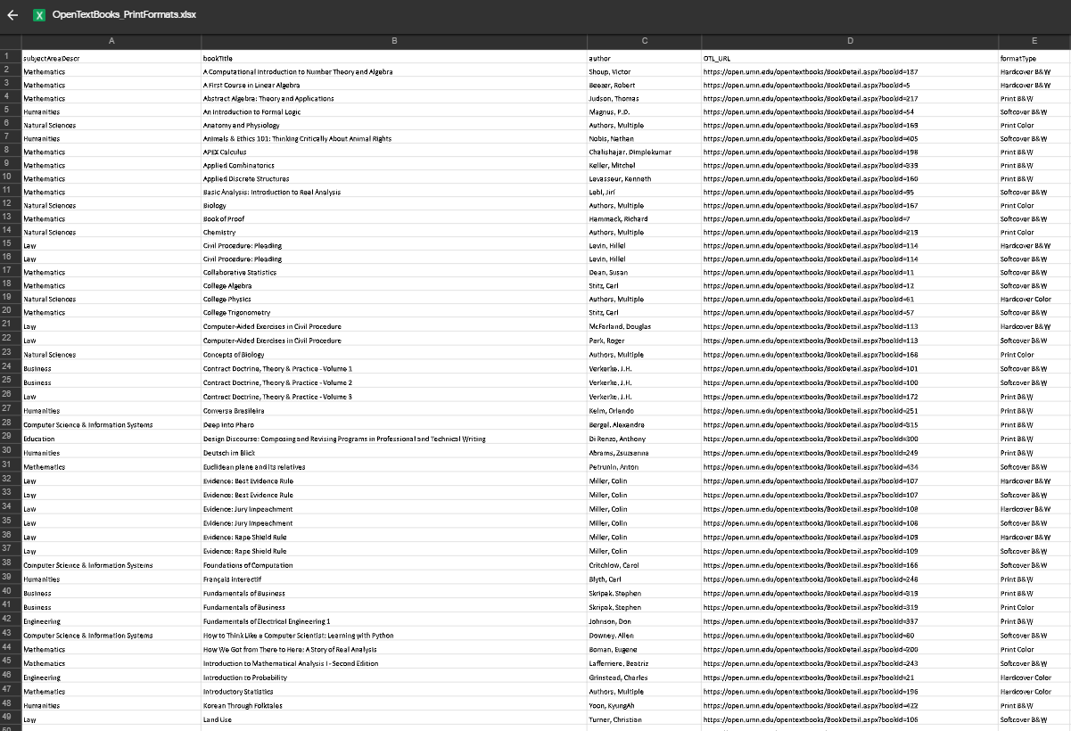

Slide 9
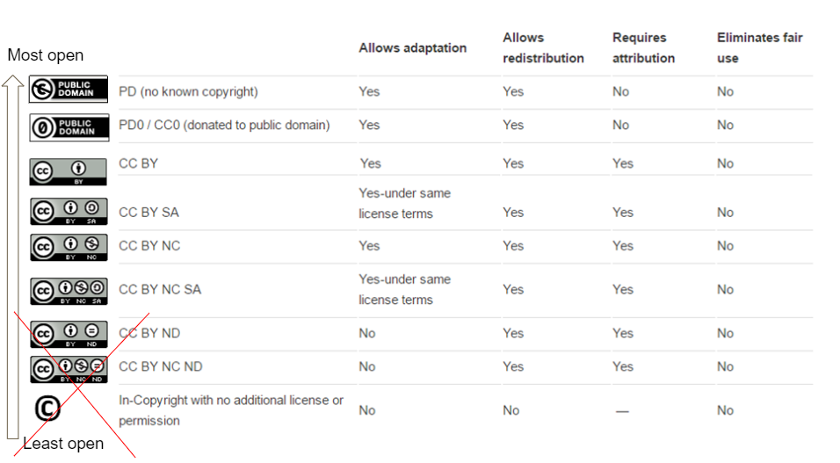
Notes:
Working to ENGAGE faculty, staff, and students with ideas about WHAT COULD BE . . .

Slide 10

Notes:
https://unsplash.com/photos/4xFXHkD9bCc

Slide 11


Which users? Which books?
Notes:
Every book its user. Every user its book.
https://unsplash.com/photos/gcDwzUGuUoI
https://unsplash.com/photos/f2Bi-VBs71M

Slide 12
We want to promote student academic achievement.
We want to encourage faculty to USE, MODIFY, CREATE OER.

Slide 13

CULTURE of learning resource selection
Notes:
Image: Public domain from UnSplash

Slide 14
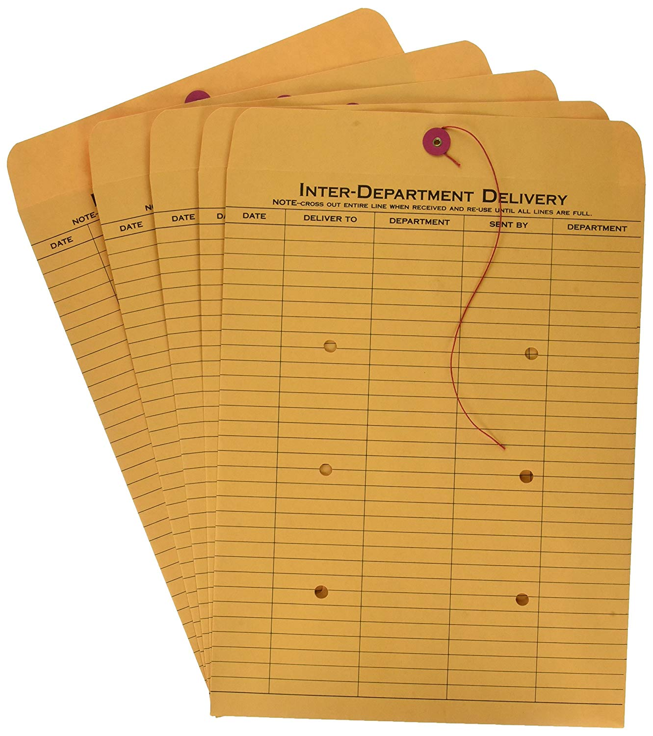

Experiment #1
Trademark: OpenStax
Image used under Fair Use
Notes:
Is this person the adopter of the book?
Are they happy with what they are using right now? What do they like / dislike about the resource(s) they currently use?
No personal contact?
“Hey, this is free” is not a big selling point.

Slide 15
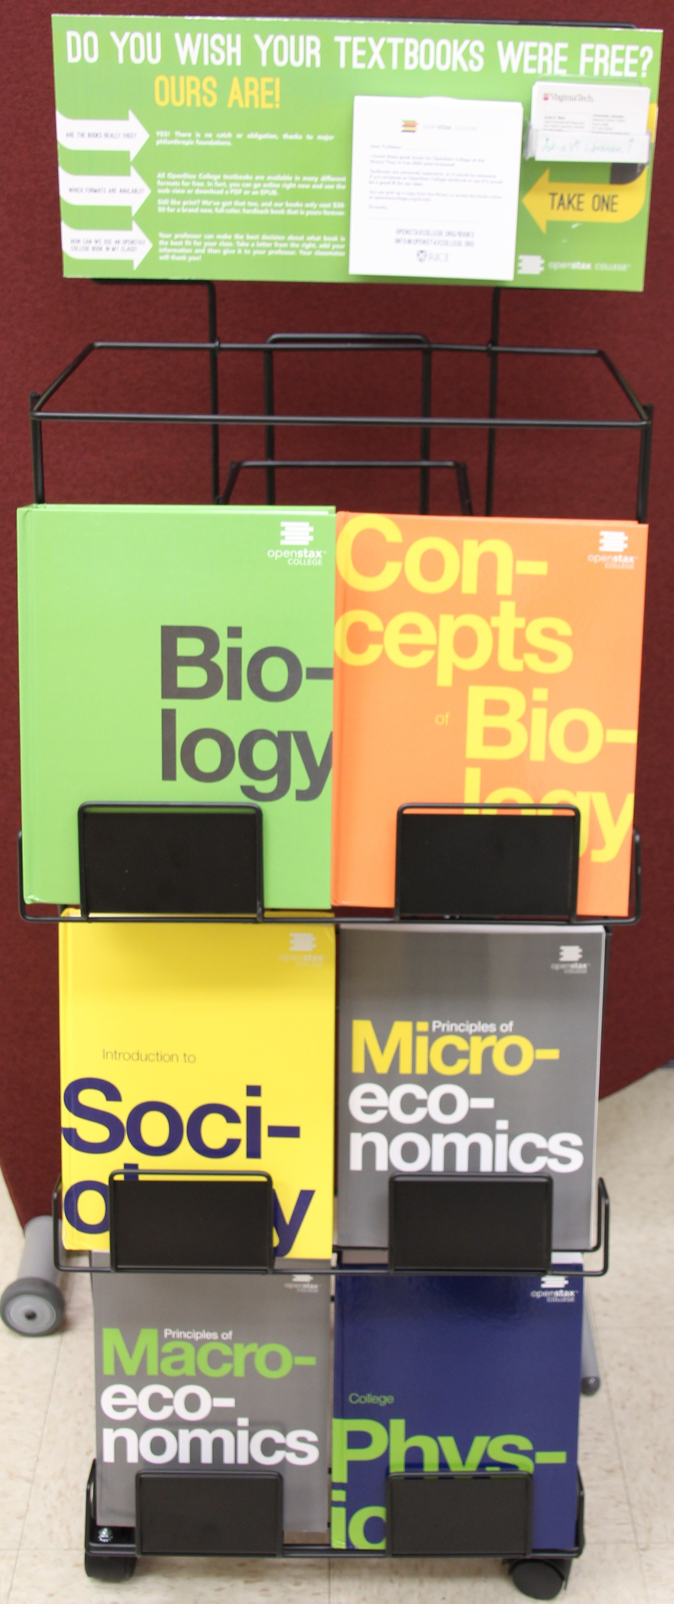
Experiment #2
OpenStax pilot book display
https://openstax.org
Covers are TM by OpenStax

Slide 16
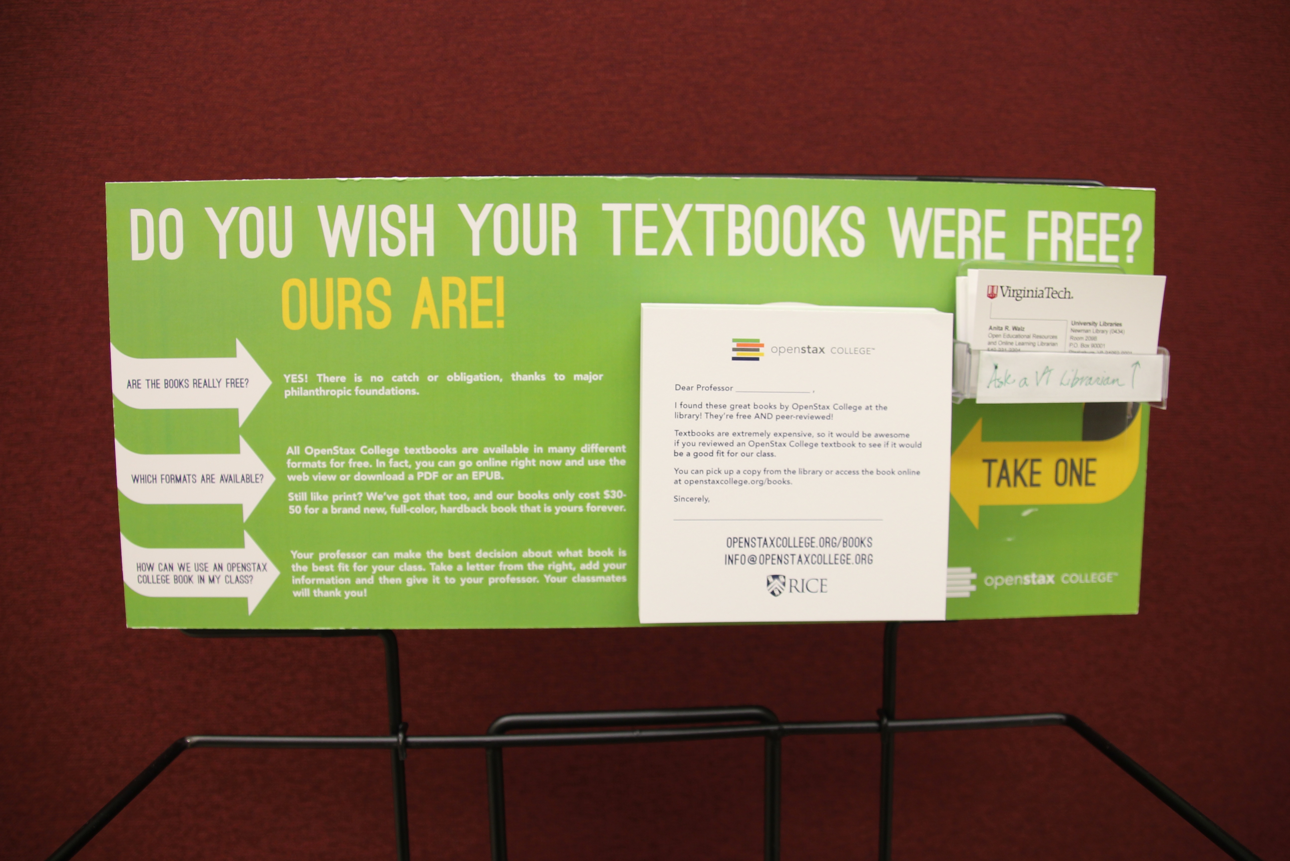

Slide 18
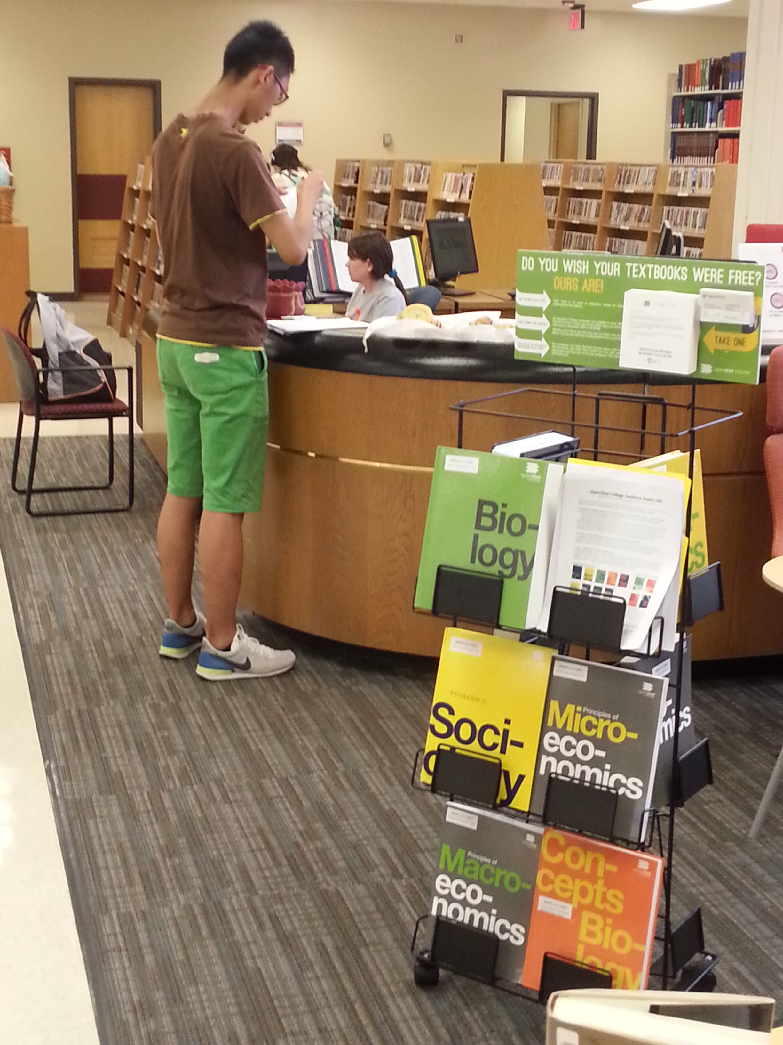
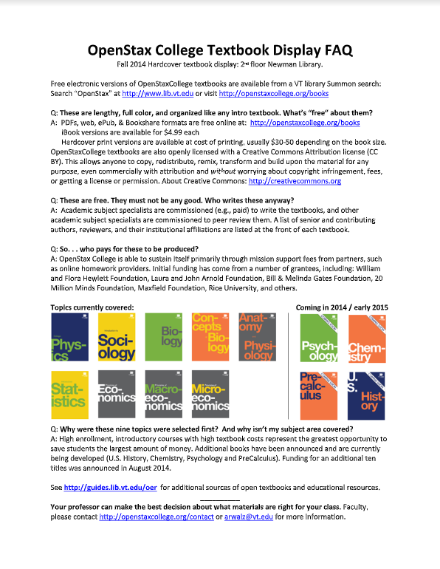
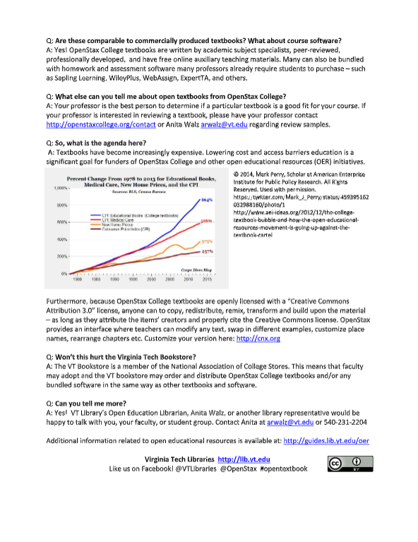
+ Blog post and “come and see” invitations

Slide 19

Results ?

Slide 20
Results ?
No known adoptions
Minimal survey participation
But . . .
Cards flying off the display
SGA relationship
Visit from the Apple Rep
Reports of students using the books to study
Notes:
Image: Public domain, Unsplash
SGA relationship
Visit from the Apple Rep
Cards FLYING off of the display
Reports of students using the books to study
No known adoptions
Survey to collect information failed miserably

Slide 21


Experiment #3
Notes:
R1
Large # faculty
This is a new thing. I’m new.
Student-faculty power dynamic

Slide 22
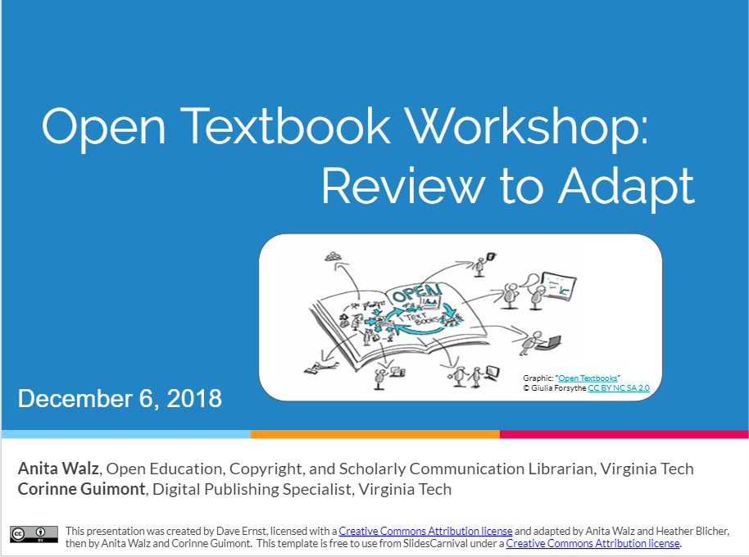
Experiment #3
Notes:
R1
Large # faculty
This is a new thing. I’m new.
Student-faculty power dynamic

Slide 23
Context matters
Notes:
R1
Large # faculty
This is a new thing. I’m new.
Student-faculty power dynamic

Slide 24

Notes:
https://unsplash.com/photos/7uPzmidQ4jI Publishers understand that they must approach faculty individually. How on earth can I do this when there are over 2000 faculty members, plus adjuncts, graduate students, etc.???

Slide 25
1. UNDERSTAND THE SITUATION opportunities & barriers

Slide 26
How DO faculty select their pedagogical approach and their course materials?
?

Slide 27
Decisions
Information
Incentives
Ideology

Slide 28
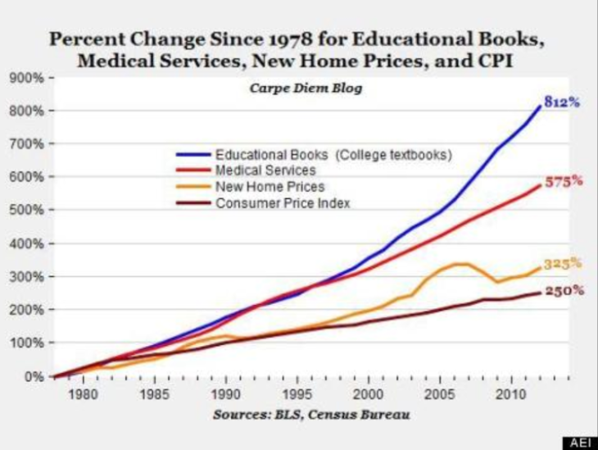
Information

Slide 29
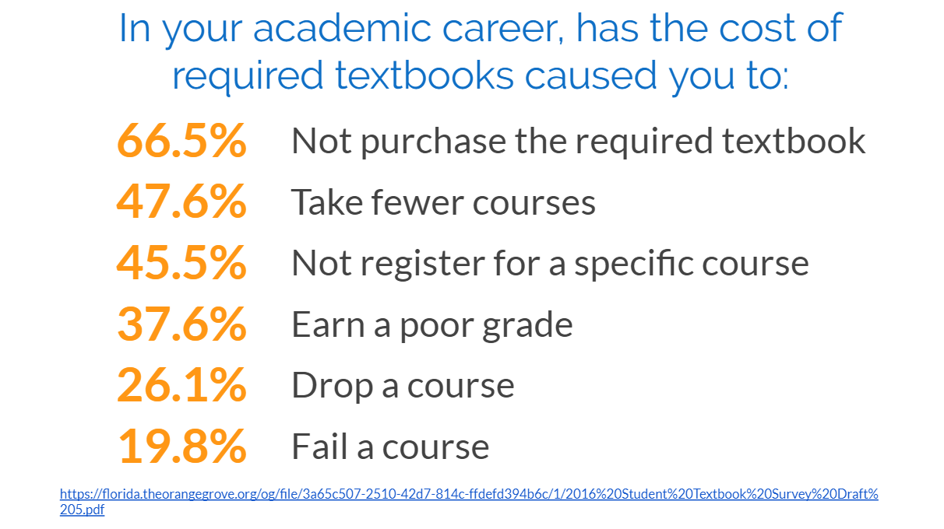
Information

Slide 30
OER is FREE + PERMISSON
Information
Notes:
Working to ENGAGE faculty, staff, and students with ideas about WHAT COULD BE . . .

Slide 31

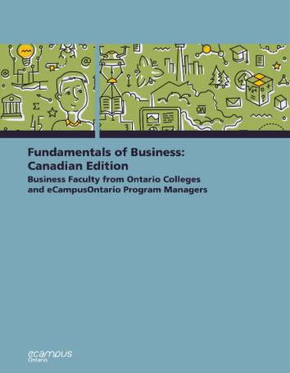

Information
Permission to ADAPT and SHARE
Notes:
Working to ENGAGE faculty, staff, and students with ideas about WHAT COULD BE . . .

Slide 32
Do you know what collaborations are available via the Library?
Information

Slide 33

INCENTIVES (and disincentives)
- Other priorities
Research vs. teaching
Career advancement
- Inertia to continue as before
- Peer pressures
- Support vs no support
Notes:
Image: Public domain from Unsplash

Slide 34
IDEOLOGY
- I assign a text even if we don’t use it.
- “We’ve always done it this way.”
- I had to pay. Students today should too.

Slide 35
2. STRATEGIC APPROACHES

Slide 36
Possible Strategic Approaches
1. Potential impact (class size/cost)
Notes:
The value of lots of little conversations, which build into larger conversations.

Slide 37
Possible Strategic Approaches
2. Departments and individuals re-working their curriculum/[re]designing courses
Notes:
The value of lots of little conversations, which build into larger conversations.

Slide 38
Possible Strategic Approaches
3. Diversity & inclusion
Notes:
The value of lots of little conversations, which build into larger conversations.

Slide 39
Possible Strategic Approaches
4. Focus on who is already engaged
Notes:
The value of lots of little conversations, which build into larger conversations.

Slide 40
Possible Strategic Approaches
5. People who know & trust you
Notes:
The value of lots of little conversations, which build into larger conversations.

Slide 41
Possible Strategic Approaches
6. Ask faculty about their priorities
Notes:
The value of lots of little conversations, which build into larger conversations.

Slide 42
Possible Strategic Approaches
7. Ask students about their priorities
Notes:
The value of lots of little conversations, which build into larger conversations.

Slide 43
Possible Strategic Approaches
8. Institutional priorities - by discipline
Notes:
The value of lots of little conversations, which build into larger conversations.

Slide 44
Possible Strategic Approaches
9. Integrate into the collection
Notes:
The value of lots of little conversations, which build into larger conversations.

Slide 45
Possible Strategic Approaches
1. Potential impact (class size/cost)
2. Departments and individuals re-working their curriculum/[re]designing courses
3. Diversity & inclusion
4. Focus on who is already engaged
5. People who know & trust you
6. Ask faculty about their priorities
7. Ask students about their priorities
8. Institutional priorities - by discipline
9. Integrate into the collection
& provide support at all stages when possible

Slide 46
3. FOSTERING FACULTY CURIOUSITY & ENGAGEMENT

Slide 47
Anita, why are you carrying around this big book?
Visibility -> curiousity

Slide 48

Notes:
https://unsplash.com/photos/lp1AKIUV3yo
The value of lots of little conversations, which build into larger conversations.

Slide 49
1. Faculty disciplinary expertise
2. Faculty like AND dislike their current course materials.
3. Their proxies for “quality” may be different than yours
Valuing the Faculty Experience

Slide 50
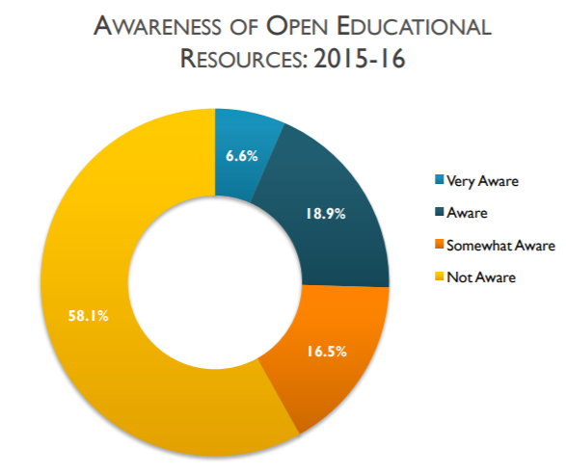
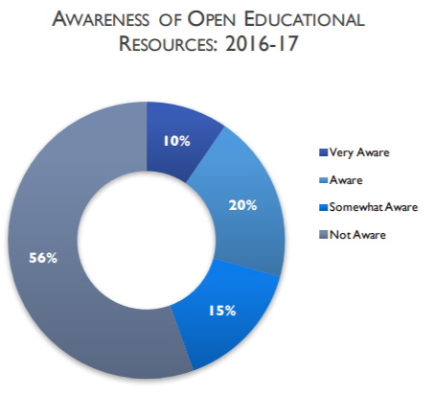
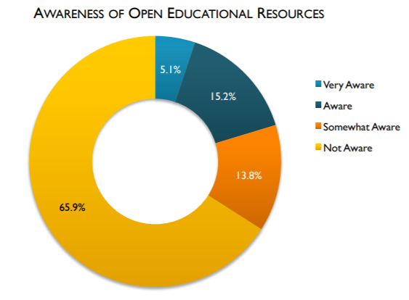
Babson Reports (2014, 2016, 2017)
https://www.onlinelearningsurvey.com/reports/openingthecurriculum2014.pdf
https://www.onlinelearningsurvey.com/reports/openingthetextbook2016.pdf
https://www.onlinelearningsurvey.com/reports/openingthetextbook2017.pdf

Slide 51
Which books? Which users?
Notes:
https://unsplash.com/photos/gcDwzUGuUoI
https://unsplash.com/photos/f2Bi-VBs71M

Slide 52
Thank you
Anita Walz
arwalz@vt.edu

