Slide 1
Optimizing Building Geometry to Increase the Energy Yield in the Built Environment
Malika Grayson
Dr. Ephrahim Garcia
Laboratory for Intelligent Machine Systems
Cornell University
June 10th, 2015
NAWEA Symposium 2015
Virginia Tech.
Notes:
- Assessing the wind energy yield with changed façade
Work will be disseminated in the Journal of Wind Engineering and Industrial Aerodynamics

Slide 2
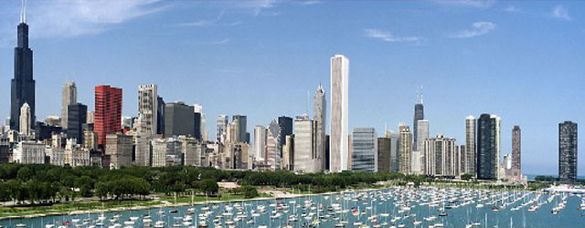
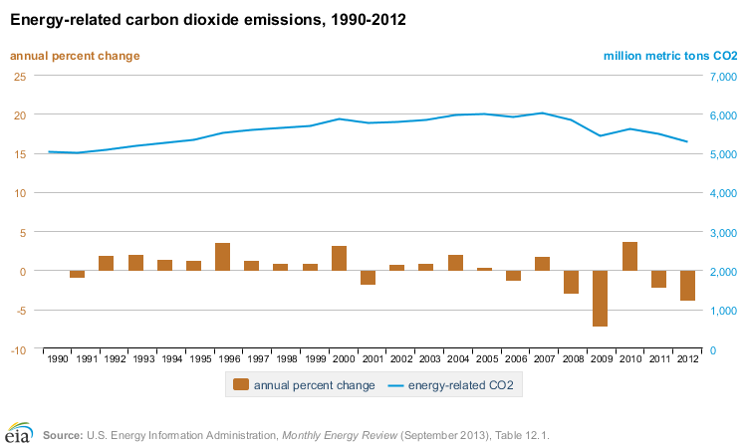
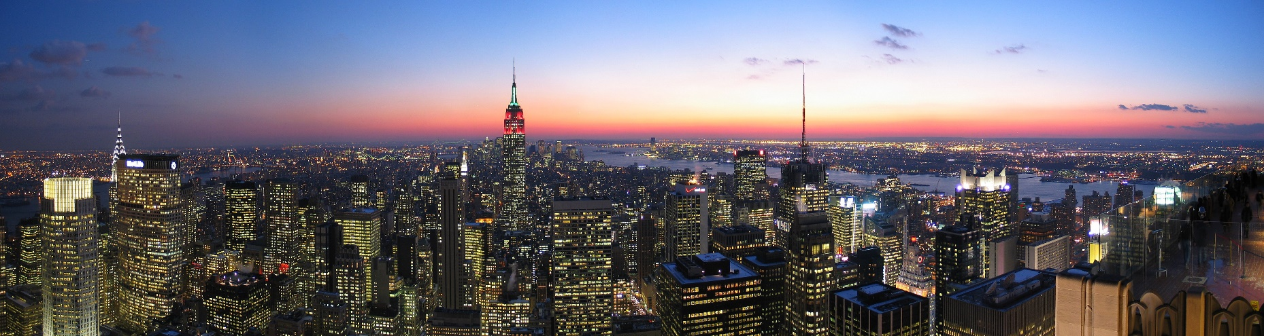
Motivation: How are urban areas defined?
http://www.rrojasdatabank.info/statewc08093.4.pdf
Large plan density
  City centres – high-rises, towers, sky scrapers
NREL, Global Renewableenergy development, October 2013
- In US, has climbed to 12% of total electricity generation (NREL)
a) Chicago
www.eia.gove/oiaf/1605/ggrpt/carbon.html
US Energy Information Administration
b) New York City
Image Source: a) topoftherock.com
b) wordpress.com
Notes:
What exactly are we calling an urban area? Environment with high roughness
High rises, commercial or residential
US Census defines urban areas based on population
NYC, LA, Chicago, Philly, Miami,Dallas – according to Cencus bureau
High rise – 35 – 100m

Slide 3
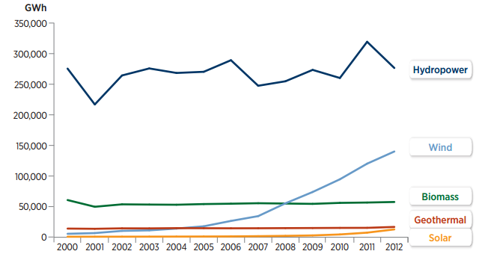
Motivation: Why Urban Areas?
http://www.rrojasdatabank.info/statewc08093.4.pdf
51% of the energy consumption in NYC came from buildings^{[1]}
  42% attributed to electricity
On-site energy generation leads to a decrease in transmission losses
  6% of electricity lost in transmission^{[2]}
Use of a clean, green, and indigenous energy source to become more sustainable
NREL, Global Renewableenergy development, October 2013
- In US, has climbed to 12% of total electricity generation (NREL)
www.eia.gove/oiaf/1605/ggrpt/carbon.html
US Energy Information Administration
US Renewable Electricity Generation by Technology
[1] http://www.rrojasdatabank.info/statewc08093.4.pdf
[2] Energy Information Administration
Image Source: U.S. Department of Energy, 2012 Energy Data Book
Notes:
Integrate renewable resources into places that need it
13% Industry – mining, quarrying, construction
36% transport – fuels, road vehicles
COMMERCIAL BUILDINGS – In recent years there has been much focus on reducing building energy consumption and building sustainability – solar panels, reusable water systems
42% of this consumption being electricity for lights and equipment (rest is heating/cooling/ water system and ventilation)
Decrease in external electrical demand
Transmission losses due to the thousands of miles can be abt 6% of the electricity that is transmitted leading to overcompensation (SOURCE EIA) – Energy Information Adminstration
1) sending more current than is needed to ensure required amount is covered
2) Or the implementation of substations with transformer systems

Slide 4
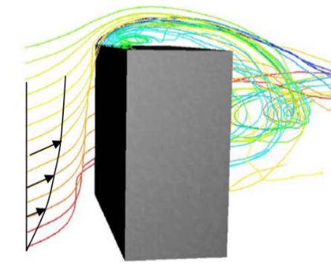
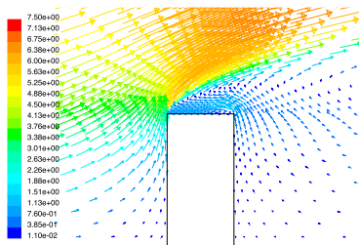
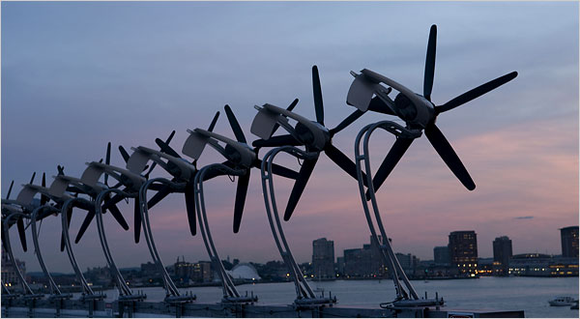
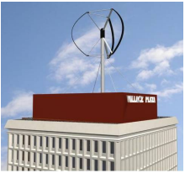
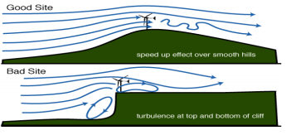

Motivation: Flow behavior over rectangular buildings
Local topography in urban areas decreases the velocity of the flow at lower levels but flow velocity increases with height
Above high-rise buildings, the wind speed increases 20% higher than the local undisturbed velocity^{[2]}
Wind- turbine located on the roof center of buildings, requires a minimum tower height of 0.25(building height)^{[4]}
a
b
www.eia.gove/oiaf/1605/ggrpt/carbon.html
US Energy Information Administration
Pathlines showing flow behavior^{[3]}
Velocity vectors showing flow behavior^{[4]}
$$Power Density=\frac{1}{2}ρ V^{3}$$
[1] Mertens, S., Wind energy in urban areas, concentrator effects for wind turbines close to buildings ,Refocus, March/ April 2002
[2] Mols, B. (2005). “Turby—Sustainable Urban Wind Power from the Roof Top.” Delft, Netherlands: Delft University of Technology. http://www.tudelft.nl/live/binaries/32943b78-
dabd-4087-9cd9-b071f0c96cd3/doc/Outlook052-18-22.pdf; accessed September 2010
Illustration of the ‘speed up effect’ in a rural area due to the presence of a smooth hill^{[5]}
[2] Mertens, 2002
[3] Mols, 2005
[4] Brussel & Mertens, 2005
[5] Blackledge et al., 2012
Image Source: a) Logan International Airport, Boston
b) Dermont Wind Turbine, Brussel & Mertens, 2005
Notes:
IN urban environment, the higher up we go the less obstacles in the flows path
Presence of cliff decreases efficiency and potential energy yield of machine
We see in the right corner that blackledge illustrated flow in the rural environment and showed the flow behavior given a change in topography…raising the question what topography in rural environments give best the best energy yield for turbine placement (How an we incorporate this in urban areas) – Clif causes flowto shift direction, putting stress on machine
In Urban areas, limited installation – low Vel, high turb..How can we change that?
Turbulence dissipation at separation zone through discontinuities and eddies affects wind quality …lose energy from dissipation
Turbulence affects wind quality and efficiency of turbines
How do we get the power eqution? – start with mass flow rate through a rotor and find the kinetic energy per unit time which is power
rhoAU = dm/dt
KE per unit time = Power = ½ (dm/dt)U^2 = 1/2rho A U^3

Slide 5
Approach: Sloped façade
Goal: Investigate the effects of building morphology on wind flow to increase the potential wind energy yield in urban environments
Two main parameters are needed for wind turbines
  High wind velocity
  Low Turbulence
Changing the structure’s façade
  Accelerate the mean flow velocity in the region directly above the roof top resulting in a higher velocity wind field on the rooftop
  Decrease the turbulence intensity
  Decrease the flow separation region
Roof middle
h_{p}
leading edge
trailing end
θ
rectangular building
Modified building using a sloped façade
Notes:
The two main parameters we will be looking at is High vel, low turb
Before I mentioned traditionally the main parameters for siting: Therefore we change the façade to see if we can get these parameters
Why Slope? Simple change that was easily replicable both in wind tunnel and CFD especially when maintaining similarity in modeling parameters
Chose simple 2D slope as a starting preliminary point
For wind turbine siting especially in rural wind farms, companies look at two main parameters (if turbulence is high and wind component is changing all the time) Yaw cannot handle it
1) IF we have an increased wind field near the roof, buildings, large towers are unnecessary which makes it easier to retrofit building - to increase energy yield on the building rooftops?

Slide 6
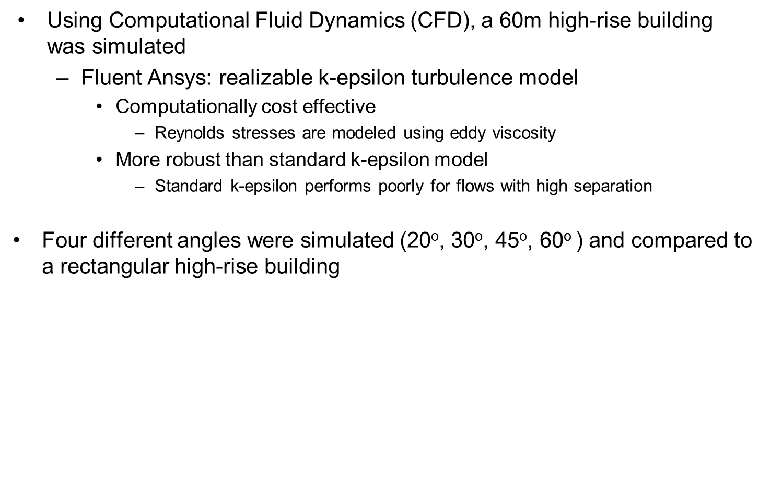
Approach: Preliminary CFD
Using Computational Fluid Dynamics (CFD), a 60m high-rise building was simulated
  Fluent Ansys: realizable k-epsilon turbulence model
    Computationally cost effective
      Reynolds stresses are modeled using eddy viscosity
    More robust than standard k-epsilon model
      Standard k-epsilon performs poorly for flows with high separation
Four different angles were simulated (20º, 30º, 45º, 60º ) and compared to a rectangular high-rise building
inlet
farfield domain
building
[3] Richards, P.J, and R.P Hoxey. "Appropriate boundary conditions for computational wind engineering models using the k-ϵ turbulence model." Journal of Wind Engineering and Industrial Aerodynamics 46-47 (1993): 145-53.
Notes:
60m building with sloped facades of 20, 30 45, 60 Angles were picked arbitrarily – Simulated 60m highrise building
Why – wanted to try a wide range of angles
Turbulence Model, Commonly used in literature
Eddy viscosity, Ignore small scale vortices and calculate large scale motion that models everything else
Turbulent transfer of momentum by eddies analogous to molecular viscosity close to wall but on a larger scale
Mesh dependence studies were done for 3 different meshes
2D vs 3D, 2D simulations are approximations 3D and some problems can be approximated as 2D with negligible different, depending on the features you want to capture you chose the simulation type
Near-wall model
The wall function or log-law ceases to be valid if the flow conditions depart too much from
the assumed (see section 3.1.1):
• constant shear stress (assumption of constant friction velocity in turbulent flow) and
• fully turbulent near-wall flow.
According to the assumptions of the log-law, the wall function is unreliable for flows with:
• a low Re number (no fully turbulent flow near the wall),
• severe pressure gradients leading to separation (shear stress not constant).

Slide 7
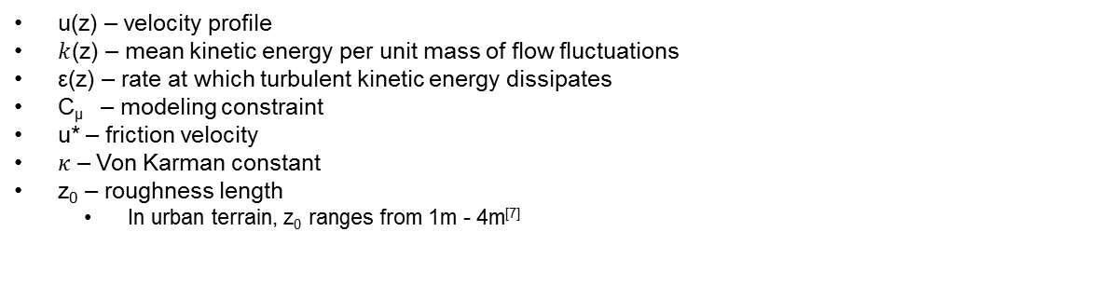

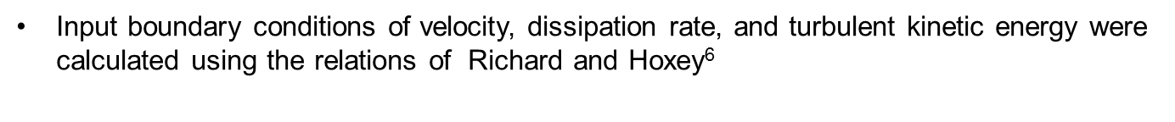
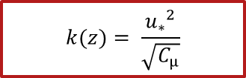
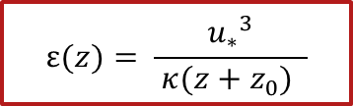

Approach: Boundary Conditions
Input boundary conditions of velocity, dissipation rate, and turbulent kinetic energy were calculated using the relations of Richard and Hoxey⁶
$$U\left(z\right)= \frac{u_{∗}}{κ}ln\frac{z+z_{0}}{z_{0}}$$
$$k(z)= \frac{{u_{∗}}^{2}}{\sqrt{C_{μ}}}$$
$$ε(z)= \frac{{u_{∗}}^{3}}{ κ(z+z_{0}) }$$
Inlet Velocity Profile
Turbulent Kinetic Energy Profile
Dissipation Rate Profile
height, m
height, m
height, m
Velocity, ms⁻¹
Velocity, ms⁻¹
Velocity, ms⁻¹
u(z) – velocity profile
$k$(z) – mean kinetic energy per unit mass of flow fluctuations
ε(z) – rate at which turbulent kinetic energy dissipates
C_{μ} – modeling constraint
u* – friction velocity
𝜅 – Von Karman constant
z₀ – roughness length
  In urban terrain, z₀ ranges from 1m - 4m^{[7]}
[6] Richards & Hoxey, 1993
[7] Counihan, 1975
[3] Richards, P.J, and R.P Hoxey. "Appropriate boundary conditions for computational wind engineering models using the k-ϵ turbulence model." Journal of Wind Engineering and Industrial Aerodynamics 46-47 (1993): 145-53.
Notes:
Common Relations used:
Why use Richard and Hoxey: Satisfies all implications for existence of a 2D incompressible homogeneous flow for modelling. TKE of eddies in turb flow
Gives us relations for input conditions satisfying the turbulence model we are using (k e model )
Z0 = 2m
U* = 0.7m/s
TKE – mean kinetic energy per unit mass of flow fluctuations – J/kg or m^2/s^2
Dissipation rate – rate at which turbulent kinetic energy dissipates J/kgs or m^2/s^3
Based on numerous turbulent flows done in CFD (wide range of flows) –Cmew, model constraint

Slide 8
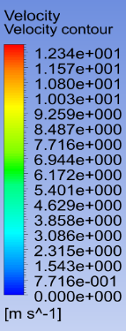

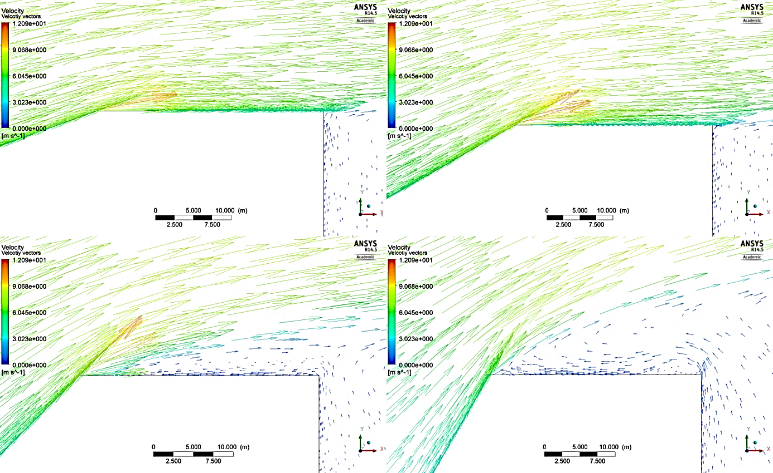
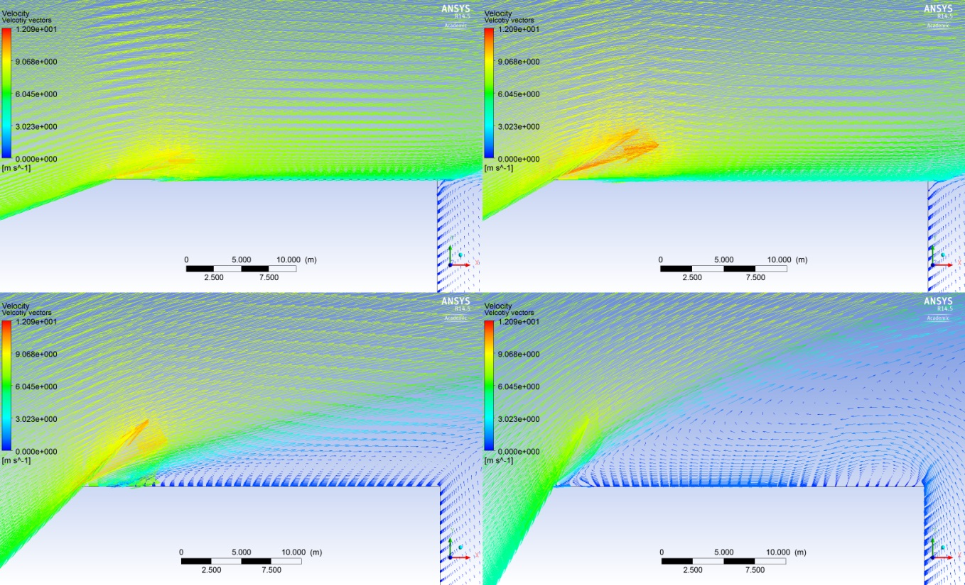
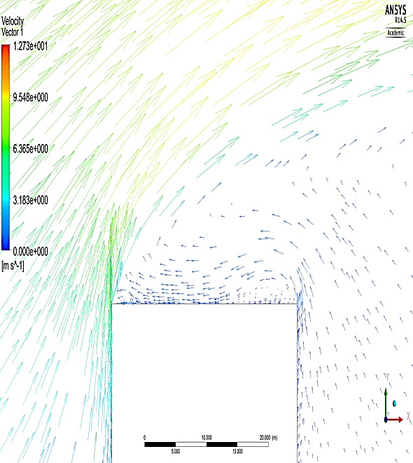
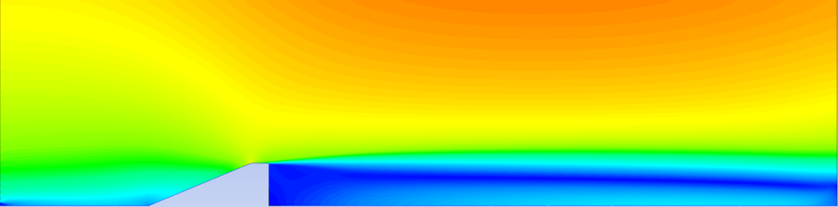
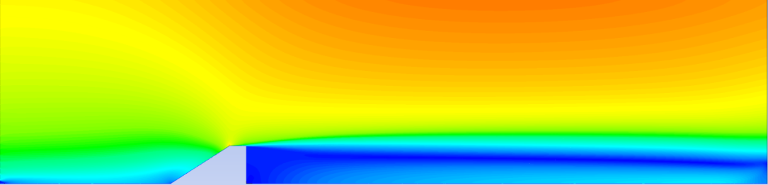
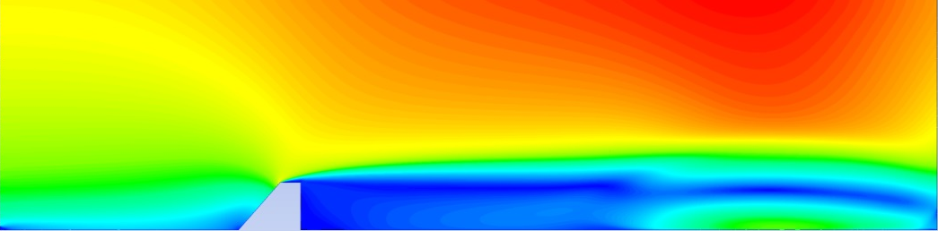
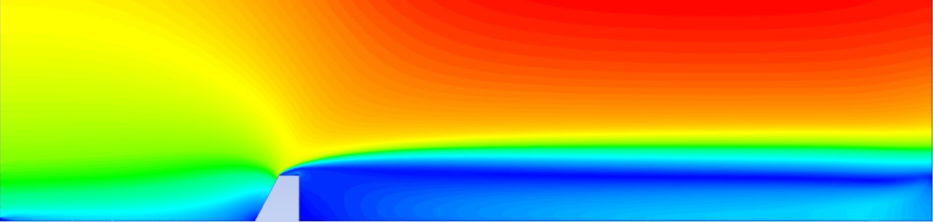
CFD Results: Velocity vectors zoomed
CFD Results: Velocity Contours
Rectangular building and angled facades: 20º, 30º, 45º, 60º
  Velocity amplification at roof edge of sloped facades
  Decrease in separation zone depth with decreasing angle
Rectangular building and angled facades: 20º, 30º, 45º, 60º
  Decrease in angle leads to minimal flow reversal and decrease in flow separation angle
  Larger wind field on rooftop region based on increased velocity
    Harness energy closer to roof
20º
30º
20º
30º
45º
60º
45º
60º
Notes:
Decreased separation encourages multiple locations for harvesting, decrease in mounting height of devices
Flow reversal not useful, contains low velocity magnitude
To assess which sloped façade worked best, looked at region of amplification at roof edge

Slide 9

Approach: Profile comparisons
Velocity profiles and power densities were compared for all slopes for a range of 0 ↔ $\frac{1}{12}H$ above the roof
30º sloped façade chosen for future investigations
  Highest power density at roof edge compared to rectangular building
Velocity profile at roof edge for varying angles
Mean Velocity Profile at roof-edge
Wind Power Density at roof-edge
height,m
20º
30º
rectangle
60º
45º
Velocity,ms⁻¹
Notes:
Graph of height on y and velocity on x showing the velocity profile at the roof edge location
Again we are looking at 1/12H building height (would not want to put a turbine too much higher than this height( 2.1m – 7m diameter) – 5m range
30 degs has increased velocity above roof, as well as 78% increase in average power density along the roof edge

Slide 10
Approach #2: Elliptical façade
Using the results of the preliminary CFD simulations
  30º sloped angle showed best results
Further changing the structure’s façade by using 30º slope as a guide parameter for an elliptical facade
  How will the velocity change?
  How will the turbulence change?
  How will the separation change?
Roof middle
leading edge
trailing end
h_{p}
θ
θ
rectangular building
Modified building using a sloped façade
Modified building using an elliptical façade
Notes:
The two main parameters we will be looking at is High vel, low turb
Before I mentioned traditionally the main parameters for siting: Therefore we change the façade to see if we can get these parameters
Why Slope? Simple change that was easily replicable both in wind tunnel and CFD especially when maintaining similarity in modeling parameters
Chose simple 2D slope as a starting preliminary point
For wind turbine siting especially in rural wind farms, companies look at two main parameters (if turbulence is high and wind component is changing all the time) Yaw cannot handle it
1) IF we have an increased wind field near the roof, buildings, large towers are unnecessary which makes it easier to retrofit building - to increase energy yield on the building rooftops?

Slide 11
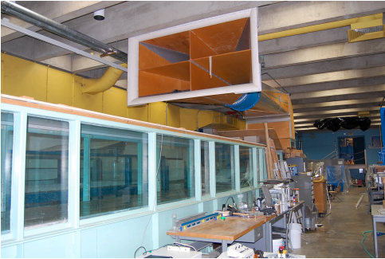
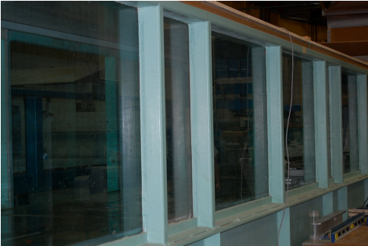
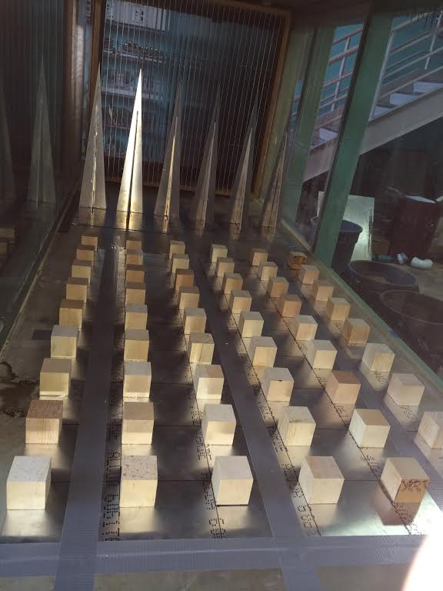
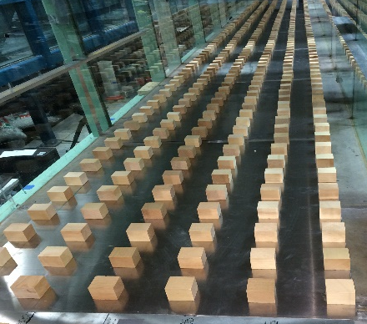
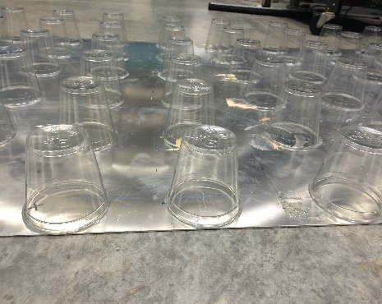
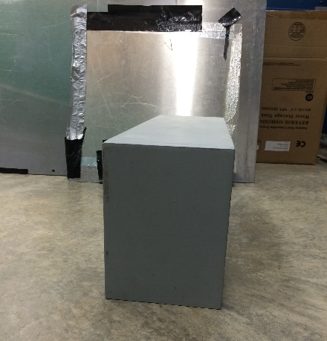
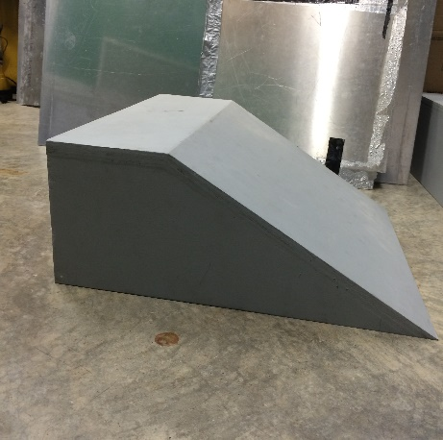
Experimental Setup
DeFrees wind tunnel system
  1m x 0.95m test section, 20m fetch
  1:300 model scale
  Protuberances used to provide continuing production of turbulence at lower level⁶
  Analytical relationship used for calculating roughness height ⁷
  11m fetch of cubes
  7m fetch of cubes with 4m fetch of cylinders
Measurement Process
  Hot wire anemometry
  2D plane in centerline of building
0.05m
0.08m
h_{m} = 0.2m
0.2m
0.5m
30º
0.15m
[6] Cook,1973
[7] Gatshore & De Croos, 1977
Notes:
Modeling requirements – geometric similarity (Re# similarity), Re # dependence vertical distribution of mean speed and intensity in longitudinal component (Minimum ) – pick a scale to have enough similarity (want to still maintain a large number and significant features )
Cups represent average building height
Approach flow modeled using locally homogeneous – fully developed, adiabatic ABL conditions – same structure in all parts of the flow
Brief view of some of our trial and error tests with cubes
For everything to be simulated we need a small scale ratio (1:1000) which is too small so we resort to only simulating a portion of ABL – ASL 10% of ABL
For studies looking at flow behavior for pedestrian winds, or flow field studies, velocity scale is arbitrary as long as the fulls scale and model flows are aerodynamically similar (independent of Reynolds number which they are)
Blockage ratio of 10 –
Open circuit wind tunnel : based on continuity and Bernoulli equation (make sure you know how it works)
Why weren’t roughness elements staggered? That’s a great idea
Adjacent of sloped building 0.3464m. Model height represents scale of 1:300
For small scale model simulation
Cook – used cylinders and cubes
Cook used lego cubes and barrier
Irwin used spires to thicken boundary layer
Packing density – 14.96% - consistent with packing density in in city center – dependent on area you are looking at
Some of these were tried and we got the best results using cubes and cylinders
Wieringa and Rijkoot (above 6m/s, fully developed abl is adiabletic and neutral

Slide 12
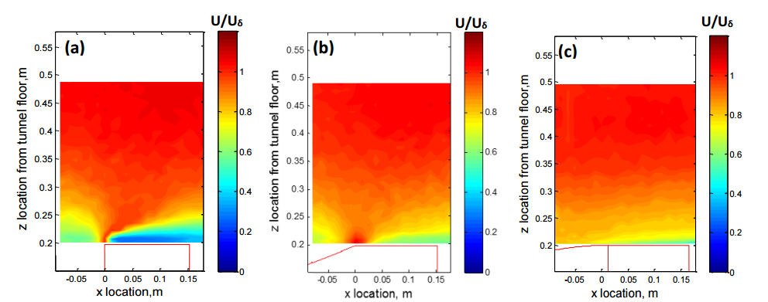
Experimental Results: Velocity Contours
0.67in = 5m full scale
30º
Increase in velocity directly above roof with sloped and elliptical façades
Area of higher velocity both close to and across entire roof top region
Enhanced velocity field increases wind energy yield potential
Potential energy yield at roof edge is increased with sloped façade
Separation bubble is further decreased with the presence of elliptical facade
Notes:
Velocity in increased closer to the roof top
Wider region of enhanced velocity field on roof top across area of interest
Even see an enhanced region above the this area.
This is where we want to put our small scale devices. Opportunity to put it at any location
Clear representation of the colors tending to red closer to the rooftop, access more power
Increase in velocity directly above roof with sloped façade
Area of higher velocity both close to and across entire roof top region
Enhanced velocity field increases wind energy yield potential
Power density at roof edge is increased with sloped façade
Region size where there is low power density is decreased

Slide 13
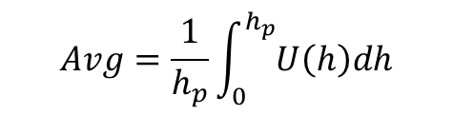
Experimental Results: Velocity Profiles
$$Avg=\frac{1}{h_{p}}\int_{0}^{h_{p}}{U\left(h\right)dh}$$
Sloped trailing end location experienced average velocity increase ~ 59%
Elliptical trailing end location experienced average velocity increase ~ 61.7%
Sloped leading edge location experienced average velocity increase over rectangle model ~ 6.29%
  Rectangle model enhanced freestream velocity ~ 23.5%
  Sloped model enhanced freestream velocity ~ 32%
Elliptical leading edge location experienced average velocity decreased compared to rectangle model ~ 13%
Sloped roof middle location experienced average velocity increase over rectangular model ~ 90%
Elliptical roof middle location experienced average velocity increase over rectangular model ~ 89.3%
Notes:
X axis is velocity, y axis is height above the model
Only interested in 5m full scale is 0.0167m on our geometric scale used, only look 0.0167m above roof
Measuring 0.66 inches to see those effects
Model height, m Full Scale, m (1:300) 0.2032 60.96; 0.206375 61.9125; 0.20955 62.865; 0.212725 63.8175; 0.225425 67.6275
Gentle elliptical façade prevented speed up effect at leading edge

Slide 14
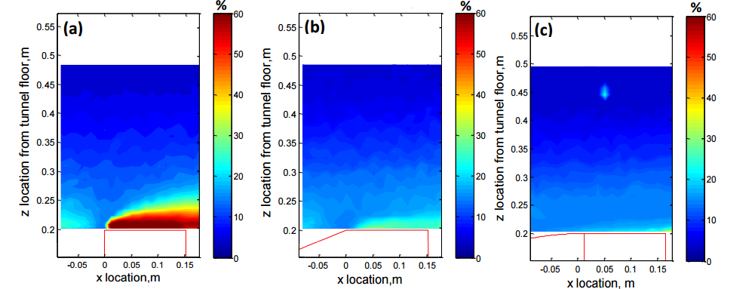
Experimental Results: Turbulence Intensity Contours
Low turbulence region with modified facades makes energy harvesting over roof field more feasible
Depth of high turbulence intensity region area decreased
Presence of elliptical façade lead to largest turbulence intensity decrease
Notes:
If we look at the colors clear representation of higher values closer to the roof top, low chance of accessing useful power in this region (close to roof top) – devices are not in high turbulence regions so less stress on machine
There is a significant decrease in the intensity, leading to encouraging locations
Low turbulence region with sloped façade makes energy harvesting over roof field more feasible: But cost factors must be taken into consideration in terms of potential energy yield

Slide 15
Experimental Results: Turbulence Intensity Profiles
Leading edge location experienced turbulence intensity on the same order
Sloped roof middle location experienced average turbulence decrease ~ 59.6%
Elliptical roof middle location had a further decrease of 69.8%
Sloped trailing edge location experienced average turbulence intensity decrease ~ 57.3%
Elliptical roof middle location had a further decrease of 64.9%
Notes:
Depth of the large area of turbulence intensity decreased
If we look at the colors clear representation of higher values closer to the roof top, low chance of accessing useful power in this region
There is a significant decrease in the intensity, leading to encouraging locations
Low turbulence region with sloped façade makes energy harvesting over roof field more feasible

Slide 16
Conclusions
Assessed the wind energy potential using a sloped façade
  Demonstrated there can be an increase by 90% in velocity with simple building façade changes
Established a larger area for potential energy yield closer roof top
    Accelerated the mean flow near the rooftop region across all roof locations
    Decreased the vertical extent of the separation bubble above the building
      Decreasing the separation angle at leading edge
      Minimizing turbulence intensity: 69% decrease
    Subsequently increased the power density near the roof top region
Notes:
Using this simple change we established a larger an useful region for energy harvesting by using the structure change that accelerated……
Can design a structure to change flow structures for energy yield
From This data, we cconclude that we can use CFD confidently for investigating flow behavior
Given the right input conditions and accurate model
2D vs 3D: 2D is an approximation of 3D simulation in order to reduce computationa lcosts. Assuming building is wide enough to have a negliblie or minimal difference across center plane.
We are not showing architects how to design buildings, we are just shoing that simple changes can leade to increased wind energy potential
How can wind in a hurricane be harnessed in urban areas for wind energy?

Slide 17
Current & Future Considerations
Optimization using angle guide to create varying elliptical façades
θ
Notes:
Using this simple change we established a larger an useful region for energy harvesting by using the structure change that accelerated……
Can design a structure to change flow structures for energy yield

Slide 18
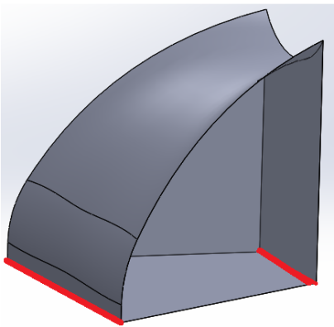
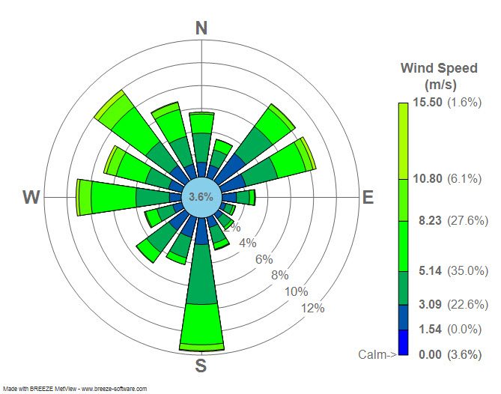
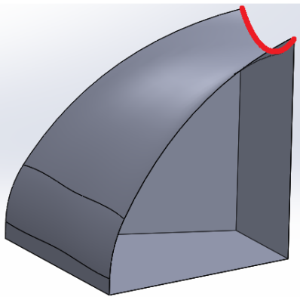
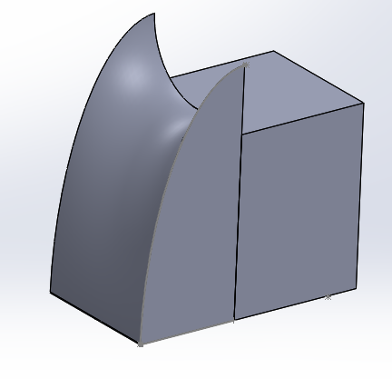
Current & Future Considerations
Further preliminary studies
  Elliptical façade models used as a base for 3D wind rose inspired structures
  Broader parameters used to find optimized shapes based on wind direction and magnitude
    Trough/Scoop radius
    Base to width ratio
Notes:
Using this simple change we established a larger an useful region for energy harvesting by using the structure change that accelerated……
Can design a structure to change flow structures for energy yield

Slide 19


Acknowledgements
National Science Foundation
Professor Bhaskaran, Swanson Simulation Lab Director
Ansys Technical Support: Mr. Guang Wu
Urban Wind undergraduate student team
Professor Ephrahim Garcia

Slide 20
Thank You
Questions?

Slide 21
EXTRA SLIDES…..

Slide 22
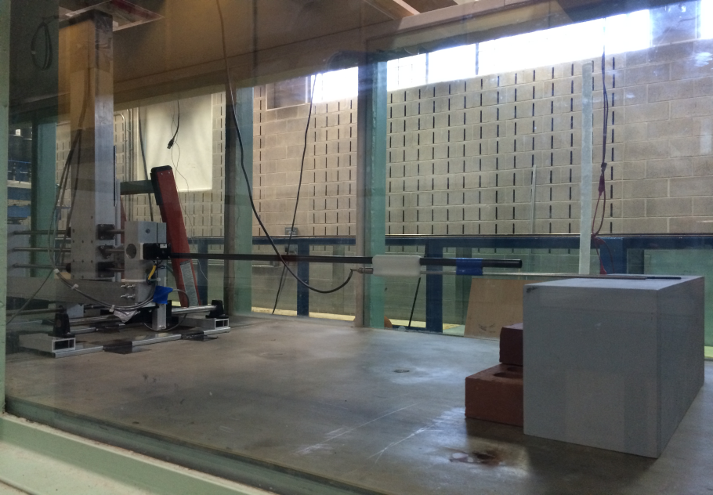
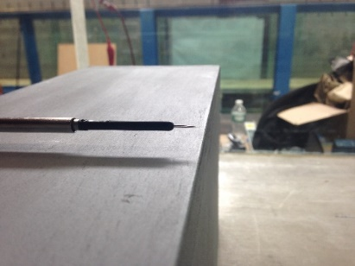
Procedure: Measurements
Designed an automated positioner system which was able to move along each axis
  Probe arm was free to move along Z axis
Measurement Process
  Hot wire anemometry
  2D plane in centerline of building
  Sampling frequency – 60s @ 1Khz
  Freestream velocity – 8.33 m/s
Measurements taken 1/8 inches above model
  0.003174m ≡ 1/8 inches
z
z
y
x
Sample points
distance from tunnel floor, in
distance downstream, in
Notes:
11inches in Z axis = 0.2794 m in Z
13 inches in X = 0.33m in X
Microcontrollers used to program positioner, Lab View for data collection
Free stream chosen to represent typical adiabatic atmospheric flow
Snake through samples
Hot wire, single wire, magnitude
Measurements taken over 2D plane
Vibration test

Slide 23
Outline
Motivation
Background
CFD Modeling
Experiments
Validation
Preliminary
Future Work
Notes:
Now we are going to talk about the validation of CFD using our experiments to see if our results align well with each other
Assumptions for turbulent modeling: incompressible, navier stokes equations. CFD: RANS equations, turbulent model, comparison of std, realizable and kw, why pic enhanced wall function. Experimental set up, different experiments ran, changes due to barrier height, talk about different ratios that I found (look for more lit to backup), graph of comparison to other authors

Slide 24
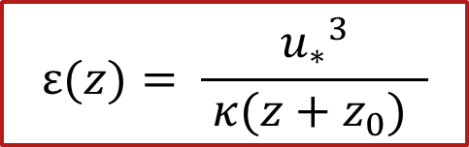

Comparison with CFD
Boundary conditions used in CFD
  Inlet velocity profile U(z), used from wind tunnel, k(z) and ε(z) calculated from previous profile equations using friction velocity, u*
Recall
$$k(z)= \frac{{u_{∗}}^{2}}{\sqrt{C_{μ}}}$$
$$ε(z)= \frac{{u_{∗}}^{3}}{ κ(z+z_{0}) }$$
k(z) – mean kinetic energy per unit mass of flow fluctuations
ε(z) – rate at which turbulent kinetic energy dissipates
C_{μ} – modeling constraint
Notes:
Used u* calculated
For Turbulent kinetic energy and dissipation rate before from profiles from the wind tunnel

Slide 25
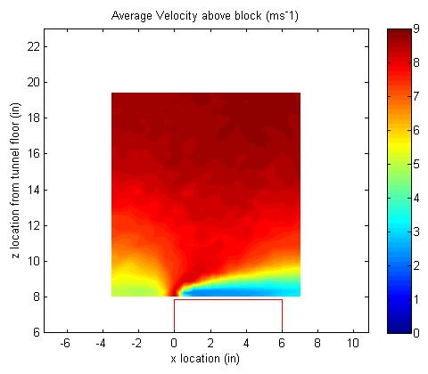
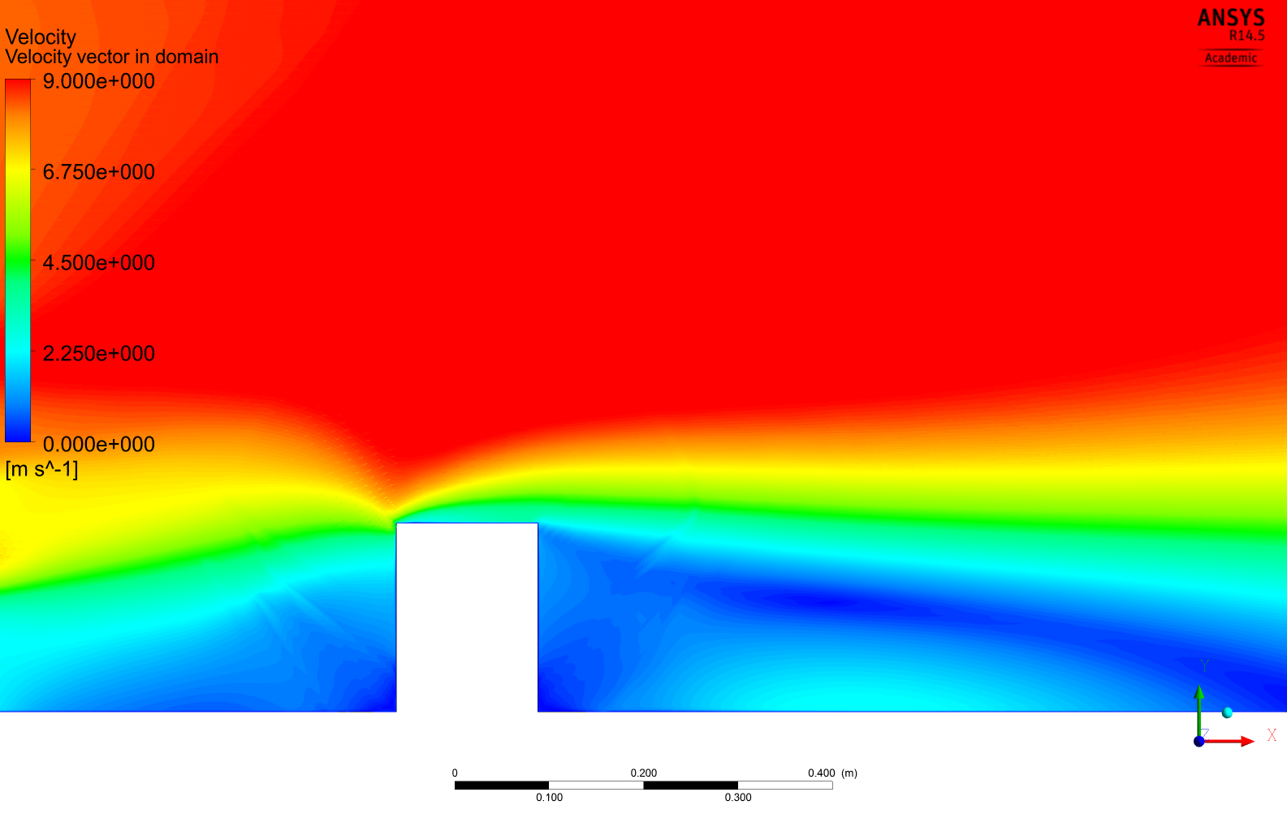
Comparison with CFD: Velocity contours of rectangle
CFD Simulation
Experiment
Both contours show similar flow acceleration above low velocity flow region
Discontinuity at leading edge
Notes:
Both contours correlate well with each other and experience similar locations of flow acceleration/ deceleration
Roof edge is not as clear, attributed to the lack of robustness in sharp gradient region for ke model. with a not very robust model which although it is an improvement, is still sensitive to separated and complex flows (roof corner)
Try more robust model and mesh refinement – more accurate and robust near wall treatment
RANS models under predict the level of turbulent stresses because of the assumption of eddy viscoscity, esp at separation

Slide 26
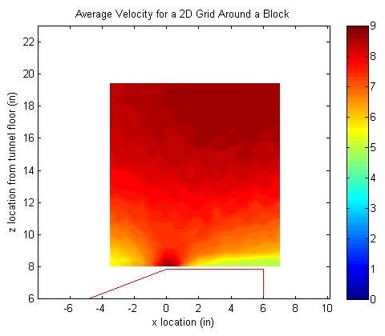
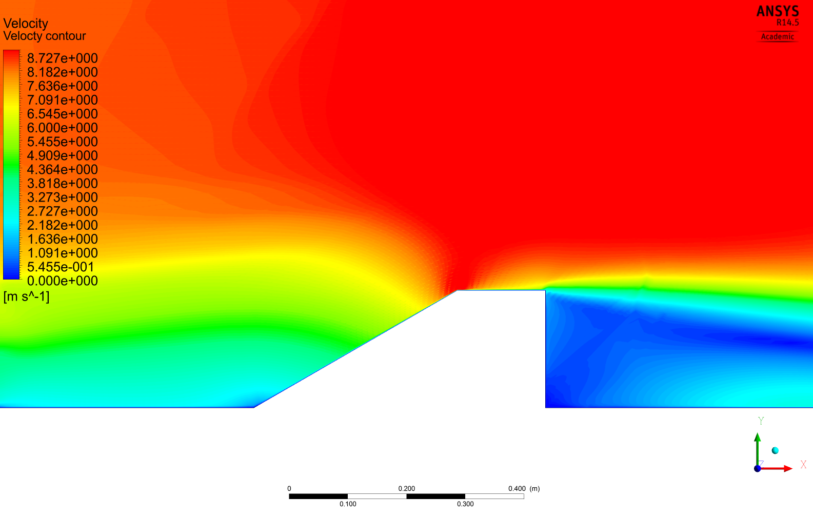
Comparison with CFD: Velocity contours of slope
Contour similarity - amplification at roof edge in both models
Enhanced flow velocity over entire roof region verified
CFD Simulation
Experiment
Notes:
Flow has to turn less, less complex flow
Flow stays attached on slope

Slide 27
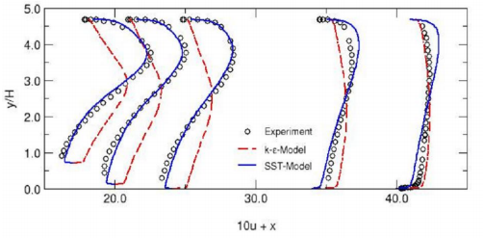
Comparison with CFD: Velocity Profiles Rectangular
Leading edge
Roof middle
height,m
height,m
Velocity,ms⁻¹
Trailing end
Velocity,ms⁻¹
a
Velocity,ms⁻¹
Notes:
Cant readily measure flow in separation zone, Ke uses isotropic eddy viscosity assumption, assuming it is a constant and proportional to the diagonal of strain tensor

Slide 28
Comparison with CFD: Velocity Profiles 30º Slope
Leading edge
Roof middle
height,m
height,m
Velocity,ms⁻¹
Trailing end
Velocity,ms⁻¹
height,m
Velocity,ms⁻¹
Notes:
K omega uses blended function with k omega close to wall and ke in outer flow
From This data, we cconclude that we can use CFD confidently for investigating flow behavior
Given the right input conditions and accurate model

Slide 29
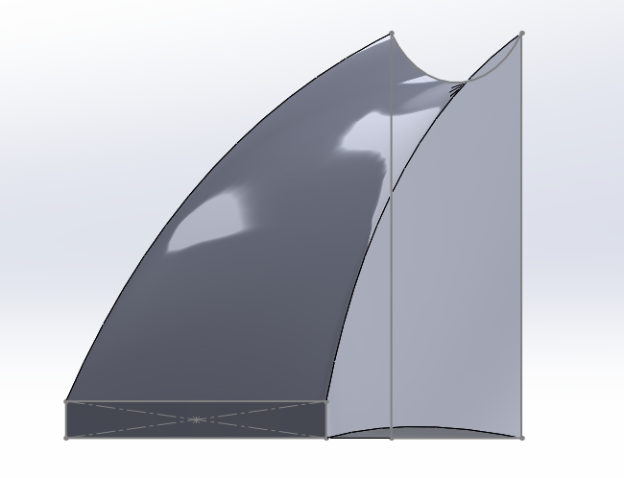
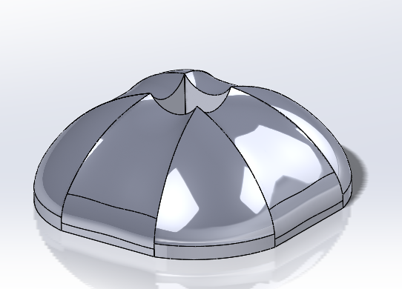
Further Research
Investigate additional façade and structure shapes
  Analysis of simple façade changes
  Three dimensional structural changes to correlate with environmental conditions such as multiple flow directions
    E.g., Wind Rose
Study the effects of the modified structure within an urban array
  Building’s effect on flow behavior from nearby building structures
  Asymmetric orientation based on wind distribution
Notes:
Specifying nearby structures to see the influence on flow characteristics as it approaches building of interest
Now Imagine a building fixed in their urban environment? What must it look like for the surrounding areas to possess these qualities?

