Slide 1
Ocean DB
Justin Nelson, Matthew Eberhard, Derek Hackenbracht, Will Hillhouse
CS4624 - Multimedia, Hypertext, and Information Access
Professor Edward Fox
Virginia Tech, Blacksburg VA 24061
April 18, 2023

Slide 2
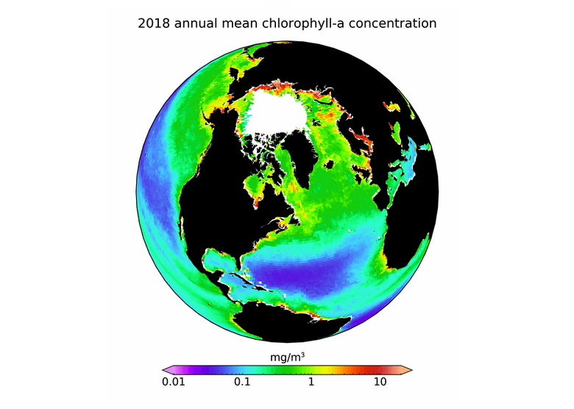
Outline
Project Overview
Deliverables
General Approach
Timeline
Work Completed
Remaining Work

Slide 3
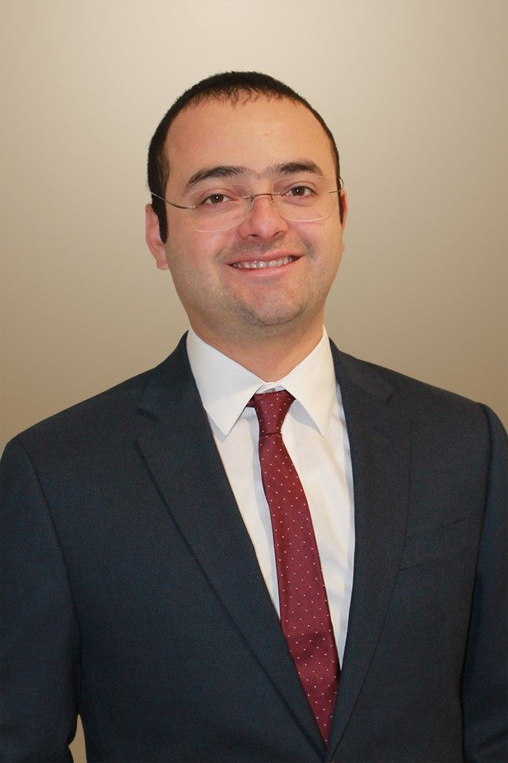
Project Overview
Our client: Dr. Luis Escobar in the Department of Fish and Wildlife Conservation
His Goal: Study the effects of climate change on the features of the ocean and the likely effects on human health and biodiversity.
Our Goal: Collect relevant ocean condition data as far back as possible to help our client with his research.

Slide 4
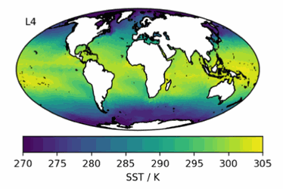
Deliverables
Collecting annual ocean salinity and surface temperature data dating as far back as possible in a GEOTiff file format.
Additionally, we will write a lightweight script that will allow Dr. Escobar to pull new data in the future and update his database of files.

Slide 5
General Approach
Already received data sources from the client
  Matter of collecting and organizing the necessary data
Build an understanding of the API for the data source
Develop script for grabbing data between user-specified dates

Slide 6
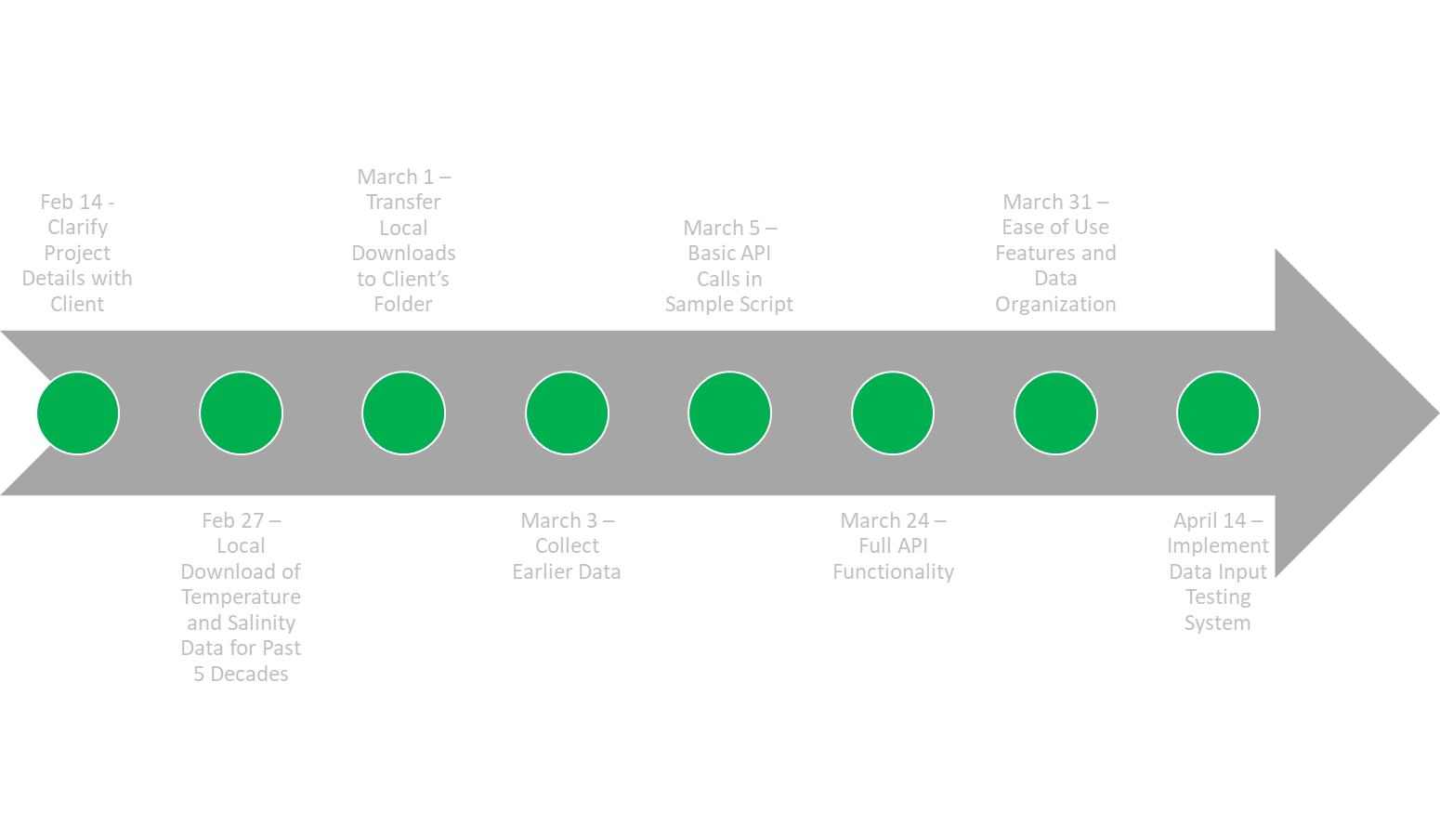
Timeline
Notes:
Red arrow points to where we currently are in our timeline: between sample scripts with basic API calls and full API functionality

Slide 7
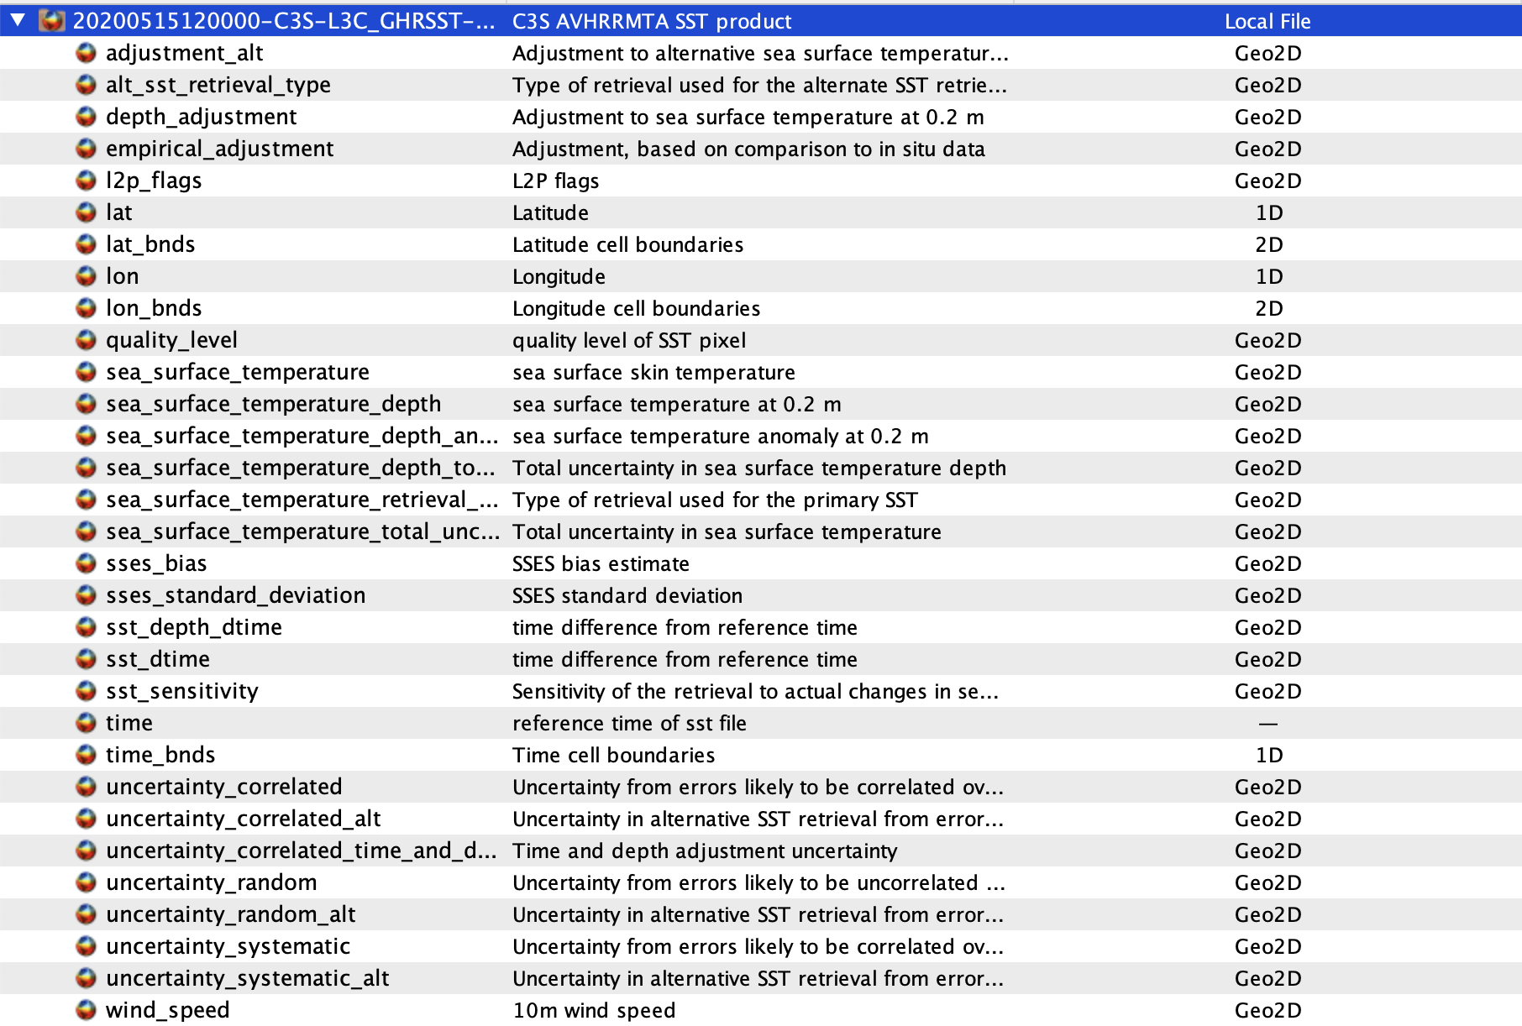
Old Conversion Technique - Raw Data Downloaded
Downloaded historical data
Data comes in as .nc file
Must extract desired parameter and convert to TIFF format
Notes:
This photo is what one file looks like and represents one month
You can see all of the data variables available in the file, but we must extract only the necessary data for our client’s research (the one highlighted in the red box)

Slide 8
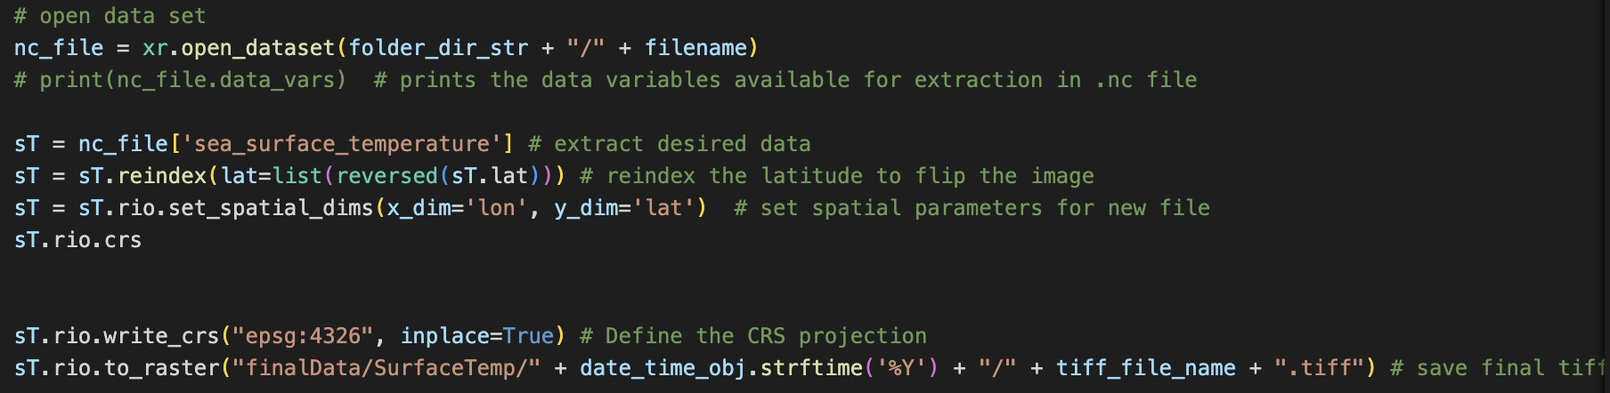
Old Conversion Technique - Scripting for Data Transforms
Notes:
This is the code that we used to convert the .nc files to .tiff
Open the dataset, extract desired data, do some manipulation, and save the file as .tiff
We wrote a script that loops through all of our historical data and converts each file

Slide 9
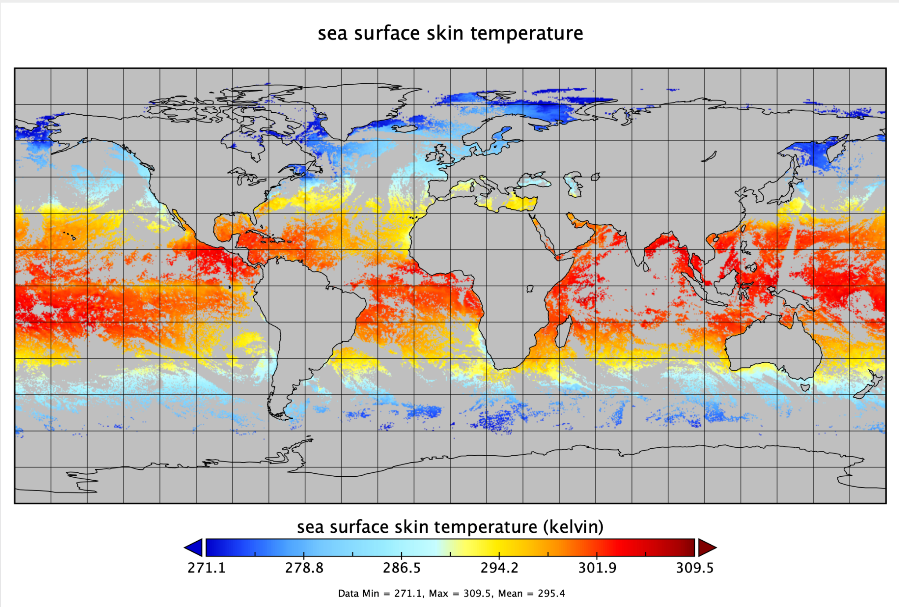
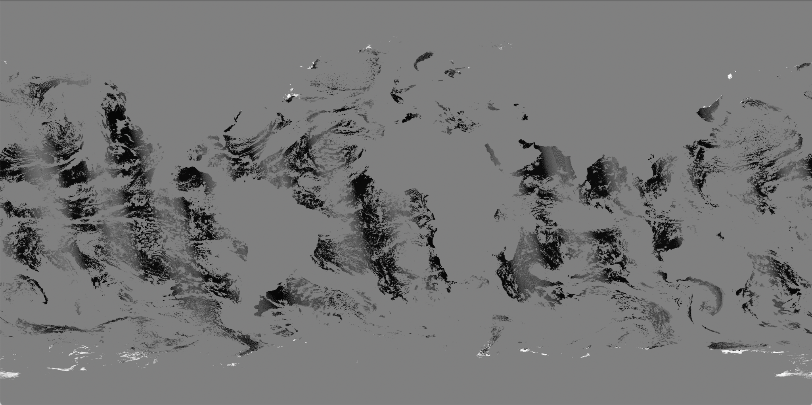
Old Conversion Technique - Final Data Sample
Before
After
Notes:
This is a sample of the final data output by our code
The before is what the .nc file data looks like when viewed through a specialized software tool, and the after is the raw surface temperature data we extracted from the .nc file
This is the format that our client requested for his research

Slide 10
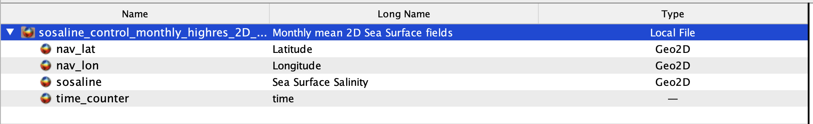
New Conversion Technique - Raw Data Downloaded
Notes:
This photo is what one file looks like and represents one month
You can see all of the data variables available in the file, but we must extract only the necessary data for our client’s research (the one highlighted in the red box)

Slide 11
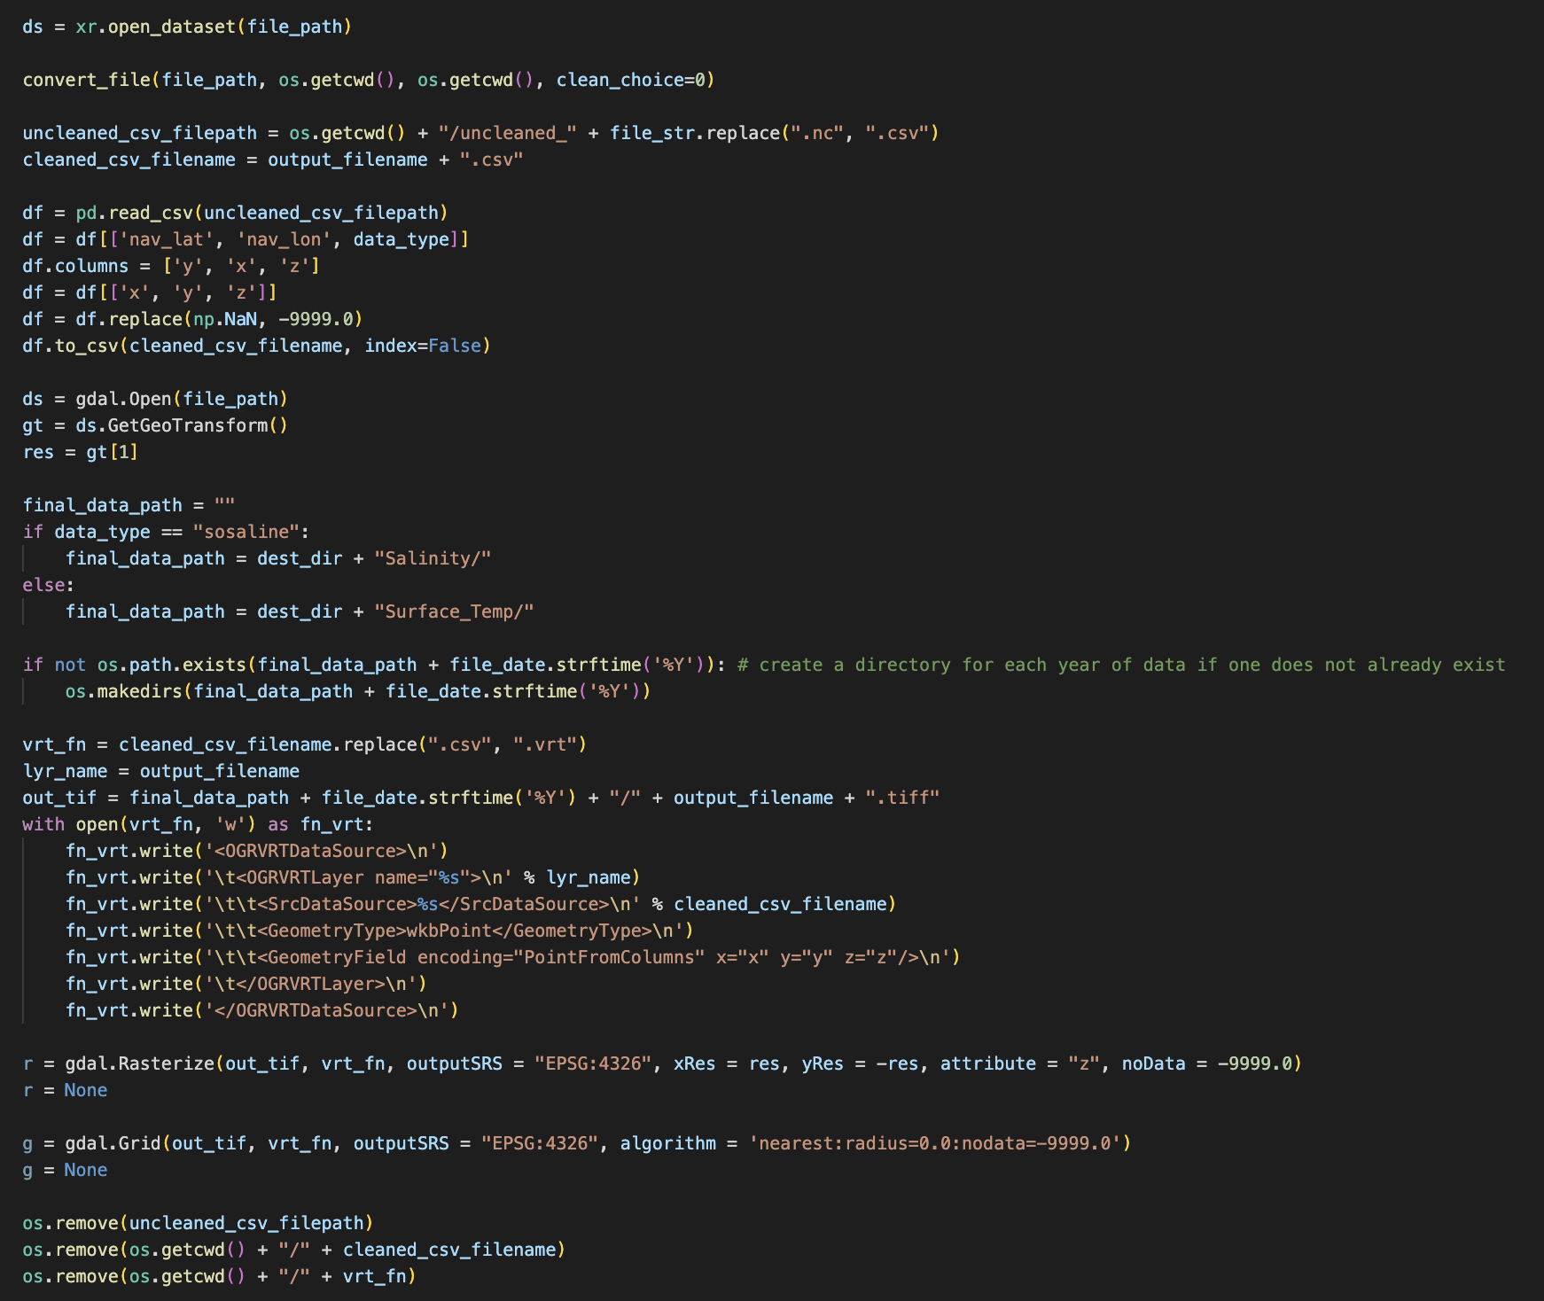
New Conversion Technique - Scripting for Data Transforms
Notes:
This is the code that we used to convert the .nc files to .tiff
Open the dataset, extract desired data, do some manipulation, and save the file as .tiff
We wrote a script that loops through all of our historical data and converts each file

Slide 12
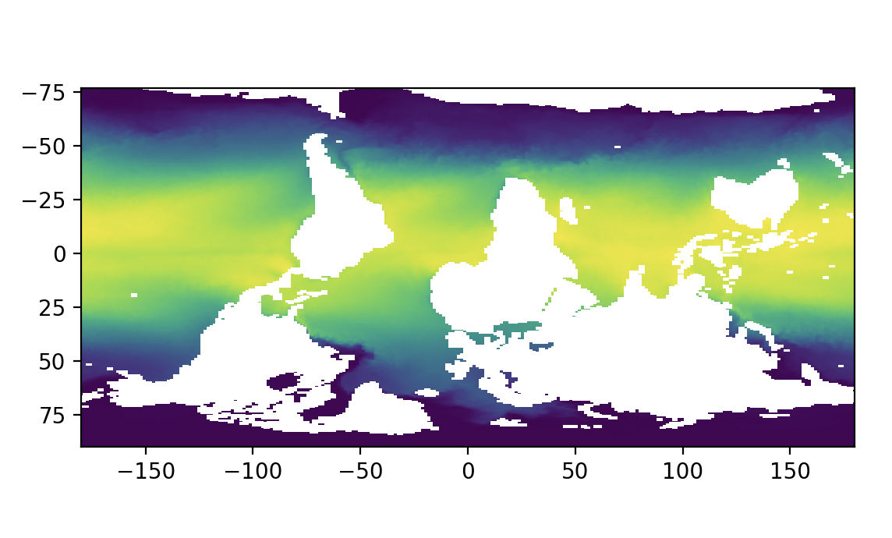
New Conversion Technique - Final Data Sample
Notes:
This is a sample of the final data output by our code
The before is what the .nc file data looks like when viewed through a specialized software tool, and the after is the raw surface temperature data we extracted from the .nc file
This is the format that our client requested for his research

Slide 13
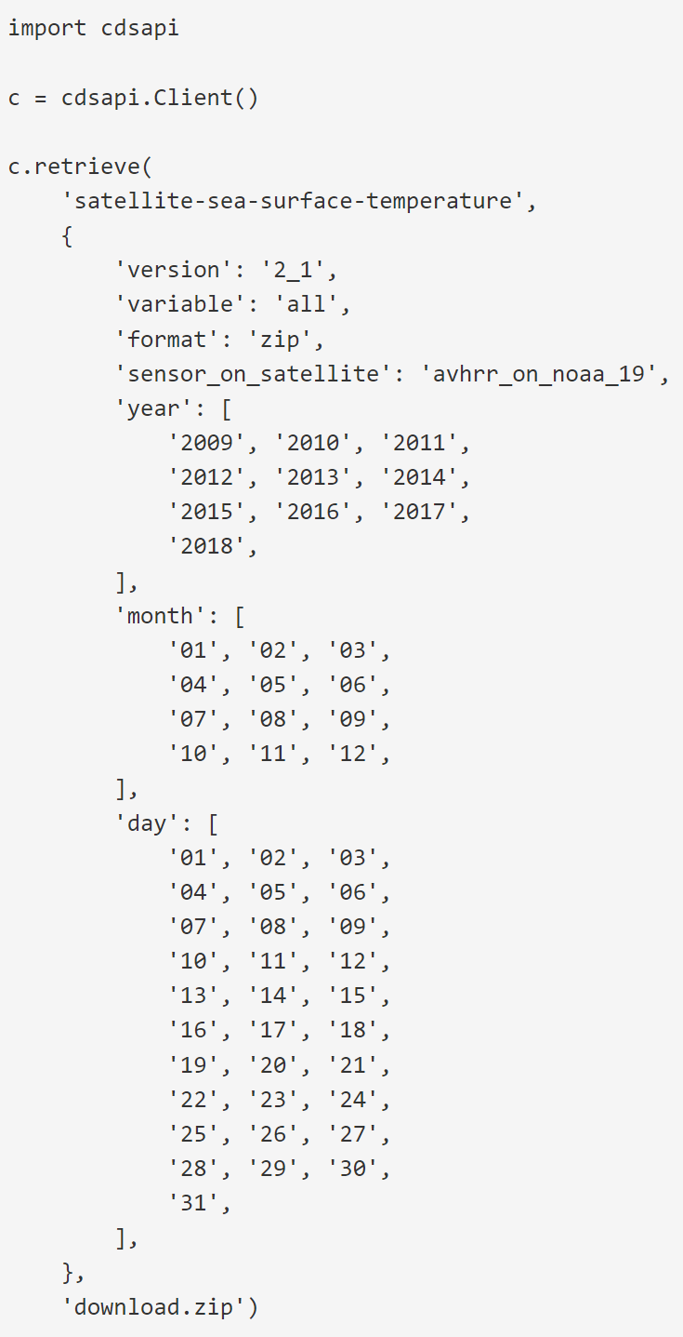
Work Completed - Scripting
Have base code for conversion technique
Has been extended to extract data directly from API
Specify months of data to grab, use same conversion techniques to convert new data
Notes:
We need to set up a program that will grab data upon the client’s request, convert that data to the desired tiff format, and update the database of historical data that we have already established
We will expand upon the code that we have already written and utilize the data source API to pull new data

Slide 14
Work Completed - Testing
Edge case testing for user input
  Ensuring input is a valid date-time
  Ensuring data availability for supplied date
API calls
  Tests for catching errors returned by API
  Sending improper API calls
File conversion testing
  Testing faulty files (aka files with improper variable names, headers, etc.)

Slide 15
Remaining Work
All assigned work has been completed
Possible Improvements Include:
  Frontend ease of use features for the script
  Extending work to more sources
  Machine learning model to analyze temperature and salinity data

Slide 16
Acknowledgements
Dr. Luis Escobar - Virginia Tech (Virginia Polytechnic Institute and State University) | VT · Department of Fish and Wildlife Conservation
Professor Edward A. Fox
GTA Ryan Wood

Slide 17
References
https://cds.climate.copernicus.eu/cdsapp#!/dataset/satellite-sea-surface-temperature?tab=overview
https://cds.climate.copernicus.eu/cdsapp#!/dataset/satellite-ocean-colour?tab=overview
https://esgf-node.llnl.gov/search/cmip6/

