Slide 1

Risk Prediction
Sentiment Analysis
Tom Himler, Eriq Taing, Evan Joaquin, Pranav Sharma, Akshay Akula
CS4624 Multimedia, Hypertext and Information Access, Edward Fox
Virginia Tech, Blacksburg VA 24061
12/13/2021

Slide 2

Outline
Project Overview
Timeline
Solution Architecture
  Data Retrieval Flow
  Model Training Flow
Costs
Frontend
  Design
  Implementation
Lessons Learned
  What Went Well
Future Plans
Acknowledgements

Slide 3

Project Overview
Reports of workplace conditions
Reviews selection of output.
Create a webapp to analyze workplace incident reports for positive or negative sentiment.
⌨
📓✎
⌨
👷
👷
🚧
Attributes
Send to database
Estimate drift or risk
Notes:
Subobjectives:
Ability to input data sets for analysis
Output of individual data as well as cumulative data

Slide 4
Timeline
Sept 2021
Oct. 2021
Nov. 2021
Dec 2021
Set Up
AWS Comprehend
Analysis of Results
Custom Comprehend
Clean Data, Make initial front end design
Setting up front-end and backend routes for AWS Comprehend and storing data in S3 and DynamoDB
Once we have run AWS Comprehend on our Data, make sure the accuracy is good enough for viable solution
Since comprehend was not up to our standards we are going to try to implement a custom model of Comprehend

Slide 5



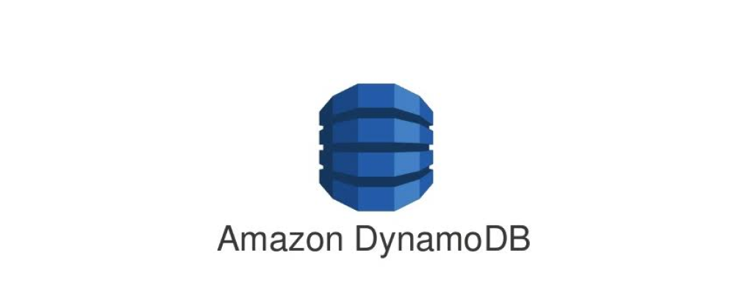
Solution Architecture
Backend
Frontend

Slide 6
Data Retrieval
Backend
Frontend

Slide 7
Model Training
Backend
Frontend

Slide 8
Sentiment Analysis
Backend
Frontend

Slide 9
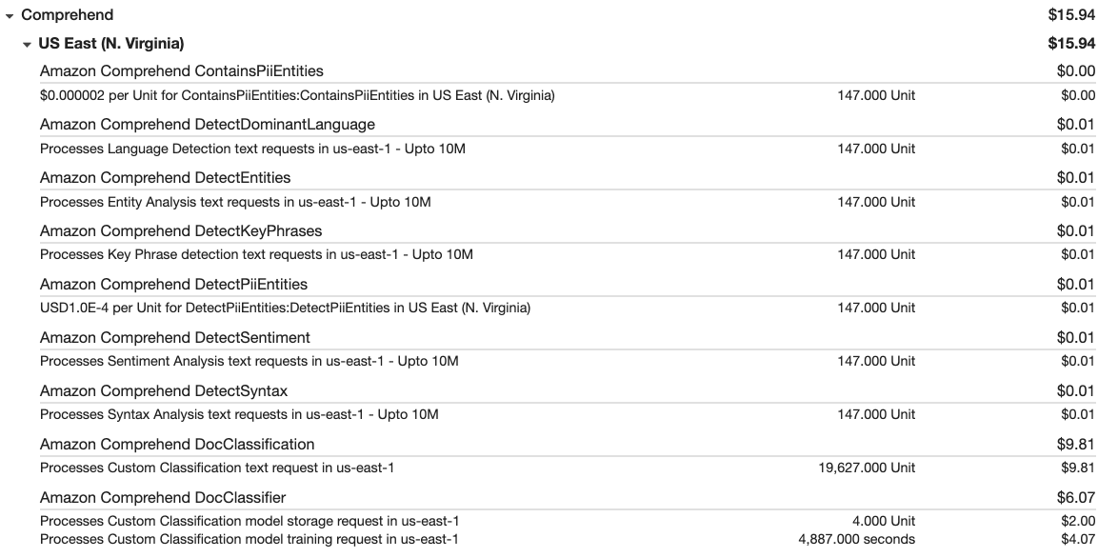
Costs
Service | October | November | December | Total
Comprehend | $5.75 | $2.02 | $15.94 | $23.71
DynamoDB | $0.04 | $0.03 | $0.02 | $0.09
Elastic Compute Cloud | $0.00 | $0.00 | $0.19 | $0.19
Relational Database Service | $7.46 | $0.18 | $0.02 | $7.66
 |  |  |  | $31.65

Slide 10
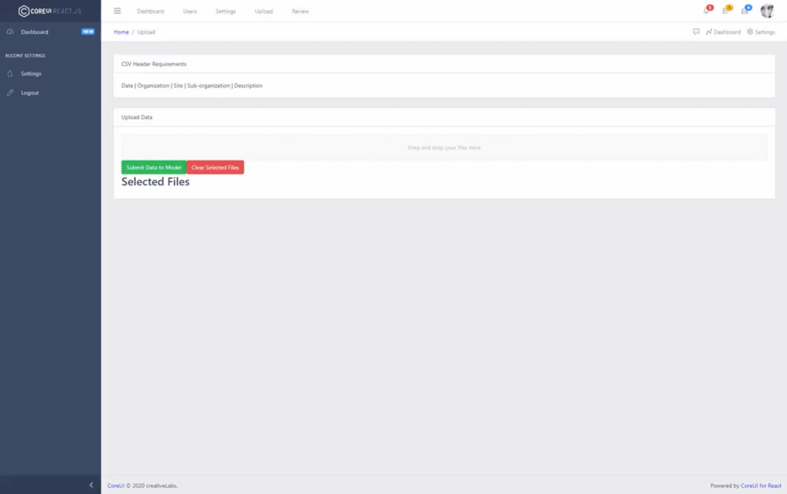
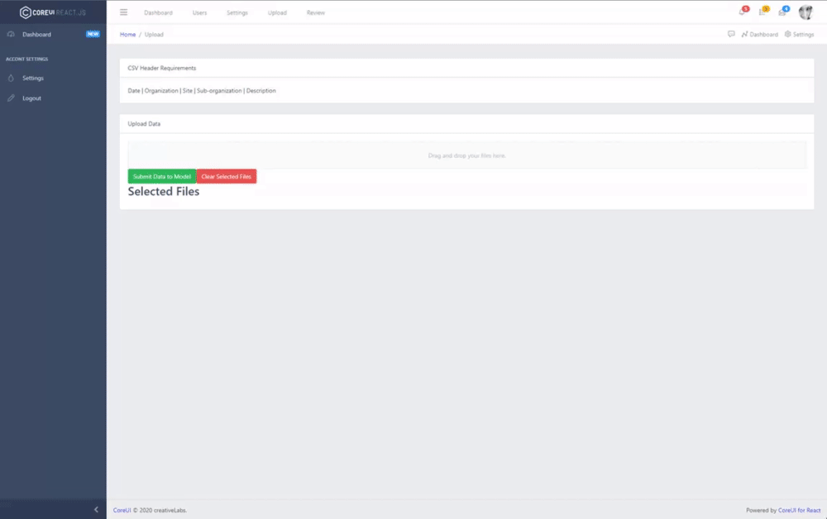
Frontend
Upload Data

Slide 11
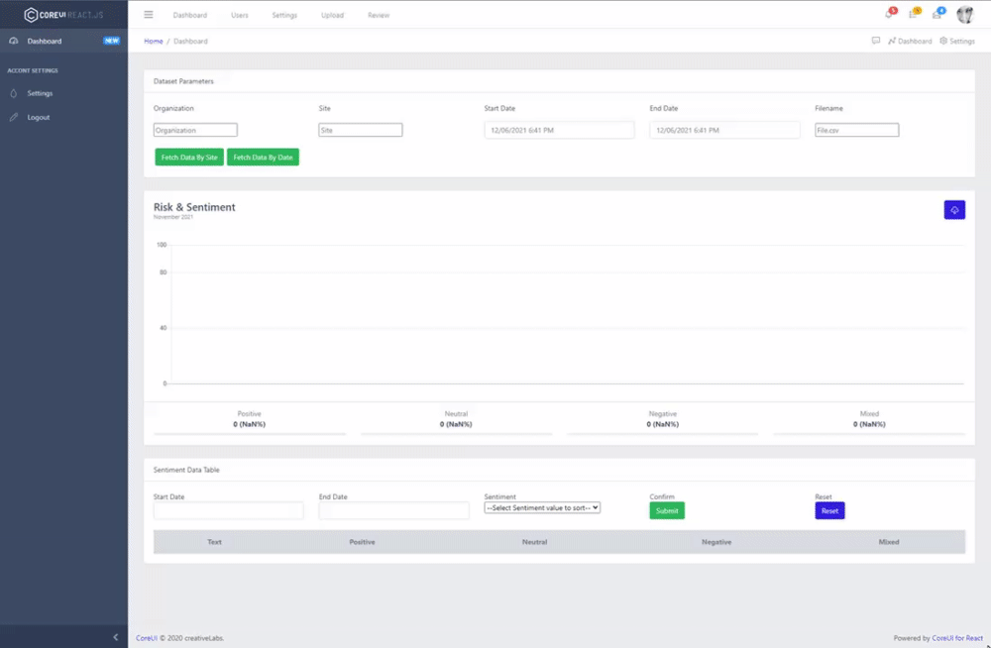
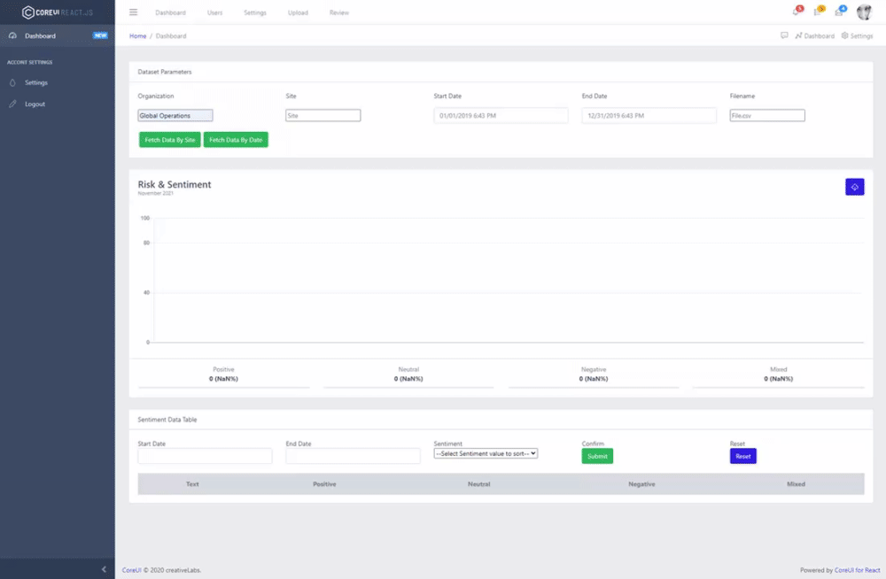
Frontend
Viewing Data

Slide 12
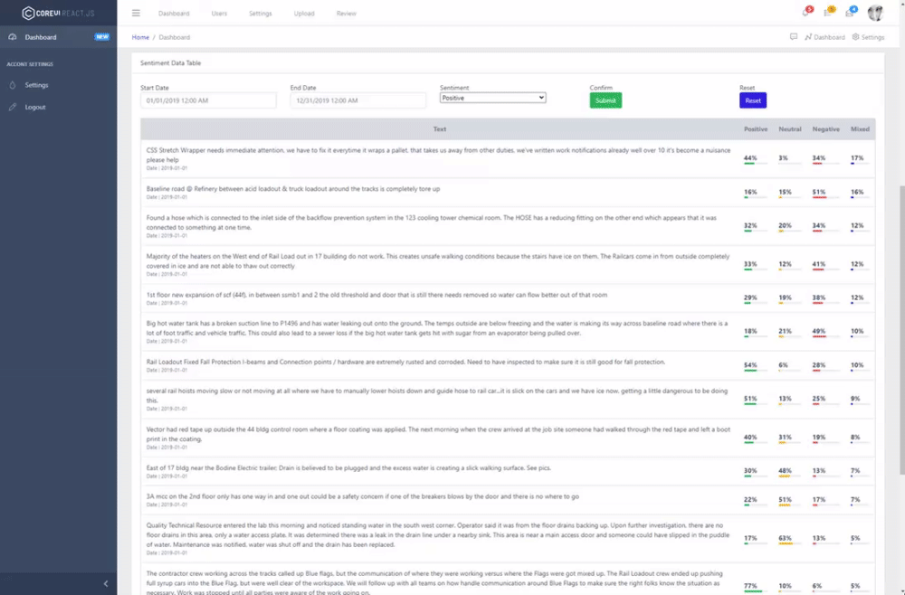
Frontend
Sorting Table

Slide 13
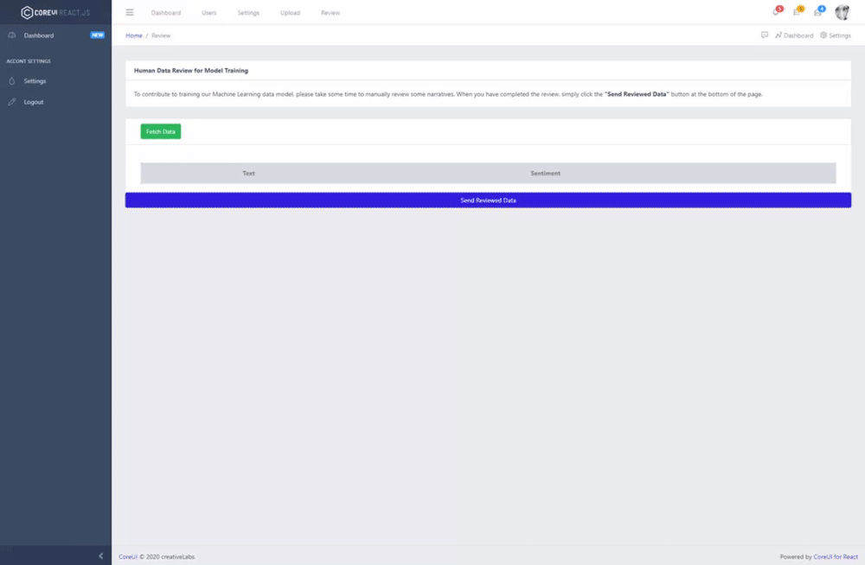
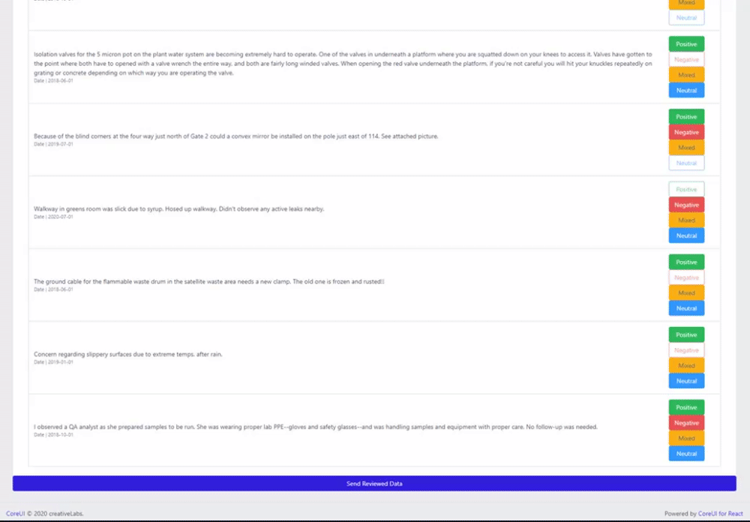
Frontend
Reviewing Data

Slide 14

Lessons Learned
Data may skew general results
Meeting times are difficult when coordinating with many different people.
Working with AWS Permissions and Costs
  Changed DB service to meet expectations/reduce costs
Managing workflow across many different machines and developers

Slide 15

What Went Well
Client Meetings
Continual development of tasks and needs
Resolution of connections between sub-tasks.
  Frontend/Backend
  AWS Permissions/Roles

Slide 16

Future Plans
Frontend Optimization
Implementing for different cloud models
Implementing Text to Speech
HTTPS
Automatically reevaluate data
Improve model accuracy with more data
  Achieved 63% with 250 samples

Slide 17


Acknowledgements
Our client and sponsor, Mr. Christian Johnson
Our professor, Dr. Edward Fox

Slide 18
References
[1]
S. J. Bertke, A. R. Meyers, S. J. Wurzelbacher, A. Measure, M. P. Lampl, and D. Robins, “Comparison of methods for auto-coding causation of injury narratives,” Accident Analysis & Prevention, vol. 88, pp. 117–123, 2016, doi: https://doi.org/10.1016/j.aap.2015.12.006.
H. Yu, Y. Pan, and C. Zhou, “Domain Adaptation Approach for Sentiment Analysis,” in Proceedings of the 2019 3rd International Conference on Compute and Data Analysis, New York, NY, USA, 2019, pp. 94–97. doi: 10.1145/3314545.3314553.
Notes:
[1] uses AI to determine injury events and exposures using a variety of techniques with generally decent accuracy
[2] breakdown of sentiment analysis and its usage on social media and how it could be applied to other fields

Slide 19
Questions?

