Slide 1
CS 5604 spring 2015
Named Entity Recognition
Instructor: Dr. Edward fox
Presenters: Qianzhou du, Xuan Zhang
04/30/2015
Virginia tech, Blacksburg, VA

Slide 2
Table of contents
Introduction
Theory
Implementation
Parallelization
Conclusion

Slide 3
NER Concept
Named-entity recognition (NER) is a subtask of Information Extraction that seeks to locate and classify elements in text into pre-defined categories such as the names of persons, organizations, locations, expressions of times, quantities, monetary values, percentages, etc.
[Wikipedia]
Why NER?
  Event Extraction
  Question Answering
  Text summarization

Slide 4
Named Entity Recognition Example
A man opposed to the joint South Korea-U.S. military drills attacked the American ambassador, Mark Lippert, in Seoul Thursday morning.
Location
Organization
Person
Date

Slide 5
Table of contents
Introduction
Theory
Implementation
Parallelization
Conclusion

Slide 6
Problem Definition
Input: a word sequence
  word_sequence = <X₁, X₂, X₃, X₄, …, X_{n}>
Output: their Named-Entity tag sequence
  tag_sequence = <Y₁, Y₂, Y₃, Y₄, …, Y_{n}>
Items in <Y₁, Y₂, Y₃, Y₄, …, Y_{n}> might be person, location, organization, etc..

Slide 7
How to assign the NE tag for a particular word?
Let us consider the following scenarios:
  I love the city of New York. (New York is a location)
  New York Times discloses the inside story. (New York is a news organization)
  Jeremy Lin unexpectedly led a winning turnaround with New York in 2012. (New York is a sport organization)
The context is a very important factor to assign the NE tag.

Slide 8



Linear-Chain CRF
CRF: Conditional Random Field that is an undirected graph whose nodes correspond to YUX. This graph is parameterized in the same way as an Markov network, as a set of factors
Goal: Get the conditional distribution P(Y|X), where Y is a set of target variables and X is a set of observed variables.
Linear-Chain CRF:
  Based on the basic CRF, and it has only two factors for each word:

Slide 9
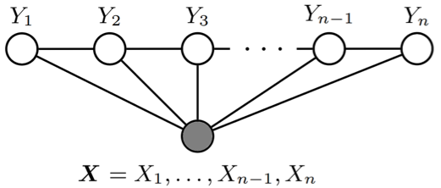
Linear-Chain CRF
Graphical Model of Linear-Chain CRF
Two Factors:
  represents the dependency between neighboring target variables. And represents the dependency between a target and its context in the word sequence.
  Arbitrary features of the entire input word sequence.
  Log-linear model, but not table factor
Forward-backward Algorithm to compute the probability distribution
Viterbi (Dynamic Programming) to choose the best tag sequence by maximizing the probability

Slide 10
Table of contents
Introduction
Theory
Implementation
Parallelization
Conclusion

Slide 11
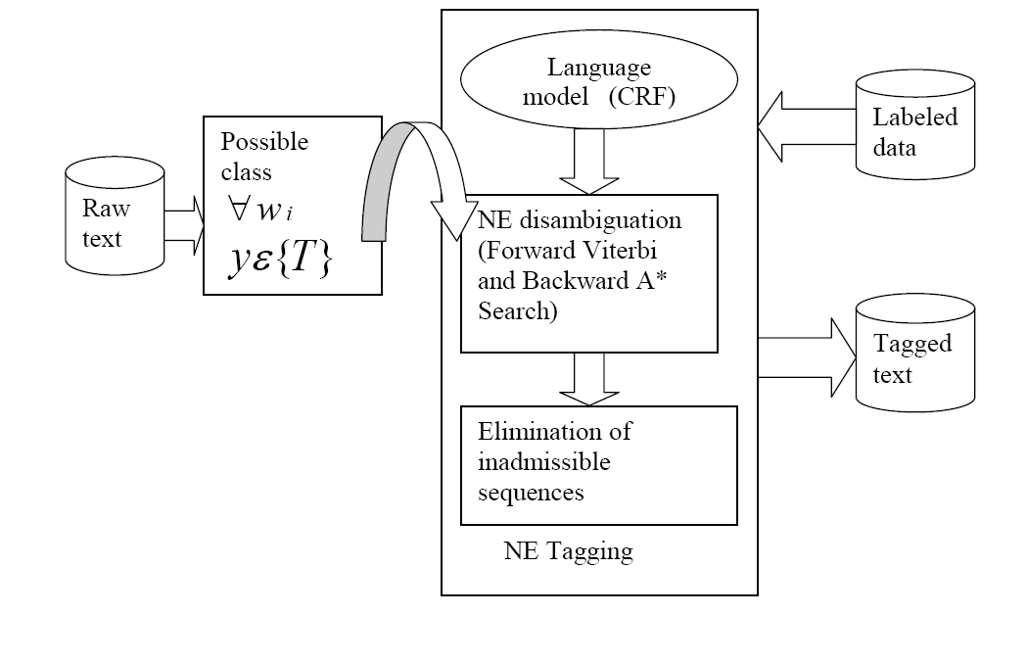
NER Architecture
NER System based on CRF
[Asif Ekbal]

Slide 12
NER Tools & Prototype
Tools | Models
Stanford NER | Linear-chain CRF
Illinois Named Entity Tagger | HMM, Neural Network
Alias-i LingPipe | HMM, CRF
TXT file
Named Entities
Eyewitnesses have described the carnage and terror that ensued as gunmen forced their way into the office of the French satirical Charlie Hebdo magazine in Paris before shooting dead 12 people…
Java Prototype
{LOCATION=France | Paris | …
ORGANIZATION=UK | European Union | …
PERSON=Charlie Hebdo | Michel Houellebecq | …
DATE=Thursday | January 2015
}
Stanford NER

Slide 13
Table of contents
Introduction
Theory
Implementation
Parallelization
Conclusion

Slide 14
NER Parallelization on Hadoop
Interim file
Interim file
Interim file
Key: Doc ID
Value: NE String
Worker node 1
Worker node 2
Worker node N
Mapper
NER
Hadoop
Reducer
WebpageNoiseReduction schema
AVRO Input
HDFS
AVRO Output
TweetNoiseReduction schema
TweetNER schema
WebpageNER schema

Slide 15
Map-Reduce Implementation
Driver for Map-Reduce job
Set configuration
Read a document
Perform NER
Write NE string
Parse NE string
Write AVRO file
Public class NERDriver extends Configured implements Tool{
public int run(String[] args) {}
public static void main(String[] args) {}
}
public static class AvroNERMapper extends
Mapper<AvroKey<WebpageNoiseReduction>, NullWritable, Text, Text> {
protected void map(AvroKey<WebpageNoiseReduction> key, NullWritable value, Context context){}
}
public static class AvroNERReducer extends
Reducer<Text, Text, AvroKey<WebpageNER>, NullWritable> {
protected void reduce(Text key, Iterable<Text> value, Context context){}
}

Slide 16
Input & Output
AVRO Schema of Input File
(By Noise Reduction Team)
AVRO Schema of Output File
(By Hadoop Team)
{"type": "record", "namespace": "cs5604.tweet.NoiseReduction", "name": "TweetNoiseReduction", "fields":
…
}
{"type": "record", "namespace": "cs5604.tweet.NoiseReduction", "name": "TweetNoiseReduction", "fields":
…
}
{"namespace": "cs5604.tweet.NER",
"type": "record",
"name": "TweetNER",
"fields": [
{"name": "doc_id", "type": "string"},
{"doc": "analysis", "name": "ner_people", "type": ["string", "null"]},
{"doc": "analysis", "name": "ner_locations", "type": ["string", "null"]},
{"doc": "analysis", "name": "ner_dates", "type": ["string", "null"]},
{"doc": "analysis", "name": "ner_organizations", "type": ["string", "null"]}
]
}
{"namespace": "cs5604.tweet.NER",
"type": "record",
"name": "TweetNER",
"fields": [
{"name": "doc_id", "type": "string"},
{"doc": "analysis", "name": "ner_people", "type": ["string", "null"]},
{"doc": "analysis", "name": "ner_locations", "type": ["string", "null"]},
{"doc": "analysis", "name": "ner_dates", "type": ["string", "null"]},
{"doc": "analysis", "name": "ner_organizations", "type": ["string", "null"]}
]
}

Slide 17
Input & Output (Cont.)
AVRO Output File with Named Entities
{u'ner_dates': u'December 08|December 11', u'ner_locations': None, u'doc_id': u'winter_storm_S--100052', u'ner_people': None, u'ner_organizations': u'NWS'}
{u'ner_dates': None, u'ner_locations': None, u'doc_id': u'winter_storm_S--10025', u'ner_people': u'Blaine Countys', u'ner_organizations': None}
{u'ner_dates': None, u'ner_locations': None, u'doc_id': u'winter_storm_S--100229', u'ner_people': None, u'ner_organizations': u'ALERT Winter Storm Watch'}
{u'ner_dates': None, u'ner_locations': None, u'doc_id': u'winter_storm_S--100364', u'ner_people': None, u'ner_organizations': u'Heavy Snow Possible Winter Storm Watch|Northeast PA|Coal Region Endless Mtns'}
…
(From winter_storm_S Tweet collection)

Slide 18
Statistics
Collections | Size | Time
winter_storm_S (Tweet) | 166 MB | 6 Min
storm_B (Tweet) | 6.3 GB | 10 Min
winter_storm_S (Webpage) | 62 MB | 4 Min
storm_B (Webpage) | N/A | N/A

Slide 19
Table of contents
Introduction
Theory
Implementation
Parallelization
Conclusion

Slide 20
Conclusion
Investigate the theory of NER
Implement NER prototype based on the Stanford NER tool
Parallelize NER on Hadoop
Export NEs to AVRO files

Slide 21
Acknowledgement
This project is supported by the US National Science Foundation through grant IIS - 1319578.
We express our deep appreciation to the Instructor Dr. Fox, GTA Sunshin Lee and GRA Mohammed for their help.

Slide 22
Thank You!
Q & A

Slide 23
NER Data/Back-Offs
CoNLL-2002 and CoNLL-2003 (British newswire)
  Multiple languages: Spanish, Dutch, English, German
  4 entities: Person, Location, Organization, Misc
MUC-6 and MUC-7 (American newswire)
  7 entities: Person, Location, Organization, Time, Date, Percent, Money
ACE
  5 entities: Location, Organization, Person, FAC, GPE
BBN (Penn Treebank)
  22 entities: Animal, Cardinal, Date, Disease, …

