Slide 1

Visualizing eTextbook
Study Sessions
Course: CS 4624 Multimedia, Hypertext and Information Access
Instructor: Mohamed Farag
Group 15
Chiang, Lily
Vellanki, Arjun
Lukiyanov, Egor
Chau, Tuan
Polina, Kavya
Virginia Tech,
Blacksburg, VA 24061
11/09/2023
Notes:
lily

Slide 2

Contents
Client & Problem
Motivation & Approach
System Architecture
Implementation
Project Timeline
Features
Demo
Future Plans
Acknowledgements
Notes:
lily

Slide 3

Client
Problem
Mohammed Farghally (mfseddik@vt.edu)
CS Professor at VT (4XXX and 5XXX classes)
Research: digital education
No straightforward way for instructors to know how students interact with OpenDSA.
Notes:
Lily

Slide 4

Motivation
Approach
Create a web interface for OpenDSA textbook interactions, enabling instructors to analyze student learning patterns and enhance teaching methods.
Upload OpenDSA event data as CSV
Python backend synthesizes data into JSON format
React frontend serves JSONs
Generate interactive visualizations
Illustrate user interactions within textbook states
Notes:
Lily

Slide 5








System Architecture
Frontend
Backend
Clients
Notes:
Arjun

Slide 6
Implementation
Frontend
Networking
Backend
Diagrams are generated using custom SVG and d3 graph rendering library
Uses React and MUI library
Upload page POSTs data to the backend and GETs processed data for frontend rendering
Separate Docker containers for frontend and backend
Process raw input files and store annotated files based on user ID
Calculate and provide data via API endpoints for graphs using Python
Notes:
Arjun:
Script: We split our implementation into three parts: networking, frontend, and backend.
For networking we used Docker to containerize the frontend and backend into separate containers to allow for a clear separation in roles between the two, and this allows for easy and dynamic deployment of the services for the client.
For frontend we created a upload page that uses POST requests to send data to the backend and then GET requests to retrieve processed data for frontend rendering. Then, there’s diagrams generated using custom SVG and d3 graph rendering library. For the layout we used React and MUI library and for the entire frontend we used React to facilitate a responsive user interface.
Lastly for the backend, we provide multiple API endpoints for the frontend to interface with the backend. Then, process the input files and store them into files separated based on each student ID and calculate and provide data relevant to the graphs displayed on the frontend through JSON objects

Slide 7
Project Timeline
October 30th Frontend + backend communication
November 14th Frontend and Backend finalized
October 2nd Working frontend prototype
October 16th Working backend prototype
October 31st All visualizations completed
Notes:
Arjun

Slide 8
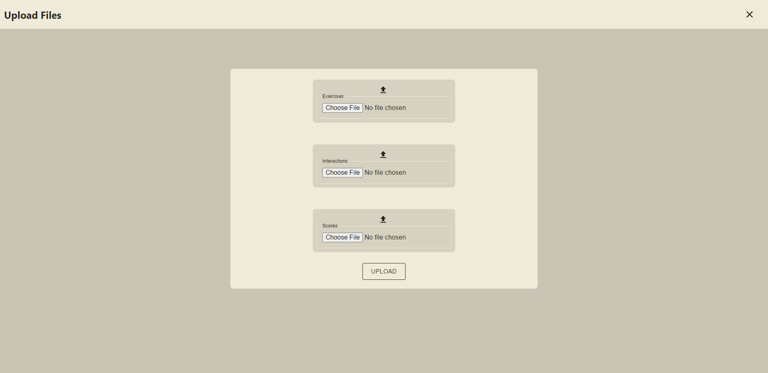
Feature 1: Upload csv
Notes:
Kavya:
Now for the features, the first one is uploading csv files. We got the core functionality working where the data is sent successfully to the backend, they modify the information accordingly to send to the frontend to display in the visualizations that will come up in the dashboard page. We still need to polish some aspects of this feature such as adding error handling.

Slide 9
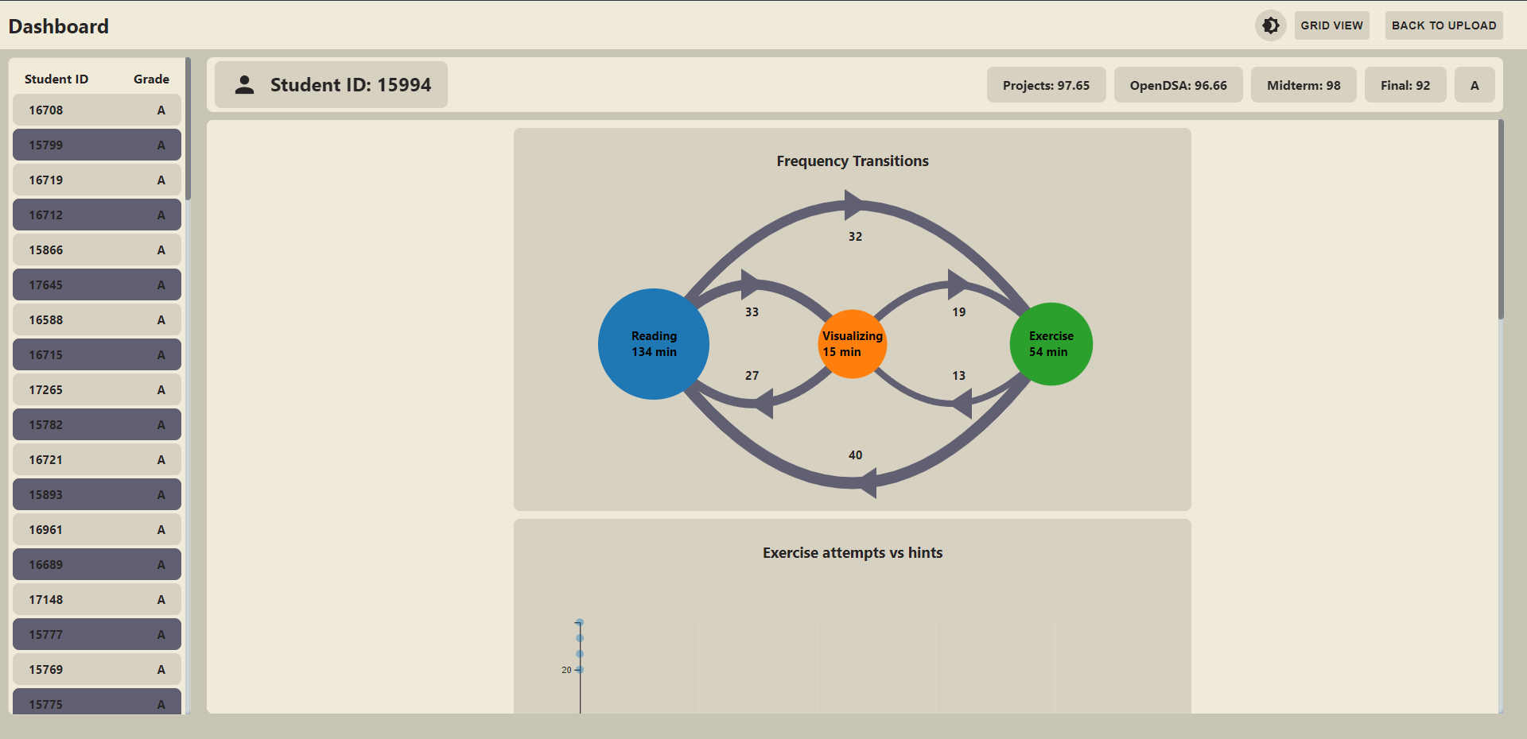
Feature 2: List of students
Notes:
Lily

Slide 10
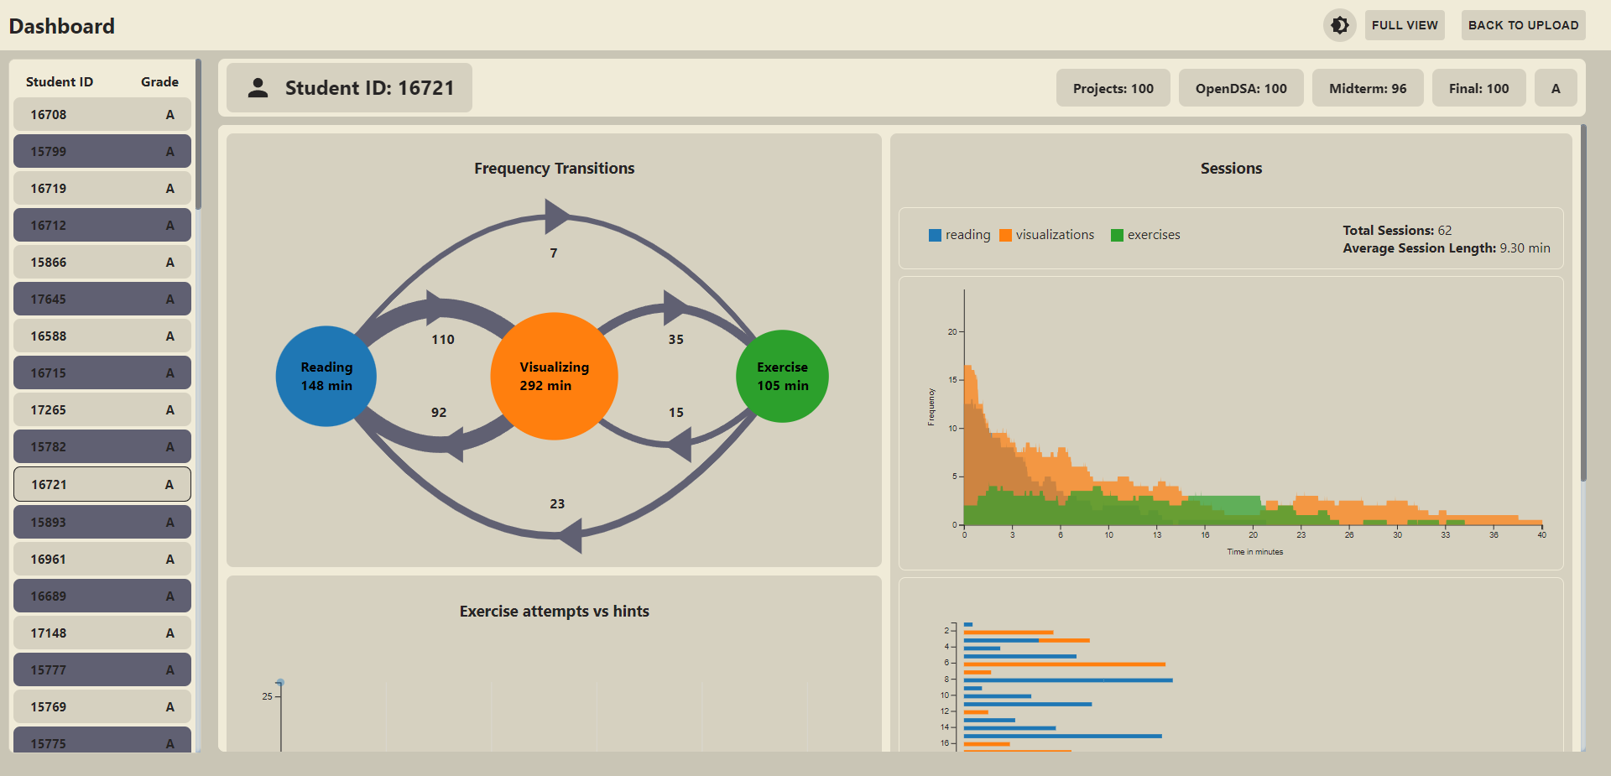
Feature 3: Visualizations dashboard
Notes:
Lily

Slide 11
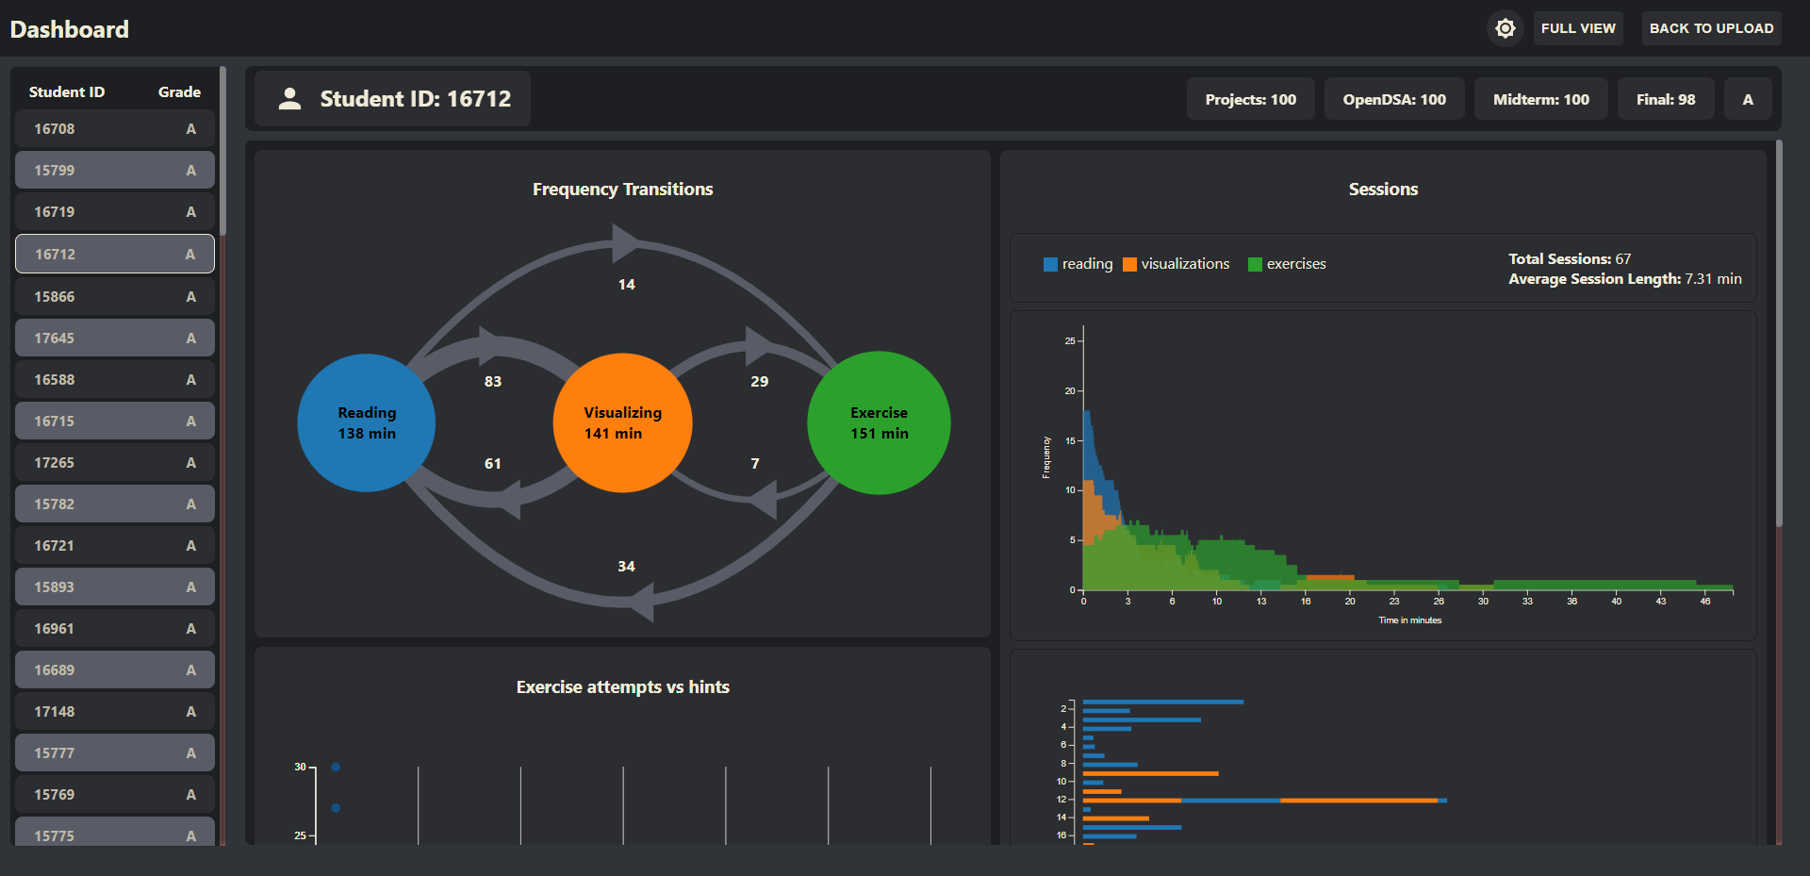
Final Demo

Slide 12
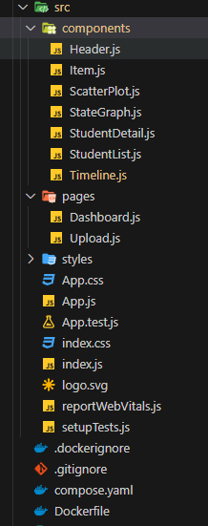
Future Plans
Multiple windows
  Multiple student display
Maintainability
  Workflow of adding additional visualizations
Processing of different data
  Modifying backend
Notes:
Egor

Slide 13

Acknowledgements
Mohammed Farghally (Client)
Mohamed Farag (Professor)
Notes:
Egor

Slide 14
References
Heo, S. (2022). Analyzing Student Session Data in an eTextbook. Masters Theses. http://hdl.handle.net/10919/111286

