Slide 1
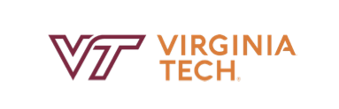
VRA 2023 Conference: Collections Management in Fashion and Media
Comparative Study and Expansion of Metadata Standards for Historic Fashion Collections
27 Sep 2023
Presenter: Wen Nie Ng
Digital Collections Librarian, Virginia Tech
MIS, UXD, CPWA, WAS, CPACC

Slide 2
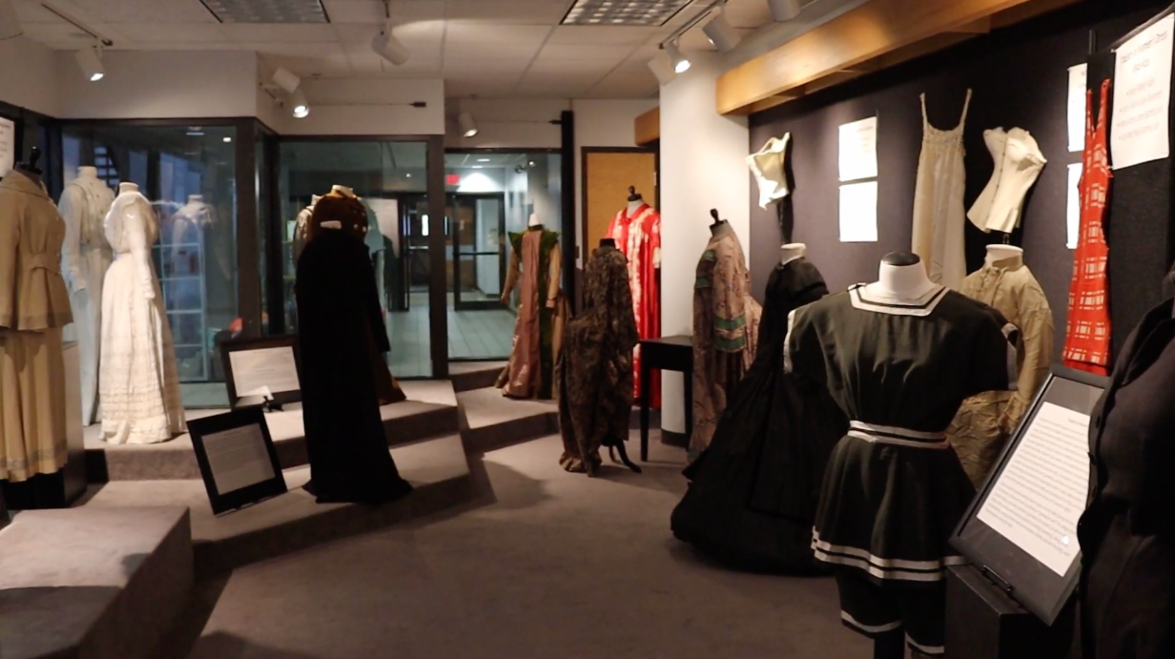
The Oris Glisson Historic Costume and Textile Collection
Founded by Miss Oris Glisson in 1958.
Expanded to over 600 iconic fashion pieces from the 1950s through the 1970s.
Partial view of the exhibit area for the Oris Glisson collection.
Notes:
We will start with the background for the collection that inspired this project. Our work is based on the Oris Glisson Historic Costume and Textile Collection housed at Virginia Tech's Department of Apparel, Housing, and Resource Management. This collection was founded by Miss Oris Glisson in 1958. Where she served various roles including Professor and Department Head at Virginia Tech from 1948 to 1978. Miss Oris Glisson personally donated and documented more than 600 fashion pieces from the 1950s through the 1970s, some of which are designer items.
Image in this slide shows a partial view of the exhibit area for the collection.

Slide 3
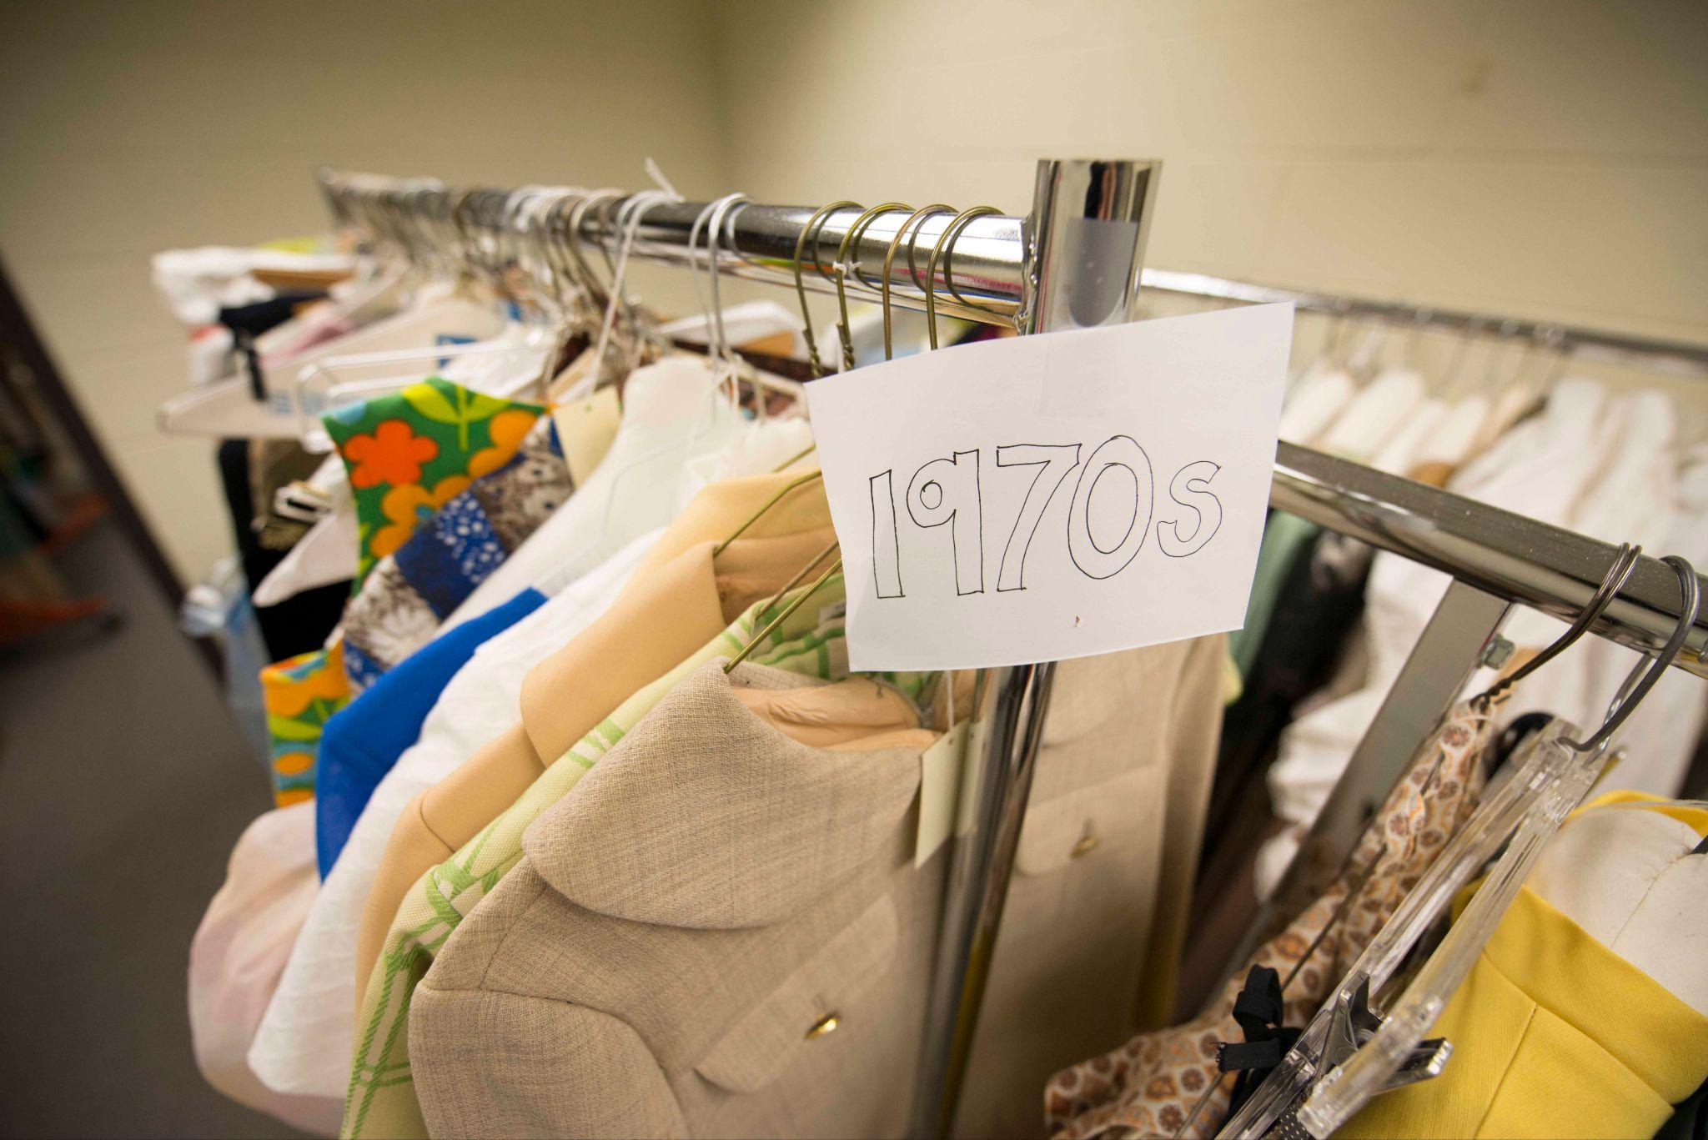
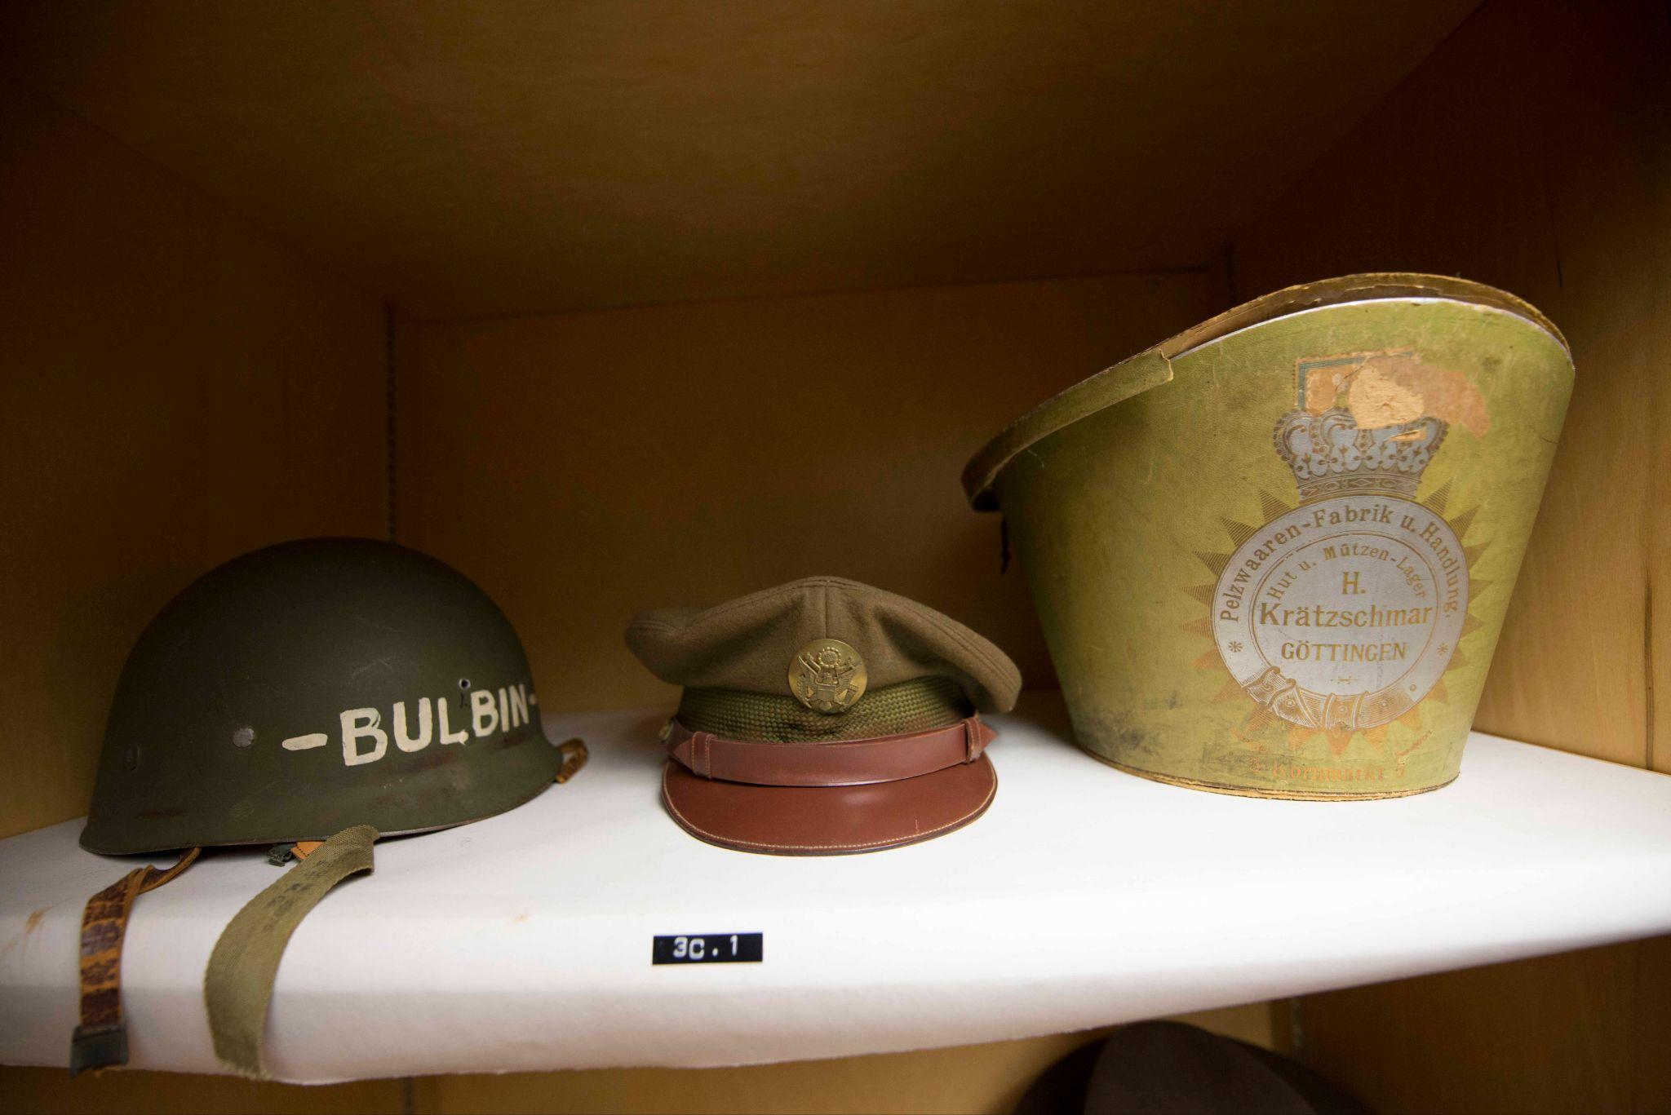
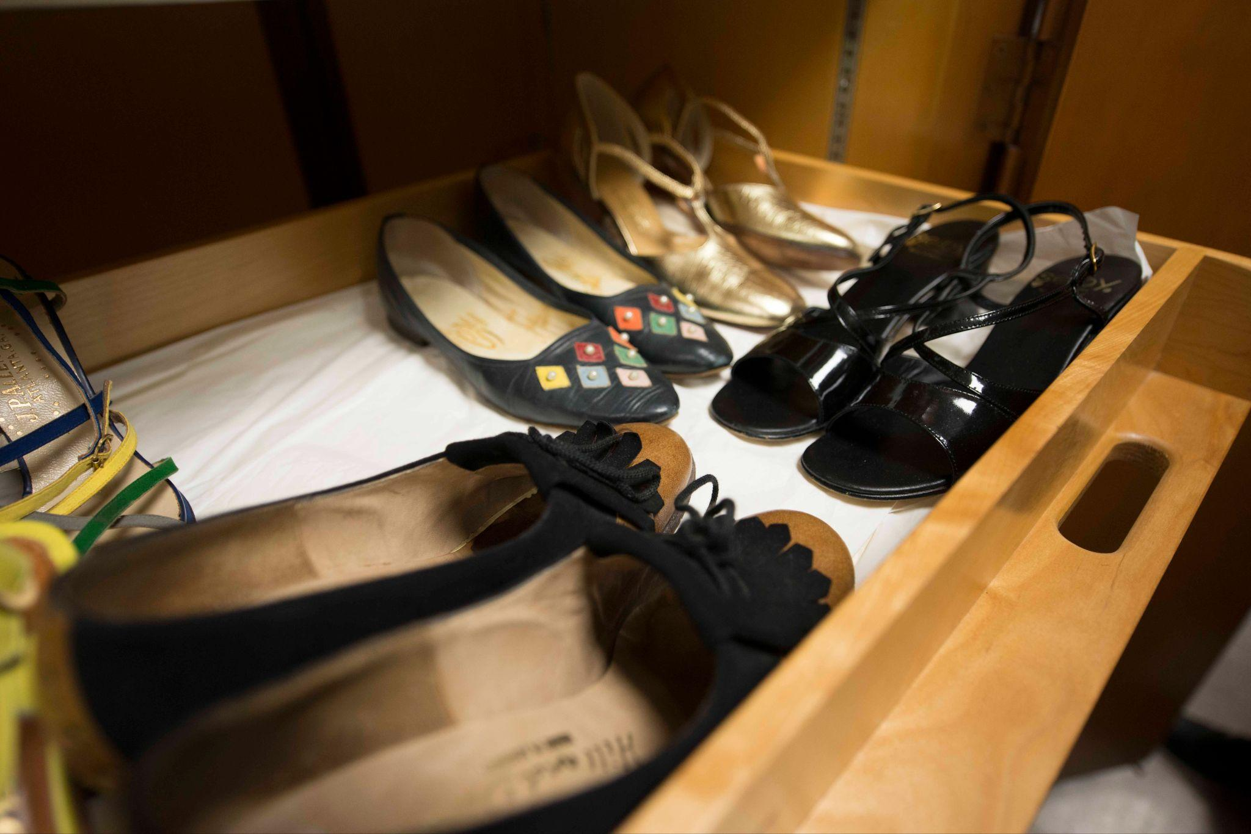
The Oris Glisson Historic Costume and Textile Collection
Over 5,000 items, including dresses, textiles, accessories.
Preserves southwestern Virginia's fashion heritage from the 18th century to present day.
Sample items from the collection.
Notes:
Miss Oris Glisson’s efforts not only built the collection's storage facilities but also significantly expanded its holdings. Named in her honor upon her retirement, this collection has grown to include more than 5,000 items, from dresses to textiles and accessories. It plays a crucial role in preserving the fashion heritage of southwestern Virginia, spanning from the 18th century to the present day.
On this slide, you will see some sample items from the collection.

Slide 4
Project Overview
The problem:
Insufficient vocabularies to describe fashion collection
The goal:
Enhancing the metadata schema with more accurate descriptors tailored for fashion artifacts, thereby facilitating the widespread adoption and utilization of Costume Core in the field.
Notes:
Initial cataloging project funded by Spring 2022 Virginia Tech University Libraries Collaborative Research Grant to digitize and transcribe catalog card, and recataloging collection
Current project funded by Spring 2022 Virginia Tech University Libraries Collaborative Research Grant to expand Costume Core
The library team started working with the Oris Glisson collection in 2019 with digitization of the catalog cards in the collection.
When cataloging the collection using costume core, we discovered the controlled terms that can be used to accurately describe items are limited to what we’re doing, so we started with adding the descriptors terms for our collection. Eventually, we even develop multiple methods to dig out terms that would also be useful for the other fashion experts. We have received two internal grants from the library since 2022 to support this project, the first grant to fund the digitization of catalog cards, second grant to fund student catalogers to re-catalog over 600 items in the Oris Glisson collection to support our project specifically to expand the metadata.

Slide 5
Project Overview
Other team members:
Dina Smith-Glaviana
Caleb McIrvin
Chreston Miller
My role:
Reviewing and verifying metadata, conducting usability studies, iterating on designs, creating and disseminating survey, analyzing the survey results.
Notes:
We've hired three undergraduate students from the Fashion Merchandising and Design program to catalog items using the Costume Core framework. These students were guided by co-PI Smith-Glaviana, who specializes in the subject matter. She coordinated with library co-PI Ng to determine the data requirements for the costume collection. Ng will then assess the historical catalog records alongside Costume Core and will work on enhancing the schema by adding new metadata elements and controlled terms to the Costume Core vocabularies. Since the co-PIs have already re-cataloged some collection items using Costume Core, we initiated NLP analysis without delay. Co-PI Miller supervised the recruitment of a fourth undergraduate research assistant and manage the application of NLP methods.

Slide 6
Methods
1
2
3
Added controlled terms in previous effort in cataloging the collection
Pre-trained Natural Language Processing model on Google News
Crowdsourcing through online survey from subject specialists
Notes:
We used three methods to expand the controlled terms for describing fashion items:
First, we add terminologies from authoritative sources, such as Fairchild Dictionary of Fashion, Survey of Historic Costume, and Vocabulary of Basic Terms for the Cataloguing of Costum while transcribing the catalog cards and re-cataloging the collection,
Second is using Natural Language Processing methods on Google News to discover more new terms,
Third is crowdsourcing by conducting a survey, gathering valuable terms from experts in the field.

Slide 7
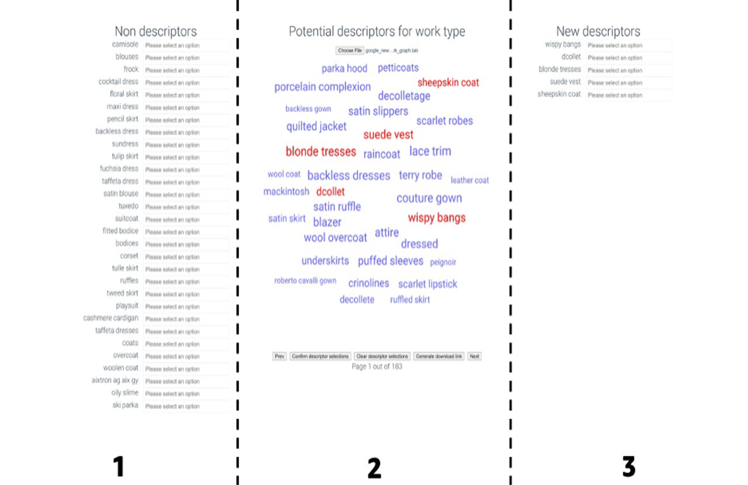
Natural Language Processing
Language model pre-trained on Google News
Use of the Model Output Confirmative Helper Application (MOCHA) application to streamlining the review process
Confirmed a total of 780 potential descriptors, 526 of which were absent from Costume Core
Interface of the Model Output Confirmative Helper Application (MOCHA) application
Notes:
For NLP, We used a language model pre-trained on the Google News dataset to identify terms similar to those in Costume Core. Then we use word embedding method by including personnel with knowledge in the fashion domain to review the terms, to ensure the quality of descriptors.
Model Output Confirmative Helper Application, AKA MOCHA helps to streamline the review process.
Screenshot of the application interface is shown on the slide. To begin using the application, the user uploads the file containing approximately 6,500 potential descriptors generated by the language model to the application. The descriptors then populated the screen in middle column, column two, where the user selects the descriptors they feel accurate. When a term is selected, the descriptor term will automatically appear in column three, labeled “New Descriptors.” Upon completion, the user exports the result in text format.
Through this method, Confirmed a total of 780 potential descriptors, 526 of which were absent from Costume Core

Slide 8
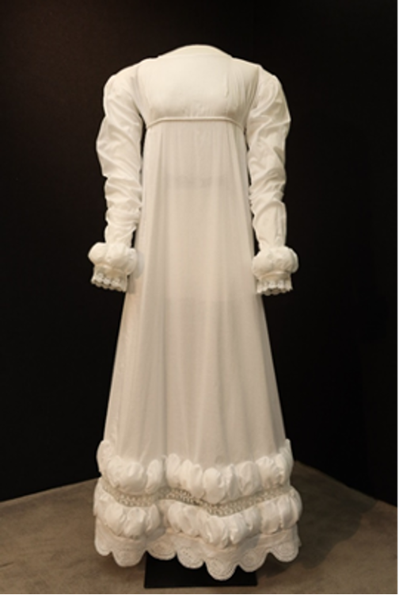
Survey
Collecting terms used by experts
Metadata standard used
Reference materials for controlled vocabularies
Decision-making processes for selecting appropriate terms for items with meanings that have changed over time
A recreation of a gown housed in the Louisiana State University Textile & Costume Museum was used as a sample artifact in the survey to prompt participants to provide sample metadata/ terminology.
Notes:
We conducted an online survey to collect controlled terms used by other professionals in the fashion domain. In our survey, we also asked the professionals’ metadata practice in describing their collection, such as:
Metadata standard
Reference materials for controlled vocabularies
Decision-making for selecting appropriate terms with meanings that have changed over time
Respondents are asked to share their sample dataset, we also provided another alternative by providing a sample dress item and asking respondents input metadata per their metadata practice. Shown here is the sample artifact used in the survey, it’s a recreation of a gown housed in the Louisiana State University Textile & Costume Museum.

Slide 9
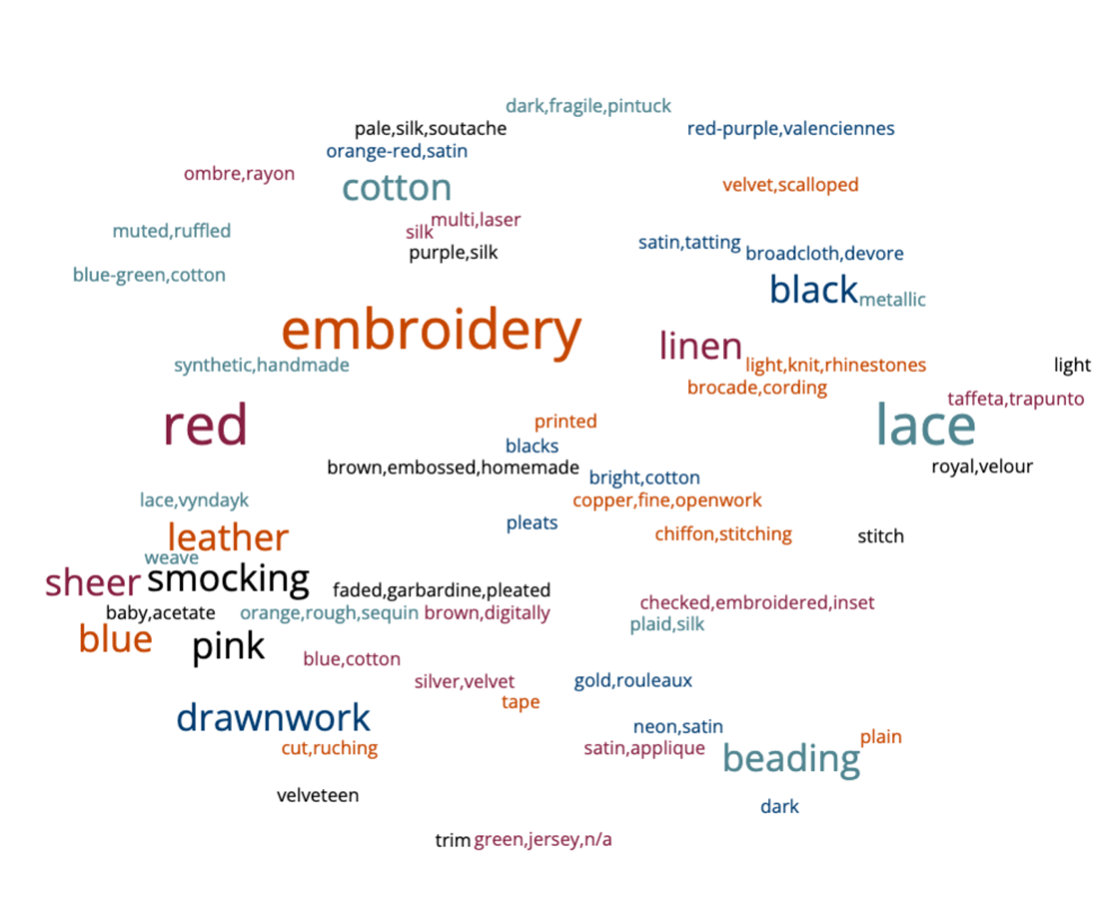
Survey findings
12 completed survey
Discovered 48 new vocabularies
Refinement metadata element for better classification of artifacts, such as fiber, color categories, hat type, etc.
Sample terminologies shared by participants in response to the sample artifacts.
Notes:
The word cloud visually represents key terms contributed by survey respondents when describing provided artifacts. The terms that stand out most prominently are 'embroidery,' 'red,' and 'lace.' These are closely followed by descriptors such as 'beading,' 'black,' 'blue,' 'cotton,' 'drawnwork,' 'leather,' 'linen,' 'pink,' 'sheer,' and 'smocking.' In addition to these, the word cloud features 48 other descriptive terms gathered from the survey.
12 out of 31 people who started the survey completed the survey, that is about a completion rate of about 40%. Interestingly, we have not received any sample digital catalog from the respondents
We discovered 48 new terms through this method
This survey suggested refined metadata elements are needed for better classification of artifacts, such as fiber, color categories, hat type, etc
Word cloud showed in this slide are Sample terminologies shared by participants in response to the sample artifacts.

Slide 10
Survey findings
Metadata Standards | count
Dublin Core | 4 (40%)
Costume Core | 1 (10%)
Others | 5 (50%)
Deciding on terms to use | count
based on reference materials | 5 (28%)
based on own lived experience | 4 (22%)
choose terms in the metadata schema | 4 (22%)
Notes:
6 responses (33%) indicated that their controlled terms derived from Fairchild’s Dictionary of Fashion or Textile, another 6 responses refer to the costume/dress history textbooks.
In deciding terms that evolved over time, Other feedback includes:
“Write redundant information to clarify definition,”
“Use the period term or take it to its broad objective use,”and
“We will do library research at a local University Library system.”

Slide 11
Next steps
1
2
Schema Refinement
Visual Cataloging Tool Development
Evaluate the 576 newly-identified terms against authoritative vocabularies like the ICOM Vocabulary for Costume Cataloguing and Getty Art and Architecture Thesaurus. Classify these terms into relevant categories and furnish them with precise definitions.
Design and test a streamlined, user-centric visual cataloging interface aimed at enhancing metadata quality and optimizing workflow processes.
Inspired by Arden Kirkland's work in Historic Dress.
Notes:
Next phase for the project:
Refine and Completing the schema work: Compare the 576 new terms with other established controlled vocabularies such as the International Council of Museums (ICOM) Vocabulary of Basic Terms for Cataloguing Costume and Getty Art and Architecture Thesaurus. Categorize the terms into the appropriate element fields and provide definitions to the terms.
Develop and testing a visual tool for cataloging, In response to a recurring issue identified during our cataloging process—where ambiguous language or change of vocabulary meaning over time led to confusion. This is inspired by Arden Kirkland's work in Historic Dress.org. This cataloging tool will contain images and description for the terms. It aims to assist students and those without metadata expertise in selecting the most accurate terms for cataloging fashion items. This will address the gap for non-metadata experts of different domains to collaborate and contribute high-quality metadata by simplifying the cataloging process, which translates into cost savings.

Slide 12
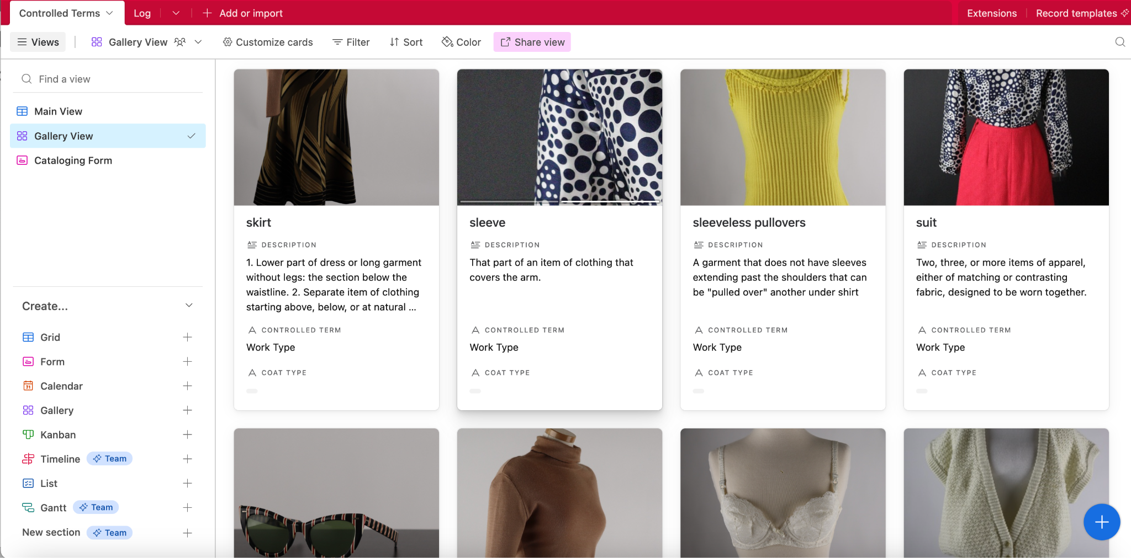
Gallery view for controlled terms under Work Type.
Notes:
A quick view to the vocabulary database built on airtable with images and description for the controlled terms for Work Type.

Slide 13
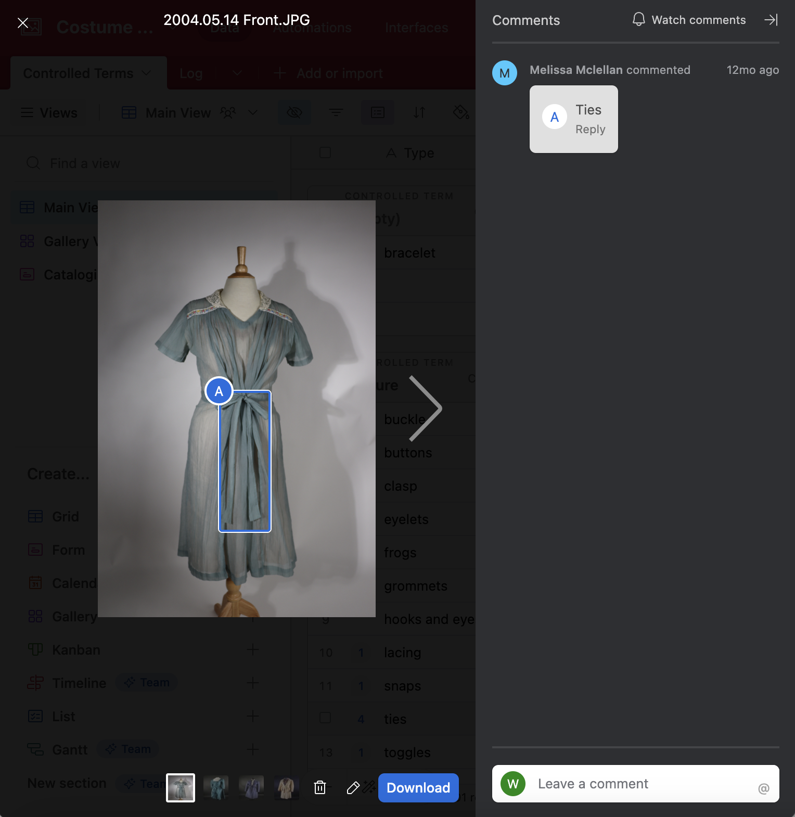
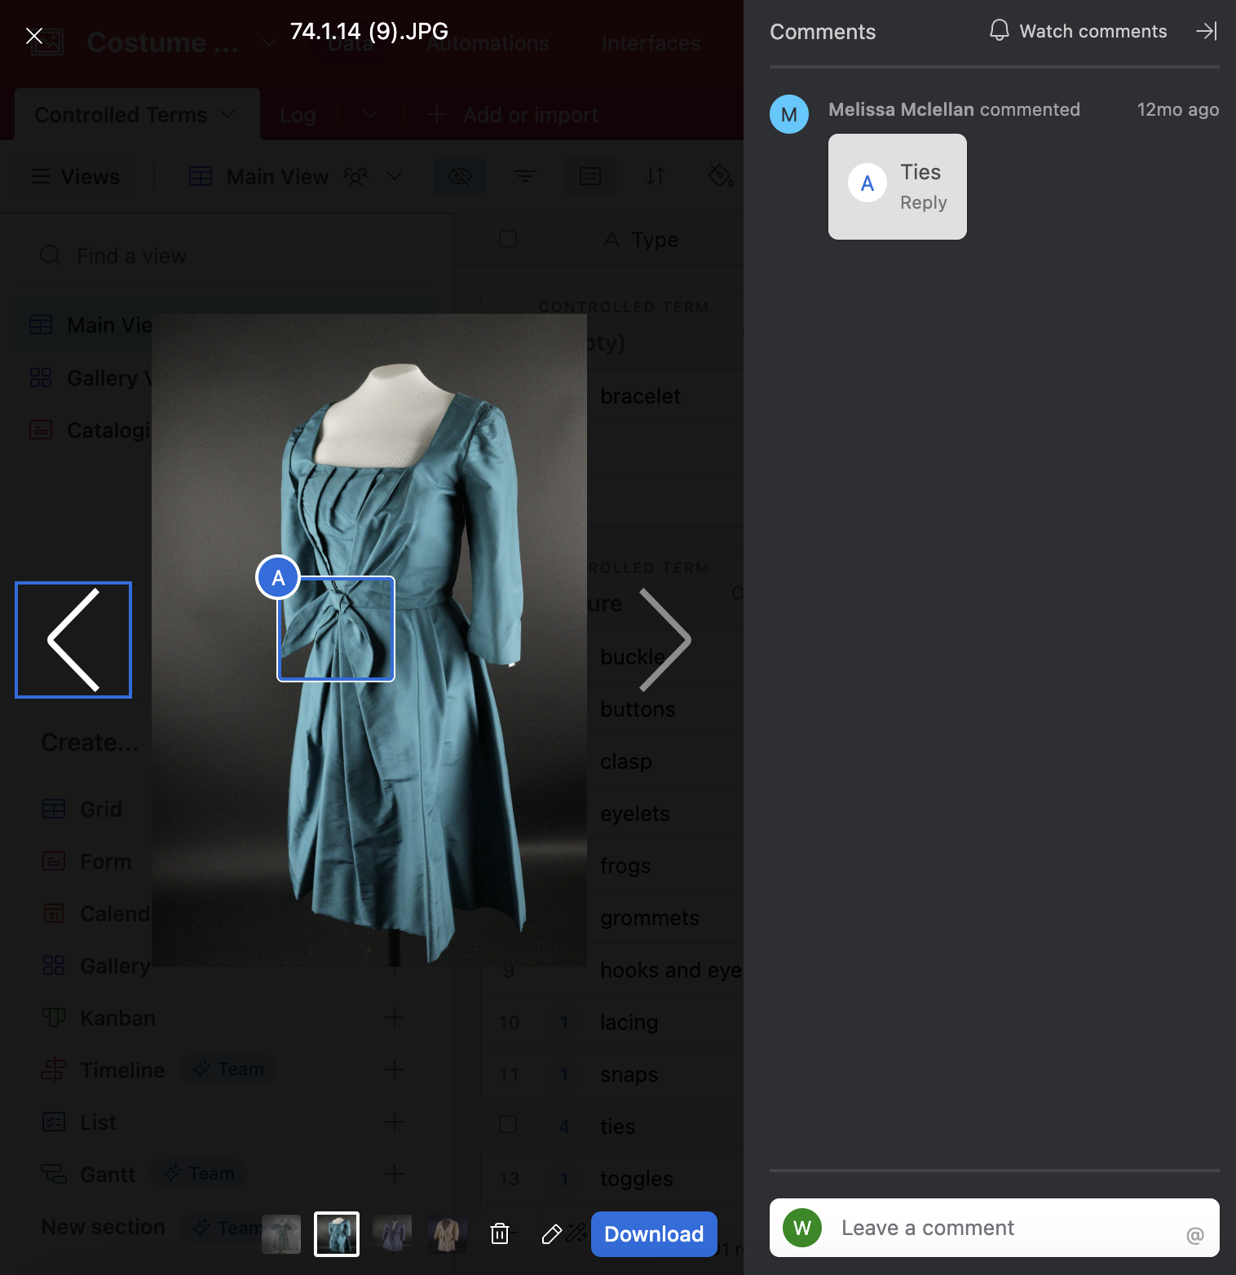
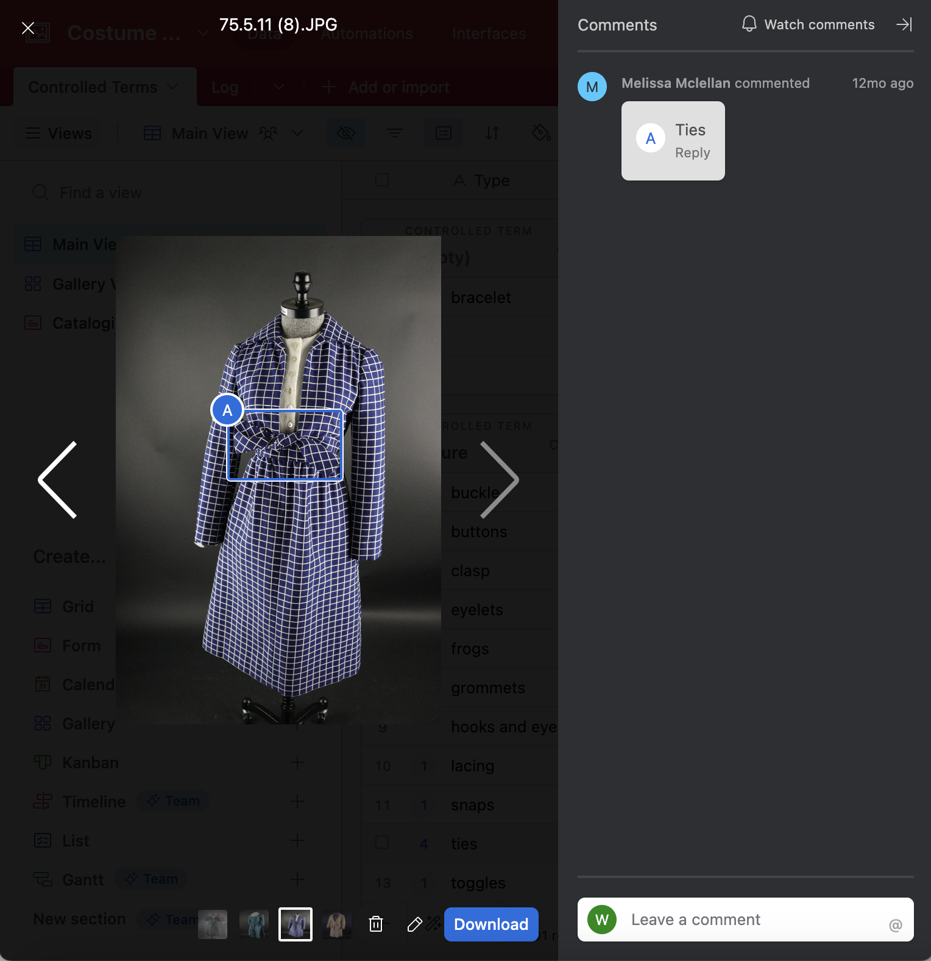
Annotated images to provide precise illustrations of the controlled term, “Ties”.
Notes:
Multiple images can be uploaded for a single term. For instance, three annotated images are included as examples to demonstrate potential locations of the feature, which is “Ties” on the dresses.

Slide 14
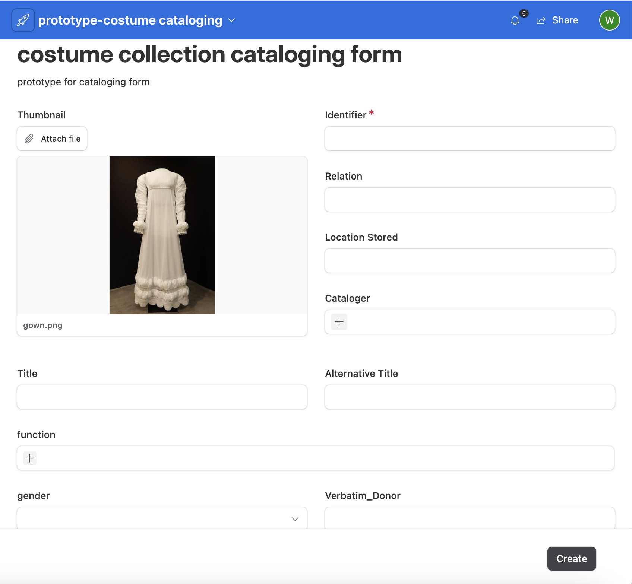
Cataloging form with a preview of the artifact being cataloged.
Notes:
As part of simplifying the cataloging process, a form also created on the airtable, it’s more intuitive and allowing multiple values entry for controlled vocabularies. This helps prevent the creation of a gigantic spreadsheet which has been reported as a problem for cataloging.

Slide 15
Outcomes
Publications:
Smith, D., Ng, W. N., McIrvin, C., Miller, C., Spencer, J. (forthcoming). “Digitizing Metadata of a University Fashion Collection’s Holdings and Beta-Testing Costume Core”. Journal of Library Metadata.
McIrvin, C., Miller, C., Smith, D., Ng, W. N. (forthcoming) “Automatic Expansion of Metadata Standards for Historic Costume Collections”. Journal of eScience Librarianship.
Smith, D., Ng, W. N., McIrvin, C., Miller, C., Spencer, J. “Comparative Study and Expansion of Metadata Standards for Historic Fashion Collections”. Visual Resources Association Bulletin 50, no. 1 (June 2023). https://online.vraweb.org/index.php/vrab/article/view/228/233
Presentations:
Ng, W. N., Smith, D., Miller, C., McIrvin, C. (2023). “Comparative Study and Expansion of Metadata Standards for Historic Fashion Collections”. 2023 Visual Resources Association Conference, September 26-28, 2023, San Antonio, TX.
Ng, W. N., Smith, D., Miller, C., McIrvin, C., Spencer, J. (2023). “Comparative Study and Expansion of Metadata Standards for Historic Fashion Collections”. 2023 ALA Annual Conference: The Collectors Poster Session, Chicago, IL. Archived in VTechWorks: https://vtechworks.lib.vt.edu/handle/10919/115699

Slide 16
Awards / Grants
Grants:
Comparative Study and Expansion of Metadata Standards for Historic Costume Collections. Smith, D., Ng, W. N., Miller, C. Virginia Tech University Libraries Collaborative Research Grant ($10,000), 2022-2023. Role: Co-PI.
Analysis of Costume Core Vocabulary and Historical Descriptions of Costume Artifacts Using Natural Language Processing. Smith, D., Miller, C., Ng, W. N. Virginia Tech University Libraries Collaborative Research Grant ($5,000), 2022. Role: Co-PI.
Honorarium:
Automatic Expansion of Metadata Standards for Historic Costume Collections. McIrvin, C., Miller, C. Ng, W. N., Smith, D. Responsible AI, IMLS-funded project through Montana State University Library ($1,000) 2023. Role: Co-PI.

Slide 17
References
Kirkland, A. (2016). Historic Dress: The Center for the Study of Clothing, Costume, Fashion and Culture. Retrieved from http://HistoricDress.org
Knight, R. C., Rodrigues, E., & Ciota R. (2020) Facilitating Collaborative Metadata Creation for Faculty-initiated Digital Projects, Journal of Library Metadata, 20:1, 51-64, DOI: 10.1080/19386389.2020.1728479
The Oris Glisson Historic Costume and Textile Collection https://liberalarts.vt.edu/departments-and-schools/apparel-housing-and-resource-management/experience/collections/the-oris-glisson-historic-costume-and-textile-collection.html
Reform, Women, and Fashion: Changes in Women's Daywear from 1840-1920 Exhibition https://youtu.be/qwuPY5NiQ9Y

Slide 18

Questions / Feedback
Slides: https://bit.ly/2023VRA-costumecore
Wen Nie Ng
Email: wenng@vt.edu
Website: https://ngwennie.org

