Slide 1
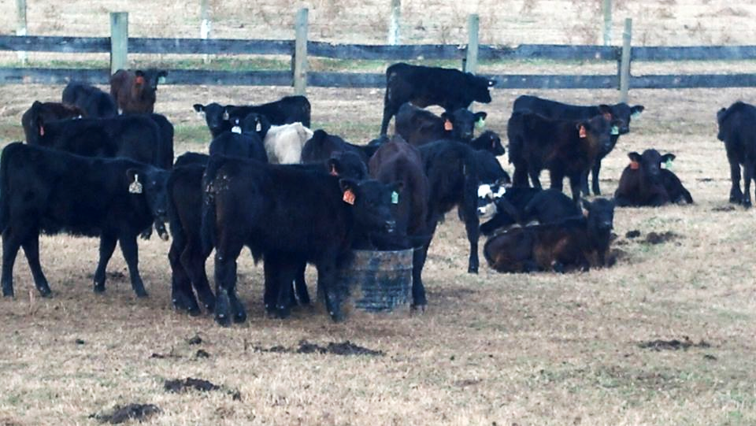
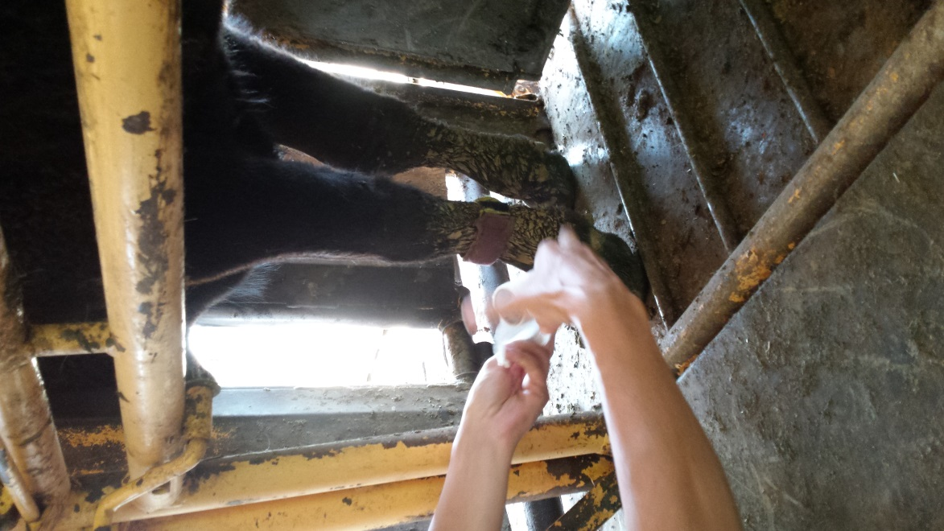
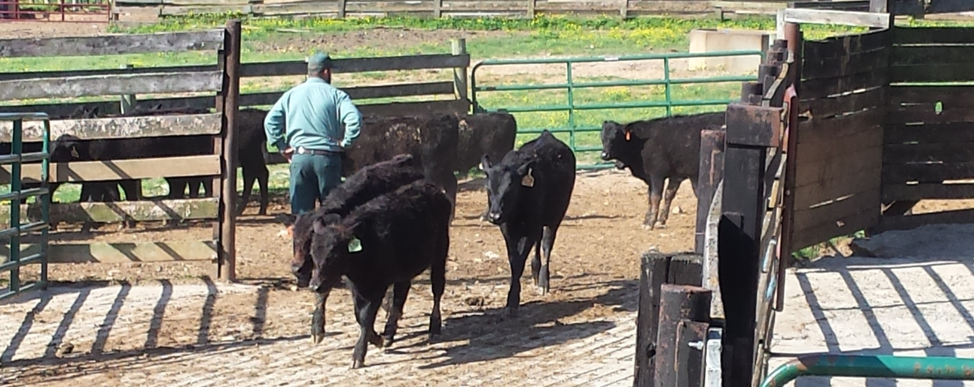
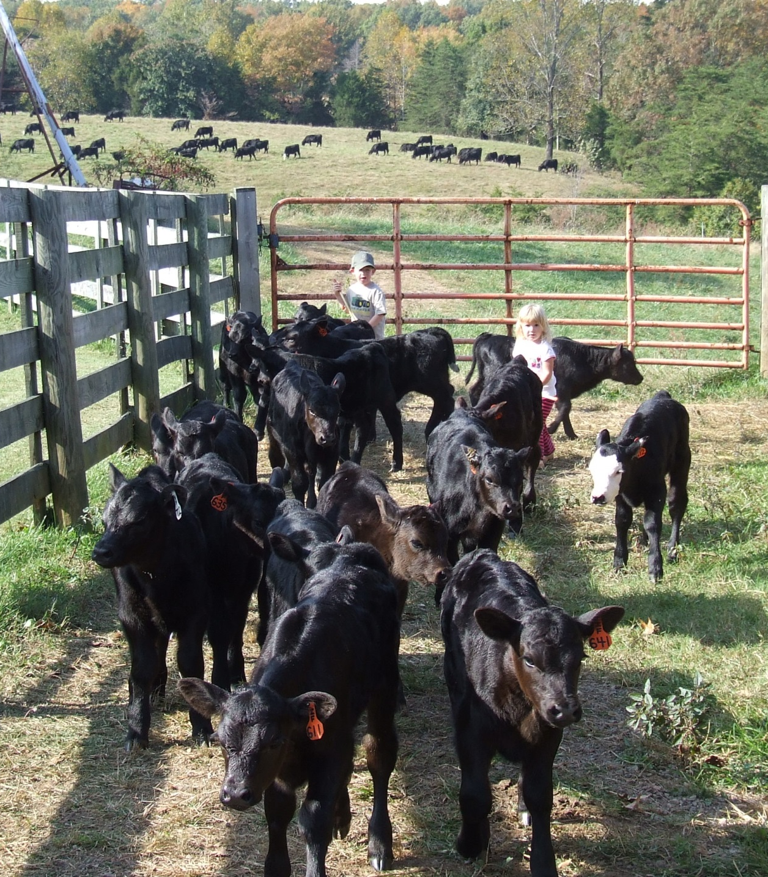
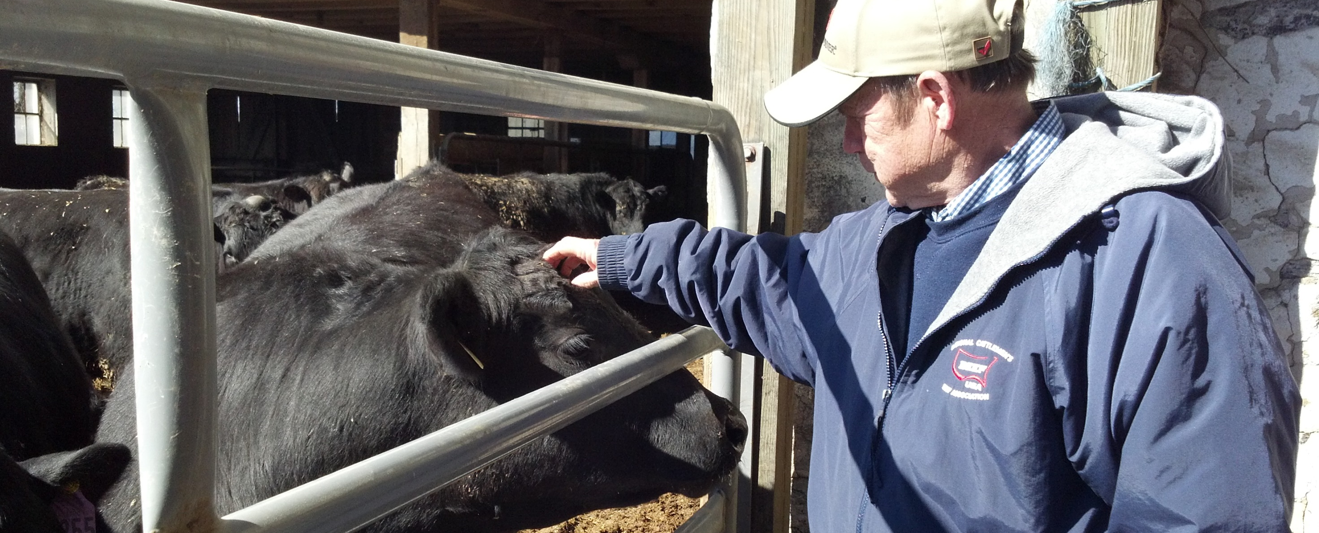
The Effects of Low Stress Cattle Handling And Weaning Training on Post-Weaning Weight Gain and Calf Activity
Ligon,* J. M. ¹; Campbell, B. T. ²; Clark, C. T. Jr. ³;Clark-Deener, S.G. ⁴; Currin, J. F. ⁵; Gregg, C. L. ⁶; Grosse, R. I. ⁷; Norton, H. M. ⁸; Overby, K. H. ⁹; Siegle, L. A. ¹⁰; Tucker, L. C. ¹¹; Whittier, W. D. ¹²
1. Extension Agent, Agriculture and Natural Resources, Buckingham County, Virginia 23921; 2. Extension Specialist, Southern Piedmont Agricultural Research and Extension Center, Blackstone, VA 23824; 3. Extension Agent, Agriculture and Natural Resources, Boydton, VA 23917; 4. Professor, VMR College of Veterinary Medicine, Blacksburg, Virginia 24061; 5. Professor, VMR College of Veterinary Medicine, Blacksburg, VA 24061; 6. Extension Agent, Agriculture and Natural Resources, Lawrenceville, VA 23868; 6. Extension Agent, Agriculture and Natural Resources, Powhatan, VA 23139; 7. Extension Agent, Agriculture and Natural Resources, Nottoway, Virginia 23955; 8. Extension Agent, Agriculture and Natural Resources, Farmville, VA 23901; 9. Extension Agent, Agriculture and Natural Resources, Amelia, VA 23002; 10. Extension Agent, Agriculture and Natural Resources, Lunenburg, VA 23952; 12. Professor, VMR College of Veterinary Medicine, Blacksburg, VA 24061
MATERIALS AND METHODS
Materials: 224 calves of Angus cross breeding from two herds in Virginia were studied. The LS handlers were trained using disk 1 of Bud Williams’, Stockmanship DVD set, and a two hour hands-on training session. Virginia Cooperative Extension professionals scored handler activity and calf activity during working sessions from calving to 30 days post-weaning. Two weaning methods were used; complete separation of the cows and calves and fence-line weaning.
Methodology: Low Stress techniques incorporate the cattle’s natural instincts and tendencies (flight zone and point of balance) to move them. Weaning training consisted of an exercise performed each time the LS cows and calves were sorted for normal scheduled management work sessions (breeding synchronization, breeding, and pregnancy checks). The cow/calf pairs were quietly brought in from the field to a holding pen. Then they were quietly moved into a pen that was adjacent to the current holding pen by working the front of the herd from the exit gate. The whole group was quietly moved from the first pen to the second pen with the key concept being to teach the cattle to walk past the handler. If an animal moved too quickly the handler would back up with that animal, using parallel movement to slow the animal down. If the cattle were not calm, the whole group would then be moved back to the first pen following the same procedure with the same concept. Finally, if calm, the cows would be allowed to move to the second pen again, and the calves would remain in the first pen, the handler gently stepping in front of each calf that tried to exit. If any calves mistakenly were let by during the sorting process, there was no attempt to stop the calf, unless easily done at the walk. The handler or another handler would go retrieve the calf and bring it back to the original pen at a walk at a later time.
ABSTRACT
The objective of this study was to assess the effect of low stress (LS) handling of Angus cross beef cattle on weight gain and calf activity associated with the weaning process. There was a difference (p < 0.0001) between handling method for weight gain in calves for one week and one month post-weaning. One week post-weaning the LS calves outgained the conventionally handled (C) calves by 12 lbs. One month post-weaning the LS calves outgained the C by 20 lbs. Pedometers were used to assess calf activity post-weaning. The LS calves expended less energy by taking 600 to 1000 less steps per hour for the first three days. Handling cattle using low stress techniques can result in lower stress, increased gain, increased profit, and has potential to increase other areas of production in beef cattle.
Treatment | Day 0 SPH | Day 1 SPH | Day 2 SPH | Day 3 SPH | Day 4 SPH
C | 1478 | 1629 | 1049 | 412 | 518
LS | 609 | 645 | 444 | 303 | 489
There was a trend for the pedometer results to be significant as the C calves displayed signs of stress by observably taking more steps than the LS calves, however the sample size was too small for statistical significance.
DISCUSSION
INTRODUCTION
Low Stress handling can reduce stress, indicated by reduced steps per hour and increased weight gain through the weaning process. This benefit can extend from the first week, when stress response is at its greatest, and continue through 30 days post-weaning. The LS handling techniques and weaning training process can effectively and efficiently compliment genetic selection and the Virginia Quality Assured marketing program (VQA) to result in more pounds sold as weaned feeder calves. Not only will cow/calf producers be creating an environment that is safer for the handler, the animal, and other segments of the beef industry, but it also creates a better working relationship with society, the media, and ultimately the consumer. LS handling methods can have a immediate financial impact for the cow/calf producer.
Behavioral responses to weaning stress, such as increased walking or pacing (Weary and Chua, 2000; Loberg, et al 2008; Price et al, 2003; Solano et al, 2007) can require 4% to 24% more energy (Ribeiro et al, 1977) and decrease growth rates (Weary et al, 2008). More excitable cattle had lower weight gain, carcass quality, average daily gain, hot carcass weight, yield and quality grade, and experienced higher mortality (Reinhardt et al, 2009). They also experienced reduced immune response and hide symptoms due to their fear response to humans as predators (Hulbert et al, 2011). Bruises and dark cutting beef results in large economic losses in the US and can be attributed to harsh handling (Mid-Atlantic BQA). Bud Williams emphasized it is not the equipment we use,
 | C handled market sold | LS handled market sold with $0.04 slide | C handled VQA sold | LS handled VQA sold with $0.04 slide | LS handled VQA sold
Average weight | 727 | 752 | 720 | 745 | 745
Price per pound | $2.0975 | $2.0875 | $2.60 | $2.59 | $2.59
Price per calf | $1,524.89 | $1,569.80 | $1,872 | $1,929.55 | $1,925.83
Price difference (C market) | 0 | $44.92 | $347.12 | $404.67 | $400.94
Price difference (C VQA) |  |  | 0 | $57.55 | $53.83
but the method and demeanor that we use it in, that most affects the health and performance of livestock. Handlers need to practice safer handling techniques to prevent injury of handlers and animals (Fox, 2003; Grandin, 1993/2003; Detering, 2006). LS handling practiced at the cow/calf level can benefit the beef industry in areas such as animal health/welfare, product quality, and public perception, as consumers are more concerned with food labeled, “humanely raised” than “organic”, “natural”, or “antibiotic-free” (Radke, 2014).
RESULTS
There was a difference in the weights between the two treatment groups at a P-value of < 0.0001. The LS group averaged a 12 lb gain per head over the C group in the first week. The LS group averaged a 20 lb. gain over those individuals in the C group 30 days post-weaning.
ACKNOWLEDGEMENTS
Special thanks to the Virginia Department of Corrections, Virginia Cooperative Extension, and the Virginia-Maryland Regional College of Veterinary Medicine.
PURPOSE
REFERENCES
The purpose of the study was to determine the physical and economic benefits of LS cattle handling to the cattle and producer in central Virginia by lowering the stress response in the calves during the weaning process, increasing weight gain and/or decreasing weight loss post-weaning.
Detering, H. 2006. Ranch Safety through Low-Stress Cattle Handling. The Cattlemen. Dec. 2006; 93, 7: pg 10.
Fox, S. 2003. Worker Injuries Involving the Interaction of Cattle, Cattle Handlers, and Farm Structures or Equipment. Thesis: Master of Science, Kansas State University.
Grandin, T. 1993. Behavioral Agitation During Handling of Cattle is Persistent Over Time. Applied Animal behavior Science. Vol. 36: 1-9.
Grandin, T. 1998. Review: Reducing Handling Stress Improves Both Productivity and Welfare. The Professional Animal Scientist. Vol. 14: 1-10.
Grandin, T. 2003. Transferring Results of Behavioral Research to Industry to Improve Animal Welfare on the Farm, Ranch and the Slaughter Plant. Applied Animal Behaviour Science. Vol. 81: 215-228.
Hulbert, L. E., Carroll, J. A., Burdick, N. C., Randel, R. D., Brown, M. S., Ballou, M. A., 2011. Innate Immune Responses of Temperamental and Calm Cattle After Transportation. Veterinary Immunology and Immunopathology. Vol. 143: 66-74.
Loberg, J. M., Hernandez, C. E., Thierfelder, T., Jensen, M. B., Berg, C., Lidfors, L. 2008. Weaning and Separation in Two Steps – A Way to Decrease Stress in Dairy Calves Suckled by Foster Cows. Applied Animal Behavior Science. Vol 111: 222-234.
Mid-Atlantic Beef Quality Assurance Program Certification Manual. 2006. Quality Assurance of Market Cows & Bulls: Economic Value of Market Cows & Bulls. 2006 and 2010 Edition.
Radke, A. 2014. 3 Questions to Ask About The “Humanely Raised” Meat Label. Beef Magazine. Nov. 18, 2014. http://beefmagazine.com/blog/3-questions-ask-about-humanely-raised-meat-label?NL=BEEF-02&Issue=BEEF-02_20141118_BEEF-02_554&sfvc4enews=42&cl=article_1_1&YM_RID=CPG02000000652009&YM_MID=1335
Reinhardt, C. D., Busby, W. D., Corah, L. R. 2009. Relationship of Various Incoming Cattle Traits with Feedlot Performance and Carcass Traits. Journal of Animal Science. Vol. 87: 3030-3042.
Ribeiro, J. M. de C. R., Brockway, J. M., Webster, A. J. F. 1977. A Note on the Energy Cost of Walking in Cattle. Animal Production. Vol. 25: 107-110. Doi: 10.1017/S0003356100039118.
Weary, D. M., Chua, B. 2000. Effects of Early Separation on the Diary Cow and Calf 1. Separation at 6h, 1 day, and 4 days after Birth. Applied Animal Behavior Science. Vol. 69: 177-188.
Williams, B. 2010. Bud’s Musings. www.stockmanship.com. September.
Group | Day 4 Ave. loss/gain | Day 30 Ave. loss/gain
Control Combined Total (110) | 4.29 | 48.80
LS Combined Total (114) | 16.94 | 68.60
Control Steer's Total Loss/Gain (56) | 7.80 | 52.27
LS Steer's Total Loss/Gain (70) | 18.12 | 75.63
Control Heifer's Total Loss/Gain (54) | 0.78 | 45.26
LS Heifer's Total Loss/Gain (44) | 13.82 | 65.32

