Slide 1


10th Annual
Schnabel Engineering Lecture
KORD J. WISSMANN, Ph.D., PE, D.GE
www.schnabel-eng.com
Build Better. Together

Slide 2

Entrepreneurship in Civil Engineering (aka "how come they don't have any start-ups for me?") 2015 Schnabel Engineering Lecture
Kord Wissmann, PhD, PE, D.GE . | Geopier Foundation Company
Schnabel Lecture | Virginia Tech | November 2015

Slide 3

Schnabel Engineering…..
Founded by Jim Schnabel when he was 26 years old.
Side business to drilling company “Foundation Test Svc.” From garage.
Hired first engineering employee. Age 30.
Started Construction Observation and Testing Services. Age 31.
Age 38, led the formation of industry association group ASFE.
Branch offices when Jim was 44.
Environmental consulting services. Age 47.
Saved one job $1/2M by pioneering doubled belled caissons in Richmond.

Slide 4
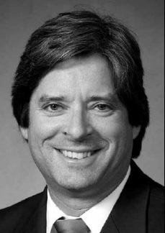
Schnabel Engineering…..
Jim Schnabel
Innovated with ground improvement solutions. Age 55.
Started geophysics practice. Age 57.
Age 58, Jim hired his most famous engineer…..
Allen Cadden.
Started Blacksburg Virginia office. Age 59.
Sold company to employees. Age 60.
What do you call Jim Schnabel?

Slide 5
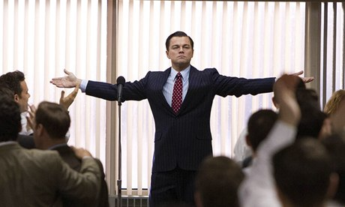
Why are we here today?
Who here wants to be like Jim? Who wants to do a start-up?
San Francisco…..
Living lean in lofts, eating pizza….
Changing the world with your dreams……
Getting some of that VC ca$h to help fund the expansion……
Living the dream after cashing out with an I. P. O.!

Slide 6


Why are we here today?
The real question we should be asking ourselves right now is:
How come there aren’t any start-ups for ME?

Slide 7



Why are we here today?
What ARE you planning to do with your career?
Go to grad school!
Academia
Government service
Construction
Consulting

Slide 8

Why are we here today?
Skills required to thrive everywhere -
Technical – covered by your great Profs right here at VT
Communication
People (emotional intelligence [thriving with others])
Business (BD, finance, organizational,…sales!)
Answering these questions will be hard. But not the hardest question you will ever face………

Slide 9

The hardest questions ….Ever.
The hardest question known to personkind -
“Does this dress make me look fat?”

Slide 10
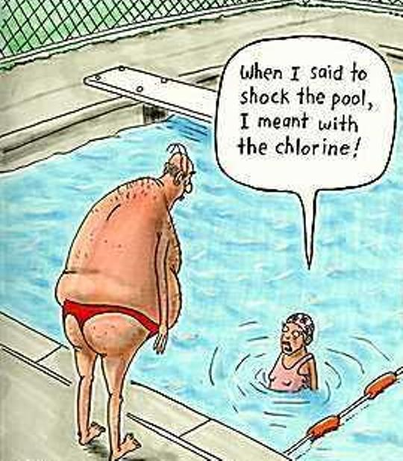
The hardest questions ….Ever.
The hardest question known to personkind -
(“Do I look good in my new swim trunks?)

Slide 11
What will we talk about?
The secrets they didn’t tell Kord way back then
Why aren’t there any start-ups for me?
Entrepreneurial Ingredients
How to answer the hardest (ever) question

Slide 12
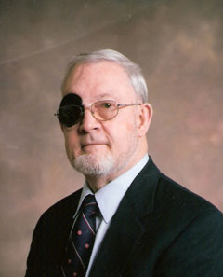
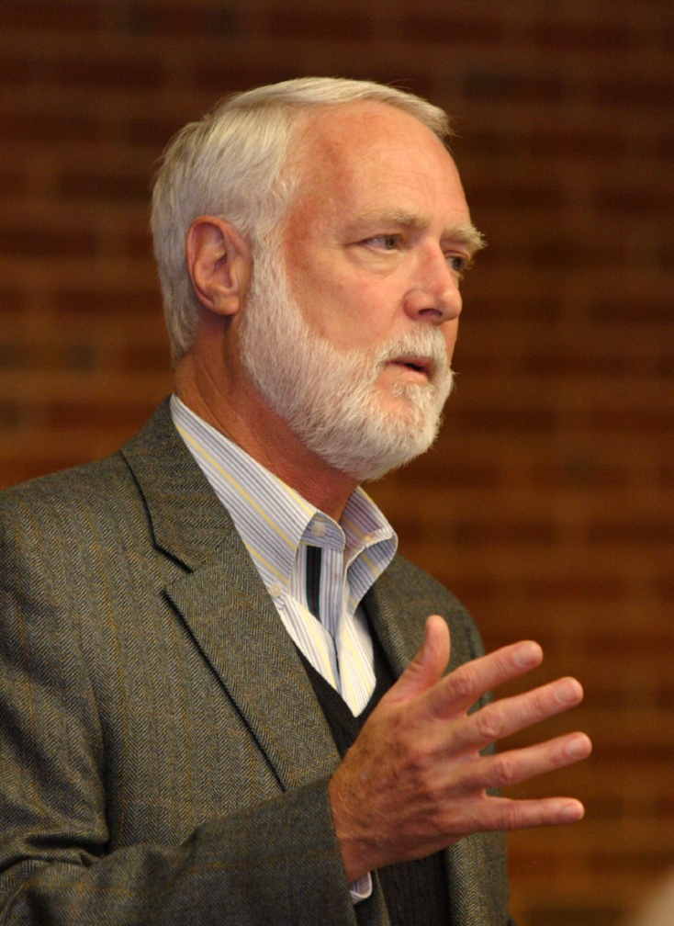
The Secrets They Don’t Tell You
30 years ago, I was you. Sitting right there where you are right now.
Pretty good role models – “go to grad school”

Slide 13
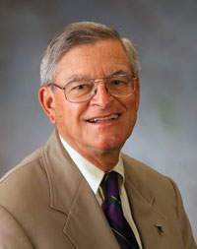
The Secrets They Don’t Tell You
30 years ago, I was you. Sitting right there where you are right now.
Advice given at grad school when he was asked - “Prof. Mitchell, which one of these great consulting firms should I work for.”
“You want me to help you decide which firm to join? They all look pretty good to me. I don’t know” - J.K. Mitchell (1988)

Slide 14
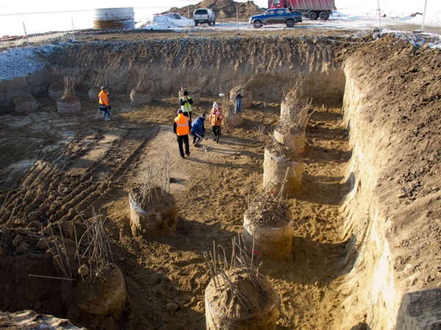
The Secrets They Don’t Tell You
Next four years at 2 engineering consulting firms
Field & lab work
Analysis & report writing
Nice big projects

Slide 15
The Secrets They Don’t Tell You
Next four years at 2 engineering consulting firms
Field & lab work
Analysis & report writing
Nice big projects
Learned the golden rule:
“He who has the gold ….makes the rules.”

Slide 16
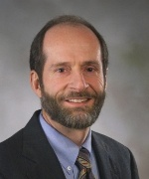
The Secrets They Don’t Tell You
After 4 more years at VT (Go Hokies!) working for……

Slide 17
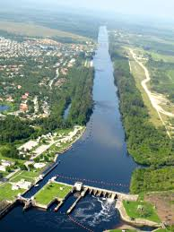
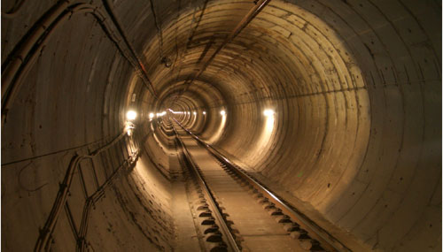
The Secrets They Don’t Tell You
After 4 more years at VT (Go Hokies!) working for……
Another 4 years in consulting -
Locks, dams, nuclear plants, Central Artery, tunnels
FEA and seismicity
Learned the answer to this question: “How do you get great projects?
“Go find some and get ‘em”

Slide 18
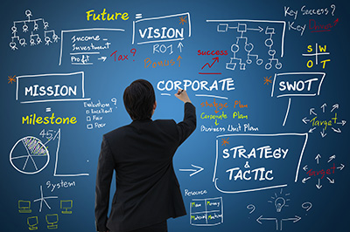
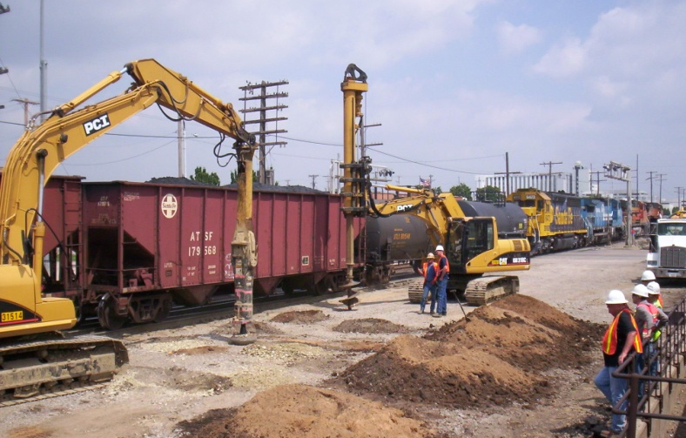
The Secrets They Don’t Tell You
4 years later my world changed -
START-UP company
Geopier invented by “crazy” Dr. Fox.
Design/build delivery – nobody did that
Chief engineer
Three years into the job…the company was sold!
Asked me to run it all - Wait a minute…I’m a technical guy.
Hired lots of great (VT) folks, expanded to Latin America….Europe…..Asia.
Created new G-I systems (patents!) - grew geography, staff, business.
They never told me & all my friends that in 20 years we will all be running a company (division / branch office etc) and needed to learn some business skills

Slide 19

The Secrets They Don’t Tell You
You can learn many secrets to running a business at Harvard Business School –
Two secrets to business (entrepreneurial or not) that they will teach you at Harvard -
Accounting / revenues
The business model

Slide 20
The Secrets They Don’t Tell You
Secret 1: Accounting: The secret B-school equation:
$ In
- $ spent
$ Made
At this point, the (evil?) Government gets involved:
= “income” = “revenue”
= “operating expense” = “OpEx”
= “earnings” = “profit (before taxes)”
Taxes ☺
= real profit to you

Slide 21

The Secrets They Don’t Tell You
Secret 1(b) - Where does your income come from?
Clients ☺
Where do these clients come from?
Will they call us?
Do we call…..them?
Client “development” (engineering term for “sales”)
Revenue generation = a people skill.

Slide 22
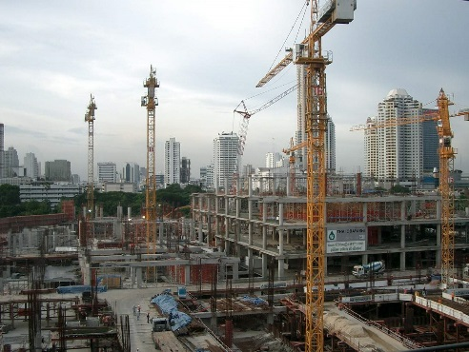
The Secrets They Don’t Tell You
Secret 2 – The business model
A business model is how you make $
Construction
Trade….buildings completed for $.
Engineering Consultants
Trade…hours worked for $
Does the consulting model feel like what you would get with a “start up” businesses?
Where’s the “entrepreneur” in all of this?

Slide 23
What will we talk about?
The secrets they didn’t tell me way back then
Why aren’t there any start-ups for me?
Ingredients
How to answer the hardest question - ever
A parting thought

Slide 24

Why aren’t there any start-ups for me?
Q: is our Civil Engineering profession innovative?
(What words and images come to mind when we think about entrepreneurial (start up?) businesses?)
Innovative
Fun
Creative
Small
Shoestring budgets
Groovy offices
Technology
Facebook / Snapchat / Instagram…
Venture Capital… oh yeah…. $$$
Q: Are these features typically associated with our field? (Why not?)

Slide 25
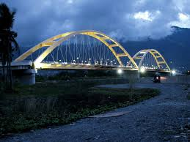
Why aren’t there any start-ups for me?
Why aren’t there any start-ups for me?
Why are we engineers?
Problem solvers
Good at Math / Science! (not so good at speling)
Pleasers

Slide 26
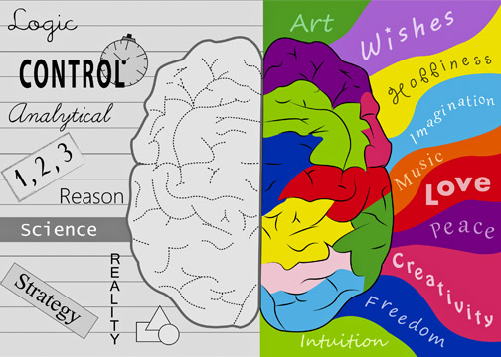
Why aren’t there any start-ups for me?
Why are we engineers?
Problem solvers
Good at Math / Science! (not so good at splling)
Pleasers
Left brained (logical)

Slide 27
Why aren’t there any start-ups for me?
Why are we engineers?
Problem solvers
Good at Math / Science! (not so good at splling)
Pleasers
Left brained (logical)
Not so much right brained (creative)

Slide 28
Why aren’t there any start-ups for me?
Why aren’t there any start-ups for me?
We don’t tend to have the brains for it!
Our business model ($ for hours) does not promote it
But there is hope! (we can learn this stuff)

Slide 29
What will we talk about?
The secrets they didn’t tell me way back then
Why aren’t there any start-ups for me?
Entrepreneurial Ingredients
How to answer the hardest (ever) question

Slide 30

Entrepreneurial Ingredients
Three fundamental ingredients for a successful (entrepreneurial) CE business:
Product & Business model…. What is it and who does what ….to whom….for what?
VP
Business development
Leadership / culture / communication
Finance (taking on and managing debt)
(man running a business)

Slide 31
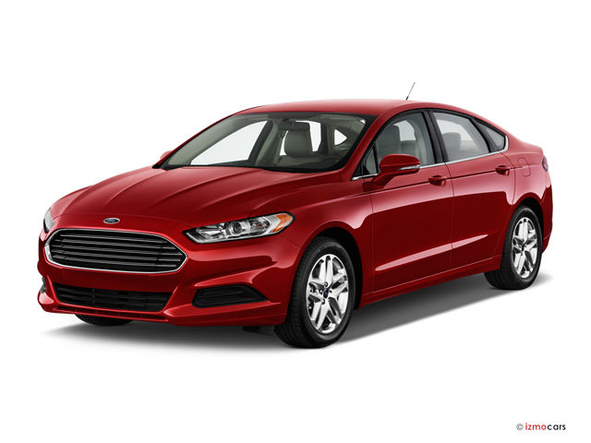
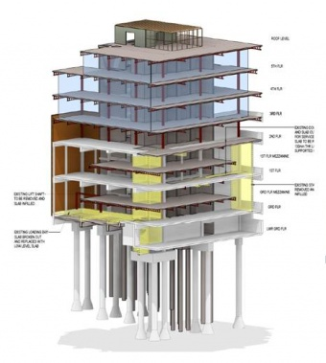
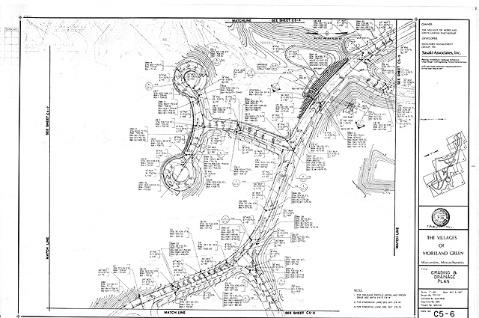
Product
Every business has a product.
Could be a physical item or a service.
What is ours in Civil Engineering?
Are these products or services?

Slide 32

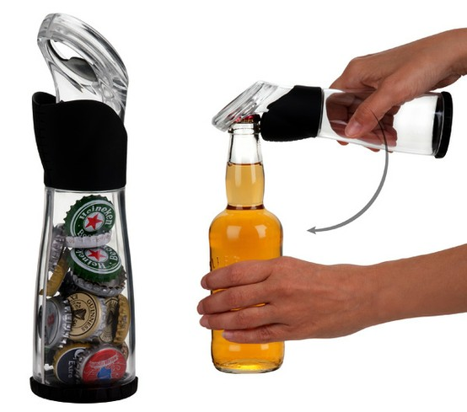

Product
Product
To be innovative, we need to come up with a great product / service.…
Let’s now put this talk aside and each of us come up with a great product……
Okay….who’s got one?

Slide 33
Product
How come it’s so hard to think of a new product?
(Hint: what side of our brains do we engineers mostly use?)

Slide 34
Product
Product – it all starts here
How come it’s so hard to think of a new product?
Who are the creative folks? Musicians……Artists………Authors …..Storytellers
Right brainiacs

Slide 35

Product
Product creativity can be learned!
Thoughts on how:
Dream. Literally.
Your best ideas come when you are:
Asleep
In a trance with your mind wandering
Rock climbing / bike riding / sequestered in the WC
Creative ideas come from your subconscious mind – which cannot be engaged by your conscious mind. Think of your subconscious mind as an exclusive night club with a hulking bouncer….

Slide 36
Product
Product creativity can be learned!
Develop the crazy right side of your brain….
Reading. Humor. Arts.
Start with the end in mind.
What is it you want to accomplish?
What are the (mechanical) needs to overcome?
What (product/device/system) would meet these needs?

Slide 37
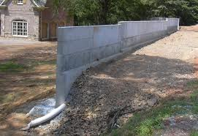
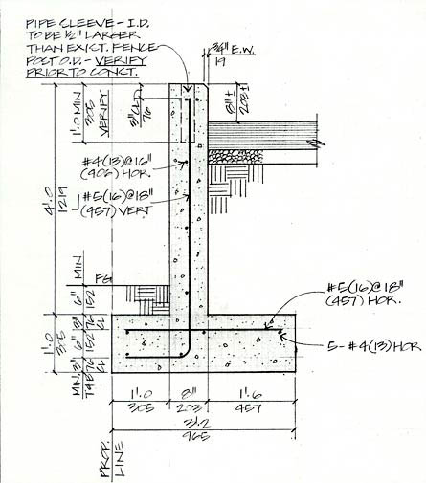
Product
Product - example
In 1970, retaining walls all looked like this...
They work GREAT!
(safe and super – no need for innovation here?).

Slide 38
PRODUCT
Product - example
What about cost?
Concrete. Strong ☺. And expensive.
How could we make the facing thinner?
Could we get rid of the base?
What would we need to do (add) to make it stable?

Slide 39
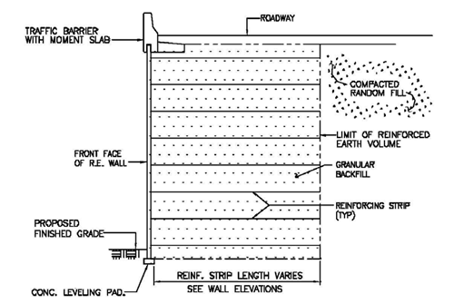
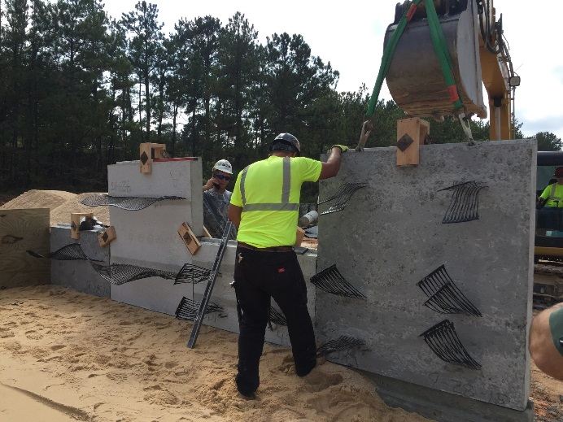
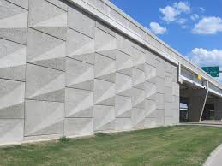
Product
Product - example
1960’s – Henri Vidal invented MSE Walls
Thick concrete replaced with thin panels connected to soil with strips.
Placing panels and connecting strips
Completed wall

Slide 40
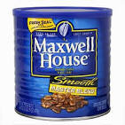

Business model
How about our business model? Does it drive or impede innovation?
Model: We trade our hours for your dollars. Does this drive product innovation??
All is not lost. There are other ways to innovate.
Consider, for example, coffee.
“Great” coffee in 1980
Coffee in 2000?
Starbucks! -
Better stuff, easy access, unmatched customer experience = innovative entrepreneurship. So it’s not only about product after all.

Slide 41
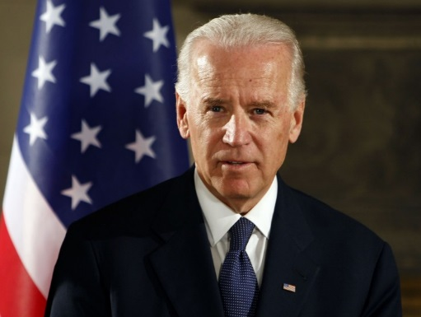
VP
Now that you know your product and business model,
Need to name your VP -
Your VP = Your Value Proposition

Slide 42
VP
Your VP (Value Proposition) describes your preferred trade offering:
“We give you ____ for ______”
Your VP describes to your customer (client) what’s in it for them

Slide 43


VP Examples
“We give you a warehouse shopping experience for consistently low prices”
“We get you there without any frills – for a price without any frills.”

Slide 44


VP
“We bring your family happiness (at the price of our naming)!”
“We give you the Ultimate Driving Machine (for a moderately high price)!”

Slide 45

VP
A great VP comes from the Hedgehog principle (Jim Collins)
“What is it that we can be the best in the world at?”

Slide 46

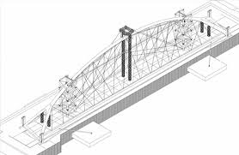
VP
A VP necessarily implies differentiation (trying to be all things to all people results in “nothin’ to nobody”)
We now know Wal*Mart’s VP – how does Target differentiate?
Your entrepreneurial Civil Engineering VP should describe your trade in a way that differentiates you from others:
We give you ___ (unique service) at ____ (low/high/fair?) price
We save you time and money while constructing your projects.”
“We are your trusted advisors [for designing nuclear power plants]”
“We are specialists in cable-stayed bridges. We’ve seen it all. We will keep your project safe at the lowest total cost to you”

Slide 47
Business Development
Now that you have your product, your business model, and your VP, there’s only one (big) thing left: your customers.
Develop great clients through need satisfaction (selling):
The ART of
Discovering what your clients real needs are and then…
Satisfying them
Two-step process requiring precise order.
Most people have only two sets of needs:

Slide 48


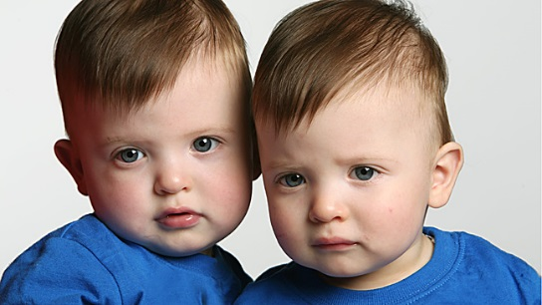
Business Development
Need No. 1: DELIVERED VALUE
Perform your engineering well. Deliver it well at good value.
Customers simply expect that we do our jobs well. Period.
No room for differentiation - our customers can’t tell the difference. (at least not when it’s delivered)

Slide 49

Business Development
Need No. 2 (usually the “need behind the need”) EMOTIONS
Acceptance
Safety
Adventure (thrill)
Love
Ego
Anger (Fear)
Client service differentiation all about becoming skilled at (1) while identifying and (2) satisfying client emotional needs.

Slide 50
Business Development
Figuring out all of this business stuff is hard.
(But maybe, it’s not as tough as you might think)
Let’s create a new Start-Up Civil Engineering Company and try it out!
Decide on Product – how about:
“Universal Consulting – We will Take Any Project”
2. Decide on our VP – maybe:
“We provide our amazing VT engineering skills on any project”
Decide on our Business development strategy – how about:
“We give our clients the exact right answer while satisfying their emotional needs”
Now let’s apply our Start Up company VP to the hardest question ever!
Let’s see if we can do this it works with our toughest customers

Slide 51
What will we talk about?
The secrets they didn’t tell me way back then
Why aren’t there any start-ups for me?
Entrepreneurial Ingredients
How to answer the hardest (ever) question

Slide 52
The Hardest Questions
“Does this dress make me look fat?”
(“Do I look good in my new swim trunks?)

Slide 53
CLIENT NEED SATISFACTION
Let’s see if it works….
Know our VP
“We use our amazing VT engineering knowledge to solve any problem…..”
Seek to understand your customer needs
“What do mean? Why don’t you like that dress?”
Pose VP in a way that meets client’s stated needs
“Well, I already know that you look great, but we can provide amazing VT engineering to solve that problem – sound good?”
Satisfy needs and needs-behind-the-needs
“NO! That dress categorically DOES NOT make you look fat.” (deliver your outstanding entrepreneurial engineering product)
Close by communicating your unique VP
“We know this because we provide amazing VT engineering knowledge….”

Slide 54
CLIENT NEED SATISFACTION
You can deliver with confidence because your detailed amazing VT Engineering analysis has told you that the DRESS is not the culprit….(it’s not the bathing suit)….

Slide 55
CLIENT NEED SATISFACTION
You can deliver with confidence because your detailed VT amazing Engineering analysis has told you that the DRESS is not the culprit….

Slide 56
What will we talk about?
The secrets they didn’t tell me way back then
Why aren’t there any start-ups for me?
Ingredients
How to answer the hardest question - ever
A parting thought

Slide 57
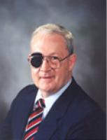
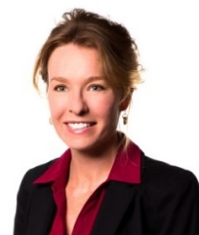
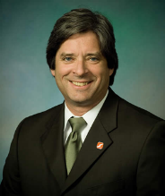
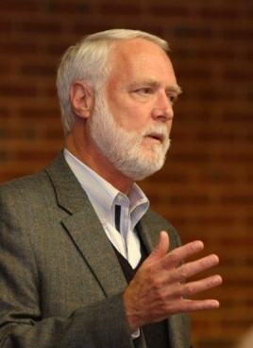
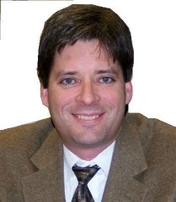
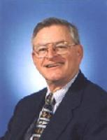
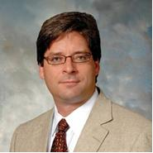
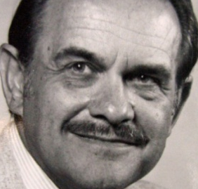
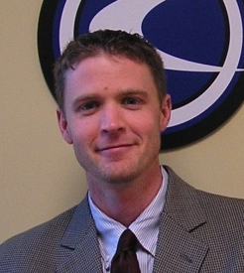
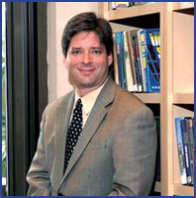
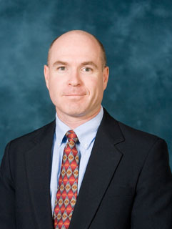
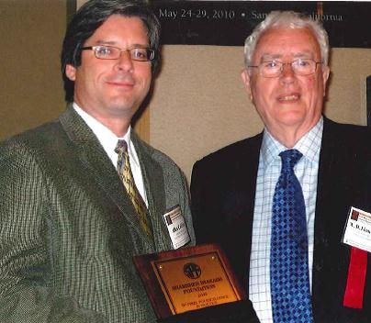
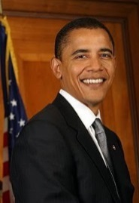
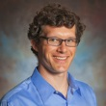
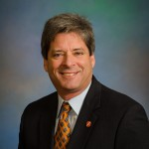
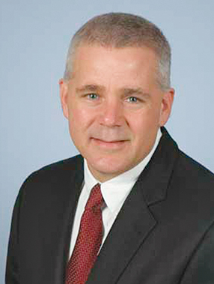
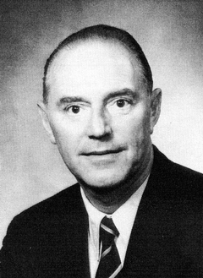
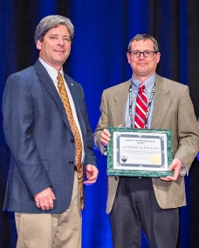
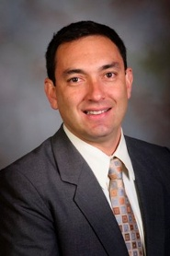

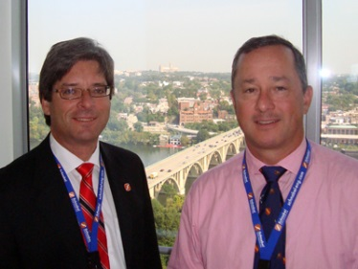
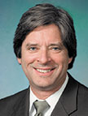
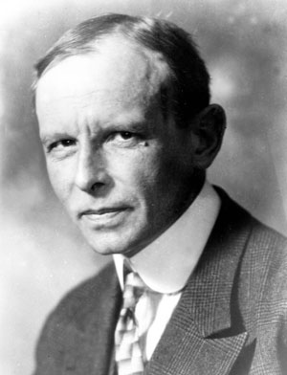


Parting thoughts
We live in a GREAT profession full of wonderful people
Your mother was right – you will become like those….

Slide 58


Thank you for the honor of being with you today
I hope I left you in a good spot.

