Slide 1

Schizophrenia Simulation
Katherine Fichera and Dillon Domnick
CS 4624 - Multimedia/Hypertext - Dr. Fox
Virginia Tech, Blacksburg, VA 24061
April 18, 2023

Slide 2
Outline
Recap
Timeline
Completed Work
Future Plans
Acknowledgements
References

Slide 3
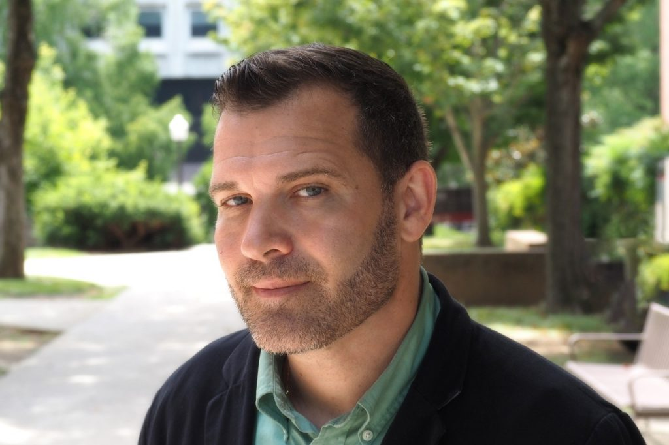
Recap
VR simulation focusing on a character experiencing schizophrenia symptoms
Designed to create awareness and address stigma around the disease
Based off Janssen Pharmaceuticals research on schizophrenia
Dr. James Ivory
Professor of Communications
Founder of VT G.A.M.E.R Lab
Notes:
As a follow-up to published research using an immersive 3D stereoscopic simulation of the visual and auditory hallucinations associated with Schizophrenia developed by Janssen Pharmaceutica, collaborators are sought to produce a new updated and accessible immersive simulation of the visual and/or auditory hallucinations associated with schizophrenia for public outreach and empirical research. Content of the presentation and hardware/software platforms can be selected by the group in concert with the research's principal investigator (Ivory).

Slide 4

Objective & Deliverable
Objective:
To create a VR simulation that recreates the symptoms of schizophrenia
Deliverable:
VR Simulation, user can experience effects of disease
Visual hallucinations
Auditory hallucinations

Slide 5

Timeline
February | March | April | May
Research | Development & Testing | Refinement & Testing | Showcase
Decide on simulation type Research tools and topics Create storyboard | Completed alpha version by end of month Begin meetings with professionals | Beta version refinement Production version by end of month Continued meetings | Present finished product, presentation, and report
ADD A TIMELINE PAGE

Slide 6
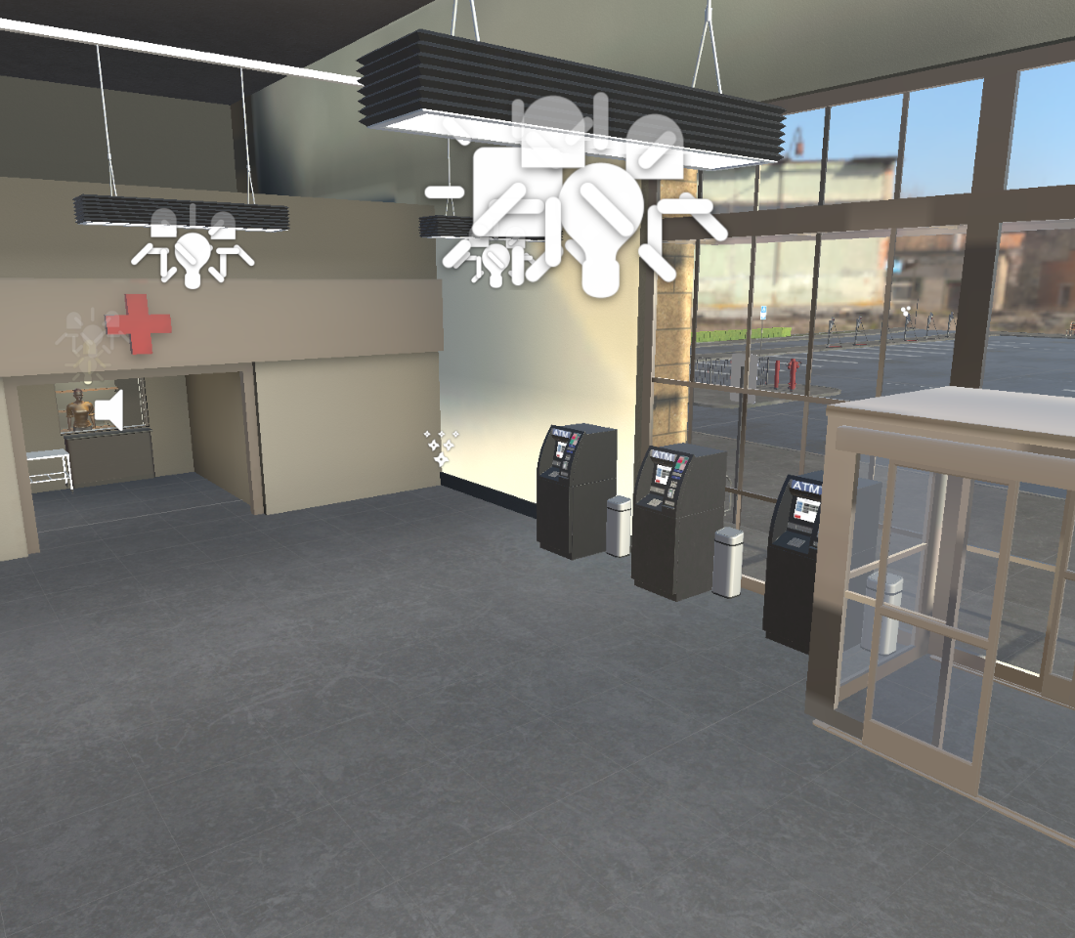
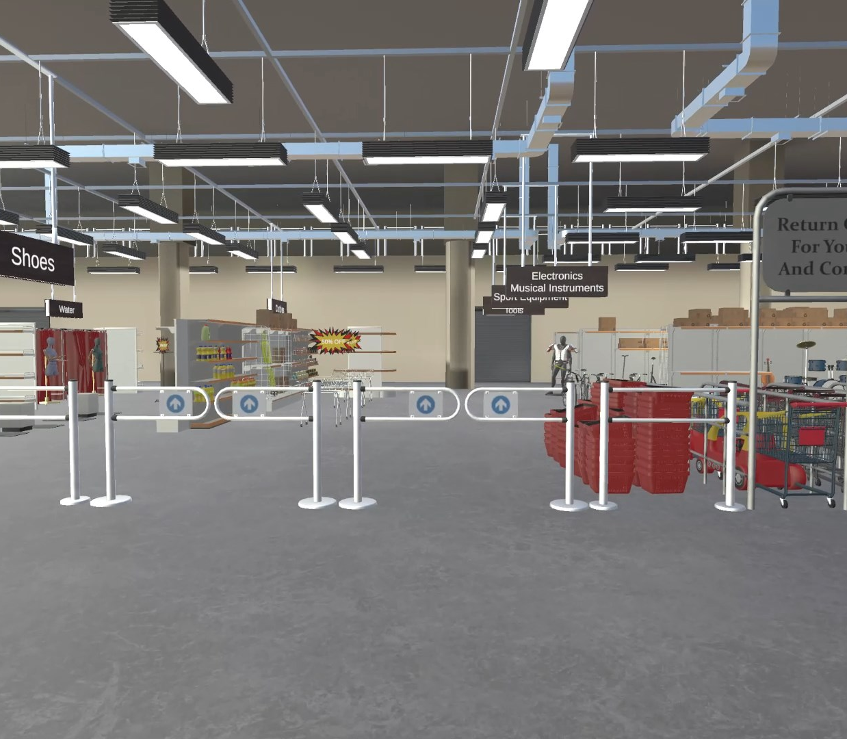
Completed Beta

Slide 7
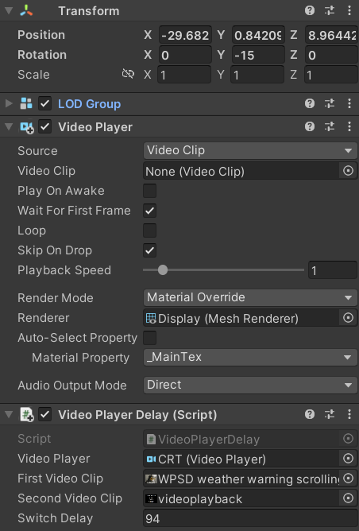
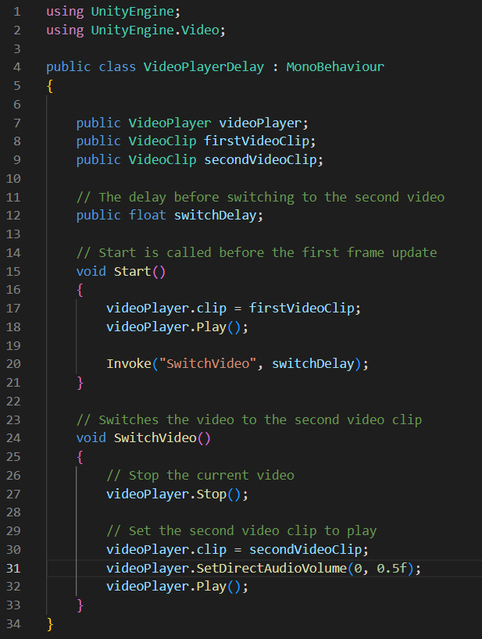
Implementation - Beta
Visual scripting API vs. C# implementation
Character design
Scene elements
  Auditory hallucinations
  Visual hallucinations
Design consequences
Visual Scripting
C# Object Oriented Scripting

Slide 8
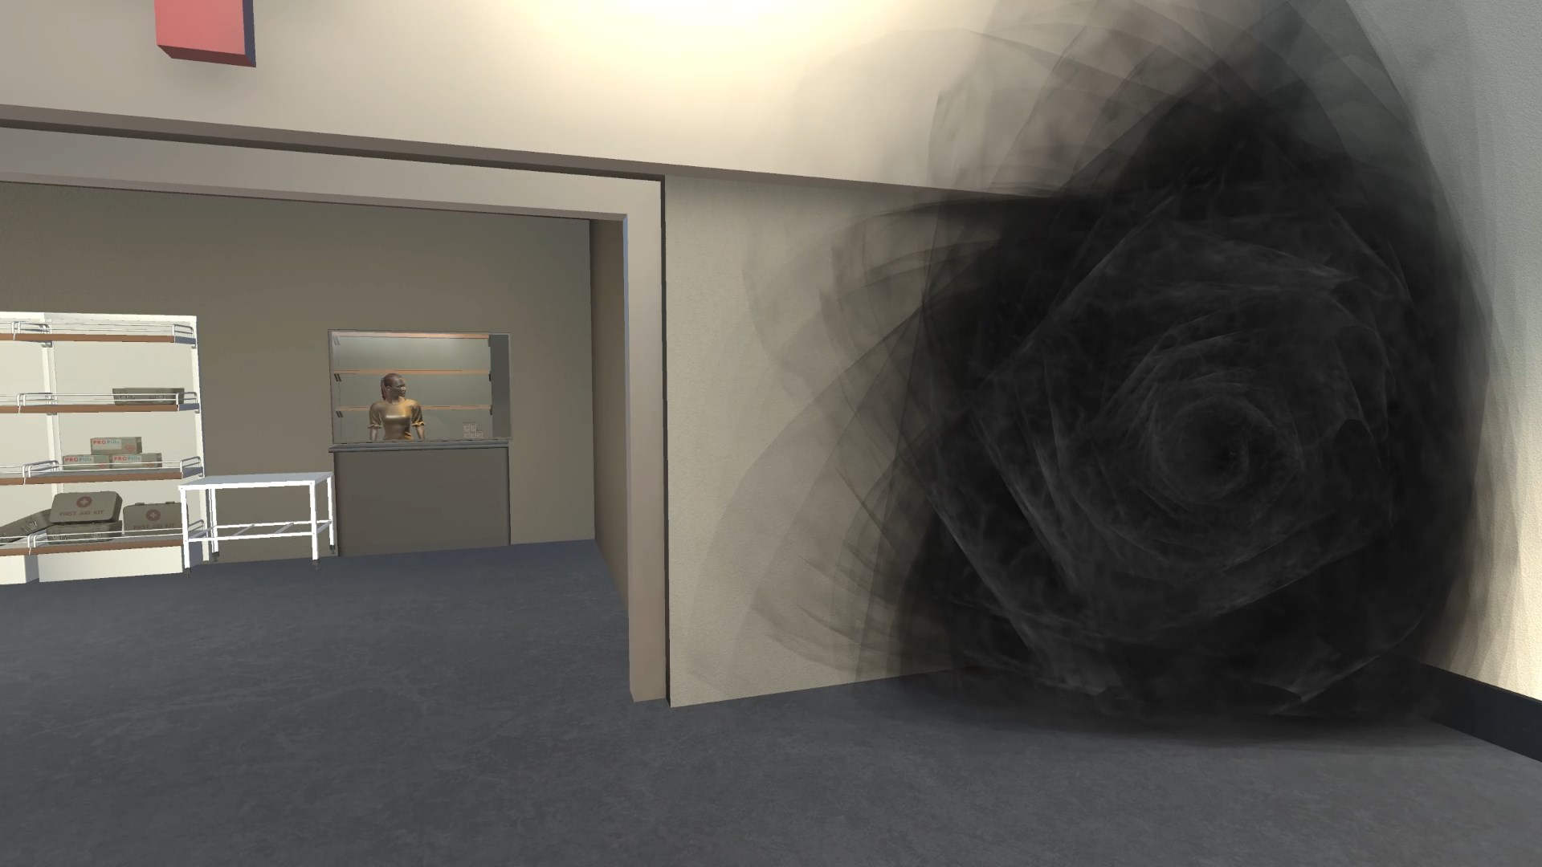
Completed Work - Design Elements
Reactive Figure Hallucinations

Slide 9
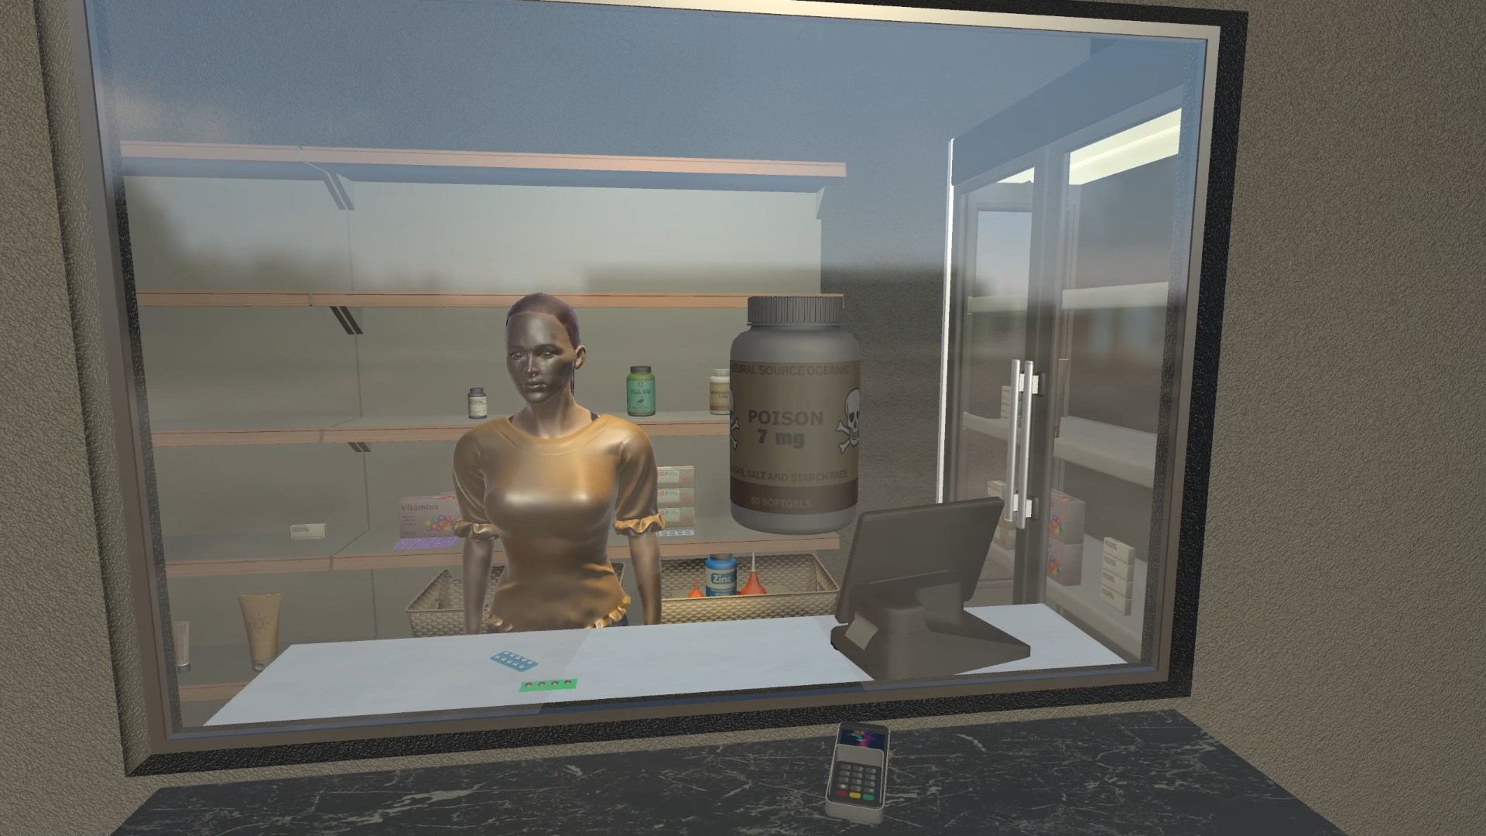
Completed Work - Design Elements
Pharmacist Scene

Slide 10
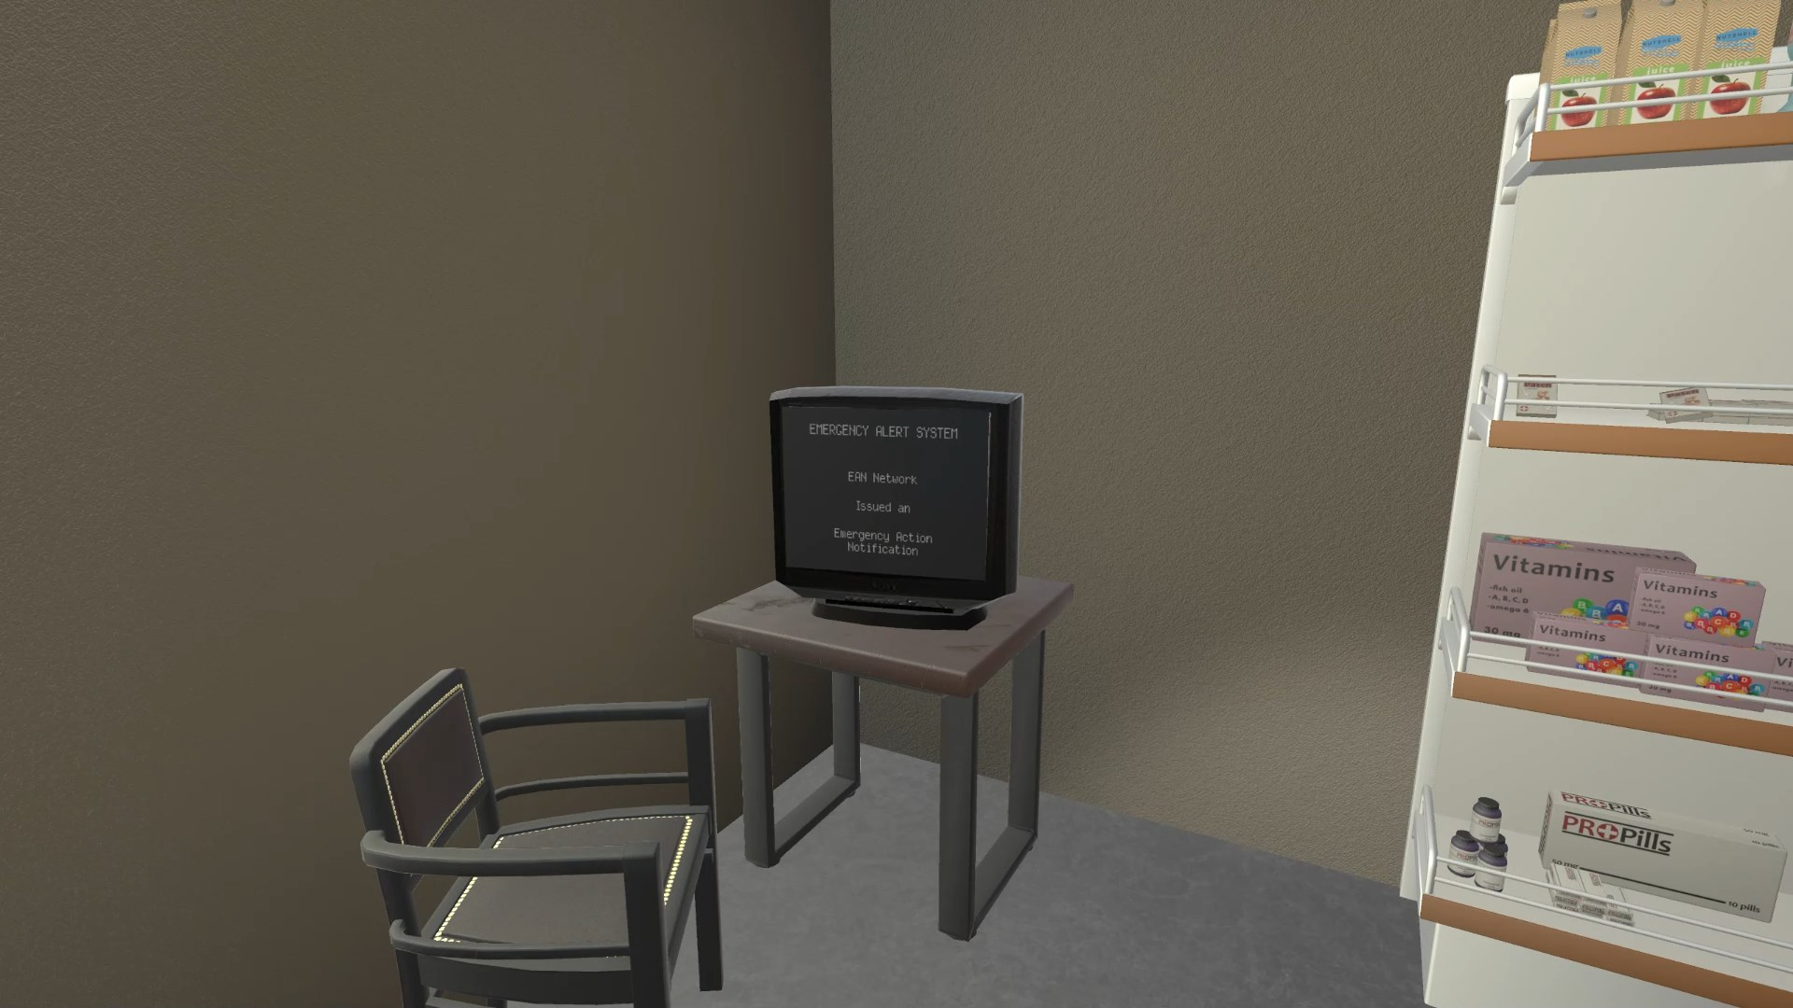
Completed Work - Design Elements
Mixed Audio/Visual Hallucination

Slide 11
Completed Work - Unity Packages
Package | Justification
High Definition RP | HD scripting rendering pipeline used for project shaders and to light the character models
TextMeshPro | Provides improved control over text formatting for in-game elements
Unity UI | Used for developing UI elements
Visual Scripting | Visual, node-based behaviors to simplify development of non-scripted objects
Oculus XR Plugin | Provides display and input support for Oculus devices
OpenVR XR Plugin | Provides display and input support for OpenVR devices in Unity XR

Slide 12
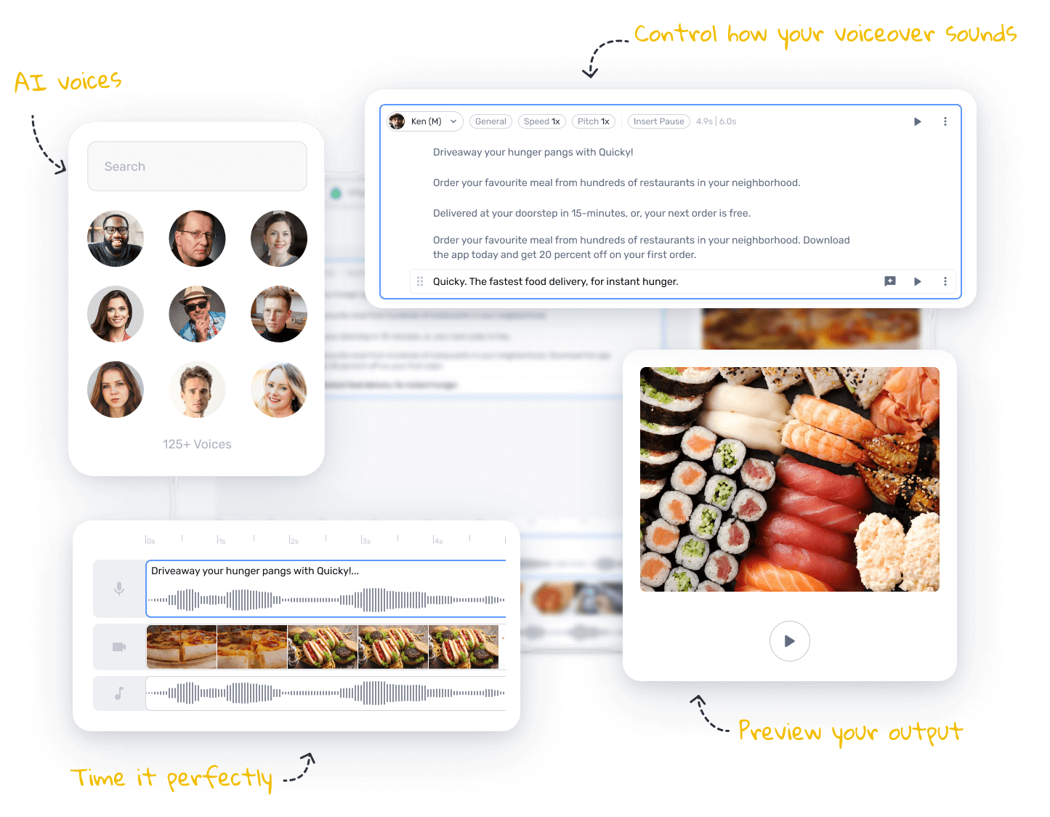

Audio
Notes:
Future of AI, like chatGPT, many are also using AI for things like podcasts, video scripts, teaching etc
We decided to follow the trend of ai and used murf ai
it is text to speech voice generator and also has capabilities of voice changers
Why this one specifically?

Slide 13
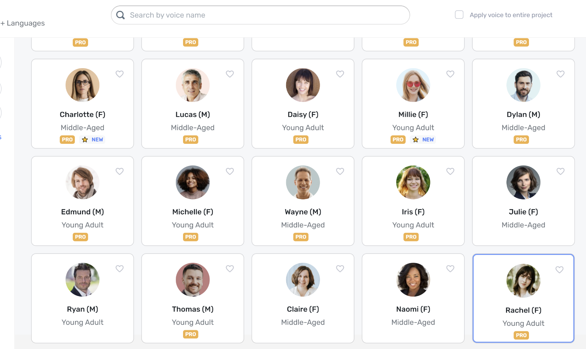
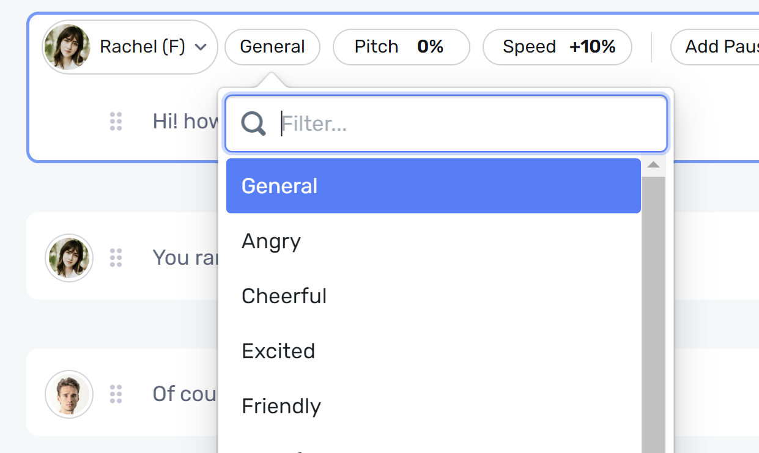
Audio
Notes:
First we chose it because of the versatility of the program.
from website: Choose from over 120+ text to speech voices, in 20+ languages
Example of some voices they have and then some of the many moods they can emulate
Really important for us to have multiple voices and emotions for the hallucinations to feel accurate

Slide 14
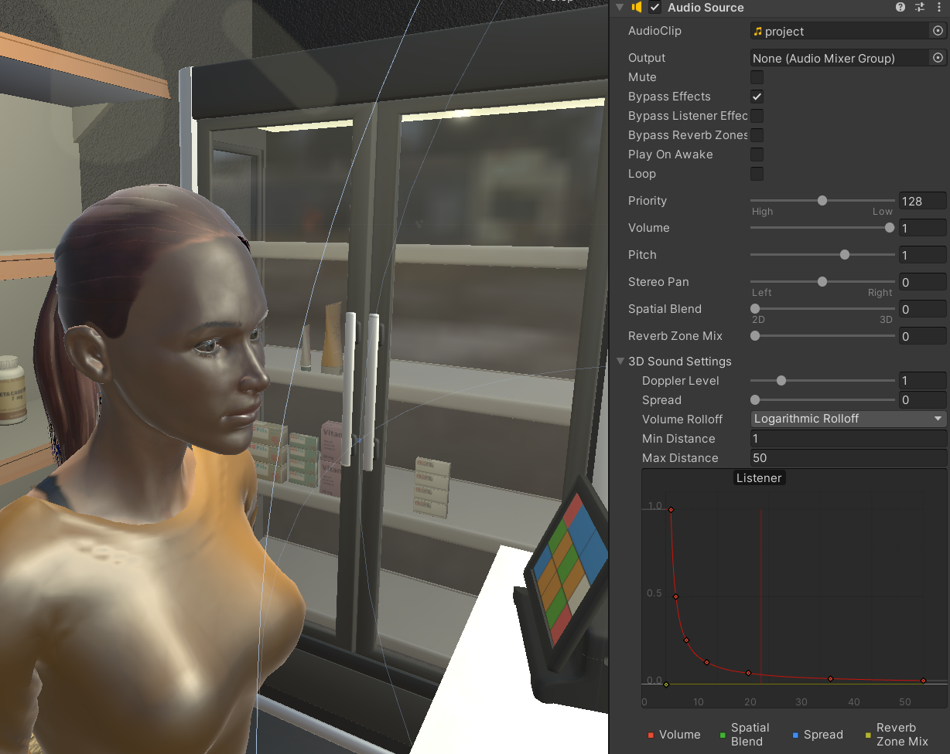
Audio
“Versatile Video game Voice Overs that breathe life into your video game. Enhance the gameplay experience for your audience by adding rich emotions into your narrative with Murf’s versatile AI voices.” [1]
Notes:
Murf.ai says its software specialises in many different aspects and one of them is video games, here is a quote from the website about how it can enhance games and programs

Slide 15
Future Work
  Project was designed with further development in mind:
    Testing and validation of simulation effectiveness
    Further scene design
      Voice acting vs. simulated voices
      Covering more types of hallucinations
    Production and distribution
      Conversion to OpenVR project structure and Universal Rendering Pipeline

Slide 16
Acknowledgements
Dr. Ivory
Dr. Fox
Dr. Clinton

Slide 17
References
AI Voice Generator: Versatile text to speech software: Murf AI. AI Voice Generator: Versatile Text to Speech Software | Murf AI. (2023). Retrieved April 17, 2023, from https://murf.ai/
Jordbugg. (2023, January 28). Character customizer: Game toolkits. Unity Asset Store. https://assetstore.unity.com/packages/tools/game-toolkits/character-customizer-241861
Mixall. (2022, June 2). Grocery store - parking and supermarket: 3D environments. Unity Asset Store. https://assetstore.unity.com/packages/3d/environments/grocery-store-parking-and-supermarket-224033
Murf.AI Video Games. Murf.AI. (2023). Retrieved April 20, 2023, from https://murf.ai/voiceover/video-game

