Slide 1



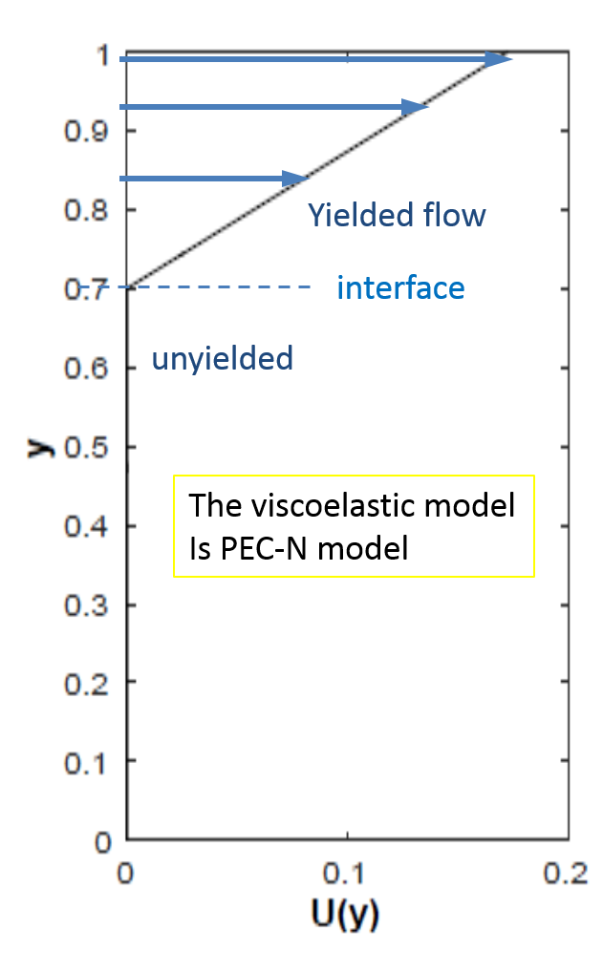
 | 88th Annual Meeting February 12 - 16, 2017 — Tampa, Florida
Session: Non-Newtonian Fluid Mechanics & Instabilities
Stability of shear banded flow for a viscoelastic constitutive model with thixotropic yield stress behavior
Yuriko Renardy (speaker) and Michael Renardy
Department of Mathematics, Virginia Tech,
Blacksburg, VA 24061
“PEC-N“ Partially extending strand convection model of Larson (1984) plus Newtonian solvent

Slide 2

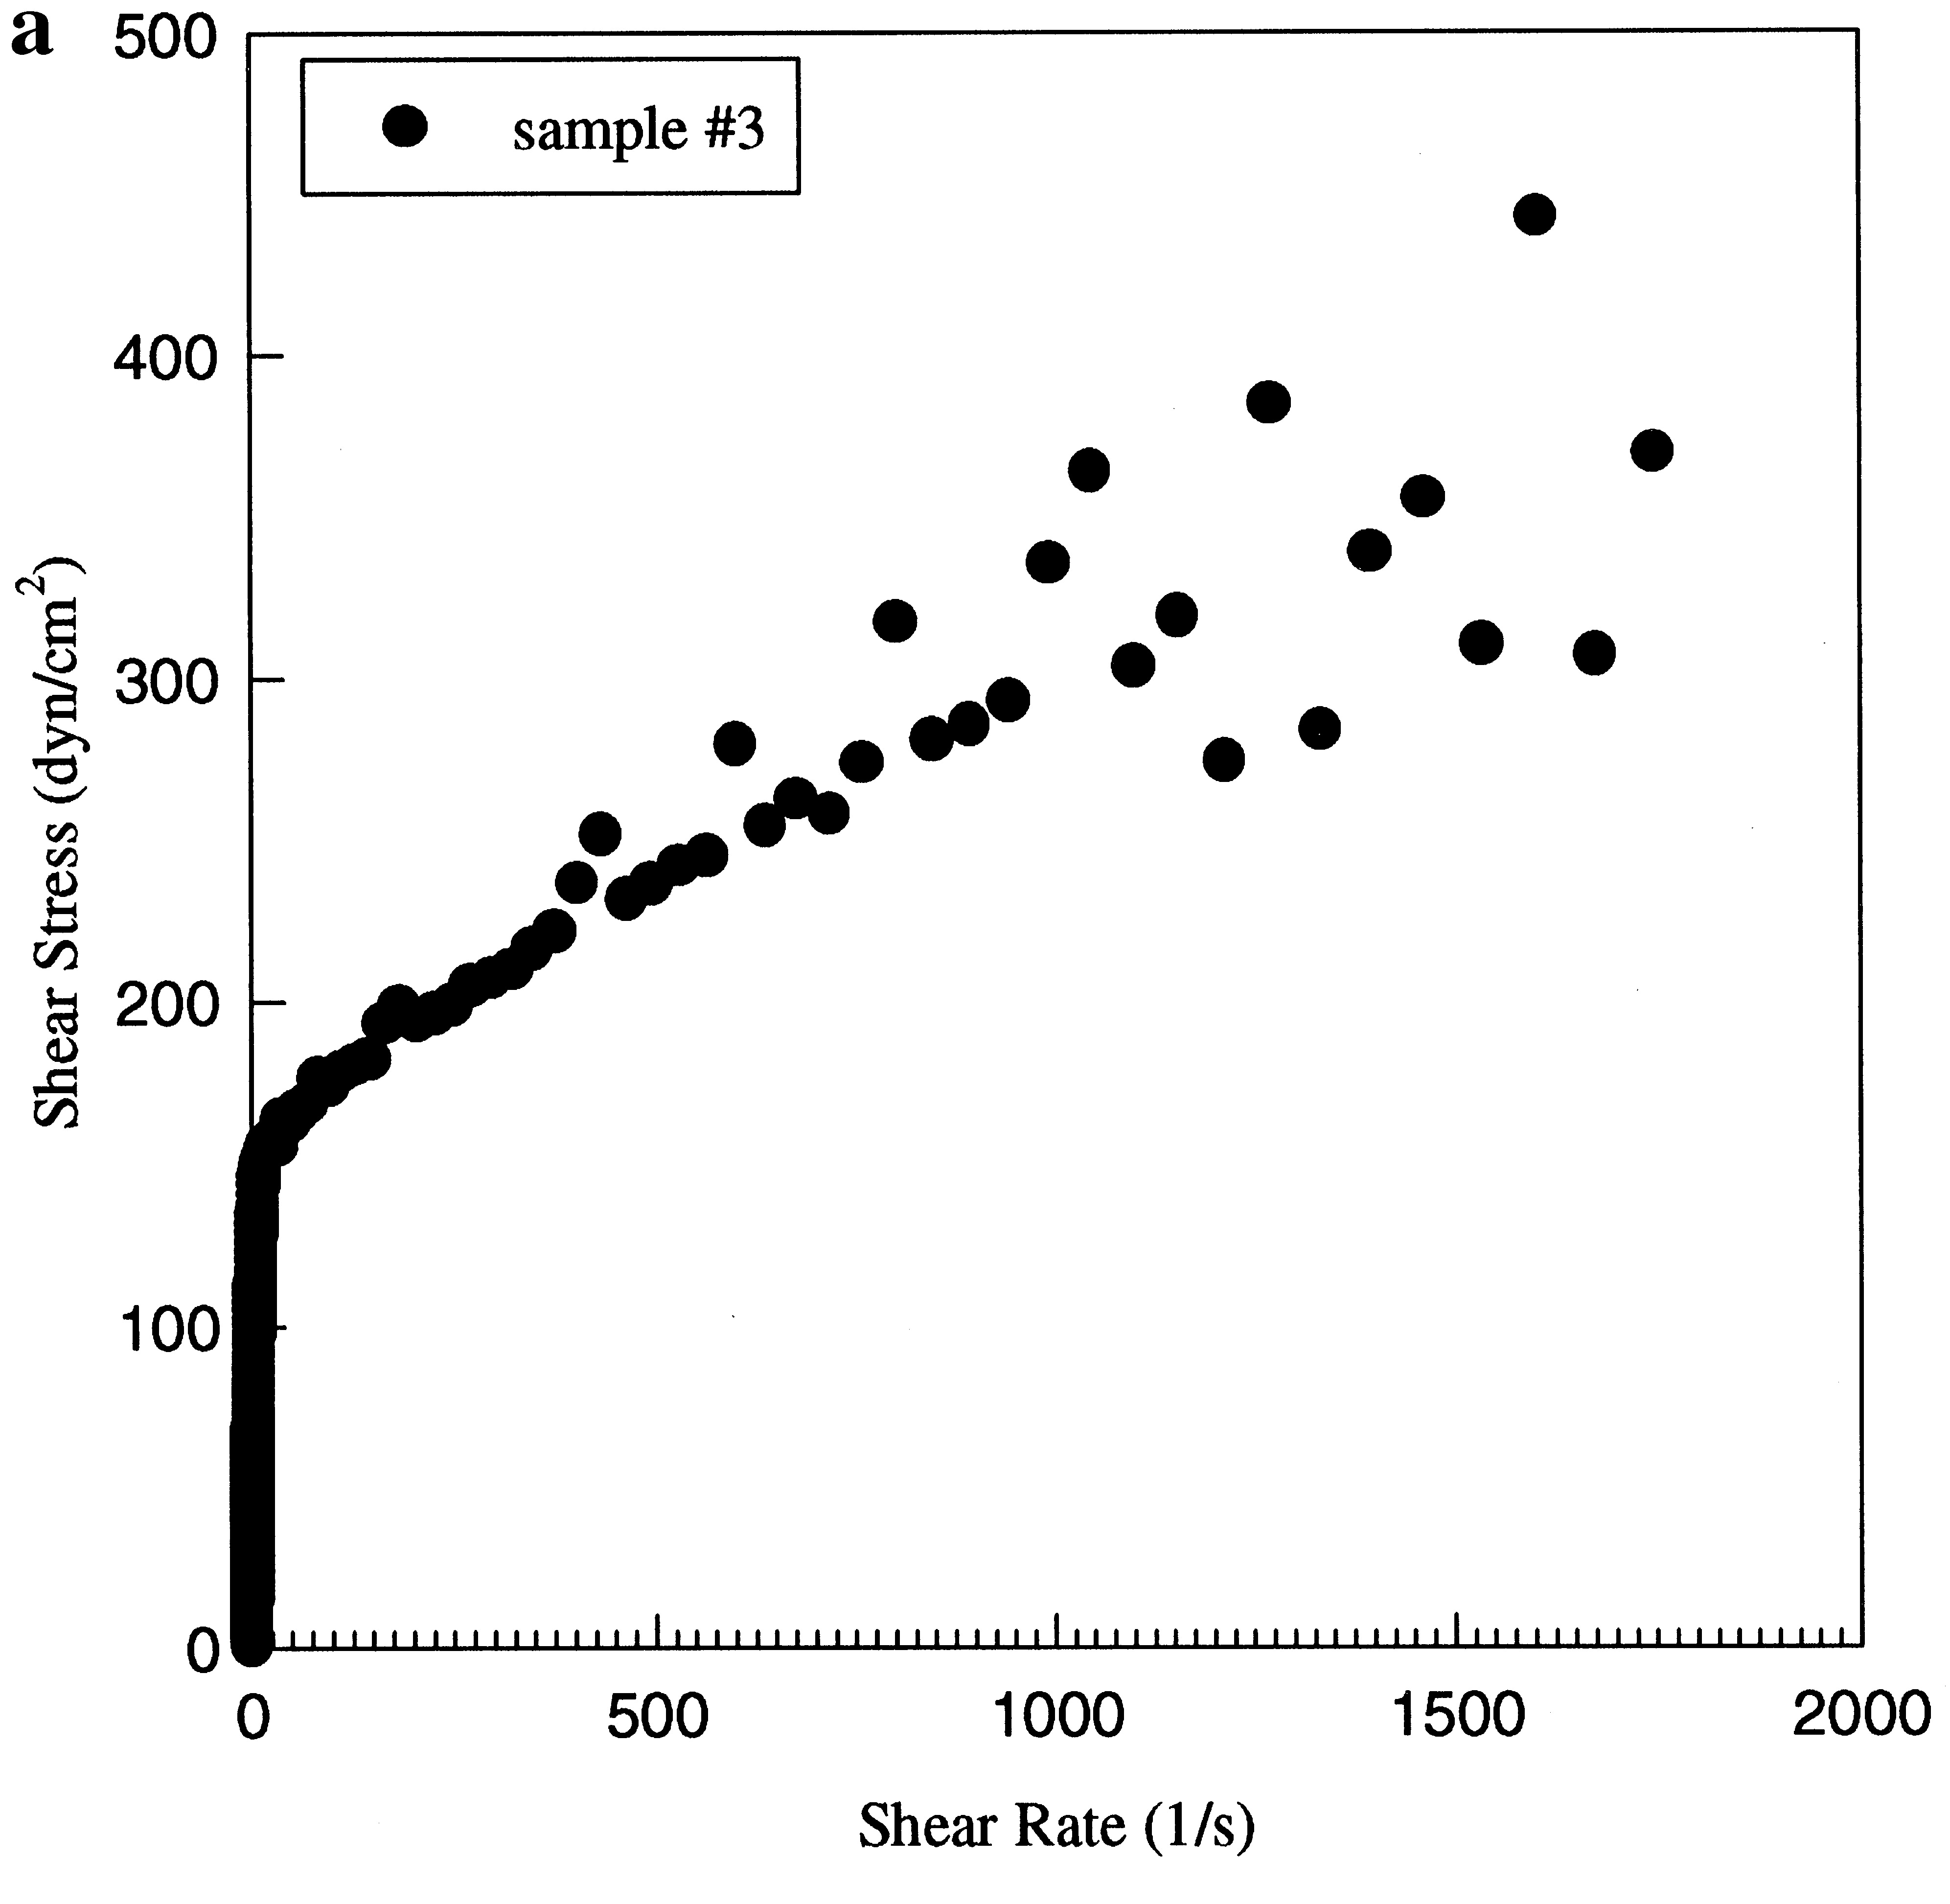
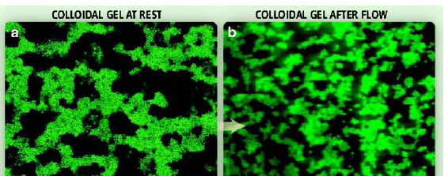
Simple yield stress fluids start flowing only if the applied stress exceeds a critical value.
Thixotropic yield stress fluids:
The yield stress depends on the time since the fluid was last stressed.
Yield stress
viscosity
ε = unyielded /yielded shear rates
= 10 ⁻³ / 10 ²
Bingham model
Yields to flow
Shear stress τ
Denn,Bonn
Shear stress τ
unyields
solid
shear rate κ
fluid
shear rate κ
Branched wormlike micelles in shampoo.
(Lin 1996)
10% bentonite solution,
Møller, Fall, Chikkadi, Derks, Bonn 2009

Slide 3
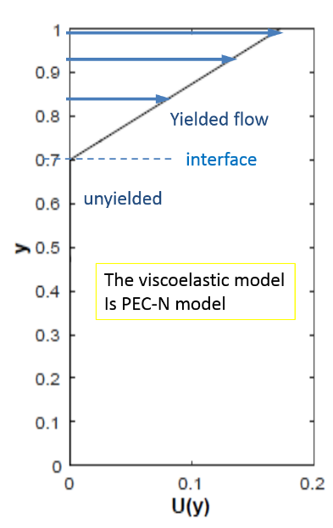

Viscoelastic models for an entangled microstructure in solvent are in use for co-existence of two shear rates.
Viscoelastic model with non-monotone shear stress – shear rate curve.
ε = retardation time
. relaxation time
Yields to flow
Physically unstable decreasing branch
Shear stress τ
unyields
solid
fluid
Among other VE models, Johnson-Segalman, Vasquez Cook McKinley, Giesekus, Rolie Poly,… Spenley, Yuan,Cates, 1996, H. J. Wilson et al, , S. M. Fielding, P. Olmsted, L. Zhou et al, T. McLeish, M. Cromer et al, …
shear rate κ
10% bentonite solution,
Møller, Fall, Chikkadi, Derks, Bonn 2009

Slide 4







Governing equations
for Partially Extending strand Convection-Newtonian solvent model
Momentum conservation and incompressibility
Extra stress tensor and tube conformation tensor.
And PEC constitutive model for the conformation tensor C .
Trace of C , microstructure elongation,
s=C₁₁+C₂₂+C₃₃
Effects leading to non-zero equilibrium length
Stretching with the flow
Functions of trC and α that are systematically derived from molecular theory in Larson 1984.

Slide 5



Dimensionless parameters.
A yielding parameter
Maximum elastic shear stress, obtained from measurements for IMMEDIATE yielding
Shear elastic modulus
Suspensions and pastes (make-up, ketchup)
Maki & Renardy 2010,2012
Wormlike micellar solutions ( shampoo)
Grant & Renardy 2015
A rescaled elastic modulus
ε = retardation time/relaxation time.
Re is low.

Slide 6

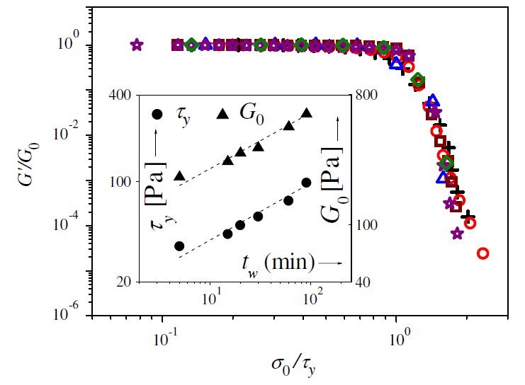
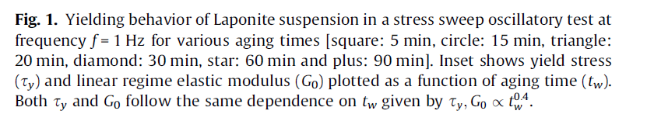
Shear data for particulate suspension:
2012
α = 2
2
- 3
=(2/7)²-3
= - 2.9

Slide 7
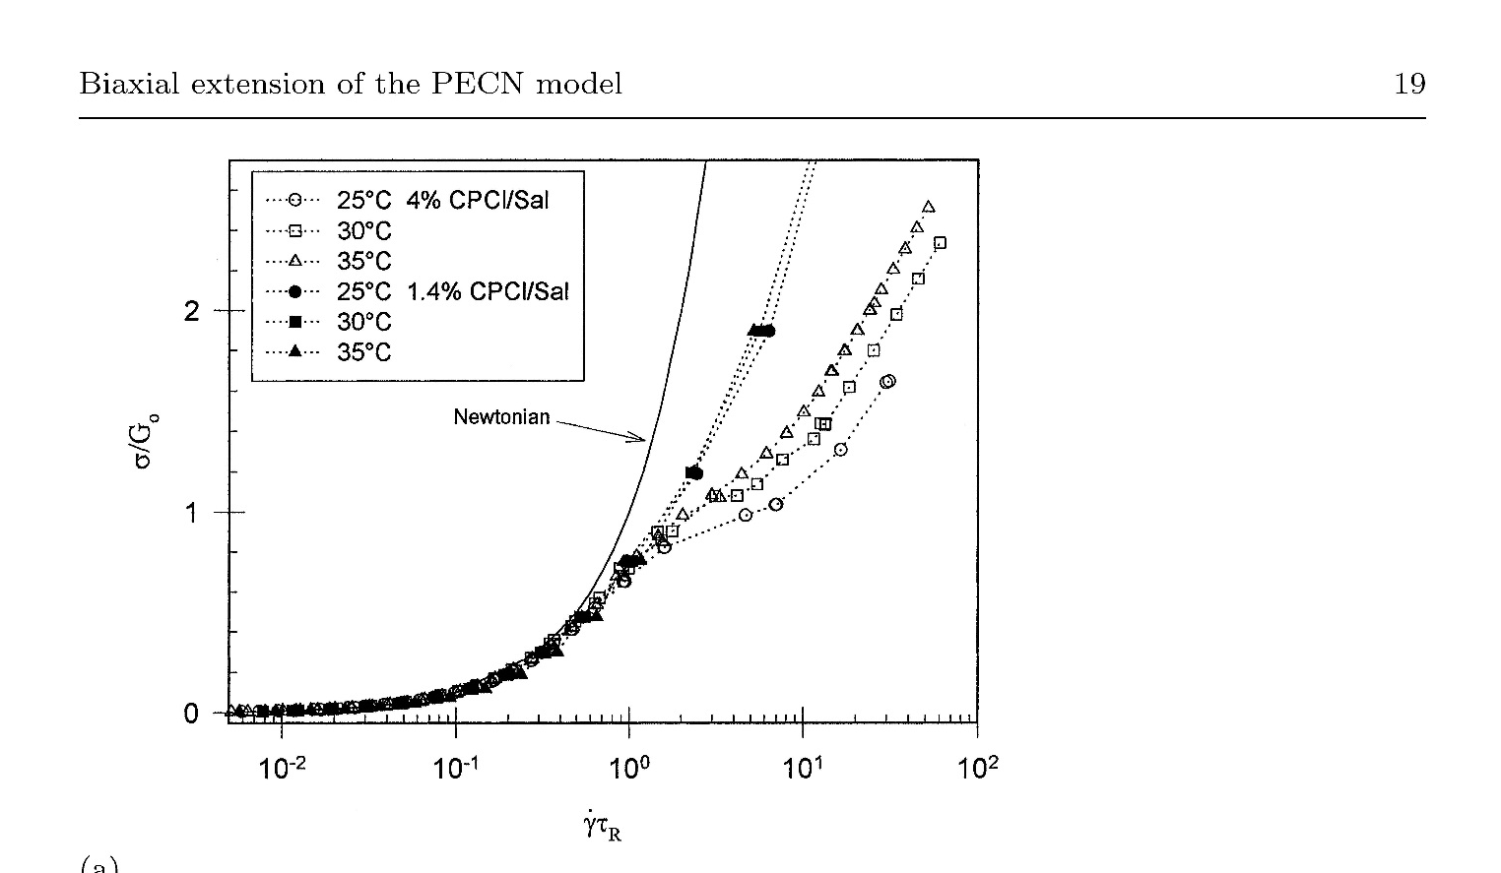
Shear data for wormlike micellar solution: Fig 1 of Walker,Moldenaers,Beret 1996.
Looking at Yielding Transition
Ratio of yielded to unyielded viscosity here is 10 to 1 =
Therefore,

Slide 8
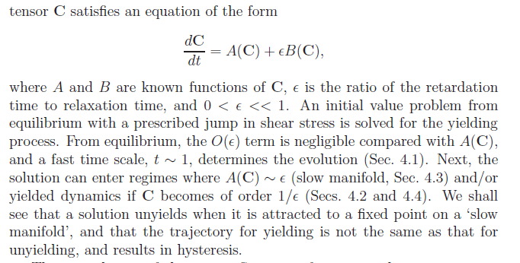
ε<<1
Asymptotic analysis for gives the scalings we see in DNS for homogeneous parallel shear flow
(M.Renardy 2010,Maki&Yrenardy 2010, 2012)
A,B, nonlinear operators on the
conformation tensor C
Initial condition
C=equilibrium at t=0. This term is small. Fast time scale t=O(1).

Slide 9

initial phase → dC₁₂ /dt = τ- ψ(s)C_{12.}
→ C = finger strain tensor for a nonlinear elastic solid.
Immediate yielding. If τ >T₁₂e, C₁₂ grows. Elastic shear stress T₁₂ -> 0,
Newtonian shear stress κ=τ-T₁₂ ->τ .
T₁₂e
If τ < T₁₂e, C₁₂ grows until τ −> T₁₂ .
And re-balancing terms in the equation, t must rescale a slow time scale.
Plot of elastic shear stress
T₁₂ =
strain

Slide 10
T₁₂e
Yields to flow
T₁₂^{M}
Shear stress τ
unyields
solid
fluid
shear rate κ
Notes:
But not all such models can be used in the limit of small epsilon. For instance, the Giesekus model develops an infinite first normal stress difference in this limit when it yields.
The Johnson Segalman model develops large oscillations in some of the stress tensor components when yielded, and that is not supported by experimental observations of yielding.
The partially extending strand convection model doesn’t suffer from any of these weird effects in the limit of small epsilon. So we use that for the microstructure with the long time scale.
(There are a number of phenomenological models out there that are used, where measured yield stresses are fed into the model. What we do differently is to take a model
That is systematically derived from assumptions about the microstructure, and the yiel.d stress is an output as a function of time scales, rather than an input.
(Coussot, phenomenological model built on the concept of a structure parameter.
Viscoelastic model plus an artificial diffusive term to kill instabilities.)

Slide 11
ε<<1
Asymptotic analysis for gives the scalings we see in DNS (M.Renardy 2010,Maki&Yrenardy 2010, 2012)
A,B, nonlinear operators on the
conformation tensor C
Initial condition
C=equilibrium at t=0. This term is small. Fast time scale t=O(1).
The solution can remain unyielded, A(C)~ ε where t ~1/ε on a slow manifold.
OR enter yielded dynamics/rejuvenation where C~1/ε
OR land on the slow manifold/aging, then enter yielded dynamics
OR cycle, aging/rejuvenation.
The transient dynamics can be solved for the leading terms , and analyzed with fixed points of the ‘yielded dynamics equations’ and those of the ‘slow manifold’.
(stable/unstable nodes, limit cycle, center manifold reduction, Fenichel theory for degeneracies…)
A variety of Initial conditions have been investigated.
If t=0 is yielded flow at applied stress τ_{initial} , which is stepped down to τ, then … we retrieve a hysteresis loop.

Slide 12



Stable fixed point
(steady parallel shear)
The initial phase is a nonlinear elastic evolution where C is a Finger strain tensor. In this slide, the applied shear stress is greater than the maximum elastic shear stress, which is always greater than the maximum for the steady shear stress - shear rate curve.

Slide 13
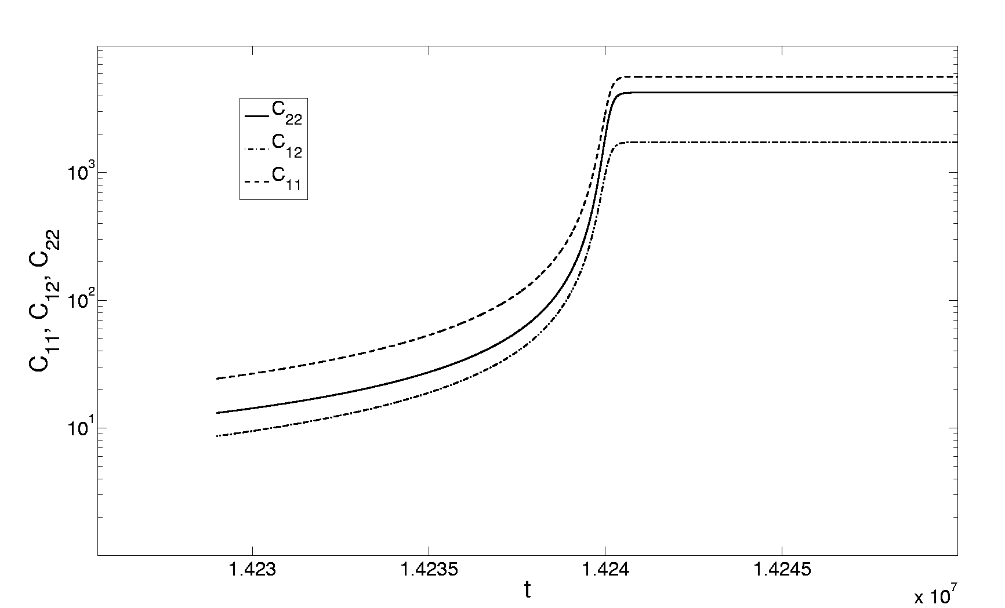

T₁₂e >τ >T₁₂^{M} : Direct numerical simulation of delayed yielding with our asymptotic annotations. (Maki & Yrenardy 2010,2012, JNNFM)
Yielded to steady shear
Slow dynamics
Blowup time on slow manifold
Note the log scale for C
Note the linear scale on t axis

Slide 14
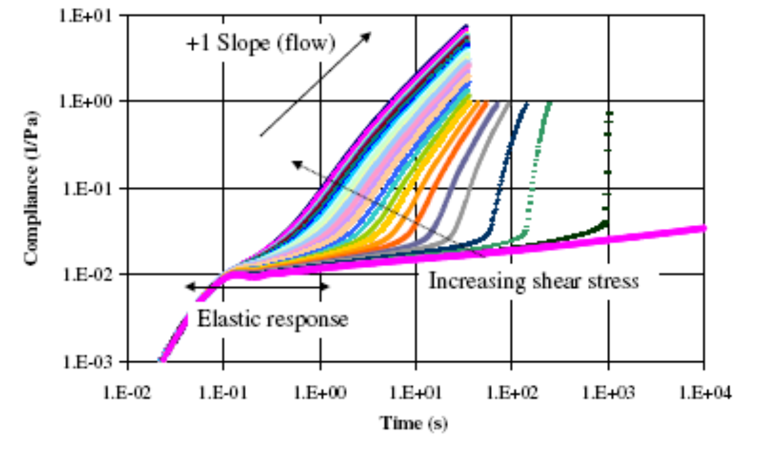
Heinz Ketchup data (Caton & Baravian 2008) overlaid with our DNS.
Notes:
Each curve represents data for a fixed applied shear stress. The y axis is strain / stress, so on each curve, since the stress is constant, we can think of the y axis as strain, And the plot represents strain evolution. Let’s take the magenta curve with slope +1 in the log log plot. It represents immediate yielding. From this data, transforming back to
Linear plot, we deduce the Newtonian shear rate, and therefore we can calculate the solvent viscosity.
(take any constant slope curve, calculate Newtonian visc)
Next the T12^e is found from the curve that separates the immediate yielding case from the ‘delayed’ yielding case, say the next blue line.
The T12^M is found from the curve that separates the slow yielding case from the non-yielding case, that is, between the black line and the lowest magenta line.
Having found T12^e and T12^M, since PECR+N gives these formulas in terms of the PEC model parameter alpha, we can estimate alpha.
The value of the PECR+N model parameter q is inferred from unyielding data and the formula for the minimum in the shear stress/shear rate curve for unidirectional shear flow.
The ratio of the time for the slow yielding (black line) to immediate yielding (+1 slope magenta) gives epsilon.

Slide 15



Thixotropy also means unyielding to equilibrium is on a slow time scale. With yielded flow as the initial condition, the asymptotic analysis of apparent viscosity τ/κ on the slow manifold is performed.
On the slow manifold
The slow manifold evolution equations give an ODE for Q(t)
This gives an apparent viscosity
=(applied stress/shear rate response)
The next slide shows DNS of the full equations to illustrate this formula.

Slide 16

The DNS of the apparent viscosity τ/κ on a log log scale. Initial condition is parallel shear flow, with stepdown to small τ .
solid
Viscosity plateau at large t
Is ~1/ε
viscosity
Ketchup simulation
C₁₁ and C₂₂ are large initially. The slow dynamics equations show that tr(C) decreases ~ t^{-N} when stress is taken off. N=1.
liquid
time
Can you finish your thesis if you wait this long for experimental data?

Slide 18
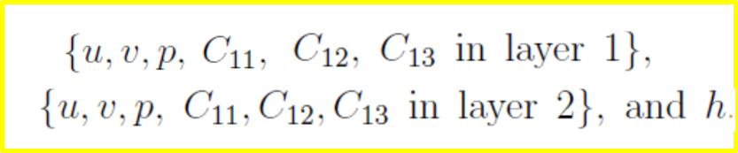
To the base flow, we add small perturbations with wavenumber β in the streamwise direction x, and proportional to exp(σ t).
The 5 interface conditions (continuity of velocity, stresses, and the kinematic free surface condition);
The no slip boundary conditions at the bottom and top plates..
Plus momentum equations, incompressibility, and constitutive equations
define the linearized operators L₁ and L₂ which depend on
Analysis for one-layer yielded flow yields explicit formulas for
Asymptotic analysis of the (stable) discrete spectrum for β -> ∞.
Asymptotic analysis for long waves β -> 0.
Continuous spectrum due to vanishing of the highest derivative in velocity v, two intervals per layer
Continuous spectrum due to vanishing of the coefficient of C_{22,} one interval per layer.
Interfacial eigenvalue is neutral.

Slide 19
Computational results. (Chebyshev collocation method, Orszag 1971,)
(For VCM model with diffusive interface in pressure driven shear banded flow, see Cromer, Cook, McKinley, JNNFM 2011. )
Single layer yielded flow is found to be stable at
=−2.8. This value of α was used to model particulate suspension, and more generally for α close to -3, we see linear stability of single layer yielded flow.
Other VE single layer Couette flows e.g. UCM, JS, have been found to be linearly stable.
We expect linear stability based on what we have seen, read, … do you?

Slide 20
Computational results. (Chebyshev collocation method, Orszag 1971) .
Single layer yielded flow can have unstable discrete bulk modes.
Unstable discrete mode emerges from continuous spectrum at β = 1.8
Discrete modes
Continuous spectrum from C22 eq.
Continuous spectra from
v equation
α For particulate suspensions

Slide 21
The single layer case of :
The growth rate curve for all β reveals an interval of instability.
Stream function of max growth rate β shows symmetry across the centerline
unstable
y
Growth rate Re( σ)
Wavenumber β of the disturbance
x over a wavelength
Bulk instability of single shear rate flow is not found in other VE. Models that we know of...
Notes:
If you seed the flow with a perturbation of wavenumber 3.6, the flow would consist of the base flow plus a traveling wave perturbation of this type. The velocity is going in the direction of the streamlineslines.

Slide 22
Single layer: There can be many unstable modes.
α=5 ( wormlike micellar solutions). Single layer yielded flow is unstable to many discrete modes which emerge from the `continuous spectrum’ for small β.
N=20,30 Chebyshev functions for smooth eigenfunctions.
This is a pair of modes with same Re(σ).
Growth rate Re( σ)
N>>300 improves the approximation of these continuous spectra and they are actually stable.
N=200, 300, and more needed.
Wavenumber β

Slide 23
Stability of shear banded (two –layer) flow can have an interfacial instability.
α=-2.8 (particulate suspensions), has long wave and finite wavenumber interfacial instabilities at any interface positions l₁
Stream function contours of max growth rate, β = 5.6
Base flow
l₁=0.7

Slide 24
Shear banded flow α =5 (wormlike micellar solution)
β = 6.8 bulk
Growth rate Re( σ)
β
β = 1.2 interfacial mode
Base flow
l₁=0.5

Slide 25
Both PECN and JS models have the first normal stress difference higher in the yielded phase. What if it is lower? We change to a more strongly shear thinning model by changing ψ
Steady solutions
Altered model: N1 is lower in the yielded phase
Magnification of long wave interfacial instability
A discrete Bulk Mode is born
Shortwave Interfacial mode
Growth rate Re( σ)
β
β

Slide 26
An unusual result is that the single layer yielded flow can have discrete unstable bulk modes.
Summary
Prior work on the PECN model suggests values for the material parameter α roughly -2.8 and -1 (particulate suspensions), and 5 (wormlike micellar solutions).
The shear banded flows are unstable. An interfacial mode for -2.8. Interfacial and bulk mode instabilities for -1 and 5.
Interfacial instabilities are driven by a jump in N1 between the base flows at the interface. We changed the PEC model to reverse the sign of the jump. We still find instabilities, so whether the yielded flow has the higher N1 or lower N1, there are interfacial instabilities.
Question?

