Slide 1
CHANDLER: A New Technology for Surface-level Reactor Neutrino Detection
Jonathan Link
Center for Neutrino Physics, Virginia Tech
IHEP Beijing Seminar
December 16, 2016

Slide 2
Talk Outline
Motivation ‒ Why do we need better reactor neutrino detectors?
Technological Foundations ‒ Where do these ideas come from?
The CHANDLER Technology ‒ The basics idea
Detector R&D ‒ What we have learned so far
CHANDLER and SoLid ‒ A sterile neutrino search

Slide 3
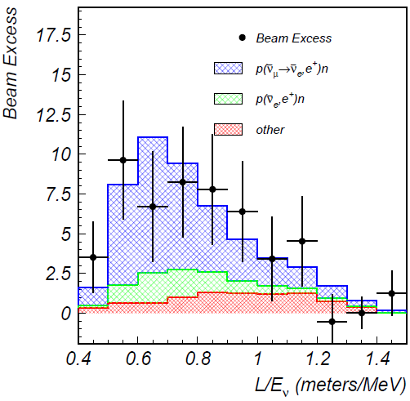
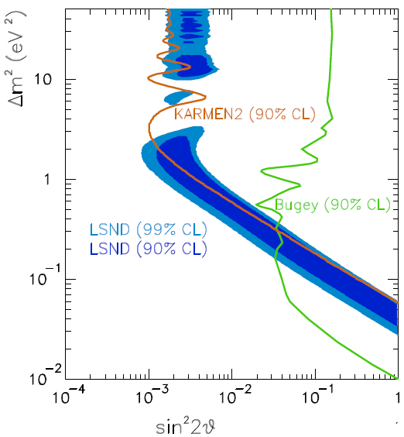
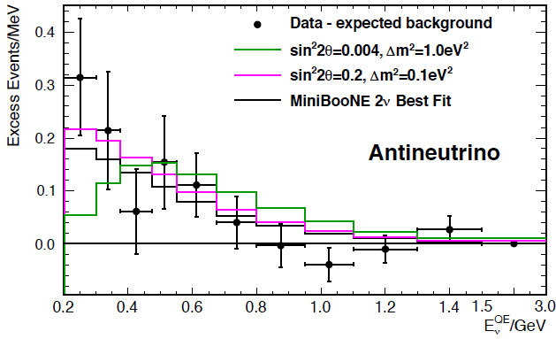
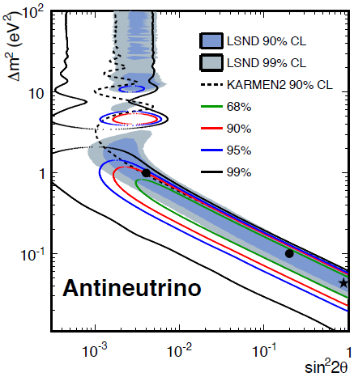
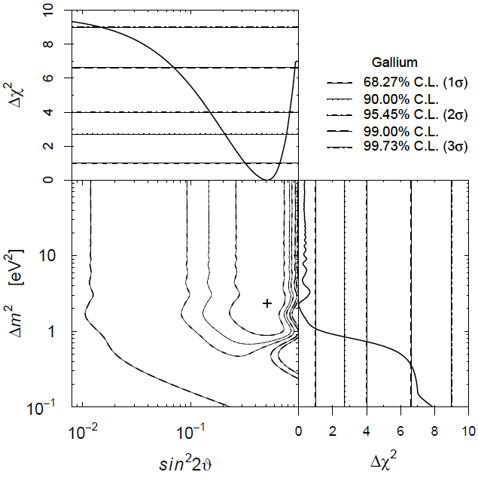
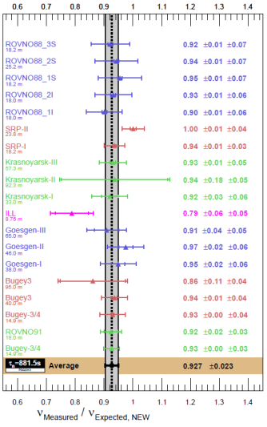
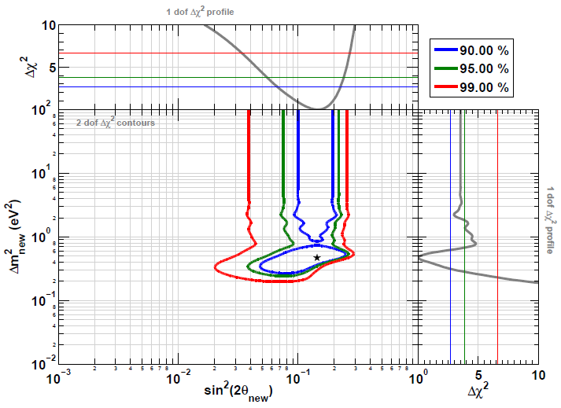
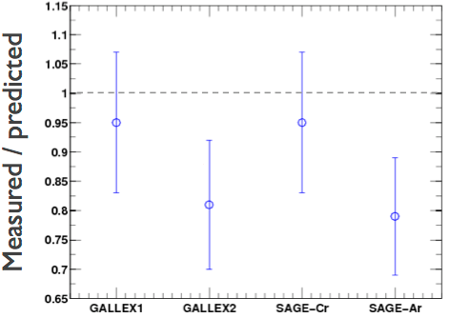




The Evidence for Sterile Neutrinos
LSND (${\overline{ν}}_{μ}→{\overline{ν}}_{e}$)
MiniBooNE (${\overline{ν}}_{μ}→{\overline{ν}}_{e}$)
Event Excess:
32.2 ± 9.4 ± 2.3
Event Excess: 78.4 ± 28.5
Aguilar-Arevalo et al., Phys.Rev.D64, 112007 (2001)
Aguilar-Arevalo et al., Phys.Rev.Lett. 110, 161801 (2013)
Gallium Anomaly ($ν_{e} Disappearance$)
Reactor Anomaly (${\overline{ν}}_{e}$ Disappearance)
Giunti and Laveder, Phys.Rev.C83, 065504(2011)
Mention et al., Phys.Rev.D83 073006 (2011)

Slide 4
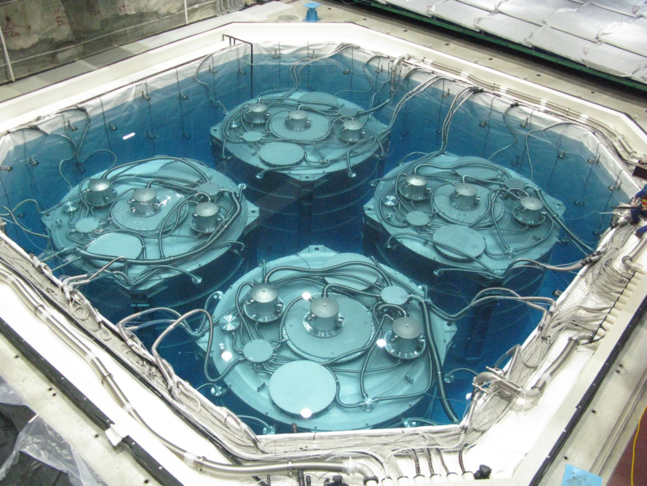
Reactor Experiments
In the Daya Bay reactor experiment the mixing amplitude, sin²2θ₁₃ has been measured to an absolute precision of 0.5%.
Extraordinary measures were taken to control backgrounds: deep underground detectors are imbedded in two meters of low-activity water shielding instrumented as a muon detector.
Short-baseline reactor experiments must be done at the surface, with limited space for shielding.
The Daya Bay Far Detectors
In Daya Bay the oscillation was initially detected as a deficit in detectors at the far site relative to detectors nearer to the reactor cores.
In order to demonstrate the existence of sterile neutrinos, short-baseline reactor experiments must detect the oscillatory pattern as a function of energy and distance in one or more detectors located at baselines of 5 to 15 meters from a reactor core.

Slide 5
Keys to a Short-Baseline Reactor Experiment
Sensitivity to the higher Δm² range (2 eV² and above) requires a compact reactor core and good energy resolution.
Relatively small detectors require careful consideration of isotope used for neutron capture and tagging.

Slide 6
Neutron Capture Options
Daya Bay, RENO and Double Chooz tag neutrons by Gd capture. All three experiments use a large gamma catcher, outside the Gd-doped volume to contain the gammas.
This will not work well in the much smaller short-baseline detectors.
Neutron Capture on Gadolinium
Neutron Capture on Lithium-6
γ
n
n
⁴He
γ
γ
⁶Li
Gd
E = 4.78 MeV
Electron Equivalent
E ~ 0.5 MeV
(in organic scintillator)
E = 8 MeV
³H
γ
γ
Poorly contained in small detectors
Contained in a few micrometers

Slide 7
Keys to a Short-Baseline Reactor Experiment
Sensitivity to the higher Δm² range (2 eV² and above) requires a compact reactor core and good energy resolution.
Relatively small detectors require careful consideration of isotope used for neutron capture and tagging.
Backgrounds, particularly from random coincidences are the most significant challenge.
  Random coincident backgrounds can be reduced by:
  Reducing background rates (shielding)
  Improving signal pattern recognition, and
  Tightening coincidence criteria in space and time

Slide 8
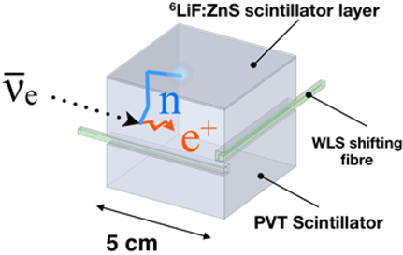
SoLid: Tagging with ⁶Li in ZnS:Ag Sheets
The SoLid detector tags neutrons in thin sheets of ⁶Li-loaded, silver activated zinc sulfide scintillator:
6LiF:ZnS(Ag).
ZnS(Ag) releases light with a 200 ns mean emission time which forms a very pure, high efficiency neutron tag.
SoLid achieves unprecedented spatial resolution by segmenting its scintillator in cubes which are readout in two dimensions by wavelength shifting fibers.
The fiber readout is inefficient at light collection and limits the energy resolution.

Slide 9
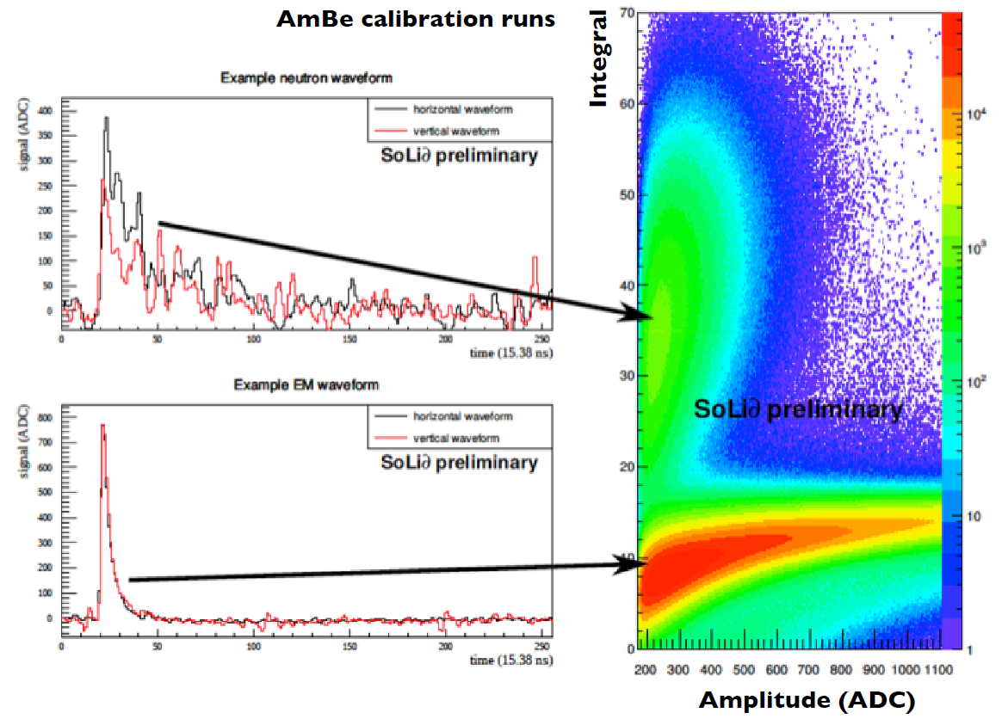
The SoLid Signal

Slide 10

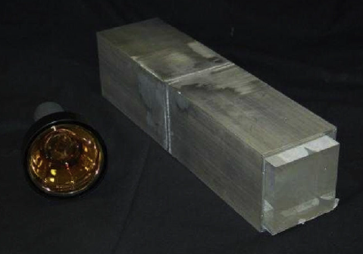
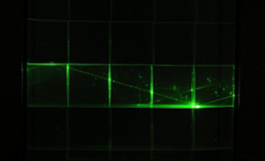
Technological Convergence
LENS
Sweany et al., NIMA 769, 37
The Raghavan Optical Lattice (ROL), invented by the late Virginia Tech professor, Raju Ragahvan, divides a totally active volume into cubical cells that are read-out by total internal reflection. LENS was designed for solar neutrino detection and not optimized for reactor antineutrino detection.
Optically isolated cubes, mated to ⁶LiF:ZnS(Ag) sheets, are used to tag IBD. Light is read-out by wavelength shifting fibers in orthogonal directions. It has the spatial resolution of the ROL optimized for reactor antineutrino detection. The small cross-sectional area of the fibers limits the light collection, dilutes the energy resolution and lowers the efficiency.
Used ⁶LiF:ZnS(Ag) sheets mated to a solid bar of wavelength-shifting plastic scintillator. This prototype demonstrated the feasibility of pairing the sheets to wavelength shifting plastic, but the long bars do not have the spatial resolution required for good background rejection
CHANDLER
Carbon Hydrogen Anti-Neutrino Detector with a Lithium Enhanced ROL

Slide 11

The CHANDLER Detector
$${\overline{ν}}_{e}$$
e⁺
Neutron
Capture
p
Positron (e⁺)
n
Detected Light
⁴He
⁶Li
³H
Time
10 ns
~50 μs
200 ns

Slide 12
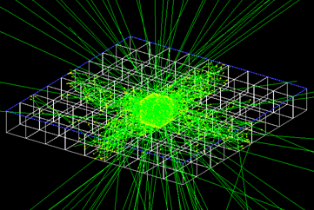
The CHANDLER Detector
CHANDLER will be constructed of cubes (6×6×6 cm³) of wavelength-shifting plastic scintillator arrayed in planes, between sheets of ⁶Li-loaded ZnS(Ag) for neutron tagging.
The light is transported by total-internal-reflection
and readout on the surface by PMTs
Photon Ray Tracing in GEANT4

Slide 13
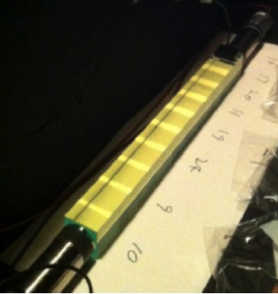
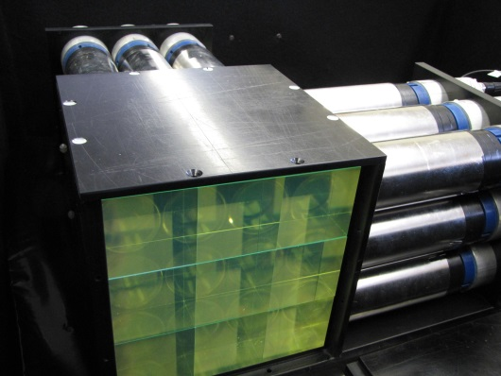
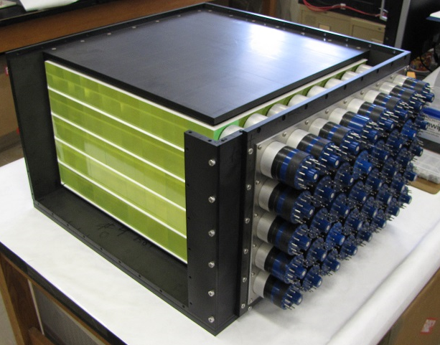
Research and Development Effort
Cube String Studies have been used to study light production, light collection, light attenuation, energy resolution and wavelength shifter concentration.
MicroCHANDLER is a 3×3×3 prototype which we are using to test our full electronics chain, develop the data acquisition system, study neutron capture identification and measure background rates.
MiniCHANDLER is a full systems test (8×8×5) which is currently commissioned and will be deployed at the North Anna Nuclear Power Plant early next year.

Slide 14
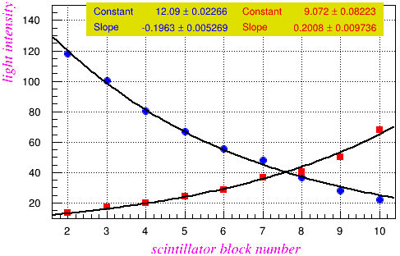
Effective Attenuation Length Study
LED Flasher
PMT1
PMT2
Cube: 1 2 3 4 5 6 7 8 9 10
Average Effective Attenuation Length λ = 31.3 cm
Data
There are two contributions to the effective attenuation:
  Bulk attenuation in the PVT and
  Fresnel reflection at the cube interfaces.

Slide 15
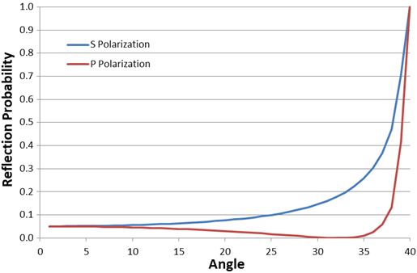
Optics of the Raghavan Optical Lattice
Fresnel Reflections
The optics are based on the interface of PVT (n=1.58) and air (n=1).
The critical angle (θ_{c}) is 39.27°
The Brewster angle is 32.22°
Because θ_{c} < 45° any light capable of passing between cubes will necessarily fall into the total-internal-reflection (TIR) channel in that direction.
Brewster Angle
Critical Angle
Each of the four TIR channels is open to 11.3% of the light produced in a cube.
Therefore 54.8% of all light can not be channeled.
Some channeled light that gets reflected off of a cube surface perpendicular to the channel direction will reach the PMT in the opposite direction.

Slide 16
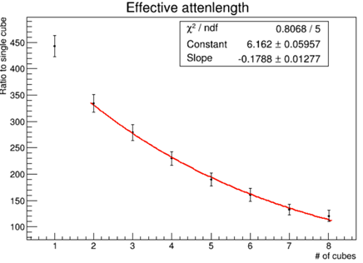
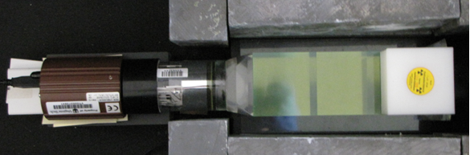
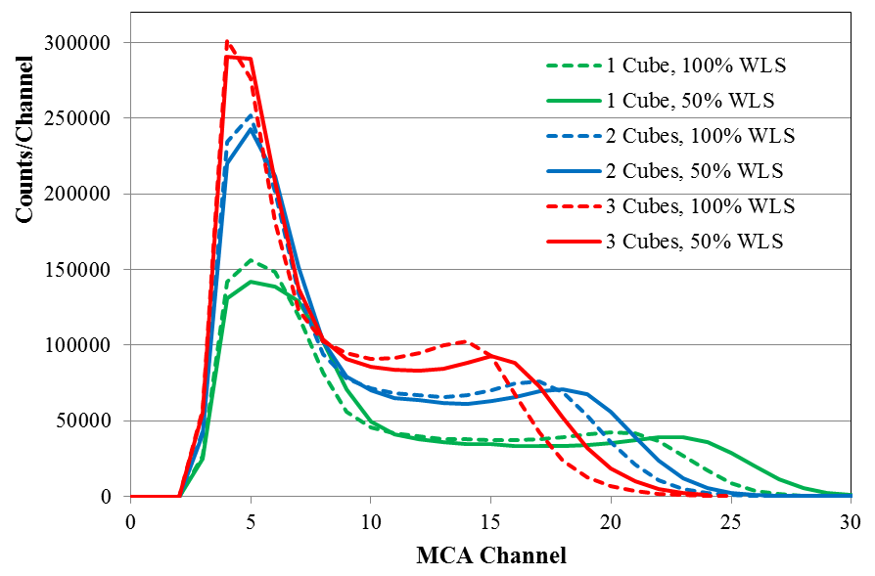
Wavelength Shifter Concentration
The wavelength shifter (WLS) dopant can be a significant source of attenuation.
Effective Attenuation Length for 50% WLS Concentration
The Compton edge of ²²Na was used to study the relative light output.
²²Na (E_{γ} of 511 and 1274 keV)
  λ = 34.7 cm
Halving the WLS concentration increases the attenuation length by 10%.
The light collection with lower WLS is greater at each position.
We have plans to study even lower WLS concentrations.

Slide 17
Light Output and Collection
An LED flasher was used to determine the resolution as a function of MCA channel.
The ²²Na Compton edge is at 1.06 MeV, and at two cubes from the PMT it reconstructs at channel 20, which corresponds to an energy resolution of 6.5%.

Slide 18
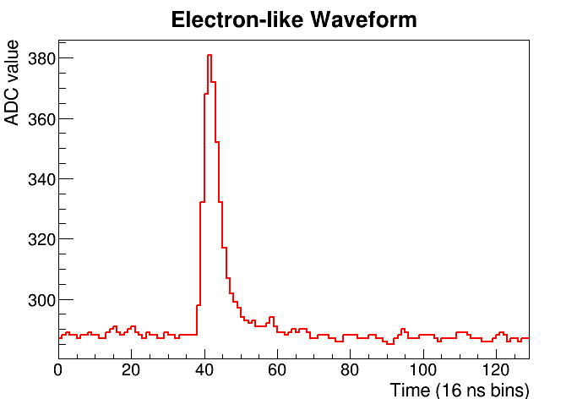
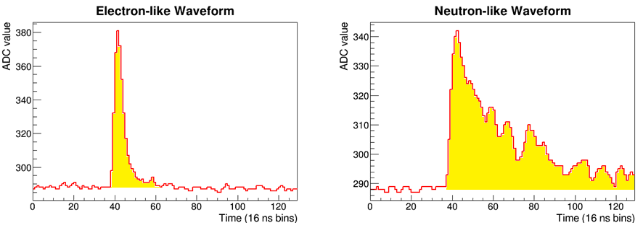
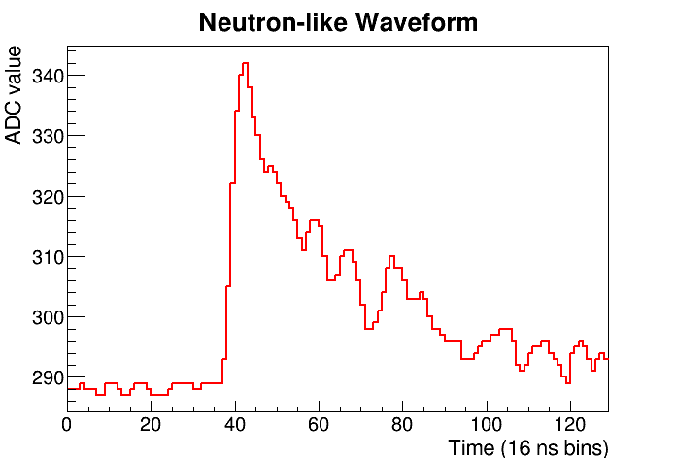
Neutron Identification in MicroCHANDLER
The 18-channel MicroCHANDLER prototype is idea for testing neutron tagging.
The positron signal (formed in the cubes) is of short duration,
While the neutron signal arrives over a much longer time.
For each hit cell, we compute a simple neutron ID variable as the ratio of the integral of the pulse to the pulse height.

Slide 19
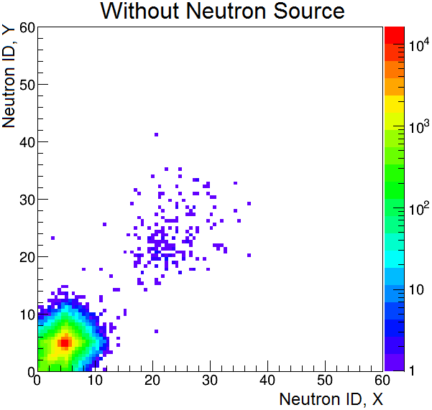
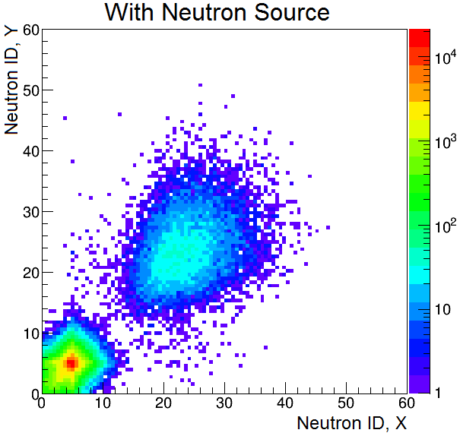
Neutron Identification in MicroCHANDLER
Then we plot the neutron ID from the x-view vs. the neutron ID from the y-view
When the source is removed the events in the neutron region mostly go away.
The neutrons candidates that remain are consistent with the cosmic ray flux.

Slide 20
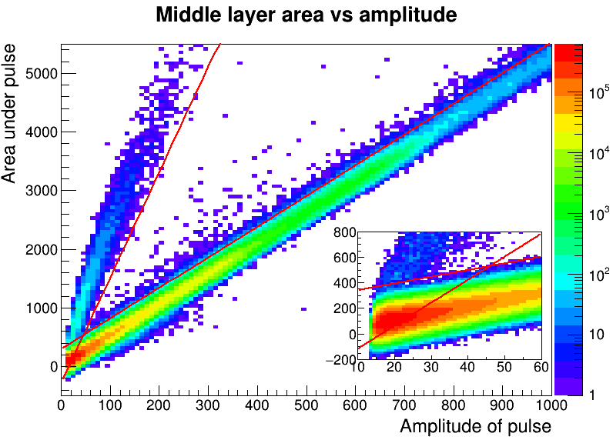
Improved Neutron Selection
The different classes of events clearly separated into distinct bands.
In the overlap region positron-like events out number the neutron candidates.
So good neutrons candidates must be above both red lines.
Is there any way to recover the neutrons in the overlap region?
Neutron-like
Positron/gamma-like

Slide 21
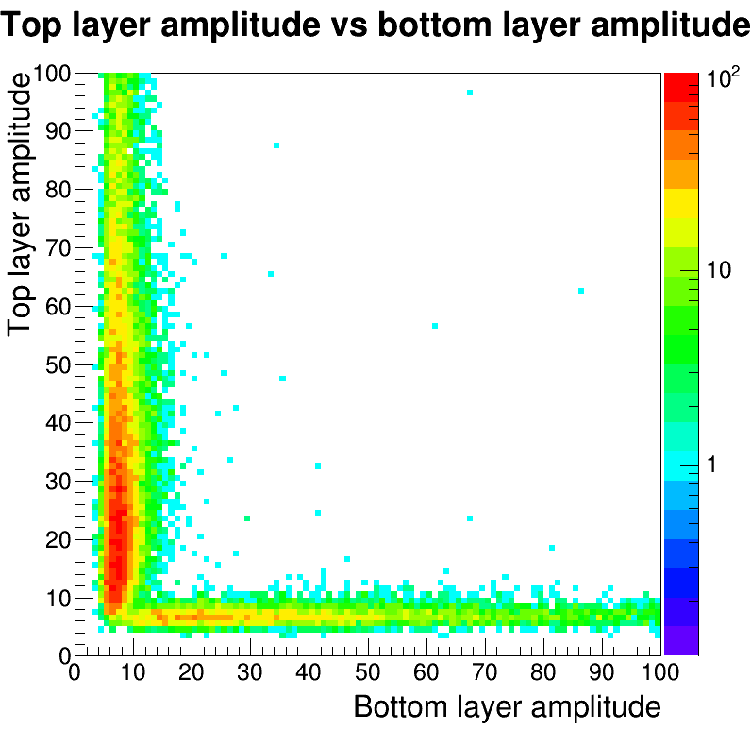
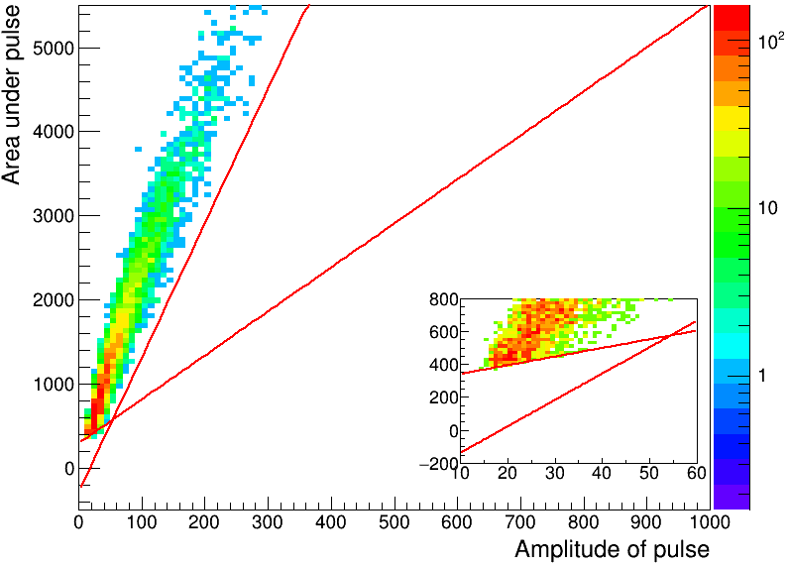
Improved Neutron Selection
In CHANDLER we can see neutron capture light on both sides of the sheet.
We use this to determine which sheet captured the neutron.
Starting with good neutrons tagged in the middle layer, we look for neutron-like light in the top and bottom layers.
The sheet is determined by the layer with the larger amplitude.
Neutron Source

Slide 22
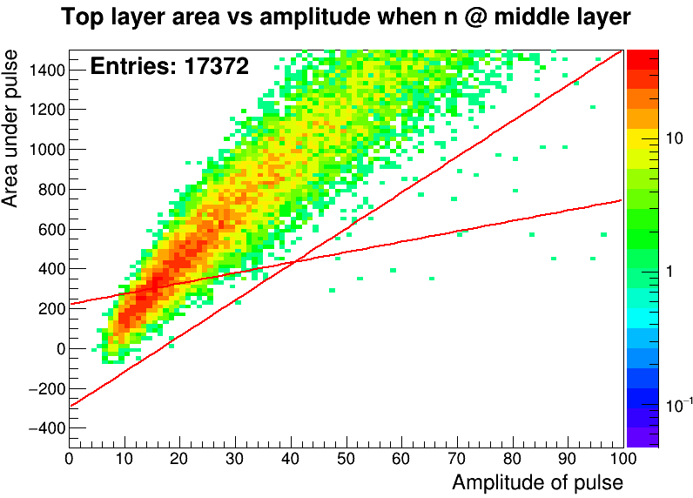
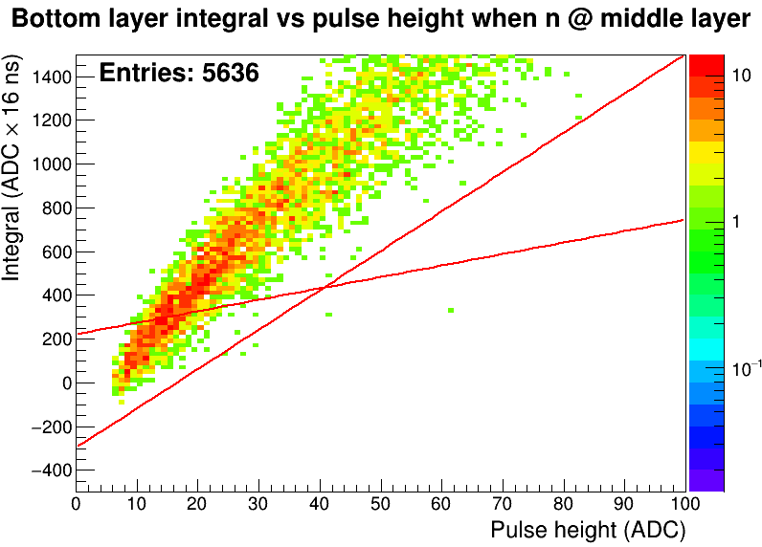
Improved Neutron Selection
Looking at good middle layer neutrons in the top/bottom layer shows the neutron band extending into the overlap region without a hint of contamination from the positron/gamma band.
Middle/Top
Middle/Bottom
Requiring the neutron to be above the red lines on a single layer recovers most neutrons.
The light in the adjacent layers is used to discriminate between the two sheets.

Slide 23
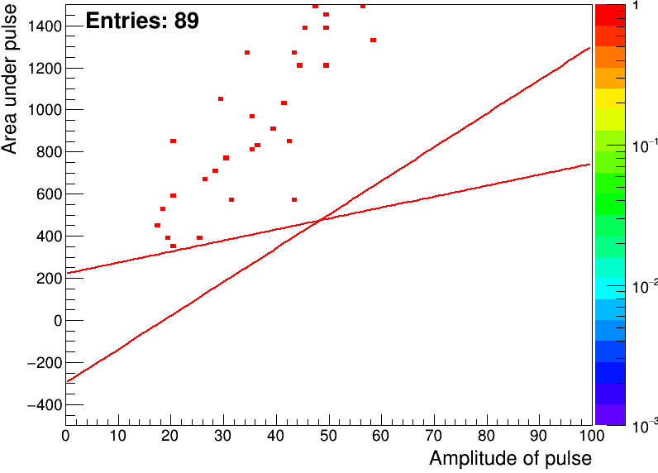
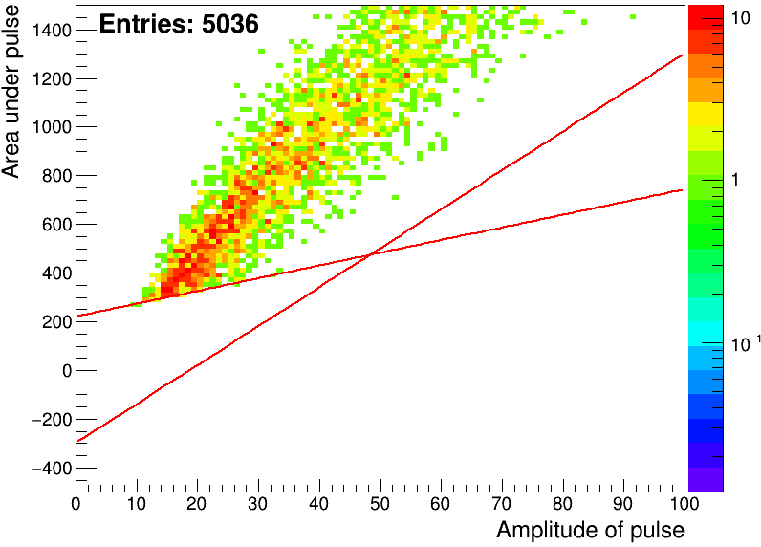
Neutron Misidentification
To study neutron misidentification we removed the lithium from one of the sheets.
With cosmogenic neutrons candidates, less than 1 in 50 comes from the ⁶Li-free sheet, therefore fake neutrons are a tiny fraction of the cosmic neutron background.
1.7% of events h
98.3% of events
⁶Li-free sheet
⁶Li sheet
Notes:
89/5638 = 0.0158, 5036/5638=0.8932

Slide 24
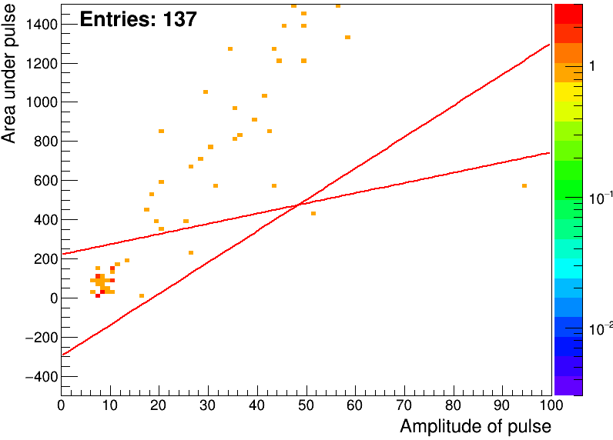
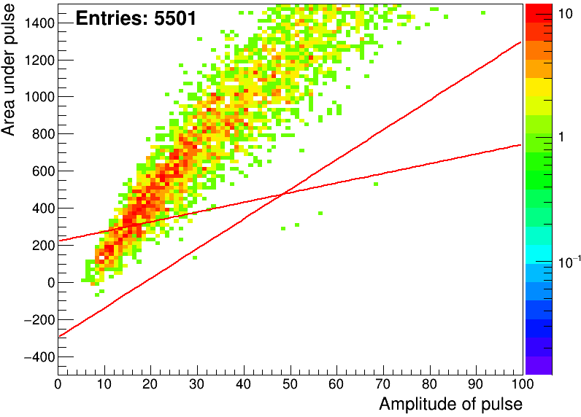
Neutron Misidentification
To study neutron misidentification we removed the lithium from one of the sheets.
With cosmogenic neutrons candidates, less than 1 in 50 comes from the ⁶Li-free sheet, therefore fake neutrons are a tiny fraction of the cosmic neutron background.
In the overlap region of above the ⁶Li sheet we see a collection of events, where the sheet determination was incorrect due to insufficient light on either side.
It represents less than 1% of all events.
2.4% of events h
97.6% of events
1.6% of events
89.3% of events
⁶Li-free sheet
⁶Li-free sheet
⁶Li-free sheet
⁶Li sheet
⁶Li sheet
⁶Li sheet
28 events
Notes:
89/5638 = 0.0158, 5036/5638=0.8932

Slide 25
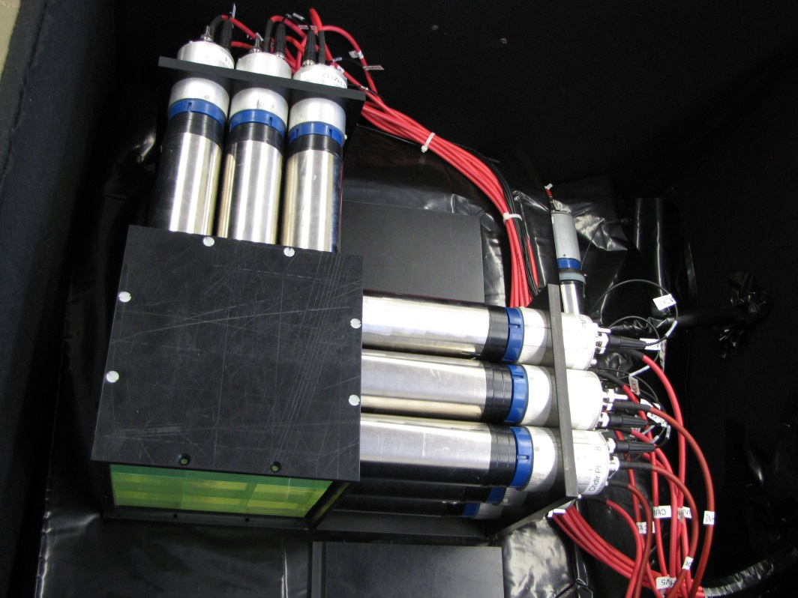
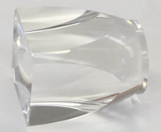
Design Studies with MicroCHANDLER
The first MicroCHANDLER prototype was built with $5,000 as a preliminary feasibility study.
It used old PMTs found in the basement.
It was not designed to be light tight.
It had no light guide to match the 62 mm
cube to the 51 mm PMT
For the full-scale detector we intend to use
High Q.E. PMTs with good linearity over a
Wide range (Hamamatsu R6231-100),
A light tight mechanical structure, and
A compound parabolic light guide which boosts the
light collection by 64%.

Slide 26
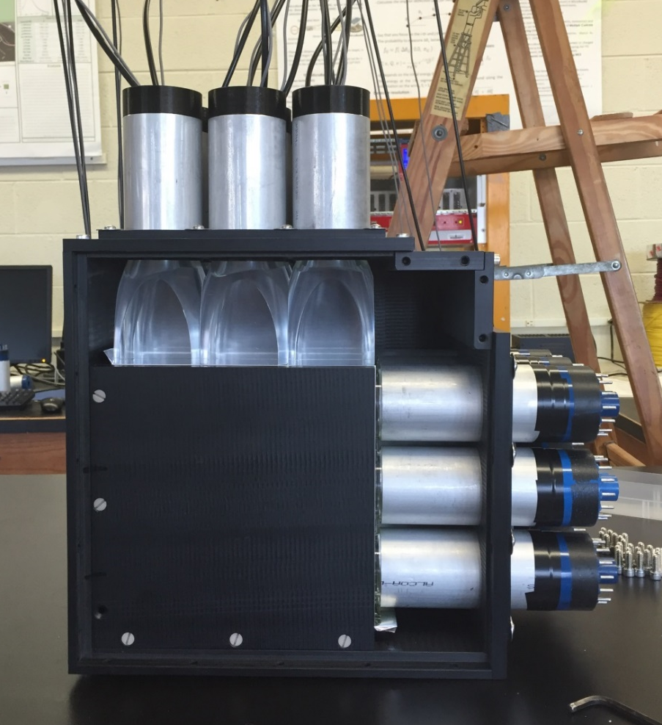
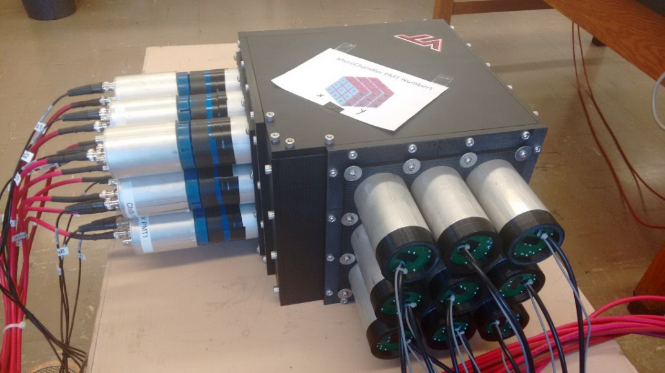
Design Studies with MicroCHANDLER
We built a new MicroCHANDLER with a fully engineered mechanical structure.
Half of the PMTs in the new design are Hamamatsu R6231-100 with acrylic light guides.
MicroCHANDLER was used to test the
mechanical structure concept for the
MiniCHANDLER detector.

Slide 27
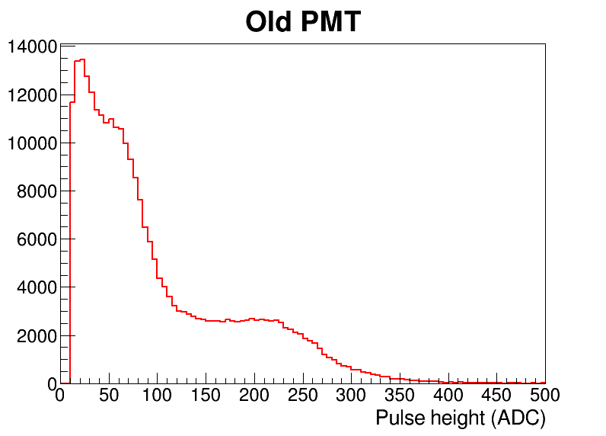
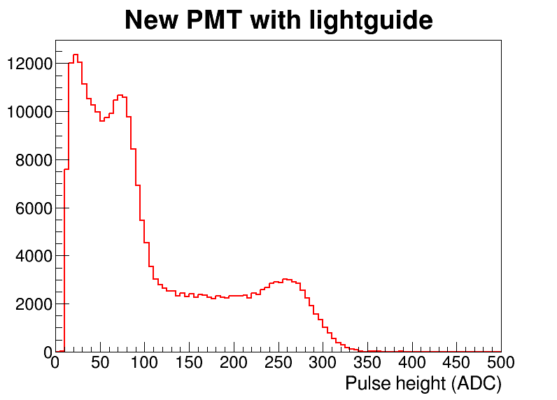
Gamma Study in the New MicroCHANDLER
Using a ²²Na source, we studied the detector resolution with new tubes and light guides:
The new light collection results in a significant improvement in energy resolution.
Compton edge for 511 keV gamma
Compton edge for 511 keV gamma
Compton edge for
1.27 MeV gamma
Compton edge for
1.27 MeV gamma

Slide 28
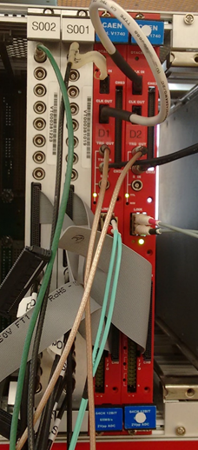
CHANDLER Electronics
Shaper
Board
We’re using a CAEN V1740 waveform digitizer:
  64 channels per board
  Samples every 16 ns
  12 bit digitizer
The digitizer is feed by a custom amplifier/shaper
16 channels per board
2× gain
Shapes the PMT signal in 25 ns
This combination takes advantage of the huge difference in scintillator time scales to minimize the sampling rate, while maximizing the energy resolution.
Digitizer

Slide 29
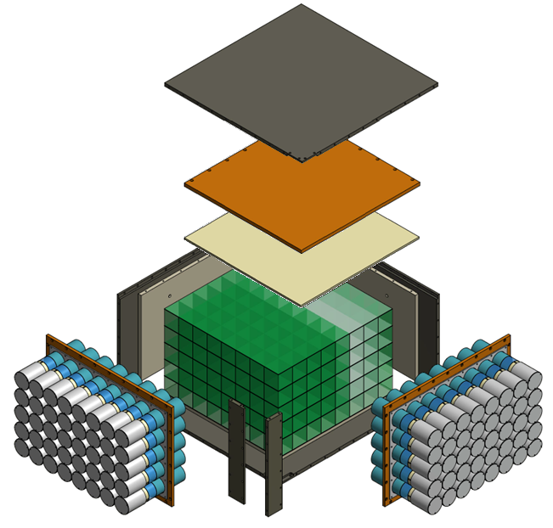
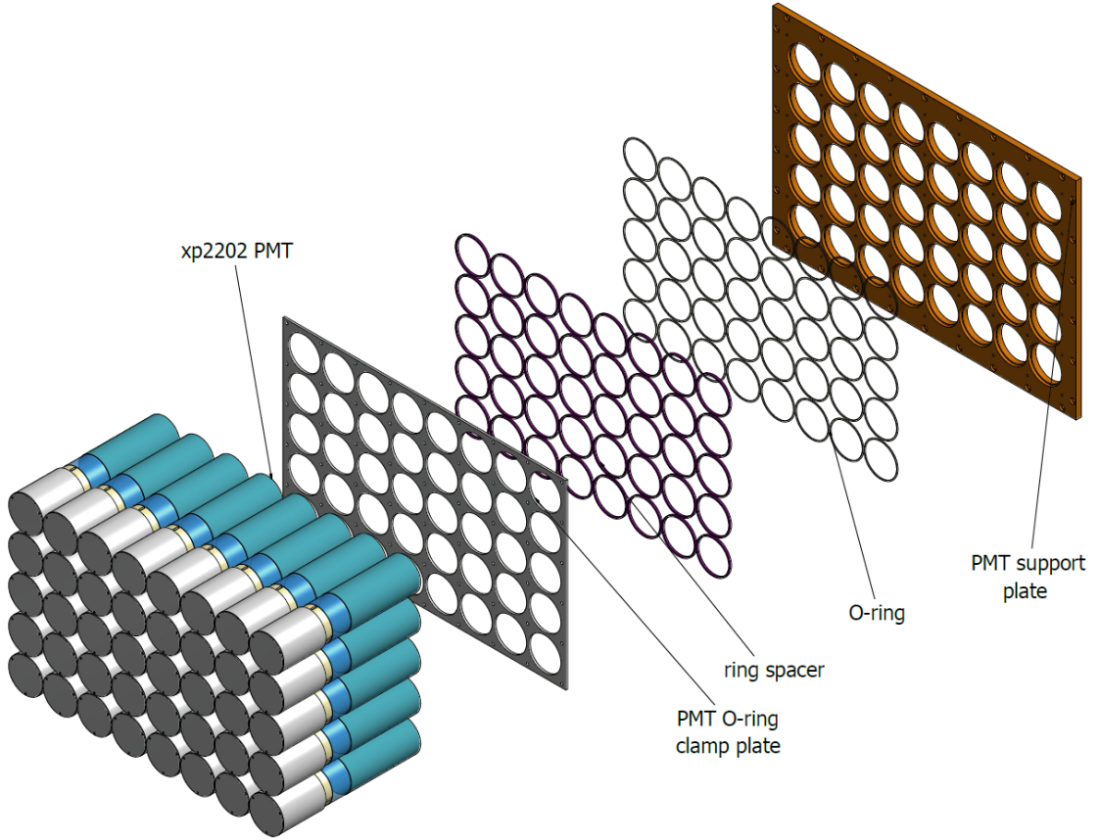
MiniCHANDLER Mechanical Structure
The MiniCHANDLER mechanical structure uses rubber o-rings, aluminum spacers and clamp plate to provide a light tight seal around each PMT.
The result is a light tight box that supports each PMT centered on its cube row or column.

Slide 30
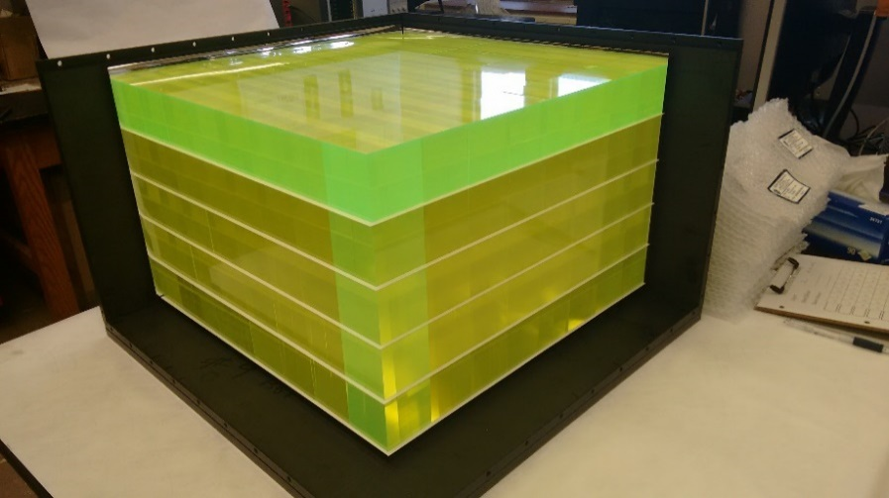
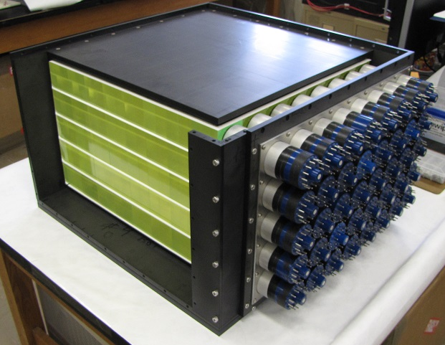
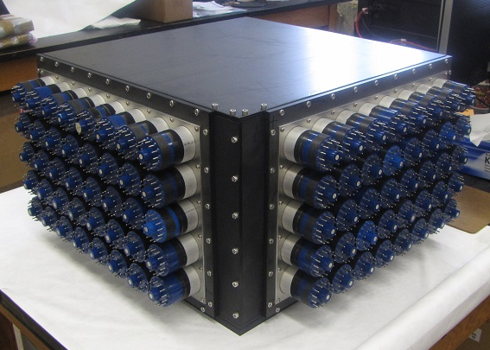
MiniCHANDLER Mechanical Structure
The 80 channel MiniCHANDLER detector is now fully assembled and is being commissioned

Slide 31
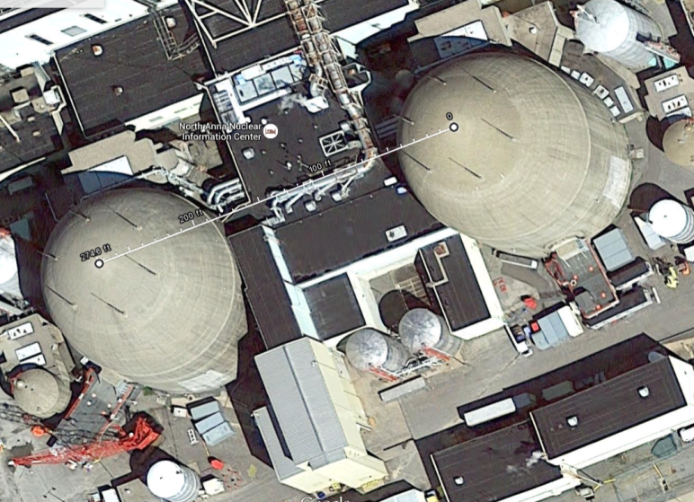
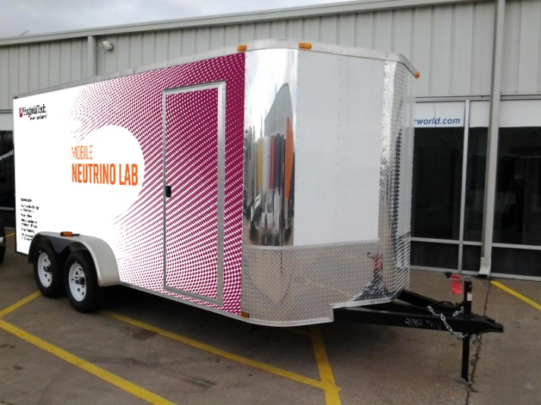
Next Steps in R&D Program…
Once commissioned, the MiniCHANDLER Detector will be deployed that the North Anna Nuclear Power Station.
We expect about 100 observed events/day. If successful, this will be the world’s smallest neutrino detector at 80 kg.

Slide 32


GEANT4: Detector Response vs. Cube Position
Simulation
Most of the light is collected in the 4 PMTs in the TIR channel directions.
About 20% of light is unchanneled, with the largest share in the adjacent PMTs.
Collected light falls off as you move away from the PMT.
Simulation
The largest excursion from the mean is in the corner cells.
The conversion to p.e./MeV assumes light guides, and a PMT maximum quantum efficiency of 25%.

Slide 33


MCNP6: Neutron Transport and Capture
 | ⁶Li Capture | Time to 90% Capture | Volume for 90% Capture
Full Cube, 350 μm Sheet | 51% | 229 μs | 37 cubes
Full Cube, 500 μm Sheet | 55% | 209 μs | 35 cubes
Half Cube, 350 μm Sheet | 69% | 120 μs | 24.5 cubes
Half Cube, 500 μm Sheet | 73% | 103 μs | 23 cubes

Slide 34

MCNP6: Neutron Transport and Capture
 | ⁶Li Capture | Time to 90% Capture | Volume for 90% Capture
Full Cube, 350 μm Sheet | 51% | 229 μs | 37 cubes
Full Cube, 500 μm Sheet | 55% | 209 μs | 35 cubes
Half Cube, 350 μm Sheet | 69% | 120 μs | 24.5 cubes
Half Cube, 500 μm Sheet | 73% | 103 μs | 23 cubes
The initial neutron directionality is apparent in the capture position.
GEANT4

Slide 35

Full CHANDLER
PMT & Base
PVT Cube
Light Guide
~1 meter
Direction of Neutrino Flux
⁶LiF:ZnS(Ag) Sheet
1 ton detector
16×16×16 cubes

Slide 36

CHANDLER and SoLid
The two detectors will be deployed at the BR2 reactor operating as a single experiment.
50 cm
BR2
CHANDLER
5.5 m
SoLid

Slide 37


The BR2 Reactor
The 60 MW BR2 reactor is a facility at the Belgian National Nuclear Lab, SCK•CEN.
With a 5.5 meter closet approach this site has the highest reactor antineutrino flux of any publically knowable compact reactor site.
The absence of any beam portals makes for a relatively low-background site with backgrounds dominated by the typical environmental sources.

Slide 38

SoLid at the BR2 Reactor in Belgium
150 Days of Reactor on

Slide 39

SoLid at the BR2 Reactor in Belgium
450 Days of Reactor on

Slide 40

SoLid and CHANDLER Sensitivity
The combined sensitivity for the SoLid/CHANDLER deployment at BR2 is compared to the Gallium and Reactor Anomalies.
The one-year, Phase I SoLid deployment covers most of the low Δm² part of the Gallium Anomaly at 95% CL.
Adding CHANDLER to the three-year Phase II extends the coverage to higher Δm² and pushes the reach well into the Reactor Anomaly.
These sensitivities are purely oscillometric, based on energy spectrum and baseline information alone.
Oscillometric Sensitivity Only

Slide 41

Conclusions
The CHANDLER Detector is a new technology for precision surface-level reactor neutrino detection.
CHANDLER uses wavelength shifting plastic scintillator cubes and ⁶Li-loaded ZnS sheets to detect IBD events.
The detector is readout by a Raghavan optical lattice in which light is collected by total internal reflection.
The high light yield, high spatial resolution and pure neutron tag make this an ideal technology for the high background surface environment.
Together CHANDLER and SoLid cover most of the ${\overline{\text{ν}}}_{e}$ disappearance allowed space.

Slide 43


Sterile Neutrinos
A sterile neutrino is a lepton with no ordinary electroweak interaction except those induced by mixing.
Active neutrinos:
LEP Invisible Z⁰ Width is consistent with only three light active neutrinos
Phys.Rept. 427, 257 (2006)
Notes:
Sterile neutrinos are present in most extensions of the standard model and in principle can have any mass. Very heavy sterile neutrinos are used in the minimal type I seesaw model and play a pivotal role in leptogensis.
Of course this is not the sterile neutrino we’re talking about here. Such a heavy sterile neutrino would not mix with the light active flavors. Somewhat more complex models can be constructed to include sterile neutrinos.

Slide 44





The Neutrino Oscillation Data
The data for the three neutrino mixing model is nearly complete and extraordinarily self-consistent:
(θ₁₂, θ₂₃, θ₁₃, ${∆m }_{21}^{2}$, ${∆m }_{31}^{2}$, and ${∆m }_{32}^{2}$ are measured, δ_{CP} unknown)
ν₃
mass²
${∆m }_{32}^{2}$ $≈{∆m }_{31}^{2}$
= 2.5×10⁻³ eV²
ν₂
ν₁
$${∆m }_{21}^{2}$$
= 7.6×10⁻⁵ eV²

Slide 45


The Laurels Have Already Been Handed Out…
2016 Breakthrough Prize in Fundamental Physics:
To the members of the Super-K, SNO KamLAND, Daya Bay, K2K and T2K Collaborations.
2015 Nobel Prize in Physics:
Takaaki Kajita of Super-K and
Arthur B. McDonald of SNO

Slide 46


The Neutrino Oscillation Data
The data for the three neutrino mixing model is nearly complete and extraordinarily self-consistent:
(θ₁₂, θ₂₃, θ₁₃, ${∆m }_{21}^{2}$, ${∆m }_{31}^{2}$, and ${∆m }_{32}^{2}$ are measured, δ_{CP} unknown)
ν₃
mass²
${∆m }_{32}^{2}$ $≈{∆m }_{31}^{2}$
= 2.5×10⁻³ eV²
ν₂
ν₁
$${∆m }_{21}^{2}$$
= 7.6×10⁻⁵ eV²
${∆m }_{}^{2}\sim 1$eV² does not fit the three neutrino model

Slide 47

The LSND Experiment
LSND took data from 1993-98
The full dataset represents nearly 49,000 Coulombs of protons on target.
π⁺→ μ⁺ ν_{μ}
Golden Mode:
ν_{e} p→ e⁺ n
Stopped Pion Beam
e⁺ ν_{μ}ν_{e}
Inverse β-decay
Baseline: 30 m
Energy range: 20 to 55 MeV
L/E ~ 1 m/MeV
LSND’s Signature
Scintillation
Čerenkov
2.2 MeV neutron capture

Slide 48
LSND ν_{μ}→ ν_{e} Appearance
Aguilar-Arevalo et al., Phys.Rev. D64, 112007 (2001)
Event Excess: 32.2 ± 9.4 ± 2.3

Slide 49


MiniBooNE ν_{μ}→ ν_{e} Appearance Search
MiniBooNE used a π⁺ (π⁻) decay in flight beam and a liquid Cherenkov detector to search for $ν_{e} ({\overline{ν}}_{e})$ appearance in a $ν_{μ} ({\overline{ν}}_{μ})$ beam
Baseline ~ 500 m
$\left\langle E_{ν}\right\rangle$ ~ 500 MeV
L/E ~ 1 m/MeV
ν_{μ}→ν_{e}?
Phys.Rev.Lett. 110, 161801 (2013)
Event Excess: 78.4 ± 28.5

Slide 50


MiniBooNE ν_{μ}→ ν_{e} Appearance Search
MiniBooNE used a π⁺ (π⁻) decay in flight beam and a liquid Cherenkov detector to search for $ν_{e} ({\overline{ν}}_{e})$ appearance in a $ν_{μ} ({\overline{ν}}_{μ})$ beam
Baseline ~ 500 m
$\left\langle E_{ν}\right\rangle$ ~ 500 MeV
L/E ~ 1 m/MeV
ν_{μ}→ν_{e}?
Phys.Rev.Lett. 110, 161801 (2013)
Excess? Yes, but it’s not very consistent with LSND
Event Excess: 162.0 ± 47.8

Slide 51

Gallium Anomaly (ν_{e} Disappearance)
The solar radiochemical detectors GALLEX and SAGE used intense electron capture sources (⁵¹Cr and ³⁷Ar) to “calibrate” the ν_{e}⁷¹Ga interaction/detection rate.
A reanalysis, based on new cross section calculations, suggests that were too few events.
Giunti et al., Phys.Rev.D86, 113014 (2012)
Giunti & Laveder, Phys.Rev.C83, 065504 (2011)

Slide 52



Reactor Anomaly (ν_{e} Disappearance)
Recent calculations of the reactor ${\overline{ν}}_{e}$ flux and spectrum predict a higher rate than the earlier calculation. This resulted is an apparent deficit of reactor neutrinos across all experiments.
Mention et al., Phys.Rev.D83 073006 (2011)
Rate only analysis

Slide 53


T2K Near Detector (ν_{e} Disappearance)
Although the T2K beam is predominantly a ν_{μ} beam, the small ν_{e} component can be used in the near detector for a ν_{e} disappearance search.
Phys.Rev. D91, 051102(R) (2015)
ν_{e} Selection
Control
Short-baseline ν_{e} appearance from the much larger ν_{μ} component of the beam could fill in the exact region depleted by ν_{e} disappearance, so ν_{μ}→ ν_{e} is assumed to be zero in this analysis.

Slide 54








Evidence Against the ~1 eV² Sterile Neutrino
KARMEN (${\overline{ν}}_{μ}→{\overline{ν}}_{e}$)
Bugey Reactor (${\overline{ν}}_{e}$ Disappearance)
KARMEN (90% CL)
Effective
${\overline{ν}}_{μ}→{\overline{ν}}_{e}$ under
certain assumptions
No ${\overline{ν}}_{e}$ Excess
Armbruster et al., Phys.Rev.D65 112001 (2002)
Achkar et al., Nucl.Phys.B434, 503 (1995)
MiniBooNE (ν_{μ}→ ν_{e} Appearance)
ν_{μ} Disappearance
(where is it?)
For $ν_{μ}→ν_{e}$ to happen there must be both $ν_{e}$ and $ν_{μ}$ disappearance
Phys.Rev.Lett. 98, 231801 (2007)

Slide 55

Relating Appearance and Disappearance Probabilities
With a single sterile neutrino we get a 4×4 PMNS mixing matrix and 3 independent Δm²s.
ν₄
U_{e4}²
U_{μ4}²
U_{τ4}²
U_{s4}²
+ + + = 1 (PMNS Unitarty)
The appearance probability:
Sterile
Δm₄₃²
P_{μe} =
sin²2θ
sin²(1.27Δm₄₃²L/E)
4U_{e4}² U_{μ4}²
The ν_{e} disappearance probability:
ν₃
P_{ee} = P_{es} + P_{eμ} + P_{eτ}
P_{ee} ≈ P_{es}
= 4U_{e4}² U_{s4}² sin²(1.27Δm₄₃²L/E)
Atmospheric
The ν_{μ} disappearance probability:
Δm₃₂²
ν₂
Solar
P_{μμ} ≈ 4U_{μ4}² U_{s4}² sin²(1.27Δm₄₃²L/E)
ν₁
Δm₂₁²
Notes:
Because P(mu, e) depends on both U(e,4) and U(mu,4), you can have nu_e disappearance without nu_e appearance, but you can’t have nu_e appearance without nu_mu disappearance.

Slide 56


Appearance vs. Disappearance
Since any 4th mass state is predominantly sterile (U_{s4} ≈1),
$$P_{μe}≈\frac{1}{4}P_{ee}×P_{μμ}$$
P_{μe} depends on both U_{e4} and U_{μ4}, so you can have ν_{e} disappearance without ν_{e} appearance, but you can’t have ν_{e} appearance without ν_{μ} disappearance.
The absence of ν_{μ} disappearance is a huge problem for the LSND and MiniBooNE signals, while the ν_{e} disappearance anomalies are consistent with all existing data.
ν_{e} Disappearance ν_{μ}→ν_{e} Appearance ν_{μ} Disappearance
Global fit from Kopp et al. JHEP 1305, 050 (2013)

Slide 57


Requirement for Disappearance Experiments
“It don’t mean a thing if it ain’t got that swing”
–American jazz great Duke Ellington
Definition:
oscillometry, n., The observation and measurement of oscillations.
In disappearance experiments the existence of sterile neutrinos can only be convincingly established through oscillometry.
Daya Bay, arXiv:1505.03456 [hep/ex]
Possible oscillations in a short-baseline reactor experiment

Slide 58

Application to Nuclear Non-Proliferation
Neutrino monitoring has been proposed as a non-invasive verification scheme to be used in nuclear treaties with nations such as Iran and North Korea. This possibility is currently under study by the IAEA and the US Departments of State and Energy.
The basic idea is to look for changes in the neutrino energy spectrum indicative of diversions of weapons grade plutonium.
The main stumbling block to the full embrace of neutrino safeguards has been the inability to demonstrate a viable detector technology.
Safeguards detectors must:
  be portable, reliable and low-cost;
  have good energy resolution;
  and be free of potential hazards such as flammable liquids (this requirement comes from the IAEA).
Huber et al. PRL 113, 042503

