Slide 1
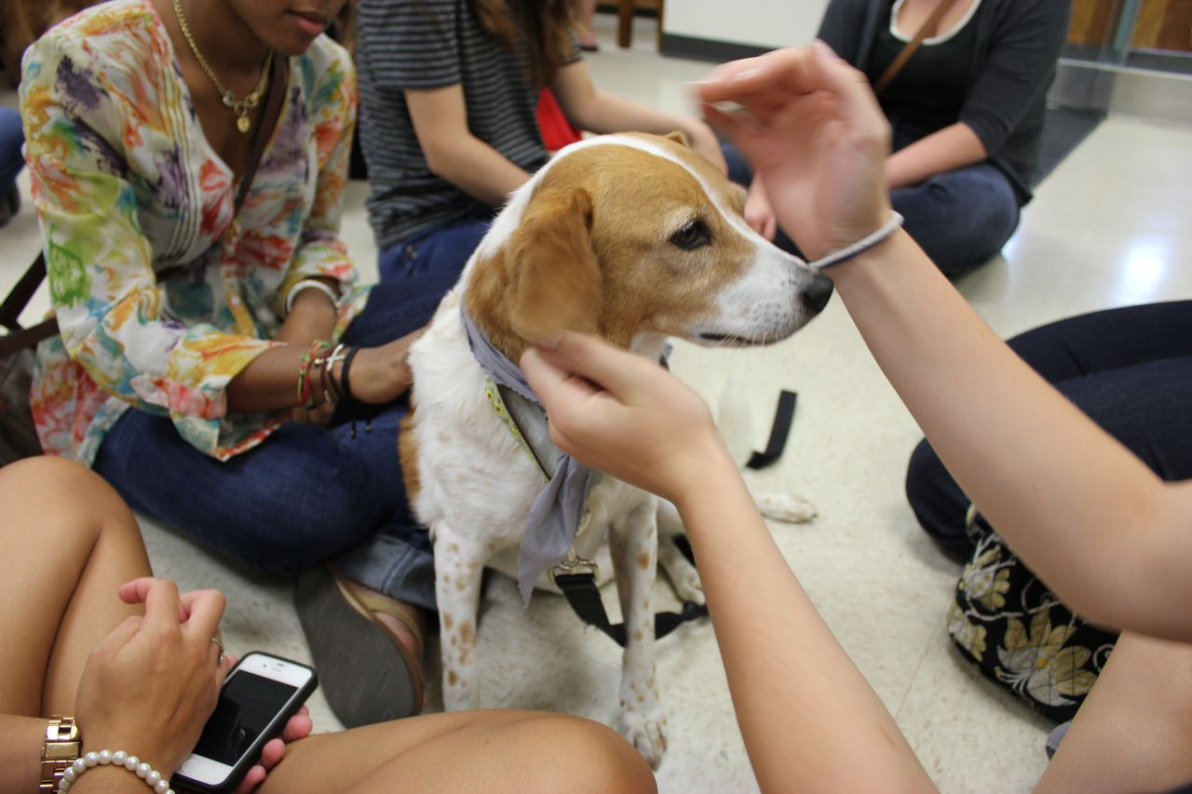
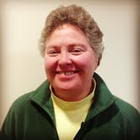
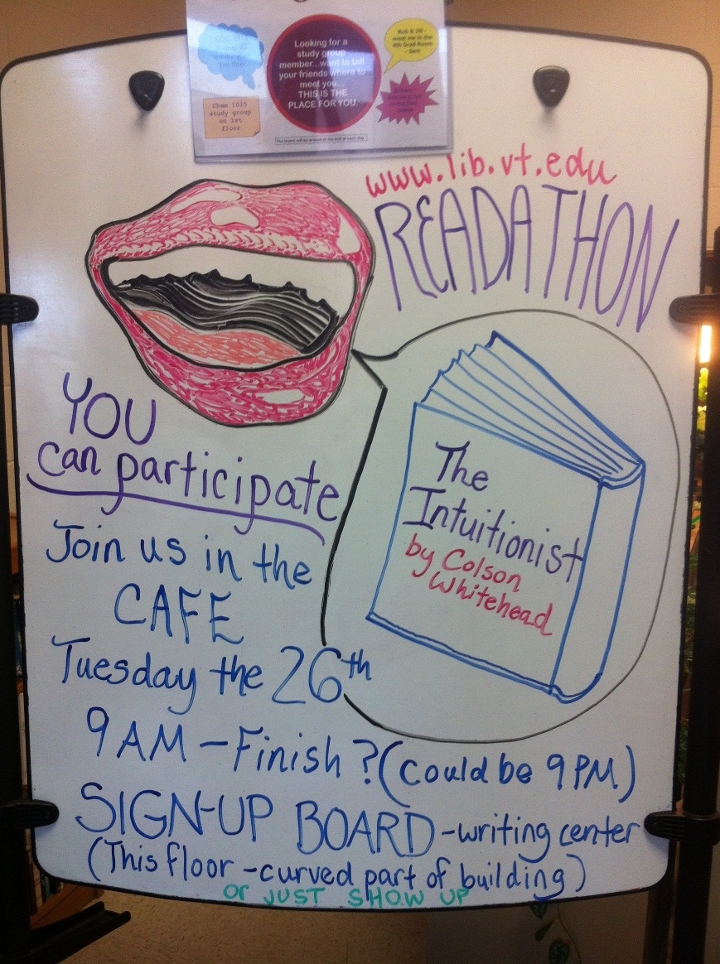
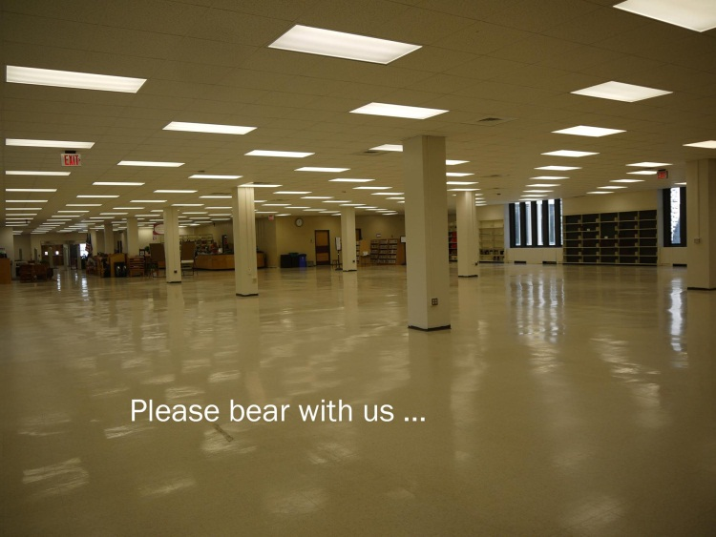
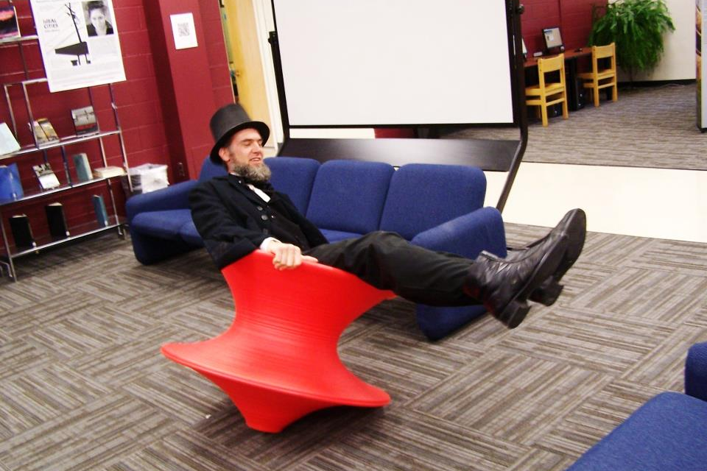
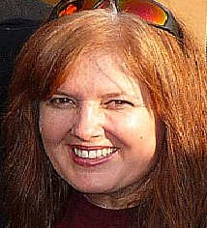
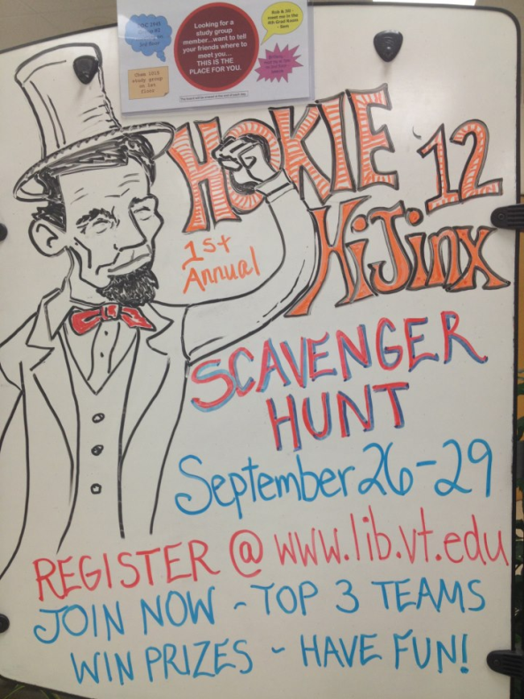
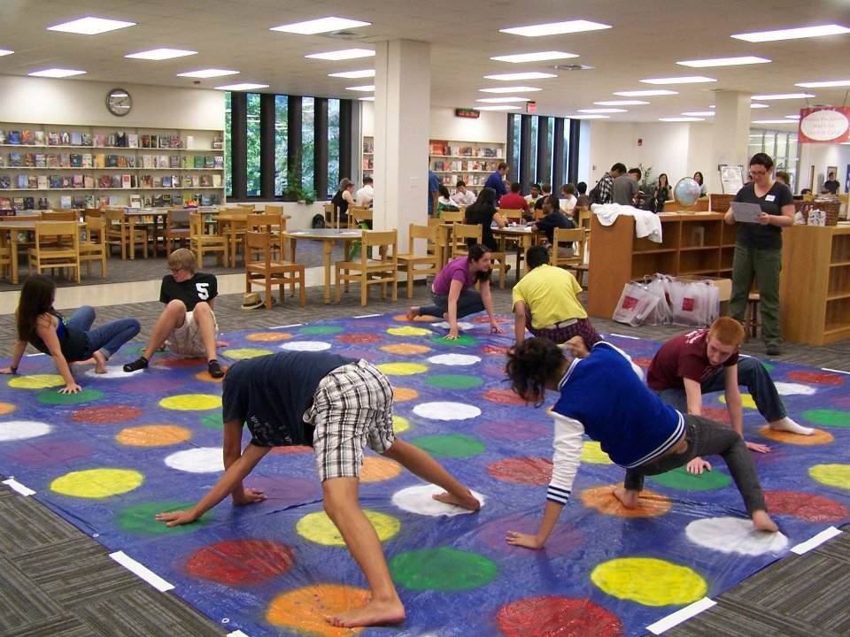
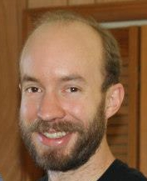
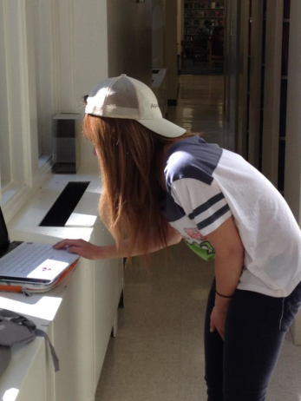
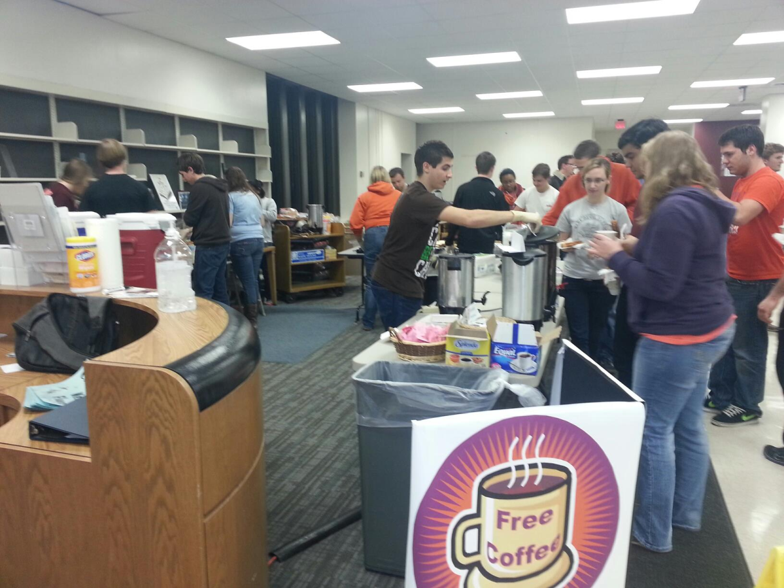
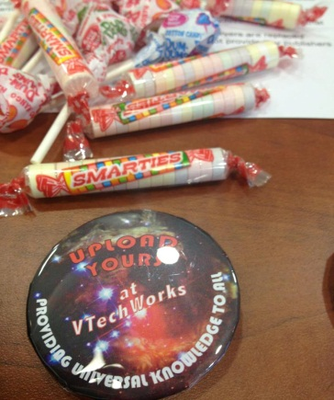

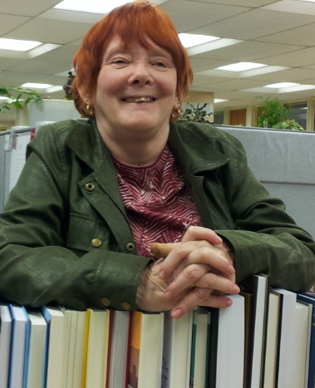
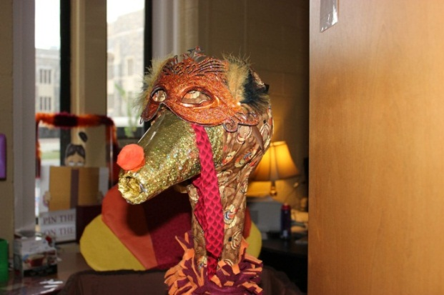
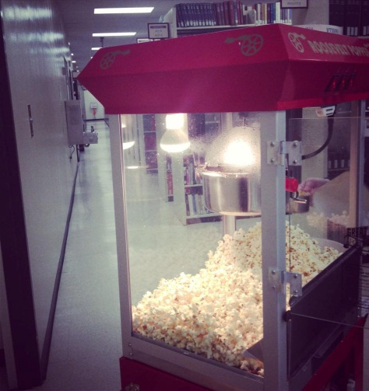
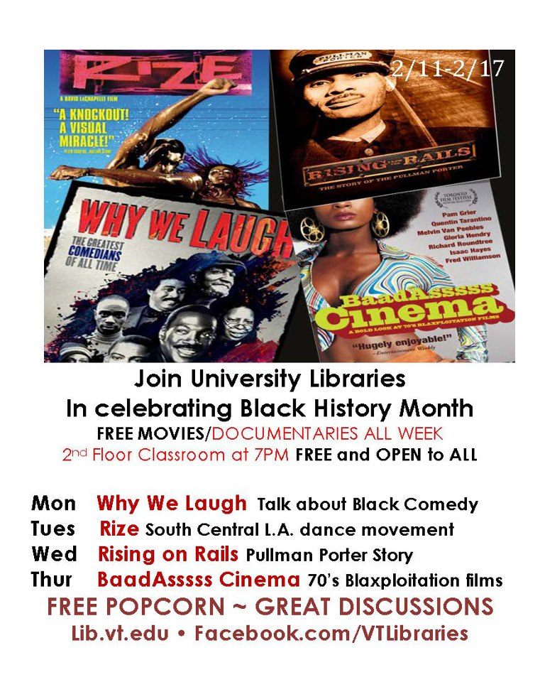
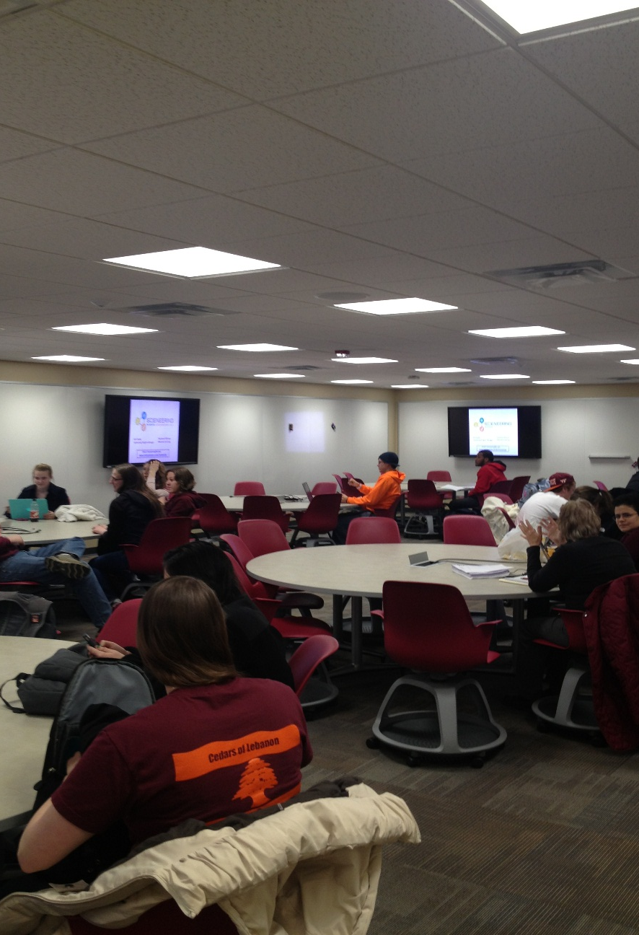
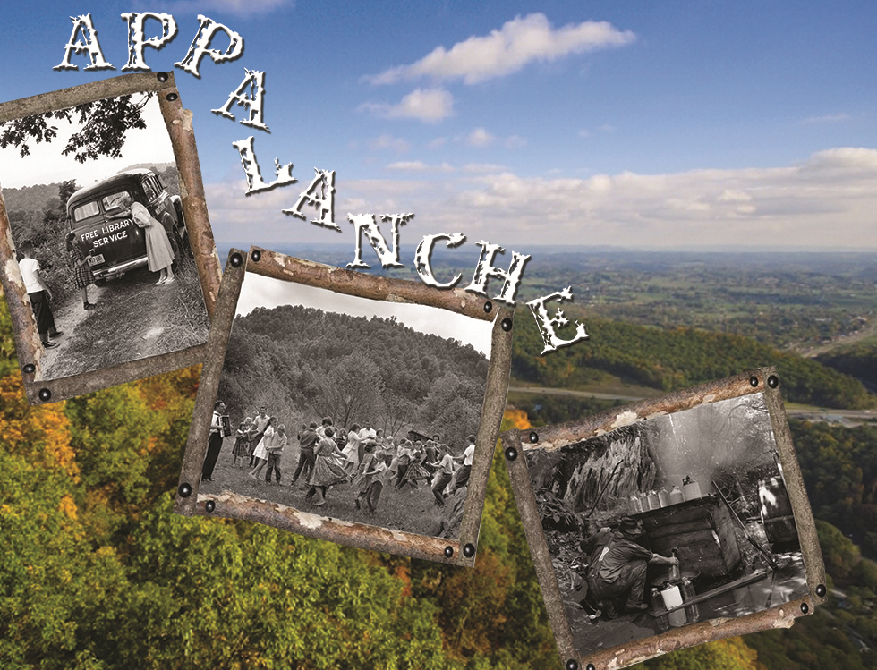
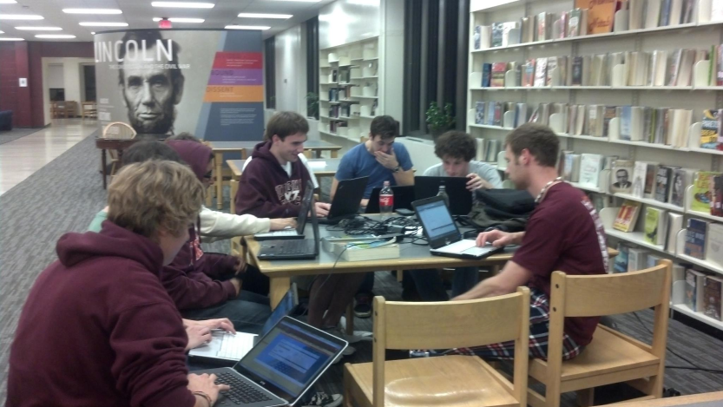
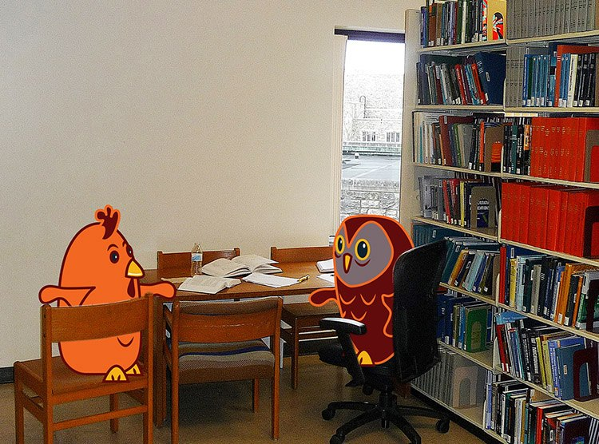
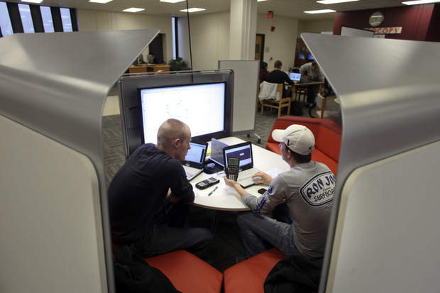
Changing Perspective by Providing the Unexpected
Monena Hall and Tracy M Hall
Twitter Feed
Introduction
Outreach and Collaboration
Quotes from staff and students
Much research has been done on the changing roles of the library in the academy, focusing heavily on the revitalization brought about by rapid technological trends, information literacy, and overall changing understanding of student learning in the 21st century.
Our observations support creating initiatives that promote
outreach and campus partnerships.
We are exploring new initiatives that improve student services,
promote outreach and collaboration and
change campus-wide perceptions of the library.
Virginia Tech Helping PAWS
Career Services
Research on the Edge
Visible Scholarship
Corp of Cadets Museum
Banned Books Week Read-a-thon
Black History Month Events
Muslim Journeys Grant
Residence Life partnerships
Open Access Week
“Had a good meal, now doin a lil studying for finals in @VTLibraries”
“my free grilled cheese made my night in the library a little brighter”
“That's right. I'm talking to @VTLibraries through the chat function on their website - it's awesome!”
“Grilled cheese+hot chocolate and dog therapy in the library is the only thing keeping me going”
“Having a conversation with #NewmanLibrary They told me I am smart and pretty!! @ Newman Library”
“I'm definitely liking the new look of @VTLibraries first floor Newman!”
Changing Perceptions of the Library
Appalanche 2013 is a brand new event that evolved from the event buzz in the library.
With a wealth of Appalachian resources it made sense to take the ball and run with it.
-Beth Lancaster
Conclusions
Objectives
Virginia Tech Libraries has become an integral partner in student life on campus due to the newfound efforts within the library.
Hosting both academically geared events and activities just for fun and in support of students has helped us build a terrific buzz that simply
did not exist before.
Students see what we are trying to accomplish with renovations and events and they love it.
At Virginia Tech we are:
Gain a better understanding of how to create a culture and awareness of events.
Viewing this poster will create a sense of excitement among participants around the idea of building a team environment in the library.
Understand how to engage the student community in order to increase public awareness of library programs and services.
Game Night
Scavenger Hunt
Appalanche 2013
Hip-Hop in the Café
Electrical Engineering Week
Participation in the Marketing Team
Student Ambassador Program
I would have to say the best marketing project was game night. The broad range of students, 700 in total, was a great measure of the success.
-Therese Walters
Building the Buzz for Events
Learning
Teaching
Laughing
Growing
Together
Improving Services
Renovations
New Technology
Scale-up classroom
Exam week events
  Grilled cheese
  Coffee
  Reiki
  Therapy animals
  Corp musicians
The scavenger hunt made campus explorers out of the participants. It was a test of endurance, resourcefulness and patience for everyone,
including myself.
-Scott Fralin
Market through Multicultural Center
Connect with Division of Student Affairs
Table Cards in the dining halls
Public Services announcements through the campus radio station
Digital signage in house and around campus
Social Media outlets to spread the message
Marketing team is inclusive of all departments in the library
  Sharing venue
  Information dissemination
I became interested in the Marketing Team after I had the privilege to work on the Game Night. I am looking forward to working on events with this team and connecting with the students.
-Marion Eaton
Acknowledgements
Special thanks to all the people that allowed us to use their event photos! Therese Walters, Cheryl Thompson, Nathan Hall, Brian Craig, Jessica Beasley, and Scott Fralin. Additional thanks to Beth Lancaster, Therese Walters, Marion Eaton and Scott Fralin for providing quotes for us to use!

