Slide 1
Toward an Intelligent Crawling Scheduler for Archiving News Websites Using Reinforcement Learning
Course: CS 6604
Instructor: DR. EDWARD A FOX
Team: Web Archive
Members: Xinyue Wang, Naman Ahuja, Ritesh Bansal, Siddharth Dhar, Nathaniel Llorens
Date: 12/10/2019

Slide 2
Motivation
The Web is growing rapidly, but so too is information frequently disappearing from the WWW. Preserving the WWW is crucial to record the history of human society.
How to preserve the web?
  Crawling and saving
The existing crawling model in the webarchive communities mainly adopts predefined crawling plans
  Does not have the flexibility to capture the web dynamics
  Needs a lot human efforts for designing the rules
Can we have a smart web crawling scheduler reduce the human efforts efficiently?

Slide 3

Motivation

Slide 4
A smart web crawling scheduler
A scheduler that can automatically predict the web content changes and generate corresponding plans to capture the content
  Web page content change
  Web site structure change
The traditional way: predict when the web content would change in the future
  Use machine learning model to track the changes and make predictions
    SVM, random forest, logistic regression etc.
  Then build the scheduler based upon the prediction results
What if a smart model generate the crawling plans directly?
We propose to explore reinforcement learning (RL)

Slide 5
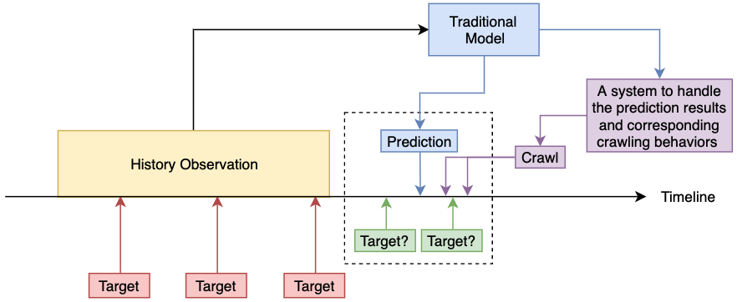
Traditional Method

Slide 6
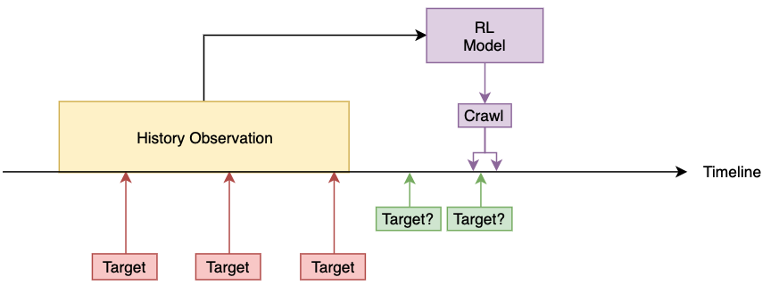
A RL idea

Slide 7
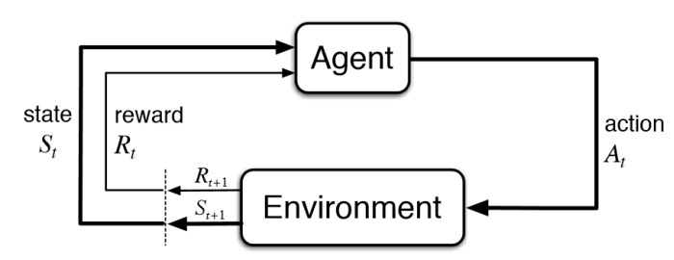
RL model basic
Crawling Decisions
Crawler Brain
Web History Information
Notes:
Inspired by game;
Not common in prediction task;
Action strategies

Slide 8
RL model design - web page change
Environment
  A continuous sequence from the data set, which represents the historical records of web pages
Action
  Continuous prediction model
  Sparse prediction model
Reward
  Reward the correct actions
  Punish the wrong actions

Slide 9
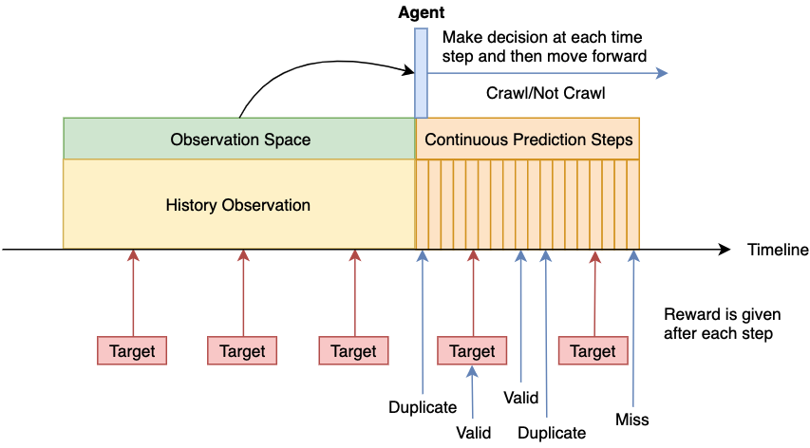
Continuous Prediction
Notes:
The orange area will be the plan for one episode; The action is crawl or not crawl; One step is one hour decision
The blue arrows are the plan

Slide 10
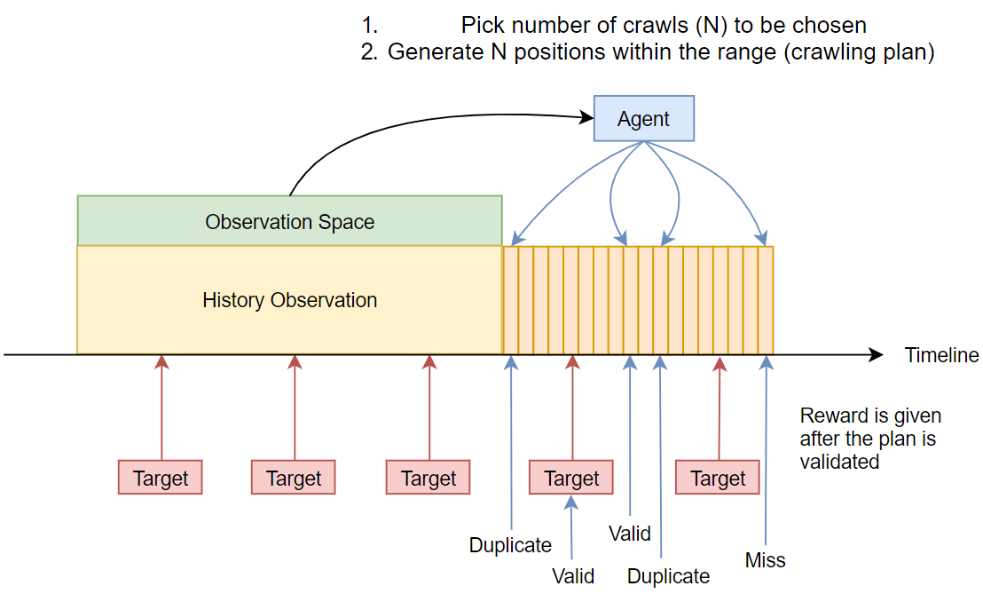
Sparse Prediction

Slide 11
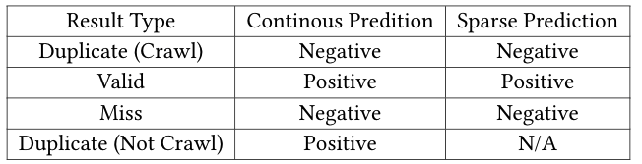
Rewarding
A RL model tend to avoid negative rewarded actions
A RL model tend to stack more positive rewards as much as possible
Reward is give after each episode (crawling plan) is generated
Notes:
We reward correct actions and punish incorrect actions.
We give reward after each plan is

Slide 12
Data Collection
CNN news: http://cnn.com/
Web Archive collection from Archive.org: CNNfocuscrawls
  From May 2019 to Oct 2019
  Contains both CNN domain crawls and external links in CNN web sites
  Crawling Tool: Heritrix
Our own focus crawl
  From Nov 6th to now
  Contains only CNN domain crawls with 2 levels depth, crawled every hour
  Crawling Tool: Web2Warc
Issue: gap from Archive.org and our own crawls
  We plan to compare the differences of our own crawl and the Archive.org collection to validate the capture accuracy of Archive.org
  Will need until Archive.org publish the Nov data
Notes:
Thanks for Internet Archive

Slide 13

Data Preprocessing
The raw web archive files are in WARC format
WARC -> Parquet
  WARC is not flexible to use
  WARC is inefficient to process
We use Spark framework to batch converting WARC to Parquet efficiently

Slide 14
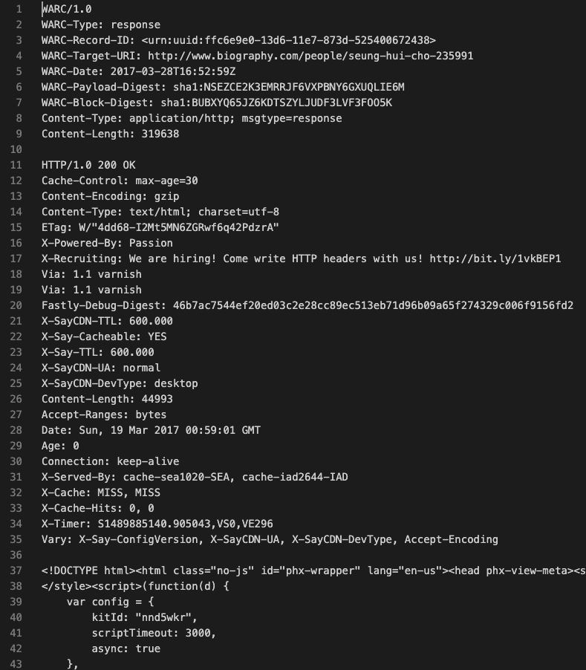
WARC and Parquet

Slide 15
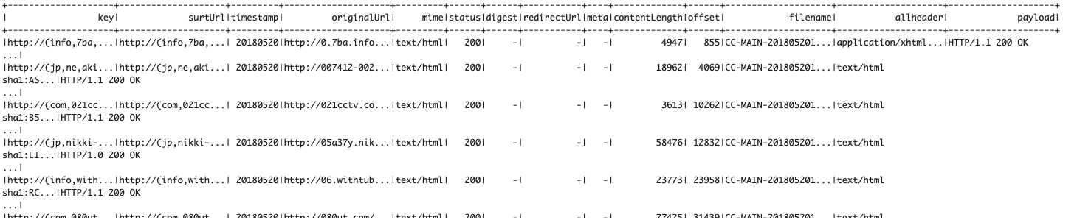
WARC and Parquet

Slide 16
Find Web Content Change
Two types of web content change:
  Web page change
  Website structure change
Get the dataset labeled
  Find unique web copies for a web page from the web archive
  Find unique website treemap from the web archive

Slide 17
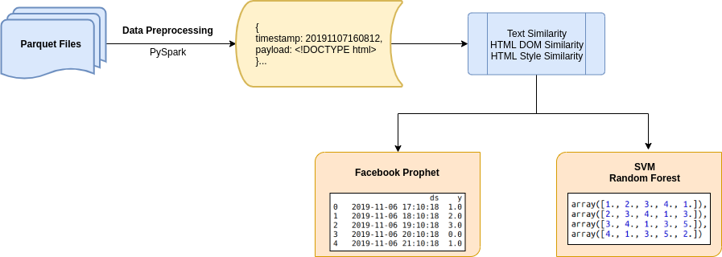
Baselines for predicting web content change - WebPage

Slide 18
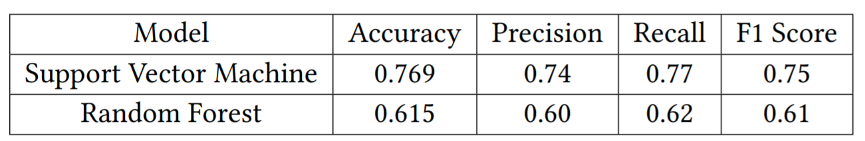
Baselines for predicting web content change - WebPage
The SVM model is able to solve nonlinear estimation problems; successful in time series forecasting.
Random Forests generally don’t fit very well for time series trends and seasonalities.

Slide 19
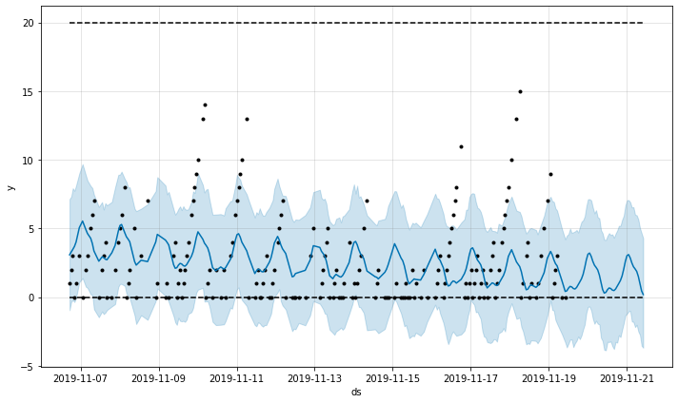
Predicting web page change - Facebook Prophet

Slide 20
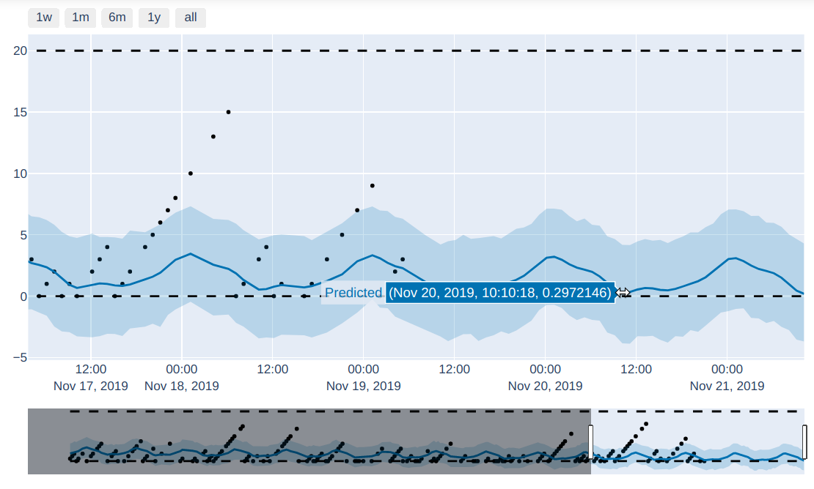
Predicting web page change - Facebook Prophet

Slide 21
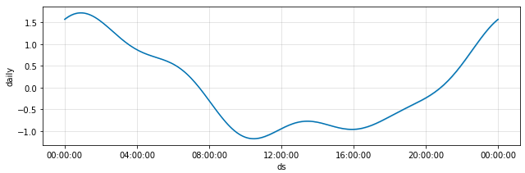
Predicting web page change - Facebook Prophet

Slide 22
Constructing unique web site treemap from the web archive
Page level prediction will help decide to crawl particular web page.
Consider the case when multiple new web pages are added, maybe during a particular time and day. We may want to crawl all these pages.
Sitemap prediction will help decide to crawl whole website of not.
Data archived contains data of multiple media-type and status code.
Initial preprocessing is required to build sitemap, ‘text/html’ and ‘200’.
Tree-Based Structure, ‘hostname’ is ‘root node’, ‘path act’ as ‘nodes’.

Slide 23
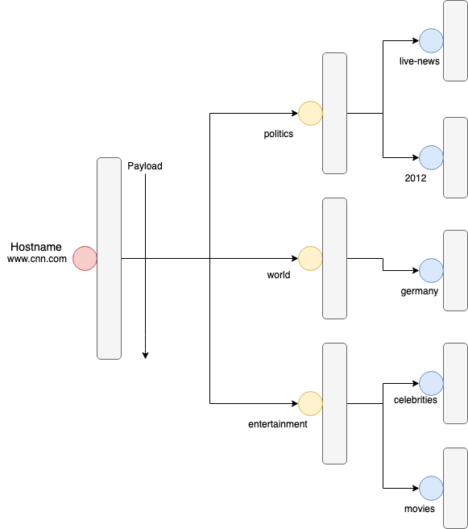

Slide 24
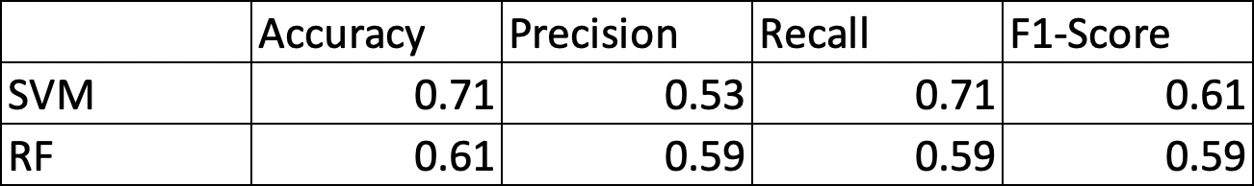
Baselines for predicting web structure change - TreeMap
Built training data based on the window size of 5 hours.
Used percentage of nodes added from the last crawled datapoint to evaluate the labels.
Number of nodes added will act as the input feature.
Used SVM and Random Forest models to predict if the website should be crawled.
Prediction is if we want “to crawl whole website in the next hour”

Slide 25
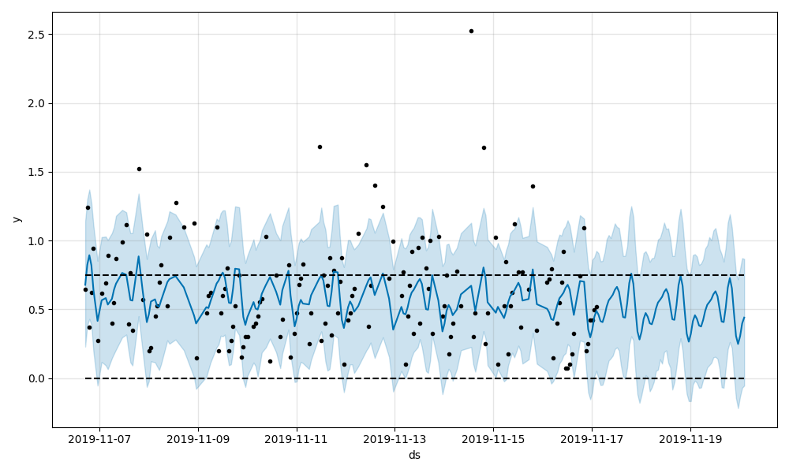
Predicting SiteMap change - Prophet

Slide 26
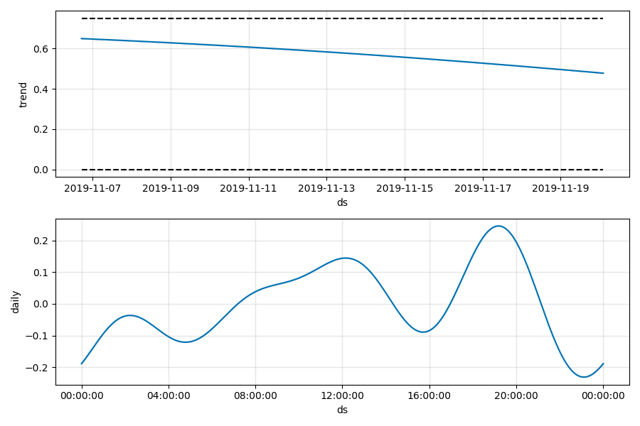
Predicting SiteMap change - Prophet

Slide 27
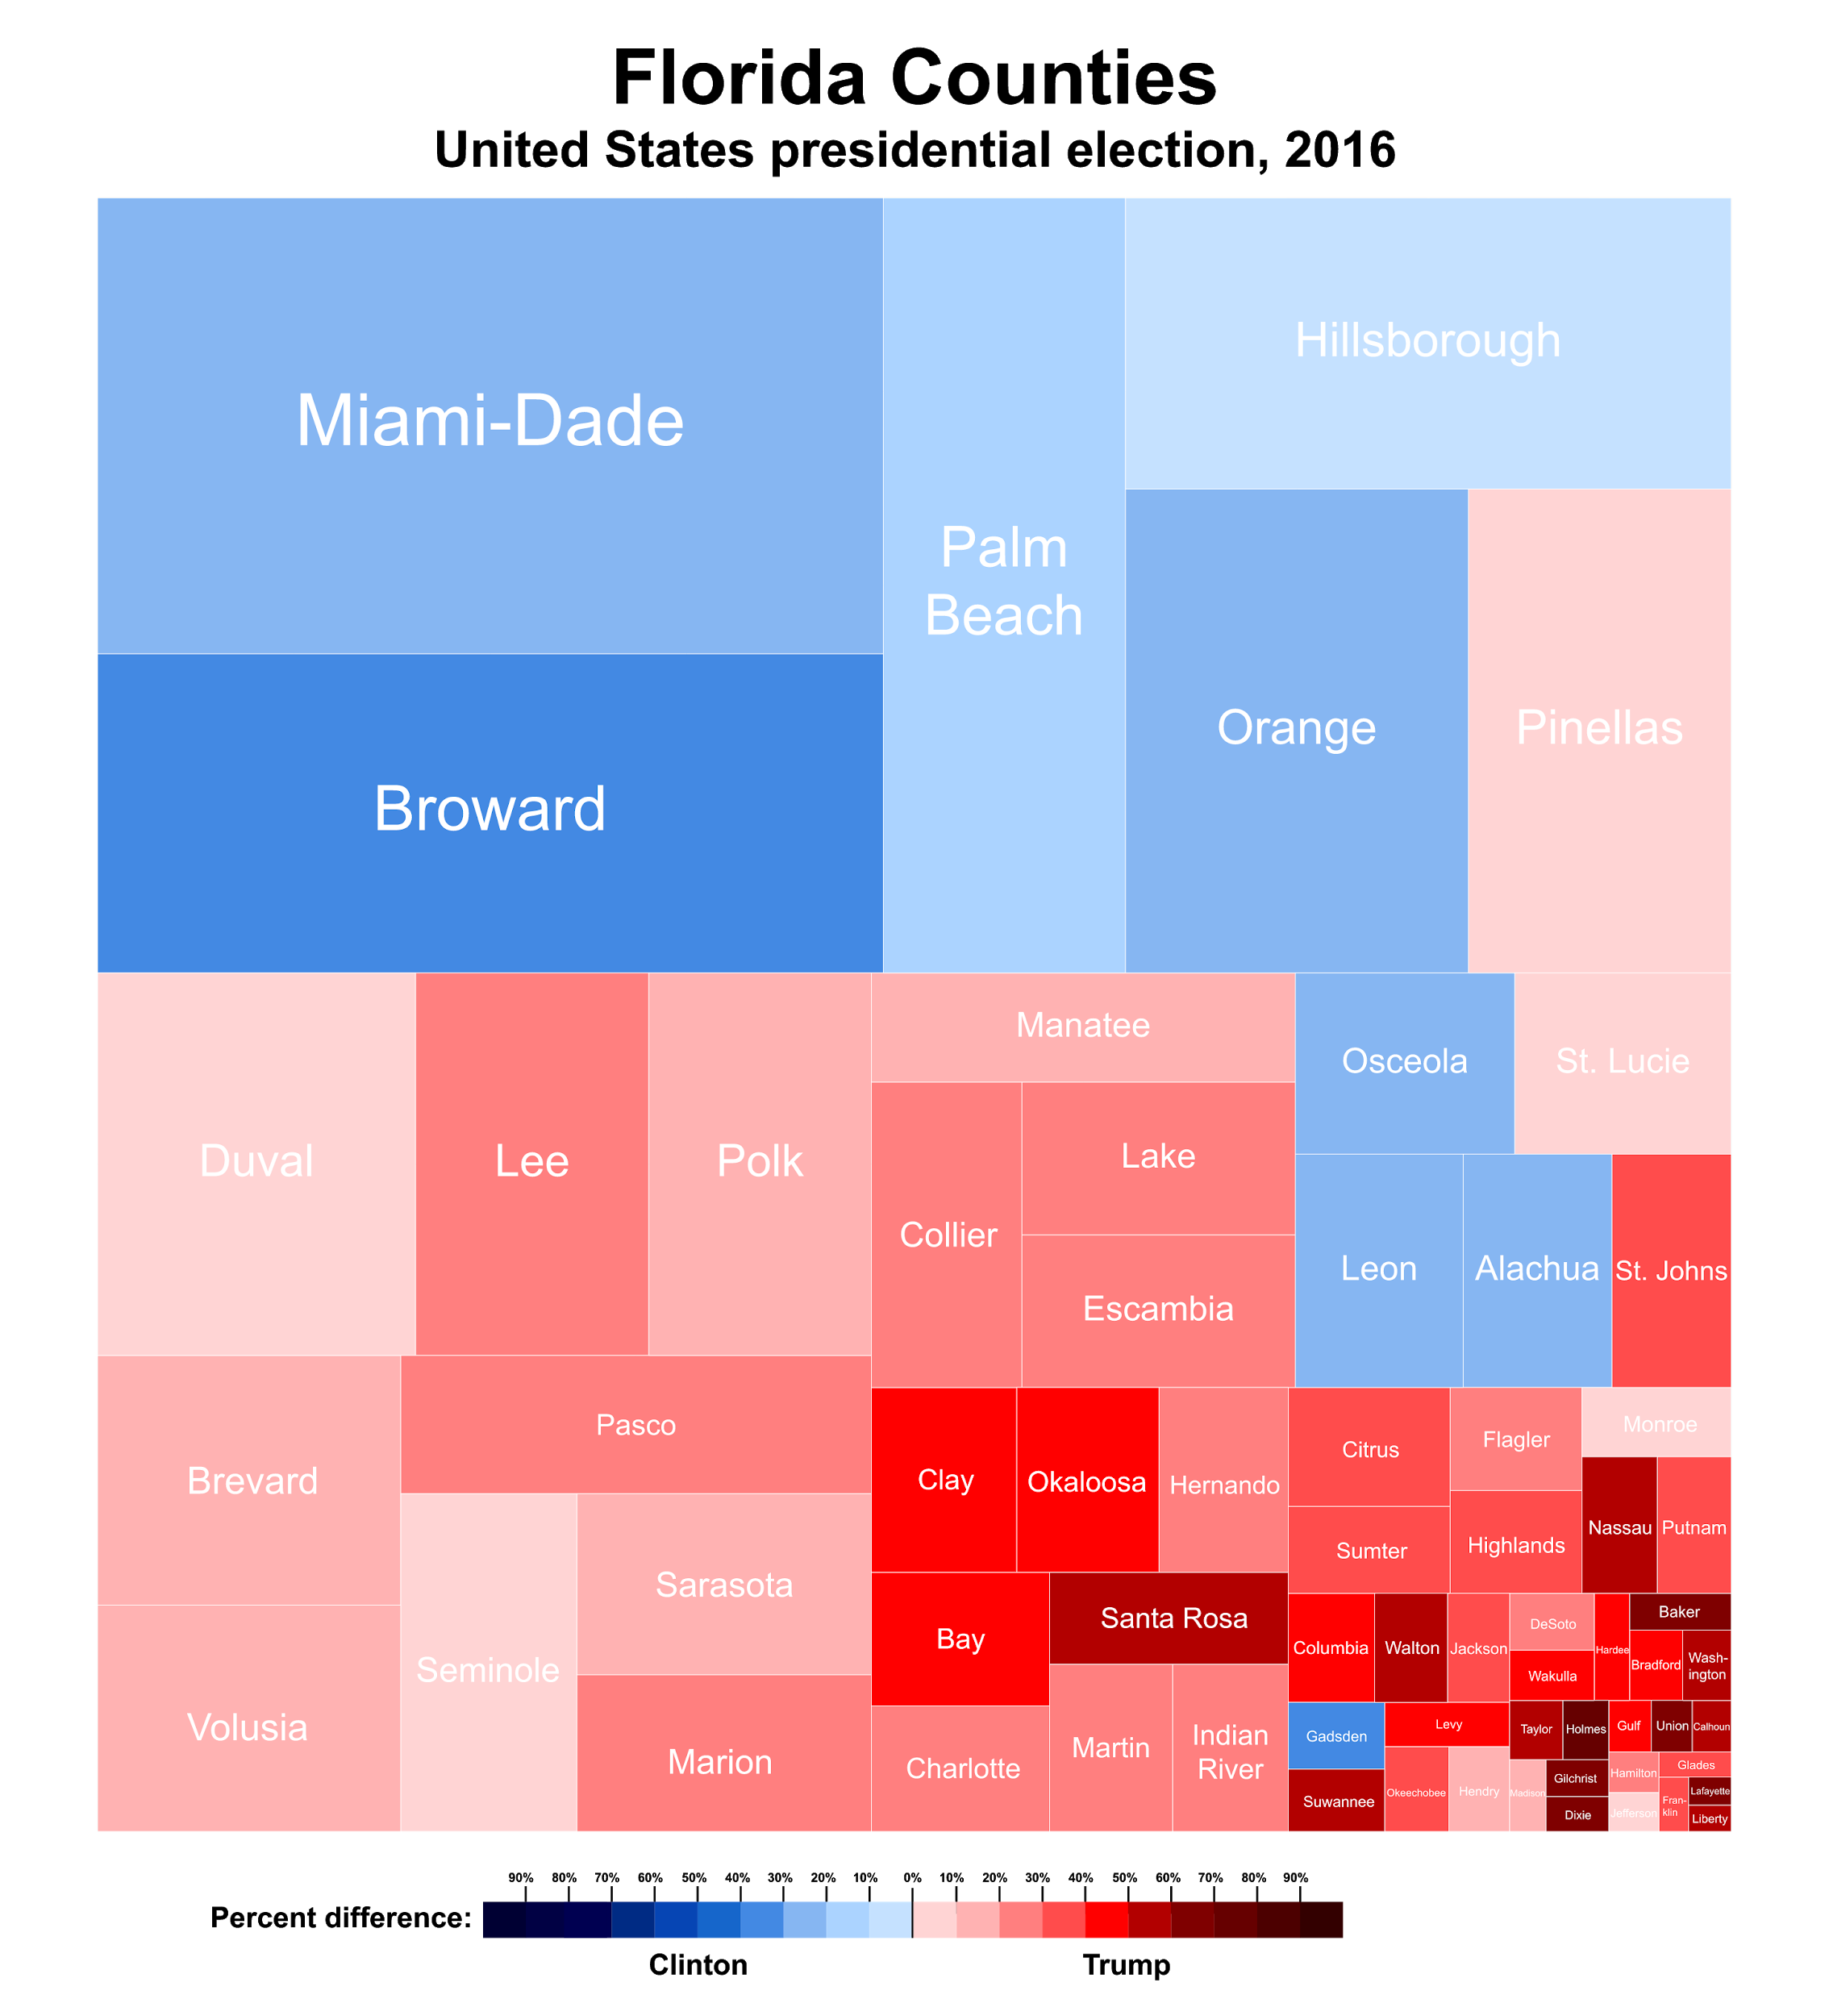
Constructing unique web site treemap from the web archive (continued)
The sitemaps generated by our algorithms are important for predicting the change of a site’s tree structure, but they are also useful for visualizing how and where a site is changing
Algorithm, when given input of two sitemaps, can show differences between them in a visualization known as a treemap (unrelated example to the right)
Allows a user to see how a site is changing between snapshots of a site
Credit: https://en.wikipedia.org/wiki/Treemapping

Slide 28
RL model evaluation - web page change
Use the same dataset as web page prediction baselines
100000 training steps for each model
8:2 training, testing ratio
Two RL learning policies: DQN, PPO
Two types of rewarding functions: fixed score, scaled score

Slide 29
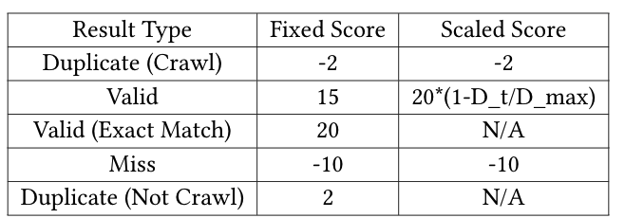

RL model evaluation - web page change
Reward
Setting
Learning Policy Used

Slide 30
Conclusion and future work
At current stage, we can not compare the RL model with baselines directly since they are different tasks
  Further experiments are needed to build a system to work with baselines for crawling plan generation
We also need more training data with a longer period of various of types
RL model has the potential to solve our web crawling
Quantitative evaluation is needed to reflect the actual performance of the model compared with baselines or predefined policies
Investigate the web site structure change model in the future
The web page change and web site structure change may also be combined as a single model

