Slide 1

Across the Miles: Engagement Across Distance
2015 ACRL/NEC Annual Conference
Worcester, MA
May 8, 2015
Anita Walz, Charla Gilbert, and Debbie Cash
http://creativecommons.org/licenses/by-nc-sa/3.0
Notes:
1

Slide 2
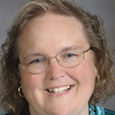
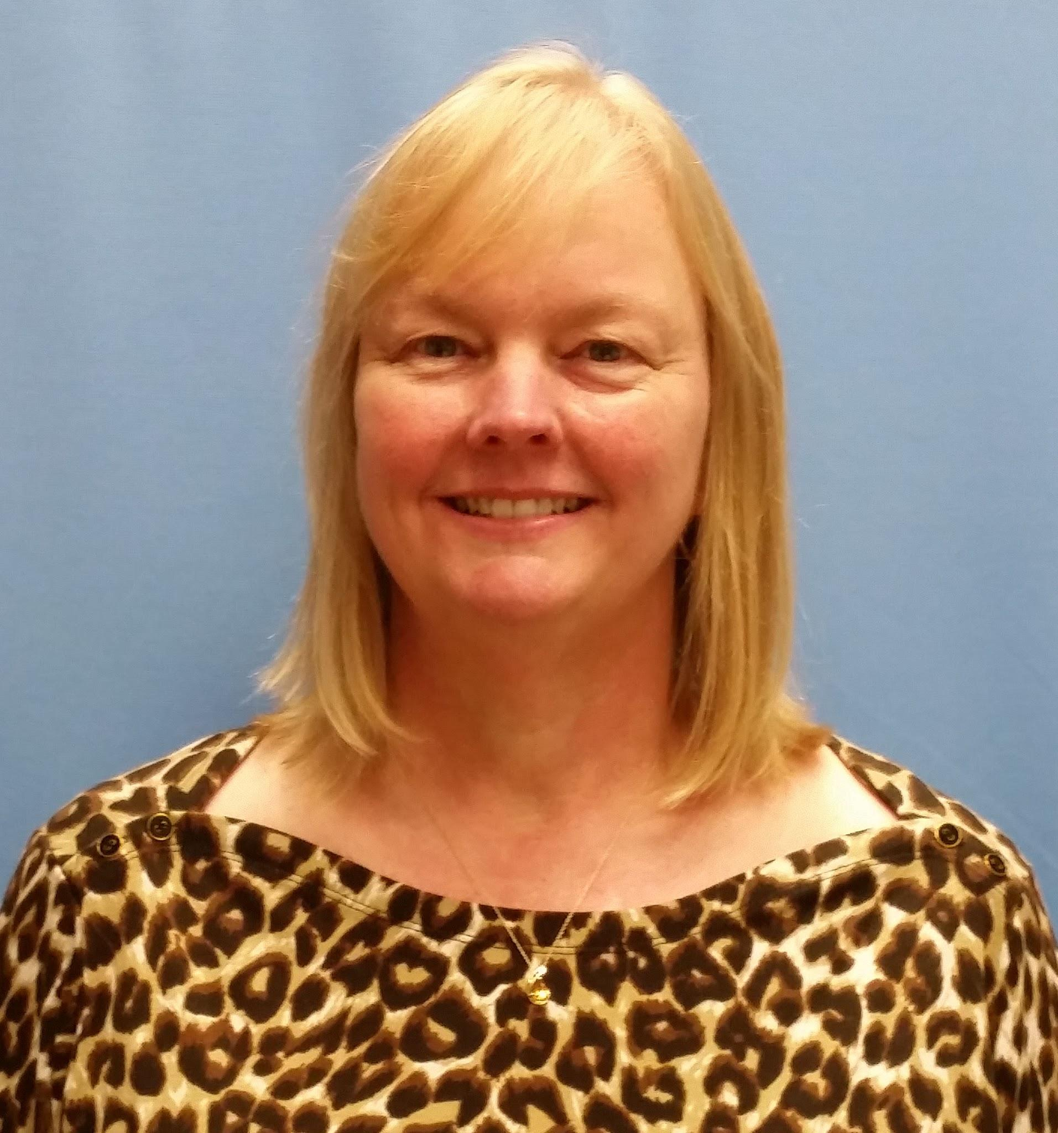
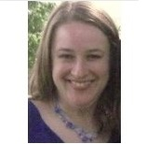
Introduction
Charla Gilbert
Director of Planning and Branch Operations
Debbie Cash
Coordinator, Northern Virginia Resource Center
Anita Walz
Assessment, Open Education & Online Learning Environments Librarian

Slide 3
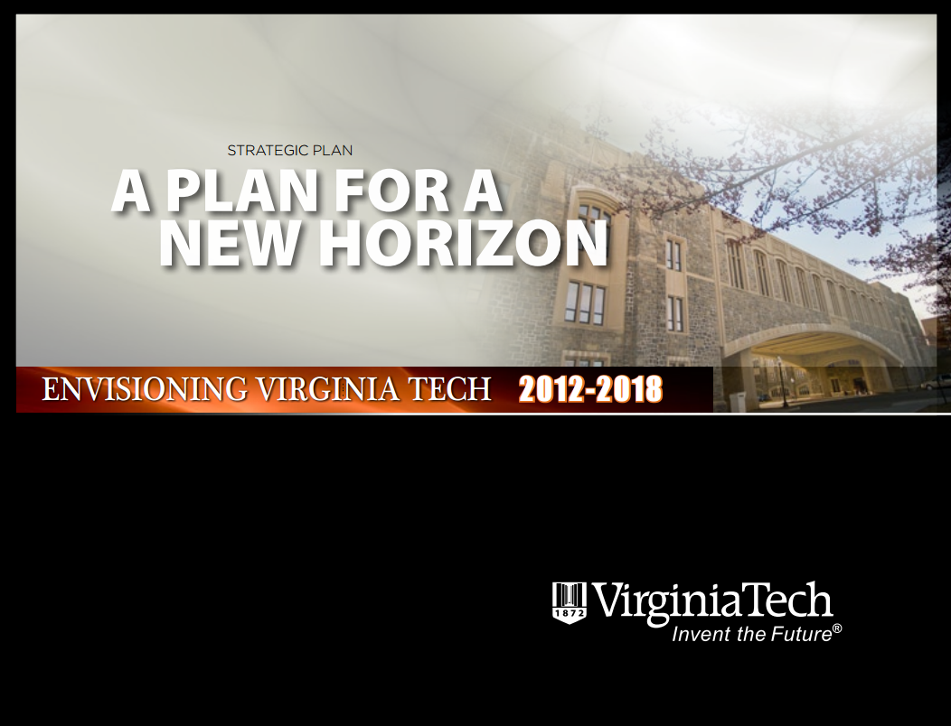
Strategic Direction of the University
… leverage networked collaborations internally...
… create and support environments for educational and research programs...
… provide infrastructure, administrative support, and opportunities for collaboration...
... explore how to best harness technology to improve the quality of education [we] offer students...
http://www.president.vt.edu/strategic-plan/2012-plan/2012-strategic-plan.pdf

Slide 4
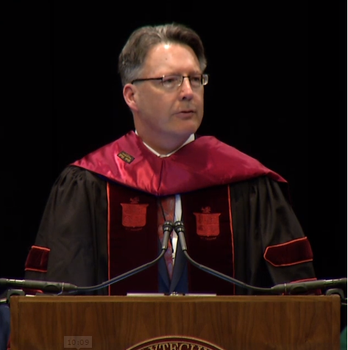
President Sands’ Vision
Discovery,
Learning & Engagement
http://www.president.vt.edu/about-the-office/statements/101714-installation-speech.html
https://vimeo.com/109597160
Notes:
https://vimeo.com/109597160 15:00 to 15:49

Slide 5
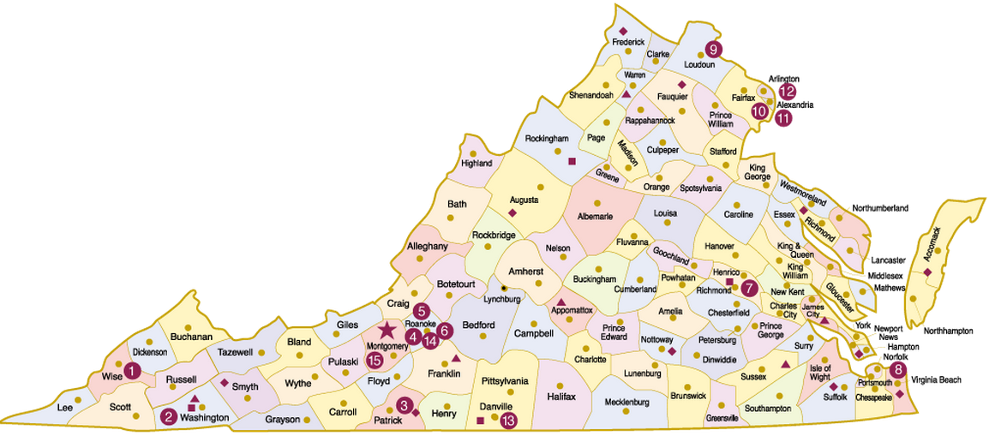
Defining the Geographic Landscape
http://hrapps.hr.vt.edu/orientation
Notes:
http://hrapps.hr.vt.edu/orientation (click on the picture of the map)

Slide 6
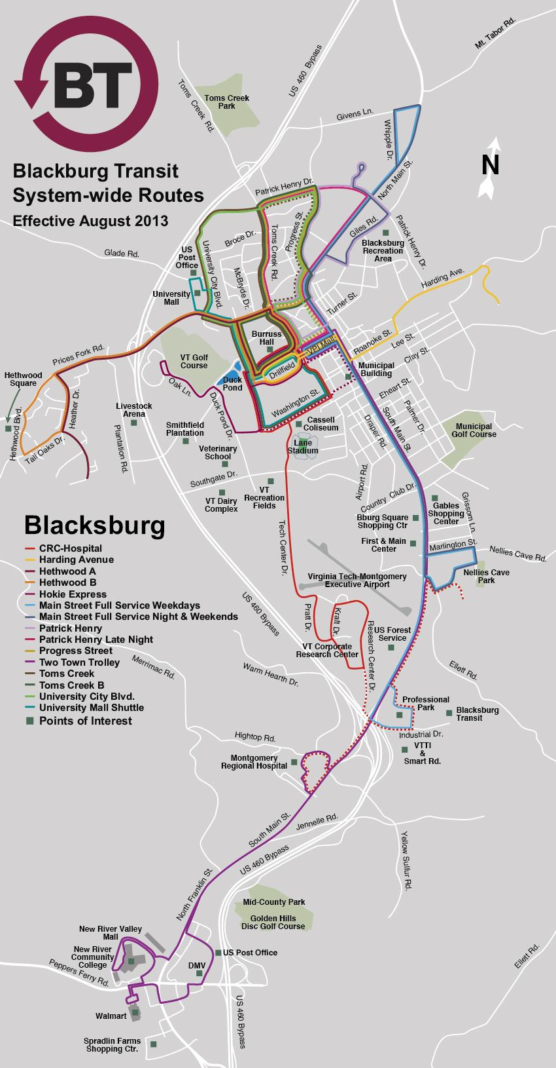
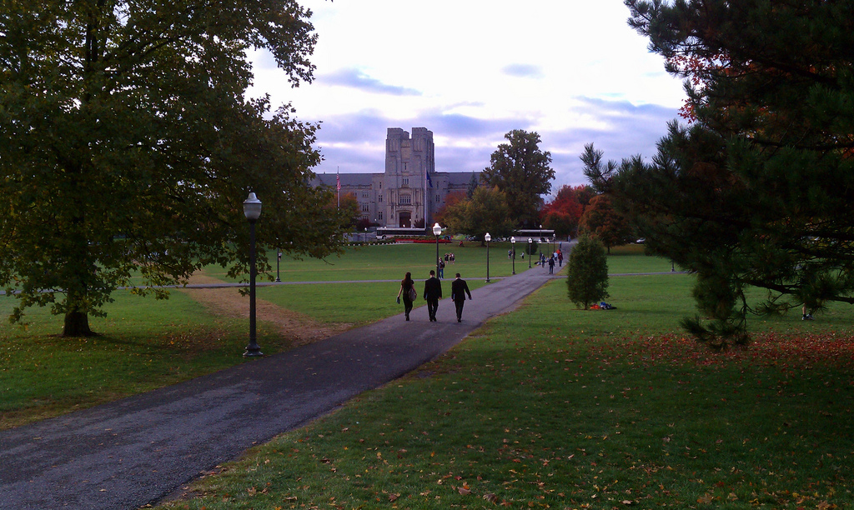
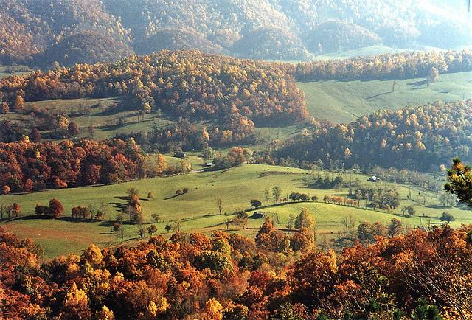
Blacksburg
Student population: ~25,000
Blacksburg population: 43,609
Montgomery Cty population: 96,207
© Blacksburg Transit http://www.blacksburg.gov/Modules/ShowDocument.aspx?documentid=3964
© Chris Lawrence CC BY SA https://www.flickr.com/photos/lordsutch/6238485771
© Scott Teresi CC BY SA https://www.flickr.com/photos/scott-teresi/3425226551
Notes:
https://www.flickr.com/photos/lordsutch/6238485771/

Slide 7
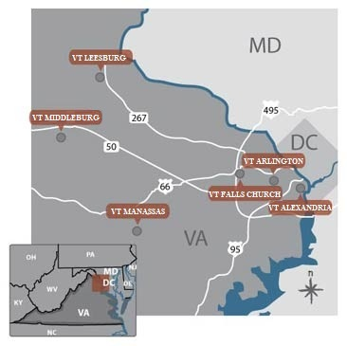
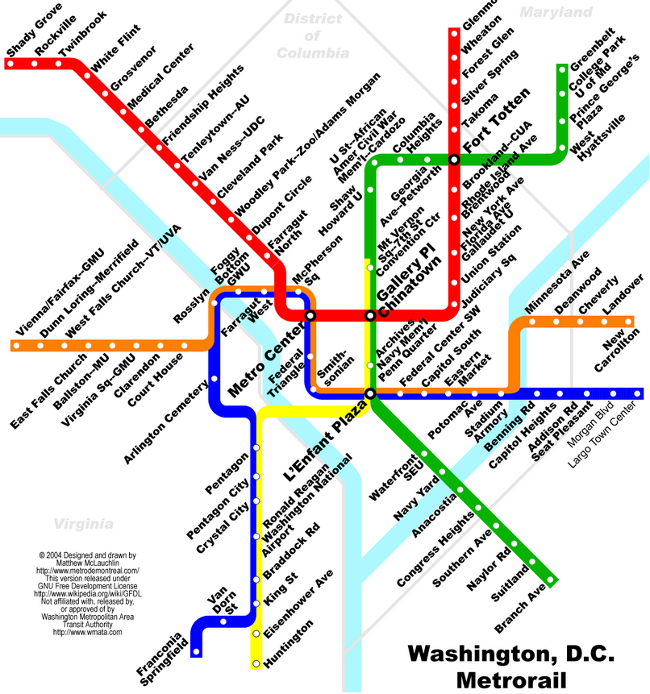
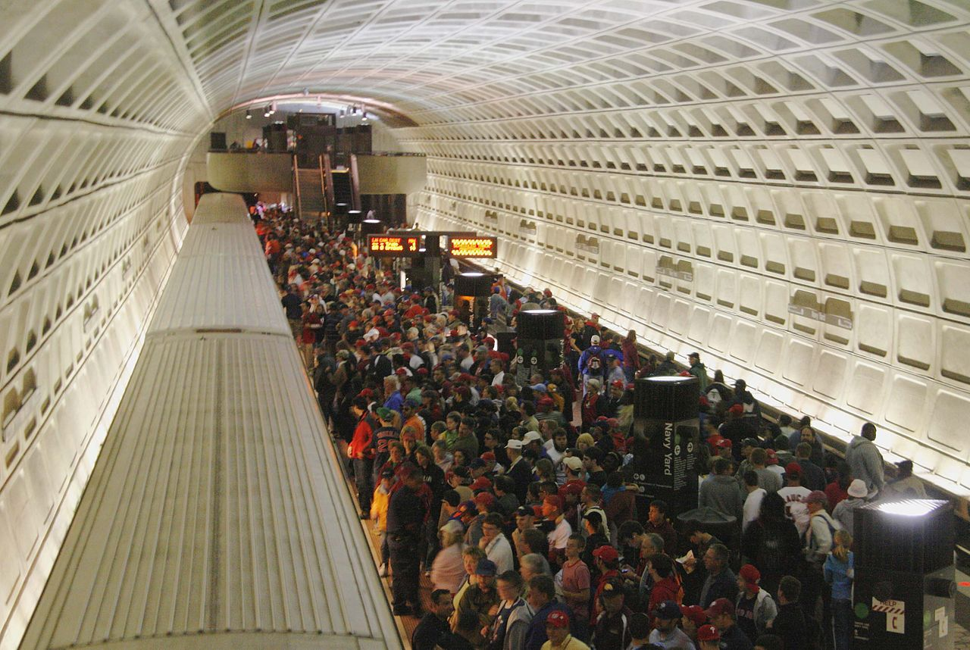
National Capital Region
D.C. Metro Area Population: 5,860,342
http://ncr.vt.edu/Locations
© dbking CC BY
http://commons.wikimedia.org/wiki/File:Navy_Yard_Metro_station_-_baseball_crowd.jpg#/media/File:Navy_Yard_Metro_station_-_baseball_crowd.jpg
© Golbez CC BY SA http://commons.wikimedia.org/wiki/File:Washington_DC_metro_map.png
Notes:
"Navy Yard Metro station - baseball crowd" by dbking - originally posted to Flickr as _MG_3719. Licensed under CC BY 2.0 via Wikimedia Commons - http://commons.wikimedia.org/wiki/File:Navy_Yard_Metro_station_-_baseball_crowd.jpg#/media/File:Navy_Yard_Metro_station_-_baseball_crowd.jpg

Slide 8
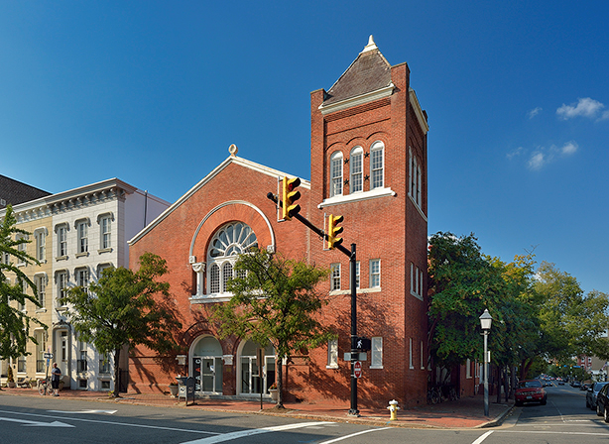
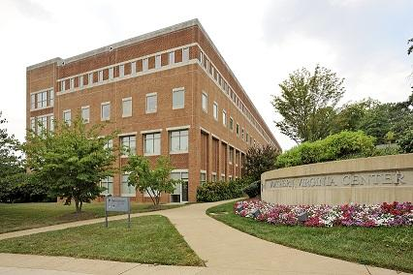
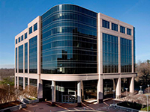
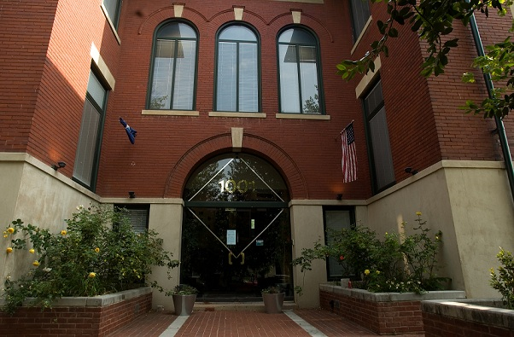
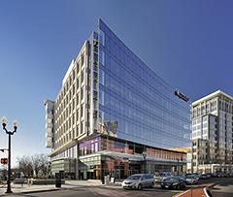
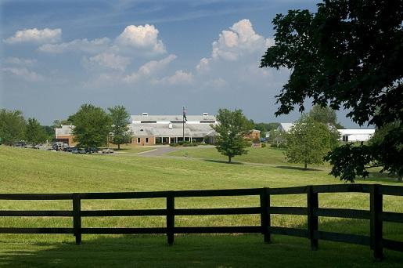
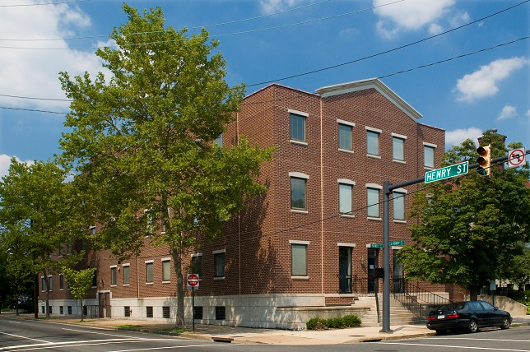
Source: University Relations http://ncr.vt.edu/Locations

Slide 9
The Northern Virginia Center (NVC)
History of the National Virginia Center (1969 & forward)
Existing Services and Spaces - Virtually and physically - all campus locations
New Services and Spaces - Proactive
vs. Reactive

Slide 10
NVC - History of the Center
1969 and Moving Forward
Partnership with University of Virginia
Graduate Degree Programs Offered
Research
Library, Classrooms & Admin Support
http://ncr.vt.edu/Locations/FallsChurch.html

Slide 11
NVC - Existing Services and Spaces
Group Study Spaces
Small Collection
Heavy Interlibrary Loan
Instructional and Reference Support

Slide 12
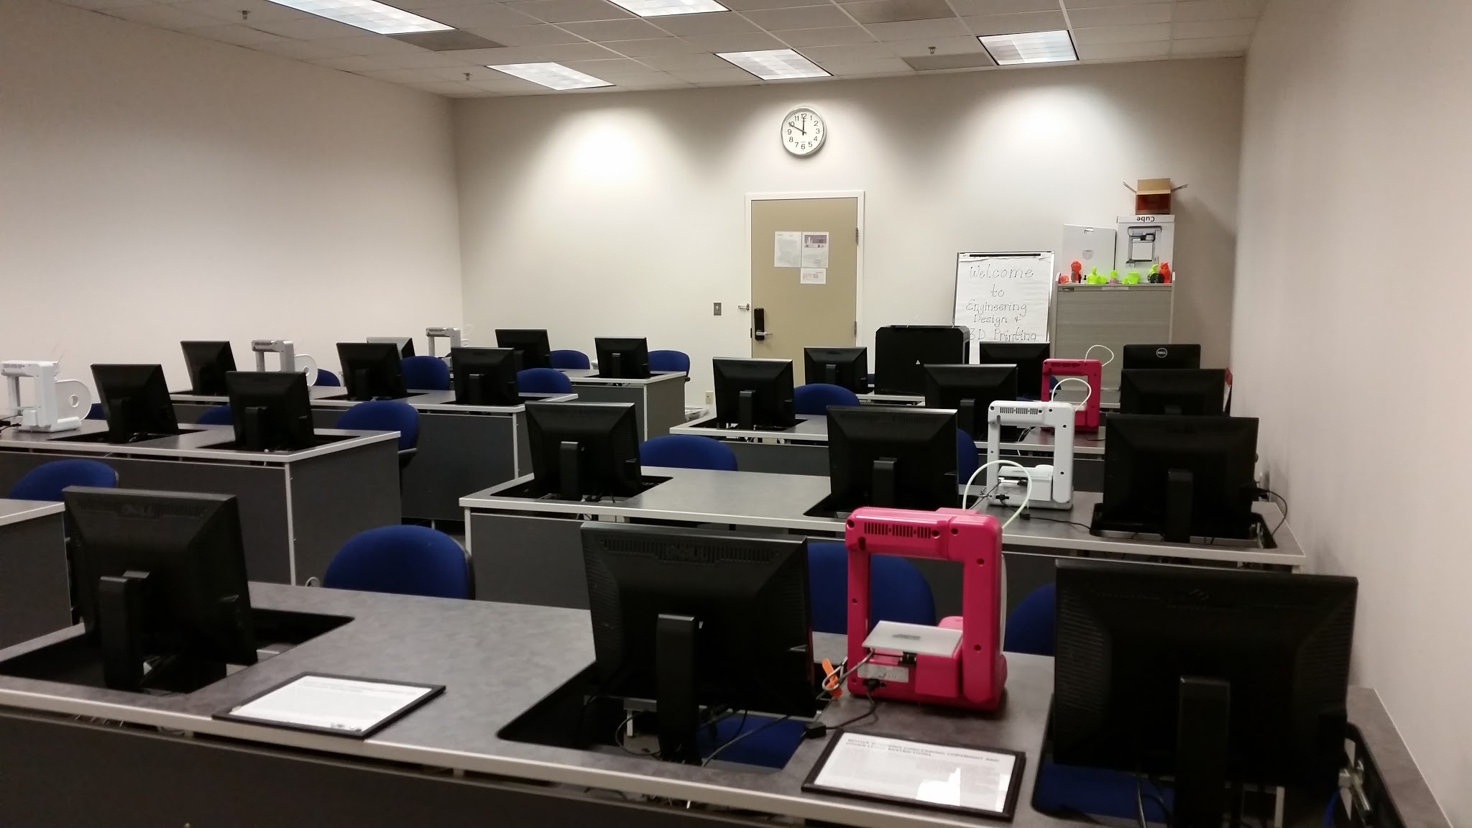
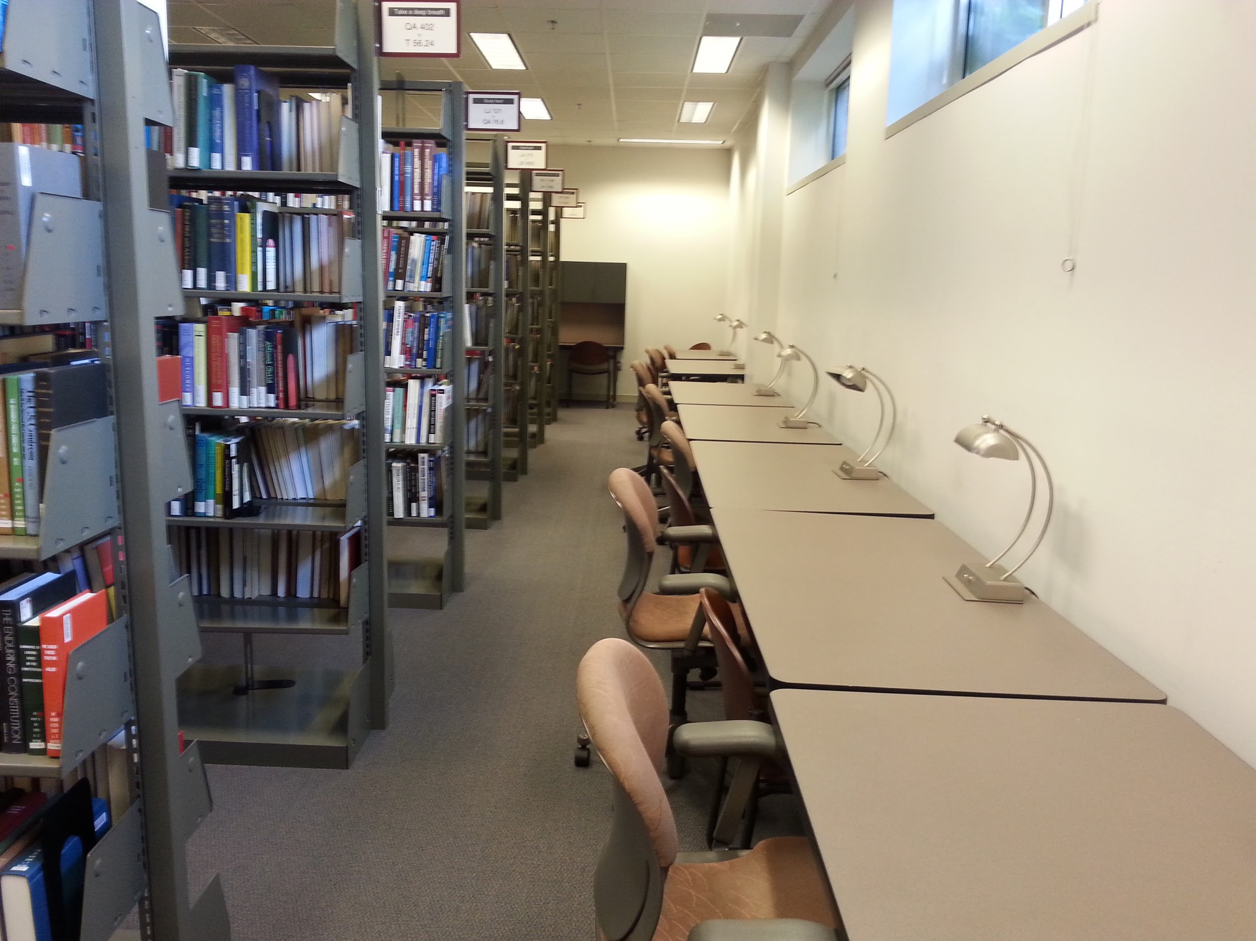
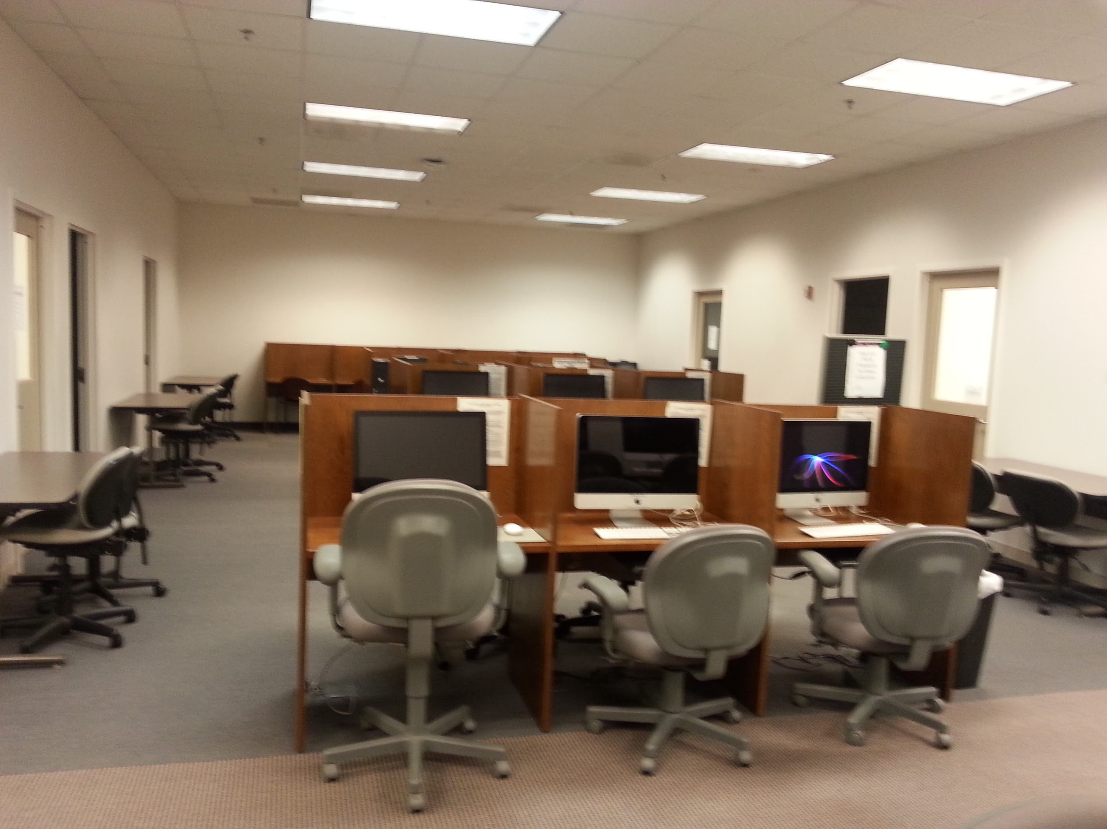
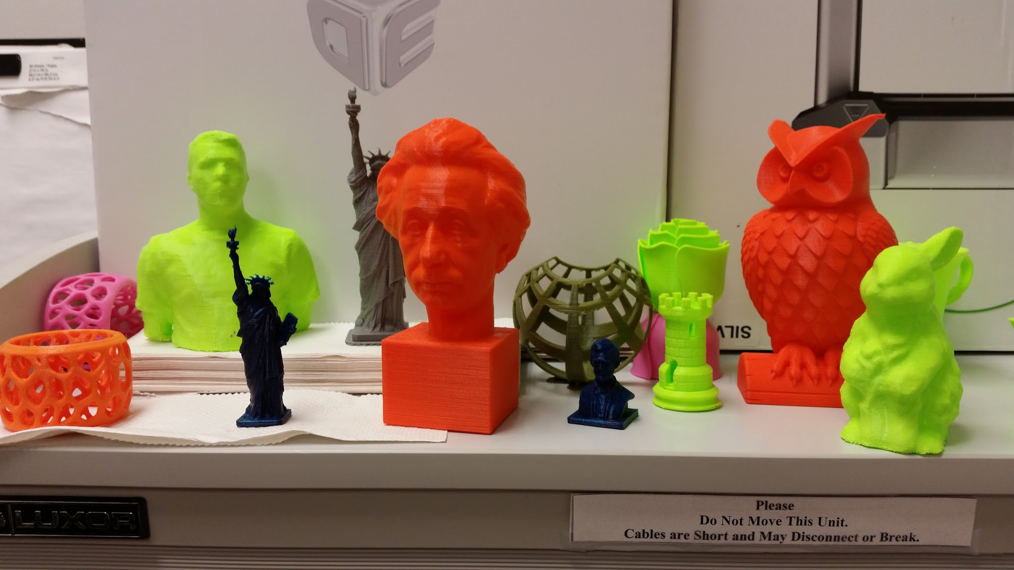
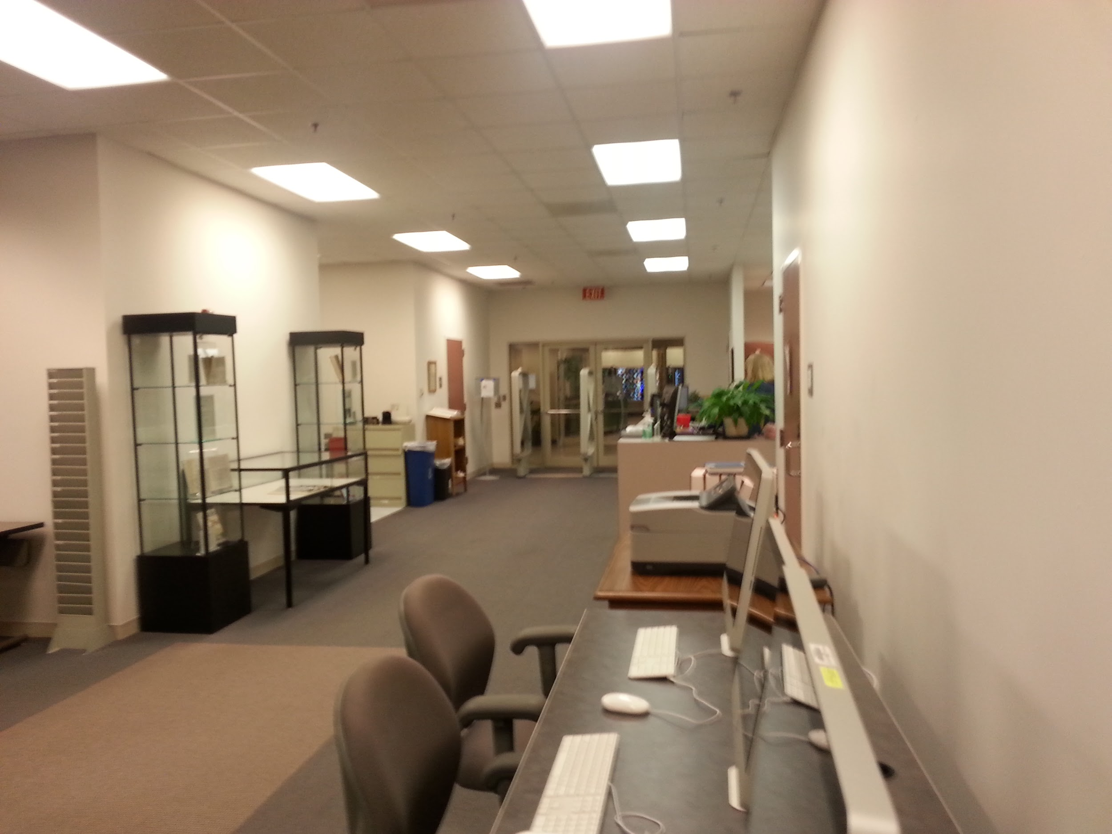
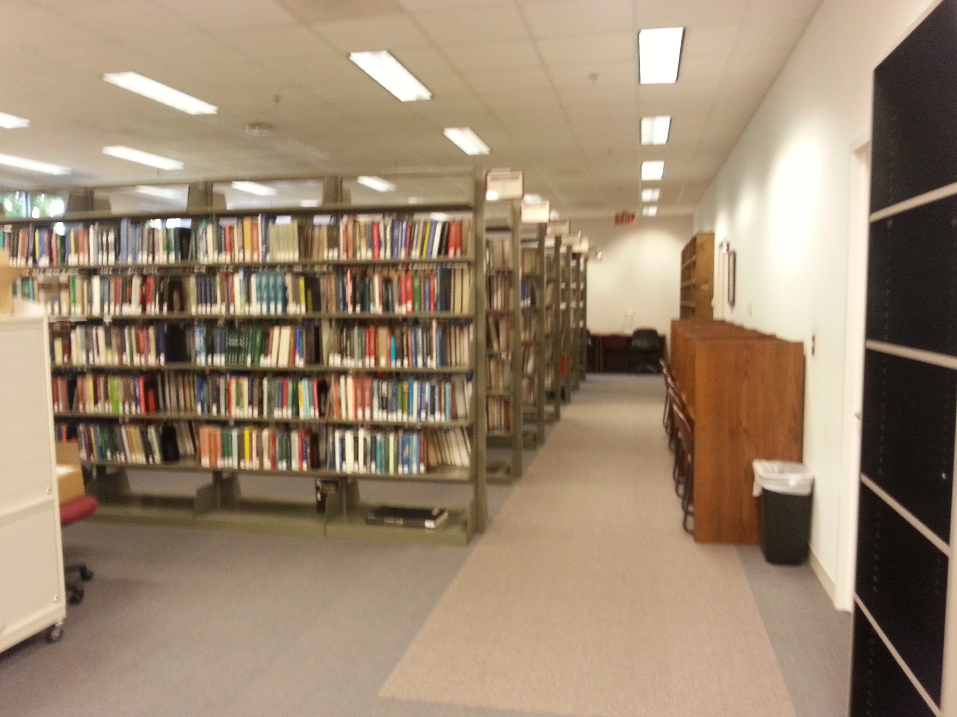
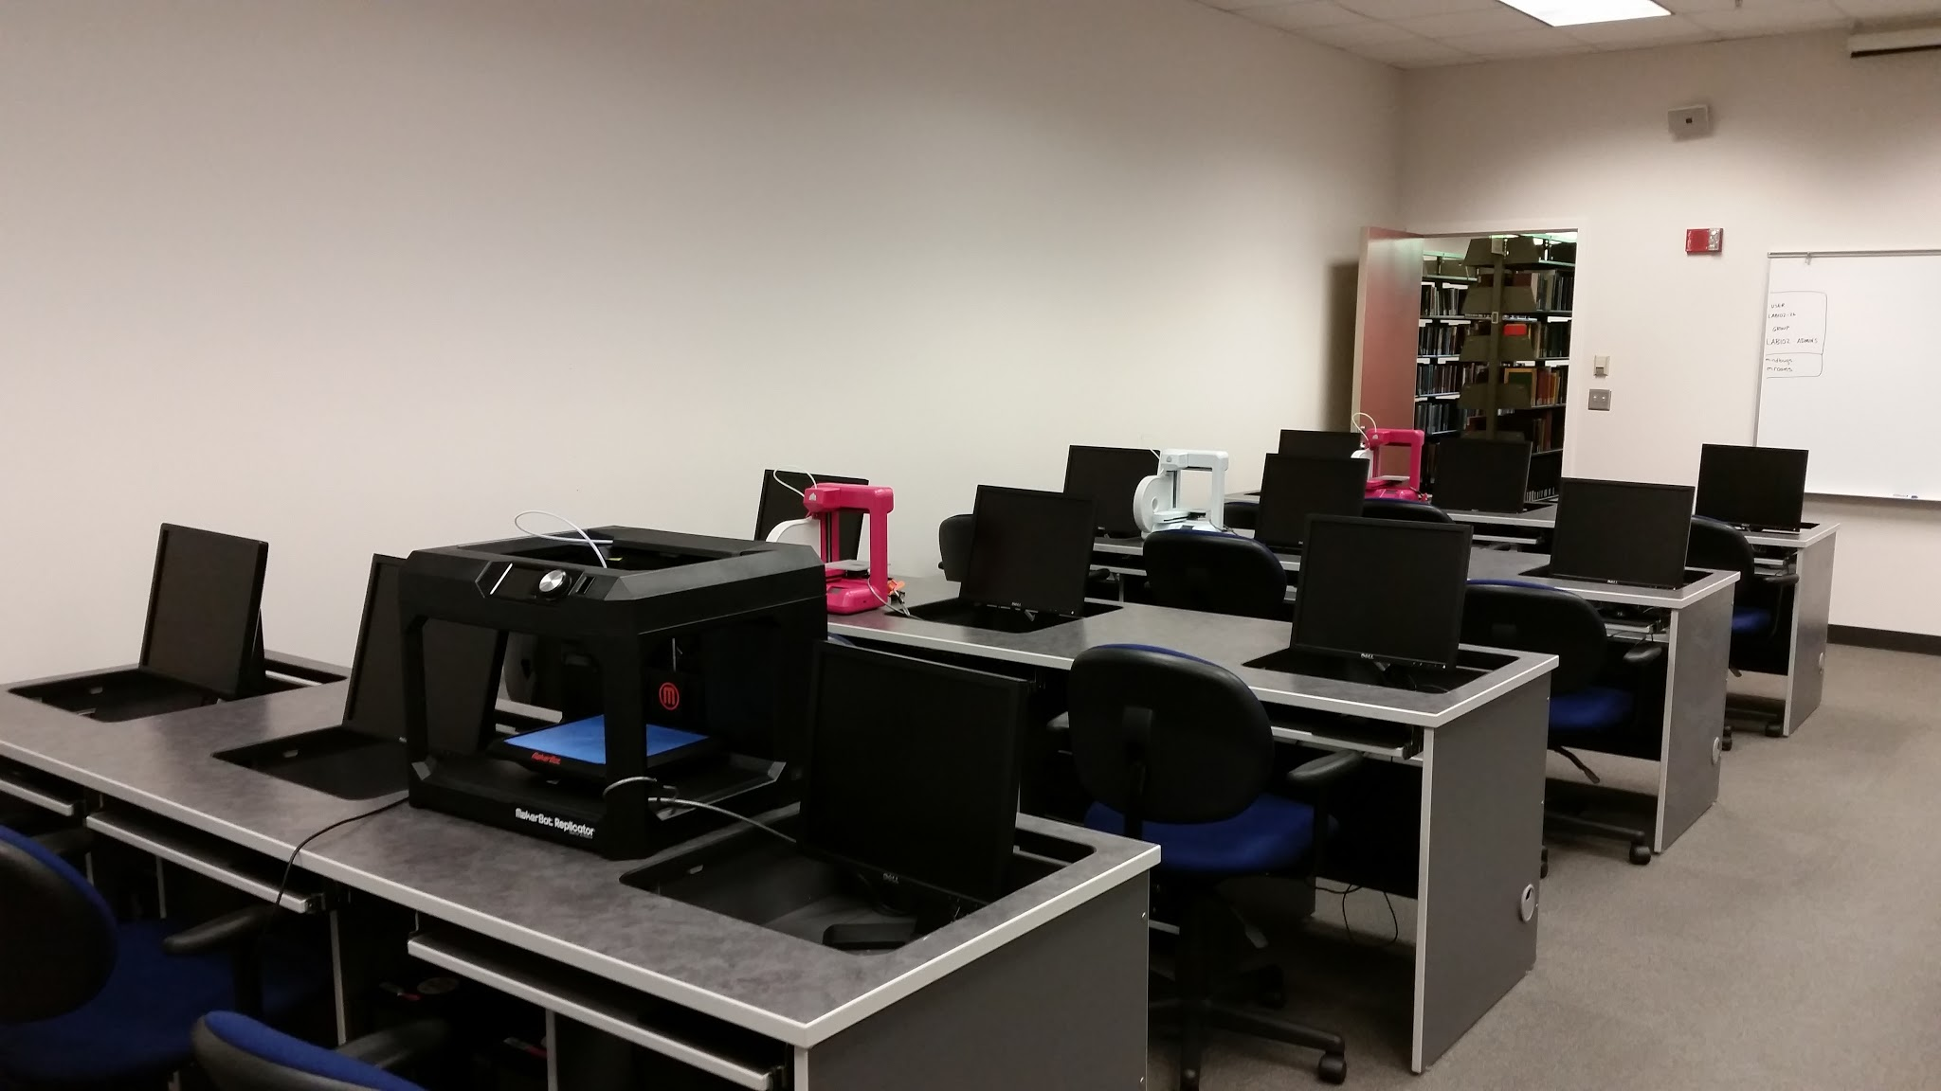
© Kristin Sorensen CC BY
© Anita Walz CC BY
© Anita Walz CC BY
© Kristin Sorensen CC BY
© Anita Walz CC BY
© Anita Walz CC BY
© Kristin Sorensen CC BY

Slide 13
NCR - New Services and Spaces
Proactive and Reactive
Event Capture
3D Printing
Campus Computing Connection
Upgraded Group Study Rooms
Partnership w/ Architecture Dept Library

Slide 14
Collaborative Efforts
Historical Context
Current Strategies & Tasks
Future Directions

Slide 15
Historical Context
Organizational Structure (reporting)
Distance Librarian
Existing Relationships (library liaisons)
Reorganization & Retirements
Notes:
Reorg plans + President Sands highlighted the need to intentionally reconnect.

Slide 16

Current Strategies (1 year plus)
Initiate New Face to Face Connections
Identify Needs and Service Gaps
Extend Services and Opportunities
Explore Marketing/Awareness Options
Plan Next Steps
© Toni Lozano CC BY http://www.flickr.com/photos/quiero-un-pantano/176909201
Notes:
opportunities and services (ScholCom, info about eReserves, various opportunities currently available ONLY on campus…)
Reciprocal borrowing, dealing with lost book returns (and student fines)
Build on strengths (group study rooms), talented and connected RC staff,
WHO to talk with about these things ….

Slide 17
Current Tasks
Assess Spaces and Services
Understanding Various NCR Sites
Explore & Extend Services (any geography)
Persistently Expand In-Class Engagement
Communicate about Changes in Blacksburg
Notes:
Pursuing more intentional engagement by the library with various locations, department, units, research groups, and administrators in the NCR.

Slide 18
Future Directions
Connect, connect, connect . . .
Notes:
Connect NCR locations, Blacksburg, ARECS (Extension sites), services, partners
Inform Liaisons
Infrastructure: Training for employees there,
Partners - LISA, VTIP, and NLI

Slide 19
Future Directions
Improve Communication Channels
Develop & Convey a Clear Message (and name)
Develop a “Research Software Sandbox”
Advocate for Staff Knowledge & Partnerships
Explore Outreach to Distance Faculty/Students
Create Processes & Expand to Other Sites
Notes:
WRITING CENTER
Connect NCR locations, Blacksburg, ARECS (Extension sites), services, partners
Inform Liaisons
Infrastructure: Training for employees there,
Partners - LISA, VTIP, and NLI

Slide 20

Challenges
Communication
Competing Work Responsibilities
Embedded Cultural Practices
Change is Effortful & Requires Mindfulness
© Mykl Roventine CC BY NC https://www.flickr.com/photos/myklroventine/3261364899

Slide 21
What We Are Learning
We asked ourselves the question
What are we learning?
“it feels like the answers are infinite in terms of landscape, interactions & impact”

Slide 22
What We Are Learning
Updating requires . . .
  Expenses for Furniture and Equipment
  Knowledge of Issues & Opportunities
  Creating Systems that Didn’t Exist Before
  High Level of Mindfulness and Effort

Slide 23
What We Are Learning
People and Relationships are Critical
  Getting New Employees Connected
  Face Time
  Open Communication

Slide 24
Discussion
http://creativecommons.org/licenses/by-nc-sa/3.0

