Slide 1





CS 4624 Multimedia, Hypertext, and Information Access
Professor Edward A. Fox | Virginia Tech, Blacksburg 24061
CONTAINER CLUSTER
Casey Haney • Ashutosh Pant
Camellia Pastore • Bethlehem Teshome
May 13, 2021

Slide 2
Contents
Project Objectives
The DLRL Cluster
Future Work
Assessment of Work

Slide 3





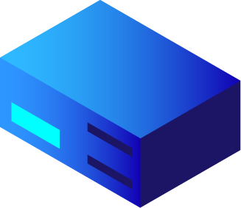


1.OBJECTIVES & SUMMARY

Slide 4

Migrated CS 5604 software from CS container cluster to DLRL
Made necessary changes to ensure operability
Documented new cluster structure for future reference

Slide 5


2. THE DLRL CLUSTER

Slide 6
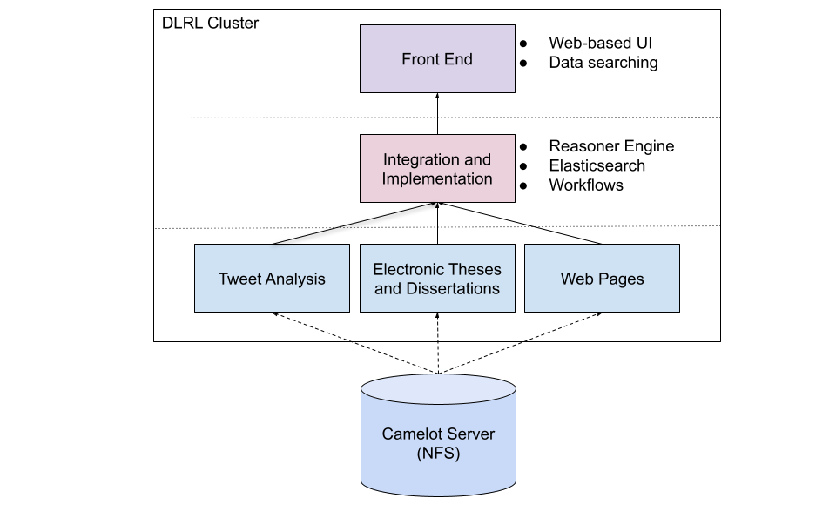

Slide 7
Container Clusters: CS, DLRL
 | CS | DLRL
# Nodes | 9 | 3
Namespaces | 12 | 7
Kubectl Version | 1.15.5 | 1.20.4
Deployed Images | 23 | 49
Rancher | Yes | No

Slide 8
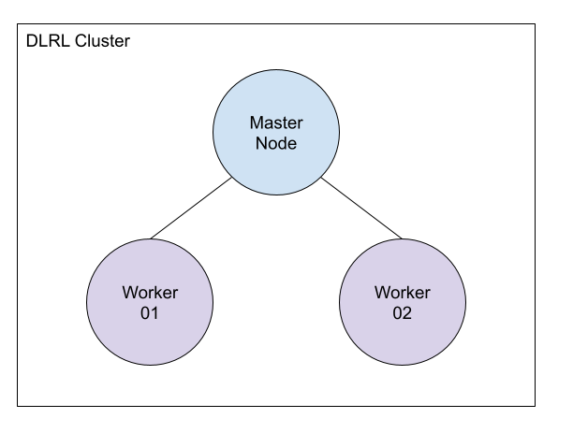
Significant Changes
All data stored in NFS
Rancher not utilized
3 node cluster - no known performance issues

Slide 9
3. FUTURE WORK

Slide 10
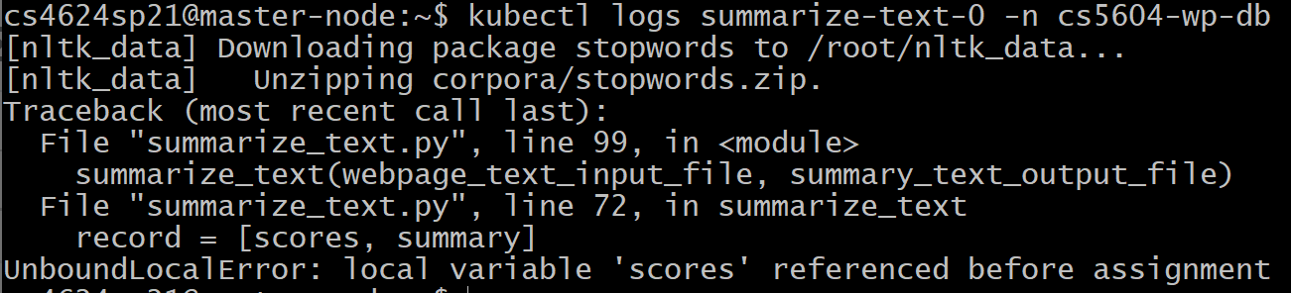
Small Changes
Additional changes to suit user needs
Application error debugging

Slide 11
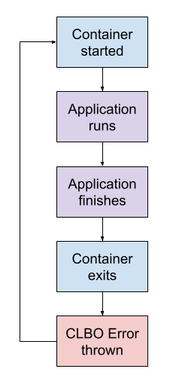
“Dangling Containers”
Many containers stuck in CrashLoopBackOff error states
Most errors come from containers exiting incorrectly
Must be fixed on the application level

Slide 12
4. ASSESSMENT OF WORK

Slide 13
 | Excellent | Average | Poor
Teamwork | X
Documentation |  | X
Objective completion | X
Quality of Work | X
Timeline Adherence |  |  | X

Slide 14

Major Takeaways
Learning new technology quickly
Resource utilization
Kubernetes debugging
Problem scope assessment
Networking with professionals
Delegation of tasks
Support for teammates

Slide 15
Thank you to:
Prashant Chandrasekar
Ola Karajeh
Edward Fox
Xinyue Wang
& the amazing VT Tech Staff!

Slide 16
References
Docker Inc. Why Docker? Docker, 2020. [Online]. Available:https://www.docker.com/why-docker. [Accessed: 15-Apr-2021].
VMware Inc. Kubernetes Cluster. VMware Inc., 2021. [Online]. Available:https://www.vmware.com/topics/glossary/content/kubernetes-cluster. [Accessed: 16-Apr-2021].
The Kubernetes Authors. Production-Grade Container Orchestration. The Linux Foundation, 2021. [Online]. Available:https://kubernetes.io/. [Accessed: 15-Apr-2021].
R. Osnat. A brief history of containers: From the 1970s till now. Container, Serverless& Cloud Native Application Security. [Online]. Available:https://blog.aquasec.com/a-brief-history-of-containers-from-1970s-chroot-to-docker-2016

Slide 17

Thank you for listening
Any questions?

