Slide 1
TaxDataDashboard
Courtney Anderson, Matthew Grillo, Namrata Inamti, Vishnu Sankaran
CS4624 -Multimedia, Hypertext, and Information Access
Dr. Edward Fox
Virginia Tech, Blacksburg, VA 24061
May 9, 2023

Slide 2
Outline
Client
Project Overview
Deliverables
Timeline
Work Completed
Future Work
Challenges
Solutions
Lessons Learned
Acknowledgements
References

Slide 3

Client
Dr. Florian Zach
Assistant Professor, Howard Feiertag Department of Hospitality and Tourism Management, Pamplin College of Business, Virginia Tech.

Slide 4
Project Overview
US non-profit organization’s tax filings are published publicly by the IRS.
Two prior project teams put together a database containing the tax data.
For the dataset to be useful to Dr. Zach in his research, correlations between interesting data points must be visualized.

Slide 5
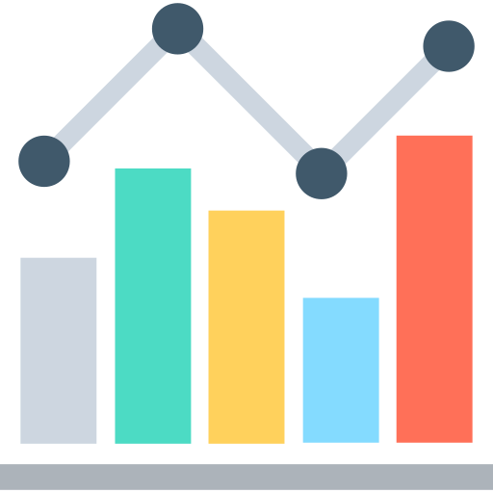


Deliverables
Data Visualizations
Dashboard
Documentation & Instructions

Slide 6
Timeline
Become familiar with the database and make sure the data is up to date.
Second round of visualizations and building the dashboard.
February
April
March
First round of visualizations and gender identification.

Slide 7
Work Completed
Visualizations
Completed list of visualizations provided by Dr. Zach, as well as some visualizations that we thought could be interesting.
Dashboard
Dashboard that showcases all of the visualizations in one easily accessible place.
Documentation & Instructions
Provided well-documented code that is easily changed to output graphs for different groups of EINs.

Slide 8
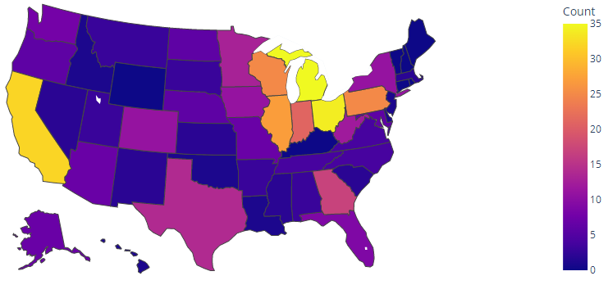
Visualization: Number of Organizations Per Year

Slide 9
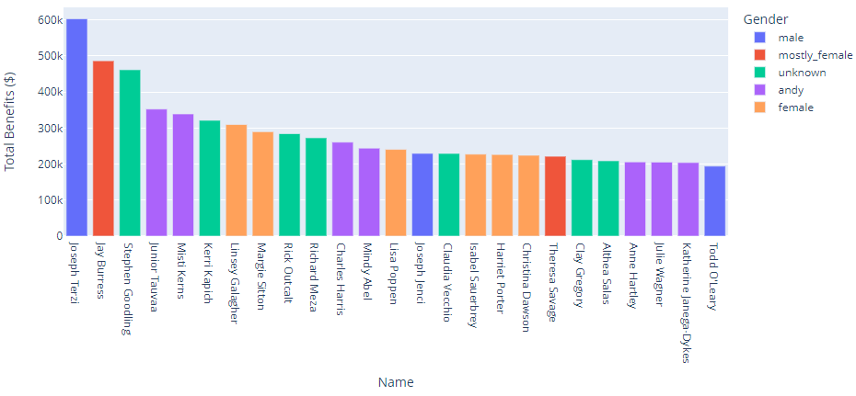
Visualization: Top 25 Highest Paid Employees

Slide 10
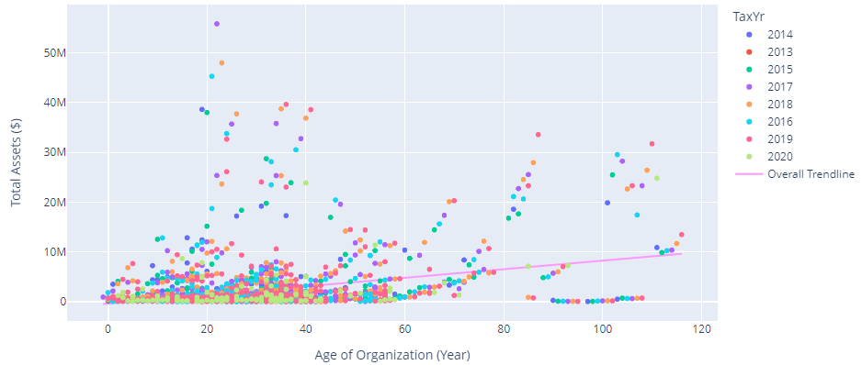
Visualization: Total Assets vs. Age of Organization

Slide 11
Future Work
Modify Database
Change the database to have one table for each form type rather than for each year.
Ensure there are no duplicates in the database.

Slide 12
Challenges
Duplicate Data
It was discovered that there is duplicate data in the database.
Number of Tables
There is currently a table for each year of data for each type of form, for a total of 189 tables.

Slide 13
Solutions
Duplicate Data
Write a script that removes all the duplicate entries from the database.
Number of Tables
Write a script that combines all of the tables into one table for each form type.

Slide 14
Lessons Learned
Documentation
Having well-documented code is crucial to a successful project, but so is documentation on the data within a database.

Slide 15
Acknowledgements
Dr. Florian Zach
Dr. Edward Fox
Past CS 4624 Teams
  Spring 2022
  Fall 2022

Slide 16
References
https://www.flaticon.com/
https://htm.pamplin.vt.edu/directory/zach.html
http://hdl.handle.net/10919/109974
http://hdl.handle.net/10919/112875

