Slide 1
CLA Team
Final Presentation
CS 5604 Information Storage and Retrieval
FALL 2017
12/15/17
Virginia Tech
Blacksburg, VA 24060
Team Members:
Ahmadreza Azizi
Deepika Mulchandani
Amit Naik
Khai Ngo
Suraj Patil
Arian Vezvaee
Robin Yang
Notes:
Deepika : I can start with the introduction

Slide 2
Contents
Team Objectives
Hand Labeling Process
HBase Schema
Class Cluster Training And Classifying Process
Current Trained Models
Webpage Classification Model Testing
Results
Future Improvement
Acknowledgement
Q&A
Notes:
Deepika : I can start with the introduction. I can mention our general goal and how the textbook helped us(Dr Fox was asking to mention that)

Slide 3
Team Objectives
Map collection names to their corresponding real world event.
Hand label over 2000+ webpages and tweets for training data.
Classify tweets and webpages to their corresponding event.
  Tweets:
    Classified 1,562,215 solar eclipse tweets.
  Webpages:
    Classified 3,454 solar eclipse webpages.
    Classified 912 Las Vegas 2017 Shooting webpages
Provide reusable code for future teams.
Notes:
Khai Ngo: I’m presenting this slice

Slide 4

Hand Labeling Process
Tweets:
  Provided a script for hand labeling in the class cluster:
    Access tweets in HBase
    Filter out unrelated tweets based on collection names
    Display each tweet and store the input label
    Store labels, clean texts, and several useful fields to a CSV file
Provided below is a screenshot of how our tweet hand labeling script works:
Notes:
Khai Ngo: I’m presenting this slice

Slide 5
Hand Labeling Process
Webpages:
  Reading webpage content from a CSV file of the class cluster data downloaded on our local machine
  Filtering out the unrelated webpages
  Writing the labels into that CSV file on the local machine
Notes:
Khai Ngo: I’m presenting this slice

Slide 6
getar-cs5604f17 HBase Table Interactions
The classification process reads and writes to a shared HBase database table
This shared table follows a HBase schema defined this semester
Each document is stored in a row
Each row has columns to store data about that document
Each column falls under a column family defined for the table
HBase tables must be configured with column families before interaction
All classification processes that involve HBase interactions will validate the table
  Existence of the table itself
  Existence of the expected table column families
Classification process HBase table interaction for table “getar-cs5604f17” defined next slide
Notes:
Robin Yang

Slide 7
getar-cs5604f17 HBase Table Interactions
Column Family | Column | Usage | Example
metadata | collection-name | Input collection filter | "#Solar2017"
metadata | doc-id | Input tweet/webpage filter | "tweet"
clean-tweet | clean-text-cla | Input clean tweet text | "stare eclipse hurts listen news"
clean-tweet | sner-organizations | Input sner text | "NASA"
clean-tweet | sner-locations | Input sner text | "Virginia"
clean-tweet | sner-people | Input sner text | "Thomas Edison"
clean-tweet | long-url | Input tweet URL | "https://www.cnn.com/news/sun_hurts"
clean-tweet | hashtags | Input tweet hashtags | "#Solar2017"
clean-webpage | clean-text-profanity | Input webpage clean text | "stare solar elcipse hurts eyes"
classification | classification-list | Output document classification classes | "2017EclipseSolar2017;NOT2017EclipseSolar2017"
classification | probability-list | Output classification class probabilities | "0.99999999;1E-9"
Notes:
Robin Yang

Slide 8
Running the Classification Process
Many input arguments to configure the execution
  Run modes: train, classify, hand label
  Document type: webpage, tweet, w2v
  Source and destination HBase tables
  Event name and collection name
  Class name strings (minimum 2 classes defined)
.sh bash scripts should be used to call spark-submits to run the code
  Makes handling input arguments much easier
  Quickly call multiple runs for various configurations such as classify one event for multiple collections
Any execution configurations using HBase will validate the defined tables just in case
Notes:
Robin Yang

Slide 9
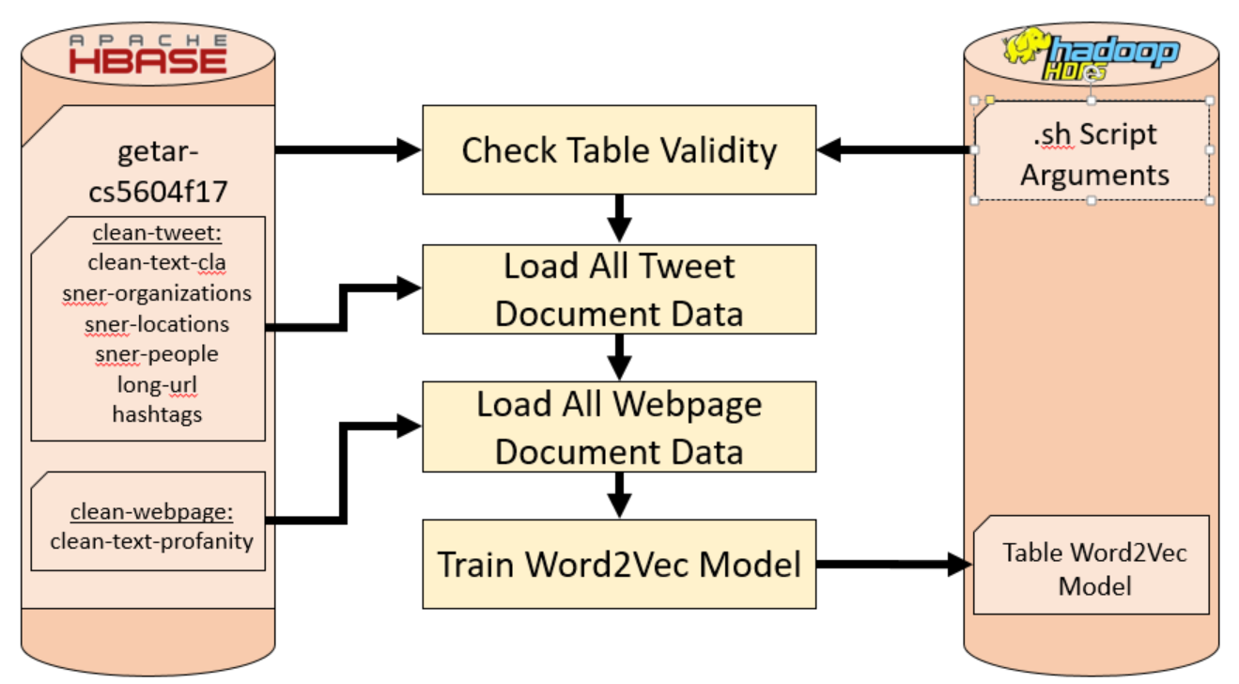
Training Word2Vec Model
Notes:
Robin Yang

Slide 10
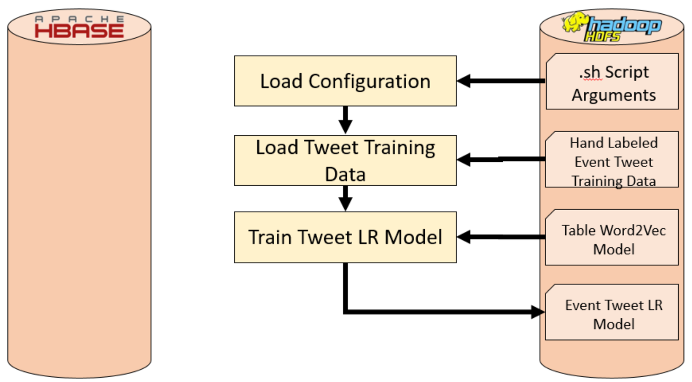
Training Tweet LR Model
Notes:
Robin Yang

Slide 11
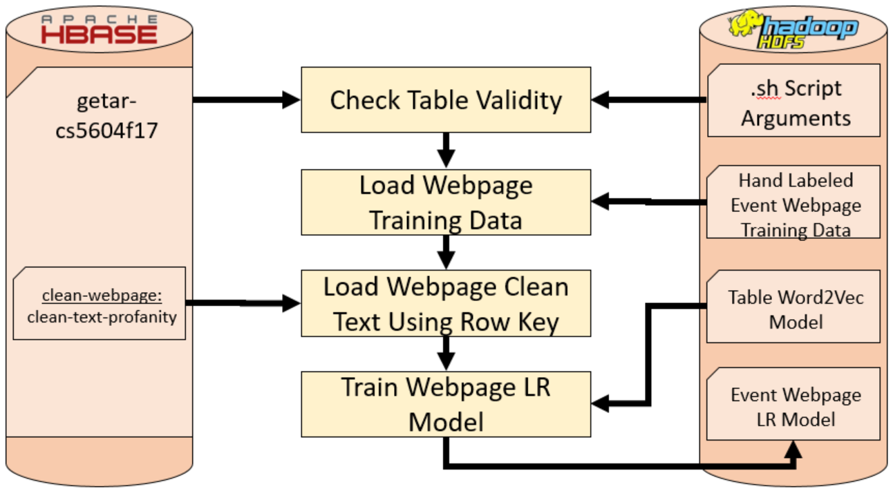
Training Webpage LR Model
Notes:
Robin Yang

Slide 12
Training Logistic Regression Models
Training Word2Vec model
  300 billion word pre-trained Google Word2Vec model cannot be converted to Spark Word2Vec model due to Spark model size restrictions
  Cannot iteratively train Spark Word2Vec models
    All training data must be loaded into one large data structure in one go
    Makes training on local machines difficult due to memory limitations
  Settled for training off of all documents in getar-cs5604f17 for now
  Only trained off of all column values we look at for classification
  Long training time - up to 1 hour for all 3.3 million documents in “getar-cs5604f17” as of 06 DEC 2017
Training LR models
  Train one model for tweet and one for web pages per event
  Webpage data trained off of table using rowkey input due to large clean text size
  80:20 training:testing document set using random split
  Fast training time - within 15 seconds per model for ~600 hand labeled documents
Notes:
Robin Yang

Slide 13
Current Trained Models On Class Cluster
Getar-cs5604f17 Word2Vec Model
  42,350,232 vocabulary count model
  Trained off all documents in table as of 06 DEC 2017
Logistic Regression Models
  Metrics on next 3 slides for :
    2017EclipseSolar2017 tweet LR model
    2017EclipseSolar2017 webpages LR model
    2017ShootingLasVegas webpages LR model
  The F-1, recall, and precision metrics are correct despite the coincidence
    If “False Positive = False Negative”, then “Recall = Precision”
    If “Recall = Precision”, then “Recall = Precision = F-1 Score”
    Poorer performing models had differing recall, precision, and F-1 score.
Notes:
Robin Yang

Slide 14
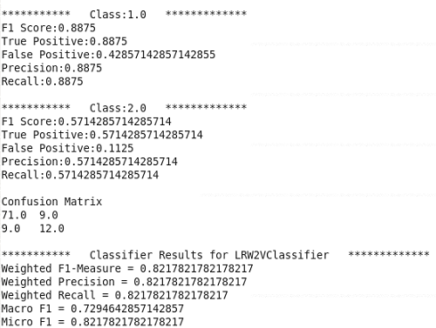
2017EclipseSolar2017 Tweet LR Model

Slide 15
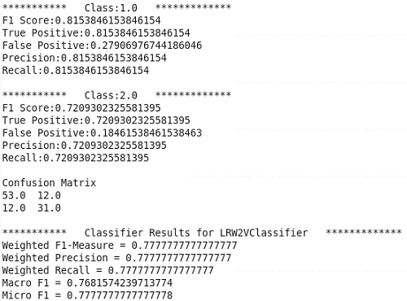
2017EclipseSolar2017 Webpage LR Model

Slide 16
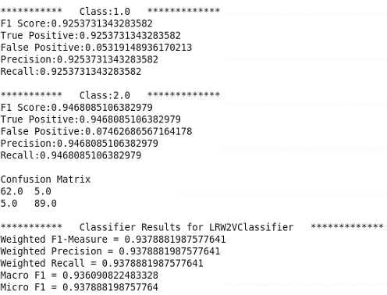
2017ShootingLasVegas Webpage LR Model

Slide 17
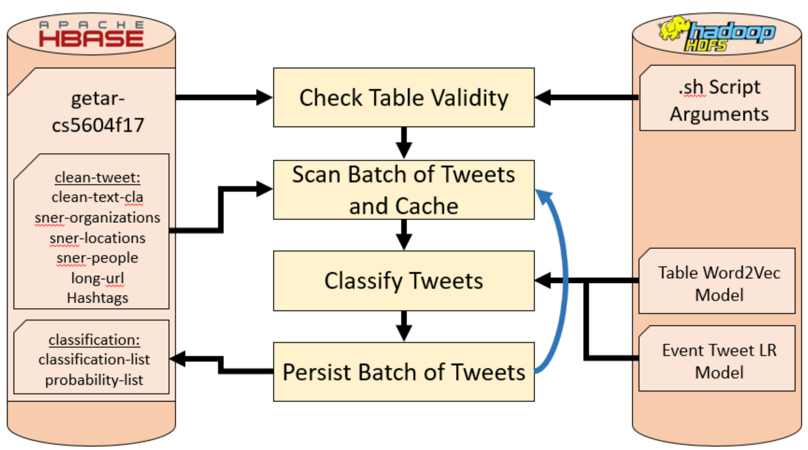
Tweet Classification Predicting
Notes:
Robin Yang

Slide 18
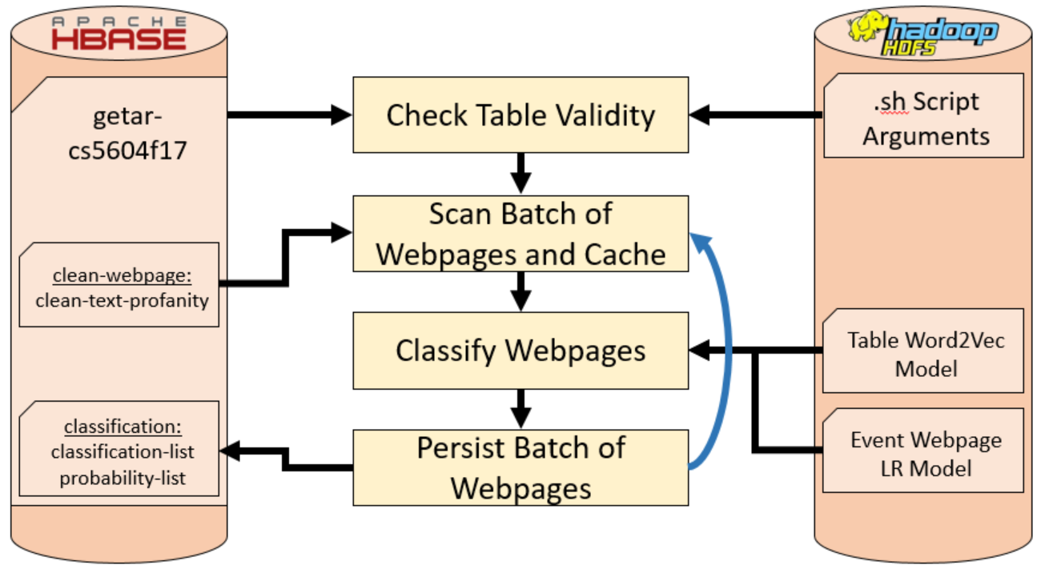
Webpage Classification Predicting
Notes:
Robin Yang

Slide 19
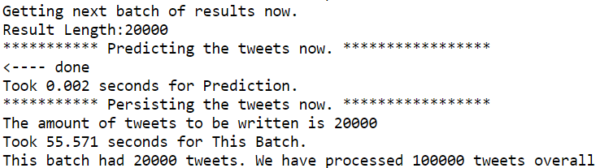
Classification Performance Metrics
Scanned document batches are cached for quicker processing
0.01~0.04 seconds to classify a batch of 20,000 tweets
0.06~0.09 seconds to classify a batch of 2,000 webpages
To scan a batch of documents, classify, and save:
  ~33 webpages / second classified - ~60 seconds average for full batch process
  ~360 tweets / second classified - ~55 seconds average for full batch process
Why longer time for full process over only classifying a batch of documents?
  99% of time is loading and writing to the HBase table
  Scan and write time can unpredictably vary tens of seconds depending on how busy the table is
Notes:
Robin Yang

Slide 20
Web Page Classification
Experiments
Tweets and webpages are very different
Major Hurdles:
  Cleaning
  Amount of text information (Normalization)
  Ads, URLs, images, graphical content, etc. (Collection Modality)
  Document Structure
Feature Selection Methodologies
  TF-IDF, Word2Vec, Chi-Squared statistic, Information gain, etc.
Classification Algorithms
  Multi-Class Logistic Regression, SVM, Multi-layer Perceptron, Naive Bayes
Notes:
Suraj Patil: I am presenting this slide

Slide 21
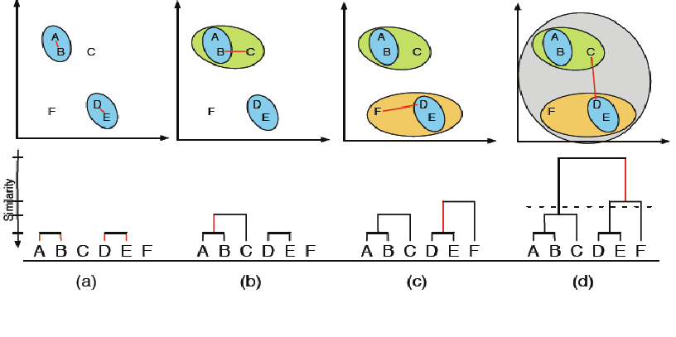
Web Page Classification Experiments
1st Iteration
Hierarchical Classification
  Agglomerative approach
Combine classes to larger classes
Distance matrix
  Single, Complete, Centroid Linkages
3 demo codes in Python tested on Local data
Binary Classifiers-Due to flexibility. They can be made to design a hierarchical classifier
Notes:
Suraj Patil: I am presenting this slide

Slide 22
Web Page Classification Experiments
2nd Iteration
Python + Spark
School Shooting
We implemented the following feature selection and classification technique combinations
Hand Labelling
Noise
Doc2Vec
1461 Webpages
Word2Vec
  LR
  SVM
TF-IDF
  LR
  SVM
Doc2Vec
  LR
  SVM
Notes:
Suraj Patil: I am presenting this slide

Slide 23
Web Page Classification Experiments
3rd Iteration
Solar Eclipse
  Hand labeled 550 and tested on 110 webpages
Vegas Shooting
  Hand labeled 800 and tested on 200 webpages
Word2Vec
  LR
  SVM
TF-IDF
  LR
  SVM
Notes:
Suraj Patil: I am presenting this slide

Slide 24
Results
Solar Eclipse Collection
Hand Labeled 550 (80/20 split for training testing)
Type of model used | Precision | Recall | F-1 Score
TF IDF- LR | 0.89 | 0.73 | 0.80
TF IDF- SVM | 0.89 | 0.8 | 0.84
Word2Vec- LR | 1.0 | 0.75 | 0.85
Word2Vec- SVM | 1.0 | 0.75 | 0.85
Notes:
Deepika: I can speak about this

Slide 25
Results
Vegas Shooting Collection
Hand Labeled 800 (75/25 split for training testing)
Type of model used | Accuracy | Precision | F-1 Score
TF IDF- LR | 0.68 | 0.80 | 0.58
TF IDF- SVM | 0.68 | 0.80 | 0.58
Word2Vec- LR | 0.67 | 0.82 | 0.54
Word2Vec- SVM | 0.73 | 0.82 | 0.64
Notes:
I added this slide for the results of vegas shooting:
Deepika: I can speak about this
@Deepiki: sure, you can present this one too, just notice that it is different from the previous slide that we have “Accuracy” instead of “recall”, also mention that W2V+SVM was very slow. (Arian)
@Arian: Thanks

Slide 26
Class Cluster Results
Classified collections for events defined in the provided authoritative collection table
Classified Following Tweet Collections
  #Eclipse2017
  #solareclipse
  #Eclipse
Classified Following Webpage Collections
  Eclipse2017
  #August21
  #eclipseglasses
  #oreclipse
  VegasShooting
Notes:
Robin Yang

Slide 27
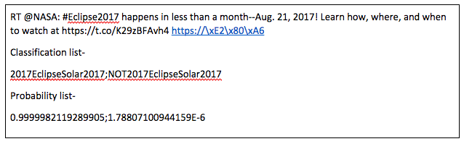
Class Cluster Classification Examples
Tweet related to the Solar Eclipse event classified correctly

Slide 28
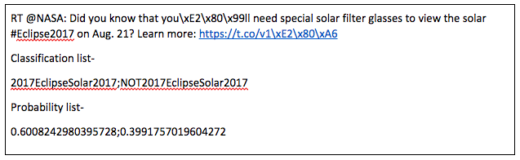
Class Cluster Classification Examples
Tweet related to the Solar Eclipse event classified correctly

Slide 29
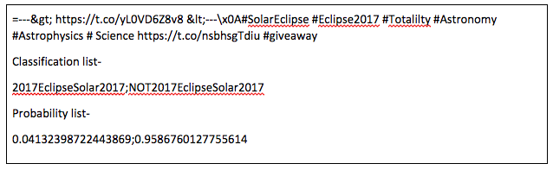
Class Cluster Classification Examples
Tweet not related to the Solar Eclipse event classified correctly

Slide 30
Future Improvements
Hand labeling code
  Sample random rows taken across the table rather than from the top of the table
  Sample across multiple collection names of the same real world event.
  Add a script to label webpages.
Override Spark Word2Vec Model code to support >(2³²⁻¹) vocabulary size
Automate reading an event-name-to-collection-name table classification
Hierarchical classification
The use of PySpark
Notes:
Amit Naik: I’ll talk about this

Slide 31
Acknowledgements
Dr. Edward Fox
NSF grant IIS - 1619028, III: Small: Collaborative Research: Global Event and Trend Archive Research (GETAR)
Digital Library Research Laboratory
Graduate Teaching Assistant - Liuqing Li
All teams in the Fall 2017 class for CS 5604

Slide 32
QUESTIONS?

Slide 33
Thank You

