Slide 1

Web-App for Merging Traffic Data
Team Members: Srinjoy Dey, Blake Marterella, Jake Horowitz, Ryan Szilvasi, and Ashton Smith
CS 4624: Multimedia/Hypertext Capstone
Instructor: Mohamed Farag
Virginia Tech, Blacksburg VA 24061, 3/25/25

Slide 2
Project Description + Requirements
Create Web App to do following:
Take three input files (road network, traffic volume, crashes)
Merge files into one combined dataset based on location
Allow users to download combined dataset
Allow users to visualize merged data
Allow users to access past collections/merges

Slide 3
Review of Problem Statement
This project focuses on preparing and merging three key traffic datasets—traffic volume, road network, and crash records—into a unified database that will serve as a critical input for a crash prediction model. The datasets currently cover highways and interstates across Virginia, and our work lays the groundwork for enabling accurate and data-driven crash forecasting

Slide 4
Deliverables
Completed Web application (frontend + backend)
User Manual
Developer Manual
Project Report

Slide 5
Backend Design
Flask-based backend connected to a Postgres database using Docker
Core Components
  Flask + SQLAlchemy: Lightweight, flexible, and scalable with direct SQL support
  PostgreSQL + PostGIS: Powerful geospatial querying and indexing
  Geopandas: Used for efficient geojson processing and uploading
Designed to ingest, process, and return GeoJSONs for seamless frontend visualization
Capable of handling large datasets with complex geometries

Slide 6
Backend Features
Endpoints
  Authentication
    POST /auth/register
    POST /auth/login
  Upload/Validation
    POST /upload_lrs, /upload_traffic_volume, /upload crash_data
    POST /validate_lrs, /validate_traffic_volume, /valdate_crash_data
  Collections
    POST /create, /delete, /list, /get, /update
  Merge
    POST /merge/<collection_id>
  Visualize
    POST /visualize_collection/<collection_id>

Slide 7


Frontend Design
Components
Layouts/
Pages/
Landing
Collections
Backend
routes
/
/auth
Auth
CollectionDetails
/dashboard
Settings
Dashboard
Upload
UploadService
end-users

Slide 8
Frontend Features
Reusable components
Admin Panel
The ability to create a new collection
  Specify name, description, and year to filter the collection
  Validate and upload 3 different datasets (crash data, traffic volume, road network)
  Create a new collection and initiate merge
View collection details
  Merge status and the duration of the merge
Visualize collection
  Interactive Map using React Leaflet
  Filter the roads displayed by ADT and total number of crashes

Slide 9
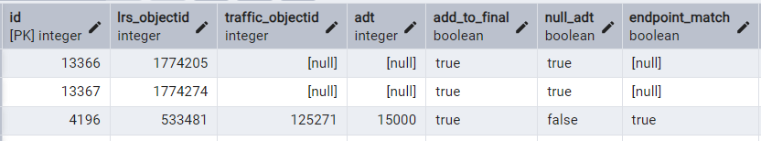
Merge #1
LRS + Traffic_Volume (ADT)
  Find all road segments that are within 2 meters of each other
    Use three booleans for each match
      Endpoint_match - Are the matched endpoints within two meters of each other
      Null_adt - Should the adt be null
      Add_to_final - Should this match be added to the final table

Slide 10
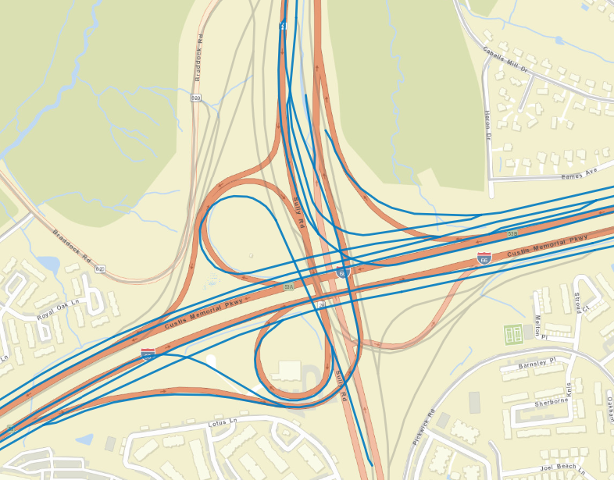
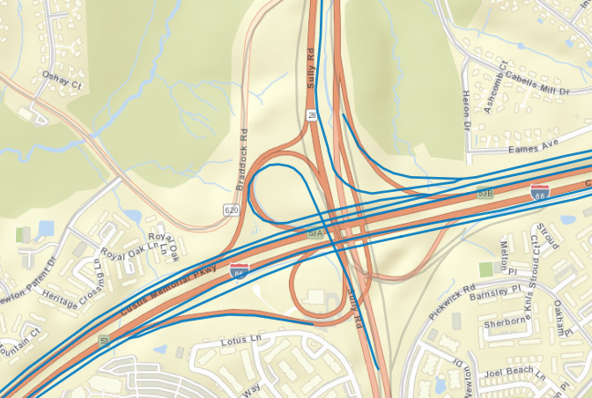
LRS Edge Route Overlap with I-66E and I-66W intersects with VA-28N and VA-28S
VDOT Bidirectional Traffic Volume showing the same road structure, but with slightly different geometries
Blue road segments are interstates in both images, while the gray segments are all other types of roads

Slide 11
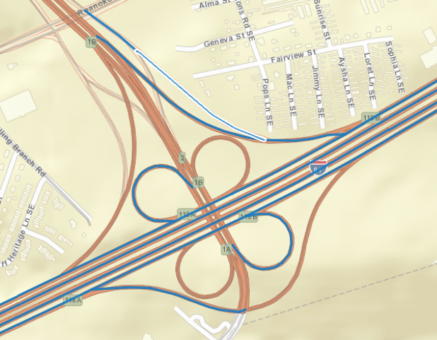
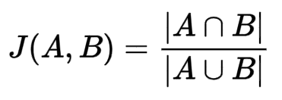
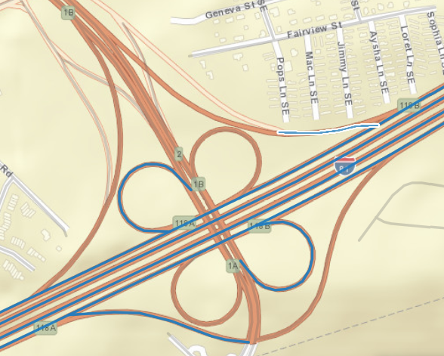
Merge #1
LRS
LRS with a single match
  Use endpoint_match to check if this single match is valid
LRS with multiple matches
  Score each match and the highest score is chosen
    Jaccard score + endpoint match bonus
Traffic Volume

Slide 12
Merge #2
LRS + Traffic_Volume + Crashes
  Add crashes to LRS road segment within 10 meters
  Count the total number of crashes per LRS road segment

Slide 13
Challenges
Solutions
Extremely large file sizes for uploading and merging
Road geometries were slightly off due to differing organizations gathering data
Testing and verifying the merge was working properly was difficult
State management between pages in the frontend
Filtered out only necessary information, i.e. interstates
Utilized functions to make geometries slightly bigger in order for an intersection to occur
Manually checked most entries to ensure edge cases were handled
Added in custom hooks to pass data between components

Slide 14
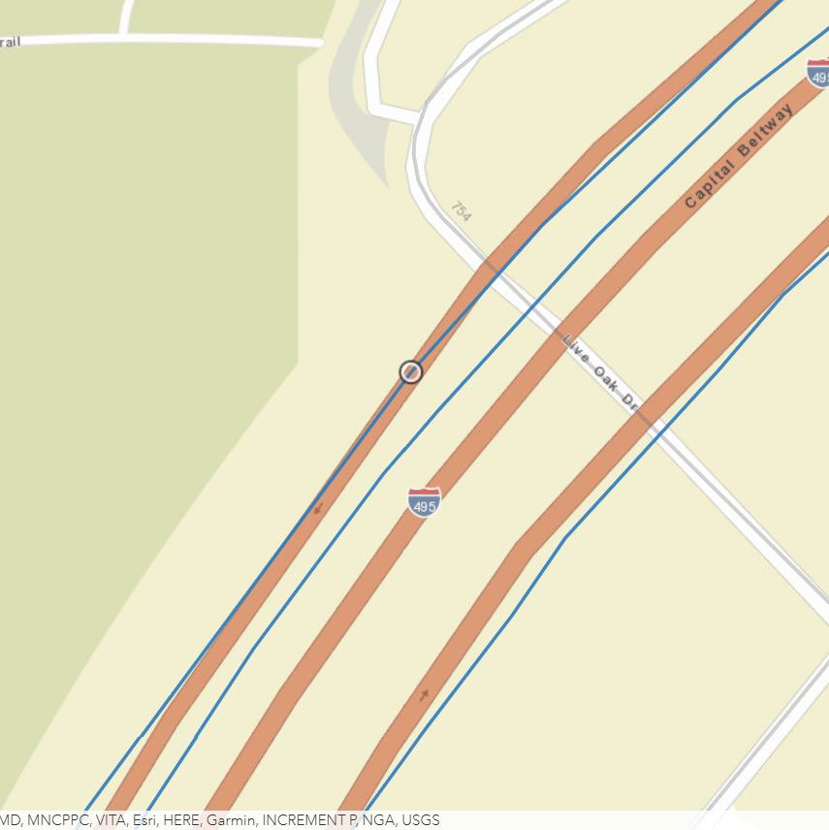
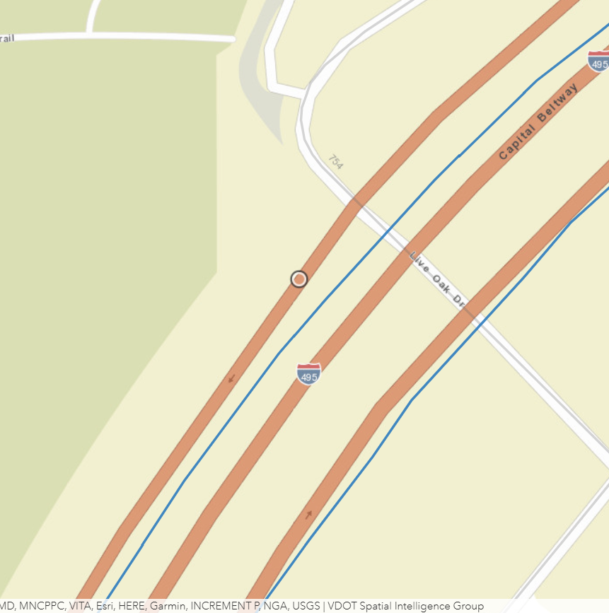
LRS Edge Route Overlap coordinate (-77.19, 38.96) on I-495
The same coordinate but on VDOT Bidirectional Traffic Volume, showing different geometries

Slide 15
Future Work & Enhancements
Optimize merging algorithm
  Takes about five minutes to complete the merge, which might be able to be sped up
Provide the user capabilities to view more columns within the dataset
  If the user wanted to view the start and end point or the county the road is in, they would be able to select such columns from the database, which would affect the SQL commands
Incorporate different road types
  Right now, we are only viewing interstates, which possibly the user will be able to select the roads they want to see, but this would increase time for both uploading and merging
Develop better testing methodology
  Manually checking each point works, however, is very inefficient

Slide 16

Acknowledgements
Client & Instructor:
Mohamed Farag
mmagdy@vt.edu
Dr. Farag, Virginia Tech Transportation Institute

Slide 17
Demo

