Slide 1
Marine Blender
By Zach Shaffer, Henry Macht, Mitchell Campbell, and Adrian Shirazi
Clients: Dr. Lisa Durbeck, Dr. Peter Athanas
CS4624: Multimedia, Hypertext, and Information Access
Professor Fox
Virginia Tech, Blacksburg VA 24061, 05/12/2023

Slide 2
Outline
Project Refresh
Current Status
Project Structure
Next Steps
Acknowledgements

Slide 3
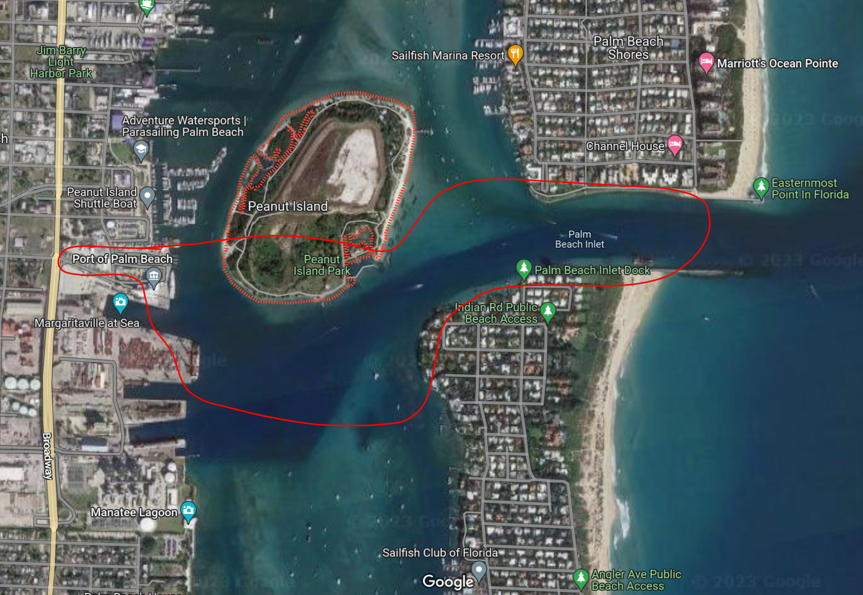
Project Refresher
Model a section of the Florida intracoastal waterway environment in Blender
Dr. Lisa Durbeck’s goal is to train an onboard optical sensor to help boats navigate

Slide 4

Current Status
Completed model of the intercoastal waterway
Created and placed assets in the environment
Rendered images and video of scene

Slide 5
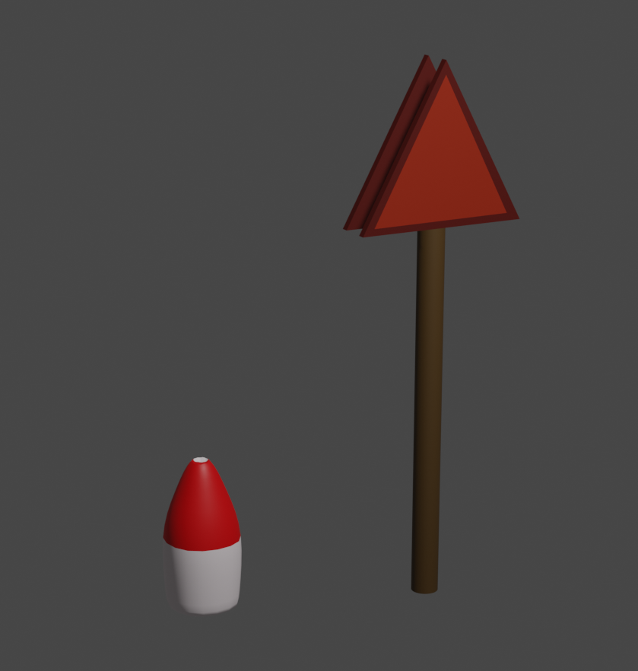
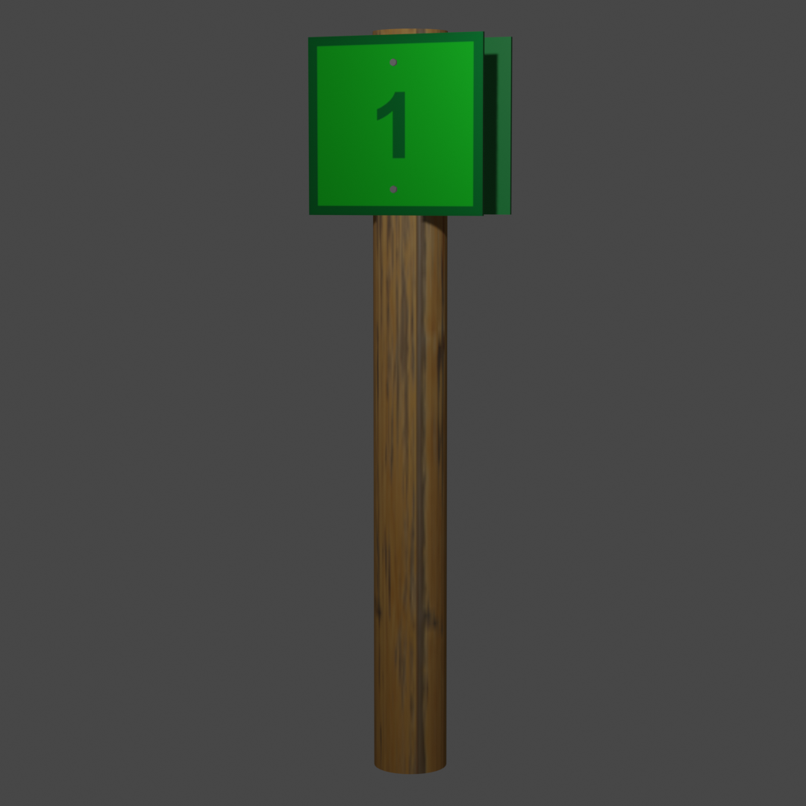
Implemented Assets List
Object Name | Object Type
Water | Scene Object
Land | Scene Object
Sky | Scene Object
Sun (Lighting) | Scene Object
Buoy/Markers/Signs | Static Object
Barge | Static Object
Sailboat | Dynamic Object

Slide 6
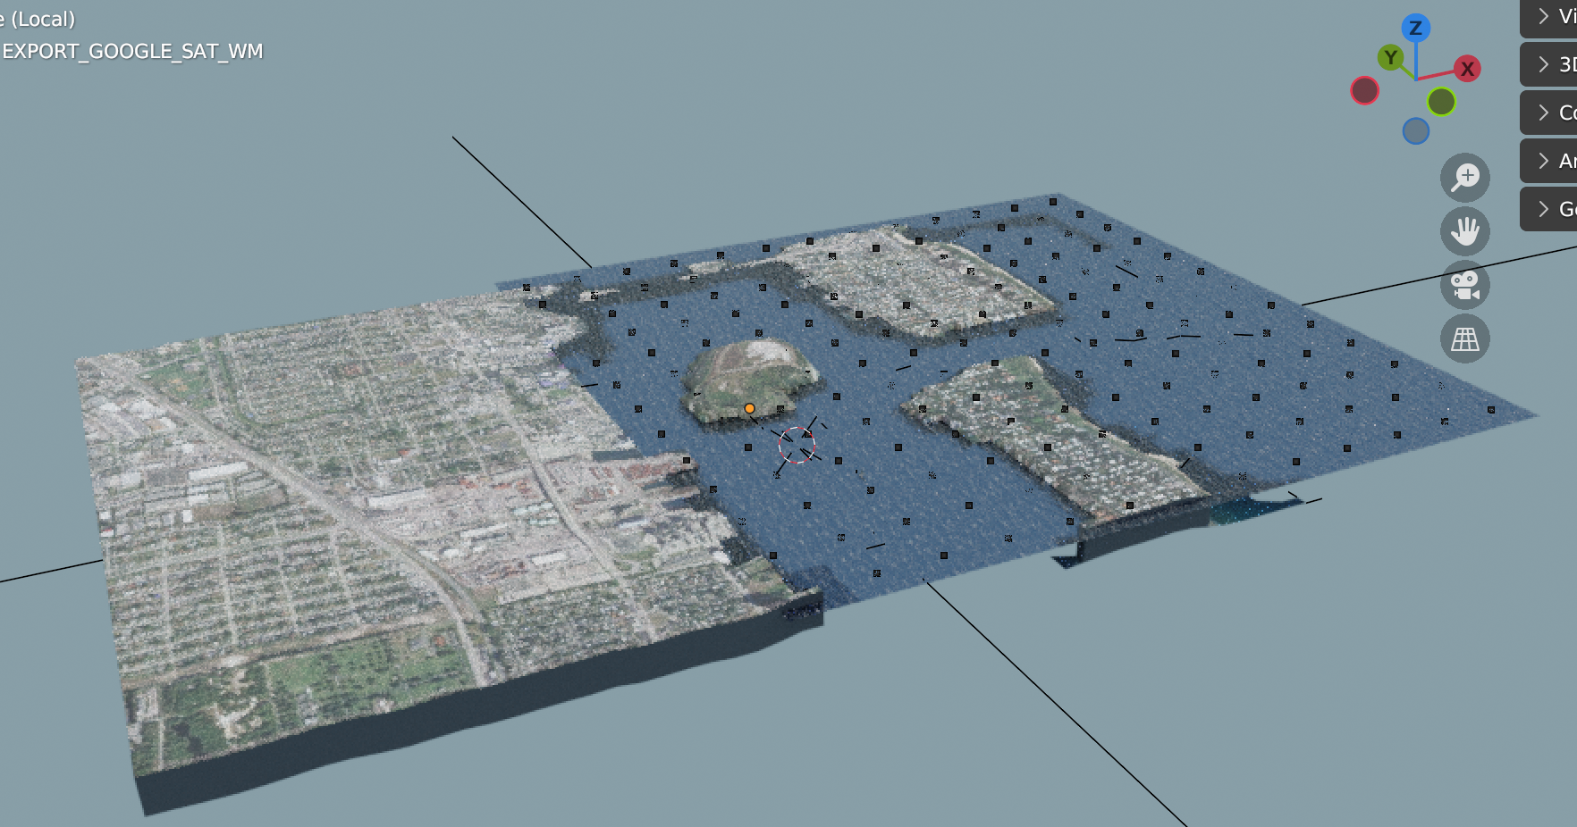
Our World
GIS data
  Elevation data
  Satellite imagery
Created main land as well as Pauntu island

Slide 7
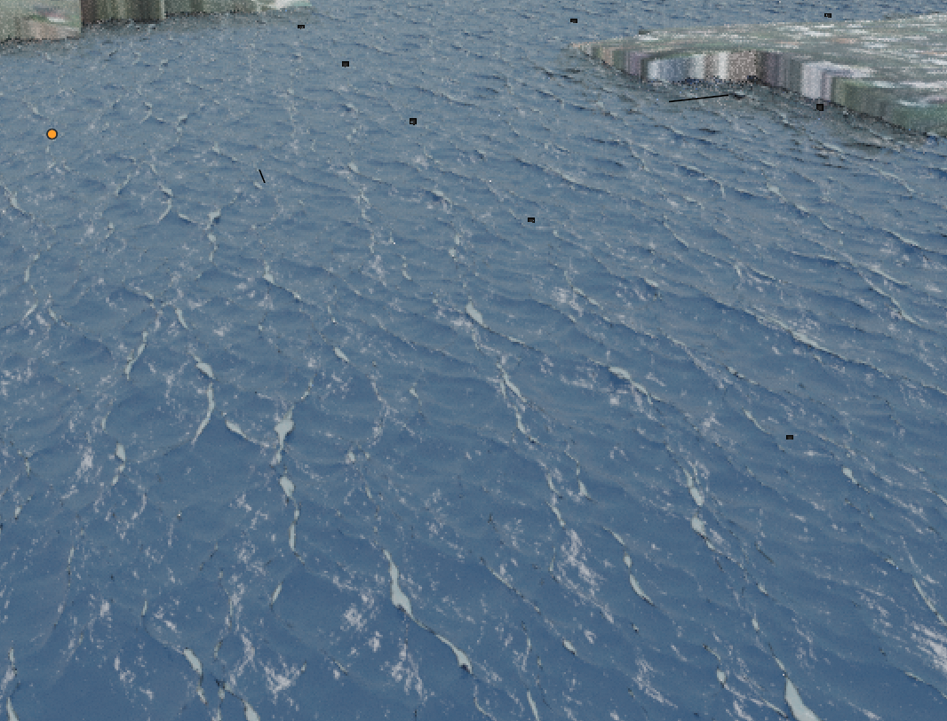
Ocean Model
Dynamic ocean model
Renders at a steady 30 fps
Sized proportionate to land, but may be adjusted to be up to 30x larger without a performance decrease
Testing done using a viewport resolution of 15

Slide 8
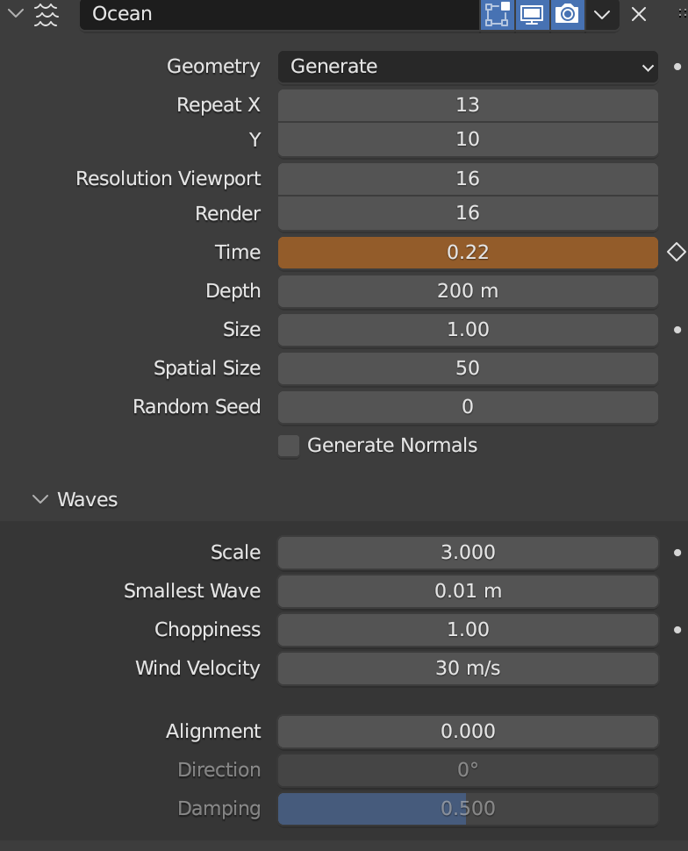
Adjusting Ocean Model
Simulate different weather conditions
Can increase/decrease size of waves via choppiness and wind velocity
Can increase/decrease land area the ocean covers

Slide 9
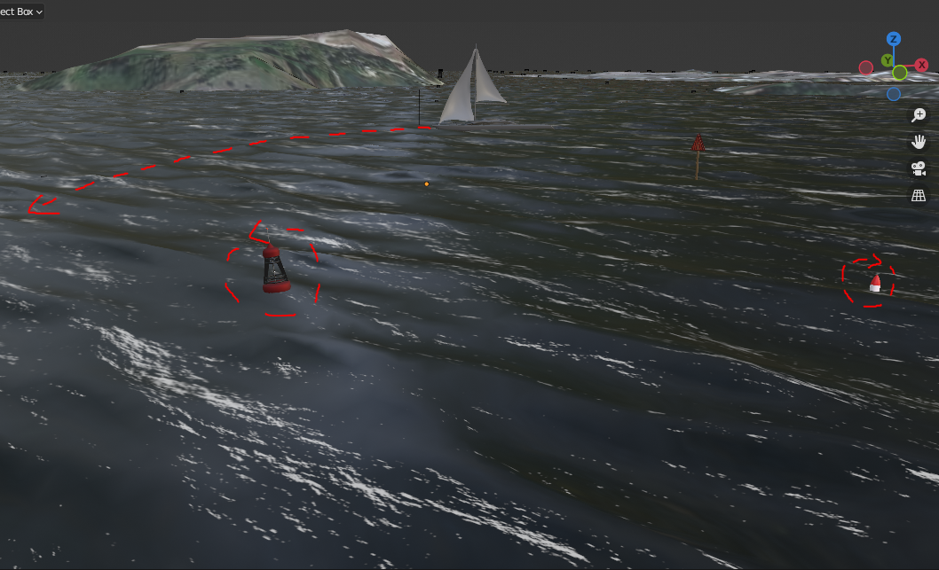
Object Animation
Objects interact with the water
Moving Boat
Floating buoys
Moving Camera

Slide 10
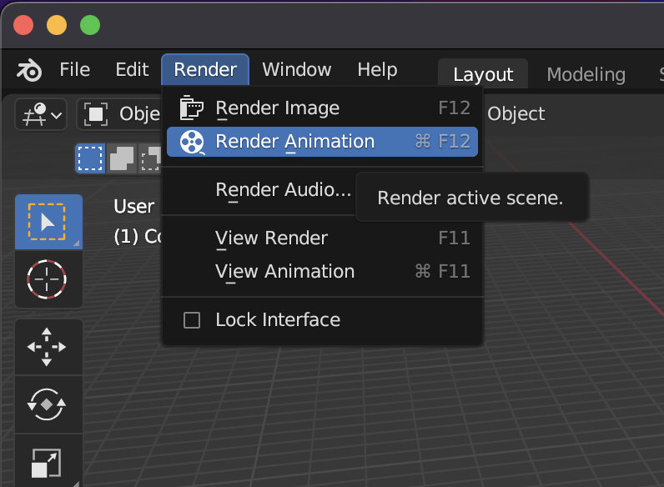
Rendering Scene
Produces final scene animation
30 Frames per second
Sample video took about 2 hours

Slide 11
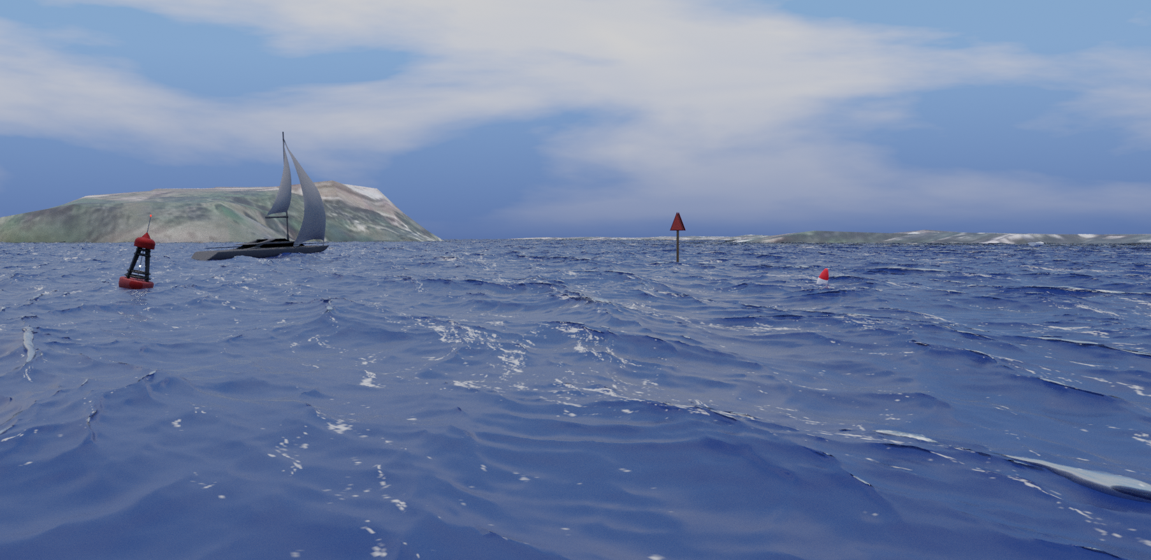

Slide 12
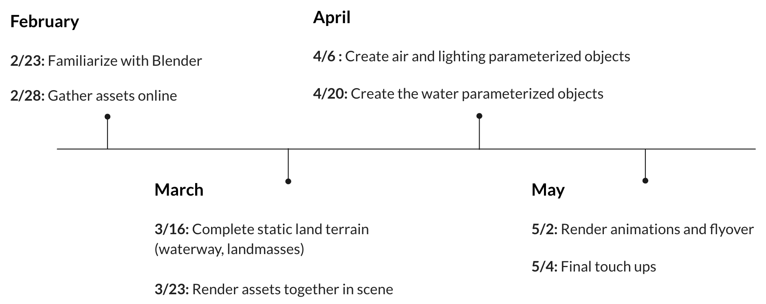
Timeline

Slide 13

Moving forward
Config file that populates the world with assets based on user input
More lighting and weather situations
More detail with environment, specifically the land

Slide 14
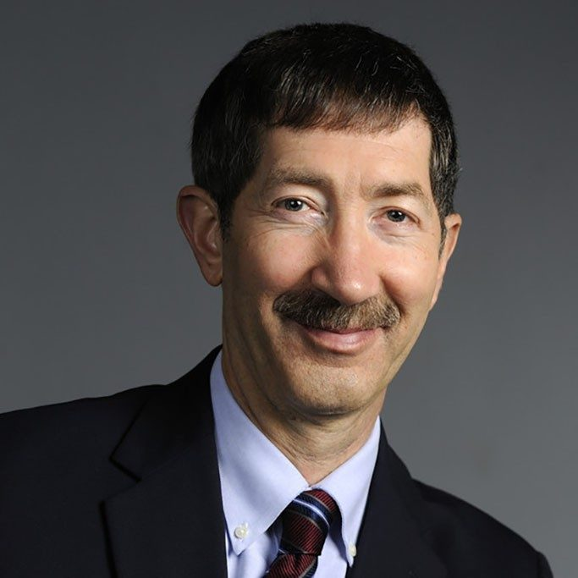

Acknowledgements
Professor Dr. Edward Fox
Cell Matrix Corporation:
  Dr. Lisa Durbeck
  Dr. Peter Athanas

