Slide 1



Using Analytical Hierarchy Process to Understand Smallholder Perceptions of Conservation Agriculture Adoption in Nepal and India.
Reed, B.F.,¹ Chan-Halbrendt, C.,¹ Tamang, B.B.,² Chaudhary, N.,³
Roul, P.⁴
¹ Dept. of Natural Resources and Environmental Management, University of Hawaii, USA
² Local Initiatives for Biodiversity, Research and Development, Pokhara, Nepal
³ Institute of Agriculture and Animal Science, Rampur, Nepal
⁴ Orissa University of Agriculture and Technology, Bhubaneswar, India

Slide 2
Introduction
Analytical Hierarchy Process (AHP) is a multi-criteria decision-making tool that breaks down difficult and complex problems into simple pairwise comparisons (Saaty, 2008).
Useful for group situations
Takes into account conflicting viewpoints and strength of preferences
Fosters conciliation and consensus
Objectively measures qualitative value judgments
For these reasons, it is increasingly being used in the field of technology transfer.
Notes:
Features of AHP, reason for its use here.
Through simple pairwise comparisons, tribal and smallholder communities can communicate their understanding and perceived value of new technologies.

Slide 3
Objectives
  Using recent case studies from Nepal and India, demonstrate how AHP can support the adoption of conservation agriculture production systems(CAPS) by:
    Determining farmers and scientist preferences
    Identifying knowledge gaps.
  Identify other uses for AHP results.

Slide 4
CAPS
CAPS integrate traditional farming methods with CA practices to:
encourage adoption
increase long-term soil productivity
improve smallholder livelihoods.
Each CAPS consists of one or more practices: year-round soil cover, minimal tillage or crop rotation (SANREM CRSP, 2012)

Slide 5
Case Study Methods
  Identify the elements: goal, objectives and alternatives.
  Construct a decision hierarchy.
  Make pairwise comparisons of each element of the hierarchy with each other element on its level, and in the level(s) above it.
  Analyze data: Expert Choice.
Notes:
Both case studies used similar methods:
1. Identify the goal of the decision and select the objectives and alternatives that are most important to meeting the goal.
2. Construct a decision hierarchy with the goal on top, objectives in the middle and, on the lowest level, the alternatives or choices available to the decision-making body.
3. Using the goal, objective and alternatives (also referred to as “elements”), structure pairwise comparison matrices so that each element is compared to each other element in its tier, and so that each element in the tier below it is compared to each other element in the same tier with respect to it. These pairwise comparisons are made on 5, 7 or 9- point scales to indicate strength of preference.
4. For each element, weigh the preference strengths in the tier below it then add each element’s weighted values to obtain its overall preference weight. Continue the process until the overall preference weights are calculated for the alternatives in the bottom tier.
5.Determine the consistency of judgments using a consistency index, or CI. This metric is used to evaluate the quality of responses; if respondents contradict previous judgments in the process, this index increases. In most cases, this index should not exceed 0.10.

Slide 6
AHP Hierarchy
Notes:
Goal and Objectives same for both studies.

Slide 7
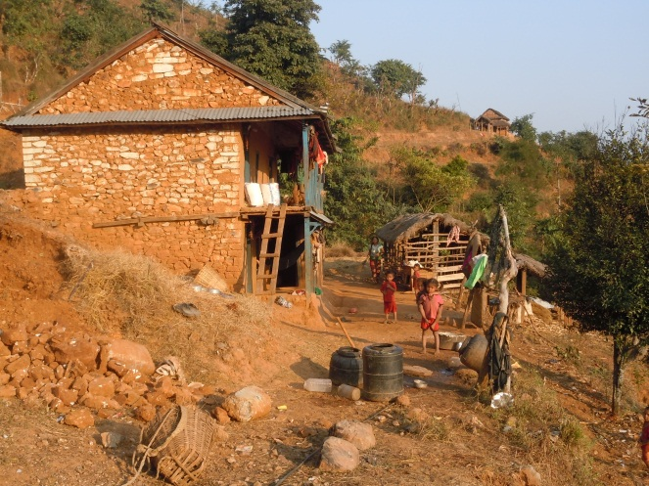
Case Study A: Study Site
  Conducted by Reed et al. (2002) at five sites in or near Pokhara, Nepal:
  Local Initiatives for Biodiversity Research and Development (LI-BIRD)
  The Institute of Agriculture and Animal Science (IAAS)
  Thumka
  Hykrang
  Khola Gaun
Notes:
In January 2012, AHP was conducted at a non-profit extension organization, Local Initiatives for Biodiversity Research and Development (LI-BIRD), a research organization, the Institute of Agriculture and Animal Science (IAAS), and the villages of Thumka, Hykrang, and Khola Gaun. LI-BIRD, a non-governmental organization located in Pokhara provides extension work for all three villages but also performs some research for other NGOs. IAAS focuses on research, which it provides for governmental, academic and development organizations.

Slide 8
Case Study A: Alternatives
Farmer Practice | Maize > Millet Conventional Tillage
CAPS 1 | Maize > Cowpea Conventional Tillage
CAPS 2 | Maize > Cowpea/Millet Intercrop, Conventional Tillage
CAPS 3 | Maize > Cowpea/Millet Intercrop, Minimal Tillage
Notes:
Maize-based systems with 2 growing seasons.

Slide 9
Case Study A: Results
 | IAAS | LI-BIRD | Thumka | Hyrkrang | Khola-Gaun
Profit | 0.17 | 0.25 | 0.101 | 0.087 | 0.104
Labor Saving | 0.123 | 0.14 | 0.087 | 0.148 | 0.052
Yield | 0.282 | 0.351 | 0.229 | 0.239 | 0.17
Soil Quality | 0.425 | 0.26 | 0.583 | 0.526 | 0.674
Improved Income | IAAS | LI-BIRD | Thumka | Hyrkrang | Khola-Gaun
T1 | 0.075 | 0.094 | 0.091 | 0.1 | 0.08
T2 | 0.169 | 0.286 | 0.477 | 0.491 | 0.348
T3 | 0.196 | 0.207 | 0.254 | 0.215 | 0.221
T4 | 0.561 | 0.413 | 0.178 | 0.193 | 0.351

Slide 10
Case Study A: Results

Slide 11
Case Study A: Results

Slide 12
Case Study A: Findings
  Objectives
  Soil quality rated highest overall (49%), indicating shared long term point of view among scientists and farmers.
  Labor savings rated lowest and may not motivate adoption.
  Alternatives
  Intercropped CAPS preferred by all.
  Farmers in two villages preferred conventional tillage over strip tillage with regard to profit and soil quality, indicating knowledge gap.
  Khola Gaun farmer preferences more in line with scientists than with other farmers.
Notes:
Objectives: Overall, the highest weighted objective in terms of improved income was soil quality (49%), followed by yield (25%), profit (14%), and labor saving (11%). Soil quality was identified as the most important contributor to improved income in all villages and by researchers (IAAS) (ranging from 43% to 67%; Figure 2). Extension staff at LI-BIRD weighted yield slightly higher than soil quality (35% and 26%, respectively).
Alternatives: Overall, CAPS 1 was weighted highest (35%) in terms of improved income and was followed by CAPS 3 (34%), CAPS 2 (22%), and farmer practice (9%). Extension agents and researchers weighted CAPS 3 (first season maize and second season millet and cowpea intercrop with minimum tillage) highest (average of 49%) while Thumka and Hykrang weighted CAPS 1 (first season maize and second season cowpea monocrop with conventional tillage) highest (average of 41%). Khola Gaun, weighted CAPS 1 and CAPS 3 almost equally (34.8% and 35.1%, respectively)
Overall, the villages and organizations weighted CAPS 1 and CAPS 3 highest and similarly in terms of potential profit (32% and 35%, respectively). In terms of labor savings CAPS 1 (38%) was weighted slightly higher than CAPS 3 (34%). Notably, labor savings is the only objective in which farmer practice (second season millet monocrop with conventional tillage) ranked higher than CAPS options. IAAS ranked farmer practice slightly higher than CAPS 2, as did Hykrang, while Khola Gaun ranked them nearly the same (a difference of 1.2 percentage points). This is likely due to high labor requirements associated with weeding and harvesting intercropped plots and the production of millet. Overall, CAPS 3 (35%) was ranked the highest for potential yields and was followed by CAPS 1 (30%). A similar weighting pattern described above was seen with yields; the organizations and Khola Gaun ranked CAPS 3 as having the most potential (average of 43%) while Thumka and Hykrang gave CAPS 1 the highest ranking (average of 39%).

Slide 13
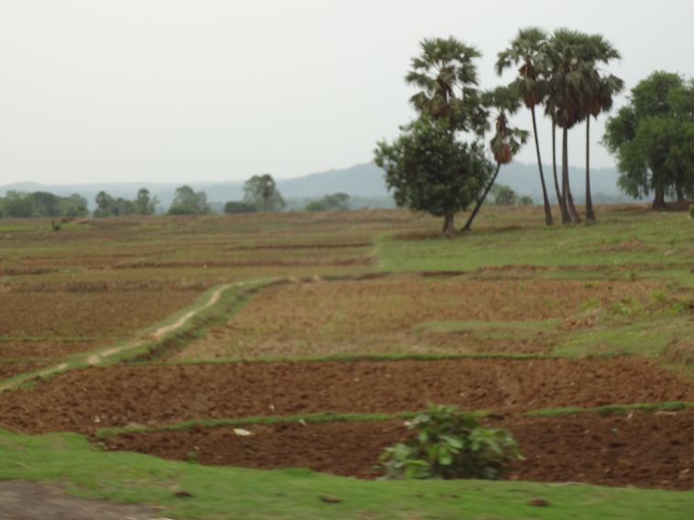
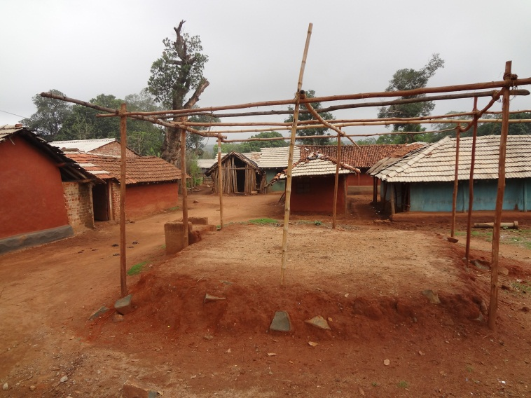
Case Study B: Study Site
  Conducted by Lai et al. (2011) at two sites in Odisha, India
  Orissa University of Agriculture and Technology, Bhubaneswar
  Tentuli Village, near city of Kendujhar.
Notes:
Interactive workshop, March of 2011, “Sustainable Management of Agroecological Resources for Tribal Societies”
Farmers and professionals survey (18 farmers, 17 professionals)

Slide 14
Case Study B: Alternatives
Farmer Practice | Maize monocrop Conventional Tillage
CAPS 1 | Maize monocrop Minimum Tillage
CAPS 2 | Maize/Cowpea Intercrop Conventional Tillage
CAPS 3 | Maize/Cowpea Intercrop, Minimum Tillage
Notes:
Maize-based, 1st season crops only.

Slide 15
Case Study B: Results
 | Tentuli | OUAT
Profit | 0.274 | 0.356
Labor Saving | 0.184 | 0.128
Yield | 0.329 | 0.245
Soil Quality | 0.213 | 0.271
Improved Income | Tentuli | OUAT
T1 | 0.141 | 0.103
T2 | 0.147 | 0.175
T3 | 0.366 | 0.25
T4 | 0.347 | 0.472
Notes:
Maize-based, 1st season crops only.

Slide 16
Case Study B: Findings
  Objectives
  Yield rated highest in villages (33%), profit rated highest by scientists (36%), indicating difference of perception in farmer needs.
  Profit rated second in villages (27%), soil quality rated third (21%) suggesting short-term perspective among farmers.
  Labor savings rated lowest and may not motivate adoption.
  Alternatives
  Intercropped CAPS preferred by all.
  Farmers value conventional tillage (37%) over strip tillage (35%), scientists highly prefer strip tillage (47%) indicating knowledge gap.

Slide 17
Conclusions
The use of AHP enabled researchers to:
  Determine that the long-term objective of soil quality was preferred in Nepal while short-term objectives of yield and profit were preferred in India
  Discover that labor savings may not motivate adoption
  Identify where extension services might be working best (Kola Guan)
  Reveal a clear, unanimous preference for adoption of new production systems and legume intercropping
  Determine that knowledge gaps regarding the effectiveness of minimum tillage exist in both study areas.

Slide 18
Conclusions
2. AHP provided useful data that may be
  Compared across time periods to evaluate project or extension effectiveness
  Combined with trial plot results to determine which CAPS are most likely to be adopted
  Used to re-align training and research efforts.
  AHP can provide valuable insight where quantitative agriculture information is scarce and complex decision-making is required. For this reason, it is an excellent candidate for use in conservation agriculture adoption efforts.

Slide 19
References
Lai, C., Chan-Halbrendt C., Halbrendt, J., Naik D. and Ray, C. 2011. “Farmers Preference of Conservation Agricultural Practices in Kendujhar, Odisha Using Analytical Hierarchy Process.” Published in the proceedings of the Second International Conservation Agriculture Workshop and Conference in Southeast Asia: Phnom Penh, Cambodia, 04-07 July 2011.
Reed, B.F, Chan-Halbrendt, C., Tamang, B.B. and Chaudhary, N. 2012. “Analysis of conservation agriculture preferences for researchers, extension agents and tribal farmers in Nepal using Analytical Hierarchy Process.” Unpublished Results.
Saaty, T.L., 2008. “Decision making with the analytic hierarchy process.” Int. J. Services Sciences 1(1), 83-98.

