Slide 1
VTCAR Final Presentation
CS 4624 - Dr. Fox
Virginia Tech - Blacksburg, VA 24061 - 5/3/16
Kyle Simmons, Steven Whitehead, Sebastian Welsh
Client: Dr. Julee Farley

Slide 2
Outline
Introduction
Old Website
Requirements
Website Prototype
Website Testing
Final Product

Slide 3
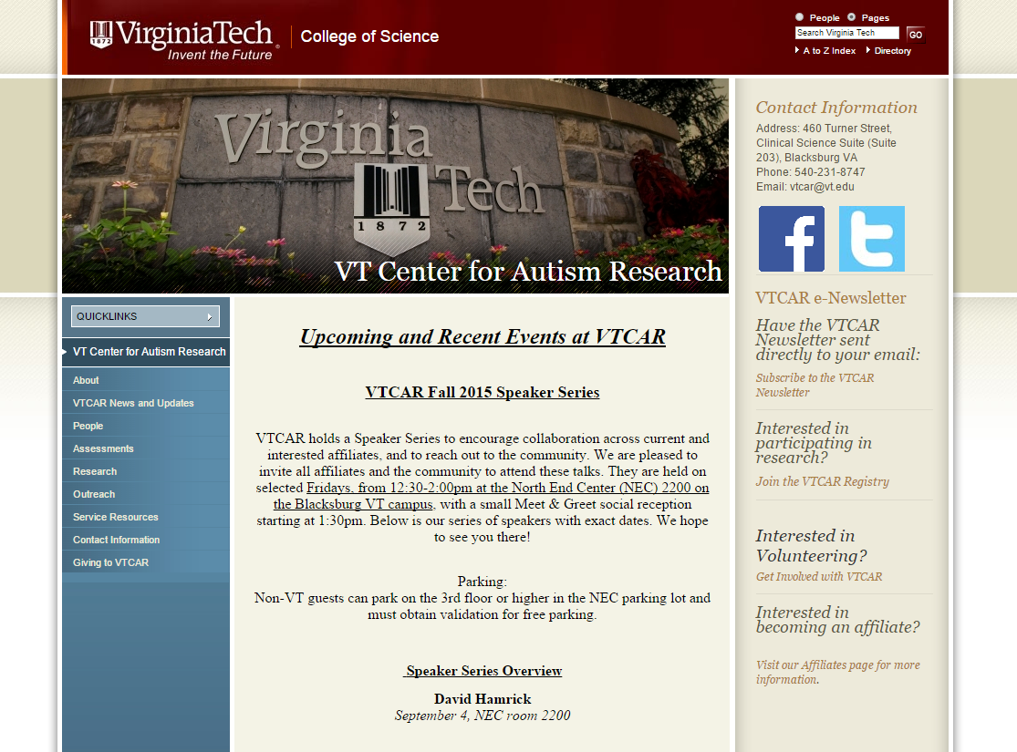
Improve VTCAR Website - Previous Home Page
- Generic photos
- Left and right sidebars
- Lots of links
- Narrow container for page-specific content
- Small text
- Outdated styles

Slide 4
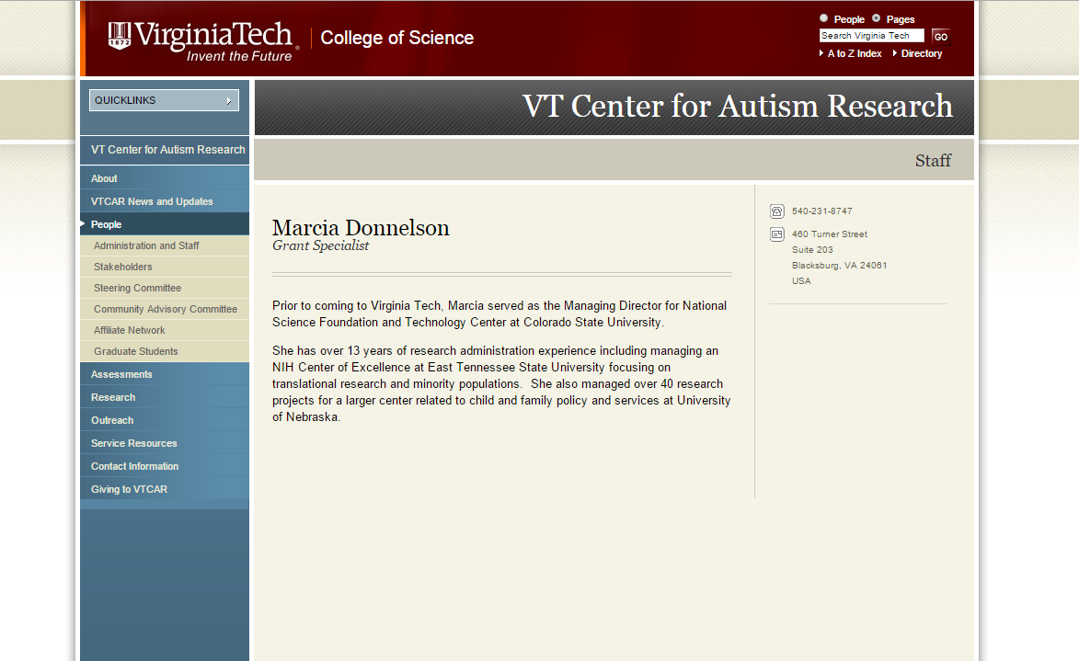
Old VTCAR Website cont. - People Page
- No photo of person
- Bland styling
- Small text
- Minimal biography

Slide 5
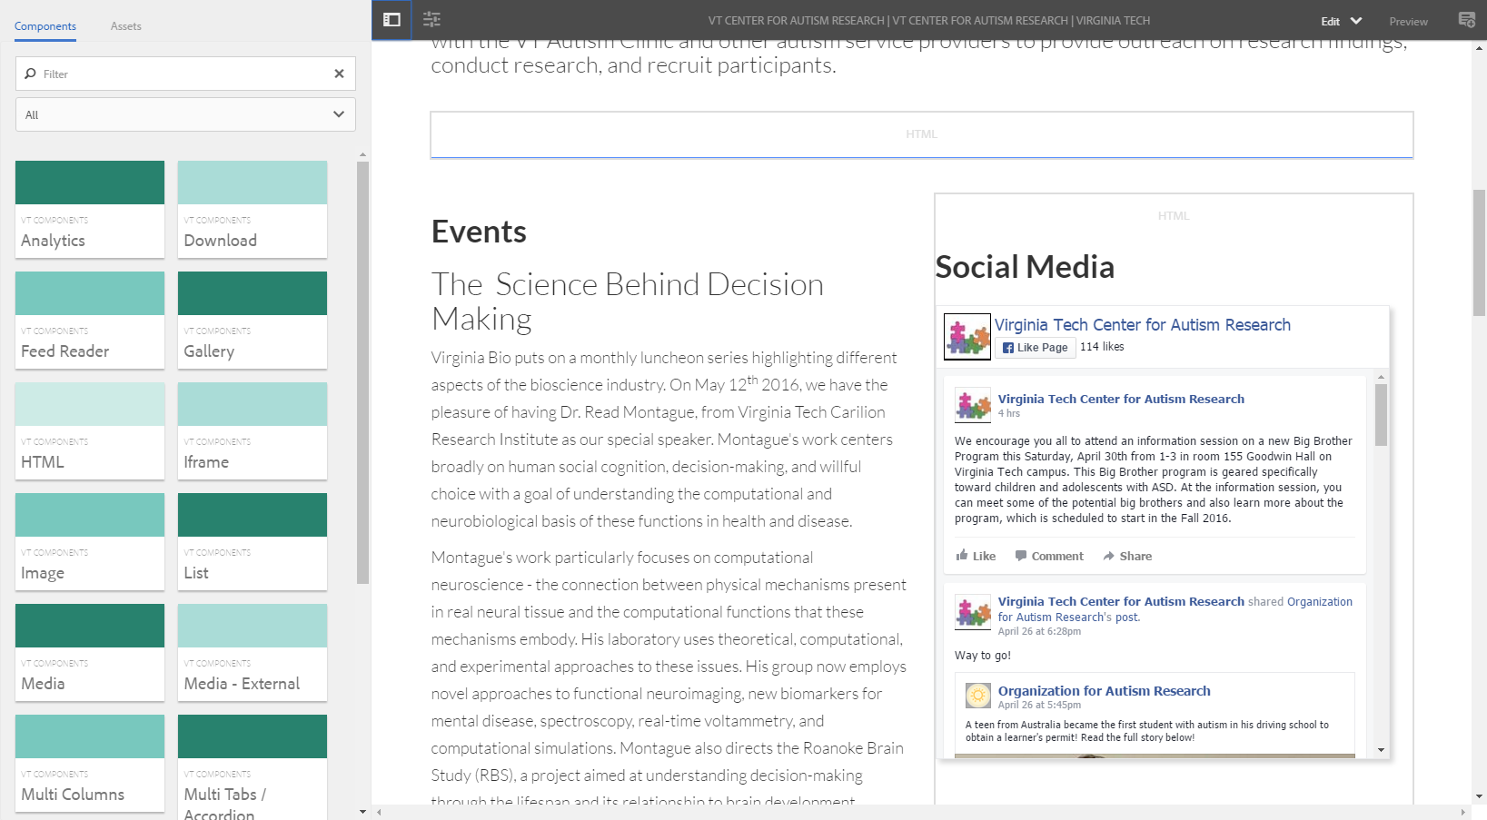
Requirements
- Ensemble CMS
- Easily maintainable
- VT Themes
- Modern designs and photos
- Social media integration
- Underlying blue theme to emphasize Autism Awareness

Slide 6

Website Prototype
- Mockups of high traffic pages
- Implemented pages using CMS components, HTML, CSS, JavaScript
- Reviewed current prototype with client on a weekly basis

Slide 7
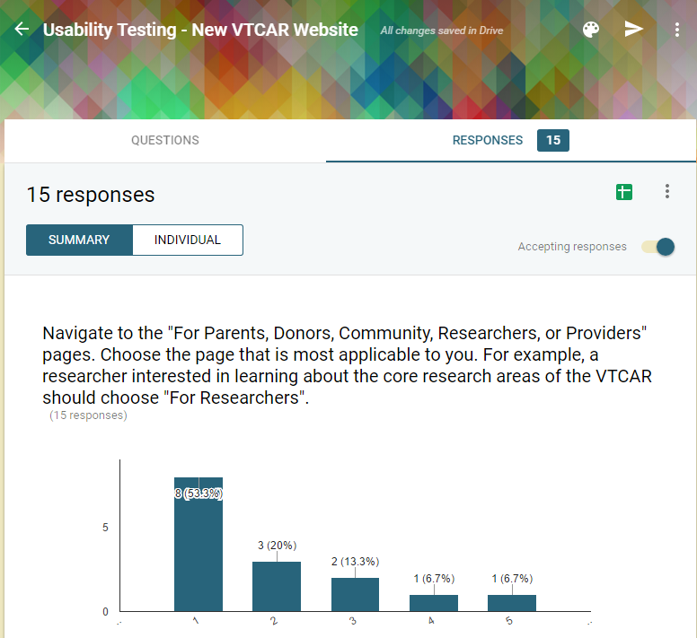
Formative Evaluation
- Received user feedback from usability survey
- Discussed potential changes with client
- Updated requirements and implemented feedback

Slide 8
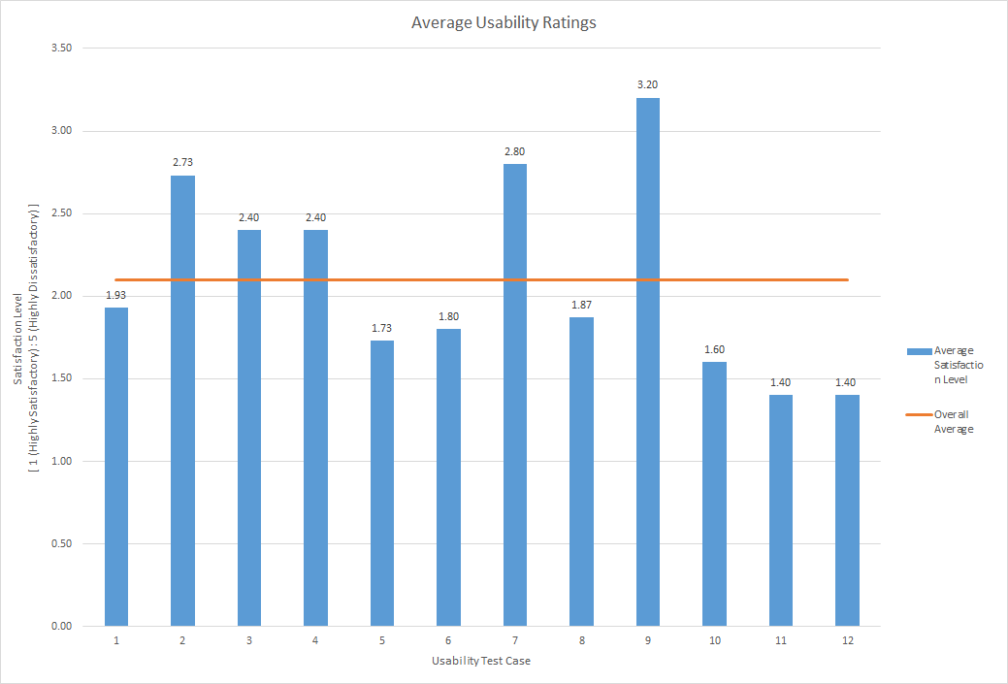
Formative Evaluation – Overall Results
2.10

Slide 9
Final Website
Screen Captures

Slide 10


Slide 11
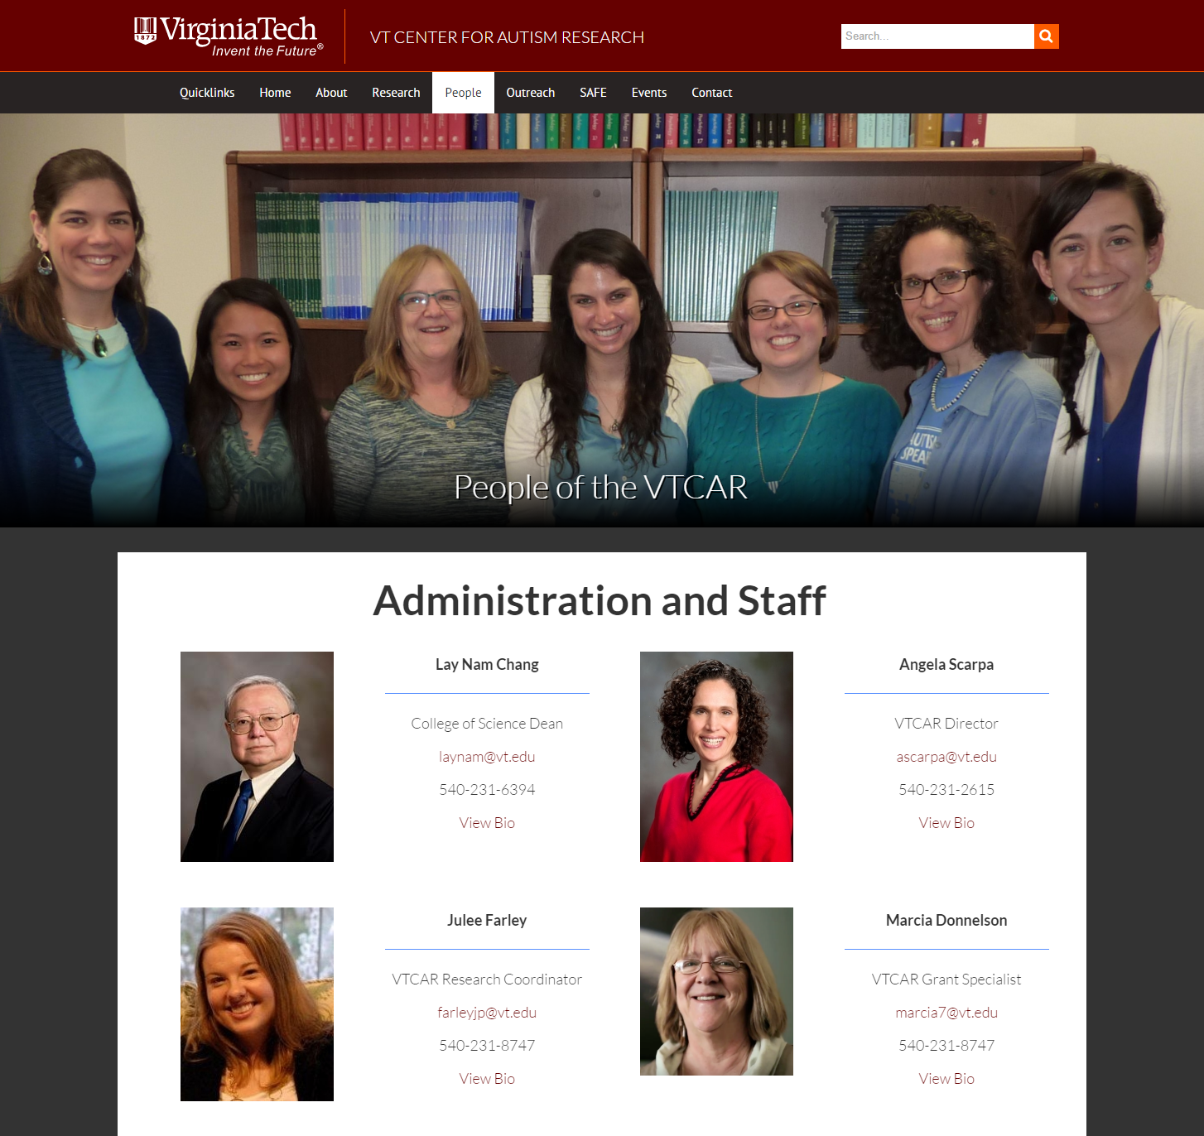

Slide 12
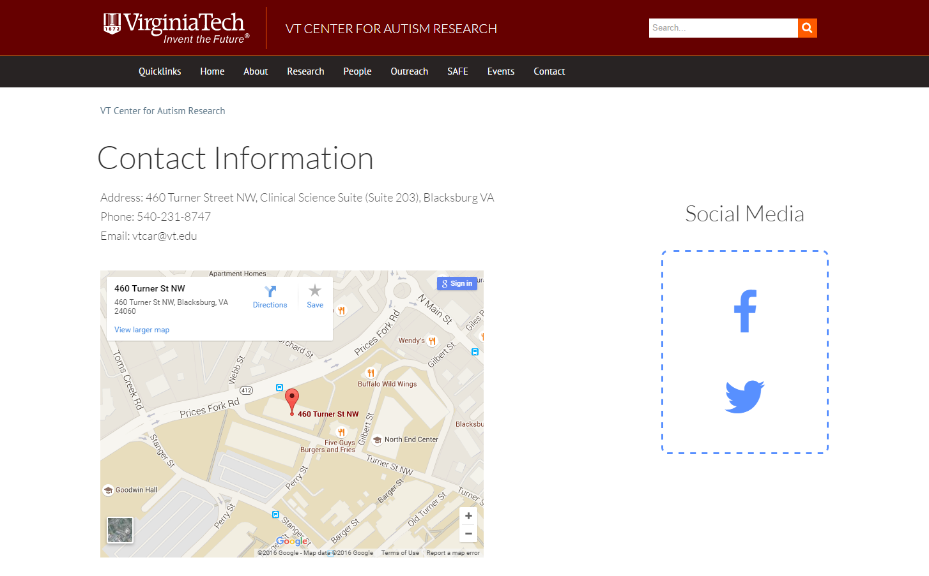

Slide 13
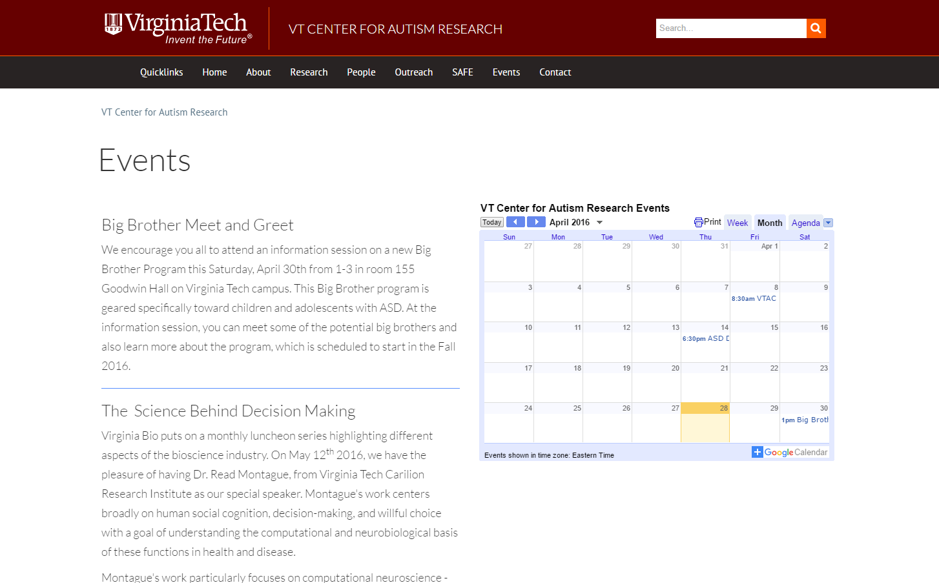

Slide 14
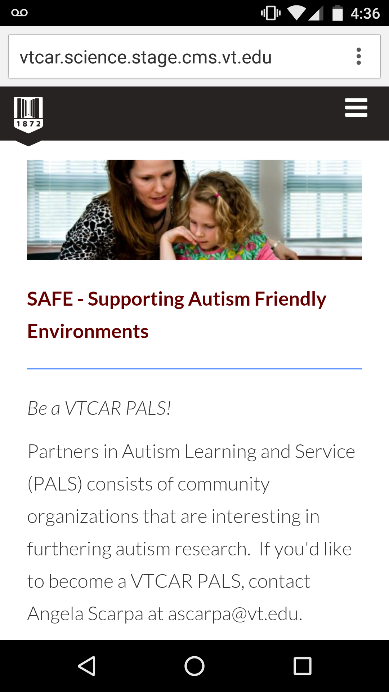
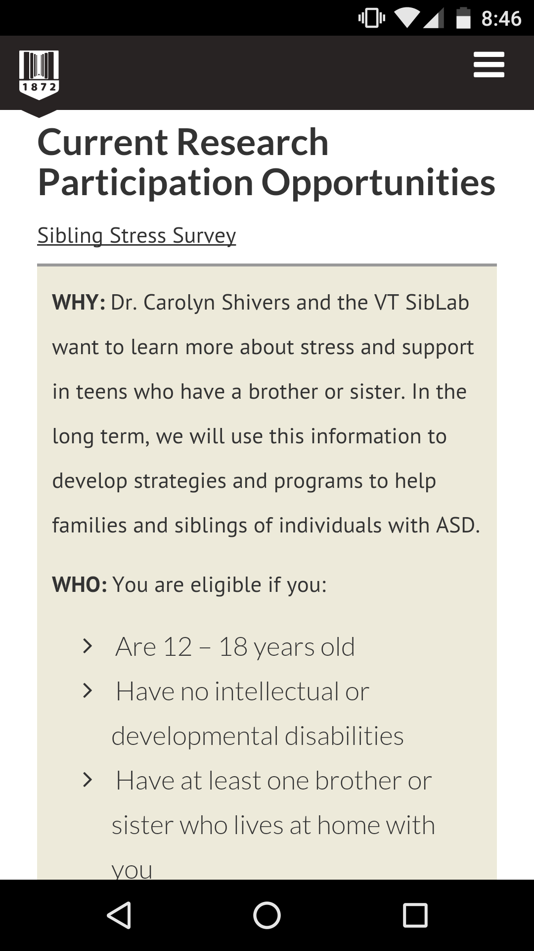

Slide 15
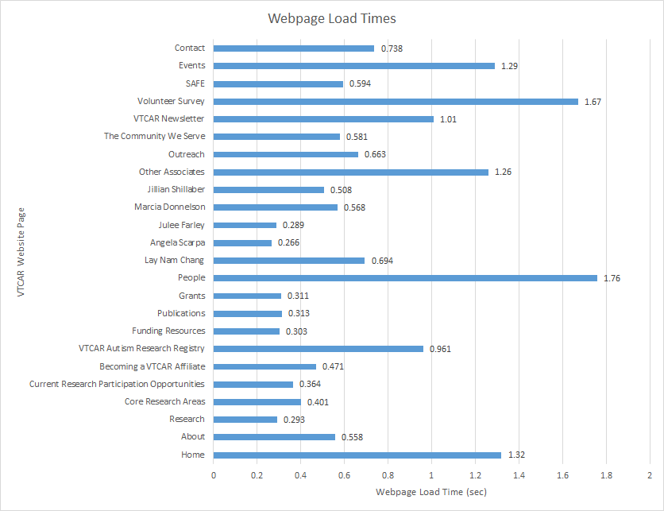
Performance Testing Results

Slide 16
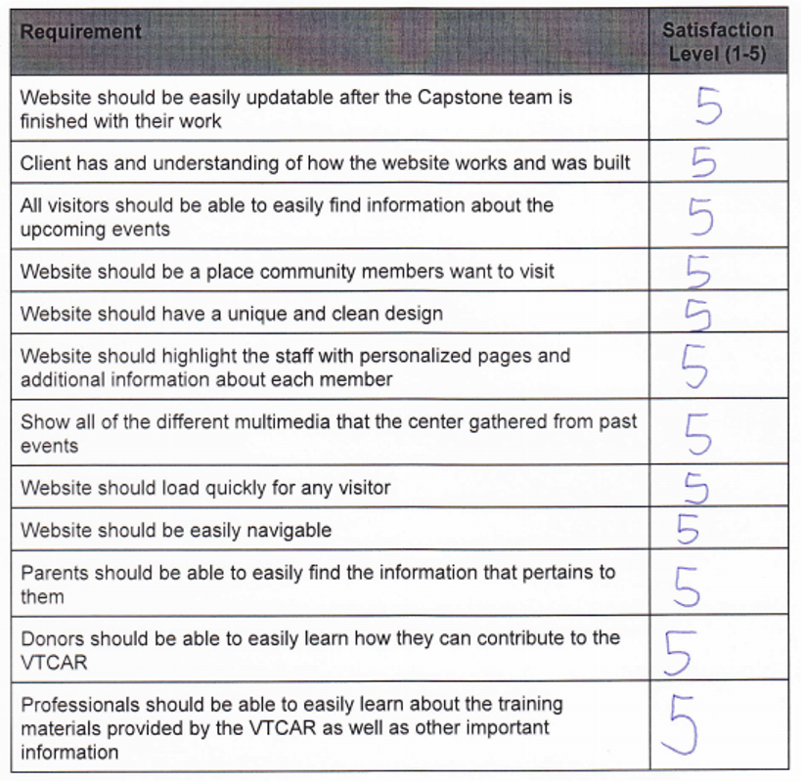
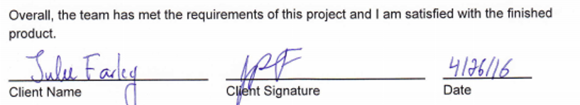
Acceptance Testing Results
Legend:
1 = Highly Unsatisfied
5 = Highly Satisfied

Slide 17
Acknowledgements
Dr. Julee Farley of the Virginia Tech Center for Autism Research
Dr. Angela Scarpa of the Virginia Tech Center for Autism Research
Ms. Marcia Donnelson of the Virginia Tech Center for Autism Research
Dr. Edward Fox
Graduate Teaching Assistant Yilong Jin
Mr. John Jackson of Ensemble CMS

Slide 18
Thank You
Any questions?

