Slide 1

Airbnb Scraping
Vinh Pham, Alex Nikolov, Alan Huang, Sabrina Wang, Han Liu
CS 4624 Multimedia, Hypertext, and Information Access
Instructor: Fox, Edward A.
Virginia Tech, Blacksburg, VA 24061, May 9, 2020

Slide 2

Outline
Background
Work Completed
Data
Timeline
Visualization
Website
Testing and Assessment
The Future
Acknowledgements/References

Slide 3

Background
Impact of Airbnb on local residents
Lower the price of short rentals
Transient occupancy tax
Notes:
Inside Airbnb (www.insideairbnb.com) is a project by Murray Cox, a digital storyteller, who made data Airbnb data scaped by author & coder Tom Slee available in a visually appealing way. The website provides scraped Airbnb data for select cities around the world; importantly historical data is also available (http://insideairbnb.com/get-the-data.html). The code used to scrape this information is hosted on Github (https://github.com/tomslee/airbnb-data-collection), but is no longer maintained. Recent Airbnb website layout pages seem to present some challenge. You can read the details on the "behind" page (http://insideairbnb.com/behind.html).
Over the past few years, big cities put regulations into place that limit short-term rentals to ensure that units stay on the housing market for year long rent, to stop the increase in rents (less supply means higher prices). Simultaneously, cities want to tax short-term rentals similarly to taxes on hotels: every guest pays a transient occupancy tax (aka hotel tax, bed tax, overnight tax) that short-term rental hosts often should pay, but oftentimes skirt the taxman. These measures are easier to implement for big cities - some of whom are listed on Inside Airbnb. However, for smaller - often rural - municipalities this is difficult, particularly as they do not have the relevant data.
Hence, while current Inside Airbnb data is useful for big cities to get a first idea of the short-term rental market in their jurisdiction, smaller cities and towns do not have this information. However, such smaller municipalities can also benefit from this data.
The goal is to scrape Airbnb data for the state of Virginia and Austria (not Australia). Tourism is an important economic factor for both Virginia and Austria and they are close in size; Virginia (42,774.2 sq mi), Austria (32,386 sq mi). Both areas have metro and rural mountainous areas, but only Virginia has a coastline.

Slide 4

Where We Come In
Our job is to scrape data from Airbnb
Starting with open-source code
Visualize data for future research

Slide 5

Completed
Tableau -> Python with pyechart.
  Static maps and dynamic graphs.
Data collection.
  Expanded script.
  Docker.
Websites done. Some designs have been changed.
  Can select different regions.
Collected data for Austria, now collecting data for rural Virginia.

Slide 6
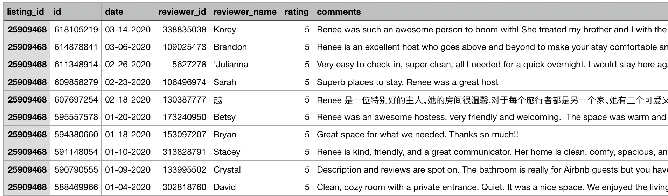
Review Data

Slide 7
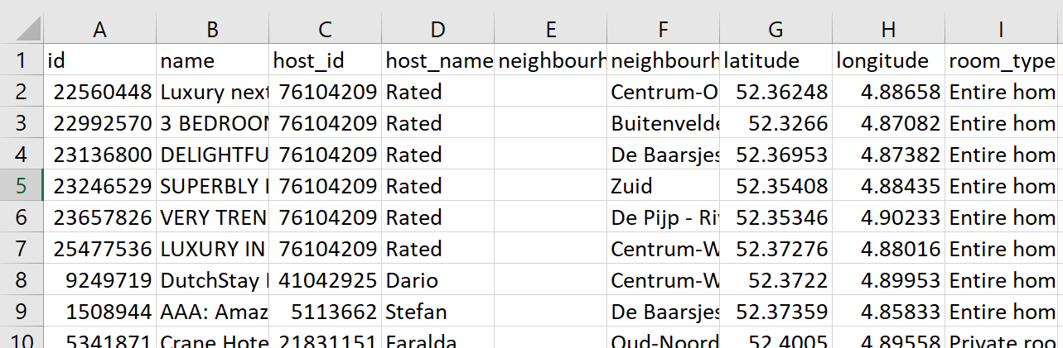
Listing Data

Slide 8
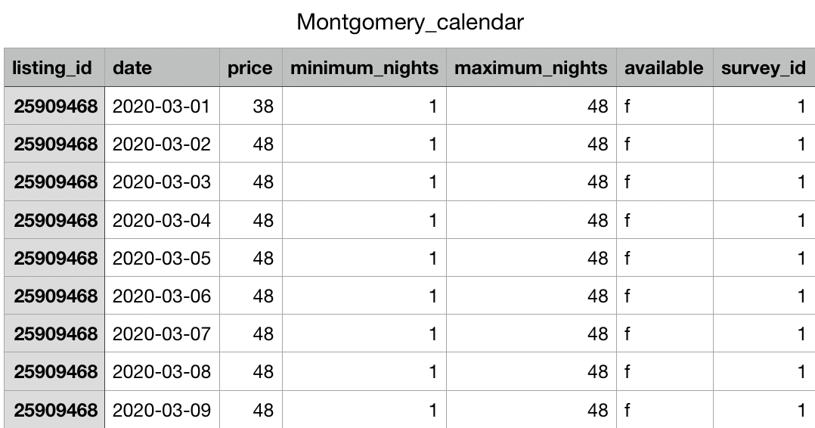
Calendar Data

Slide 9
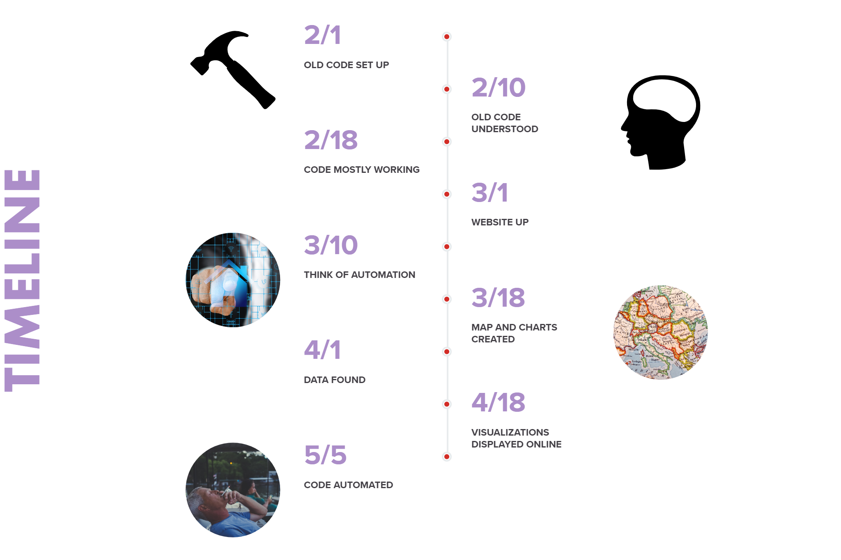
Old Code Up
Old Code Understood
Code mostly working
Website Up
Think of automation
Map & Charts
Data Collecting
Data Collecting
Visualization on Website
<- Currently

Slide 10





Visualizations

Slide 11
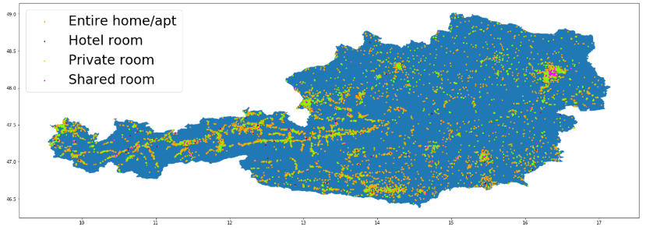
Geomap
Austria
A geographic graph for the room types distribution in Austria
Notes:
The graph on this slide represent the distribution of four types of airbnb houses for Austria. diff The area in that red box represents Vienna state. A lot of airhouses are

Slide 12
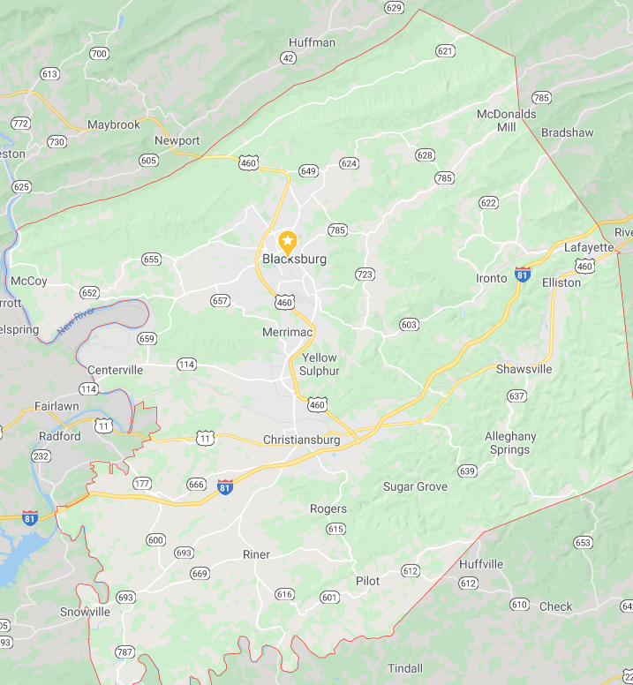
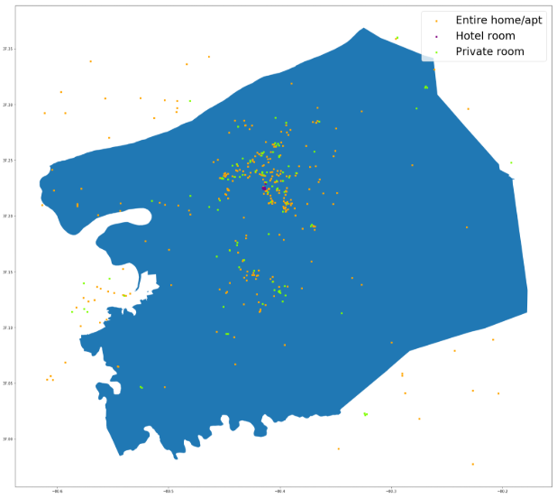
Geomap – Montgomery Co.
Notes:
Besides showing the airbnb room distribution as a whole state, we also made visuals for each county. On this slide, the left graph is the real geography map of montgomery county, and the image on the right side is the airbnb room distribution it is reasonable to see most of the airbnb houses are around the area of Blacksburg and Christiansburg. We have more visualizations for Montgomery in the following sldies

Slide 13
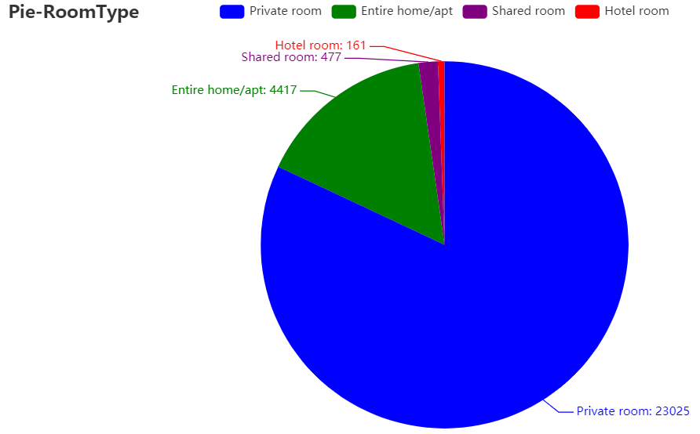
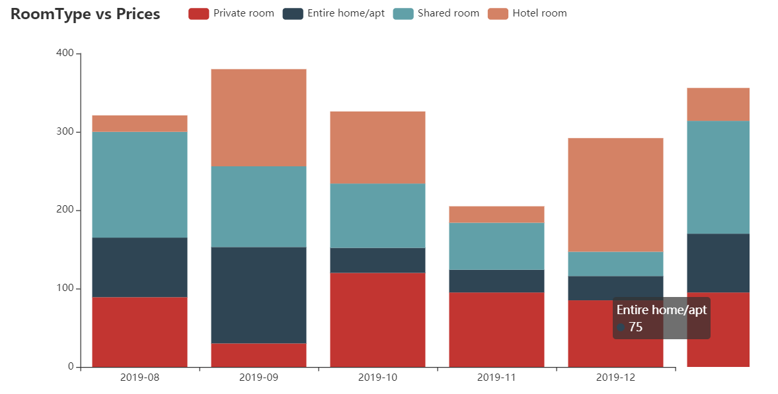
An interactive stacked bar chart for the representation of room types, prices, and timeline
An interactive pie chart of room types
Notes:
Interactive charts
Left: distribution of four room types
Right: how the number of different room-types changes over time, x-axis time, y-axis is prices, four colors represent the four room types.

Slide 14
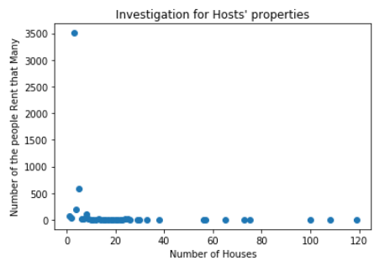
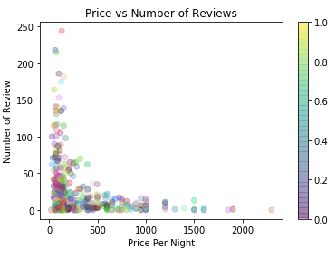
The relationship between reviews and prices
.
People vs. How many properties they own
Notes:
Someone owns 120 rooms
The rooms which has Lower price tends to have higher number of reviews

Slide 15
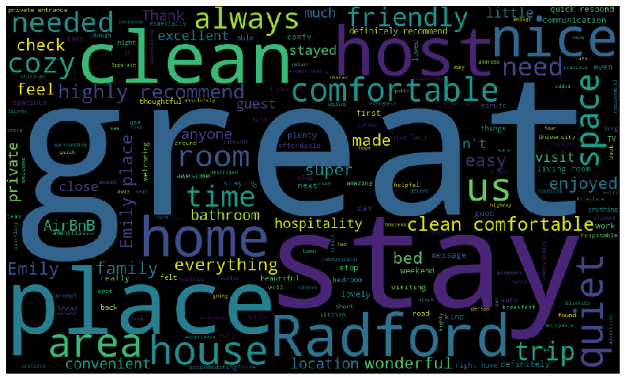
A WordCloud map for the reviews from the users for Montgomery County
NLTK, Stop Words, Word Frequency

Slide 16
Website
List
Switch between different county and countries
Display visualizations
Notes:
The reason for us to build the website is the website can easily manage the graphs for the following researchers. Since there are more than 100 counties for a single state on the Airbnb website. For each county, we will make several graphs and charts. Thus, there will be thousands of images. The website is a good way to let the users to access the graphs based on the county names.
Users can switch from different countries and countries, also they can see the graphs of the specific county. To achieve this, we changed our design during the implementation.
In the next page, you will see our ogrinal desgin.In the beginning, we thought of using three web pages linked together to lead users into each level of geo. One is for searching the target country, One is for searching the target state and one is one for searching the target county.
But later, we combined all three into one. It is simple and easy for the user.
In the next page, you can see our current website. Below the big picture, we have three drop boxes.
In the next page, we will show more detail in the selection. Starting from the left to right, is the country, state, and county. Once the user clicks the first one, it will show two countries we have researched, the US and Austria. If the user chooses United States, the second box will show the possible states in United States. And so does the third box.
In the next page, when users choose the specific county, the website will display the graphs of such county below the three boxes,. And for our example here, if the user choose us. Va. montgomery,. The website will show the graphs related to montemry, which is where we live

Slide 17
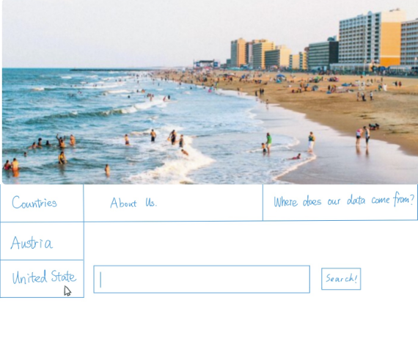
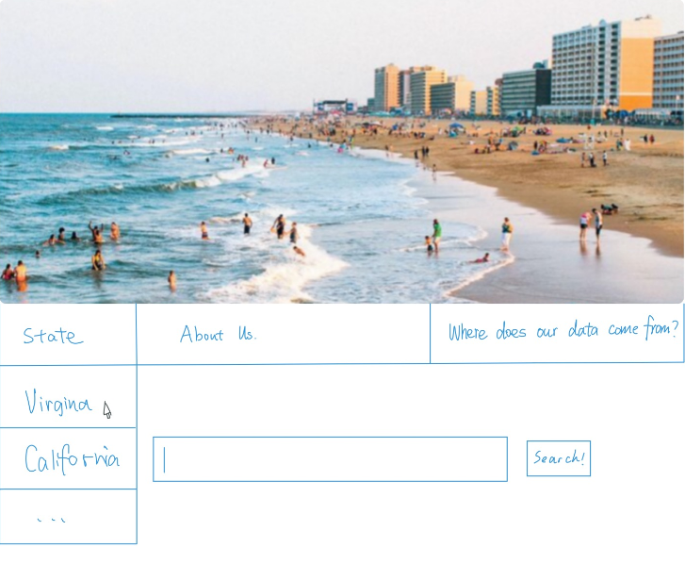
Website
Old design

Slide 18
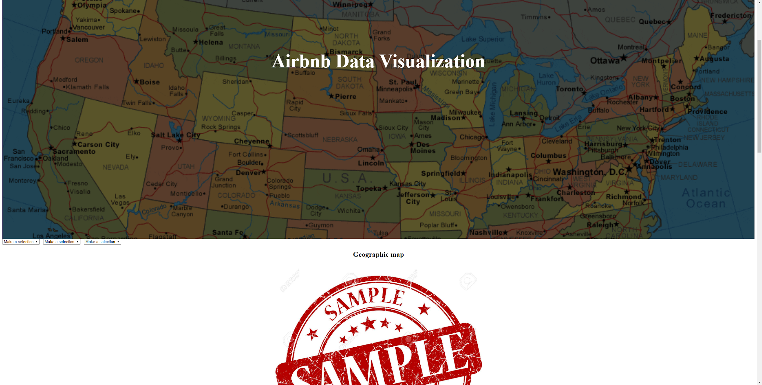
Website
New Design

Slide 19
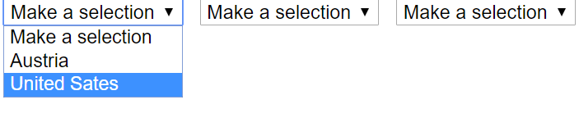
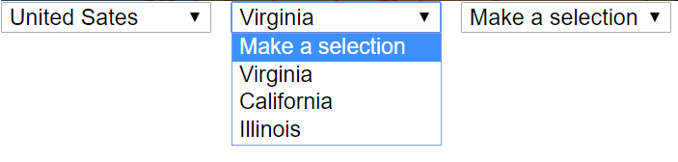
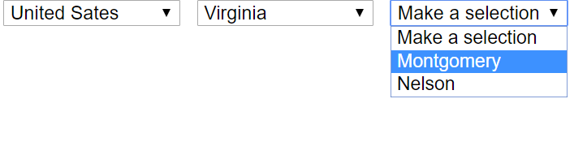
Website

Slide 20
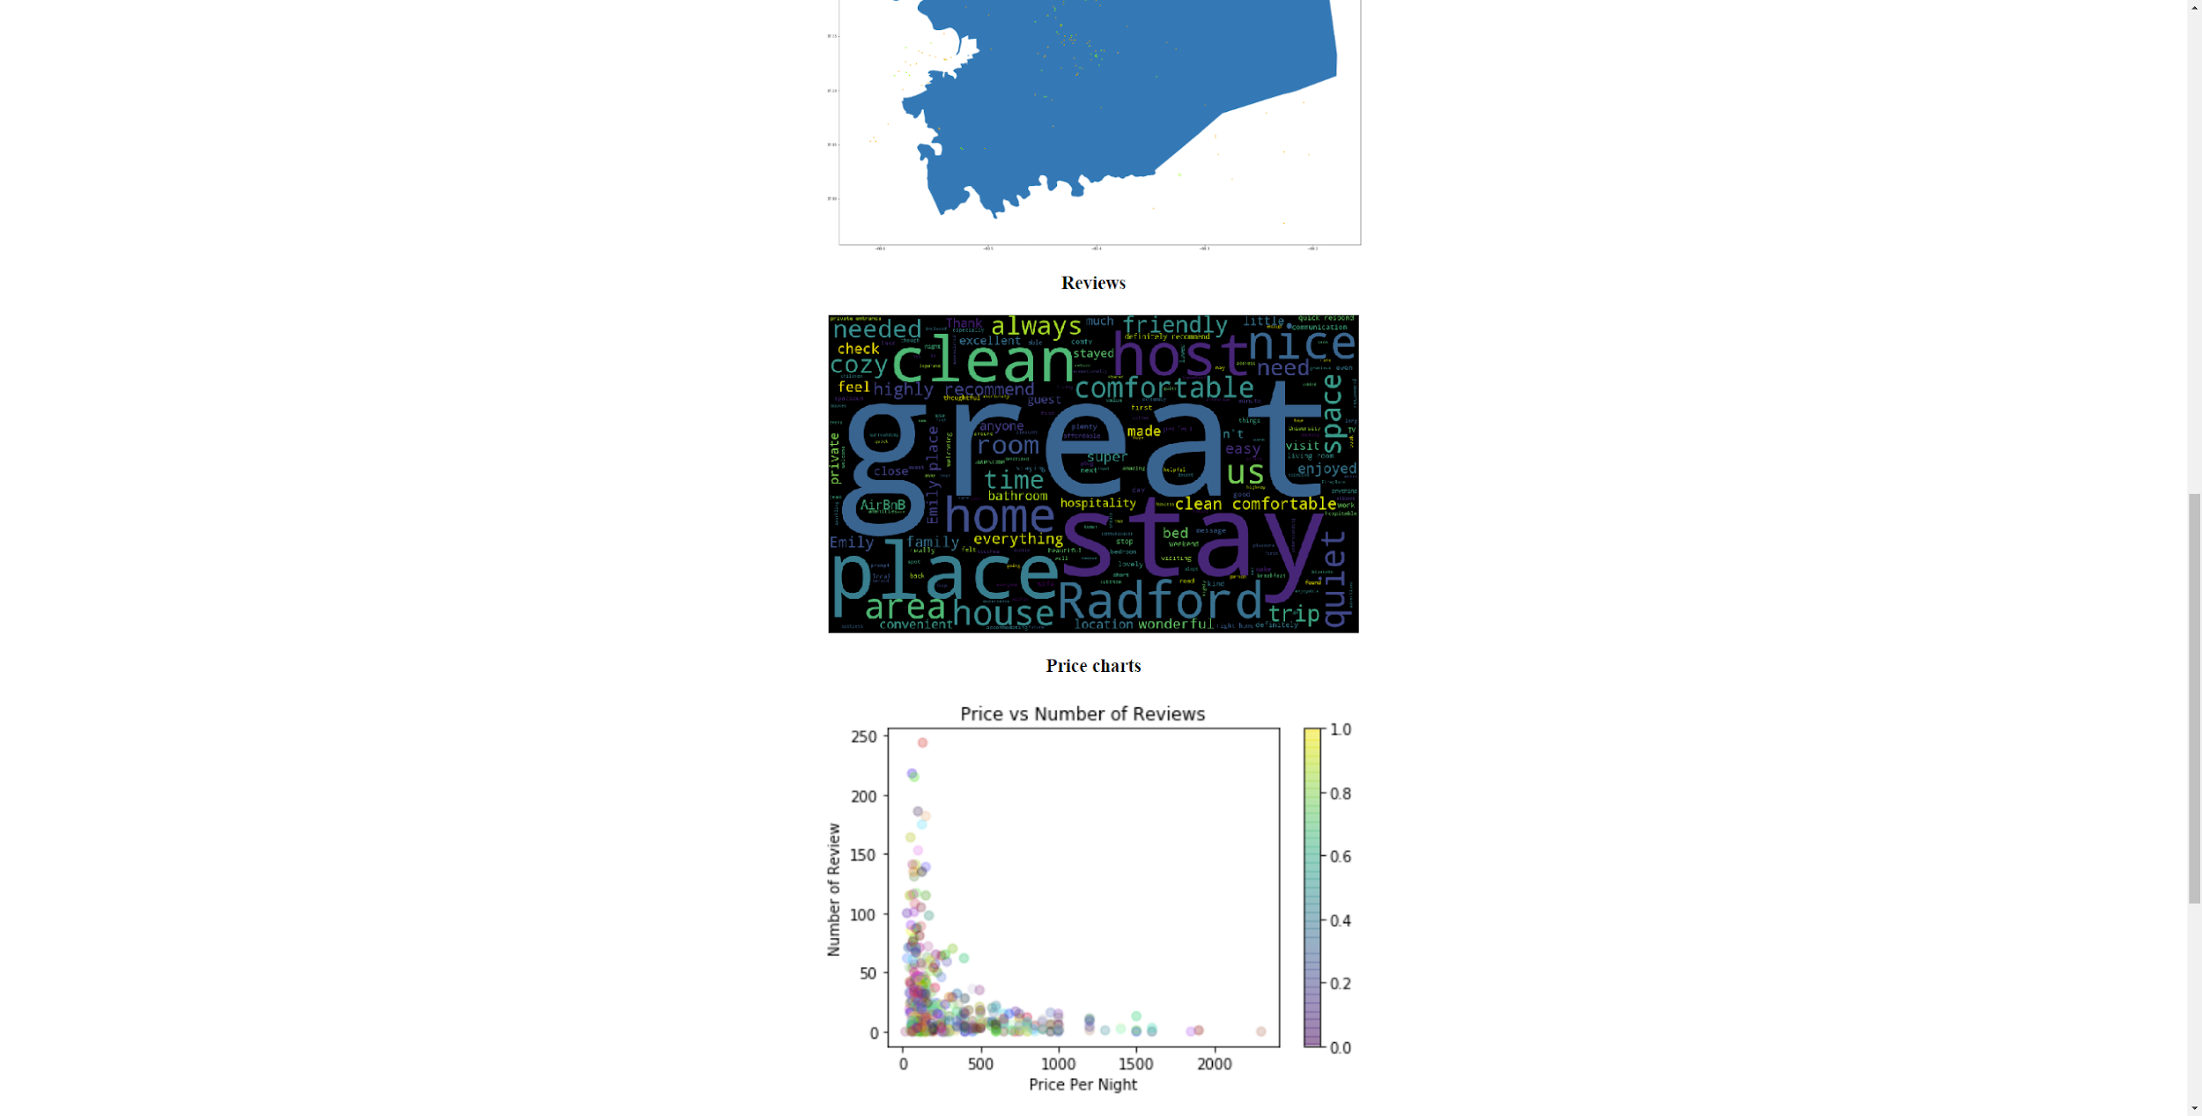
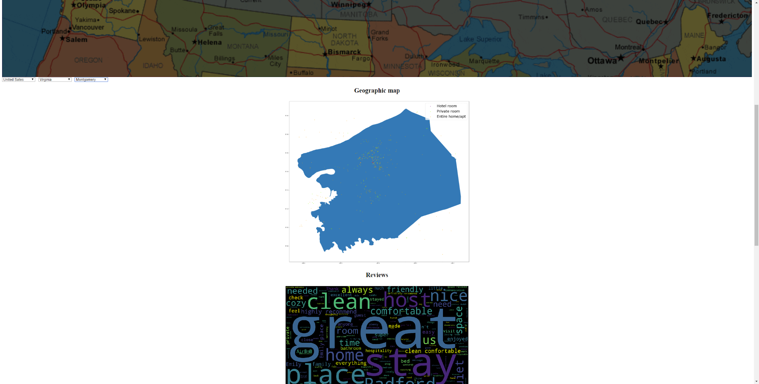
Website

Slide 21

Testing and Assessment
User interviews
Benchmark testing
Surveys
Notes:
For testing our result, we want to make sure that our design match our requirements. We asked some volunteers to help. First, we randomly list several counties. And we let the volunteers try to access these counties by themselves. Since we want to make sure the anyone else can easily understand how to use this web page.
We also run a benchmark testing to confirm the response time of the website.

Slide 22


Lessons Learned

Slide 23

Ideas for the Future
Make the website more visually appealing
Dynamic and interactive maps
More visualizations
Collect data on other regions

Slide 24

Acknowledgements
Clients:
Dr. Florian Zach

Slide 25
Questions?

