Slide 1




Agricultural Training and Education
to Feed the Future:
SANREM Educating
for Sustainable Intensification

Slide 2

Outline
Background/context
Accomplishments to date
Future challenges
Lessons from university self-assessments
Innovations in education and training
OIRED/Virginia Tech - SANREM

Slide 3
Title XII Legislation
Declaration of Policy-Sec. 296(a)
(2) Improved human capacity and institutional resource development for the global application of agriculture and related environmental sciences.
OIRED/Virginia Tech - SANREM

Slide 4
Comparative Advantage of Innovation Labs in Human Resource Development
Integration of academic, research and outreach in degree training programs
Focus on finding solutions to private and public sector problems
Collaboration with diverse partners (e.g., agribusiness, government institutions, IARCs, NGOs, foundations, etc.)
Long-term institutional collaborative relationships
OIRED/Virginia Tech - SANREM

Slide 5
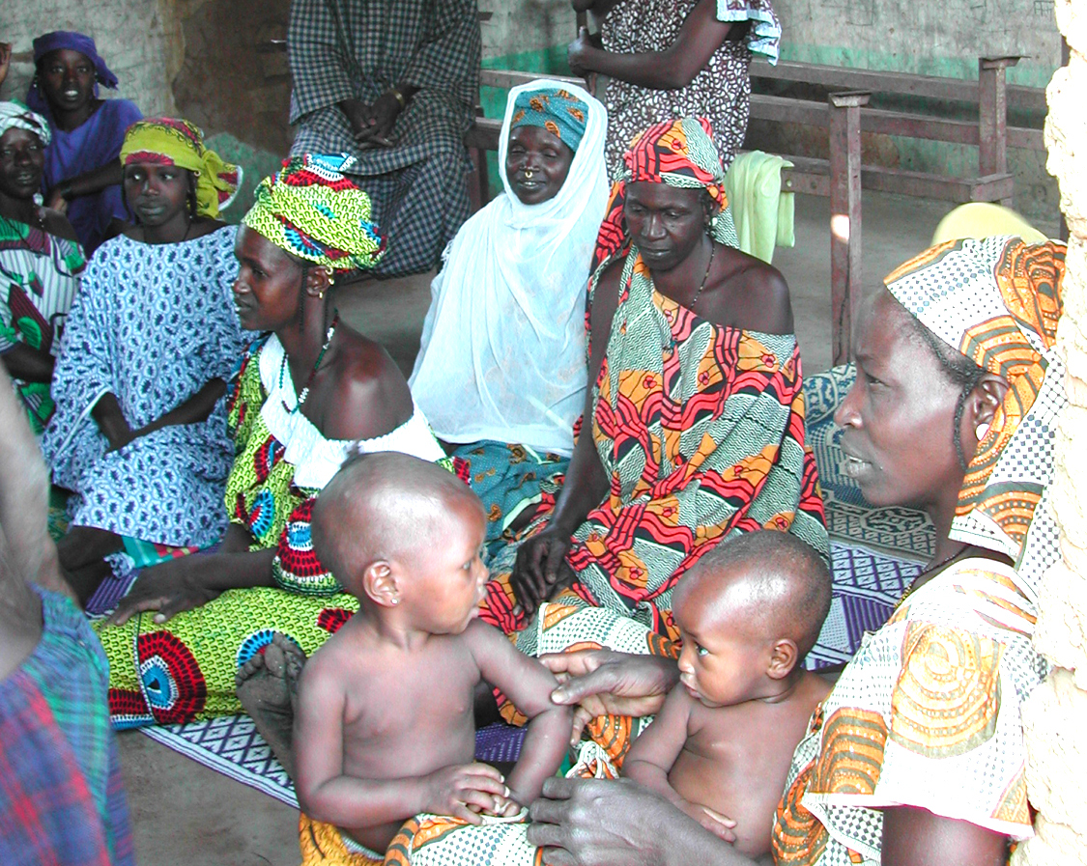
CRSPs Degree Training
Total across ten CRSPs
Total Degrees (BS, MSc and PhD) awarded (1978–2014) 4,324
Total post-graduate degrees awarded (1978–2014) 3,397
Proportion of women among all trainees 36%
Notes:
The achievements to date.
Nearly all return to build careers in their home country institution, unlike nearly every other higher education program.
However, many have now retired or been lost to HIV/AIDS
40% continue to collaborate with their major professors 10 years later

Slide 6
OIRED/Virginia Tech - SANREM
Notes:
SANREM has been quite productive during the past 20 years.
Compared to 35 years for INTSORMIL

Slide 7
SANREM CRSP Phase III-IV Degree Trainees
 | Bachelor’s | Master’s | Ph.D. | All
Men | 44 | 50 | 31 | 125
Women | 35 | 44 | 38 | 117
TOTAL | 70 | 94 | 69 | 242
48 % Women
OIRED/Virginia Tech - SANREM

Slide 8
SANREM CRSP Phase III-IV Short-term Trainees
Country | Men | Women | Total
Bolivia | 4,897 | 3,480 | 8,377
Cambodia | 482 | 284 | 766
Ecuador | 3,805 | 2,129 | 5,934
Ghana | 459 | 239 | 698
Guatemala | 12 | 6 | 18
Haiti | 1,495 | 1,054 | 2,549
Honduras | 20 | 15 | 35
India | 626 | 357 | 983
Indonesia | 366 | 324 | 690
Kenya | 604 | 372 | 976
Lesotho | 1,601 | 1,451 | 3,052
Mali | 70 | 47 | 117
Mexico | 47 | 29 | 76
Mozambique | 4,051 | 3,911 | 7,962
Nepal | 333 | 188 | 521
Peru | 779 | 596 | 1,375
Philippines | 2,160 | 1,398 | 3,558
Tanzania | 63 | 42 | 105
Uganda | 1,512 | 1,498 | 3,010
USA | 294 | 200 | 494
Vietnam | 359 | 223 | 582
Zambia | 18,843 | 19,016 | 37,859
TOTAL | 42,878 | 36,859 | 79,737
80,000 trainees
22 countries
46 % women
OIRED/Virginia Tech - SANREM
Notes:
Agricultural training and education is not just about academics and scientific research.
A large effort has been made to support training of farmers and other value chain actors.
Even if we don’t include COMACO in Zambia, these numbers are still impressive.

Slide 9
Sustainable Intensification Pretty et al. (2011)
“……producing more output from the same area of land while reducing the negative environmental impacts and at the same time increasing contributions to natural capital and the flow of environmental services”
Seven key components of successful sustainable intensification are:
combining science and farmer inputs
creating novel social infrastructure
improving farmer knowledge and capacity
engaging with the private sector
focusing on women’s education
ensuring availability of microfinance
ensuring public sector support for agriculture
To what extent are our traditional practices of agricultural education and technology transfer applicable to the promotion of sustainable intensification?
OIRED/Virginia Tech - SANREM
Notes:
So what does the task look like for the future?
Let’s recall the document that initiated the call for sustainable intensification and how it is cited on the Africa RISING web page.
<Read quote>
In order to accomplish this, we’re going to need a greater appropriation of science by farmers.
We need to pay attention to questions of:
scale, trans-disciplinarity, non-linearity, social construction,
negotiation, social learning, and innovation systems.
This means new approaches for addressing complex adaptive systems and adaptive management

Slide 10
The Transition to Complex Adaptive Systems
In the early 20th century, Quantum theory taught us that (instead of being the objective observers of the universe) we are participants along with the objects of our observation.
It is only now that the implications for the applied sciences are becoming apparent.
This involves not only:
the traditional sciences and new partners
but also:
interactions and feedback mechanisms
across multiple systems and scales
All partners are learning and adapting simultaneously
OIRED/Virginia Tech - SANREM

Slide 11
The Transition to Adaptive Management
Farmers are the key actors.
They face dynamically changing climate and markets.
They need to appropriate new science and technology
so that they can make sustainable adaptations
Why does the farmer need to know about how agricultural technology works beyond simply how to use it?
S/he may want to use it to solve another problem.
Waiting for researchers to figure out what to do next will likely cost the her farm or his livelihood.
OIRED/Virginia Tech - SANREM
Notes:
We’re asking farmers to do more, with less –
sustainably at higher production levels
This exposes them to greater risks
They will need to learn a lot more on a continuing basis to become resilient managers.
This means researchers (and other supporting agents) will have to communicate science and technology to farmers more effectively.

Slide 12
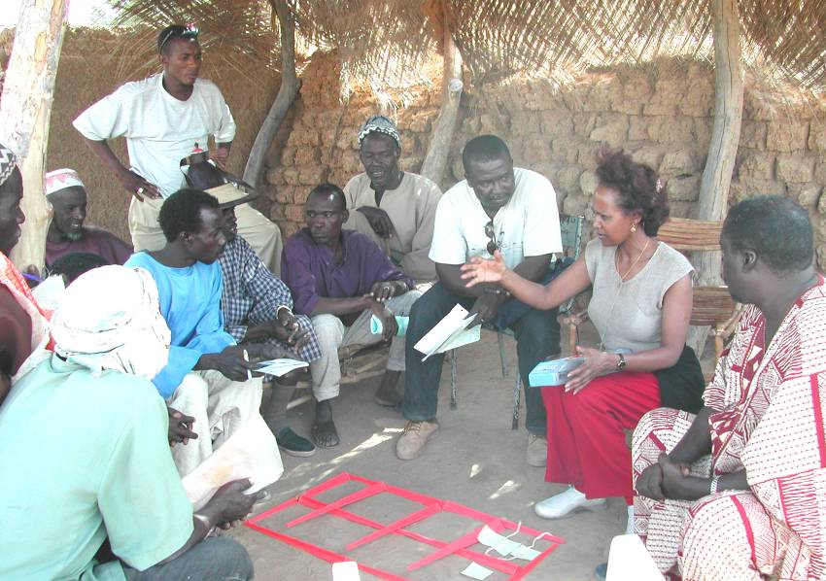
Fostering Technical Change in Agriculture
How does adaptive management change agricultural education and training?
What is the role of learning in the process of innovation?
Is learning a matter of information transfer resulting in adoption of innovations?
Or, is learning a matter of developing capacities for on-going adaptation?
Whose capacities should be
developed?
Where, in fact, does innovation
occur?
Notes:
1 - This pushes us beyond the technology transfer framework.
<read questions>
3 - We need to think in terms of a more dynamic interactive modality.
We need to engage developing country farmers and non-farm stakeholders intellectually and emotionally in the promotion of sustainable intensification.

Slide 13
The Educational Challenge
Change agent perspectives
Agricultural change agents are trained in conventional production practices and that are conveyed as memorized scientific “facts”
Farmer agro-ecological perspectives
agro-ecological knowledge and its application in production informs farming discourse at the local level
Conservation agriculture requires adaptation
CA doesn’t fit well with that memorized knowledge and challenges conventional farming wisdom
OIRED/Virginia Tech - SANREM
Notes:
However, CA is not really the problem – we are confronted with a different challenge.
The majority of non-farm change agents are “educated”.
Science from their perspective is the best knowledge, and it is experienced as a set of memorized “facts”
This is largely created when underpaid and under recognized college professors conduct lectures by reading from the notes they took in the same class decades earlier
The scientific methods of observation and hypothesis testing are largely ignored
When confronted with farmer responses to our questions on farming practices, a group of agricultural officials felt we “didn’t ask the right question”. – And therefore, farmers misunderstood and “got the responses wrong”

Slide 14
Lessons from institutional self-assessments
Instructional quality is characterized by:
A lack of syllabi (and their use)
A lack of coherence between
Learning objectives
Pedagogical practices
Student assessment
Although experiential learning is valued and emphasized by faculty and administrators, the tradition of memorization is profoundly engrained.
Quality control efforts are only just beginning across Africa.
OIRED/Virginia Tech - SANREM
Notes:
Quality control assessments are routine business in land grant disciplinary programs.
They are quite alien to most of our partners’ educational institutions.
As we increase innovative programs for
distance learning
joint or sandwich programs
We need to take these institutional weaknesses into account
Training an individual is good, but how does that promote communication?
Communication requires at least two persons, and ultimately involves not only farmers but the entire sets of value chains in which they are involved.

Slide 15
Lessons from institutional self-assessments
Underfunding agricultural education leads to low morale and rent-seeking behaviors of talented faculty members.
Individuals take on teaching assignments across multiple institutions leading to instructional reliance on non-permanent faculty.
Others seek and win externally-supported research projects that don’t compensate the institutions for the time lost to instruction.
There is a lack of incentives for quality (student-oriented) teaching suggesting that even minimal rewards may help
to re-focus efforts.
OIRED/Virginia Tech - SANREM

Slide 16
Innovations in Graduate Training
New models for graduate degree programs
Joint or dual institutional degree programs
Sandwich programs
Distance education programs
Life-long professional development programs
2. Changes in Graduate Program Structure
Professional training vs. research focus
Multidisciplinary vs. disciplinary
Value Chain vs. subsector focus
“Designer” graduate programs for target populations
3. Value Addition to Host Country Graduate Programs
Research opportunities in U.S. university laboratories
Internships in U.S. agribusinesses
Participation in U.S. university outreach programs (Land-Grant Model)
U.S. university faculty instruction of courses at HC universities
OIRED/Virginia Tech - SANREM
Notes:
So how can we address these circumstances to improve education and training in support of sustainable intensification.
These are some of the innovations that have been proposed for the role of land grant universities.
List
How can these address the real problems of African education?

Slide 17
Innovation Networks
Innovation networks configure actors to facilitate the flow of information and access to resources and services
Composed of:
Farmers
Farmer organizations
Extension
Input suppliers
Researchers
Agencies
Policymakers
OIRED/Virginia Tech - SANREM
Notes:
With respect to farmer training (a spin-off of research funding), learning models are more advanced.
The focus is on forums which foster the process of social learning.
Innovation networks and platforms facilitate social learning by creating the context for collaboration and information/knowledge exchange.
Consciously constructed networks facilitate collaboration between actors:
Information sharing
Access to physical inputs
Collaborative value production

Slide 18
Innovation Platforms
Create a forum for social learning
Establish a foundation for negotiation
Facilitate network connections
Foster farmer-market connections
OIRED/Virginia Tech - SANREM
Notes:
Create a forum for social learning
Brings together a variety of stakeholders for mutual benefit
Establish a foundation for negotiation
This is an environment where scientific and local knowledge can be equalized,
where disagreements can be worked out and productive negotiation occur
Facilitate network connections
Creates closer ties between participants
Works to strengthen networks in the community
Foster farmer-market connections
Allows for adaptation to changing market conditions

Slide 19
Innovations in learning for agricultural professionals (from suppliers to producers to processors to consumers)
1. New models for local innovation
Innovation networks
Cluster development among value chains
Peer-to-peer training; farmer field schools
Public/private partnerships
2. Developing communities of practice
Bridging across localities
Connecting local with regional and national partners
Creating spaces for innovation
3. Negotiating new roles and skills for facilitators and learners
Local leadership development
Support and sustain new brokerage roles
An enabling national policy environment
OIRED/Virginia Tech - SANREM
Notes:
Connect learners in new ways to each other and to new knowledge
Promote communities of practice wherein new ideas can be tested locally
Create sustainable intensification champions – innovation brokers
These innovations are good, but how do we connect new approaches to science and technology to them?

Slide 20
Innovation Brokers
Main Functions of Innovation Brokers:
Analyzing the context and articulating demand
Bringing together stakeholders into networks
Facilitating interaction for innovation
Challenges include:
Formal education still reinforces top-down approaches
Acquiring and maintaining funding
Maintaining neutrality
OIRED/Virginia Tech - SANREM
Notes:
This brings us back to the university role in higher education for agriculture.
Innovation Brokers are needed to catalyze the process of innovation.
A broker is an individual or an organization with a neutral role in the system who fosters collaboration.
The problem with extension is that they are trained to be subject matter specialists, rather than as skilled facilitators and negotiators.
Challenges:
this role is challenged by formal education and training which reinforces linear approaches
It is difficult to acquire and maintain funding for a position whose success relies on the role’s invisibility
Brokers may have overlapping functions, such as working as an extension agent or researcher

Slide 21
21st Century Land Grant Legacy
Leaves behind:
Intellectual leadership in transdisciplinary negotiation
Strategic and creative partnerships involving all stakeholders
An engaged next generation of agricultural leaders
Integrates research/teaching/action into locally responsive institutions
Existing models appear to be largely NGO-led
Maintains the role of the ‘honest broker’
Educated negotiation
Communicative competence of all partners is critical
OIRED/Virginia Tech - SANREM
Notes:
There is a new emphasis at USAID on science, technology and higher education to combat food insecurity and reduce poverty
The land grant university response needs to focus on fostering the conditions for adaptive management at the local level.
This includes educating the conveyers of science and technology to farmers.
The mission: to invest in human and institutional capital to Feed the Future
< read ‘Leave behind’ bullets >
Publically funded research and outreach has an important role to play with respect to smallholder farmers (women and men) around the world.

Slide 22
Thank you for your attention.
Comments/questions
welcomed

