Slide 1

From Repository to Silver Screen: Building a Moving Image Licensing Practice
Alan Munshower
SAA Archives Management Section Meeting
July 26, 2022
Notes:
Good afternoon, my name is Alan Munshower, I’m the Digital Collections Archivist at Virginia Tech University Libraries, and I’ll be speaking about how to add moving image licensing to your archives’ services.

Slide 2
Identifying Material and Patrons
Collecting areas and licensing potential
What collecting areas have AV representation?
Strengthening local and regional holdings / geographic representation
Identify collections from underrepresented groups
Who are your identified user personas?
Academic researcher, student, genealogist, etc
Now includes documentary producers, commercial film producers, and most commonly organizations doing archival footage research of behalf of content producers
Notes:
Among the first things to consider are: which collecting areas have good AV licensing potential. Raw numbers of time-based media, and knowing what percentage has been digitized is important, but also knowing which materials are unique and have the copyright retained by the archives. The importance of strengthening and promoting your local and regional AV holdings can not be understated. Researchers are inclined to contact institutions local to their subject matter, assuming they are the best starting place for regional material. Also, take the time to identify AV collections that are underrepresented both in your institution and more broadly.
If you are starting a moving image licensing practice, you will likely be adding a new user persona to your regular patrons. Read types of personas

Slide 3
Benefits of Licensing
Money for your organization
Can be designated for care of collections, future digitization of time-based media, or any other specific use that helps the patron understand how this fee supports the archives
Publicity / Raise awareness of organization
Licensing and associated documentation controls the paper trail and allows control of organization’s intellectual property
Notes:
Money for your organization is likely the benefit of licensing that has your interest in the subject. It’s important though to consider where this money will go, and how it will be used. It benefits the patron to understand how this fee can directly support the research and access they are engaged in. The publicity and awareness of the archives that comes from a prominent licensing deal is a major benefit. Lastly, licensing controls the paper trail and helps manage the organization’s IP.

Slide 4
Considering a Fee Schedule / Rate Card
To charge or not?
Some institutions may purposely not charge or not have a set fee schedule
Do you currently charge for digitization, photocopying, or other regular patron services?
There is a calculable cost to use of time and resources
Have ability to explain to patron that it’s not an arbitrary fee
Clear costs and targeted support of program included on schedule
Notes:
Licensing may not be the right choice for your archives. You may decide that licensing will not work for a number of reasons, including legacy donor agreements, collecting areas, lack of AV formats, or general attitude among institutional stakeholders. Are there currently services that carry a cost for patrons, such as digitization or photocopying? You will want to consider the organization’s history regarding fees. Not having a stated policy, but operating on a case-by-case basis may be possible to start, but could present issues of equity in your licensing structure.
That being said, there is a calculable cost to staff time and resources. An estimate of these costs will be helpful in creating your rates and/or seeking approval for a new licensing policy. Once the fee is determined, buy-in from the patron base is helped by clear explanation of how the funds support this program.

Slide 5
Other Fee Schedule Considerations
Rates can vary based on any equitable scale you design.
Commercial use vs non-profit or small press
Scale of distribution
Discount for length of material
Minimum fee
Beware interchangeable terms (TV, video)
Would you consider one-off digitization? In house equipment may be adequate. Additional fees for this?
Strive for equitable fees to encourage wide use of materials in a variety of productions
Notes:
I recommend an equitable, tiered scale, for licensing rates. The scale is best if customized to the needs of the institution. The variety of uses that become evident during the first years of a licensing program will help shape adjustments and future design of this scale. Some example tiers or delineated rates may include one for commercial use and one for non-profit or small press publication. You may consider the scale of the distribution in determining the rate. Depending on the nature of the moving image material and frequency of use, a minimum fee or discount for length of licenced material may also make sense. Your fee schedule should be aware of the changing media landscape and interchangeable terms. The tiers and categories of fees should be clear to the licensor to avoid unnecessary negotiation. Inevitably you will get a request to digitize a video for potential licensing patron based off basic description in the finding aid. Have a plan for how you will address this. And, again a reminder to strive for equitable fees to encourage wide use of materials.

Slide 6
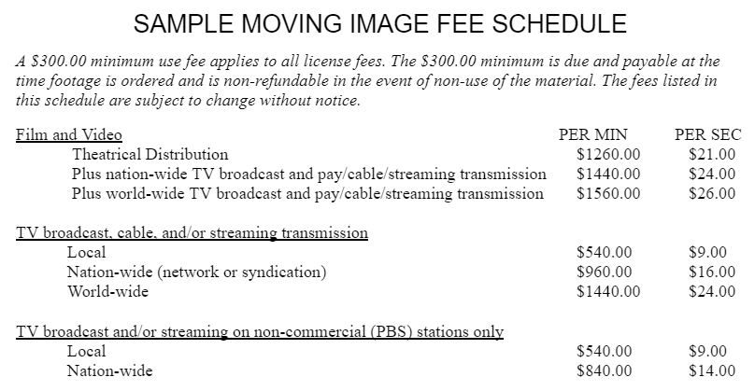
Notes:
Sample fee schedule
Notice the minimum use fee is clearly at the top
Fees per minute and per second are included. Another consideration may be a rate per frame depending on the content you have. It’s not uncommon for producers to have the exact frames identified. This fee schedule delineates type of medium, commercial vs non-profit, and level of distribution. As the media landscape evolves, there may be a logical reason to have separate fees for cable and streaming services, but in this example they are grouped together.

Slide 7
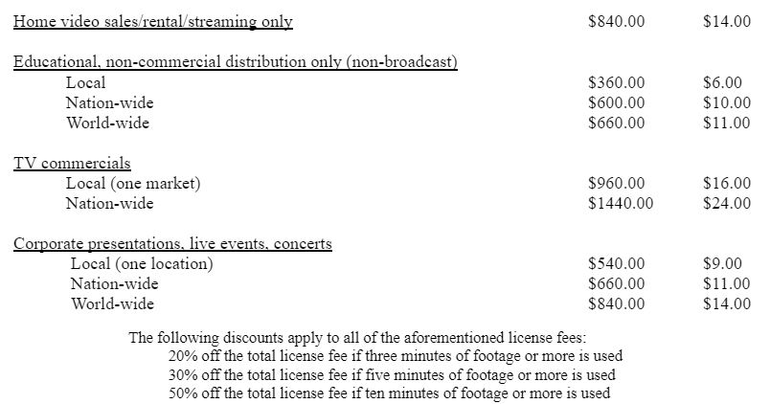
Per Minute Per Second
Notes:
Part two of the sample fee schedule has categories for home/streaming distribution only, Educational uses by region, Use in commercials and advertising, and use live events. Volume discounts are also included.

Slide 8
Use agreements, contracts, and riders
Will you license for a specified time, use, media or program?
Changing media landscape - streaming now ubiquitous
Not getting ‘ in perpetuity’ may be a dealbreaker for some
Excluding advertising uses is a common exception to in perpetuity agreements
Patrons are often dealing with multiple archives, different terms, and different lengths of contract
Publish your agreement on the Archives website
Include documents, FAQ, turnaround times, etc.
Riders and involving legal department
Make clear to patrons that this will slow down the process
Who is signing agreements and rider? Department Head? Dean?
Notes:
What should be spelled out in the use agreement? The duration of the contract, exact use and distribution.
When constructing a movie image use agreement, consider that the publishing model is very different from traditional physical books. The media landscape is continuously evolving, and streaming is now ubiquitous. While platforms, formats, and producers change, the work or program rarely changes from it’s form. Use should be for a single, specific program or edition.
Not getting an in perpetuity deal may be a dealbreaker. Keep in mind, if you in the archives are negotiating five-year licensing terms, what will be the process for identifying use renewals for content still available online after five years?
Make your use agreements public and be transparent about the process, including turnaround times.
Some organizations may want to add their own terms, which will mandate more legal review. This can be a very slow process, especially at academic institutions where there is not a designated attorney for Library matters. Also be mindful that even with approved forms, who is the signee?

Slide 9
Access Lifecycle Considerations
Initial discovery and access of AV
Moving image digital collections described well, chaptered, transcribed
Reading room access for analog materials
Ability to deliver a screener (access) copy so studios are able to determine exact length of licensed footage
Use existing system (Google Drive, Dropbox)
Larger AV files may require other solutions such as an FTP
Always on a deadline - much more so than archivists are used to
Design the agreement to be clear legally
Establish a timeline and expectations for delivery of content
Notes:
Moving image file management comes with additional challenges that may be familiar to many of you. The importance of a digital content platform that has discoverability and ease of access is key in building your moving image licensing practice. Detailed description will go far, and any chaptering or ways to expedite web playback and searching will be appreciated by researchers. Ultimately there may be a need for an offline or downloadable access copy for studios to edit content into their video production.
Common tools such as google drive and dropbox will work for many transfer applications, but when working with hi-resolution or larger videos, you may need to explore other methods.
And I’ll say from experience that movie image researchers are almost always on a deadline. With so many moving parts in a film production, timelines can be accelerated beyond what archivsts might be used to. Ways to mitigate this include having a clear use agreement from the start, as legal review can often be the biggest hurdle. And also establishing a timeline and expectations when the initial request is made.

Slide 10
Common Obstacles
There is an assumption if you pay for something, you’re getting the copyright. Educate patrons about this.
Be aware of stockpiling of footage
Education is needed, especially for younger patrons, and those used to everything being free on internet.
Rights
Know rights issues among archival collections
Is approval needed from a third party?
For unknown rights, orphan works
Charge for digitization or ‘access fee’
Complete use agreement charging patron with seeking permission from rights holder
Notes:
Some other obstacles discovered through years of practice…
There is an assumption that if you pay for something, you’re getting the copyright. Educate your patrons on this, just as you would for reading room procedures, or fair use of materials
Be aware of third party vendor stockpiling your footage. You will get regular researchers who are contracted with major studios. In the best cases, you’ll develop a great working relationship with them, and they will come to really know the collections. However, you should pay attention to third parties that request large amounts of screeners, or who may be harvesting material from you digital platform, without any other discussion about processes, policies or procedures. Rights are always a huge concern. Know the rights issues associated with the collections and items. Old donor agreements don’t always have the clearest language, if there is even paperwork! Maybe you need to contact the donor or a family member for verbal permission. If copyright is not known, you could still pass responsibility for seeking publication rights onto the patron. In this case, there is still potential to recoup costs in the form of an ‘access’ fee or digitization fee.

Slide 11
Consulting Resources
Existing Internal Archives Agreements
MOUs from Publishing and Special Collections, Digitization MOA
Project proposal forms
Donor agreements
Ad-hoc agreements based on stakeholder needs
Professional literature
Other libraries’ forms, including digitization and licensing rates
Anecdotal experiences with existing projects and patrons
Notes:
In building your moving image licensing program, here are are few other resources to consider.

Slide 12
Conclusion / Major Decisions
Who are you serving?
To charge or not to charge?
Have a fixed fee schedule or a flexible one?
Duration and limitations present in the use agreement?
Do you have the capacity to license analog material?
How will your digital collections and discovery systems support access for a new group of researchers?
Notes:
Who are you serving? Identifying materials and researchers that would be likely new users.
To charge or not? Consideration for institutional culture are important.
Fixed or flexible fee schedule? How can you curated the rates to be equitable?
Duration and limitations? How will your use agreement help to manage rights and IP in perpetuity.
Do you have the capacity to license analog materials?
How will your existing system support this new group of researchers?

Slide 13
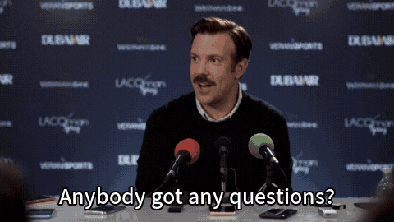
Thank you!
Contact:
Alan Munshower
Digital Collections Archivist
alanmun@vt.edu

