Slide 1
Collection Management Webpages
Final Presentation
CS 5604 Information Storage & Retrieval
Professor Edward A. Fox
M. Eagan, X. Liang, L. Michael, S. Patil
Virginia Polytechnic Institute and State University
Blacksburg, VA 24061
December 7, 2017

Slide 2
Review and Background

Slide 3
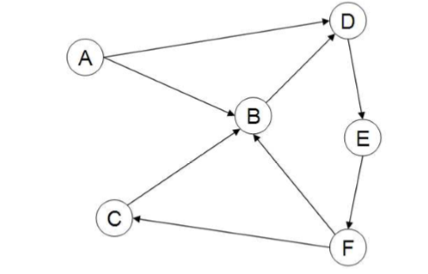
The Web as a Graph
Represented as a directed graph with nodes being webpages and edges being links.
The anchor text pointing to page B is a good description of page B.
The hyperlink from A to B represents an endorsement of page B by the creator of page A.

Slide 4
Web Crawlers
Must have Robustness (resilient to traps) and Politeness
Should Be - Distributed, Scalable, Efficient, Biased towards Quality, Continually Operate, and Extensible

Slide 5
Web Crawler Architecture
1. Start with a seed set of URLs
2. Fetch content from a URL and parse content
3. Text is fed to a text indexer
4. Extracted links added to the URL frontier
5. If continuous, URL is added back to the frontier

Slide 6
Event Focussed Crawler (EFC) Overview
Designed by Mohamed Farag
Event: “Something that happened at a certain place on a specific date”
Generates a list of URLs based off
of user provided seed URLs
Uses much of the standard crawling principles like anchor text for information

Slide 7
Input
Collection Management Tweets (CMT) team
URLs generated collected by hand
WARC files from organizations such as Internet Archive
Notes:
Mischa

Slide 8
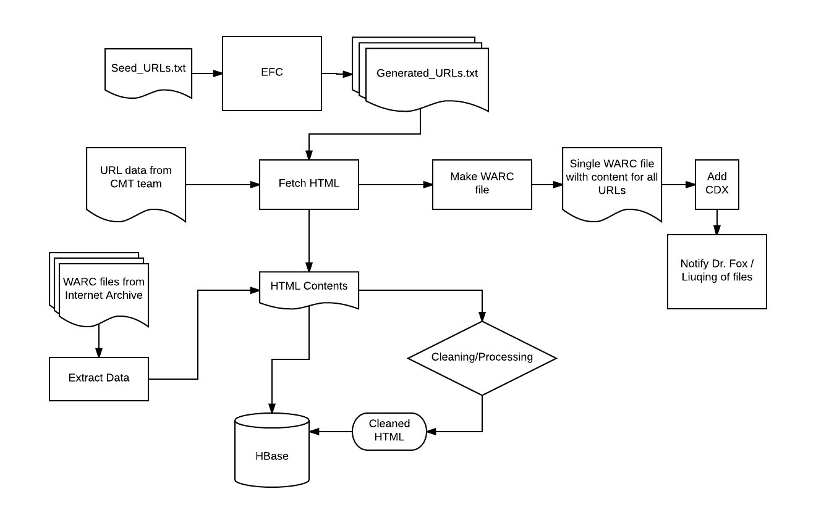
Current System
Design
Notes:
Mischa

Slide 9
Output
WARC Files
WARC Files - to be uploaded to the Internet Archive
Raw and Cleaned HTML along with associated entities such as ‘collection_name’, ‘location’ etc. - stored in HBase
HBase
Notes:
Mischa

Slide 10
Twitter Data Flow
CMT provided CSV files for tweets stored in HBase
We pulled out only tweets with URLs
We check these URLs for uniqueness
We fetch these pages, clean them
Upload processed data to HBase

Slide 11
Processing Completed and now in HBase

Slide 12
Processing Pipeline for August21
 | CSV from CMT | URL CSV | Unique URL CSV | Processed TSV
File Name | August21_final.csv | August21_finalURL.csv | August21_finalURL_condensed.csv.csv | August21_finalURL_rst_bk.tsv
Number of Rows | 2,017 | 690 | 510 | 510

Slide 13
Processing Pipeline for oreclipse
 | CSV from CMT | URL CSV | Unique URL CSV | Processed TSV
File Name | oreclipse_final.csv | oreclipse_finalURL.csv | oreclipse_finalURL_condensed.csv | oreclipse_finalURL_rst_bk.tsv
Number of Rows | 15,243 | 2,411 | 992 | 992

Slide 14
Processing Pipeline for eclipseglasses
 | CSV from CMT | URL CSV | Unique URL CSV | Processed TSV
File Name | eclipseglasses_final.csv | eclipseglasses_finalURL.csv | oclipseglasses_finalURL_condensed.csv.csv | eclipseglasses_finalURL_rst.tsv
Number of Rows | 20,618 | 3,364 | 2,399 | 2,399

Slide 15
Processing Pipeline for totaleclipse
 | CSV from CMT | URL CSV | Unique URL CSV | Processed TSV
File Name | totaleclipse_final.csv | totaleclipse_finalURL.csv | totaleclipse_finalURL_condensed.csv.csv | totaleclipse_finalURL_rst.tsv
Number of Rows | 1,005,938 | 41,735 | 8,683 | 8,683

Slide 16
Processing Pipeline for totalsolareclipse
 | CSV from CMT | URL csv | Unique URL CSV | Processed TSV
File Name | totalsolareclipse_final.csv | totalsolareclipse_finalURL.csv | totalsolareclipse_finalURL_condensed.csv.csv | totalsolareclipse_finalURL_rst.tsv
Number of Lines | 26,788 | 4,703 | 2,941 | 2,941

Slide 17
WARC Files Processed For HBase

Slide 18
Process Overview
Provided with WARC files from EFC runs in CS 6604
HTML is extracted and cleaned
Resulting information is uploaded to HBase

Slide 19
Collection Name | oregon school shooting | Dunbar High School shooting | NIU shooting | University Alabama shooting | Virginia Tech shooting
Number of Rows | 521 | 258 | 19 | 328 | 3442
These collections were based on WARC files provided to us, we speculate their sizes were a function iteration, growing bigger as the CS 6604 group worked throughout the semester

Slide 20
Crawling We Did

Slide 21
Process Overview
URL List
HTML is extracted and cleaned
Resulting information is uploaded to HBase

Slide 22
Collection Name | Eclipse2017 | VegasShooting | Hurricane Irma
Number of Lines | 1344 | 913 | 2726
These crawls were conducted throughout the semester and their size was based of hand examining urls to evaluate their relevance and setting the EFC to conduct crawls that produce quality results

Slide 23
Parallel Processing
Big data!
Better performance
We have finally exploited the advantage of cluster

Slide 24
PySpark
What is Spark:
Apache Spark is an open-source cluster-computing framework.
What is PySpark:
Python Spark API that allows us to use Spark with Python (our processing script is written in Python)
Notes:
We want to use PySpark because our processing...

Slide 25
Parallel Processing I - PySpark
Total time used (crawling + cleaning), without NER and language detector Parallelized using PySpark, default number of nodes Unit: seconds
URL size | Baseline(s) | Parallel Stemming(s) | Parallel Crawling(s)
13 | 12.08366489 | 16.3642930984 21.1652750969 | 15.4960489273 15.6808428764 20.149545908
46 | - | - | 39.8726541996 26.4784898758
1000 | 650.2592189 | 714.77546 | 480.311785936 497.93241787
Parallel Crawling did show speed up but was most likely bottled necked by network constraints
Notes:
By that time we didn’t figure out how to run NER and language detector on cluster
Stemming is only one small step in cleaning, the only step which does not depend on nltk_data or some uninstalled libraries (on other nodes)
Here are some results using PySpark
This table shows the total time used for crawling and cleaning, without some functions that we didn’t figure out how to run on the cluster by that time.
It is not a complete validation so you can see some blanks in the table, but it gives us some sense about the result. We tried several different things. First we tried parallelizing stemming, which is one small step in cleaning. You can see the performance don’t get any better both for a small URL size and a large URL size. So we tried something else, which is parallelizing the crawling step. You can see the performance get better, especially for a relatively large URL size. This makes it feasible for us to process more URLs.

Slide 26
Parallel Processing II - PySpark
Crawling time used Paralleled using PySpark, default number of nodes Unit: seconds
URL size | Parallel Crawling(s)
992 | 259.0064449
1000 | 288.0420101
2399 | 2097.015636
Notes:
This is incomplete and missing baseline but that is all the information we have
Here we can look at the actual crawling time used, without any cleaning. You can see the paralleled crawling actually does not consume a lot of time. If we also have a way to parallel our entire cleaning step, we should be able to have a much better performance.

Slide 27
Parallel Processing III - Processes and Pipes
WARC Processing time used, populating all fields Parallelized using Python multiprocessing module to create additional processes and pipes for communication Unit: minutes
WARC File/Number of Records | No Parallelization on Local Machine | Parallelized on Local Machine | Parallelized on Cluster
Dunbar High Shooting / 259 | 11.83 minutes | 10.74 minutes | 6.68 minutes
Reynolds High Shooting / 522 | 23.09 minutes | 21.91 minutes | 13.75 minutes
VT Shooting / 1941 | n/a | 78.81 minutes | 52.14 minutes
Parallel Crawling did show speed up but was most likely bottled necked by network constraints

Slide 28
Future Work
Build up a single pipeline for all sources of inputs (WARC, EFC, tweets)
Parallelized EFC (feasible using PySpark + URL queues)
Speed up cleaning
Phrases in NER (now separated words)

Slide 29
Acknowledgements
Our team would like to thank Dr. Fox for his guidance during this project. We would also like to thank Liuqing Li for answering our questions and helping us to get up and running. Our efforts contribute and benefit from the work done on the Global Event and Trend Archive Research project funded by NSF Grant IIS-1619028.

